Slide 1
Recent target development at Isolde - 2016
M. Delonca on behalf on TISD

Slide 2
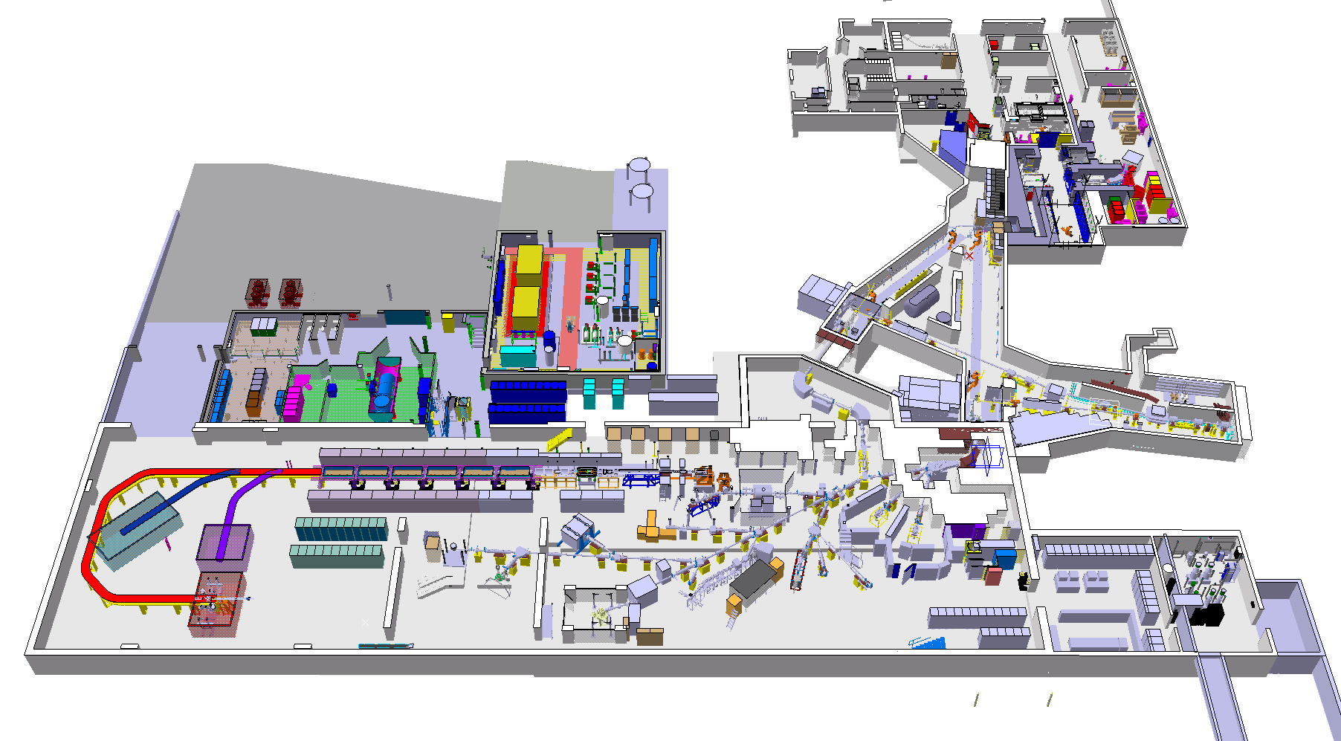
Isolde hall layout
Experimental hall
HRS target
Target area
HIE-ISOLDE
GPS target
Protons
HIE-ISOLDE Linac
ISOLTRAP
REX
CRIS
Travelling Setup
COLLAPS

Slide 3
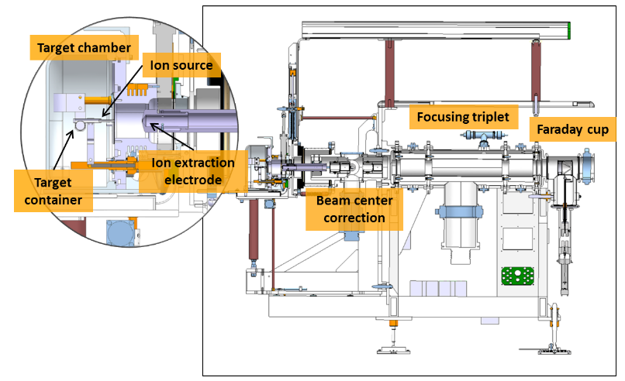
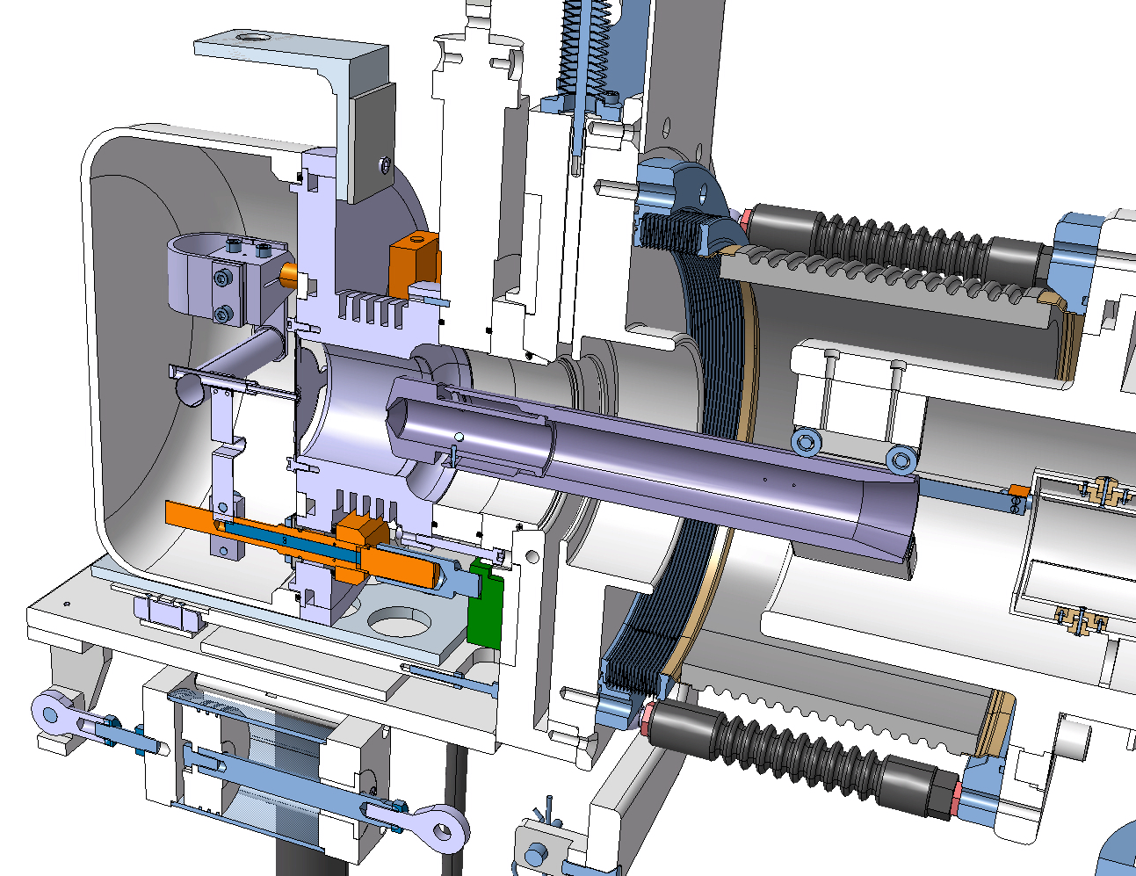
Front end layout
Standard ISOLDE target unit with surface ion source – cut view
Courtesy of J. Montano

Slide 4
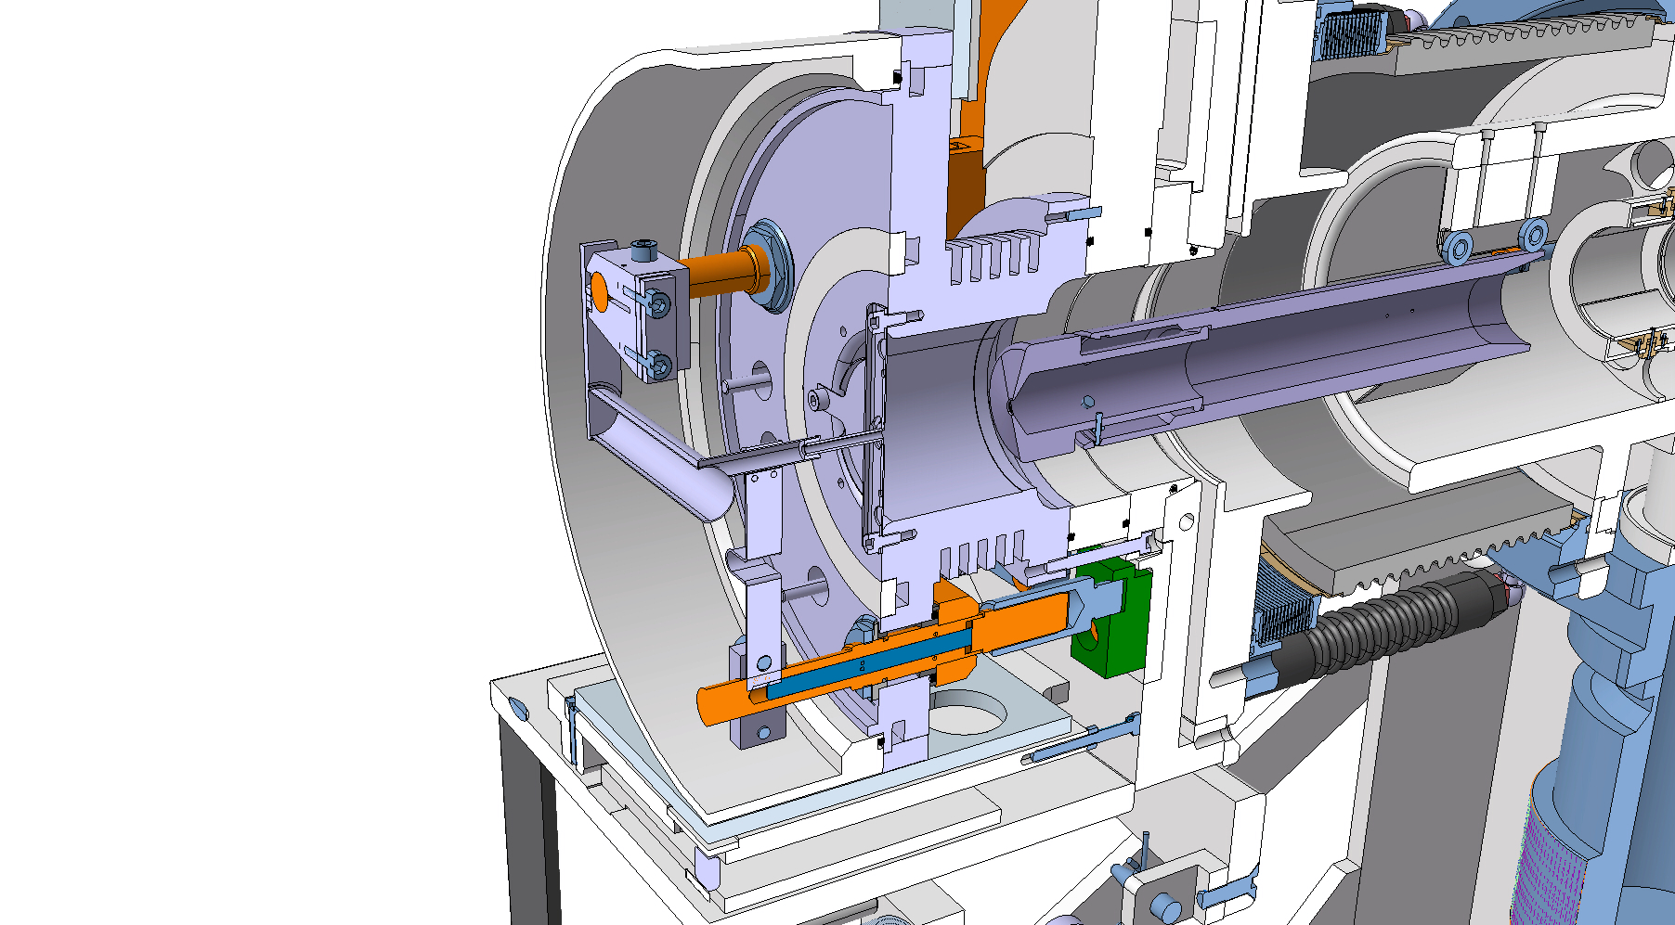
Target & Ion source unit - example
Primary beam
Radioisotopes
Ions
Primary beam
Standard ISOLDE target unit with surface ion source
$$i=Φ.σ.N.ε_{target}.ε_{source}.ε_{sep}.ε_{transport}$$
TISD projects
Intensity (ion/sec)
Efficiencies
Flux (ion/sec)
Number of target nuclei (cm⁻²)
Cross section (cm²)
Animation inspired from A. Andrighetto, EURISOL DF conference

Slide 5
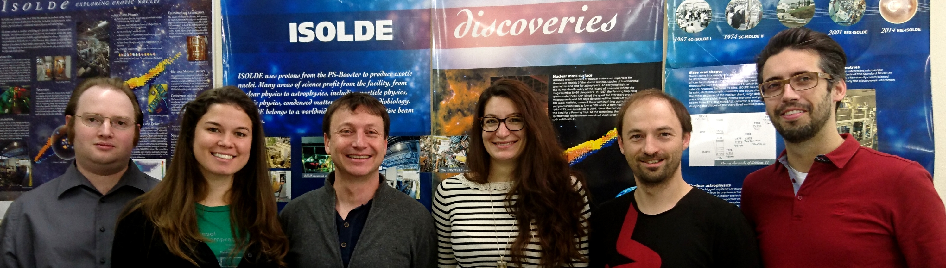
Target and ion Source Development (TISD) mandate
Who?
What?
Providing a large choice of intense and pure radioactive beams,
How?
Target development:
- target design,
- ion source design and mode of operation,
- material development,
- release study, impact of chemical environment…
+ target yield tests and optimization

Slide 6
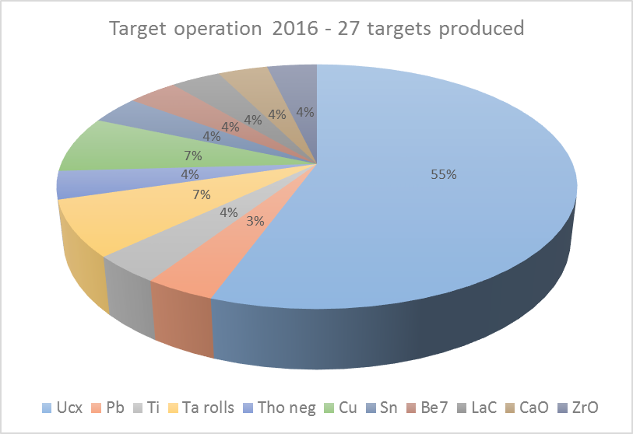
Target overview for 2016
27 targets operated in 2016,
5 targets developed a leak after ~ 5.10¹⁸ protons
  Investigations are on-going, o-rings already changed
Interesting results:
New UCx batch confirmed its results: good and constant yields,
Intense n-rich chromium (Z=63) studied for the first time (ISOLTRAP),
¹³²Sn³²S broken up before delivery as pure ¹³²Sn to Miniball
Extremely successful ⁵⁷Mn & ¹¹⁹In runs: >65 individual experiments,
Absolute measurement of the βα decay of ¹⁶N using silicon strip detector (ISOLDE Decay Station).
Courtesy of K. Johnston

Slide 7
TISD projects
8B beam
Germanium Sulfide beam
Negative ion source
Ti-C nanocomposite material
VADIS ion source update
N-converter new generation
The LIEBE target
Carbonyls beams
Release study (PhD thesis Dr. C. Seiffert)
Release study (all)
Ion source development (all)
Material development (PhD thesis Dr. J.P. Ramos)
Ion source development (PhD thesis Y. Martinez)
Target development (J.P. Ramos fellowship)
Target development (PhD thesis Dr M. Delonca)
Target development (PhD thesis J. Ballof)
2015/2016
2017/2018
+ many other collaborative project with the RILIS team
see talk “The ISOLDE RILIS 2016, achievements, developments and future plans”, T. D. Goodacre – Technical session 1 @ 12.15
see poster “Online prototype TiC-carbon nanocomposite target material: constant release properties and material development” – J.P. Ramos

Slide 8
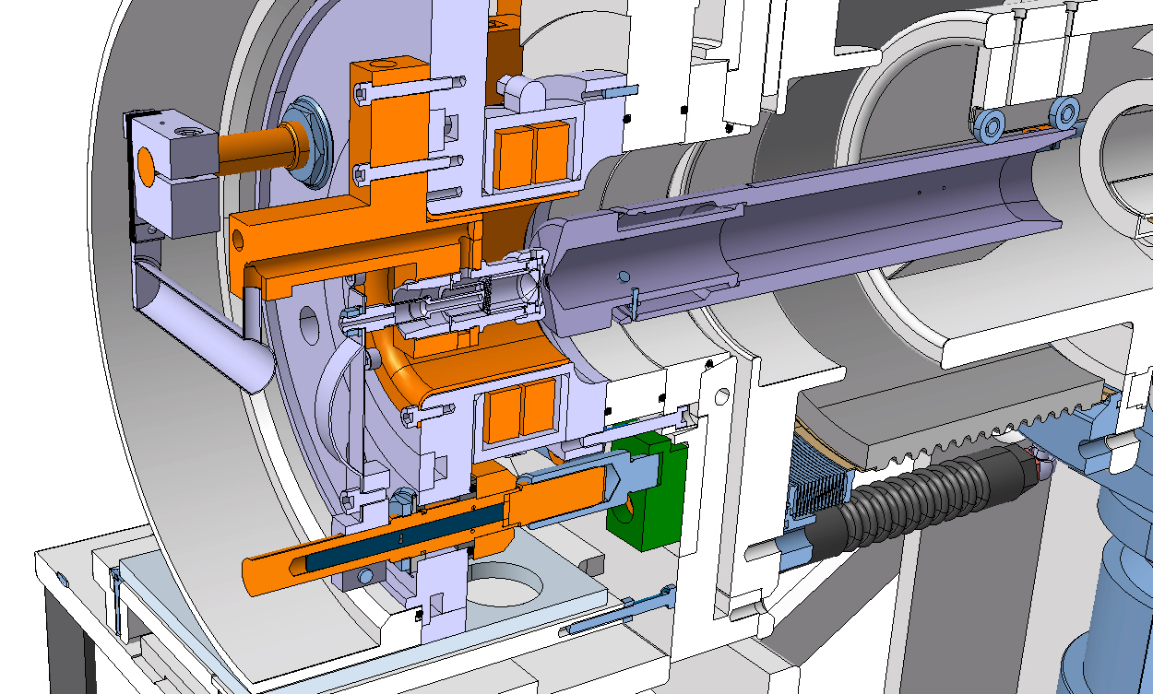
8B beam
Primary beam
Boron
Context: MWCNT target with VD7 – SF6 gas
Fluor
Primary beam
Boron form stable bonds with material in the target -> no extraction of B
Adding Fluor to form volatile molecule with Boron (BF2 – BF3)
Standard ISOLDE target unit with VADIS ion source

Slide 9
8B beam
Primary beam
Boron
Solution: MWCNT target with VD7 – SF6 gas
Fluor
Boron form stable bonds with material in the target -> no extraction of B
Adding Fluor to form volatile molecule with Boron (BF2 – BF3)

Slide 10
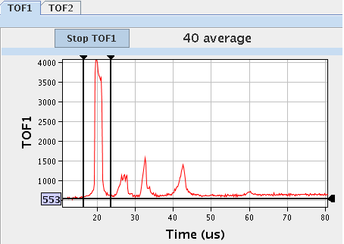
8B beams
Results:
Yield measured:
Injection into REX: ¹¹B¹⁹F₂¹⁺ → ¹¹B⁴⁺
    Space charge effect on trap (decrease of efficiency with higher beam current),
    Flat trap, cooling on A=30 only 9% efficiency,
    TOF: many breakups in trap,
    EBIS might accept all masses,
    When taking ⁸B¹⁹F₂¹⁺ into the trap, radioactive beam is seen after the separator with Geiger counter
 | Yields (ions/µC)
8B | ~ 1e3
8BF | ~ 7e2
8BF2 | ~ 2e4
8BF3 | ~ 4e2
¹¹B
11B19F
19F
11B19F₂
Courtesy of J. Pitters, FJC. Wenander

Slide 11
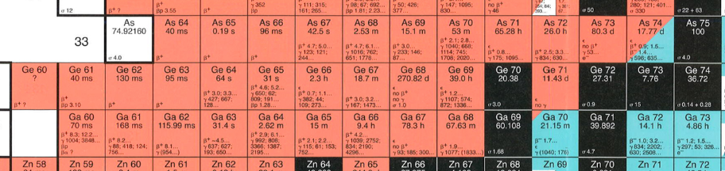
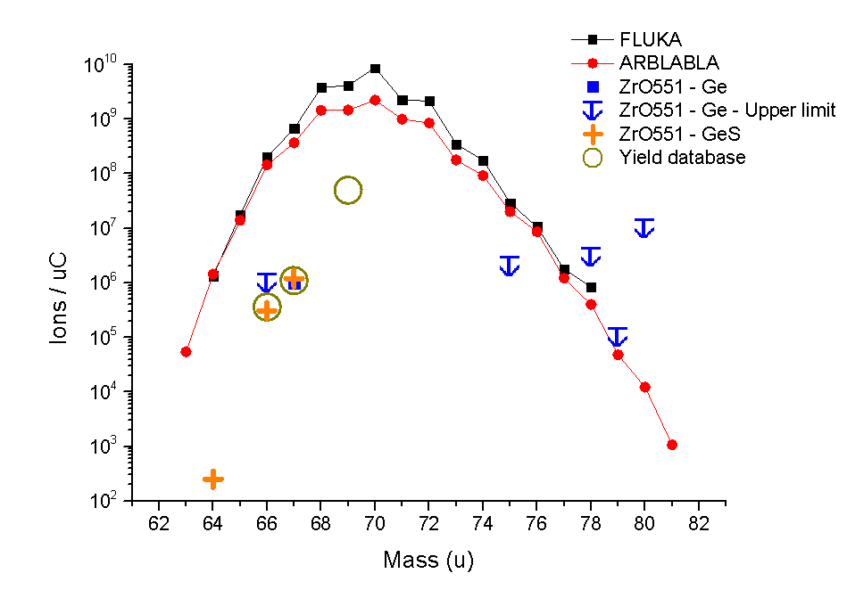
Neutron deficient Germanium Sulfide beams
Context:
Atomic Ge comes with strong isobaric contaminants (Ga, AlCl, ..)
Proposal: shift to other mass region by adding S with a mass marker (no reaction between S and Ga!)
Ge + S → GeS
Results: ZrO2 target with VD5 – S mass marker
Mass |  | Yields (ions/µC)
 |  | Ge | Ga | Factor
66 | Database | 3.6e5 | 4.4e8 | ~ 2
 | New | 5e5 | 2e8
67 | Database | 1.1e6 | 8e8 | ~ 4
 | New | 1.2e6 | 2e8
Ratio ⁶⁷Ge / ⁶⁷Ge³²S = 1 / 1
Courtesy of J. Ballof, JPR. Ramos

Slide 12
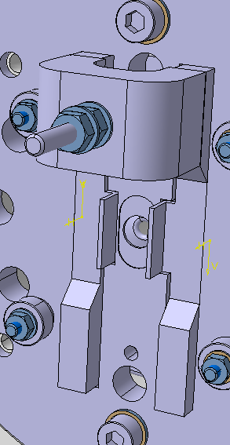
Negative beams @ PSB : Target tests Th/Ta-MK4 576
Electrons
Neutral isotopes
Context:
Negatively ionized isotopes
+ 1 kV
Magnet
Ionizer
Magnetic field
I _{source (neg)}
Electron deflector
MK4 (planar-ionizer) negative ion source
Electron thermally generated

Slide 13
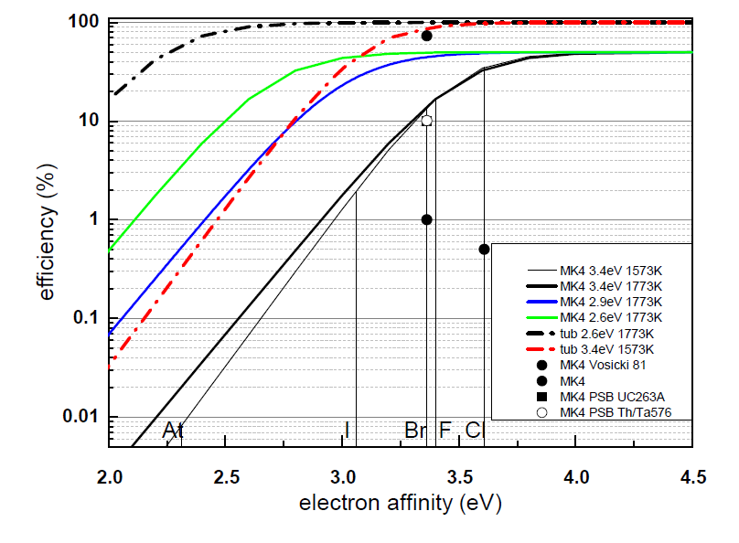
Negative beams @ PSB
Expected efficiencies:
Higher efficiency expected with LaB6 source,
Good agreement between theory and experiment for MK4 source.
Measured ion yields from target with MK4 LaB6 surface source (UC target in 2005, Th/Ta in 2016)
Isotope | Half-life | Yield / Production rate [ ions/s/mA ¹H⁺]
 |  | 2005 | 2016
³⁸Cl | 37.2 m | 1.6 10⁵ | 1 10⁵
⁴⁰Cl | 81 s | 4.3 10⁴ | 9 10⁴
⁴¹Cl | 38.4 s | 1.4 10⁴ | 3.5 10²
⁴²Cl | 6.9 s | 1.1 10³ | 1.4 10¹
⁸⁵Br | 2.9 m | 9.6 10⁵ | 1.6 10⁶
⁸⁹Br | 4.4 s | 8.4 10⁴ | 3.6 10³
¹²²I | 3.6 m | 4.4 10⁴ | 6 10⁵
¹³⁷I | 24.2 s | 1.3 10⁵ | 9 10⁴
¹³⁸I | 6.4 s | 7.3 10⁵ | 9 10⁴
²⁰⁴At | 9.2 m | - | 9 10³ (5 10³ after 5 days)
²⁰⁶At | 29.4 m | - | 6 10³
Theoretical and measured efficiencies – MK4 ion source and tubular LaB6 – Saha-Langmuir equations
Yields stable over time for MK4,
Slow release for MK4,
Tubular LaB6 ion source not operated on-line successfully due to poisoning -> instable operation but higher efficiencies expected
Courtesy of T. Stora
Y. Liu, D.W. Stracener, T. Stora, Production of negatively charged radioactive Ion Beams, 2016 (to be published)

Slide 14

TiC-Carbon Black nanocomposite material
Context:
Reduction diffusion time = Increase yield
Reduction grain size to nm!
Standard ISOLDE target unit with surface ion source
Standard material grain size: μm
Toward ion source

Slide 15
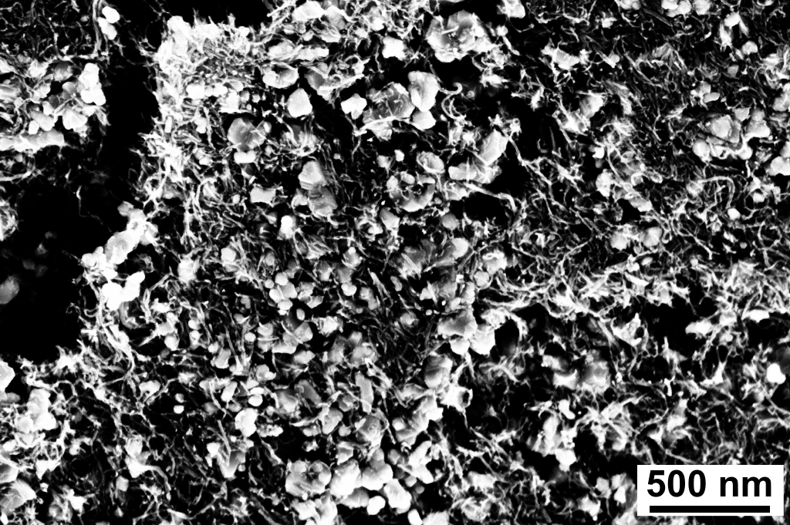
TiC-Carbon Black nanocomposite material
Application: development of a TiC nanocomposite by adding Carbon black
New nanostructure developed with carbon nanotubes,
Allow for extraction of 35 Ca (t_{1/2} = 25.7 ms) and 35K (t_{1/2} = 190 ms)
132 nm TiC grains – 84 % porosity, Stable for T > 2100 °C
Yield [ions/s]
normalized to μC
(TiC micron)
Yields stable over time (Ti foil targets degrade over few hours)
Good yields on Li and Na
Lower yield of K and Ca
Courtesy of JPR. Ramos

Slide 16
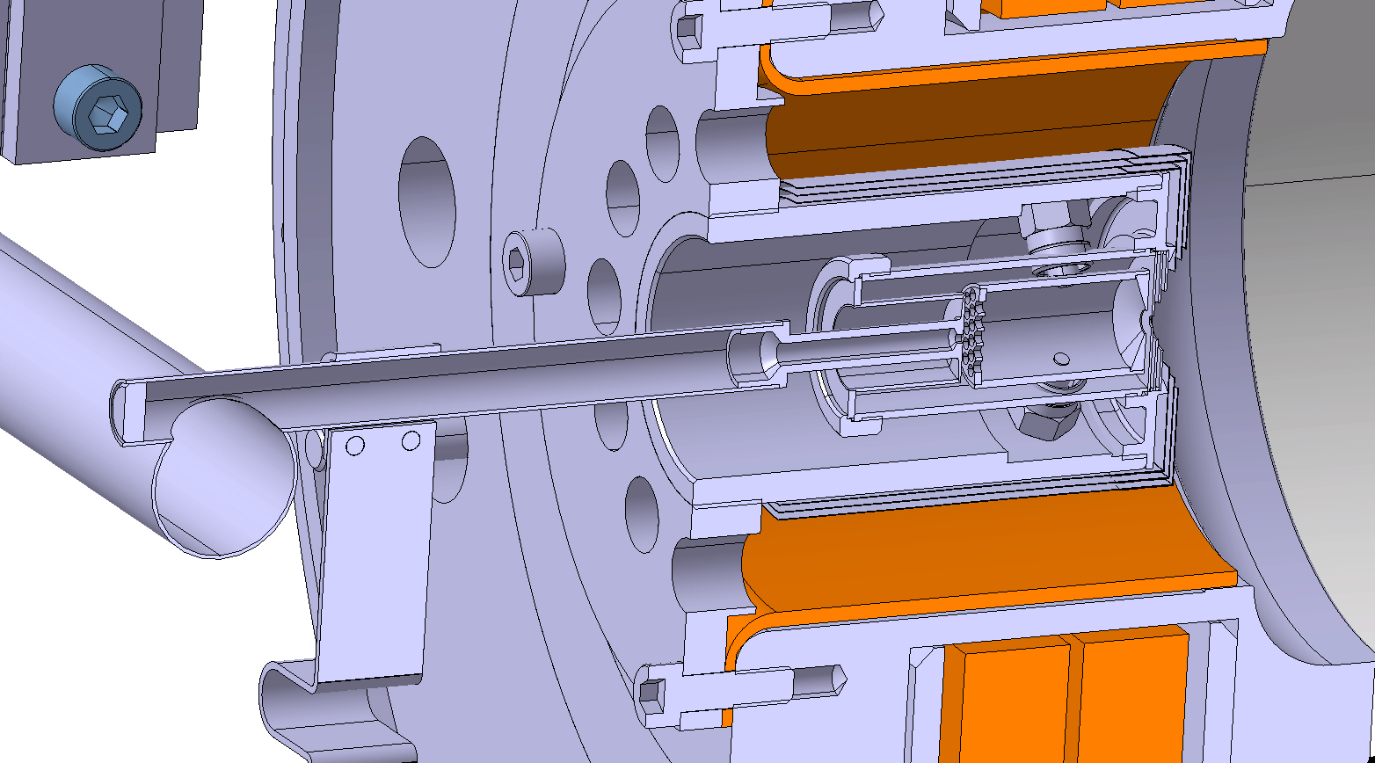
VADIS ion source development
Context:
Magnets
Ionization by electron impact
150 V
Joules effect
Cathode
Anode
I _{cathode}
150 V
Magnets
Standard VADIS MK5 (first design from Kirchner in 1976!) use: Anode @ 150V & hot Cathode

Slide 17
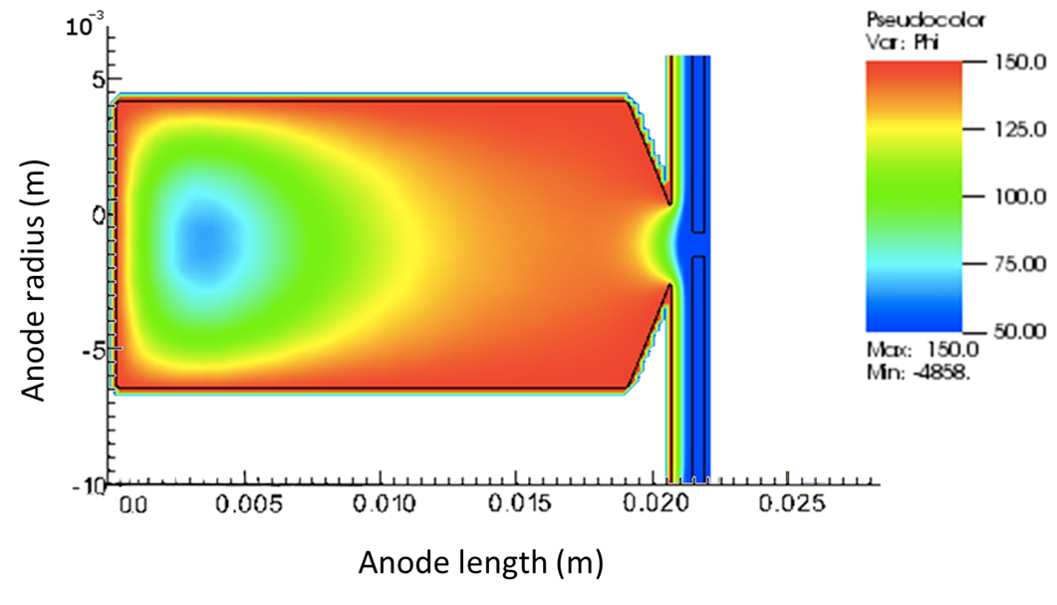
VADIS ion source development
Context:
Magnets
Ionization by electron impact
BUT not homogeneous electrical field
Cathode
Anode
Electrons
Neutral isotopes
Magnets
Ionized isotopes
Electron thermally generated
Neutral isotopes get ionized

Slide 18
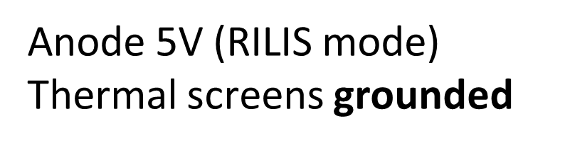
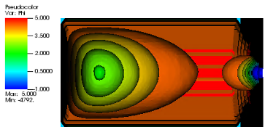
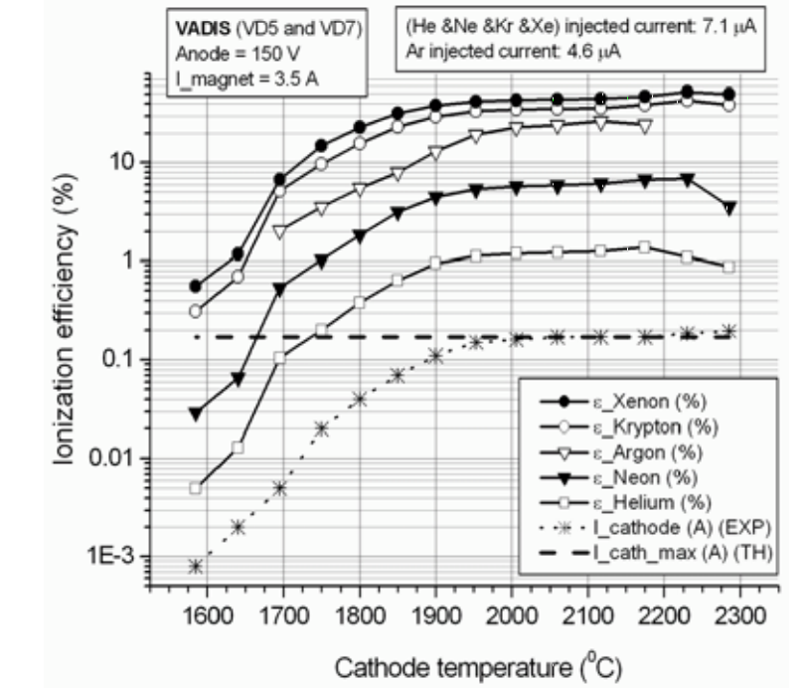
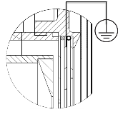
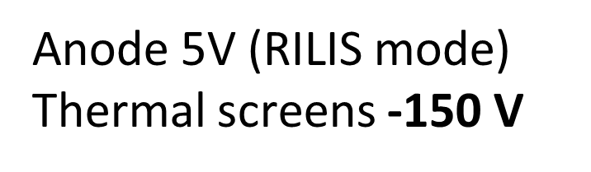
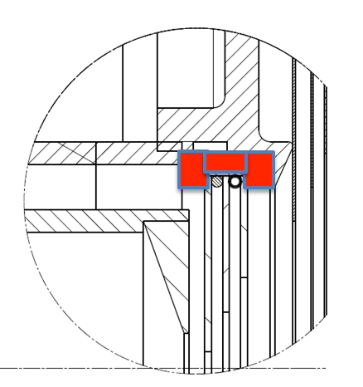
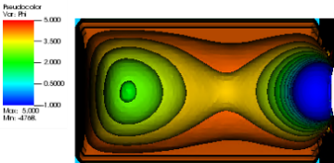
VADIS ion source development
Proposed modifications
Current VADIS efficiencies
Further investigations
    Reproduce with simulations time profile of extracted beam measured experimentally (RILIS mode),
    Optimize the anode geometry, reduce inactive volume for an increased efficiency/faster ion extraction,
    Determine beam emittance and energy spread, compare with experimental results,
    Determine the extraction efficiencies for metals.
Ion source with insulated thermal screens with
variable voltage
L. Penescu et al., Rev. Sci. Instrum. 81
Beam extraction
Expected increase in efficiency
Offline measurements – efficiencies noble gases
Beam extraction
Courtesy of Y. Martinez

Slide 19
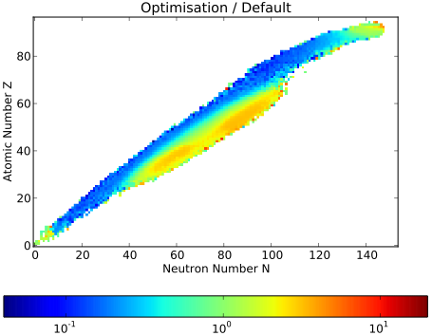
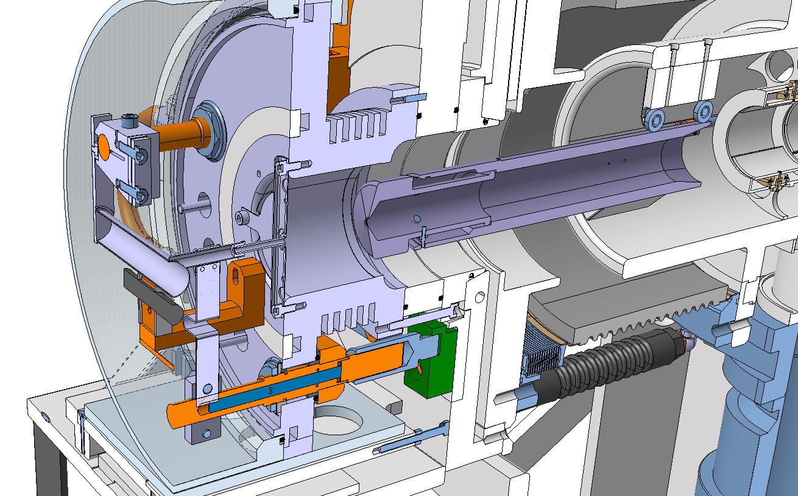
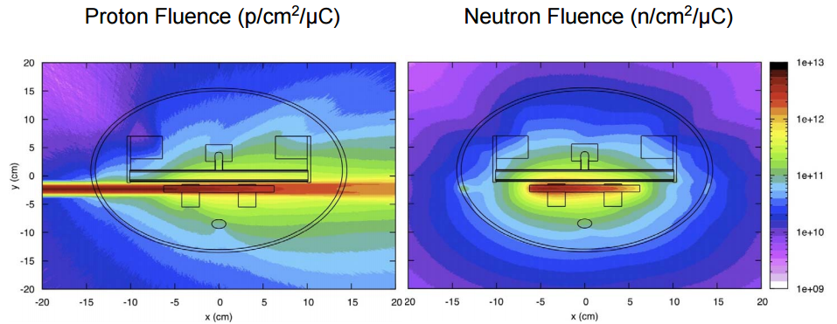
Neutron-converter new generation
Primary beam
Less contaminant from the neutron-deficient side -> beam more pure
BUT current design not yet optimized on proton & neutron fluence
yield reductions in neutron-deficient isotopes
Neutrons
Secondary isotopes
Context:
yield gains in neutron-rich isotopes
Primary beam
Secondary reaction created from neutron impacting onto target material
Secondary isotopes diffuse/effuse out of the material toward ion source

Slide 20
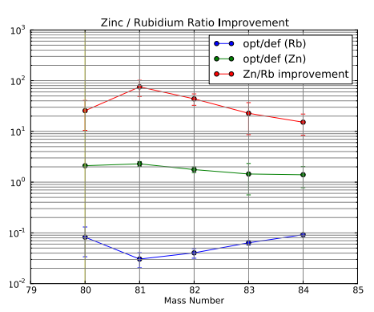
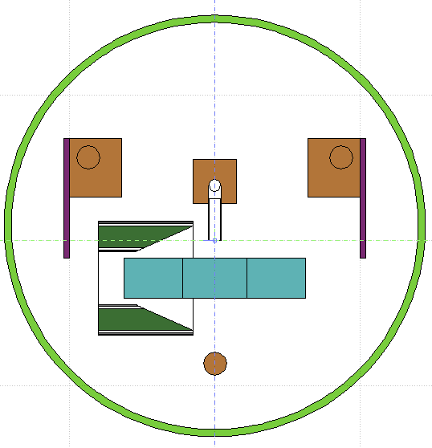
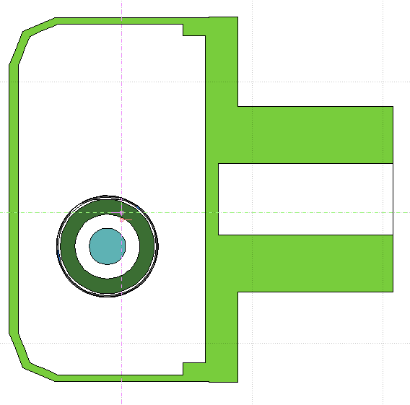
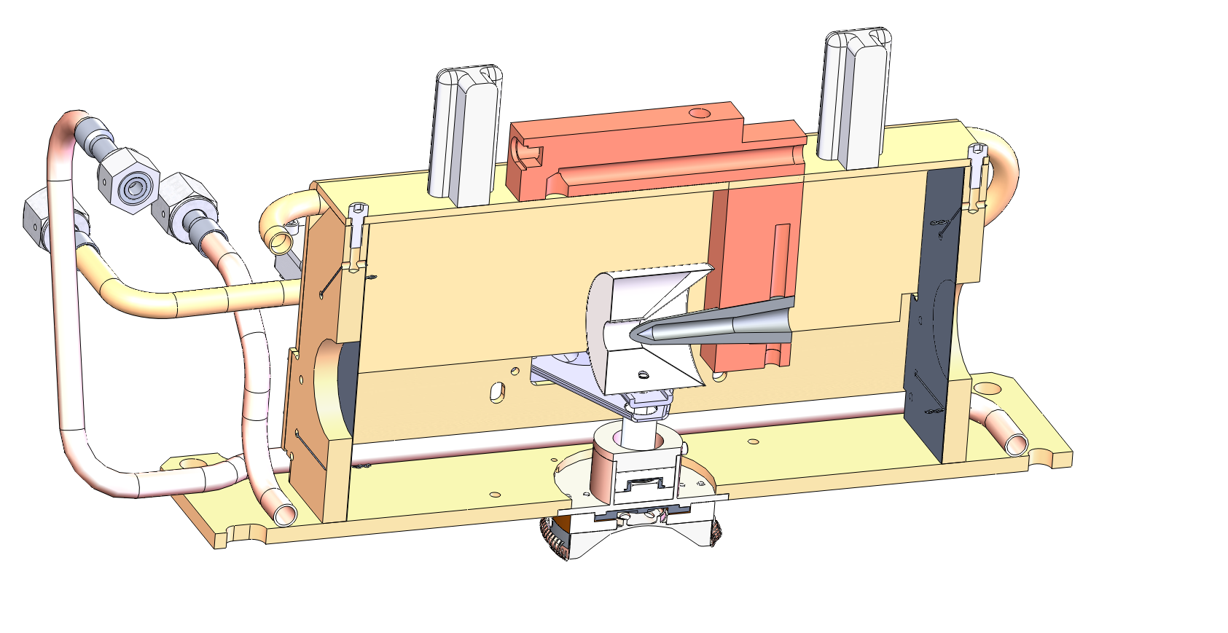




Neutron-converter new generation
Zinc/Rubidium Ratio improvement
Results
Collaboration started between 4 institutes
Online tests foreseen:
  In 2017 in Triumf
  In 2018 in Isolde
52 cm³ UC_{x} container
hollow W converter
Converter water-cooled body
Proposed design for ISOLDE target
Proposed design for TRIUMF target
Courtesy of R. Luis, A. Gottberg and JPR. Ramos

Slide 21


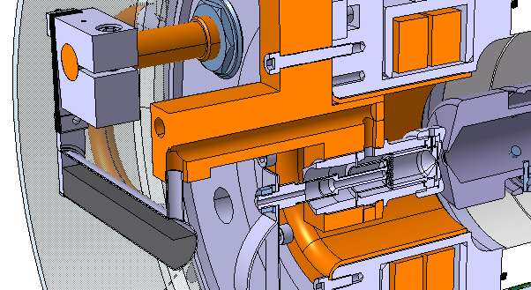
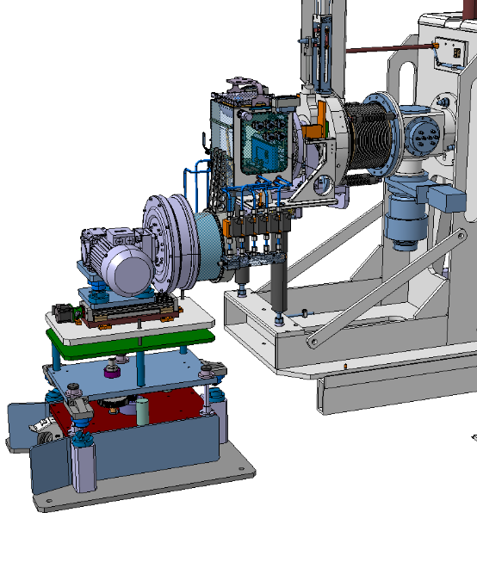
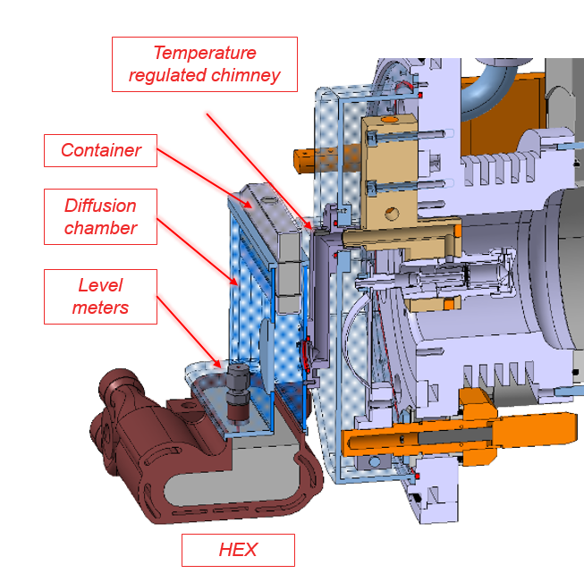
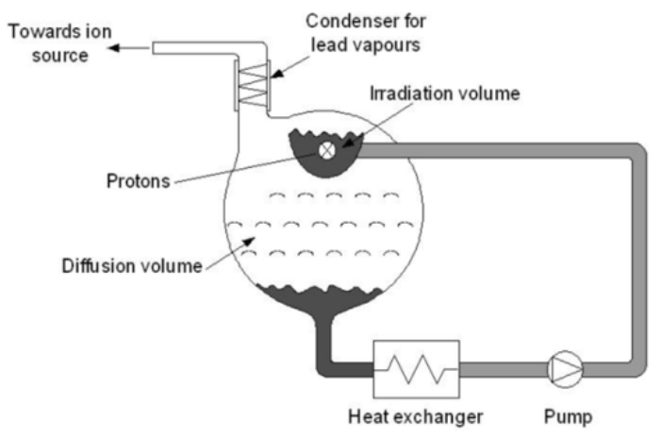
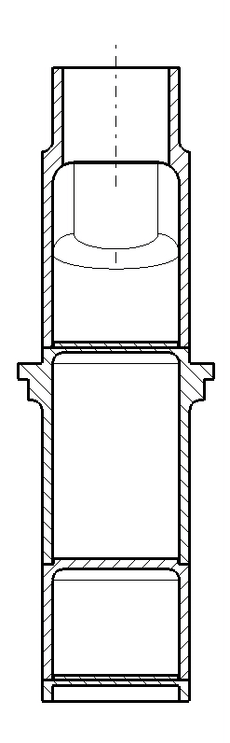
The LIEBE project: toward short lived isotopes
Context:
! Picture not contractual for a Pb target!
Primary beam
Creation of droplets under specific proton & target conditions: faster release of isotopes

Slide 22
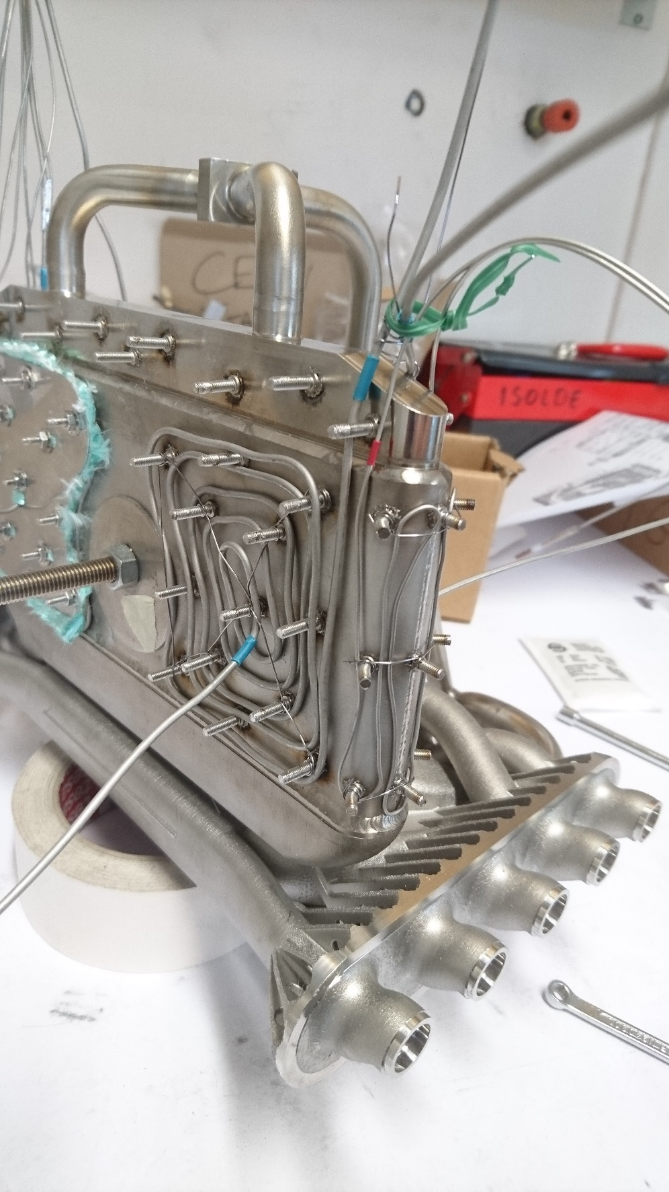
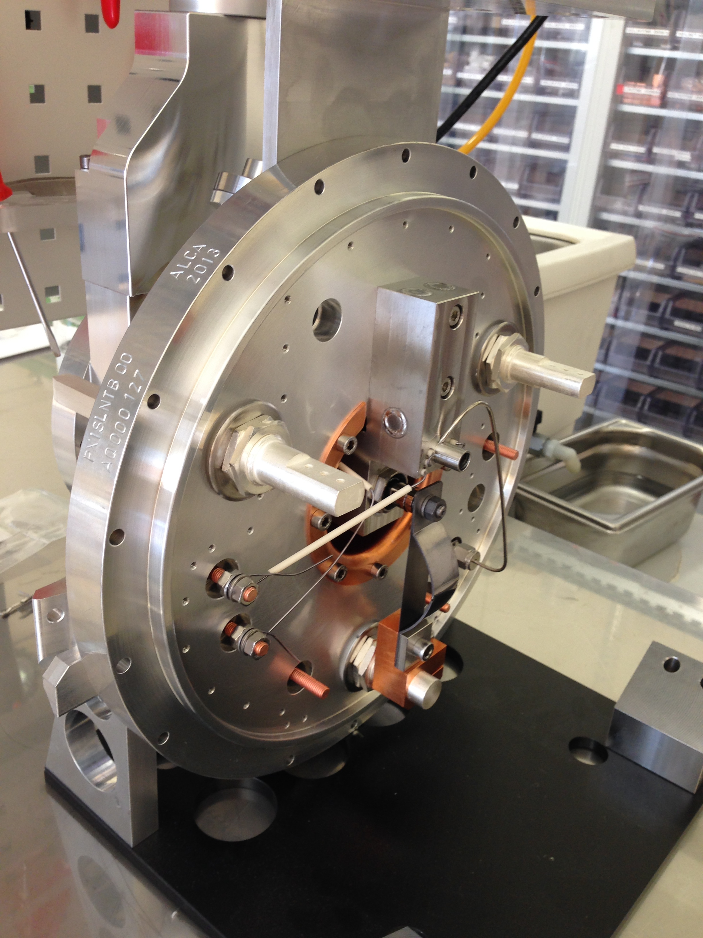
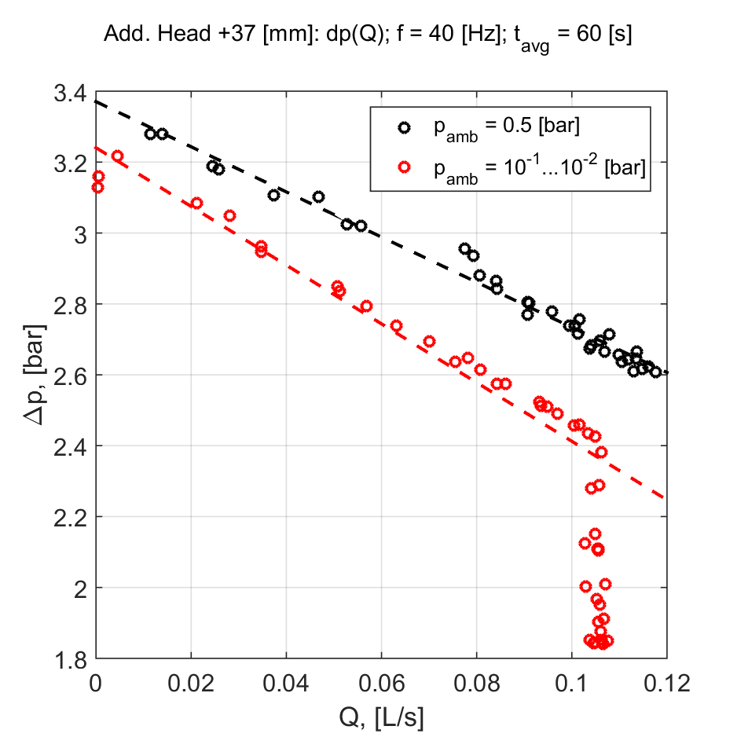
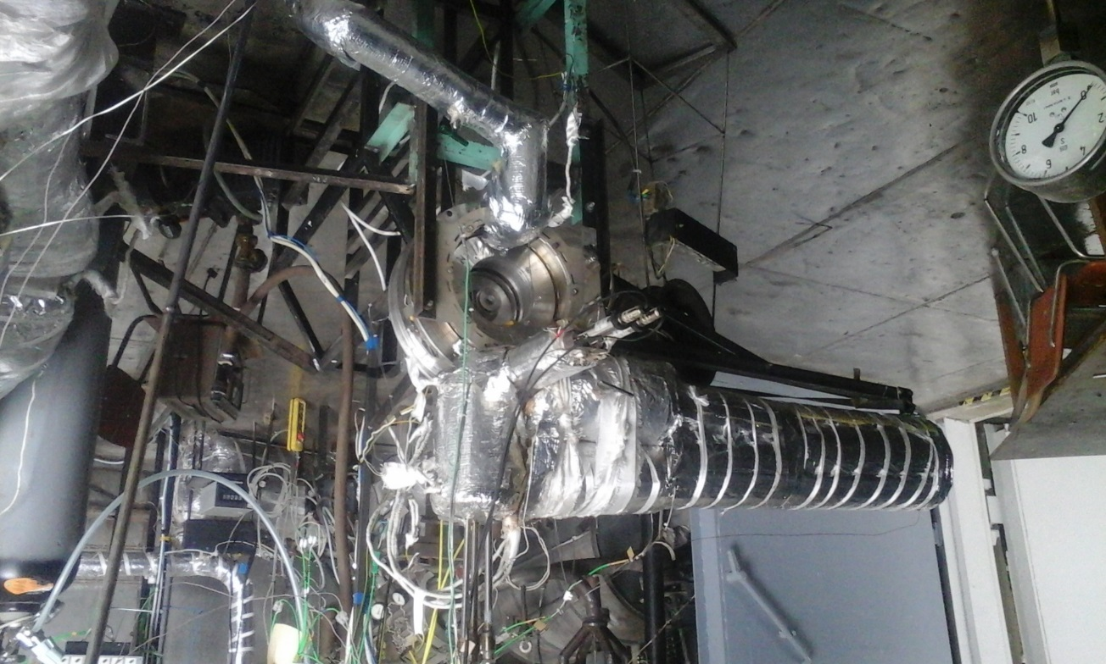
The LIEBE project: toward short lived isotopes
LIEBE ion source & Sub-assembly 1 with heating elements
Current situation:
  Assembly on-going,
  Heating elements installed & tested on sub assembly 1,
  Ion source installed,
  Pump manufactured: modification required (cavitation occurred before the required P-Q)
  On-line pushed to 2017
LIEBE pump – test @ IPUL – August 2016
LIEBE pump – test @ IPUL – August 2016 – P=f(Q)

Slide 23
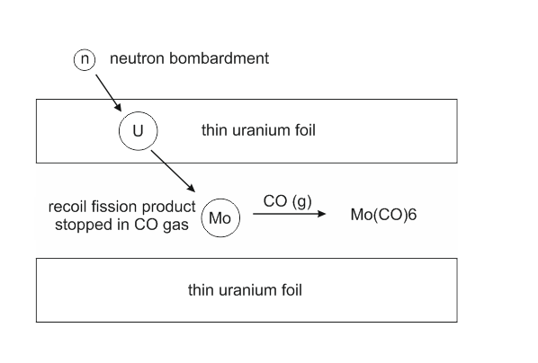
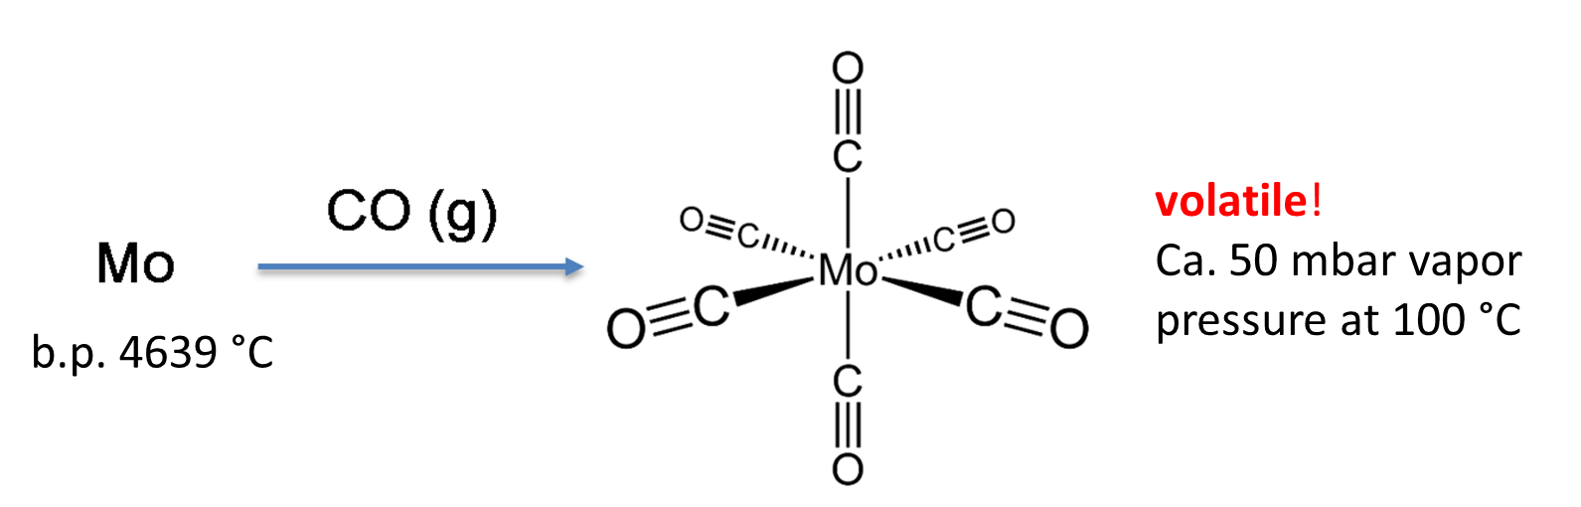
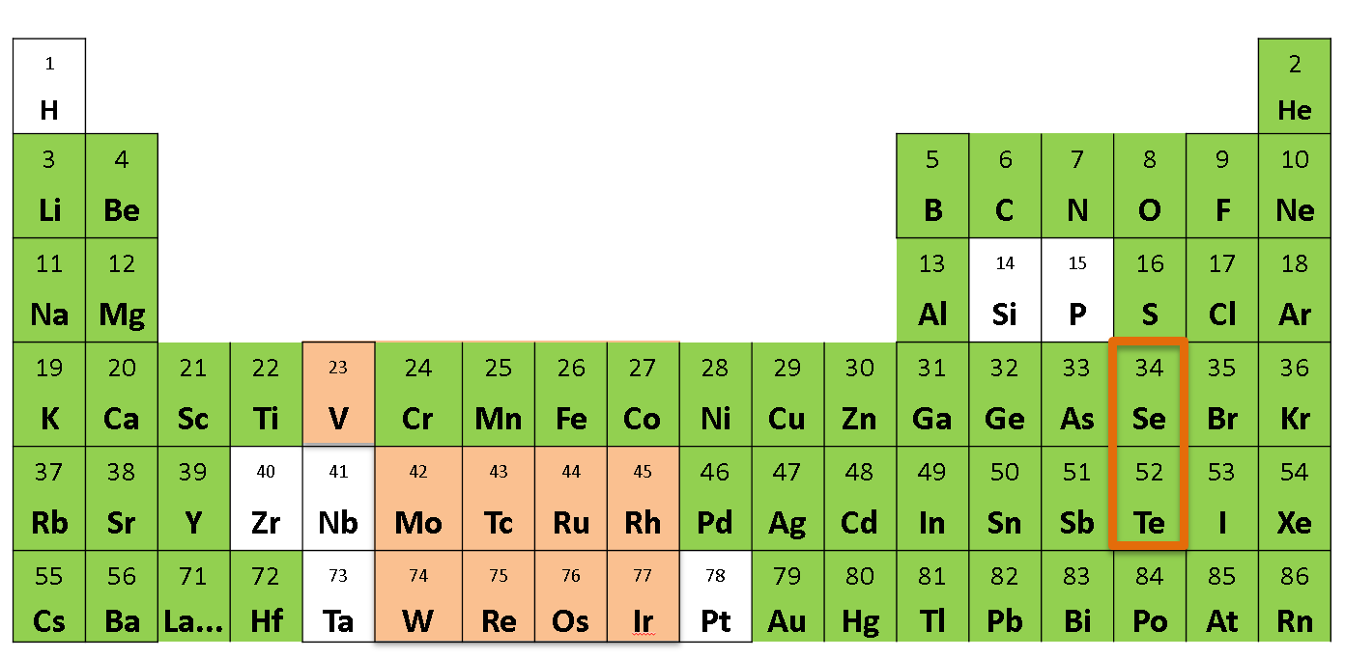
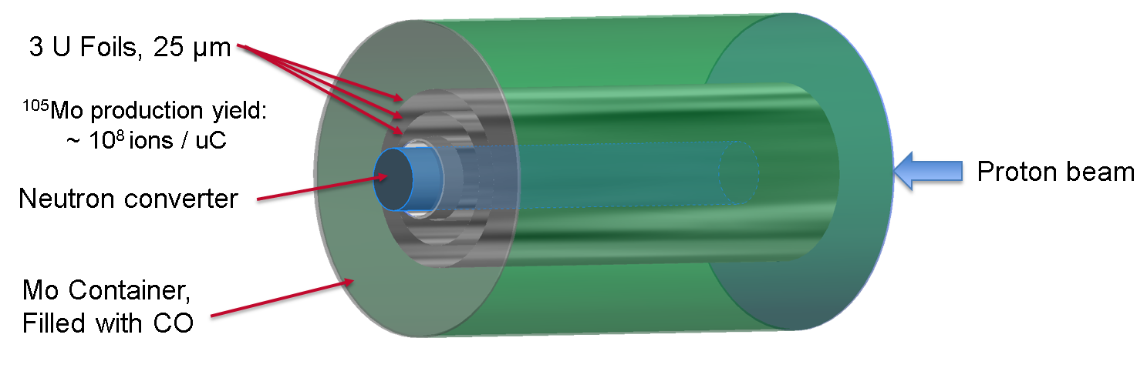
Carbonyls beams @ ISOLDE
Context:
Some reactive species and refractory elements are not extracted -> extraction as volatile species by in-situ volatilization
Proposed solution:
Neutron bombardment
Target in gas
Courtesy of J. Ballof

Slide 24
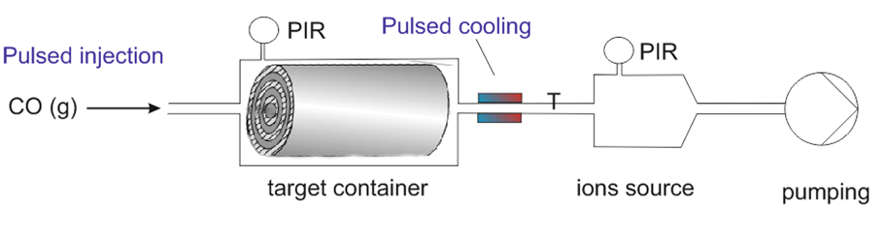
Carbonyls beams @ ISOLDE
Primary beam
Neutrons
Beam extraction:
Molecular beam
Primary beam

Slide 25
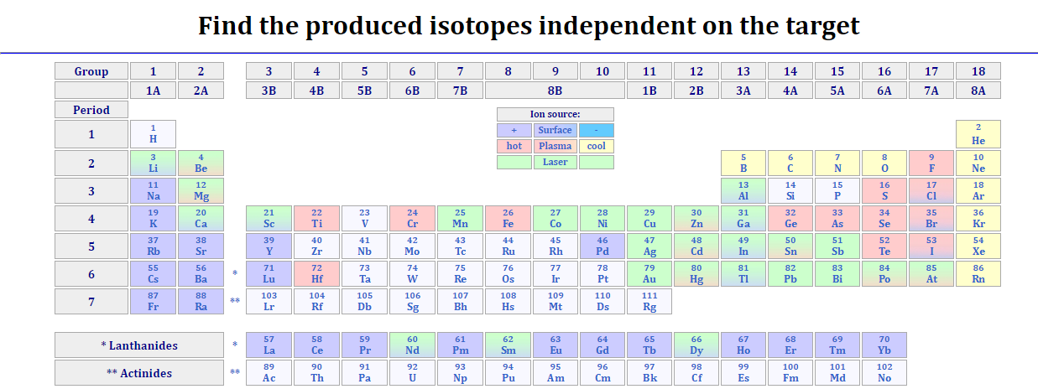
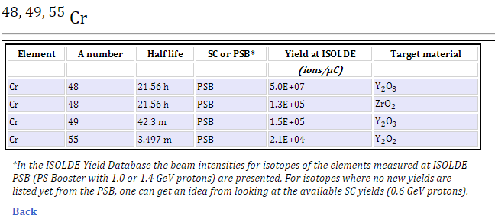
New yield database
Current situation:

Slide 26
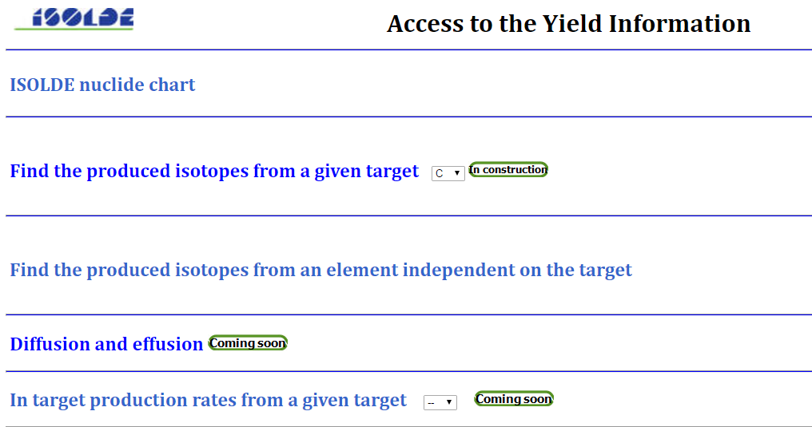
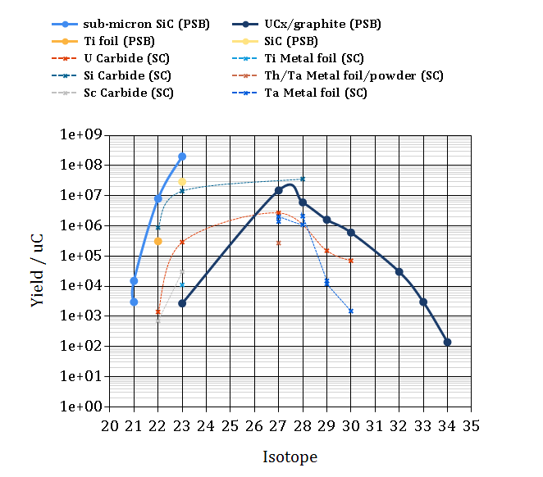
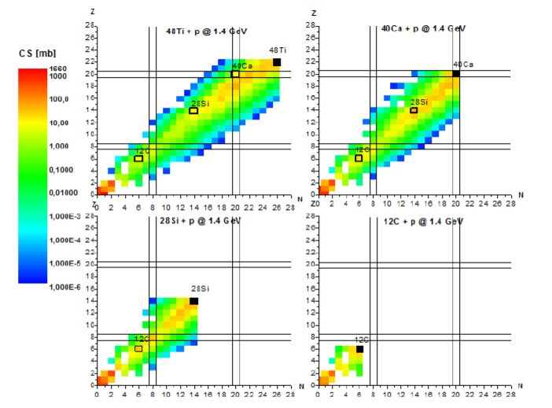
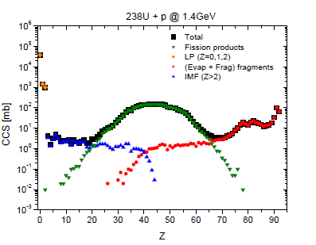

New yield database
Coming soon (release foreseen in 2017/2018):
Current situation
- Redesign the database structure
SQL
GUI
- Build a new user interface
Courtesy of J. Ballof, J.P. Ramos, J. Klimo

Slide 27
Thank you for your attention
And a special thanks to all our colleagues from HSE-RP-AS, BE-OP-ISO and EN-STI-RBS for their collaboration!

