Slide 1
Light nuclei, new set-ups, persistent challenges
K. Riisager on behalf of
O.S. Kirsebom, O. Tengblad,
IS605 and IS561 collaborations

Slide 2
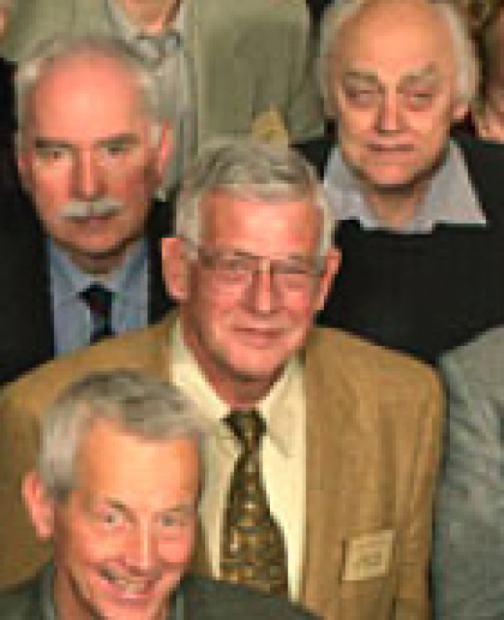
“Persistent challenges”
P. Gregers Hansen: some problems take decades…
ISOL beams / reaching exotic nuclei
the nature of neutrinos
He-burning in stars
nucleon-nucleon force
structure of drip-line nuclei

Slide 3
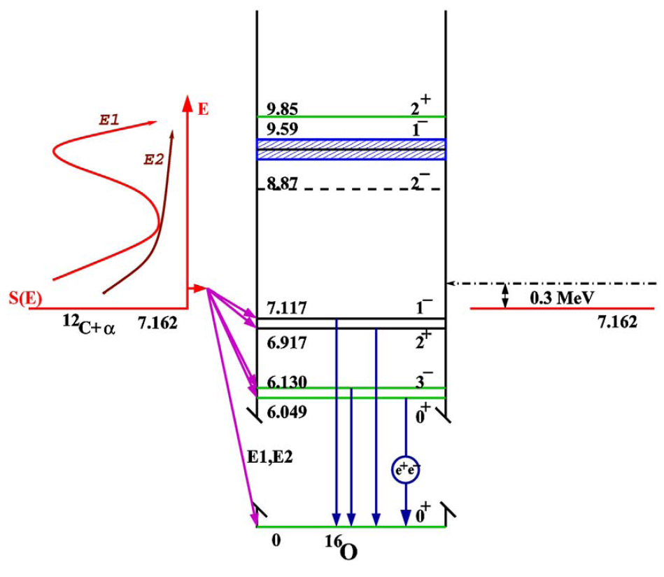
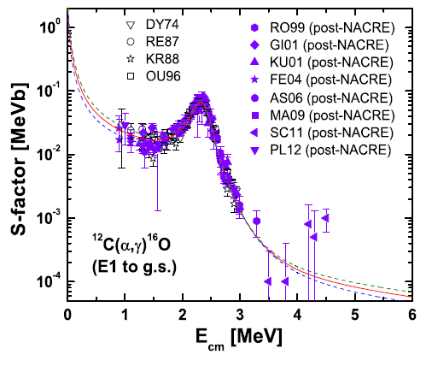
¹²C to ¹⁶O…
S-factor needed to 10%, look here at E1 part
(recent improvements on E2 and cascade parts)

Slide 4
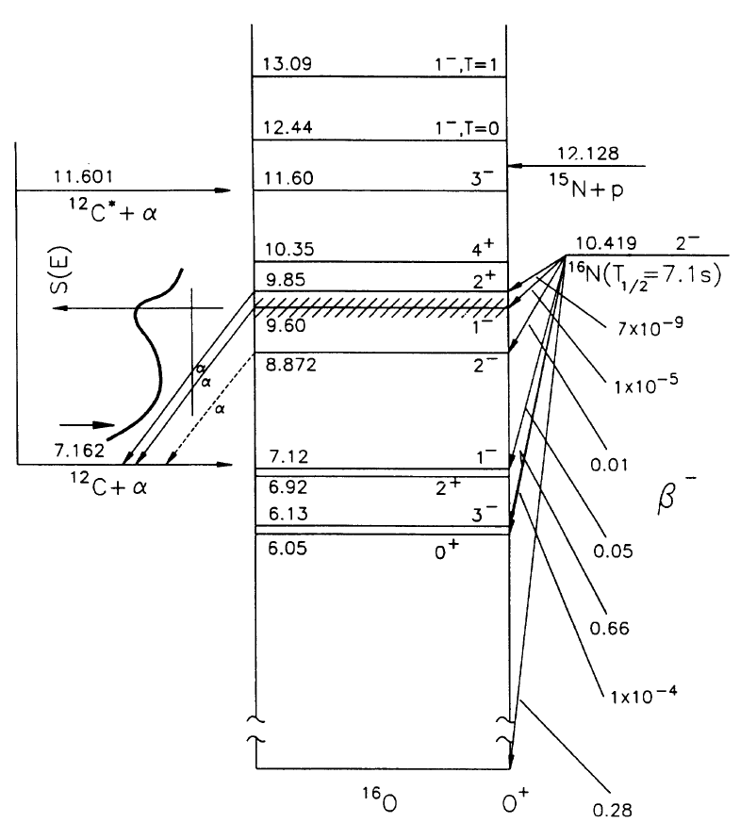
Information from decay of ¹⁶N
Shape well known
Azuma et al, PRC50, 1194
Branching ratio ?
Tabulated value from 1961
New KVI exp: 24% higher
Refsgaard et al, PLB752, 296
Would increase S-factor by 10%

Slide 5
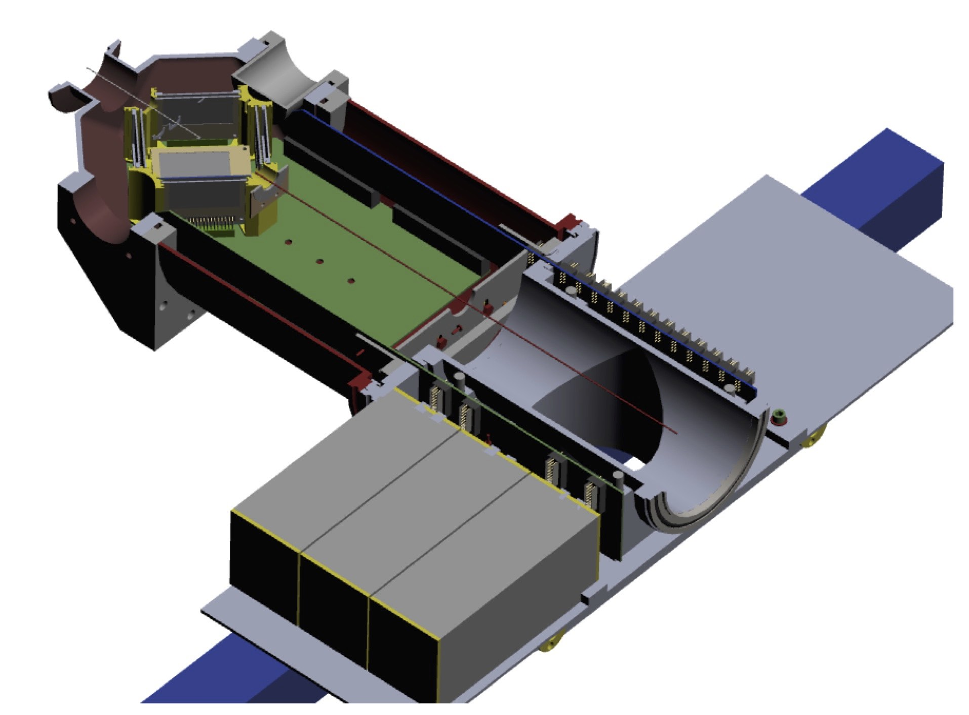
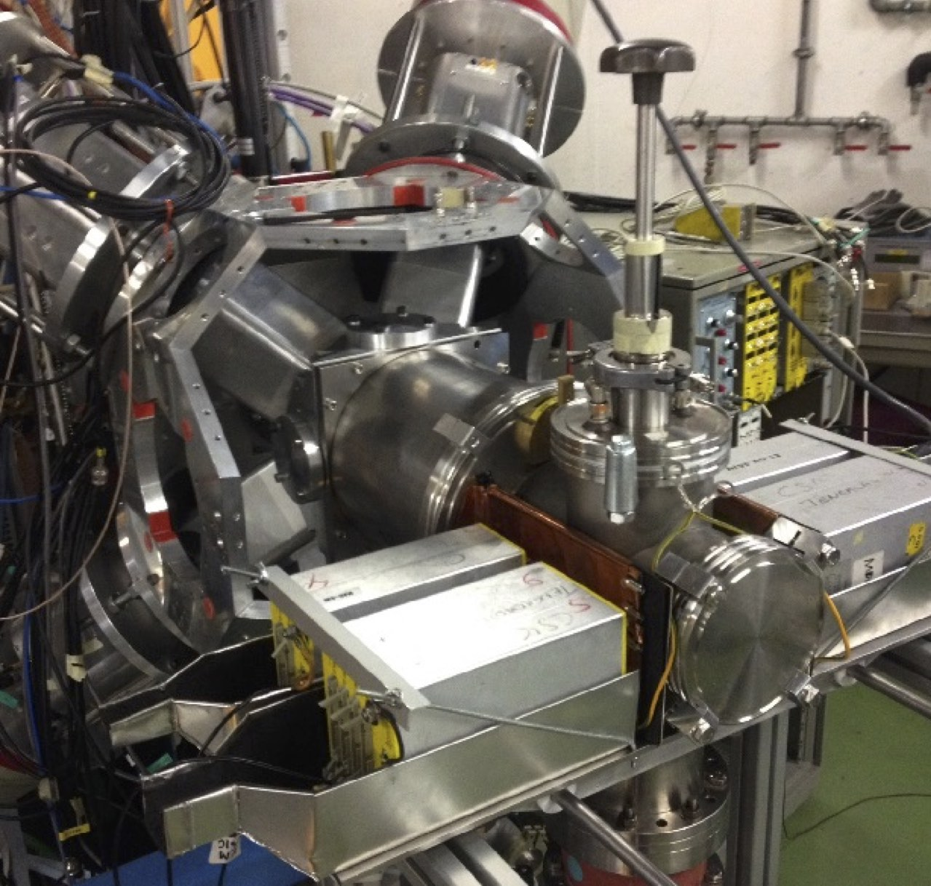
IDS new set-up

Slide 6
IS605 = ¹⁶N beta-alpha branching
Normalize with gamma-transition
  2.74 MeV gamma-ray known to 7% accuracy
  sources + ³⁴Ar gammas, could get 10%...
  6.13 MeV gamma-ray known to 0.9% accuracy
  ¹⁶N or ¹⁷Ne via coincidence/singles, reach 2% ?
Measure alpha intensity…
Branching ratio better than 5% within reach !

Slide 7
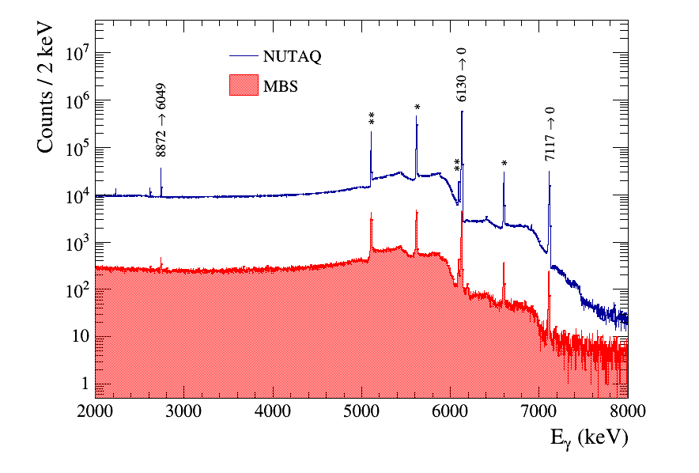
¹⁶N gamma-spectrum, addback

Slide 8
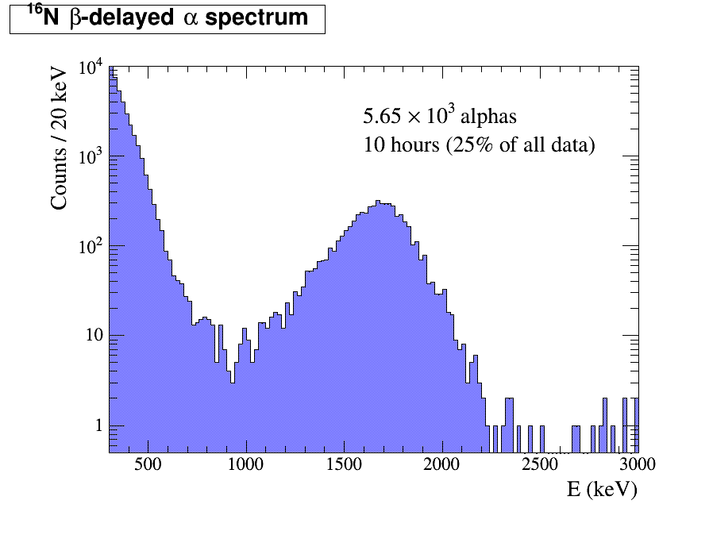

Slide 9
Future use at IDS
Beta-delayed charged particle emission
Nuclei with beta-proton/alpha and beta-gamma competition
Very proton-rich nuclei with beta-proton-gamma cascades, e.g. elements Na-Cl

Slide 10

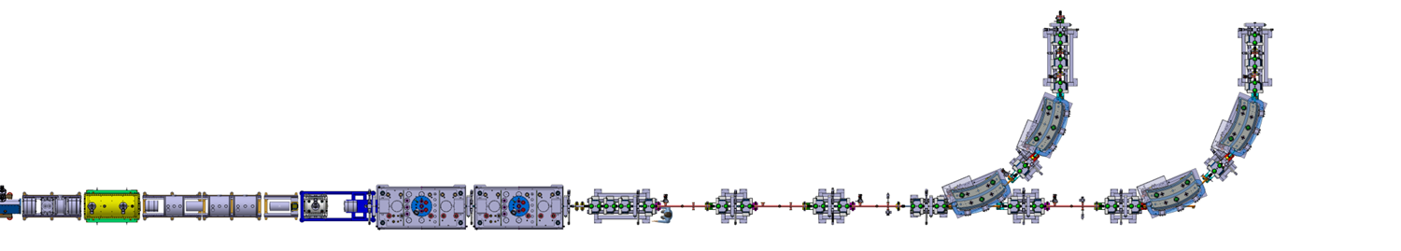
XT02 beamline
HIE-ISOLDE M.J.G. Borge + KR, Eur.Phys.J. A (2016) 52: 334
Now: General purpose scattering chamber
Miniball at XT01
With 3rd beamline: ISS

Slide 11
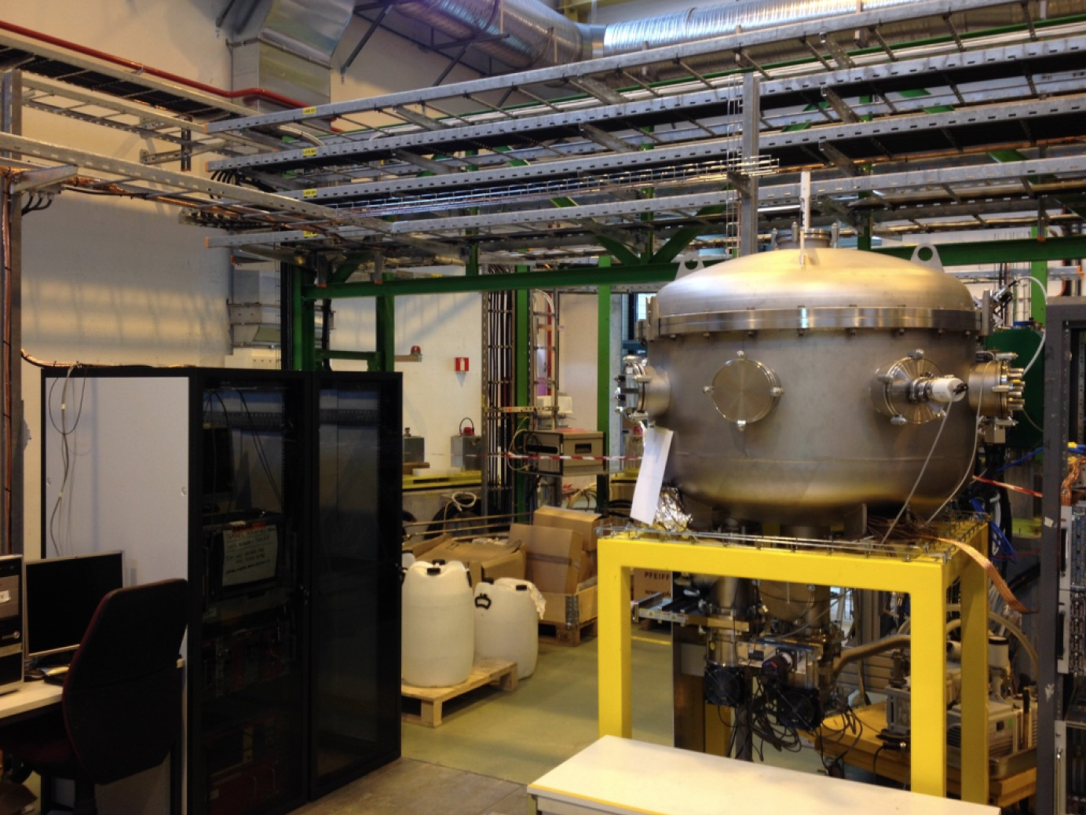
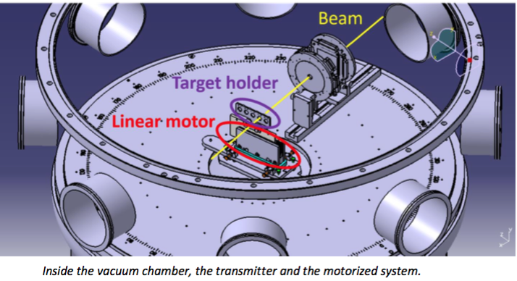
General purpose scattering chamber
Several different experiments:
IS550 (Z₁+Z₂=120), IS561 (⁹Li), IS616 (⁸B), …

Slide 12
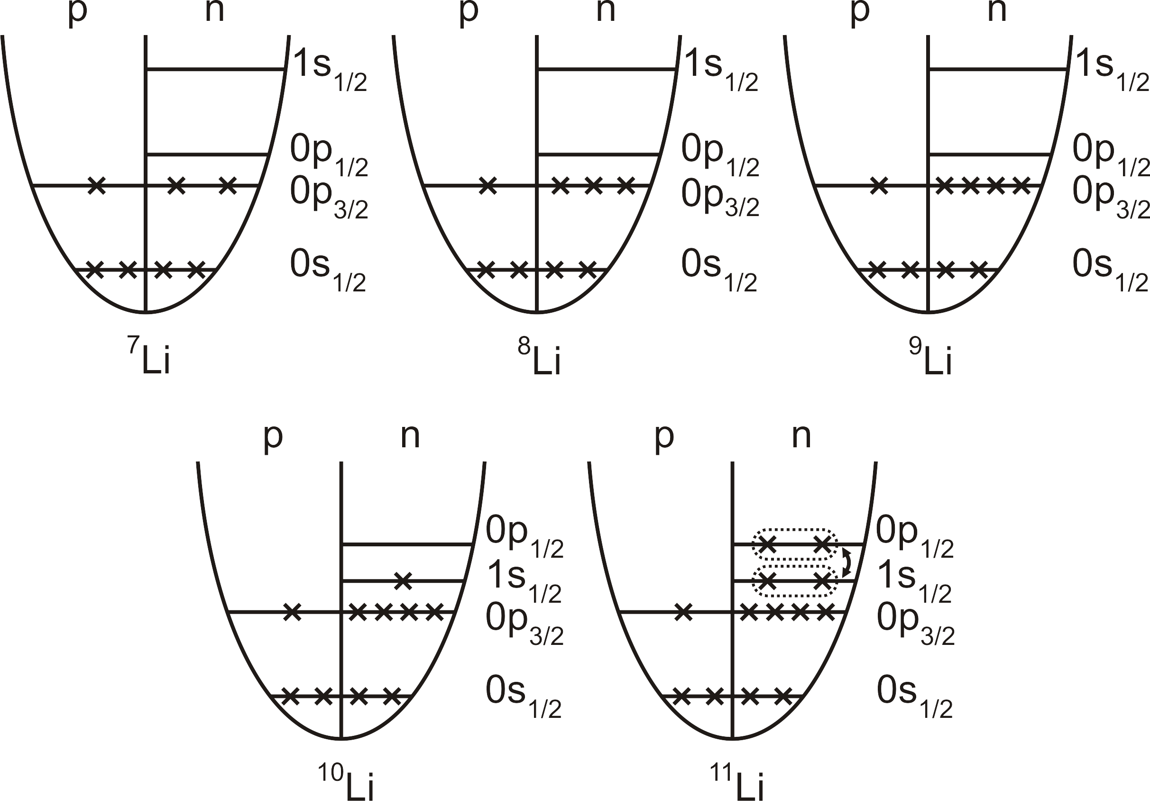
IS561 = ⁹Li+d/t scattering
Purpose: Study the structure of neutron-rich lithium isotopes using transfer reactions.
Goal: Reaction cross-sections compared with theoretical models, spectroscopic factors.

Slide 13
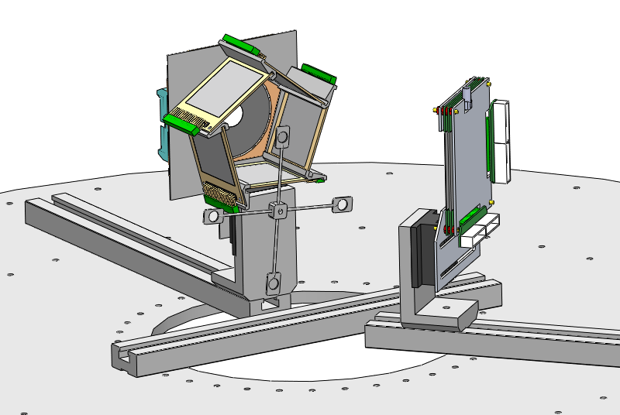
Experimental set-up for ⁹Li
5 | 16 | 16 | 256 | 1280
1 | 32 | 32 | 1024 | 1024
1 | 24 | 32 | 768 | 768
 |  | Total number of pixels: 4 - 9 mm² |  | 3072

Slide 14
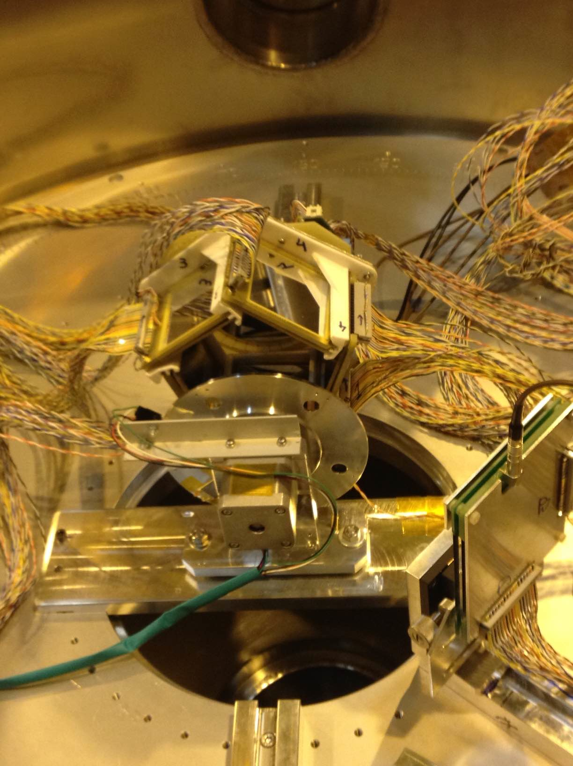
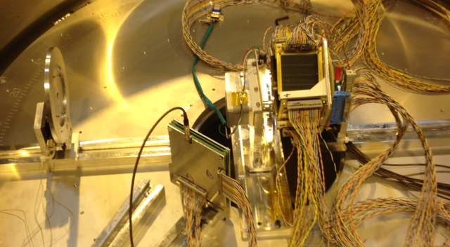
Photo of set-up in XT02 chamber

Slide 15
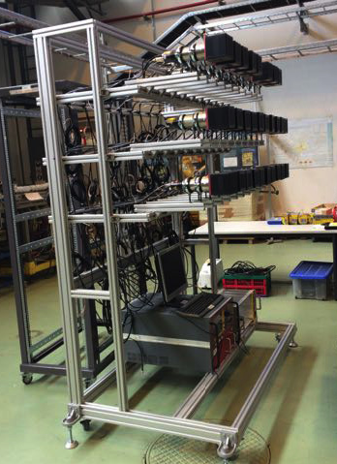
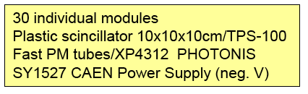

Neutron detector array SAND

Slide 16
Preliminary results
Run with A/Q = 3, 6.8 MeV/u
Low ⁹Li intensity, contaminants not a problem
Alignment difficulties
Good data taken:
Courtesy Jesper H Jensen

Slide 17
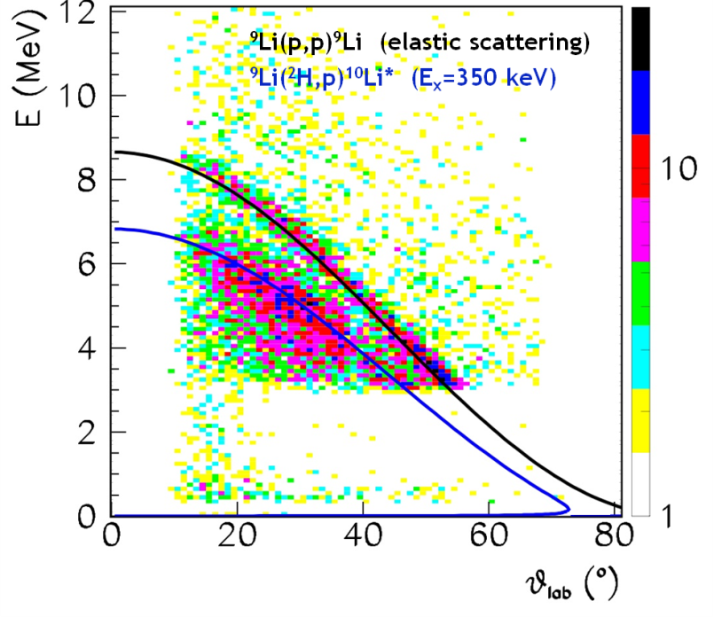
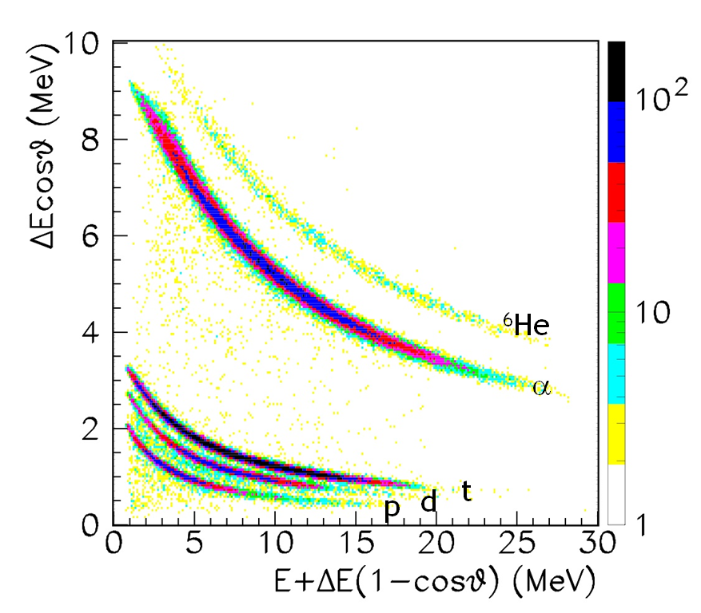
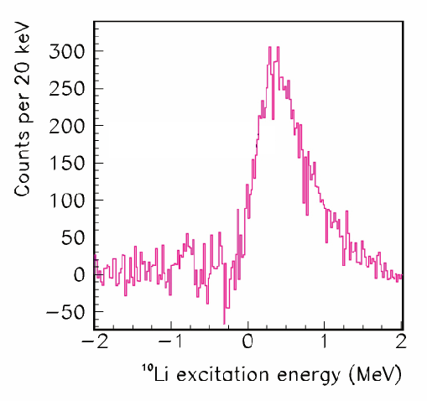
Comparison to 2.77 MeV/u
2 10⁵ 9Li/s
¹⁰Li from protons
⁸Li + t
⁹Li + d
¹⁰Li + p

Slide 18
Outlook
XT02 + scattering chamber in operation
IS561 to continue in 2017
More physics possibilities at HIE-ISOLDE…
New/improved set-ups enables ISOLDE to contribute on persistent challenges

