Slide 1
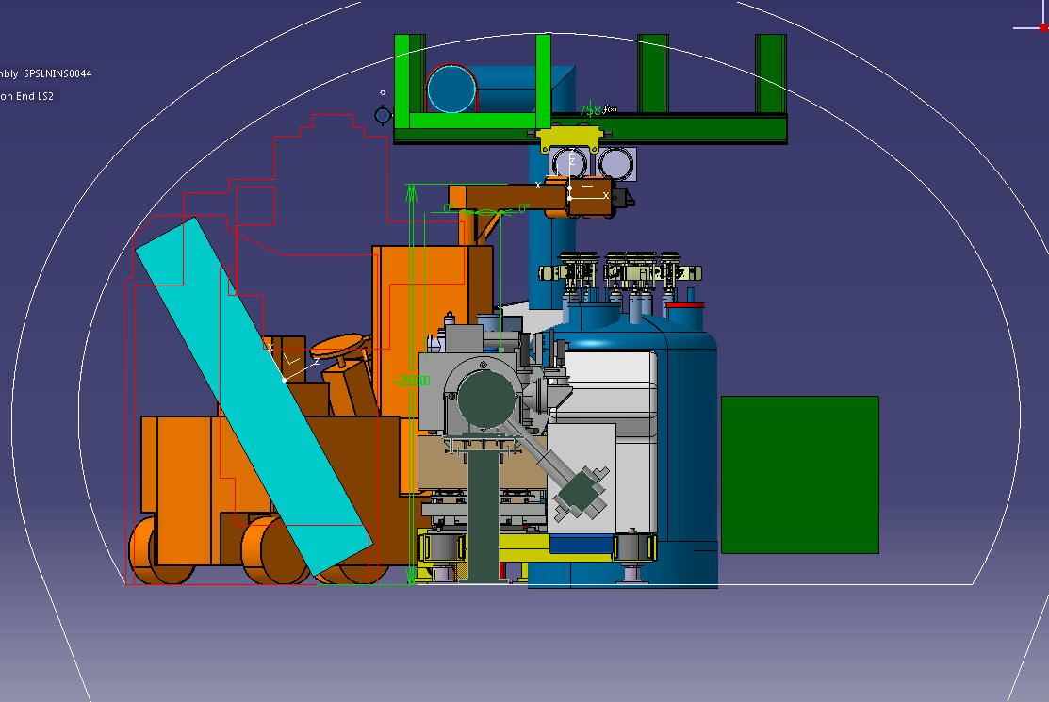

Slide 2
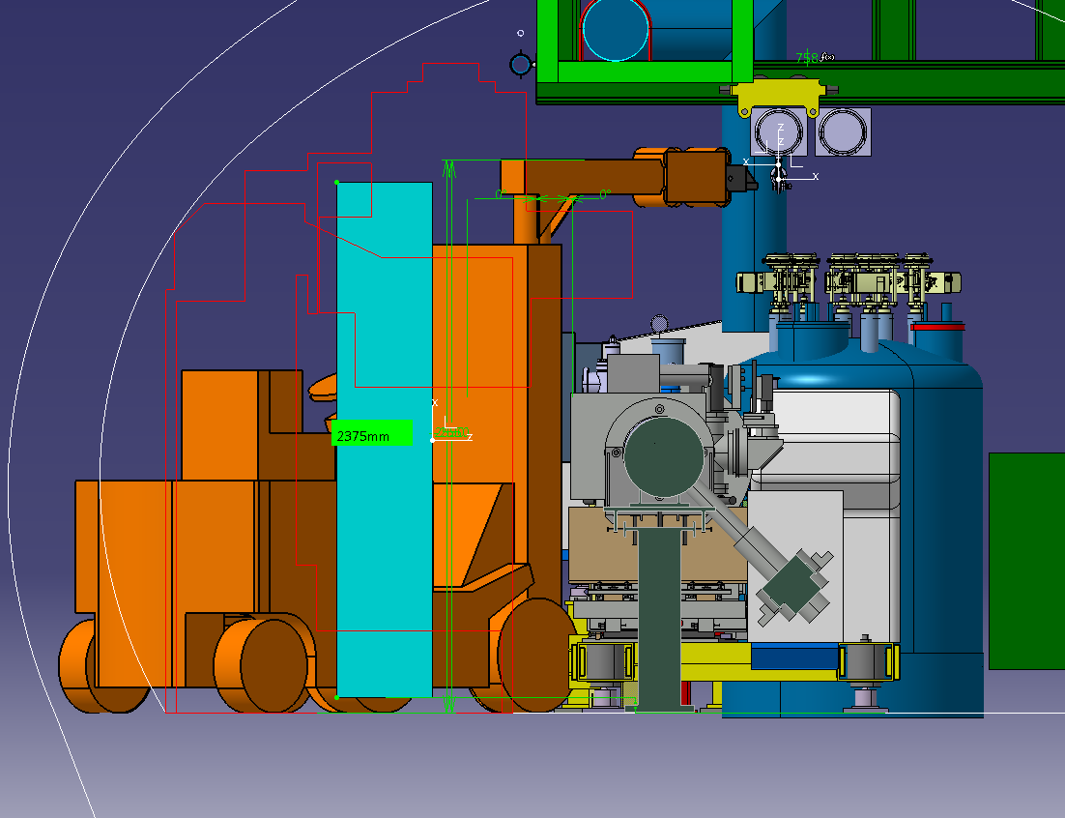

Slide 3
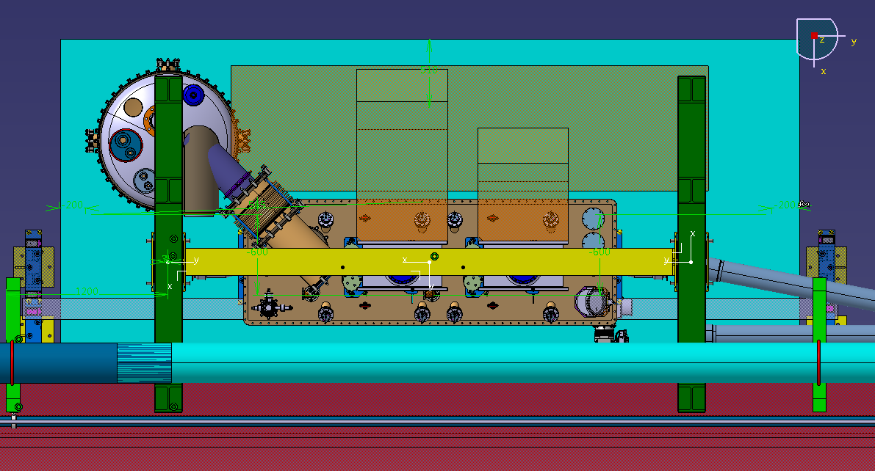
Interferences
lower the collar/ gain space?
Is there any chance to prepare the TRANSPORT model in catia?

Slide 4
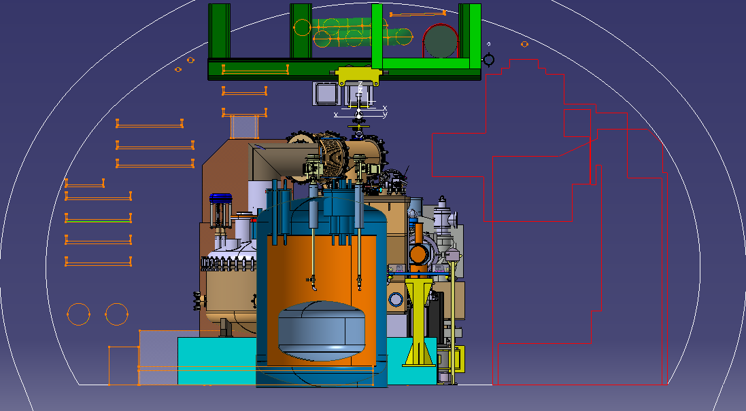
Interference with cable trails (longer beam)
move the cable trails?

Slide 5
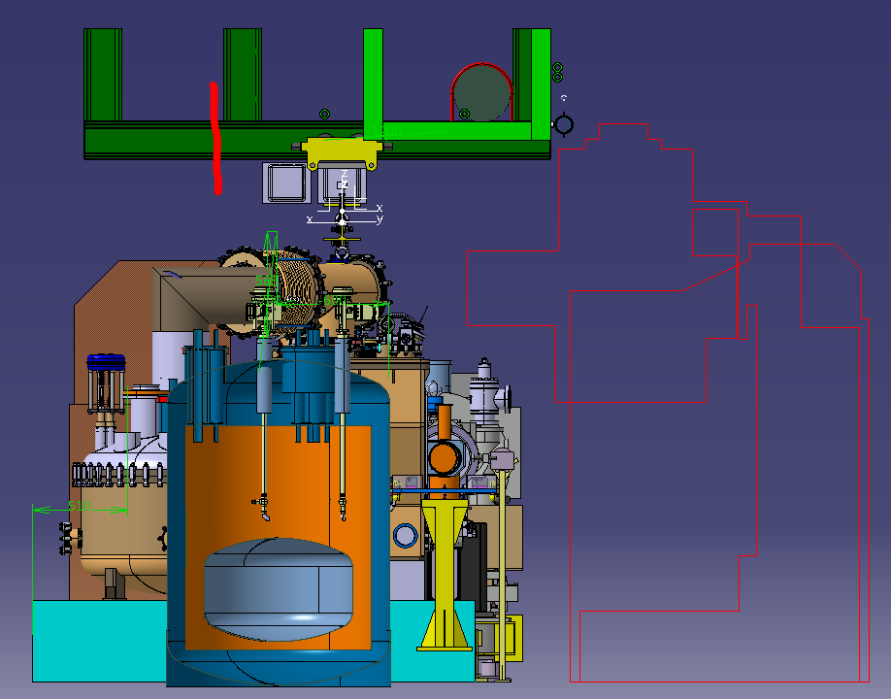

Slide 6
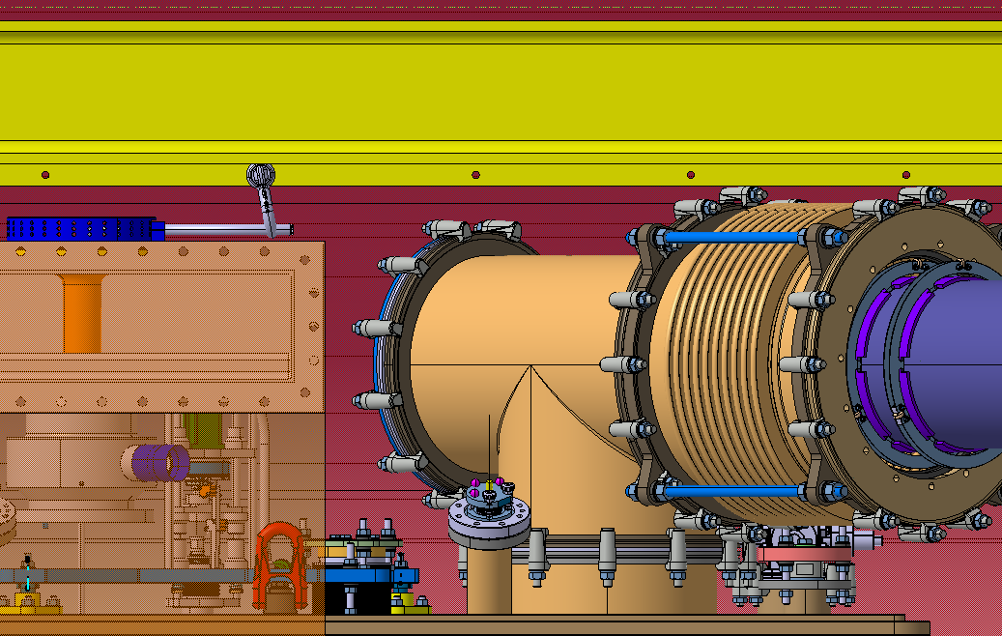
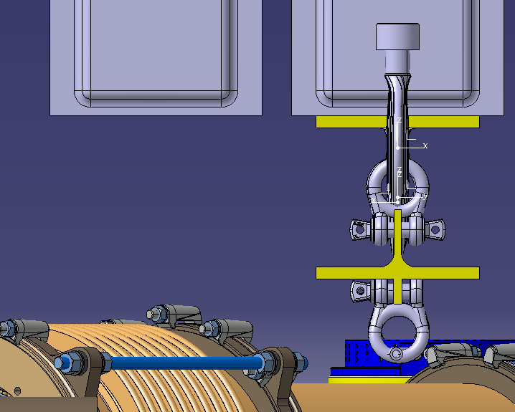

Slide 7
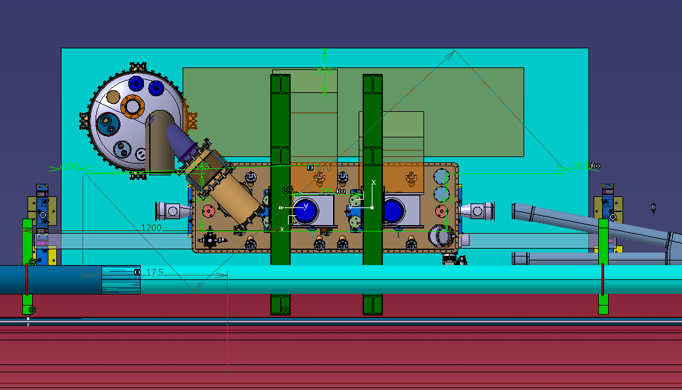
Different approach:
Two beams directly above the picking points (no problem with interference)
3rd beam above the barrel (service)

Slide 8
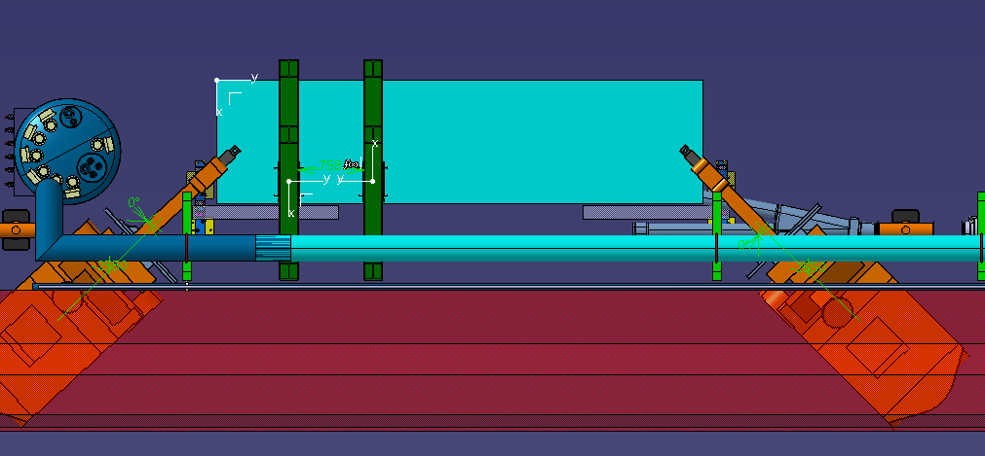
Installation with the YALEs

Slide 9
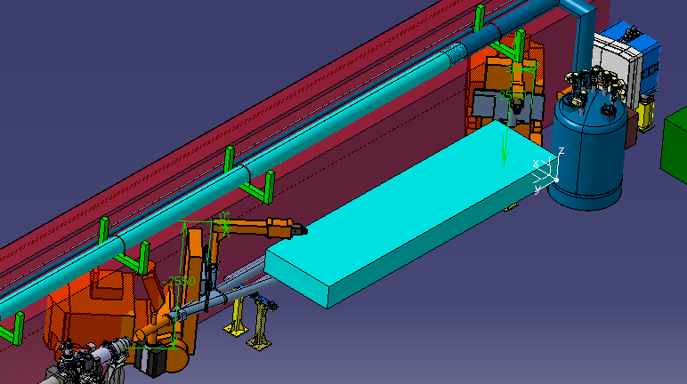
Installation with the YALEs

