Slide 1


DOE Office of HEP Report
2016 U.S. LHC Users Association Annual Meeting
Lawrence Berkeley National Laboratory
November 4 , 2016
Anwar Bhatti
Office of High Energy Physics
Office of Science, U.S. Department of Energy

Slide 2

Outline
HEP Mission
Energy Frontier Program Overview
Intensity Frontier Program
Cosmic Frontier Program
HEP Program Planning and Budgets
Closing Remarks
This talk will describe HEP program with emphasis on Energy Frontier
research at the LHC and future particle colliders — within the
broader context of the overall HEP program

Slide 3
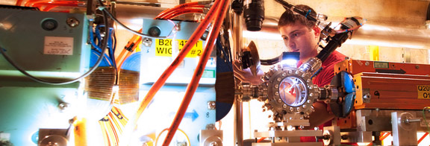
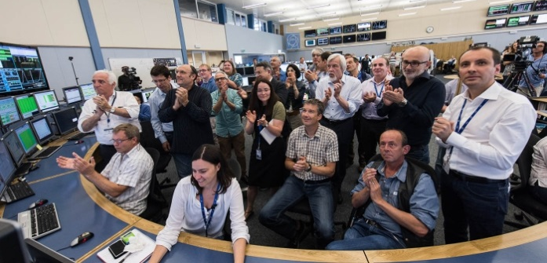
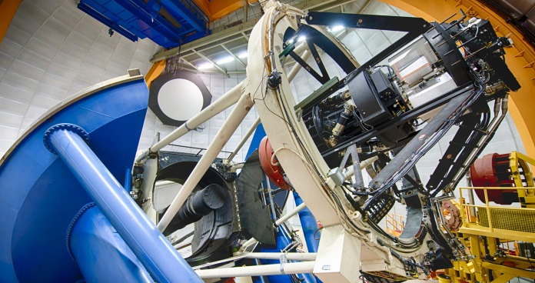
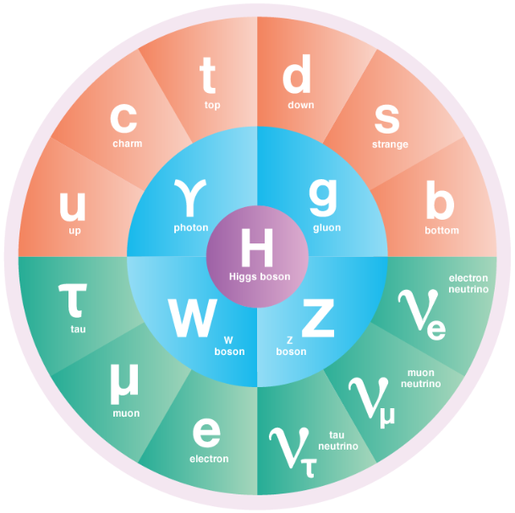
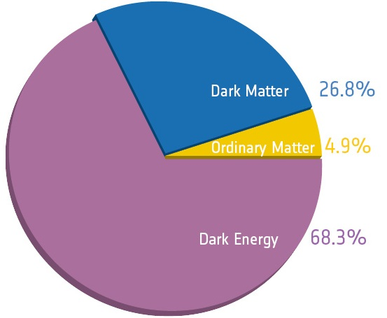
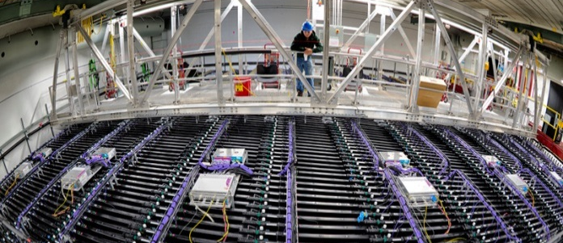
The High Energy Physics Program Mission
…is to understand how the universe works at its most
fundamental level:
  Discover the elementary constituents of matter and energy
  Probe the interactions between them
  Explore the basic nature of space and time
The Office of High Energy Physics fulfills its mission by:
  Building projects that enable discovery science
  Operating facilities that provide the capability to
  perform discovery science
  Supporting a research program that
  produces discovery science

Slide 4




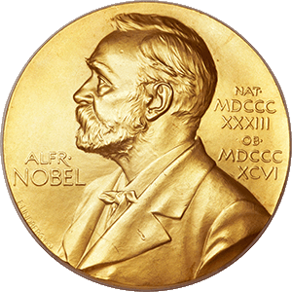


The Science Drivers of Particle Physics
The Particle Physics Project Prioritization Panel (P5) report identified five intertwined science drivers, compelling lines of inquiry that show great promise for discovery:
Use the Higgs boson as a new tool for discovery
Pursue the physics associated with neutrino mass
Identify the new physics of dark matter
Understand cosmic acceleration: dark energy and inflation
Explore the unknown: new particles, interactions, and physical principles
*2013
*2015
*2011
* Since 2011, three of the five science drivers have
been lines of inquiry recognized with Nobel Prizes

Slide 5






HEP Research Subprograms
Energy Frontier researchers accelerate particles to the highest-energies ever made by humanity and collide them to produce and study the fundamental constituents of matter and the architecture of the universe
Intensity Frontier researchers use a combination of intense particle beams and highly sensitive detectors to make extremely precise measurements of particle properties, study rare particle interactions, and search for new physics
Cosmic Frontier researchers seek to reveal the nature of dark matter and dark energy by using particles from space to explore new phenomena
Theoretical and Computational Physics provide the framework to explain experimental observations and gain a deeper understanding of nature
Advanced Technology R&D fosters fundamental research into particle acceleration and detection techniques and instrumentation
Accelerator Stewardship coordinates with accelerator user communities and industry to develop innovative solutions to critical problems, benefitting the broader user communities and the discovery science

Slide 6
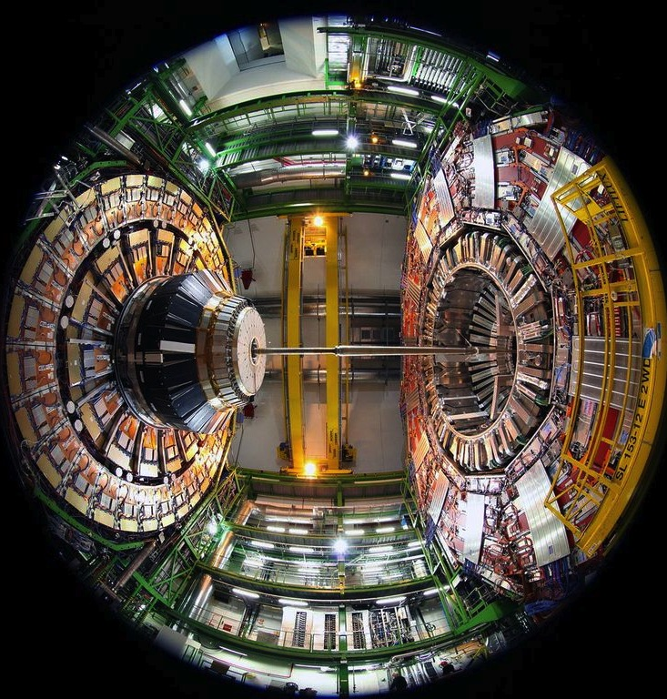
Energy Frontier

Slide 7
HEP Energy Frontier Experiments
Experiment | Location | Center-of-Mass Energy; Status | Description of Science | # Institutions; # Countries | #U.S. Institutions | #U.S. Coll.
DØ (DZero) | Fermilab Tevatron Collider [Batavia, Illinois, USA] | 1.96 TeV; Operations ended: Sept. 30, 2011 | Higgs, Top, Electroweak, SUSY, New Physics, QCD, B-physics | 74 Institutions; 18 Countries | 31 Univ., 1 National Lab | 187
CDF (Collider Detector at Fermilab) | Fermilab Tevatron Collider [Batavia, Illinois, USA] | 1.96 TeV; Operations ended: Sept. 30, 2011 | Higgs, Top, Electroweak, SUSY, New Physics, QCD, B-physics | 54 Institutions; 14 Countries | 26 Univ., 1 National Lab | 194
ATLAS (A Toroidal LHC ApparatuS) | CERN, Large Hadron Collider [LHC; Geneva, Switzerland / Meyrin, Switzerland] | 7-8 TeV; 13-14 TeV Run 1 ended: Dec. 2012 Run 2 started: May 2015 | Higgs, Top, Electroweak, SUSY, New Physics, QCD, B-physics | 180 Institutions; 38 Countries | 41 Univ., 4 National Labs | 629
CMS (Compact Muon Solenoid) | CERN, Large Hadron Collider [LHC; Geneva, Switzerland / Cessy, France] | 7-8 TeV; 13-14 TeV Run 1 ended: Dec. 2012 Run 2 started: May 2015 | Higgs, Top, Electroweak, SUSY, New Physics, QCD, B-physics | 209 Institutions; 45 Countries | 48 Univ., 1 National Lab [+1 National Lab as sub-institute] | 670
Tevatron data as of October 2014; LHC data as of July 2016
One main scientific thrust – LHC at CERN (pp collider): CMS and ATLAS Collaborations
Modest support for two additional thrusts:
  Tevatron research at Fermilab (pp collider): DØ and CDF Collaborations
  Future collider initiatives (mainly ~2-3 FTEs on ILC detector R&D) to universities and laboratories
U.S. is the single largest collaborating nation in both the ATLAS and CMS experiments at LHC
  US-ATLAS: ~22% of the international ATLAS Collaboration
    ~200 U.S. graduate students
  US-CMS: ~27% of the international CMS Collaboration
    ~250 U.S. graduate students
-

Slide 8
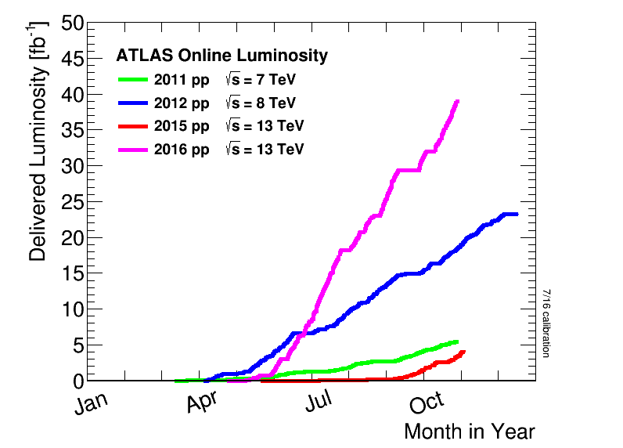
Excellent LHC Performance and Near-term Challenges
LHC continues to set new performance records
  Unprecedented peak instantaneous luminosity ~1.4 x 10³⁴ cm⁻¹s⁻¹ exceeds design luminosity by ~40%!
  Data accumulation ~60% beyond the goal of 25 fb⁻¹ for 2016!
Congratulations to the CERN accelerator team for the hard work in operating the LHC, and to the experiments for the high performance efficiency in acquiring data!
LHC performance has immediate challenges in computing resources that are needed to support operations and analysis efforts as a result of the increased amount of data generated by ATLAS and CMS by 20-40% in Run 2
  Increases anticipated need for additional CPU, Disk, and Tape resources by ~20% in FY 2017
This presents a challenge in the anticipated flat budget, but DOE will continue to coordinate with the experiments, CERN, and its partners through the international process to address these issues

Slide 9
U.S. Contributions to the LHC
The LHC and its upgrades are a core part of the U.S. program
  DOE participated in the design, construction, and operation of the LHC and its detectors since the original 1997 International Cooperation Agreement between CERN, DOE, and NSF
  The unique scientific capabilities of the LHC promise compelling science for decades to come
DOE contributions to the HL-LHC accelerator and detector upgrades will leverage our areas of technical expertise and capitalize on previous investments, for example
  Long-term investments in the U.S. LHC Accelerator Research Program (LARP) enables accelerator contributions that will be key to the HL-LHC program
  Long-term investments in silicon-based detector R&D enable U.S. leadership in the ATLAS and CMS inner trackers and the CMS
  high-granularity calorimeter

Slide 10
ATLAS HL-LHC Upgrade
U.S. ATLAS has defined the scope of its potential contributions to the HL-LHC upgrades
  Driven by future science discovery potential while leveraging the interests and experience of U.S. groups
  Active coordination with international ATLAS ― at all levels
DOE Scope:
  Barrel ITK (pixel & strip detector)
  DAQ hardware (data flow elements)
  LAr front end analog chip development
NSF Scope:
  Trigger and readout electronics for
  LAr, Tile, Muons
* Large eta scenarios, as described in the 2015 scoping document for
the reference 275 MCHF CORE cost scenario

Slide 11
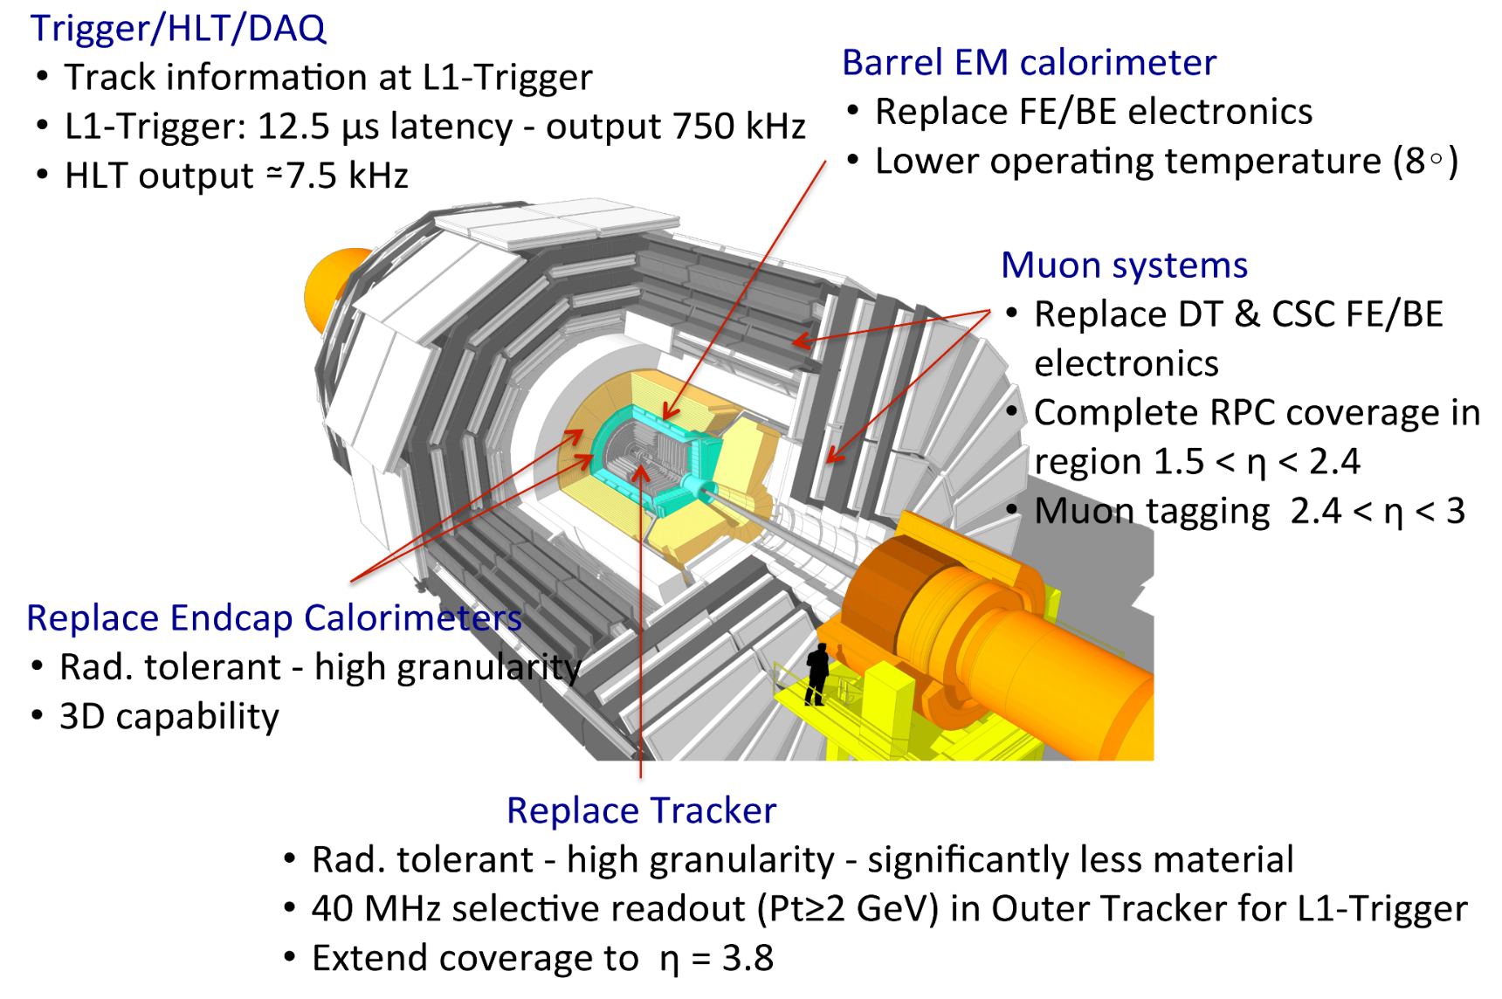
CMS HL-LHC Upgrade
U.S. HL-LHC CMS upgrade scope driven by future science opportunities, expertise by U.S. scientists, and coordination with international CMS
DOE
NSF
NSF
NSF
NSF
DOE
*
*
DOE
3.8
NSF
Significant U.S. contributions
= Significant
U.S. contributions

Slide 12
HL-LHC Detector Upgrades Budget
U.S. ATLAS and U.S. CMS are planning towards NSF MREFC contributions not to exceed $75M (in U.S. accounting) for each experiment
Profile DOE used for planning now needs to be fine-tuned and optimized to ensure U.S. “fair-share” commitments to the HL-LHC Detector Upgrades are met
  Plan at CD-0 targeted U.S. scope for each upgrade as a fair-share of ~235 MCHF CORE cost
    i.e., CD-0 Total Project Cost in U.S. accounting: $155M (DOE) + $75M (NSF) per experiment
  October 2015 RRB approved “scale of funds between 235 – 275 MHCF CORE cost,” DOE
  plans to adjust contributions to target total fair-share for U.S. near midpoint of range
    Working with the U.S. project teams, experiments, & CERN to update profile prior to CD-1
FY17 President's request includes $1.25M for each DOE ATLAS/CMS HL-LHC project
  U.S. responsibilities will be finalized after TDRs are complete in 2017
  Remaining R&D support required for TDRs provided via redirections from LHC Ops funds
    U.S. LHC Operations already contained the R&D component for HL-LHC prior to CD-0
CD-0 Funding Profile: HL-LHC Detector Upgrade Projects (AY $M; in U.S. accounting)
Fiscal Year | FY16 | FY17 | FY18 | FY19 | FY20 | FY21 | FY22 | FY23 | FY24 | Total
ATLAS TPC | 1.5* | 5.0* | 14.0 | 31.5 | 42.3 | 26.1 | 20.1 | 10.0 | 4.5 | 155.0
CMS TPC | 1.5* | 5.0* | 14.0 | 31.5 | 42.3 | 26.1 | 20.1 | 10.0 | 4.5 | 155.0
* Upper limits, based on redirection of funds from U.S. LHC Operations R&D line-item to Other Project Costs (OPC)

Slide 13
Laboratory Comparative Review
All Laboratory Research Groups (experimental frontiers, Theory, and Detector R&D) have been undergoing Comparative Review since 2008.
Panels evaluate all laboratory research groups at once and make recommendations on how to best allocate resources to labs, indicating areas of weakness and strength
Energy Frontier Lab Research groups were reviewed in July 2015, report issued this year
The recommendations of the Review Panel are forwarded to lab management for implementation, and the DOE-HEP budget line is adjusted accordingly
From review report:
“The overall impact of these laboratories in the field is truly significant and highly competitive, at an international level. This is achieved thanks to excellent infrastructure at the laboratories and thanks to excellent staff often carrying clear leadership roles in the most important international research endeavors (in particular the ATLAS and CMS experiments at CERN’s LHC).”

Slide 14
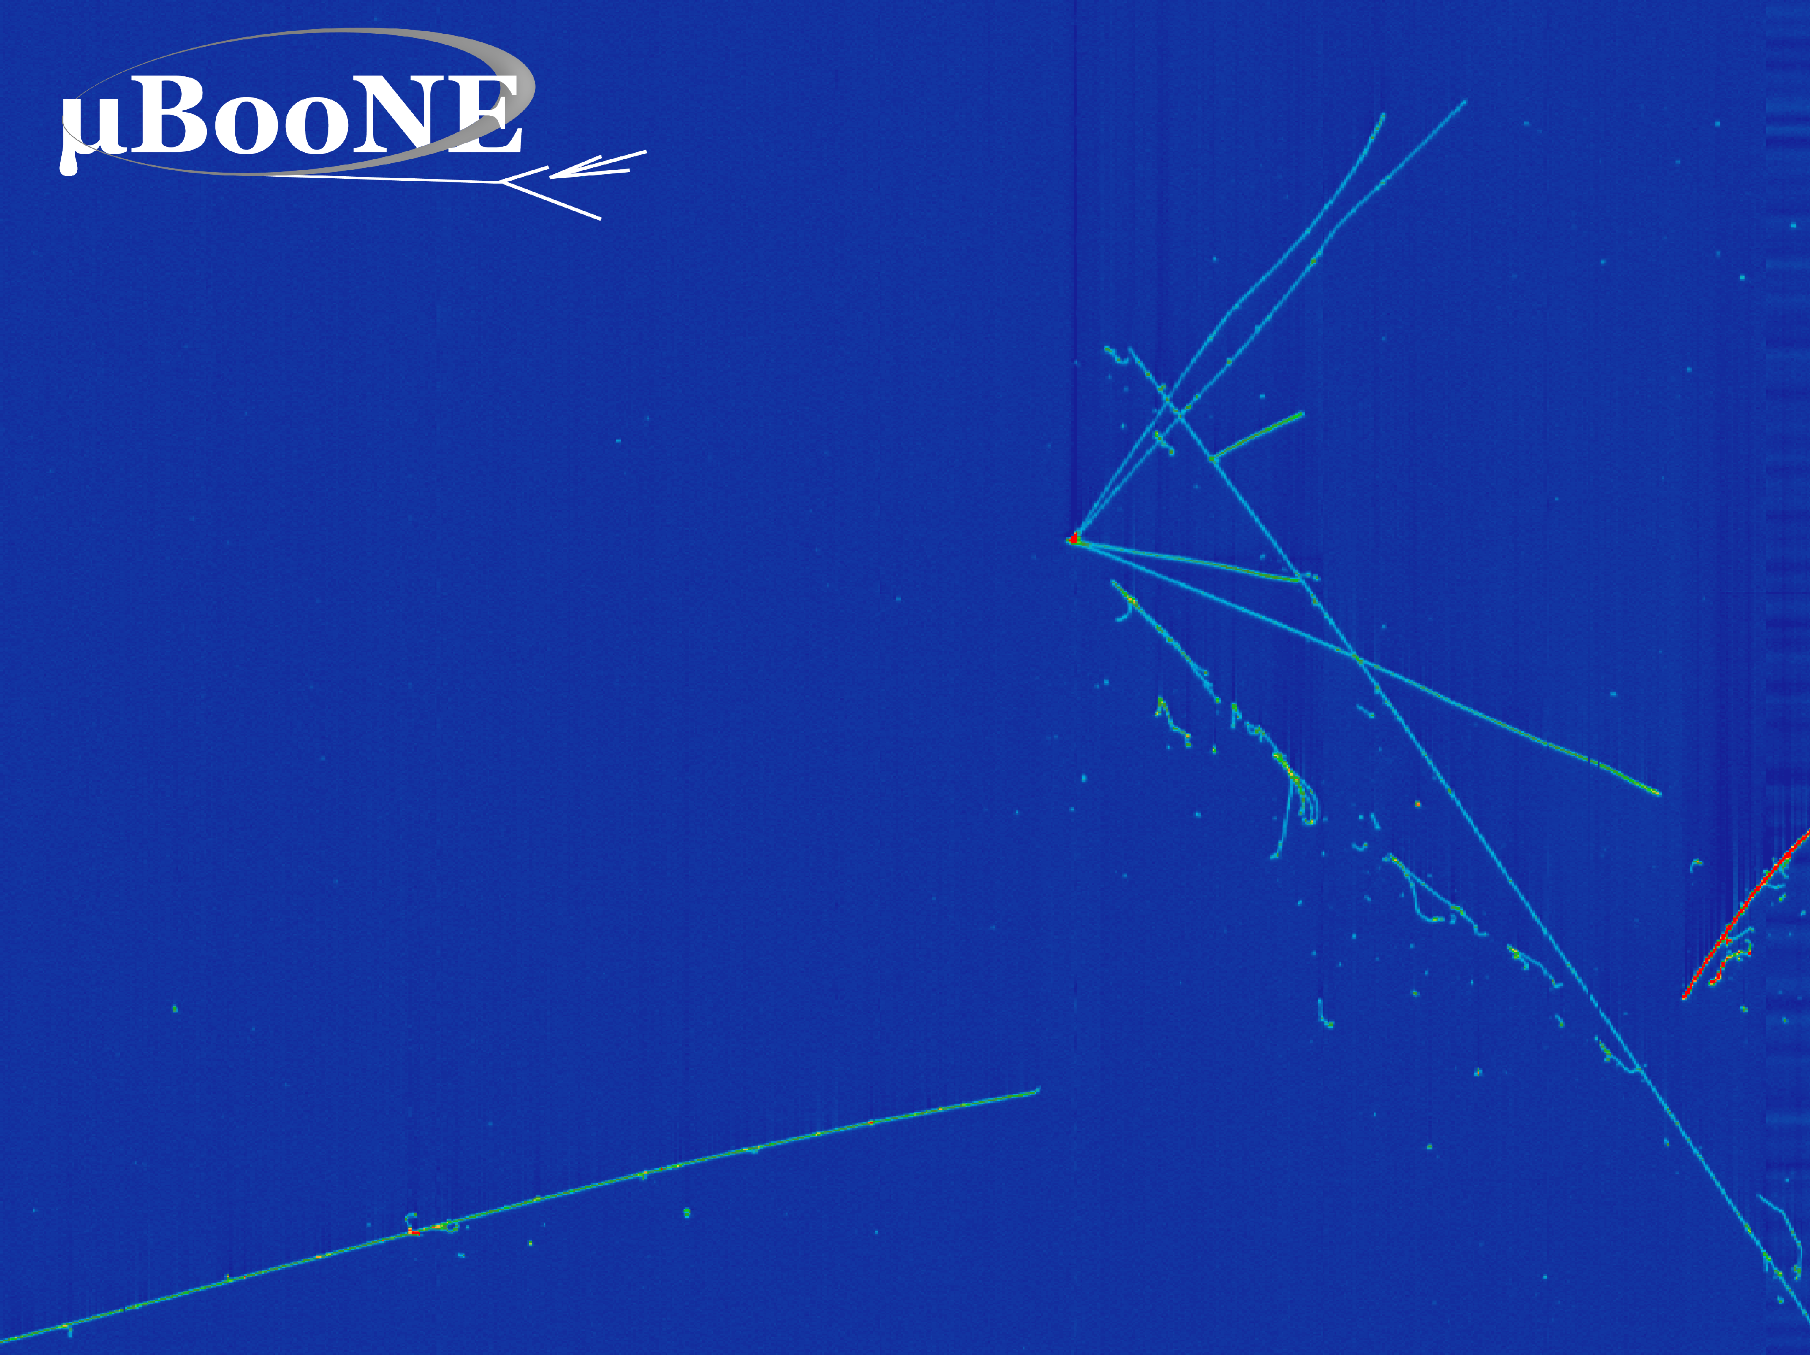
Intensity Frontier

Slide 15
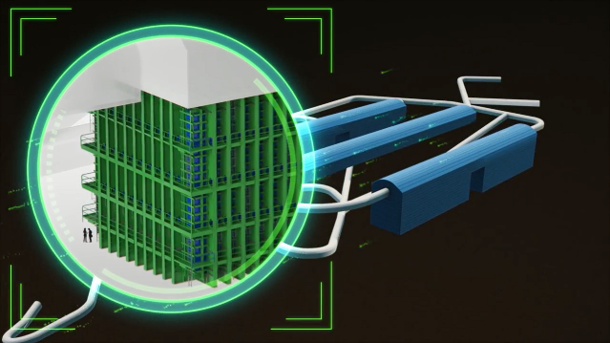
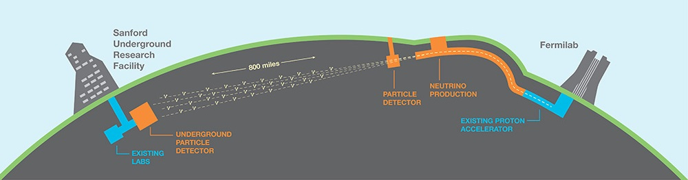
Intensity Frontier
Intensity Frontier experiments address the P5 Science Drivers through intense beams and sensitive detectors
Exploring the unknown through precision measurements: Muon g-2, Mu2e, Belle II, K0TO
Identify the new physics of dark matter: APEX and Heavy Photon Search
Pursuing the physics associated with neutrino mass: NOvA, Daya Bay, MINERvA, Super-K, T2K ongoing; ramping up Fermilab Short-Baseline Neutrino Program (MicroBooNE, SBND, ICARUS)
P5 recommended Long Baseline Neutrino Facility (LBNF) as the centerpiece of a U.S.-hosted world-leading neutrino program, recognizing it as the highest-priority large project in its timeframe
Given the compelling discovery potential, Fermilab is working closely with CERN and other global partners to establish a truly international “mega-science” facility with first physics in the mid-2020s
LBNF will produce the world’s most intense neutrino beam and send it 800 miles through the earth
The Deep Underground Neutrino Experiment (DUNE) will be a large (40 kiloton) liquid argon neutrino detector located nearly 1 mile underground at the Sanford Underground Research Facility
LBNF/DUNE project received CD-3A (early far-site construction) approval in September 2016
  FY17 investments in site preparation and cavern excavation aim to solidify international partnerships

Slide 16

Cosmic Frontier

Slide 17
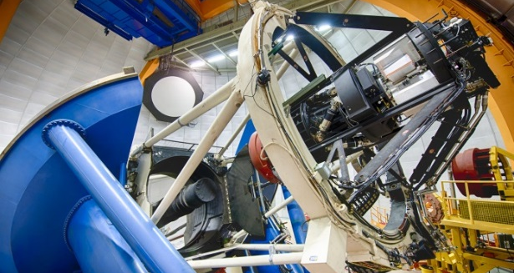
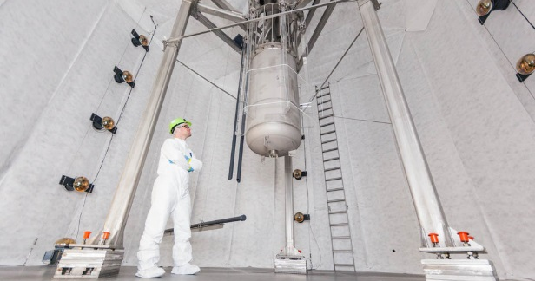
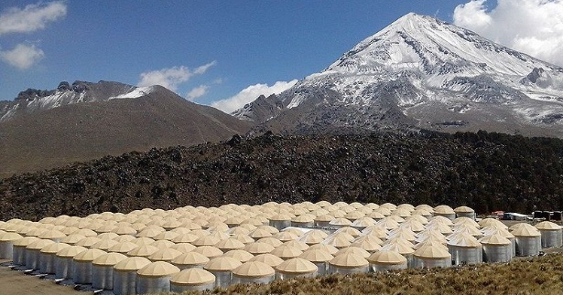
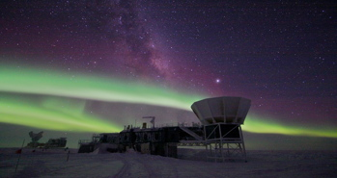
Cosmic Frontier
Dark Energy: Staged program of complementary suite of imaging and spectroscopic surveys
Imaging: Dark Energy Survey (DES) continues operations, Large Synoptic Survey Telescope (LSST) received CD-3 in August 2015
Spectroscopic: BOSS final results out soon; eBOSS continues operations, Dark Energy Spectroscopic Instrument (DESI) received CD-3 in June 2016
Have agreements with NSF-AST for LSST partnership & DESI cooperation
Dark Matter (direct detection): Staged program of current (G1) and next-generation (G2) experiments with multiple technologies
Completed operations of DM-G1 experiments in FY 2016
Progress continues towards DM-G2: ADMX-G2, LZ, SuperCDMS-SNOLAB
  LZ received CD-2A/3B in August 2016
  SuperCDMS-SNOLAB received CD-1 December 2015
Cosmic-ray, Gamma-ray
Fermi/GLAST, AMS, and HAWC continue operations
Cosmic Microwave Background (CMB)
South Pole Telescope polarization (SPTpol) continues operations
SPT-3G begins operations in December 2016; partnership with NSF
Community planning proceeding for CMB-S4 experiment

Slide 18
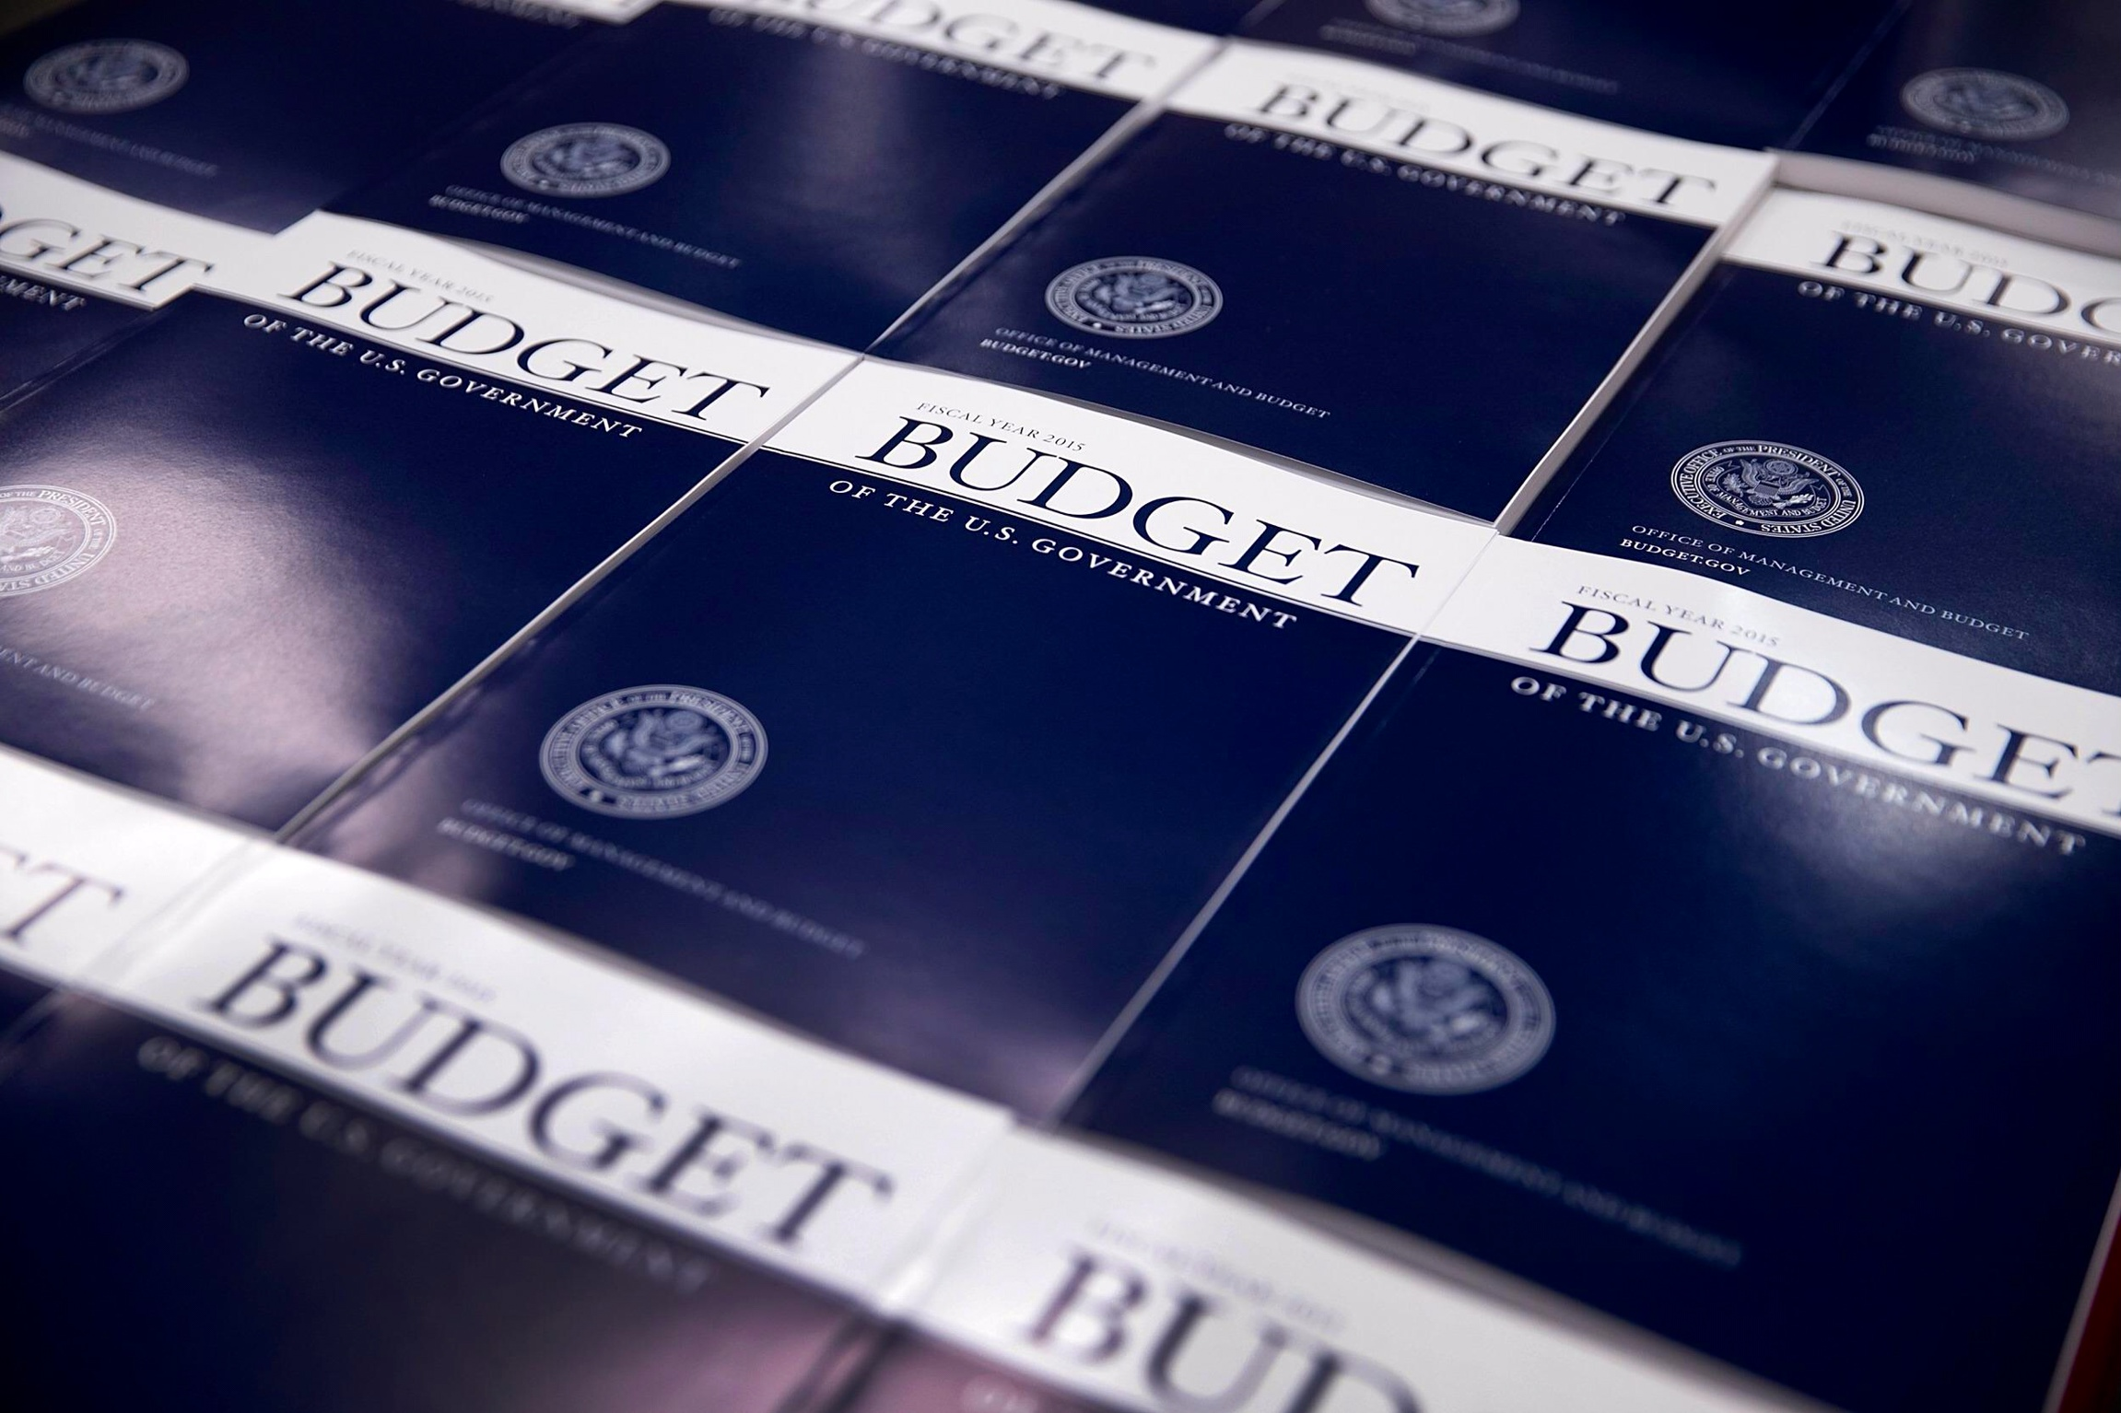
HEP FY 2017 Budget

Slide 19
HEP FY 2017 Budget Overview
Energy Frontier: Continue to support leadership roles in highly successful LHC program
  Initial LHC detector upgrade project funding ends in FY 2017
  Scope being determined for High Luminosity (HL)-LHC, P5’s highest priority near-term project; CD-0 in 2016
  The U.S. will continue to play a leadership role in LHC discoveries by remaining actively engaged in LHC data analysis
Intensity Frontier: Solidify international partnerships for U.S.-hosted LBNF/DUNE
  Rapid progress on LBNF/DUNE has attracted attention from interested international partners and FY 2017 investments in site preparation and cavern excavation aim to solidify international partnerships
  Fermilab will continue improvements to accelerator complex while serving high-intensity neutrino beams to short-and long-baseline experiments, enabling full utilization of the FNAL facilities
Cosmic Frontier: Advance our understanding of dark matter and dark energy
  Fabrication funding ramp up in FY 17 supports key P5 recommended Cosmic Frontier projects to study dark matter and dark energy: LSSTcam, DESI, SuperCDMS-SNOLab, LZ

Slide 20
FY 2017 HEP Funding by Activity
HEP Funding Category ($ in K) | FY 2015 Current | FY 2016 Enacted | FY 2017 Request | Explanation of Changes (FY17 vs. FY16)
Research | 334,225 | 327,389 | 331,123 | Sustain support for research program
Facilities | 264,634 | 254,979 | 252,037 | Overall operations support reductions due to scheduled completion of projects
Projects | 99,373 | 107,620 | 108,516 | *Other Project Costs (OPC) includes CDR, project-specific R&D, prototyping and testing, installation and commissioning/pre-operations before CD-4
Energy Frontier Projects | 15,000 | 19,000 | 18,967 | Initial ATLAS/CMS upgrades complete in FY17; OPC* begins for HL-LHC detector upgrades
Intensity Frontier Projects | 48,170 | 17,685 | 9,349 | Reduction from ramp down of g-2 & end of LBNF/DUNE OPC*; SBN Program increases
Cosmic Frontier Projects | 45,203 | 66,835 | 70,200 | Planned ramp up supports fabrication of LSSTcam, DESI, SuperCDMS-SNOLab, LZ
Other Projects | 1,000 | 4,100 | 10,000 | Increase to support the FACET-II project
Construction (Line Item) | 37,000 | 84,115 | 103,741 | Request engineering design, site preparation and long-lead procurement for the LBNF/DUNE; planned profile for Mu2e
SBIR/STTR | 20,768* | 20,897 | 22,580
Total | 766,000* | 795,000 | 817,997 | House mark $823M; Senate mark $833M
adf
* SBIR/STTR added to FY 2015 for comparison to FY 2016/2017

Slide 21
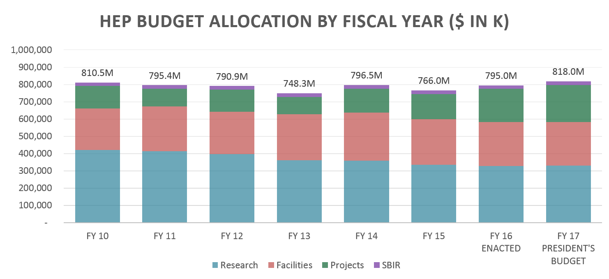
Overall HEP Budget Trend
House mark $823M
Senate mark $833M
All funding shown in “then-year” U.S. dollars
Significant dip in FY 2013 from Congressional sequestration
FY 2015 request developed prior to P5 report release
FY 2017 Continuing Resolution (CR) through December 9, 2016
  Funding through December 9 is equivalent to $791M level of funding, if extrapolated to full FY

Slide 22
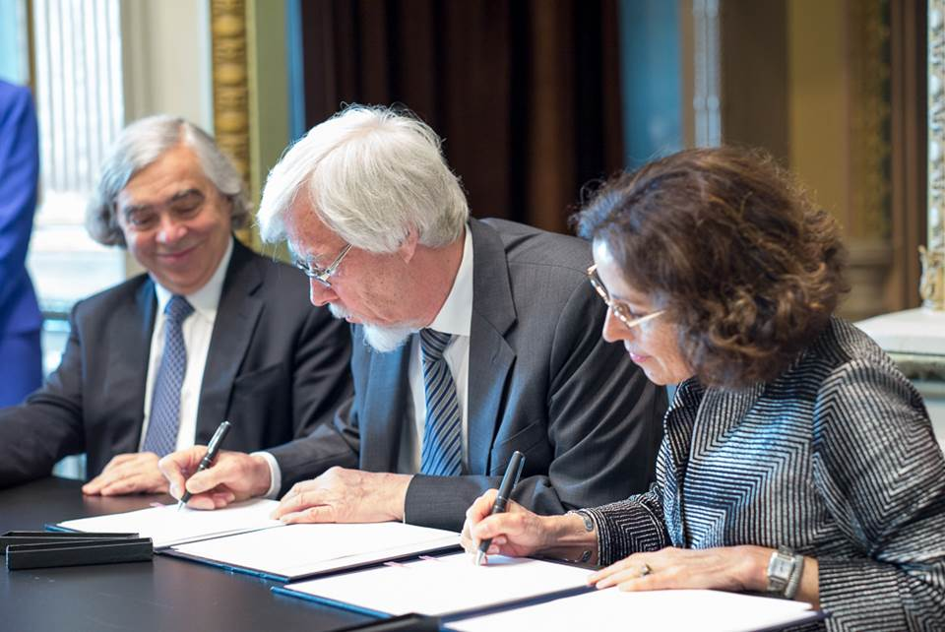
Messages for the U.S. LHC Community
The lion’s share of current DOE HEP investment remains the LHC program and will be for many more years
Our traditional partnership with CERN has been strong and we look forward to continuing it through the U.S.-CERN Agreement and Protocols signed in 2015
We realize that with the initial (Phase-1) and HL-LHC upgrades, as well as ongoing LHC Operations, resources are quite stretched
  We are actively taking steps to address this in FY17-18 as the HL-LHC upgrade projects ramp-up and Phase-1 projects ramp-down
  As a first step, we have added resources to the HL-LHC upgrade projects, for
  the accelerator, ATLAS R&D, and CMS R&D
  DOE is leveraging its expertise in high-field magnets
  and silicon-based detectors to help enable the strong
  scientific and technological performance of the LHC
P5 recognized that a compelling and comprehensive
LHC program is a core part of U.S. particle physics,
and DOE intends to support key leadership roles in
all areas of the ATLAS and CMS experiments
  U.S. participation is enabled by leveraging U.S. expertise in
  accelerator science and technology to exploit future opportunities at the LHC

Slide 23
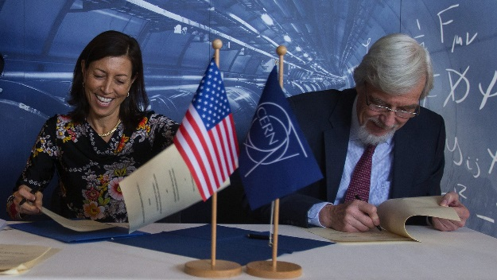
Messages for U.S. Neutrino Community
As part of the P5 global vision, DOE is working to establish a U.S.-hosted world-leading neutrino physics program with LBNF as its centerpiece
  This major U.S. initiative in the global program must succeed to balance U.S. participation in science facilities hosted elsewhere, including the LHC
  Given the compelling scientific discovery potential of LBNF/DUNE, Fermilab is working closely with its global partners to establish a truly international “mega-science” facility with first physics in mid-2020s
  International partners are beginning to come aboard with contributions; more are expected…
    CERN will be a major partner through the agreements signed last year
“Scenario B+” strategy aims to accelerate LBNF/DUNE using additional funding while maintaining program balance and supporting priorities of Scenario B
  Investments in early far-site construction
  necessary to enable interested international
  partners to make “in-kind” contributions on
  schedule
Completion of ProtoDUNE is an important R&D
step towards timely realization of LBNF/DUNE

Slide 24
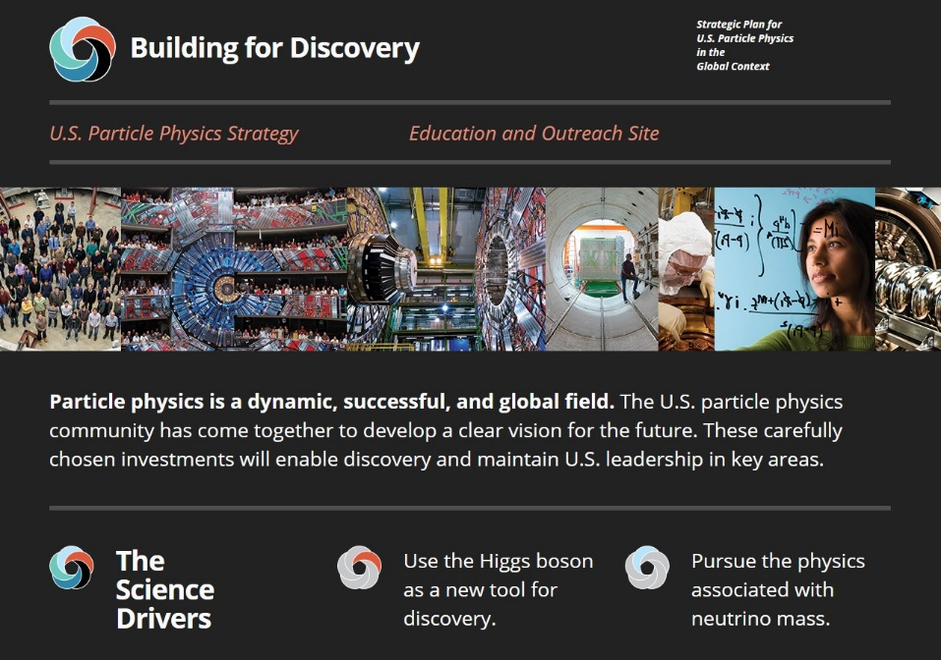
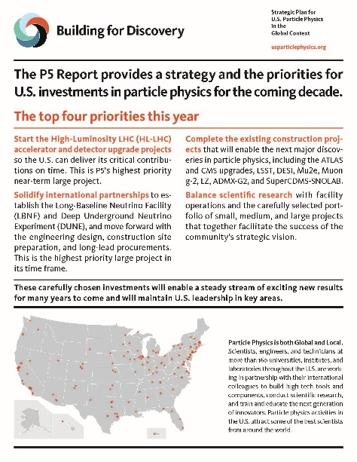
Community Materials
Steve Ritz is leading community efforts to produce materials to help maintain the visibility of the P5 report
  Initial materials are available at:
  http://www.usparticlephysics.org/
  Steve plans to continue working with the U.S. particle physics community to update the material as needed
Users’ Groups report that Steve’s material was helpful during their March 2016 visit to Washington, DC
U.S. particle physics community should consider using Steve’s messages as part of their communications strategy

Slide 25
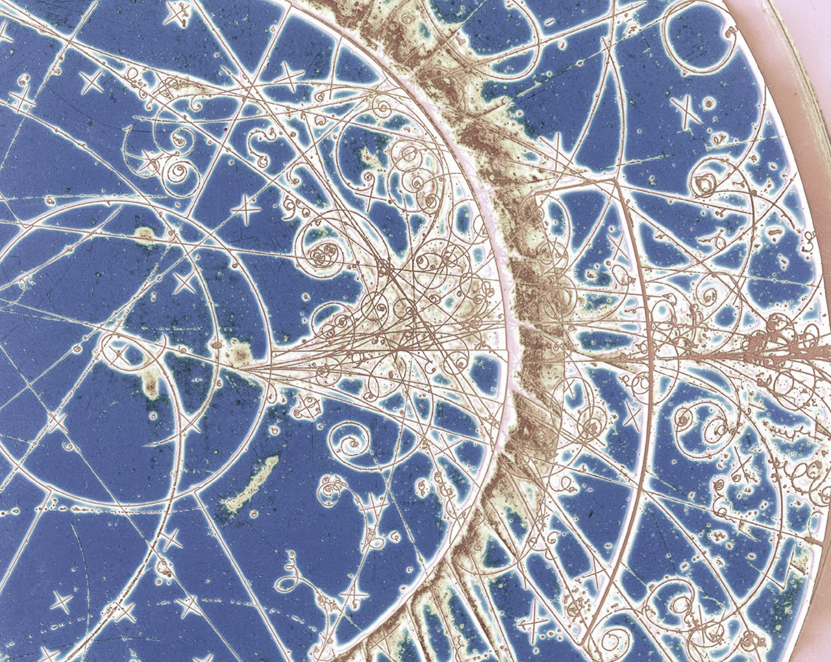
Backup

Slide 26
Addressing HL-LHC Concerns from U.S. LHC
Recent concerns from the U.S. HL-LHC project managements
  Accelerator: long-lead procurement of coil strands for Nb₃Sn magnets to begin fabrication in FY18 and meet scheduled delivery by end of 2023
  Detector: R&D support necessary for completion of TDRs in 2017 and
  begin long-lead procurement of silicon-based subsystems
Steps are being taken to address immediate FY17 concerns
  Accelerator Upgrades: Additional $2M in FY17
    This is a first step, with funding redirected from lower-priority directed accelerator R&D to LARP for HL-LHC
    LARP and HL-LHC completely coordinated for U.S. to deliver Nb₃Sn magnets
  Detector Upgrades: Additional $1.25M in FY17 for each of ATLAS/CMS R&D
    HEP identified this additional $2.5M total that can be redirected to HL-LHC ATLAS and CMS R&D from lower-priority tasks
    These funds are in addition to the CD-0 profile shown earlier
In the longer term, we plan to continue working with U.S. HL-LHC projects to optimize HL-LHC project profiles, including adjusting Total Project Cost, as we move toward CD-1 (planned for 2017)

Slide 27
The U.S. Federal Budget Cycle
Typically, three budgets are being worked on at any given time
  Executing current Fiscal Year (FY; October 1 – September 30)
  White House Office of Management and Budget (OMB) review and Congressional Appropriation for coming FY
  Agency internal planning for the second FY from now
FY 2016 | Spend the Fiscal Year Budget
FY 2017 | OMB Review |  |  |  | Budget Release | Congressional Budget and Appropriations |  |  |  |  |  |  | Spend the Fiscal Year Budget
FY 2018 | DOE Internal Planning with OMB and OSTP Guidance |  |  |  |  |  |  |  |  |  |  |  | OMB Review |  |  |  | Budget Release | Congressional Budget and Appropriations |  |  |  |  |  |  | Spend the Fiscal Year Budget
 | Oct | Nov | Dec | Jan | Feb | Mar | Apr | May | Jun | Jul | Aug | Sep | Oct | Nov | Dec | Jan | Feb | Mar | Apr | May | Jun | Jul | Aug | Sep | Oct | Nov | Dec | Jan | Feb | Mar | Apr | May | Jun | Jul | Aug | Sep
 | 2015 |  |  | 2016 |  |  |  |  |  |  |  |  |  |  |  | 2017 |  |  |  |  |  |  |  |  |  |  |  | 2018
CR through Dec 9, 2016,…
You are here

Slide 28
Breaking the Cycle: Continuing Resolution
If the U.S. Congress and the President have not passed all appropriations bills by September 30, a Continuing Resolution (CR) may be passed to avoid a U.S. Government shutdown
  CRs typically extend the level of funding from the previous year for set amount of time
A CR may impede the start of new projects
  Projects with total cost >$10M must be line-items approved by Congress in an appropriations bill before funding can begin
  It is possible, though not typical, for CRs to include “anomalies” that would allow new starts
A CR may impact the ramp-up of new projects
  DOE is committed to the successful execution of projects that have reached
  CD-2 and aims to provide the baseline funding profile
  Projects that have not reached CD-2 are most likely to be impacted under a CR
A CR may also impact future-year planning through such effects…
Given the current political climate, we expect a CR for at least part of
FY 2017 and are planning accordingly
  DOE has limited flexibility for adjustments under a CR, but will work closely with laboratory and project management to minimize any impacts

Slide 29
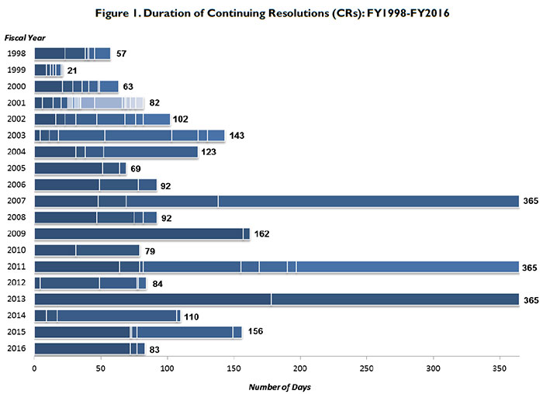
Duration of CRs: FY 1998 – FY 2016
Chart from Congressional Research Service Report R42647, "Continuing Resolutions, Overview of Components and Recent Practices," 2016.

Slide 30
DOE Project Management
Construction projects and fabrication of large pieces of experimental equipment costing over $5M are managed through a series of “Critical Decision” milestones
The CD process ensures successful project execution and scientific return on agency investments, but funding must still be appropriated
  Projects reaching CD-3 may have technical readiness, but they must be supported in the President’s Budget Request and receive funding from Congress before they can begin
U.S. projects require use of U.S. accounting (contingency, labor, etc.) vs. CORE (M&S only)
Project Definition
Project Execution
Project Closeout
Operating
Funds
Total Project Cost (TPC)
Operating
Funds
Initiation
(pre-project R&D)
(R&D continues…)
CD-0
Approve
Mission
Need
CD-1
Approve
Alternative
Selection
and Cost Range
CD-2
Approve
Performance
Baseline
CD-3
Approve
Start of
Construction
CD-4
Approve
Start of
Operations
(or Project Completion)
DOE 413.3B:
Critical
Decisions
Definitive
cost, scope, and
schedule
baselines have
been developed
Project has
demonstrated
technical
readiness for
implementation
Identifies there
is a need that can
only be met thru
material needs
Ensures the
selected alternative
and approach is the
optimum solution
Project is completed
and ready for
turnover to
program operations

Slide 31
HEP MIE Project Status
Subprogram | TPC ($M) | CD Status | CD Date
INTENSITY FRONTIER
Long Baseline Neutrino Facility (LBNF) / Deep Underground Neutrino Experiment (DUNE) | 1,260 - 1,860 | CD-3A | September 1, 2016
Muon g-2 | 46 | CD-2/3 | August 20, 2015
Mu2e | 273 | CD-3 | July 14, 2016
ENERGY FRONTIER
LHC ATLAS Detector (Phase-1) Upgrade | 33 | CD-2/3 | November 12, 2014
LHC CMS Detector (Phase-1) Upgrade | 33 | CD-2/3 | November 12, 2014
HL-LHC ATLAS Detector (Phase-2) Upgrade | 155 | CD-0 | April 14, 2016
HL-LHC CMS Detector (Phase-2) Upgrade | 155 | CD-0 | April 14, 2016
COSMIC FRONTIER
LZ | 46-59 | CD-2/3B | August 9, 2016
SuperCDMS-SNOlab | 16-21 | CD-1 | December 21, 2015
Dark Energy Spectroscopic Instrument (DESI) | 56 | CD-2 | September 17, 2015
Large Synoptic Survey Telescope Camera (LSSTcam) | 168 | CD-3 | August 27, 2015
ADVANCED TECHNOLOGY R&D
Facility for Advanced Accelerator Experimental Tests II (FACET-II) | TBD | CD-1 | December 21, 2015
Proton Improvement Project (PIP-II) | TBD | CD-0 | November 12, 2015
HL-LHC Accelerator Upgrade | 200 | CD-0 | April 7, 2016

Slide 32
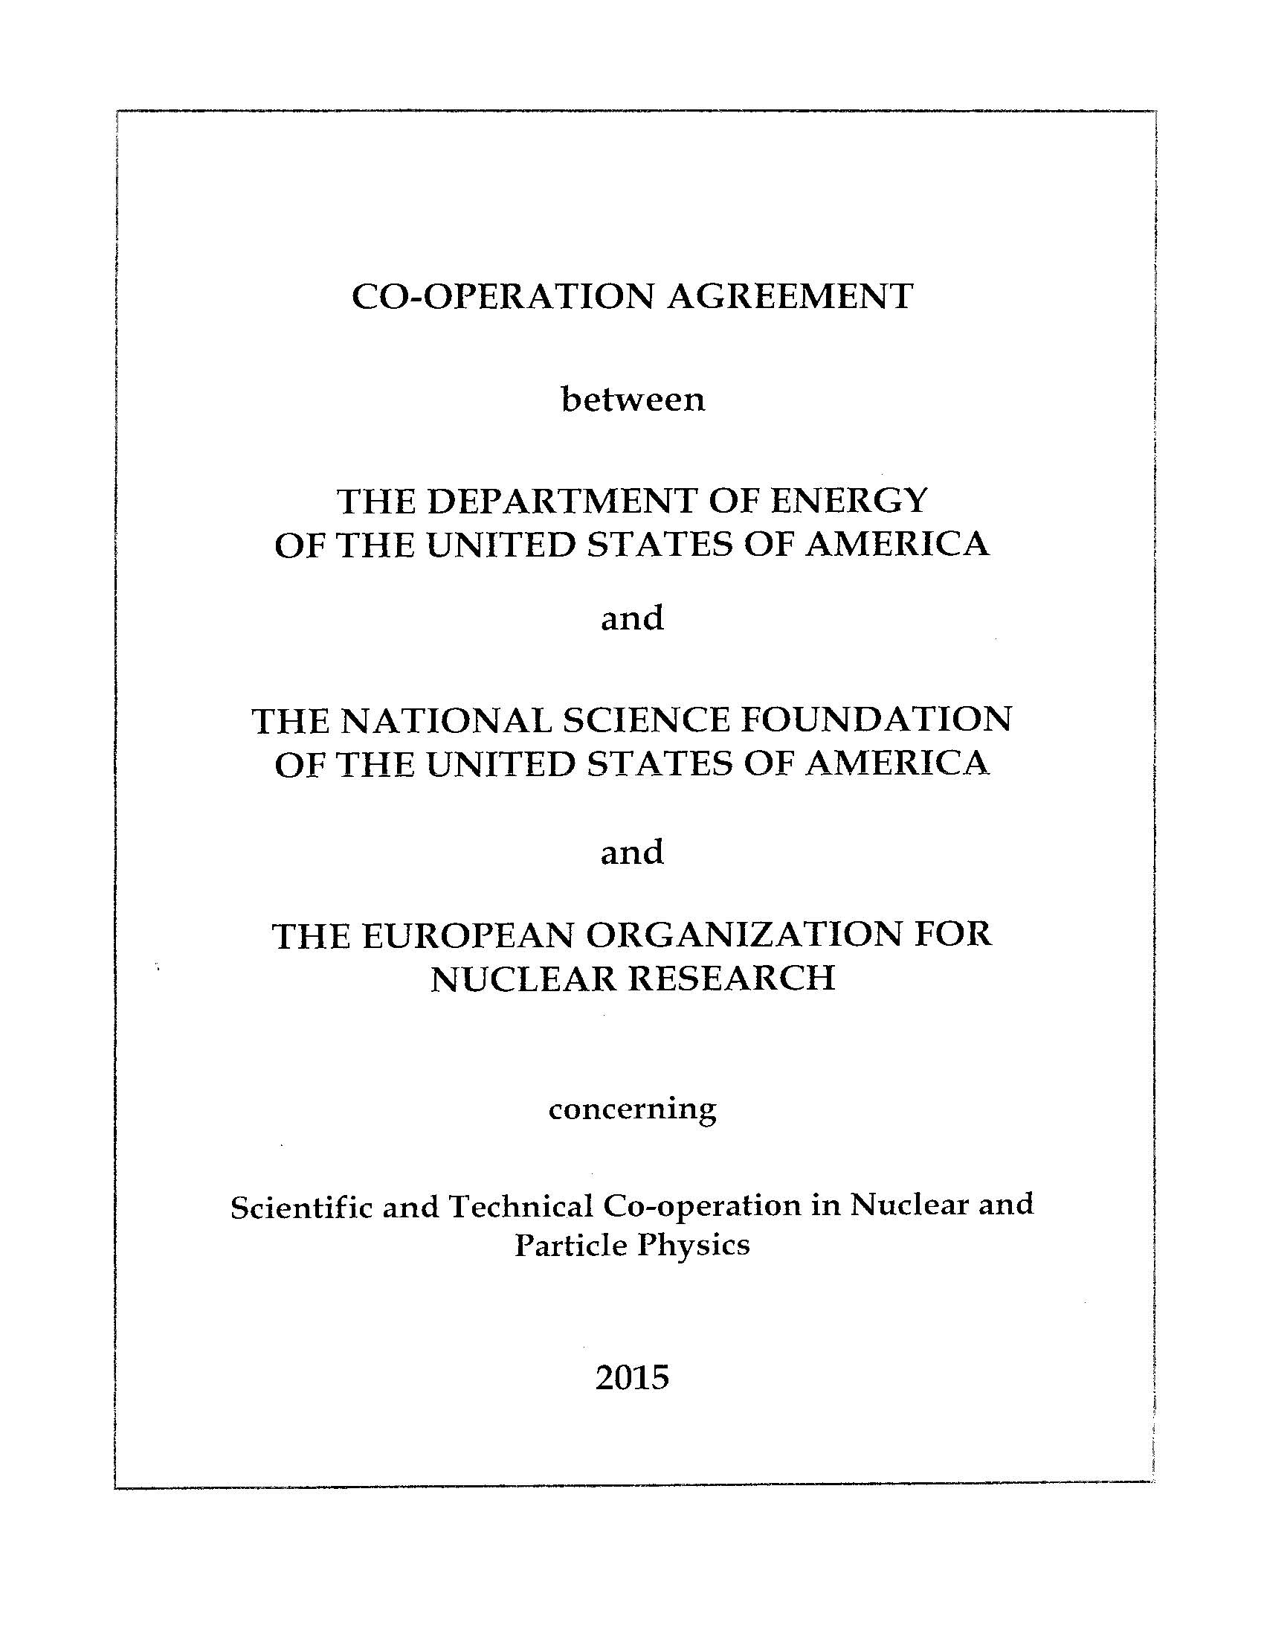
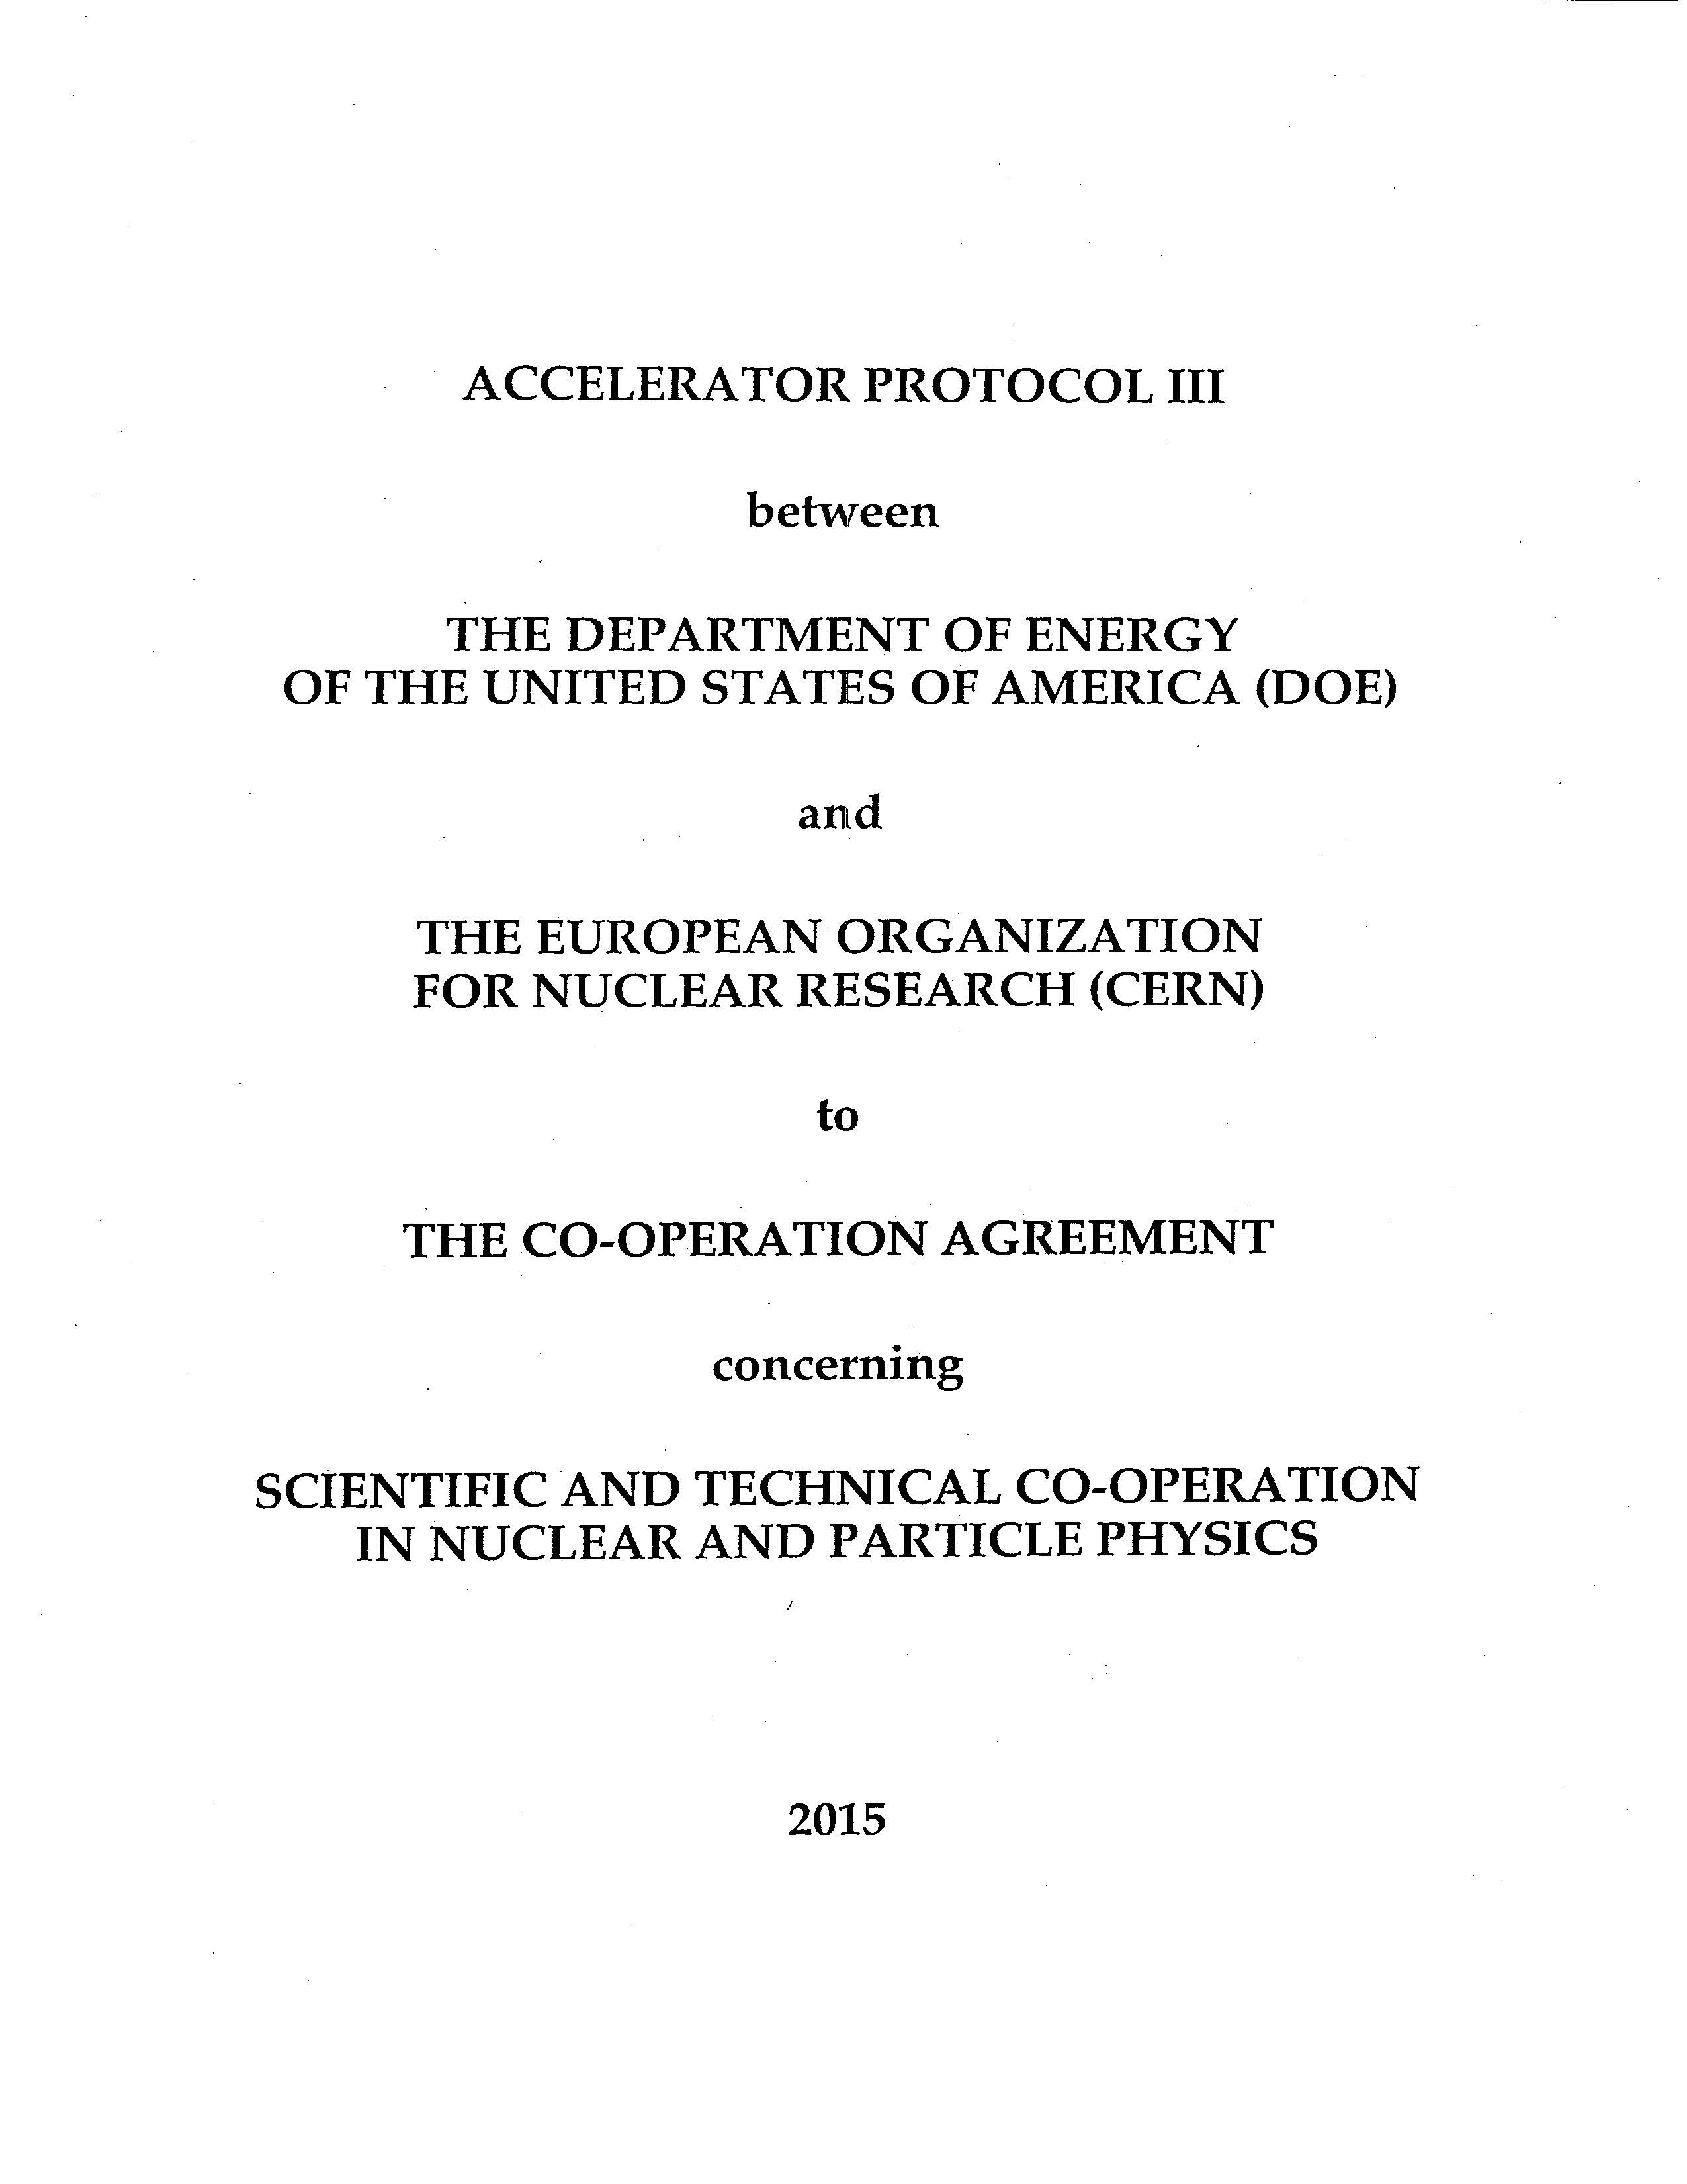
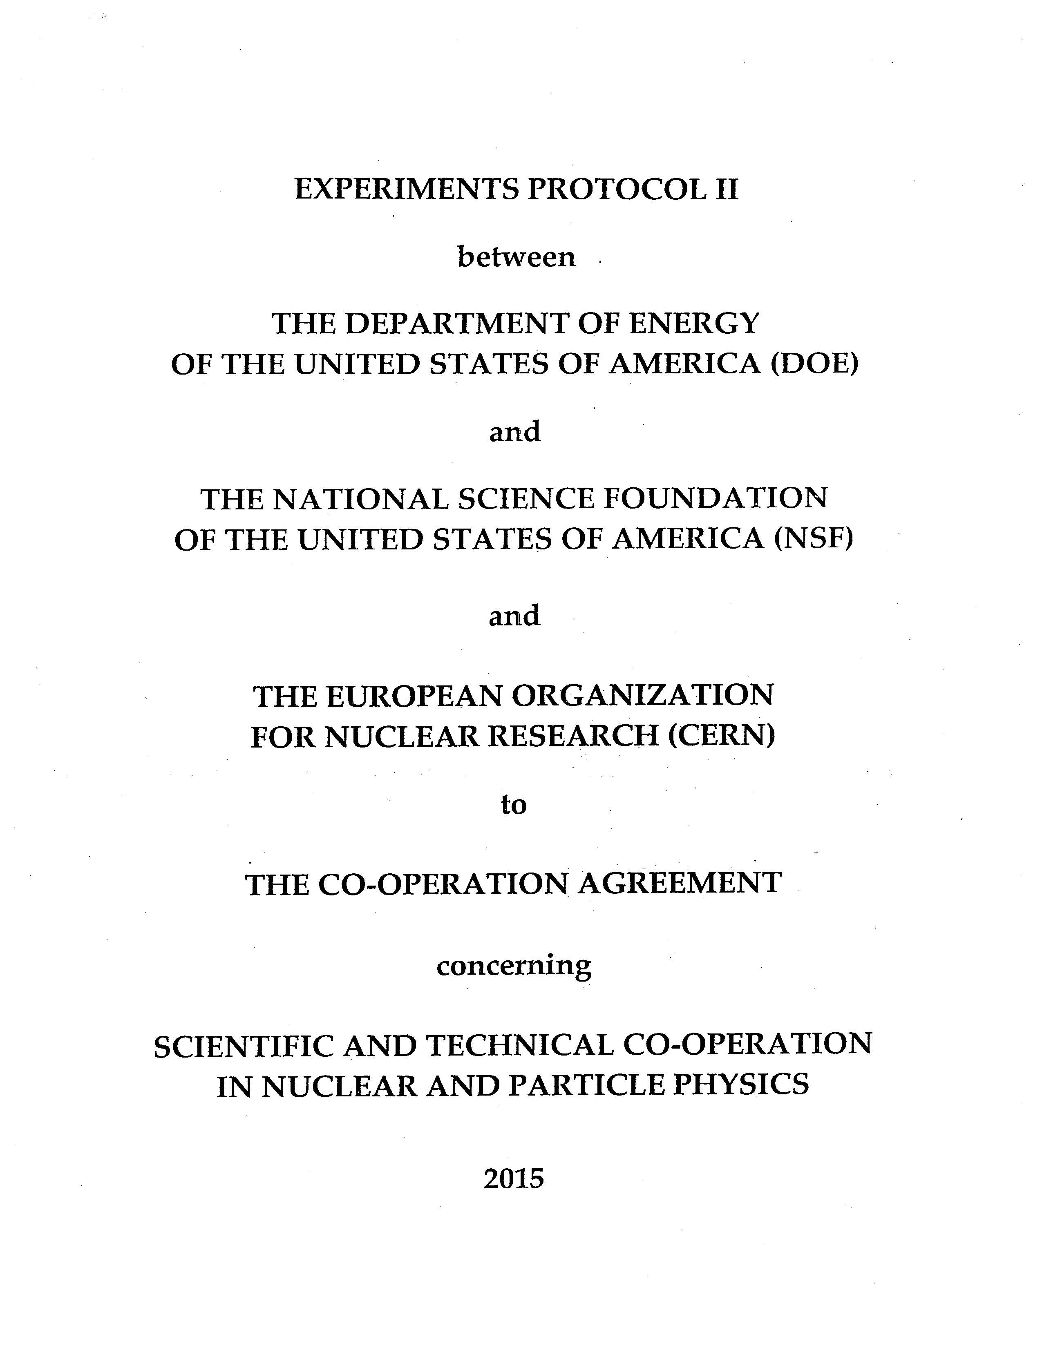
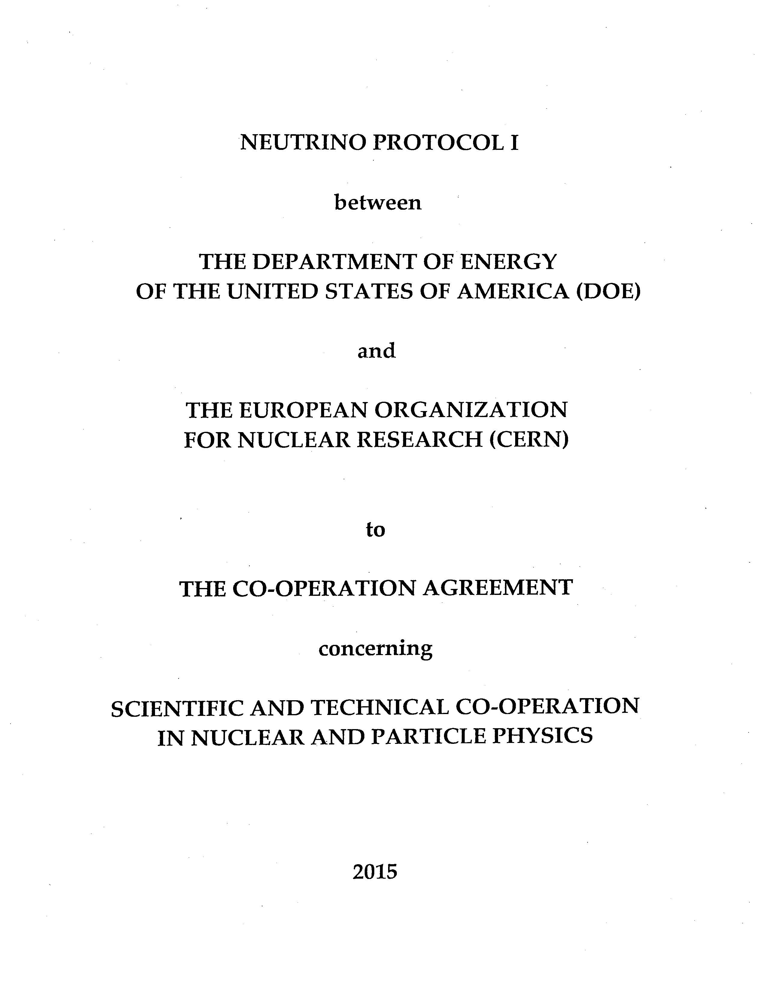
U.S.-CERN International Agreements
International Co-Operation Agreement between the U.S. and CERN concerning Scientific and Technical
Co-Operation in Nuclear and Particle Physics
Parties: United States (DOE and NSF), European Organization for Nuclear Research (CERN)
Signed at Washington, D.C. May 7, 2015; Entered into force May 7, 2015. With Annex.
Document: http://www.state.gov/documents/organization/244968.pdf
Accelerator Protocol III between the U.S. and CERN to the Agreement of May 7, 2015 on Scientific
and Technical Cooperation
Parties: United States (DOE), European Organization for Nuclear Research (CERN)
Signed at Geneva, Switzerland December 18, 2015; Entered into force December 18, 2015. With Addendum on FCC.
Document: https://www.state.gov/documents/organization/253295.pdf
Experiments Protocol II between the U.S. and CERN to the Agreement of May 7, 2015 on Scientific
and Technical Cooperation
Parties: United States (DOE and NSF), European Organization for Nuclear Research (CERN)
Signed at Geneva, Switzerland December 18, 2015; Entered into force December 18, 2015.
Document: https://www.state.gov/documents/organization/253294.pdf
Neutrino Protocol I between the U.S. and CERN to the Agreement of May 7, 2015 on Scientific
and Technical Cooperation
Parties: United States (DOE), European Organization for Nuclear Research (CERN)
Signed at Geneva, Switzerland December 18, 2015; Entered into force December 18, 2015.
Document: https://www.state.gov/documents/organization/253290.pdf

