Slide 1
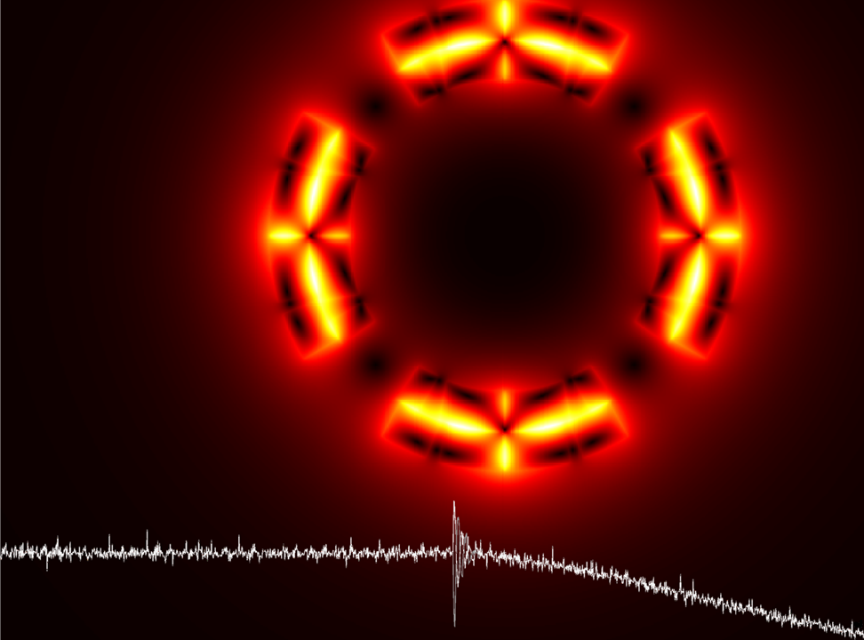
Protecting
High Field Magnets with the
Coupling
Loss
Induced
Quench System,
CLIQ
E. Ravaioli (LBNL)
4 November 2016
E. Ravaioli, “CLIQ”, PhD thesis, 2015
http://doc.utwente.nl/96069/

Slide 2
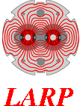

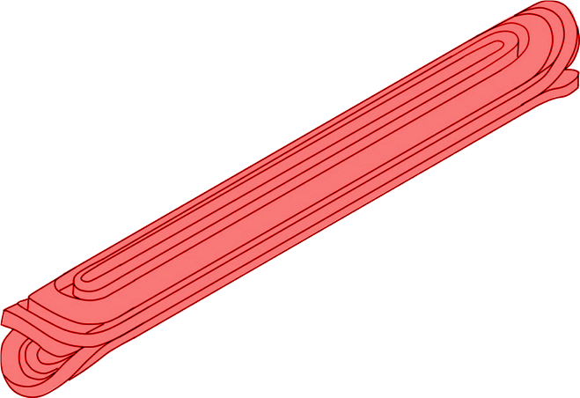
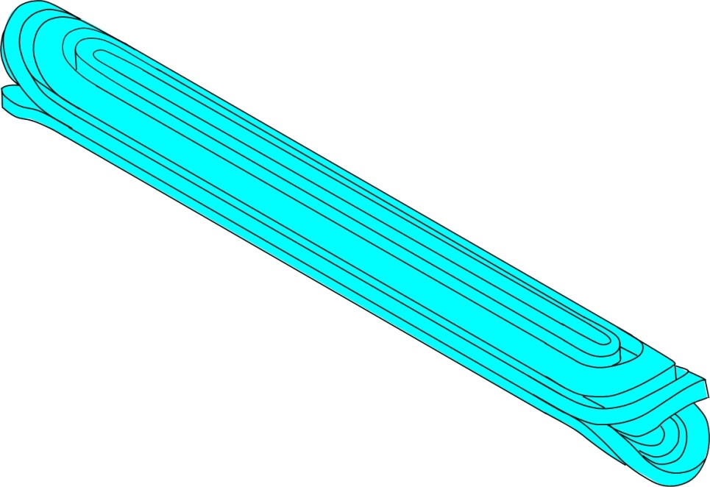
Quench in a superconducting magnet
High Current Density
J ≈ kA/cm²
High Magnetic Field
B = 5-20 T
High Energy Density
e = B2/(2 µ0) ≈ 10-40 MJ/m3
Quick propagation
of the resistive zone is needed
Quench
If of a point of conductor suddenly becomes non-superconducting, it starts heating up
Homogeneous distribution of the quench energy
Discharge of the magnet current with coil resistance
The energy stored in the magnet is usually sufficient to melt kilos of copper and damage the magnet!
Today’s focus:
Active protection systems quenching quickly and homogeneously the entire coil

Slide 3
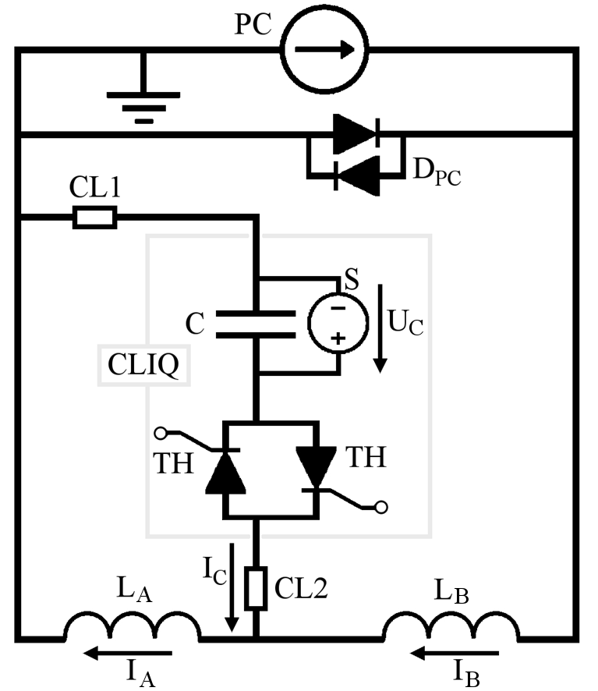



Current change
CLIQ – Coupling-Loss Induced Quench
Patent EP13174323.9
Magnetic field change
Coupling losses (Heat)
Temperature rise
QUENCH

Slide 4
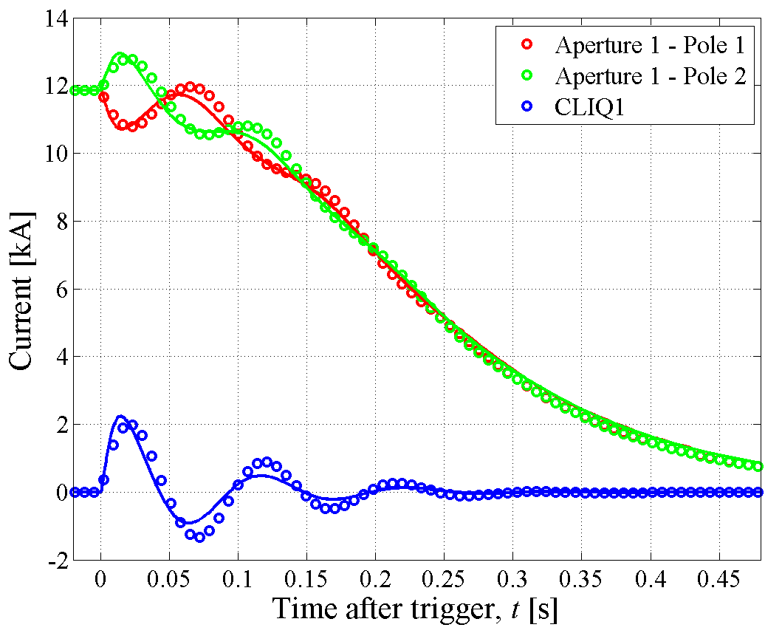
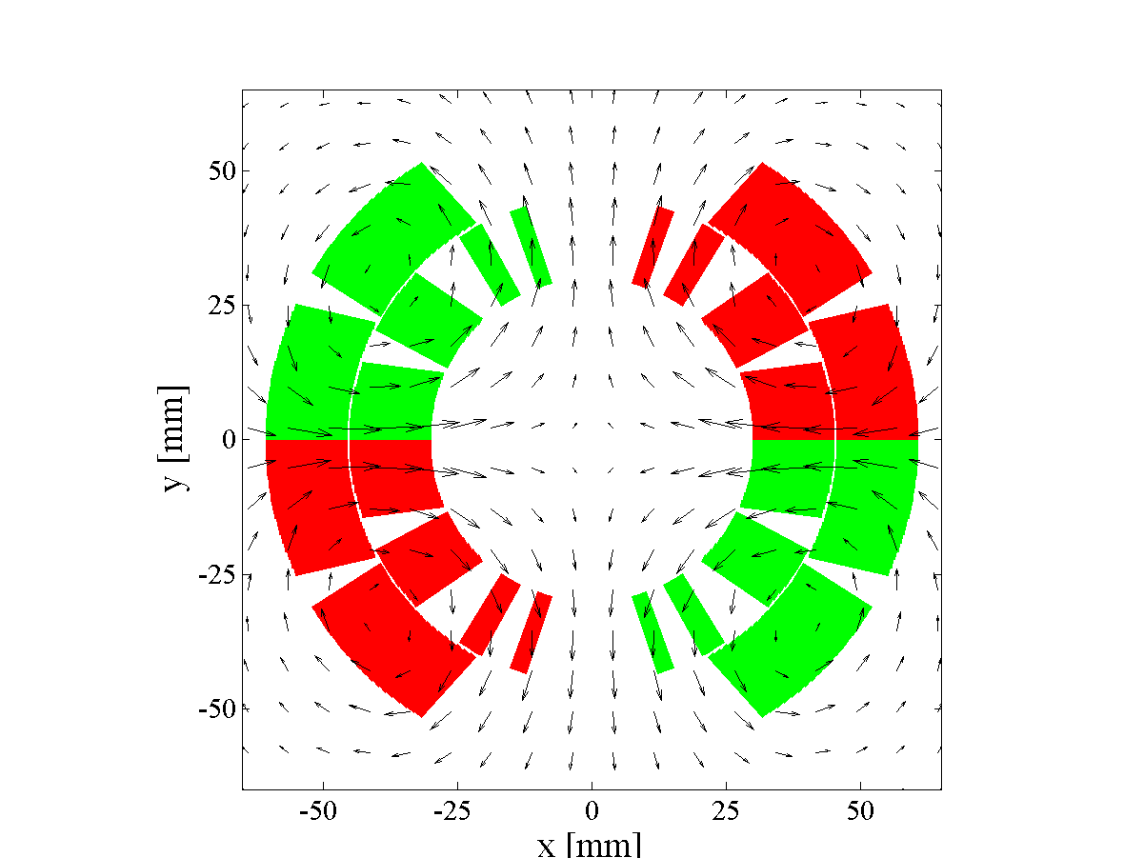
CLIQ on a full-size 14 m LHC main dipole
LHC main dipole magnet
Twin aperture magnet
Magnetic Length 14.3 m
Self-inductance 100 mH
Nominal current 11.8 kA
Peak magnetic field 8.3 T
Superconductor Nb-Ti
2 CLIQ Units
U0=500 V C=80 mF
Fast and effective heating mechanism
Technology proven on full-scale magnets
Validated simulations

Slide 5
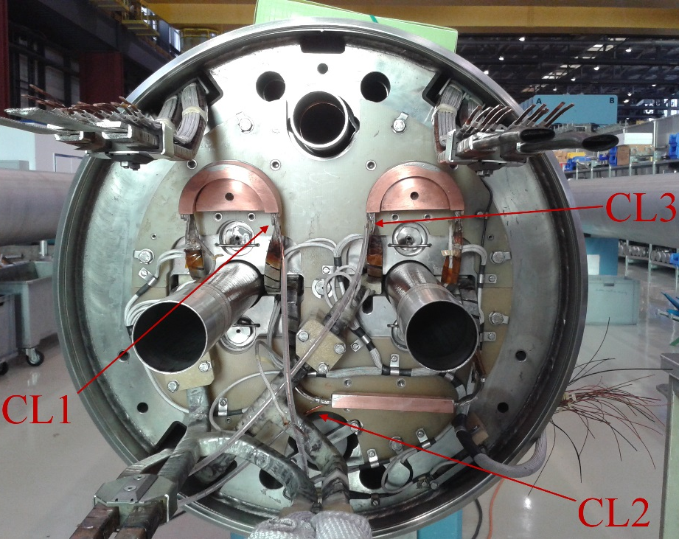
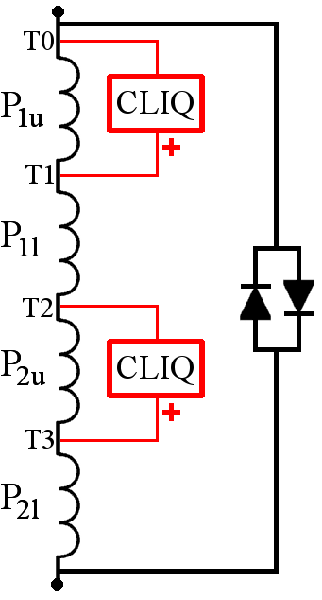
CLIQ on a full-size 14 m LHC main dipole
LHC main dipole magnet
Twin aperture magnet
Magnetic Length 14.3 m
Self-inductance 100 mH
Nominal current 11.8 kA
Peak magnetic field 8.3 T
Superconductor Nb-Ti
2 CLIQ Units
U0=500 V C=80 mF
Very robust and reliable components

Slide 6
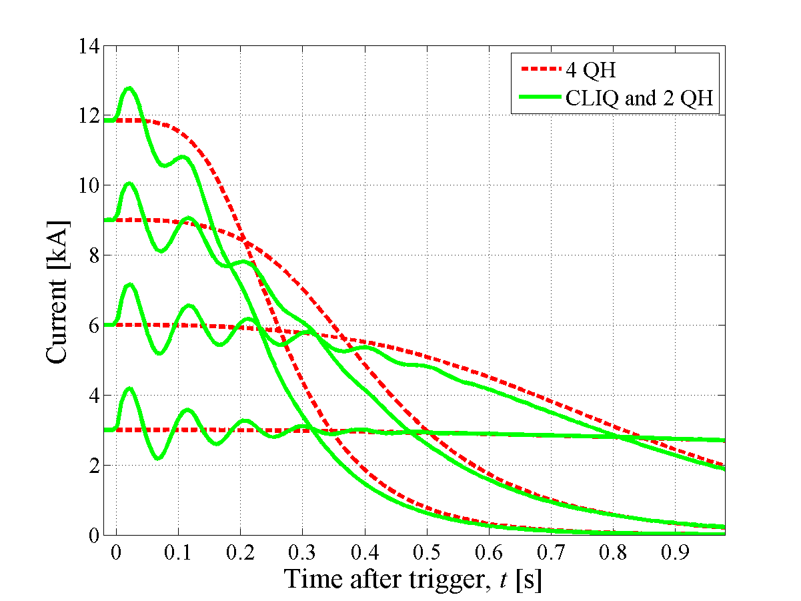
Comparison with traditional technology
Faster current discharge

Slide 7
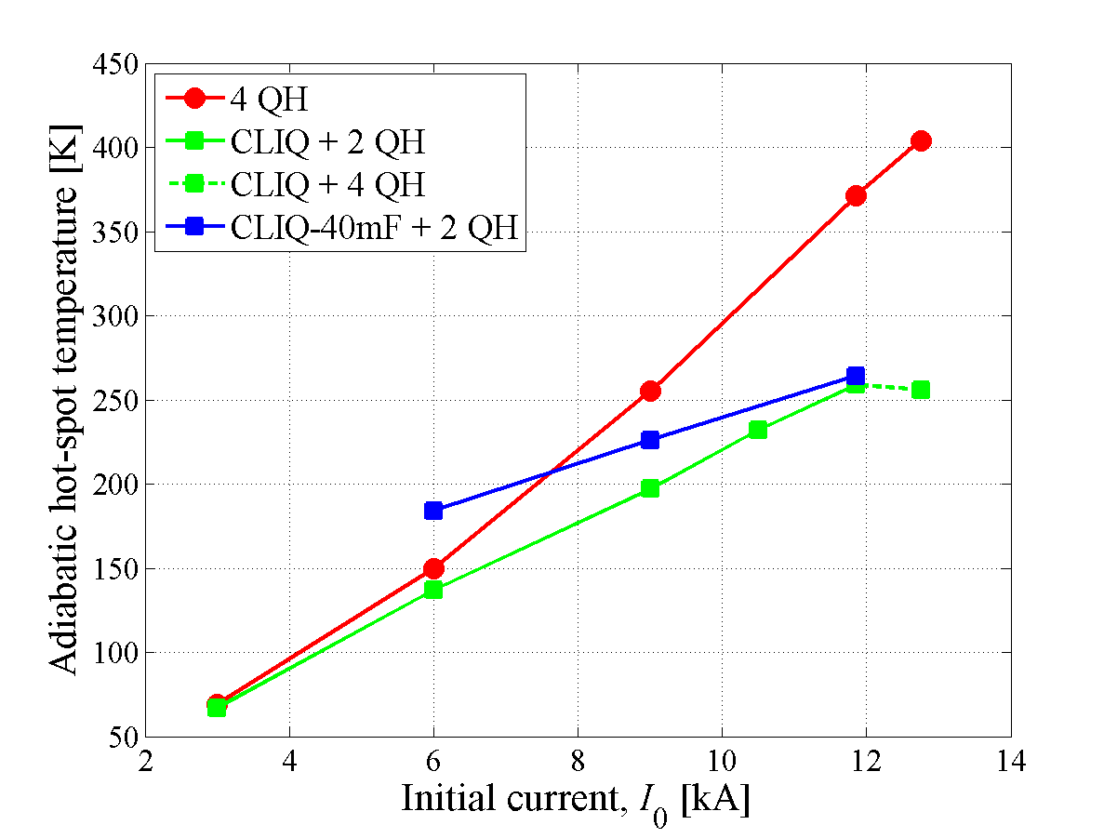
Comparison with traditional technology
Lower hot-spot temperature

Slide 8
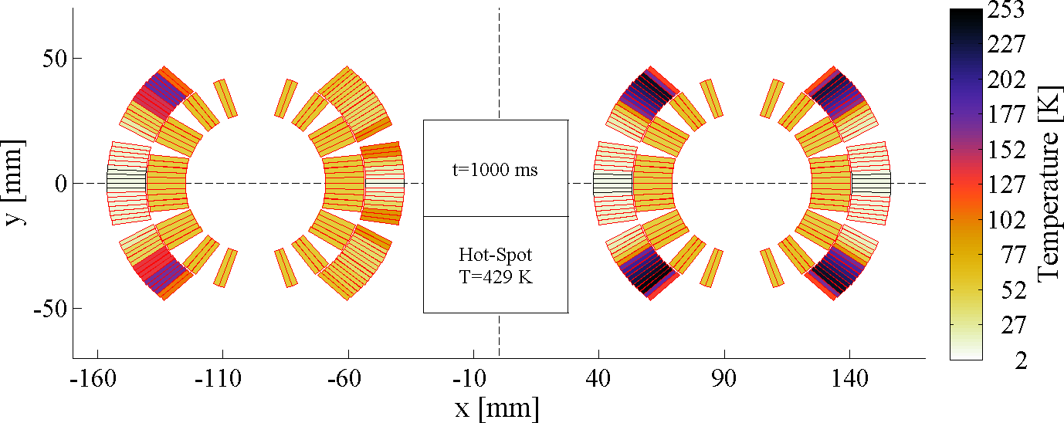
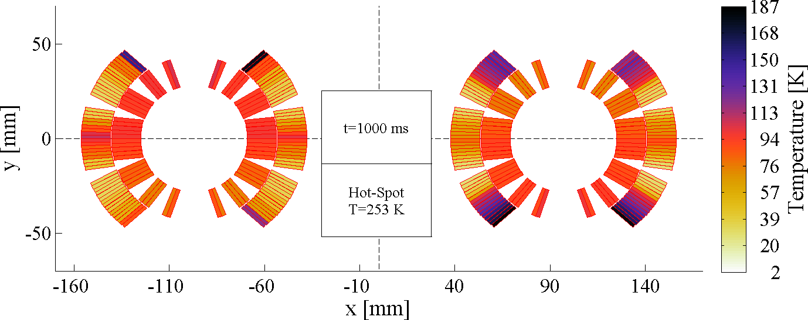
Simulated temperature profiles
Traditional technology
CLIQ
More homogeneous temperature

Slide 9
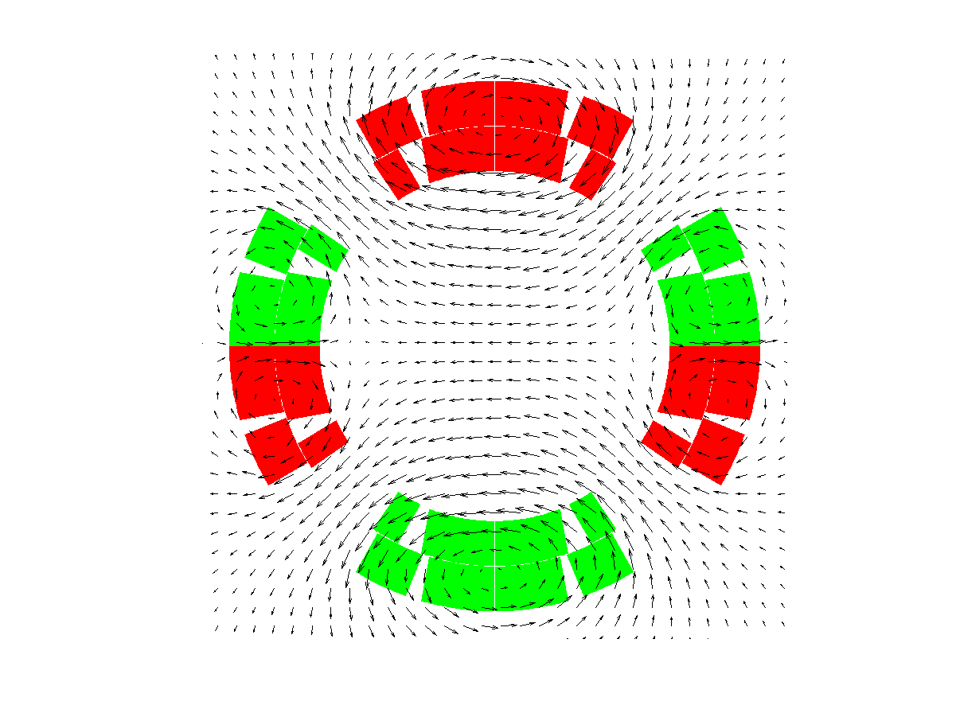
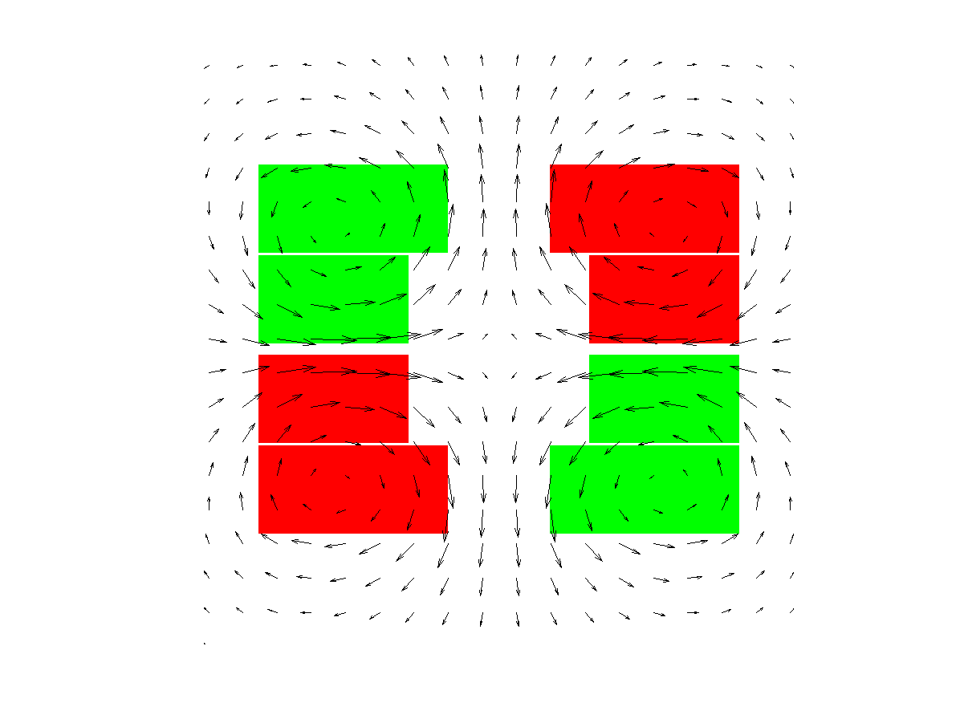
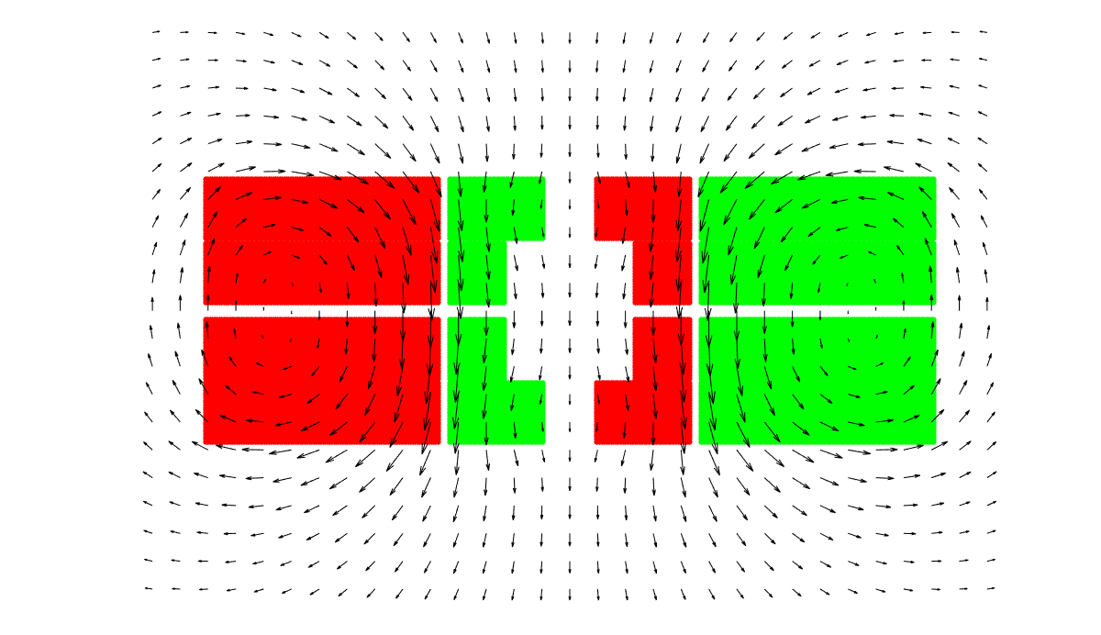
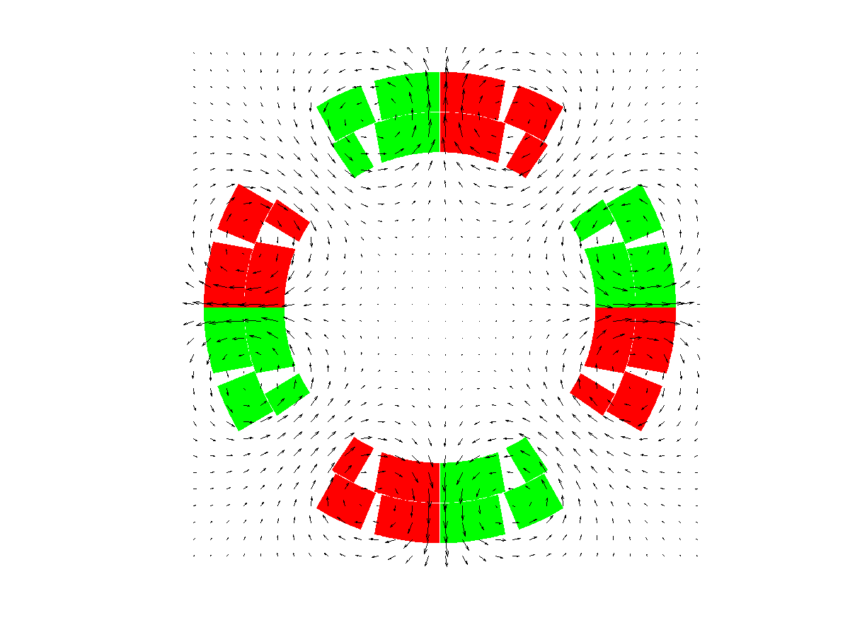
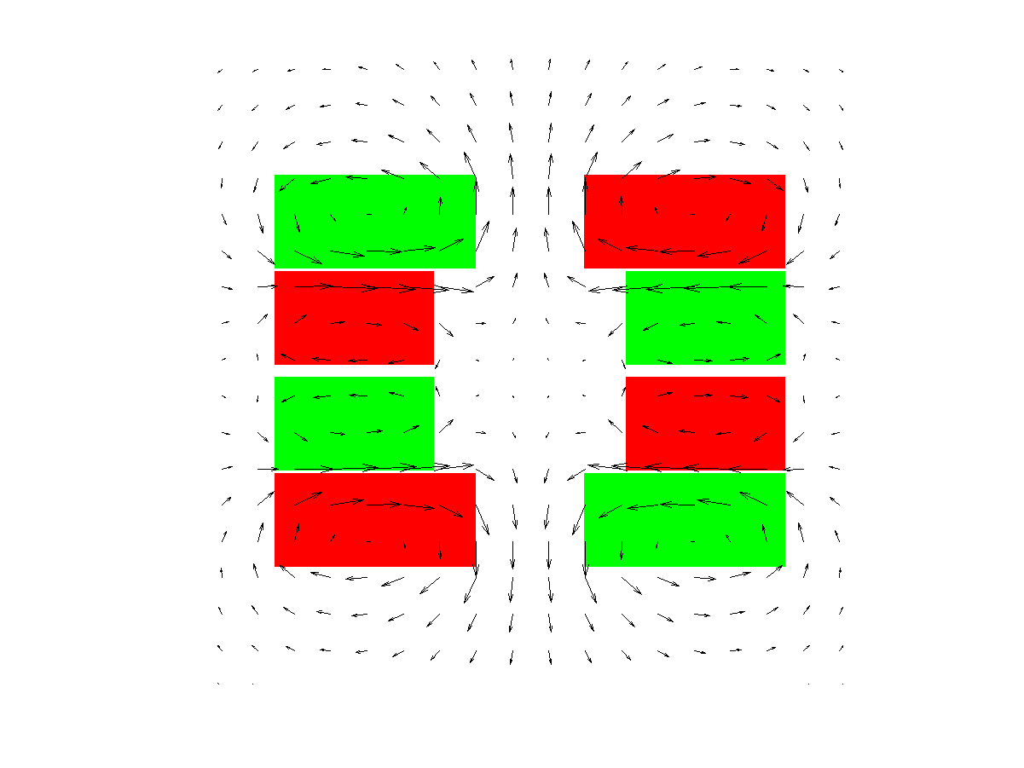
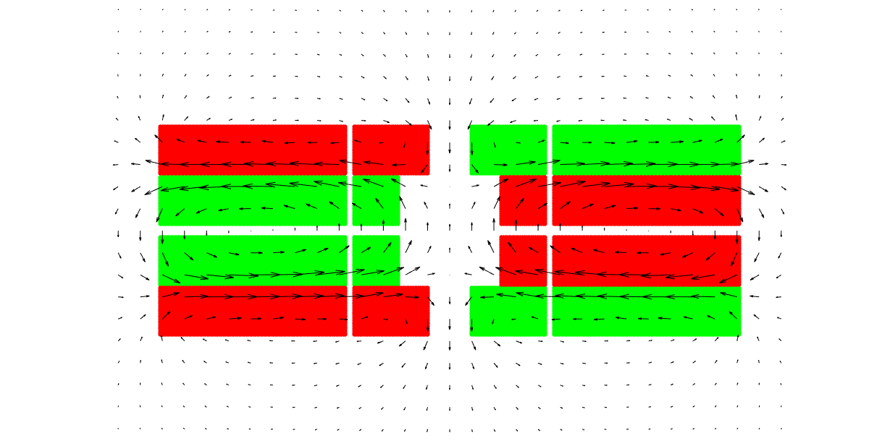
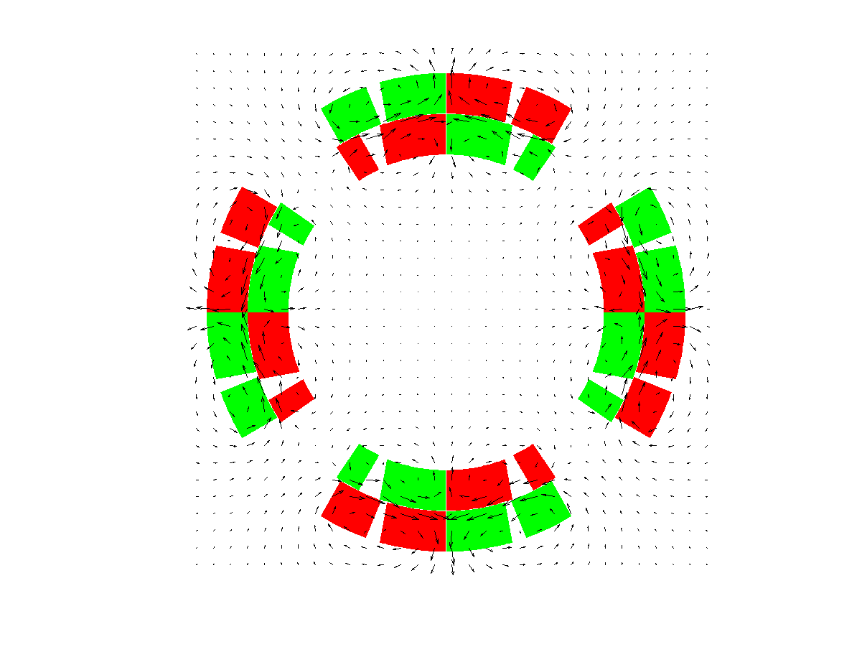
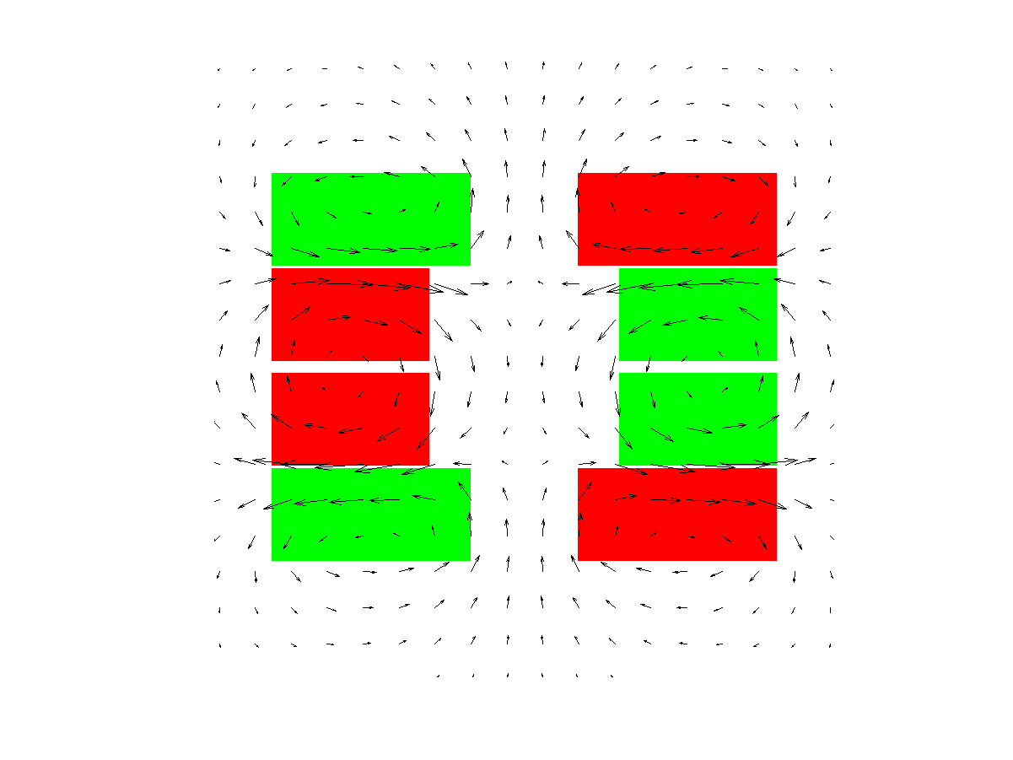
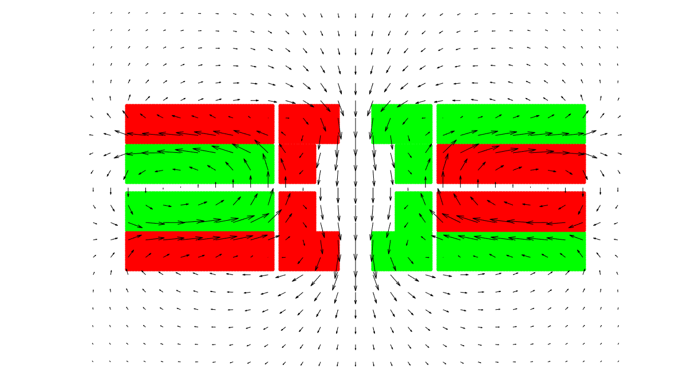
Some examples of CLIQ applications…
HL-LHC
12 T quadrupole
FCC
16 T dipole
FCC
20 T dipole

Slide 10
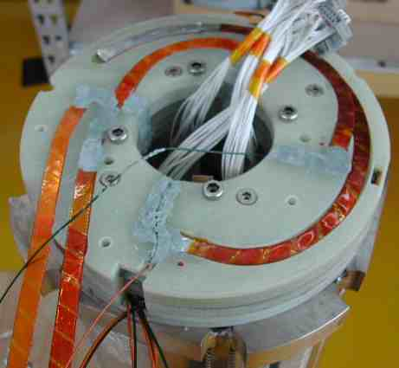
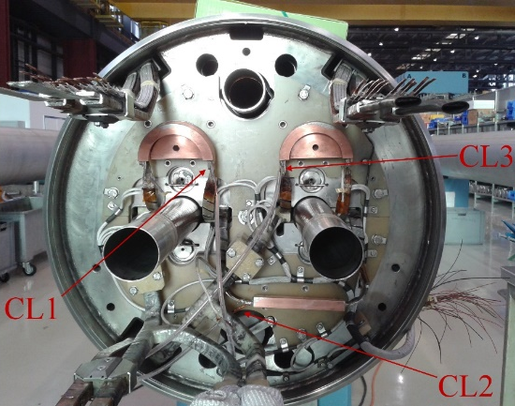
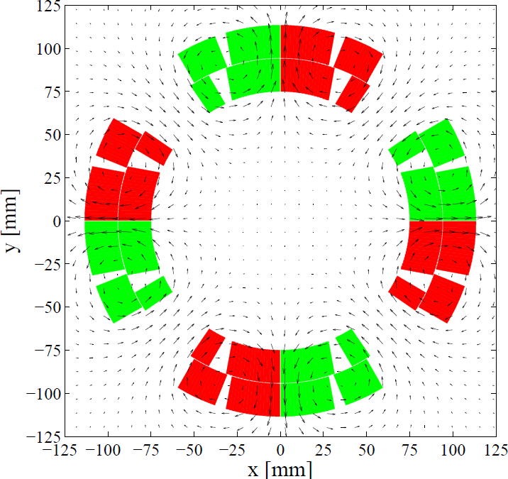
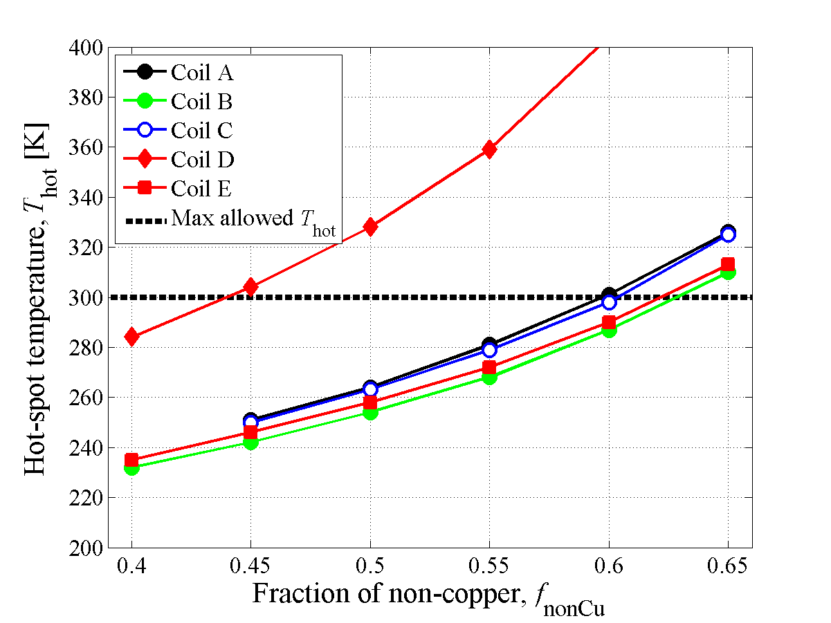
Outlook
CLIQ: Faster and more effective energy deposition mechanism
CLIQ: More robust electrical design
Tested on a full-size accelerator dipole & quadrupole magnets
In the baseline for the protection of HL-LHC Nb₃Sn inner triplets
Protection of future magnets
(Future Circular Collider, HTS)
Will CLIQ technology influence
the design of future accelerator magnets? (less Cu, more compact)

Slide 11
2012
Idea
2013
Patent
2015
PhD, “CLIQ”
HL-LHC baseline
2016
QUESTIONS?
ERavaioli@lbl.gov
E. Ravaioli, “CLIQ”, PhD thesis, 2015
http://doc.utwente.nl/96069/

Slide 12
Annex

Slide 13
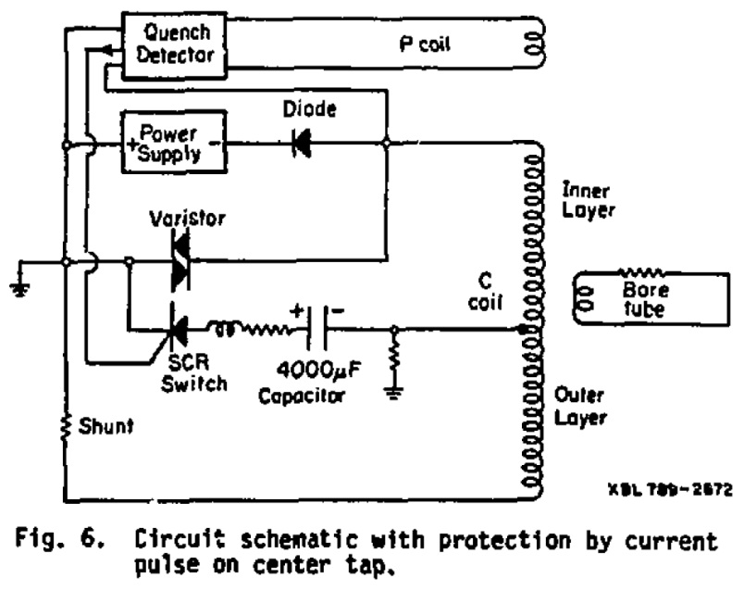
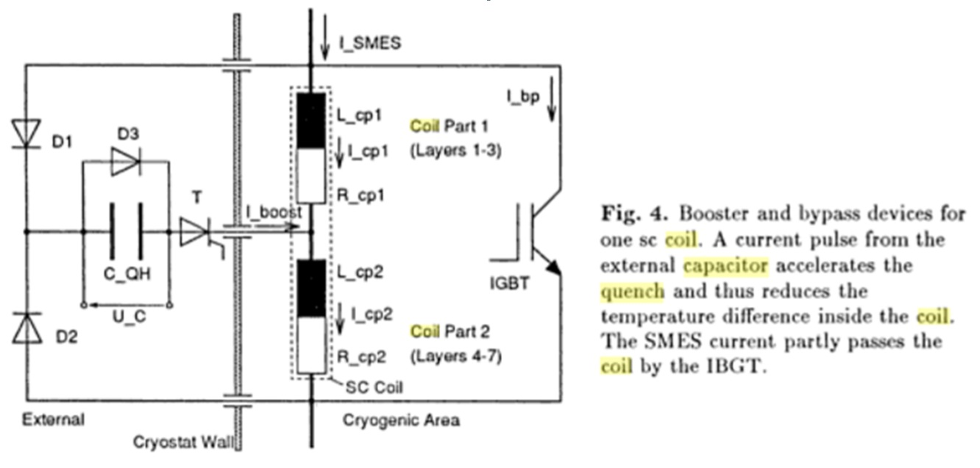
Previous work
Quench using a capacitive discharge
1978
1996
“Quench Protection for a 2-MJ Magnet”, Taylor et al., Lawrence Berkley National Laboratory
“…turning the entire magnet normal by dumping a short pulse of current from a capacitor bank through the windings.”
“Temperature and Pressure Rise in Supercritical Helium during the Quench of Indirectly Cooled SC Coils”, R. M. Schotter and H. W. Lorenzen, Technische Universität München
“…a short pulse with high amplitude is obtained which makes the coil normalconducting nearly instantly by superconductor losses, field distortion and current amplification.
2012-13
Glyn Kirby was looking for a way to quench/protect the magnets with AC induced heating inside the cable.
Vladimir Datskov suggested capacitive idea from the two old paper.
Emmanuele Ravaioli added the improvement with the reverse diode to keep the capacitive current oscillating.
February 2013: CLIQ tests on a solenoid in B165. June 2013: EU Patent filed.

Slide 14
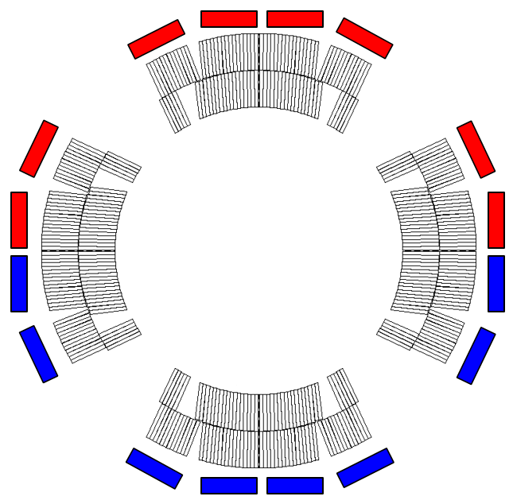
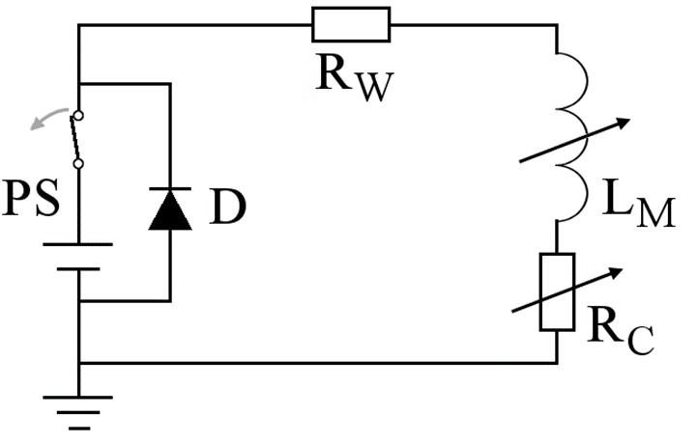


Traditional approach: Quench heaters
Quench heaters are μm-thin strips glued to the coil, which heat the turns by thermal diffusion
Example:
HL-LHC 12 T Nb₃Sn quadrupole model magnet (MQXFS1, 1.2 m)

Slide 15
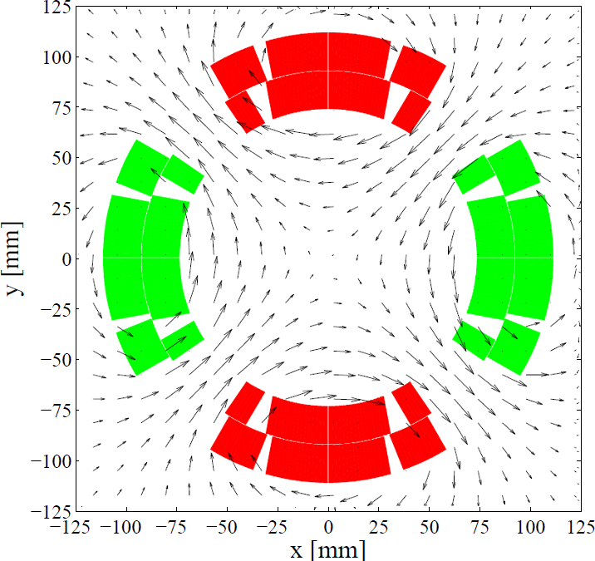
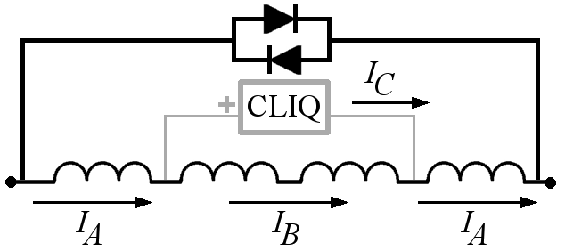
CLIQ magnetic-field change
Quasi-static field during operation
Oscillating field at CLIQ discharge
.
B
B
The oscillating current introduced by CLIQ rapidly change the local magnetic field

Slide 16
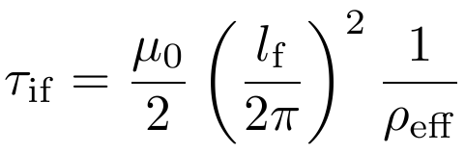
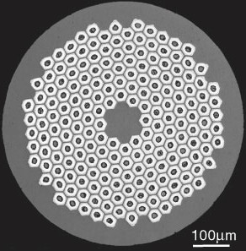
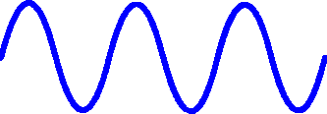
Inter-filament coupling loss
.
Filament twist-pitch
B
Matrix effective transverse resistivity
More effective heat deposition with respect to conventional technology based on thermal diffusion
“Fast” loss:
Characteristic time constant in the order of ms or tens of ms
Deposited power density roughly proportional to B²
Faster and more homogeneous quench initiation
.
SC
Lower hot-spot temperature
Cu

Slide 17
CLIQ main advantages & disadvantages
More effective energy deposition
Faster and more homogeneous quench initiation
Integration in the magnet circuit to be studied
Internal voltage distribution to be carefully analyzed
More robust electrical design
Easier to implement and repair
Lower expected failure rate
Redundancy of the system

Slide 18
Scaling CLIQ performance
At high current
Low energy needed to start the quench
High energy density, needs to be quick!
→ POWER density is the key parameter
  CLIQ effectiveness
  → Coil geometry
  → Position of CLIQ connections
  → Electrical order of the poles
  → etc…
(Number of CLIQ units)^2
(Charging voltage)^2
(magnetic length)^-2 (fixed by design)
At low current
High energy needed to start the quench
Low energy density, velocity not critical
→ ENERGY density is the key parameter
Number of CLIQ units
(Charging voltage)^2
Capacitance of each unit
(magnetic length)^-1
Magnetic length
# of CLIQ units
Capacitance

Slide 19
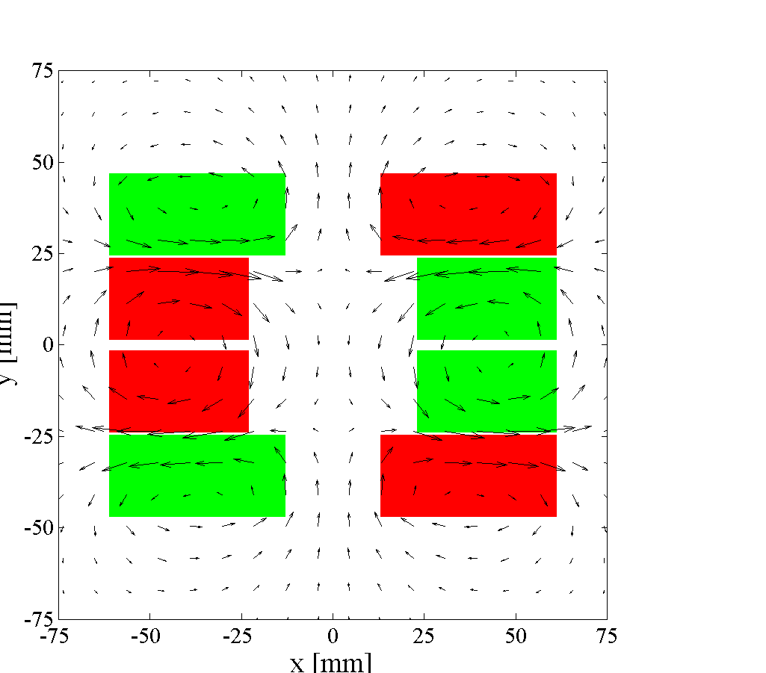
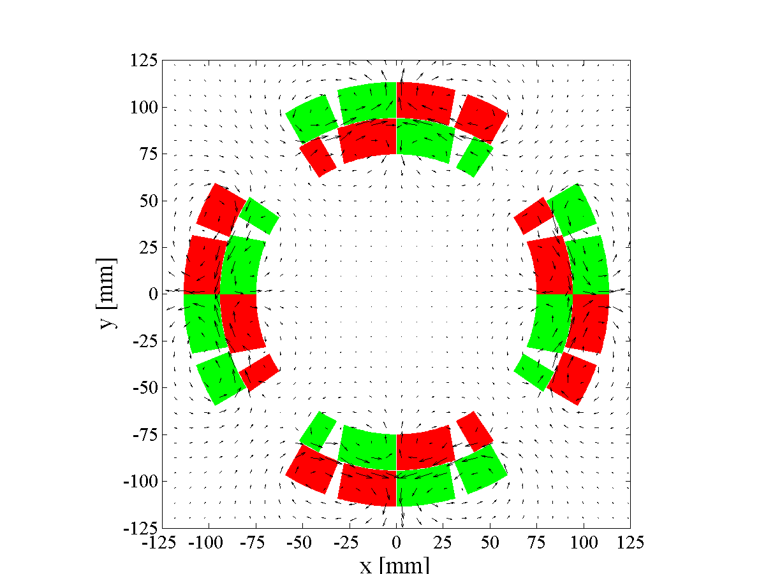
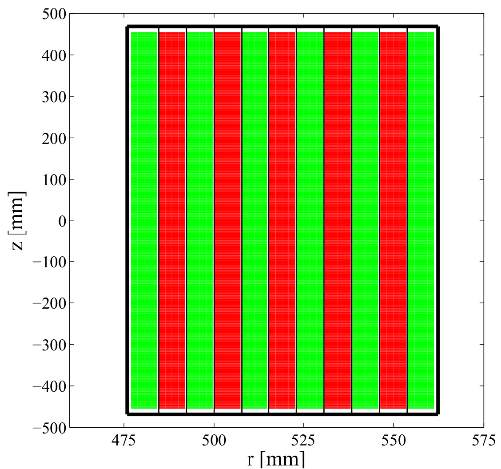
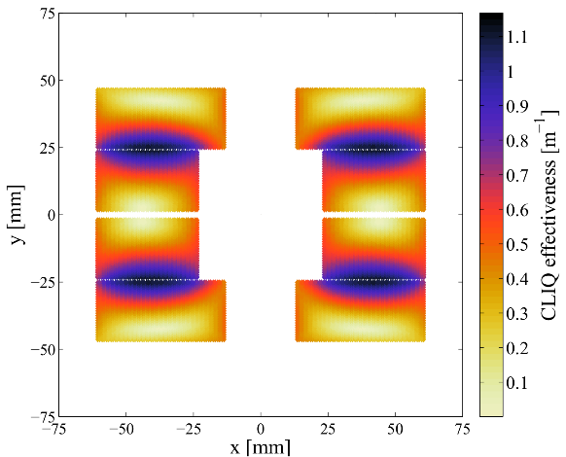
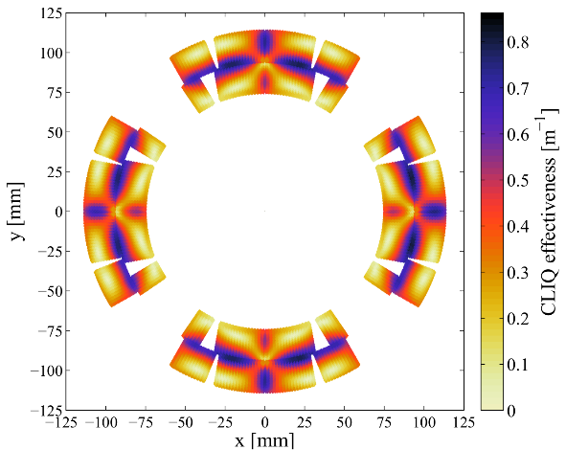
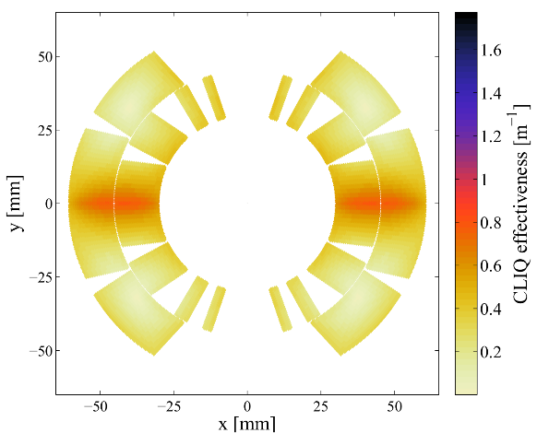
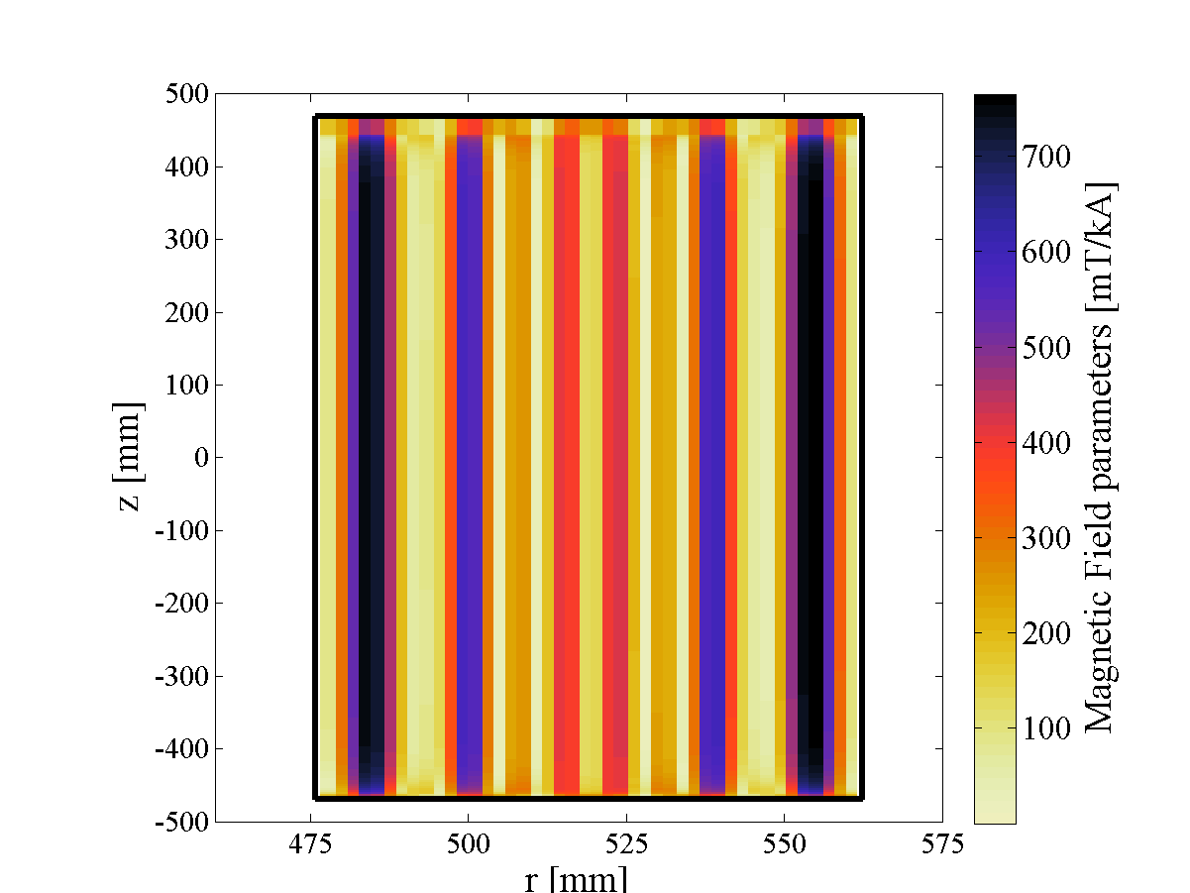
CLIQ effectiveness, Ѱ₁
How much dB/dt for given voltage and magnet length?
Cos-θ
dipole
Solenoid
Block-coil
dipole
Quadrupole

Slide 20
CLIQ on a 1 m Nb₃Sn model magnet
Fast and effective heating mechanism
Technology proven on Nb₃Sn magnets

Slide 21
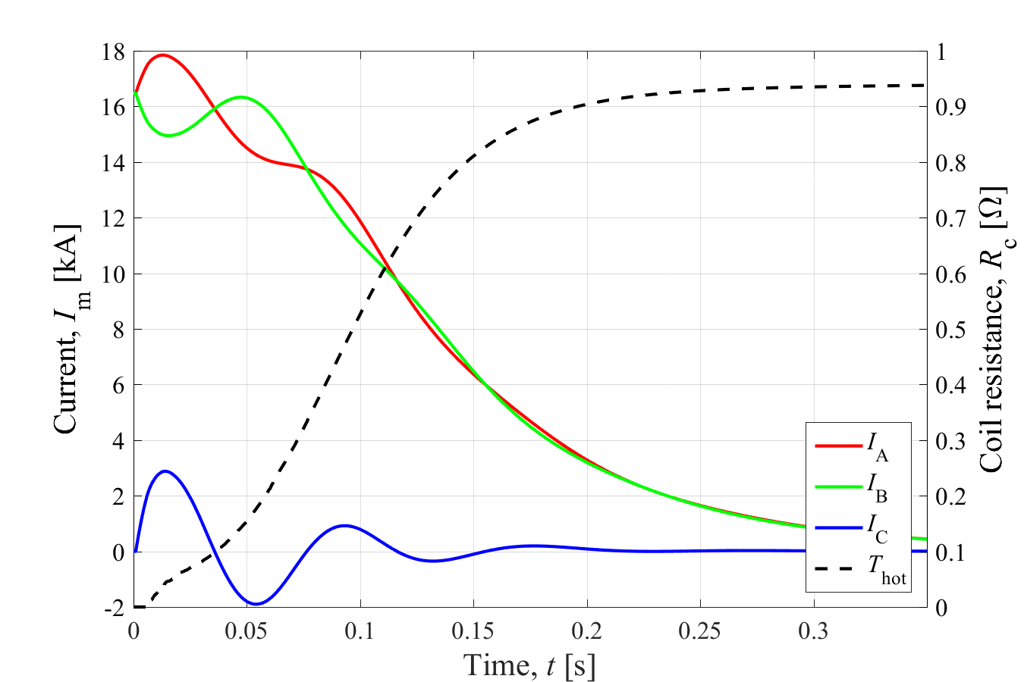
CLIQ on full-scale Nb₃Sn low-β quad
HL-LHC inner triplet quad
Magnetic Length 7.15 m
Self-inductance 68 mH
Nominal current 16.5 kA
Peak magnetic field 8.3 T
Superconductor Nb₃Sn
1 CLIQ Unit
U0=1 kV C=40 mF
CLIQ in the baseline: first application in an accelerator
All simulations performed with the software LEDET

Slide 22
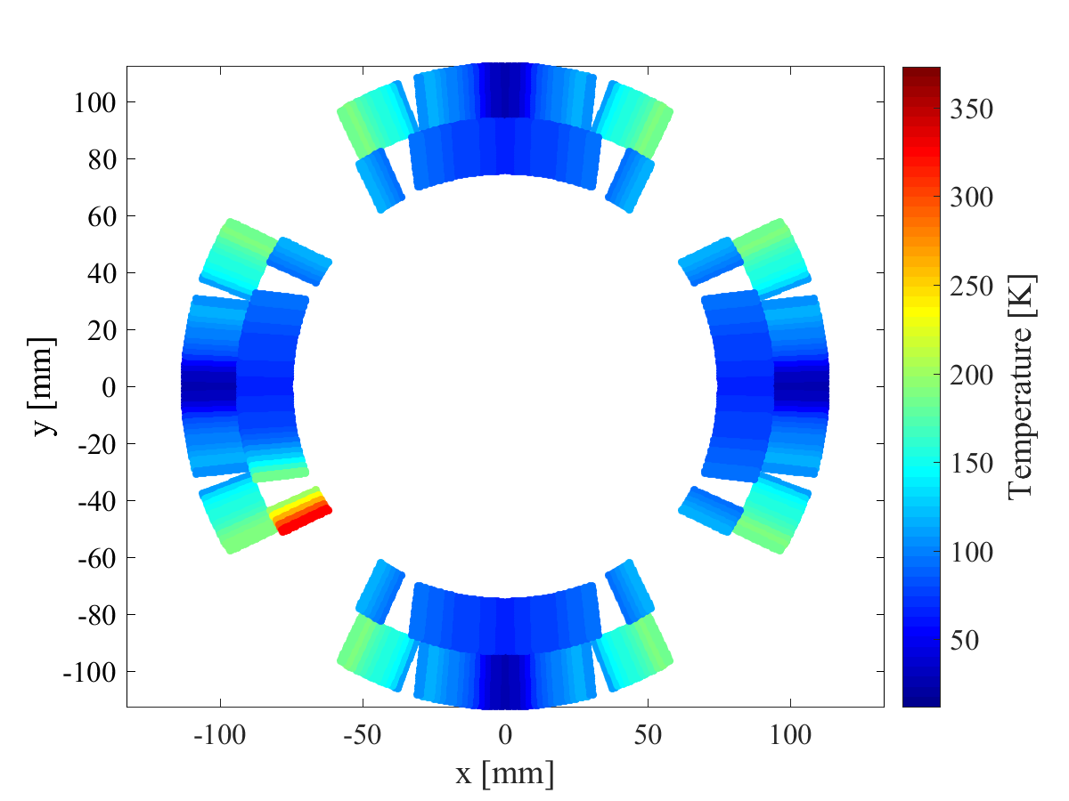
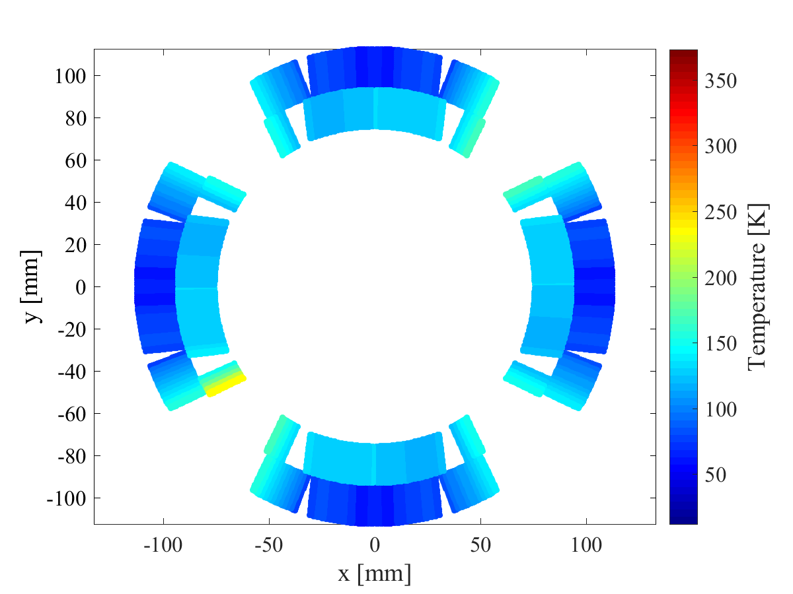
Simulated temperature distribution
With outer quench heaters
With CLIQ
Due to CLIQ’s faster quench initiation,
lower hot-spot temperature and more homogeneous temperature distribution

Slide 23
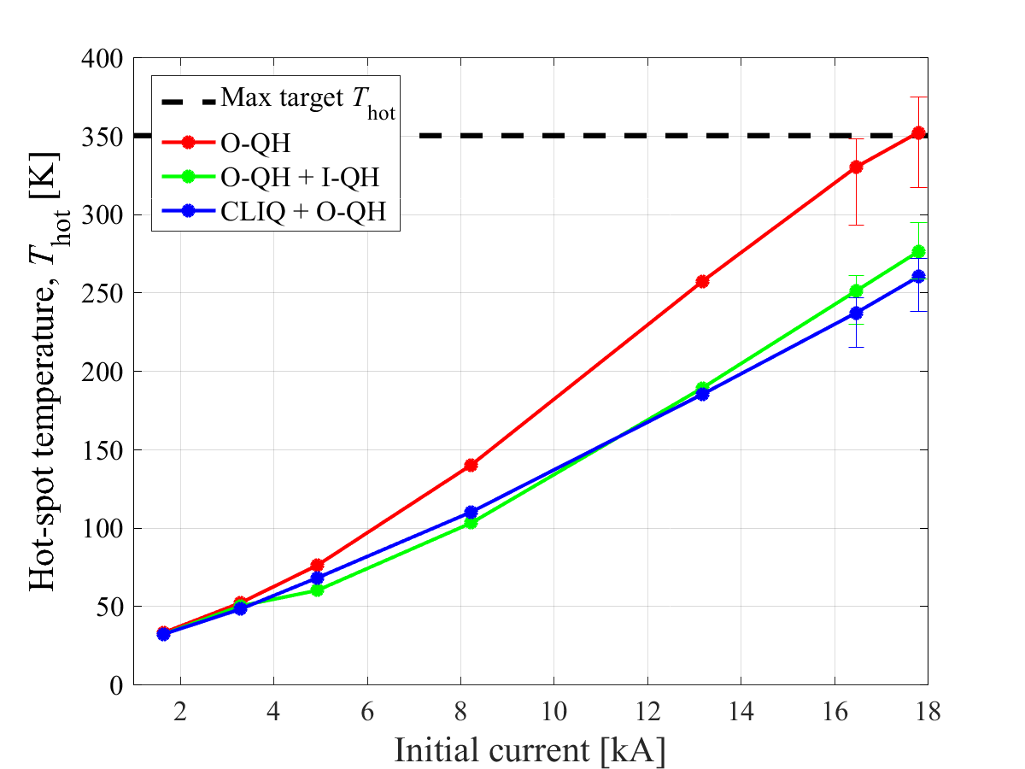
Simulated protection performance
CLIQ performance similar to QH’s covering most coil turns

Slide 24
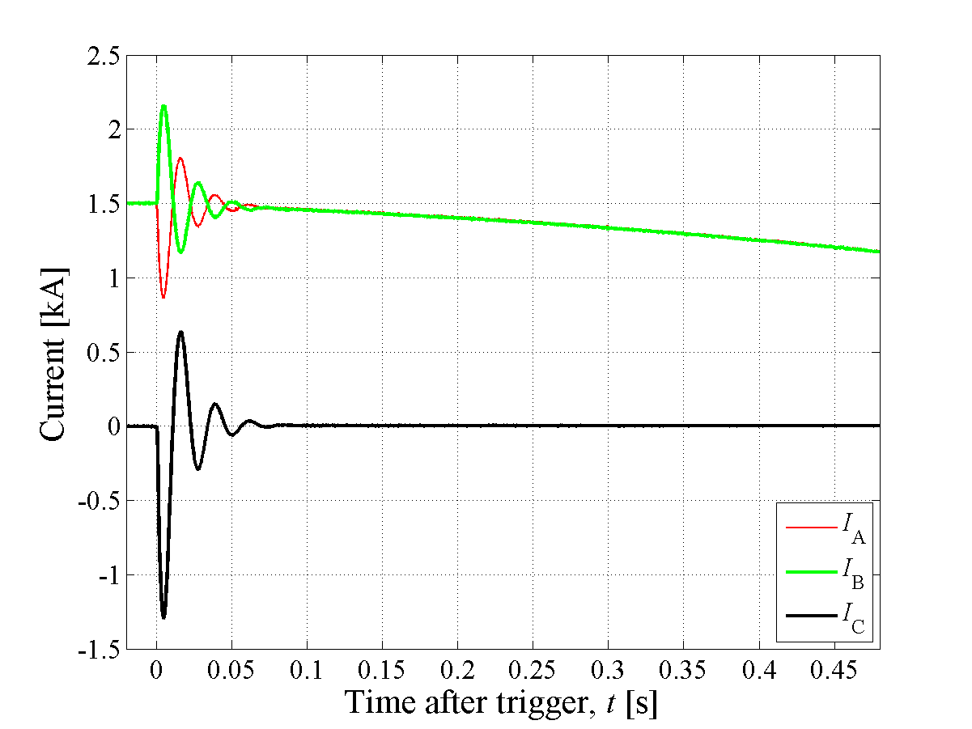
CLIQ on full-scale LHC quadrupole
LHC matching quadrupole
(1 aperture)
Magnetic Length 3.4 m
Self-inductance 72 mH
Nominal current 3.6 kA
Superconductor Nb-Ti
1 CLIQ unit
U0=650 V C=8.8 mF

Slide 25
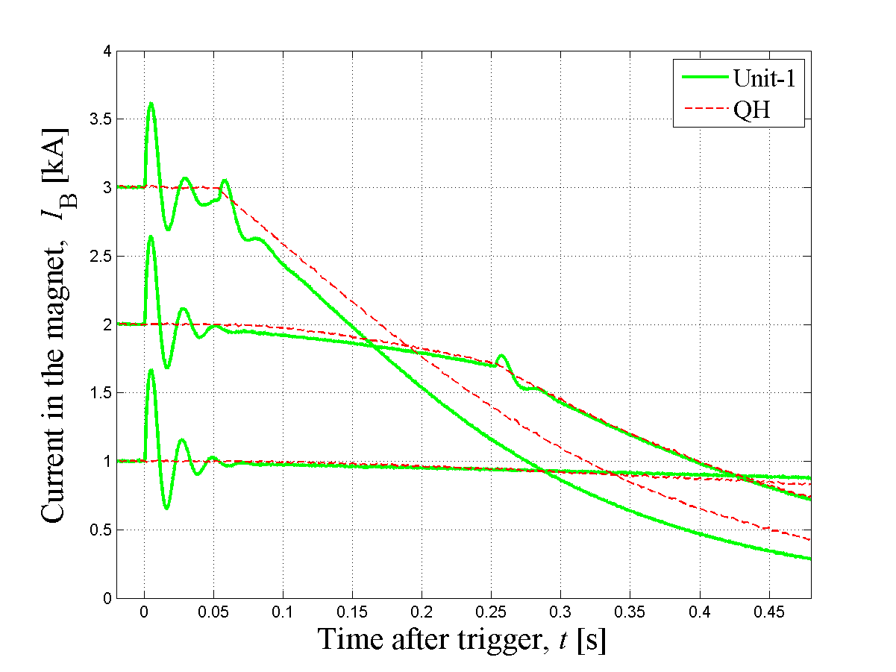
Comparison with conventional QH’s
EE
EE

Slide 26
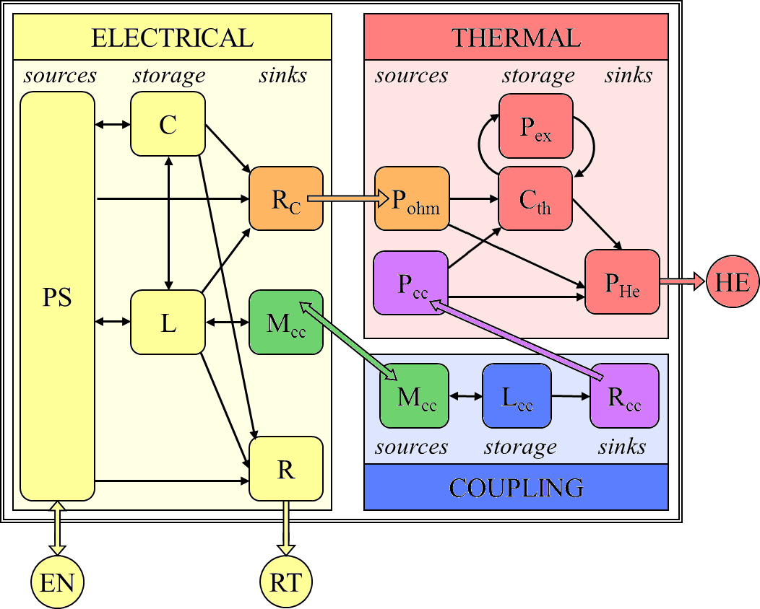
Electro-Thermal and Coupling modeling
How to implement this coupling mechanism?

Slide 27
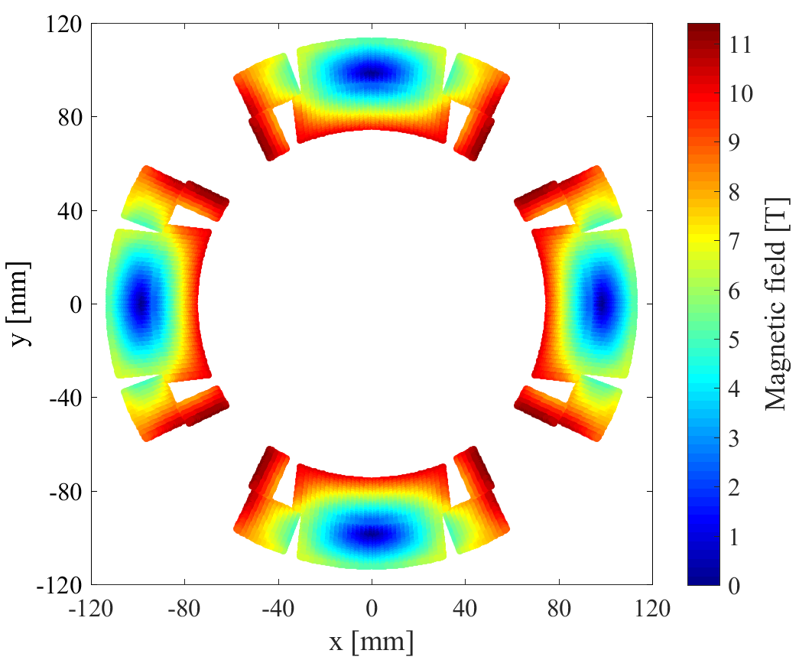

Runs in 3 minutes!
LEDET model
The interaction between the superconducting magnet and the local coupling currents is modeled with an array of RL dissipative loops mutually coupled with the magnet self-inductance
All simulations presented today are performed with the LEDET 2D model
(Lumped-Element Dynamic Electro-Thermal)
Example: HL-LHC 12 T Nb₃Sn quadrupole magnet (MQXF)
2x 16000 IFCL loops
400 ISCL loops
Inter-filament coupling currents
Inter-strand coupling currents
[1] E. Ravaioli, “CLIQ”, PhD thesis, 2015
[2] E. Ravaioli et al., Cryogenics 2016

Slide 28

Influence of effective transverse resistivity
Good protection performance in a wide range of f_{eff}
Significant influence of f_{eff}
on the introduced current I_{C}

Slide 29


First HL-LHC Nb₃Sn model quadrupole
FNAL vertical magnet test facility

Slide 30


CLIQ units and terminals
Main leads
CLIQ leads
CLIQ units designed and manufactured at CERN
CLIQ terminals added at LBNL

Slide 31

CLIQ integrated in the MQXF circuit

Slide 32

CLIQ on 11 T dipole magnet
11 T dipole magnet
Twin aperture magnet
Magnetic Length 6 m
Self-inductance 69 mH
Nominal current 11.8 kA
Peak magnetic field 11.2 T
Superconductor Nb₃Sn
2 CLIQ Units
U0=1 kV C=40 mF
J. Blomber Ghini, “Protecting the superconducting
11T Hi–Lumi LHC dipole with the new Coupling-Loss Induced Quench protection system”, CERN Report, 2015
CLIQ is not considered for the quench protection of the 11 T dipole magnets in the HL-LHC

Slide 33



CLIQ integration in the MB/11T circuit
MB
Magnetic Length 14.3 m
Self-inductance 100 mH
Nominal current 11.8 kA
Peak magnetic field 8.3 T
Superconductor Nb-Ti
2 CLIQ Units
U0=500 V C=80 mF
J. Blomber Ghini thesis
Not considered for implementation
CLIQ is not considered for the quench protection of the 11 T dipole magnets in the HL-LHC

Slide 34

CLIQ on 11 T dipole magnet
MB
Magnetic Length 14.3 m
Self-inductance 100 mH
Nominal current 11.8 kA
Peak magnetic field 8.3 T
Superconductor Nb-Ti
2 CLIQ Units
U0=500 V C=80 mF
J. Blomber Ghini thesis
CLIQ is not considered for the quench protection of the 11 T dipole magnets in the HL-LHC
J. Blomber Ghini, “Protecting the superconducting
11T Hi–Lumi LHC dipole with the new Coupling-Loss Induced Quench protection system”, CERN Report, 2015
Not considered for implementation

Slide 35






CLIQ on 16 T block-coil magnet
Pole-Pole
Crossed-Layer
Layer-Layer
Requiring 1 intra-pole CLIQ terminal
Requiring 2 intra-layer CLIQ terminals
J. Blomber Ghini, thesis, 2015

Slide 36



CLIQ on 16 T block-coil magnet
Pole-Pole
Crossed-Layer
Layer-Layer

Slide 37

CLIQ on 16 T block-coil magnet
CLIQ allows a safe increase of the non-copper fraction
→Compact, cost-effective magnets
Baseline 2014

Slide 38
CLIQ on 20 T LTS/HTS block-coil magnet
Nb₃Sn 15 T Outsert
in series to
Bi-2212 5 T Insert
1 CLIQ Unit
U0=1 kV C=150 mF
Optimum CLIQ configuration

Slide 39
CLIQ on 20 T LTS/HTS block-coil magnet
T_{hot} Nb₃Sn <350 K
T_{hot} Bi-2212 <300 K
LTS+HTS protection with CLIQ: HTS insert is safely discharged by the resistance developed in the LTS outsert connected in series

Slide 40
CLIQ on 20 T LTS/HTS block-coil magnet
Performance at 20 T | Outsert | Insert
Operating current | 13.5 kA
Peak field in the conductor | 15.4 T | 20.4 T
Current density in the sc | 970 A/mm² | 1980 A/mm²
Operating temperature | 4.2 K
Self-inductance at 20 T | 33.8 mH/m
Self-inductance at 1 T | 68.5 mH/m
Magnet length | 14 m
Conductor | Outsert | Insert
Superconductor | Nb₃Sn | Bi-2212
Stabilizer | Cu | Ag / AgMg
Number of strands | 51 | 48
Strand diameter | 0.80 mm | 0.85 mm
Fraction of non-stabilizer | 54% | 25%
Cable width | 22 mm | 22 mm
Cable thickness | 1.40 mm | 1.49 mm

