Slide 1

HE RadDam Analysis with 2015 pp Data
Hasan Huseyin Isik, Yalcin Guler, Ilknur Baldan, Semiray Girgis,
Shuichi Kunori,
Isa Dumanoglu, Eda Eskut
4.08.2016
Weekly Meeting

Slide 2
Introduction
/SingleMuon/Run2015D-PromptReco-v4/RECO
Cert_246908-260627_13TeV_PromptReco_Collisions15_25ns_JSON_v2.txt
Trigger was selected ‘HLT_Mu20_v2’ (PreScale=1)
No Energy cut

Slide 3
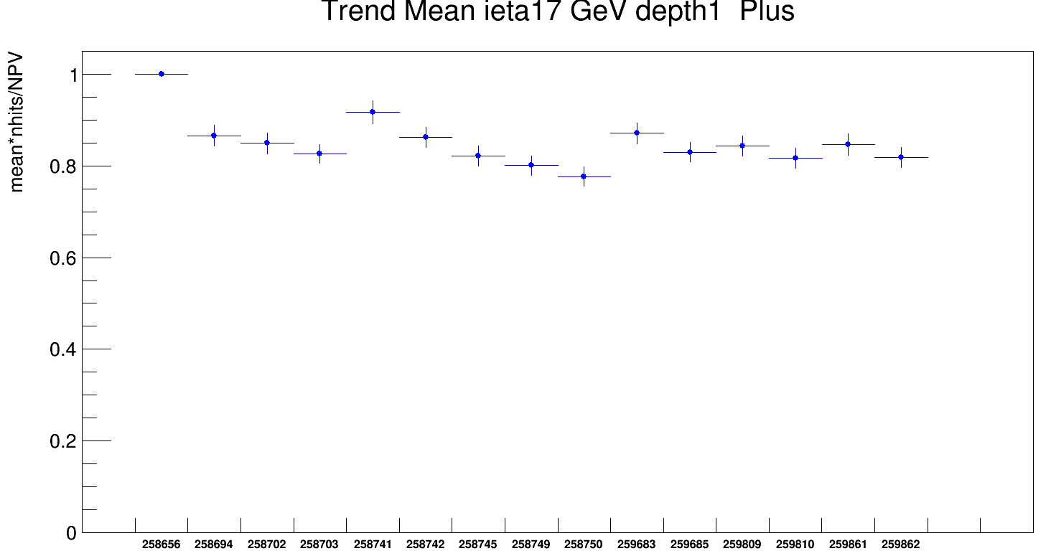
SingleMu_2015D_PreScale4
25ns_1825b_1813_1495_1536_144bpi16inj
25ns_1825b_1813_1495_1536_144bpi16inj
25ns_1825b_1813_1495_1536_144bpi16inj
25ns_1825b_1813_1495_1536_144bpi16inj
25ns_1825b_1813_1495_1536_144bpi16inj
25ns_1825b_1813_1495_1536_144bpi16inj
25ns_1825b_1813_1495_1536_144bpi16inj
25ns_1825b_1813_1495_1536_144bpi16inj
25ns_1825b_1813_1495_1536_144bpi16inj
25ns_1825b_1813_1495_1536_144bpi16inj
25ns_1825b_1813_1495_1536_144bpi16inj
25ns_1825b_1813_1495_1536_144bpi16inj
25ns_1825b_1813_1495_1536_144bpi16inj
25ns_1825b_1813_1495_1536_144bpi16inj
25ns_1825b_1813_1495_1536_144bpi16inj
Normalized first run ieta 17
PreScale 4 - 2015D
Same injection scheme

Slide 4
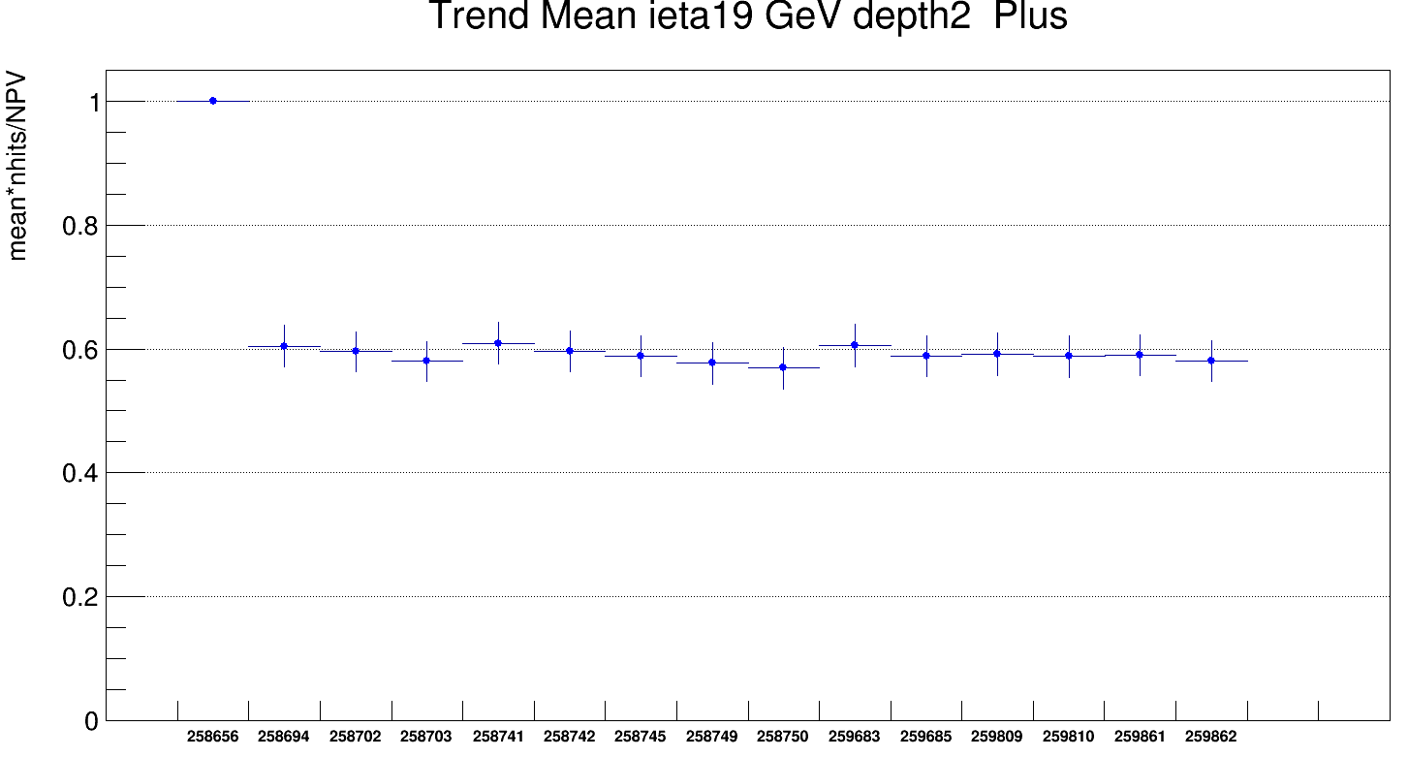
SingleMu_2015D_PreScale4
Normalized first run ieta 19 depth2
PreScale 4 - 2015D

Slide 5
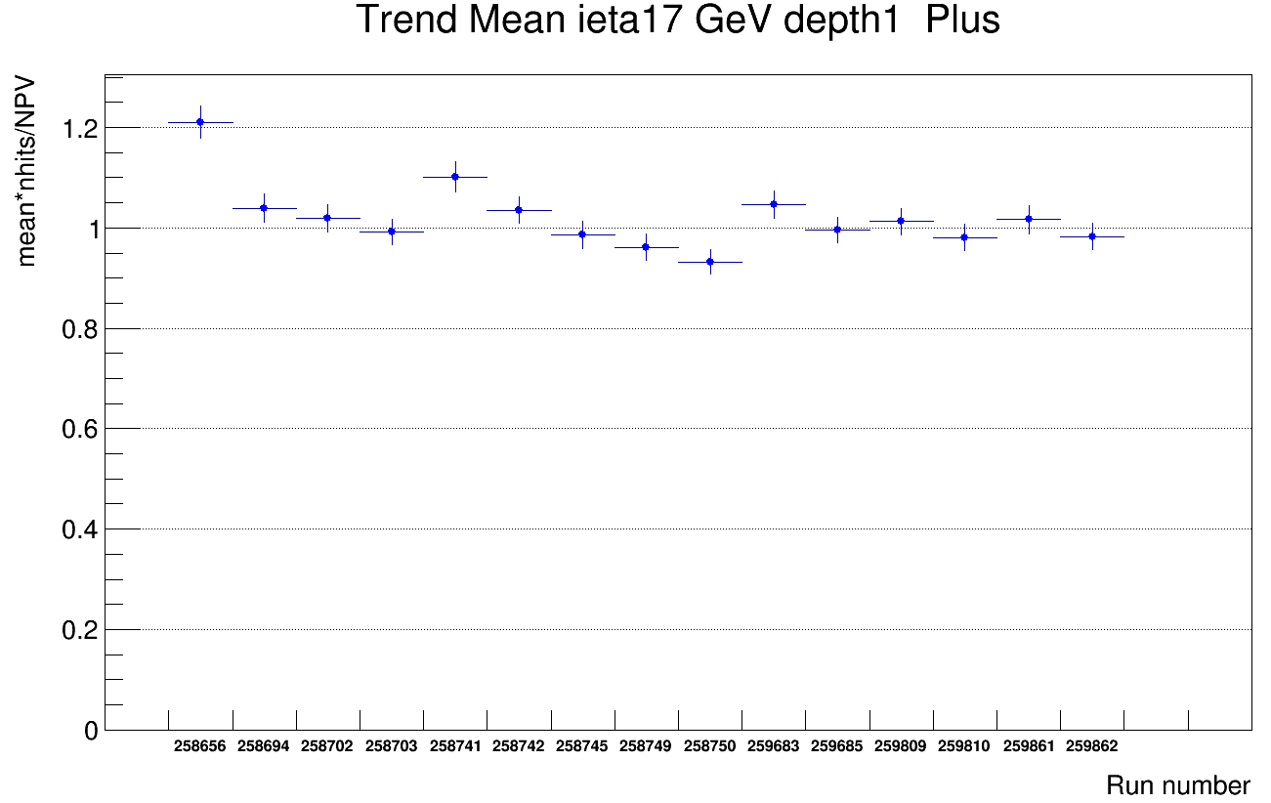
SingleMu_2015D_PreScale4
Normalized first run ieta 19 depth2
PreScale 4 - 2015D

Slide 6
Conclusion
We Analyzed 2015D SingleMuon data using HLT_Mu20_v2 trigger.
HLT_Mu20_v2 is prescale value 1.
we normalized our result to first run ieta 19 depth2 .
Thanks

