Slide 1
43nd Bi-weekly meeting
F. Sanchez Galan, 20-09-2016

Slide 2
News
Visit Staubli last Thursday, very compact connectors look promising.
Mini-TAN @ P8. Solution found, no impact on BRAN, Y-chamber or collimators. Start design.
Next meetings & reviews
CMAC CSR
EFCA, Annual meeting
HL-LHC, Collaboration meeting
HL-LHC TCC (mini-TAN)
F. Sanchez Galan, 43nd WP8 Bi-weekly meeting 20-09-2016

Slide 3
CMAC CSR
the 2nd Cost & Schedule review of the HL-LHC and LIU projects will be held at CERN on 17-19 October 2016.
  A plenary session addressing the status of both projects and providing an overview of the HL-LHC technical infrastructure work-package and its challenges is organized on the 17/10 in the morning.
  On the 17/10 afternoon and on the 18/10, the review is organized in parallel sessions as follows (HL-LHC sessions here mentioned):
  Session 2: HL-LHC – Magnets, powering and cryogenic systems (Convener: J.-M. Jimenez)
  Session 3: HL-LHC – Superconducting RF and other accelerator systems (Convener: P. Collier)
  Session 4: HL-LHC – Technical Infrastructures, Integration and (de)installation (Convener: L. Tavian)
  Session 5: HL-LHC/LIU – Cost, schedule and change management methods (Conveners: L. Rossi/M. Meddahi)
  A preliminary version of the agenda of each session is available on Indico.
F. Sanchez Galan, 43nd WP8 Bi-weekly meeting 20-09-2016

Slide 4
CMAC CSR
The talks will include the following elements:
  Impact of 1st Cost & Schedule review
  Changes to the baseline since the 1st Cost and Schedule review
  Status of work in progress
  Budget related items (Material cost, Manpower, level of uncertainty)
  Schedule related items (schedule, critical path)
  Risks and mitigation measures
F. Sanchez Galan, 43nd WP8 Bi-weekly meeting 20-09-2016

Slide 5
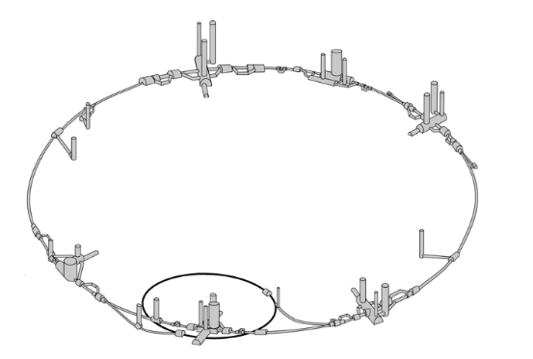
WP8 – Collider-Experiment Interface Installation Overview (oct 2016)
Equipment | Quantity | Location
TAXN for LHCb | 2 units (1 per IP side) | P8
TAXN for ATLAS | 2 units (1 per IP side) | P1
TAXN for CMS | 2 units (1 per IP side) | P5
TAXS for ATLAS | 2 units (1 per IP side) | P1
TAXS for CMS | 2 units (1 per IP side) | P5
TAXS
TAXN

Slide 6
WP8 – Collider-Experiment Interface Installation Overview for LS2
Equipment | Quantity | Location
TAXN for LHCb | 2 units (1 per IP side) | P8
TAXN
Shielding modifications (option)
New Vacuum pump support (option)

Slide 7
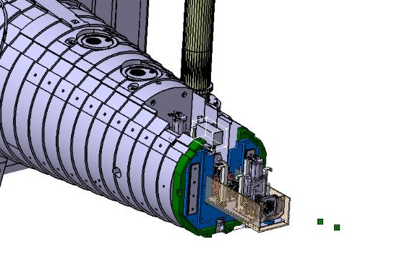
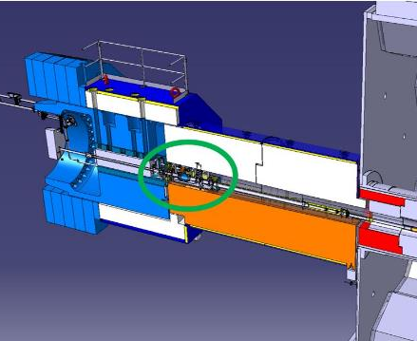
Summary table of LS2 activities (2/2)
Description | WP | Period | Location
NON-BASELINE (options)
CMS New support for vacuum pump at FIN | 8 | LS2 | P5
ATLAS JFC3, JFC3 Shielding modification | 8 | LS2 | P1

Slide 8
Risks and mitigation
Equipment / Systems | Risks | Risk level class | Mitigation

Slide 9
News
HL-LHC Collaboration Meeting day 3. “Final solution for VAX integration”.
https://indico.cern.ch/event/549979/timetable/#20161116.detailed
BPM
Vacuum layout
Connectors, survey &alignment
Cabling
Survey
Motorization
IP far side: JTT, New pump
Q1-TAXS
F. Sanchez Galan, 43nd WP8 Bi-weekly meeting 20-09-2016

Slide 10
News
Next steps
Finalise integration replaced VAX
Prototype (CMS chassis design).
Define operations that could be advanced to LS2
Test alignment capabilities, remote operation.
Internal review together with experiments in 2017
https://indico.cern.ch/event/549979
F. Sanchez Galan, 43nd WP8 Bi-weekly meeting 20-09-2016

Slide 11
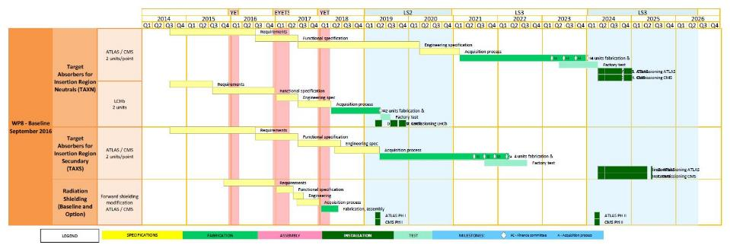
WP8 – Collider-Experiment Interface
Schedule
F. Sanchez Galan, 43nd WP8 Bi-weekly meeting 20-09-2016

