Slide 1

43nd WP8 Bi-weekly meeting
VAX status
Lukasz Krzempek TE-VSC-DLM
20.09.2016

Slide 2
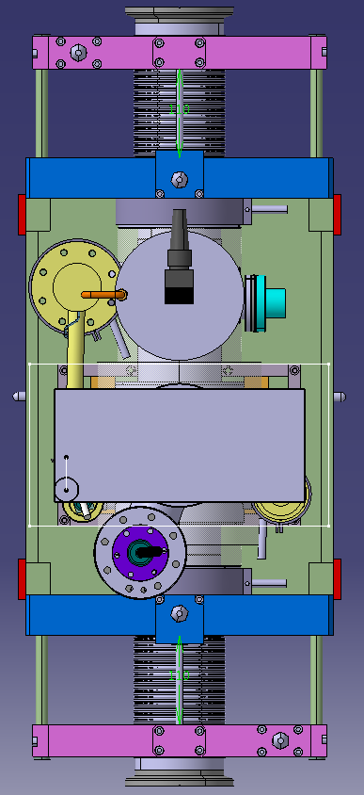
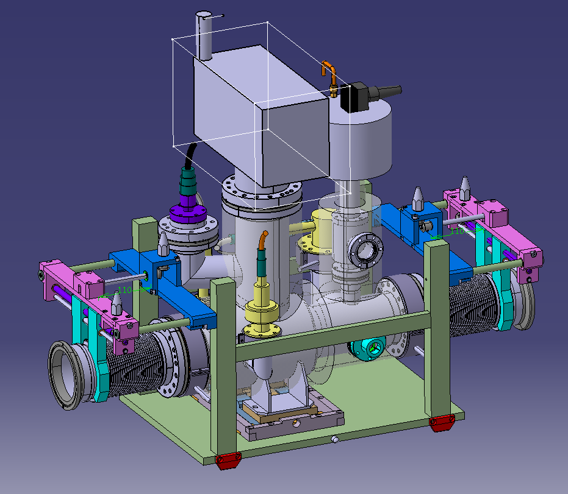
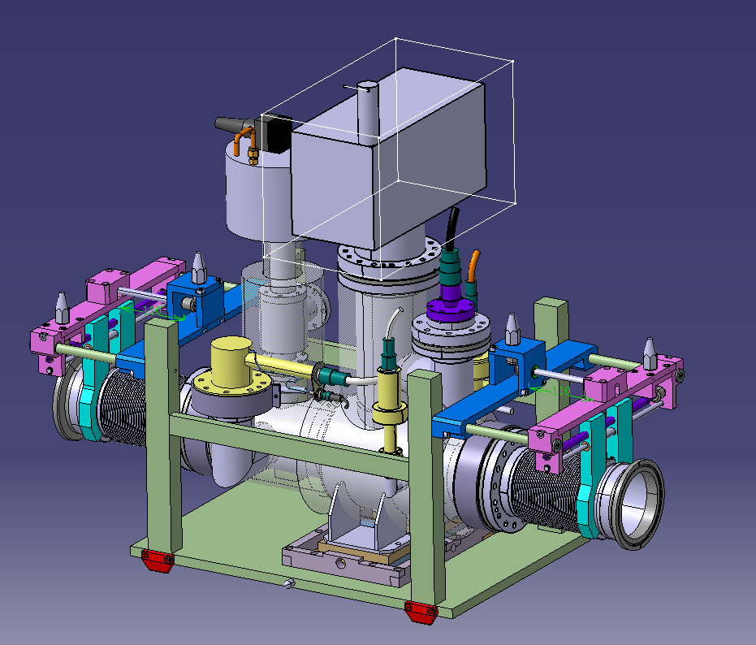
VAX
Ion pump
Angle valve
NEG cartridge
Penning gauge
Bayard Alpert gauge
Rupture disc
Pirani gauge
Comments:
Baseline pump: VacIon Plus 75 Starcell

Slide 3
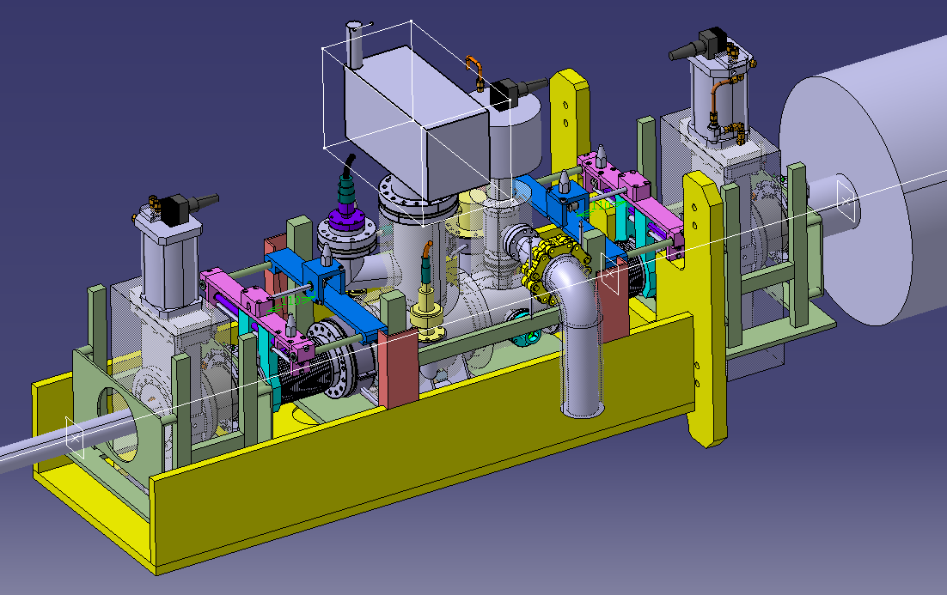
Integration in ATLAS
Comments:
One service line for pumping down and gas injection - DN63
Service line
Lukasz Krzempek TE-VSC-DLM

Slide 4
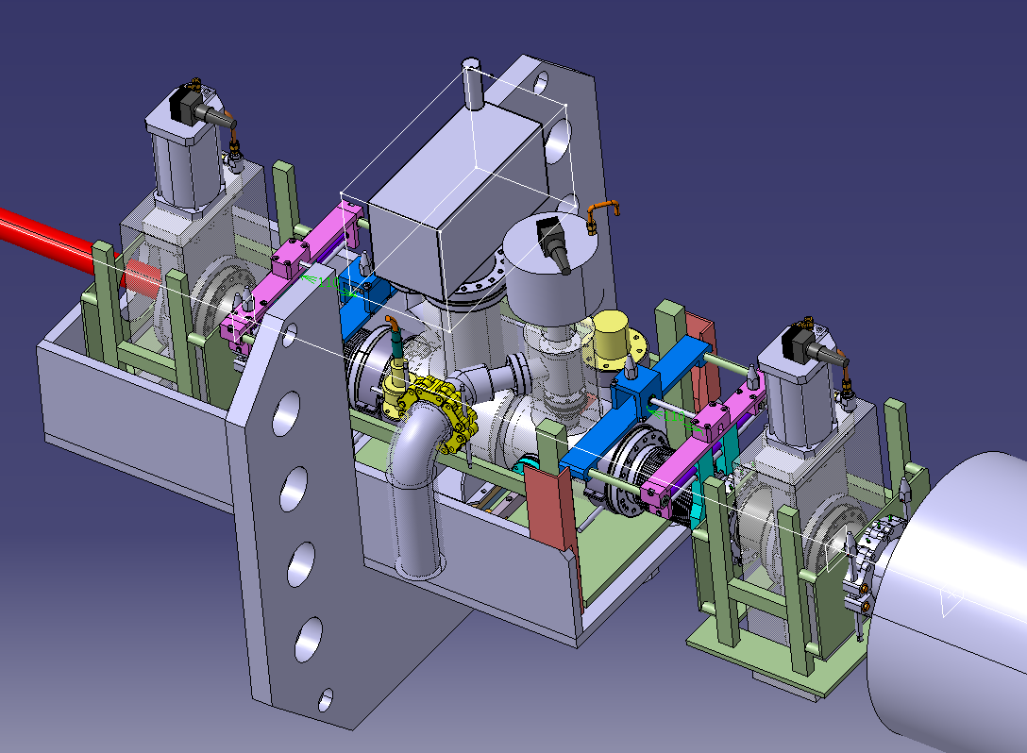
Integration in CMS
Comments:
One service line for pumping down and gas injection - DN63
Service line
Lukasz Krzempek TE-VSC-DLM

Slide 5
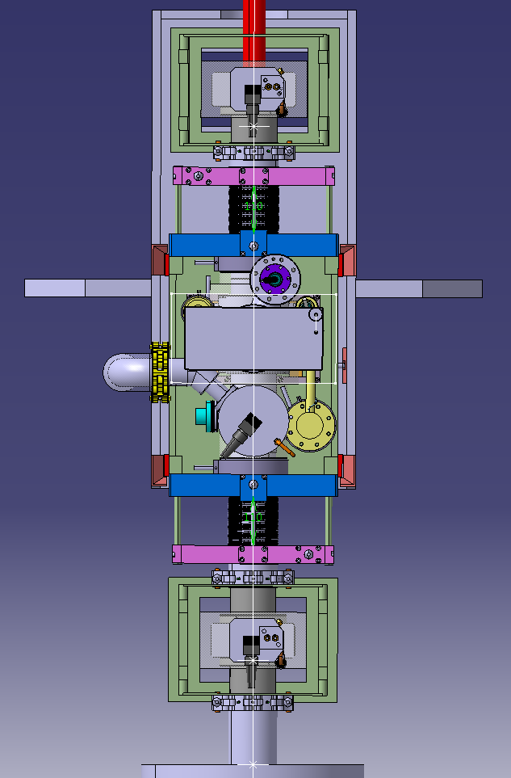
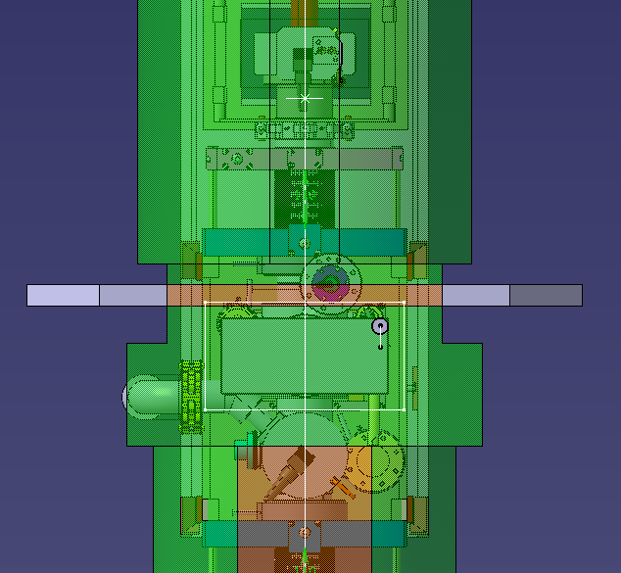
Space constrains in CMS for service line
Available space envelope
Lukasz Krzempek TE-VSC-DLM

Slide 6
Thank you
Lukasz Krzempek TE-VSC-DLM

