Slide 1


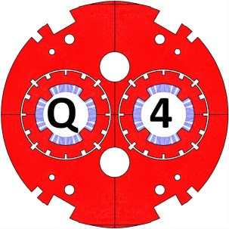
Q4 update
Q4 update
M. Segreti, H. Felice, J.M. Rifflet, E. Todesco
WP3 - Q4 update - 25 November 2015

Slide 2
Magnetic design using MQM cable
Magnetic design optimized at the nominal current in the two apertures
Harmonics are calculated at the reference radius (2/3 of the aperture radius)
Magnet integrated strength = 440 T
Margin on the load line = at least 20 %
Cable used= MQM insulated with its classical insulation (0.08 mm thick after curing & collaring). Main characteristics of MQM cable are listed below
WP3 - Q4 update - 25 November 2015
| P 2

Slide 3
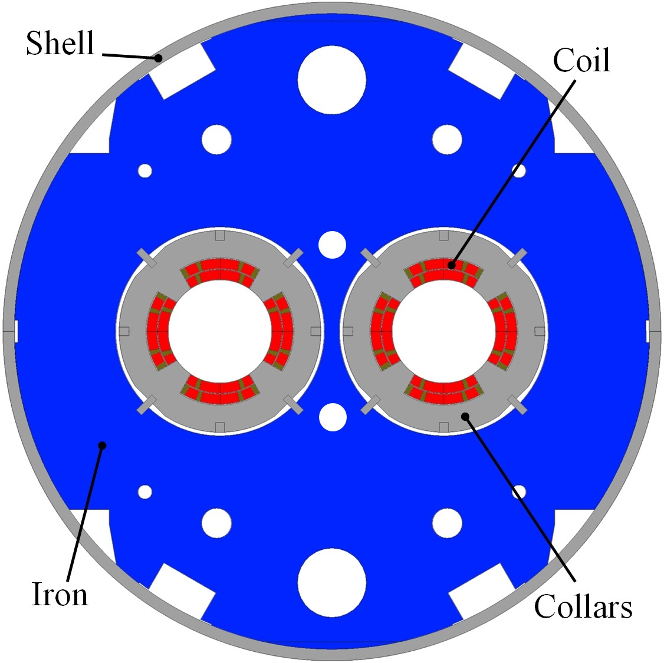
Magnetic design using MQM cable
2 layers of MQM cable
Inner blocks: 17 + 8 turns
Outer blocks: 16 +10 turns
Aperture = 90 mm (as before)
Integrated gradient = 440 T
Magnetic length = 3.67 m
Nominal gradient = 120 T/m
Loadline margin = 20 %
Temperature = 1.9 K
Nominal current = 4590 A
Stored energy = 0.81 MJ
Differential inductance = 2 × 37.5 mH
WP3 - Q4 update - 25 November 2015
| P 3

Slide 4
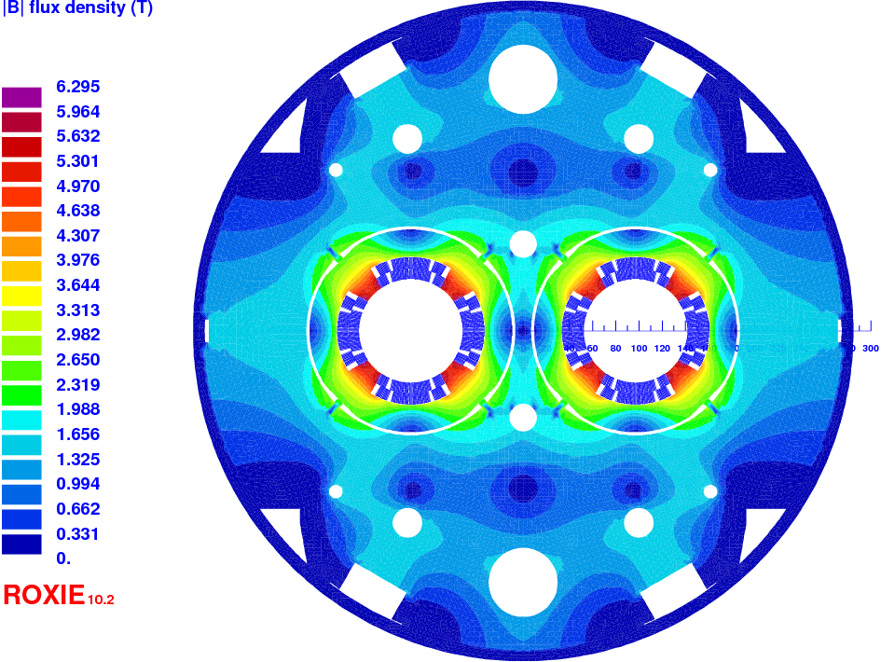
Magnetic design using MQM cable
Calculation with collars (assuming a relative permeability of 1.0025)
Re-optimized cross-section to minimize impact of collars on b6
WP3 - Q4 update - 25 November 2015
| P 4

Slide 5
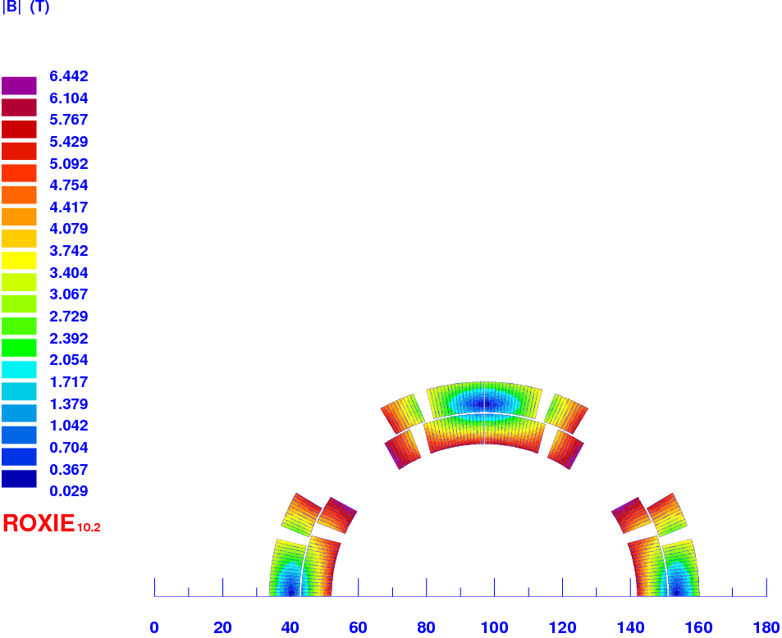
Magnetic design using MQM cable
Calculation with collars (assuming a relative permeability of 1.0025)
At 4590 A, collars increase the peak field on conductor by about 0.12 T
Peak field = 6.4 T
WP3 - Q4 update - 25 November 2015
| P 5

Slide 6
Field quality
WP3 - Q4 update - 25 November 2015
| P 6

Slide 7

Field quality
Transient from 250 A to 6 kA
Evolution of normal relative multipoles with the current (cable eddy currents taken into account)
I nom
WP3 - Q4 update - 25 November 2015
| P 7

Slide 8
Field quality
Transient from 50 A to 6 kA
Evolution of b6 with the current (cable eddy currents taken into account)
I nom
WP3 - Q4 update - 25 November 2015
| P 8

Slide 9
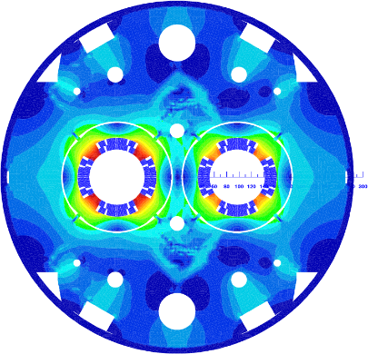
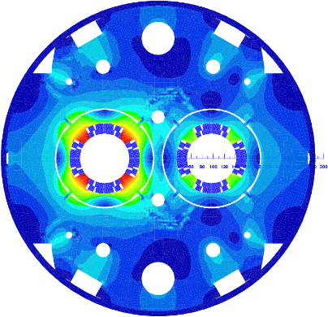
Field quality
Unbalanced regime
WP3 - Q4 update - 25 November 2015
| P 9

Slide 10
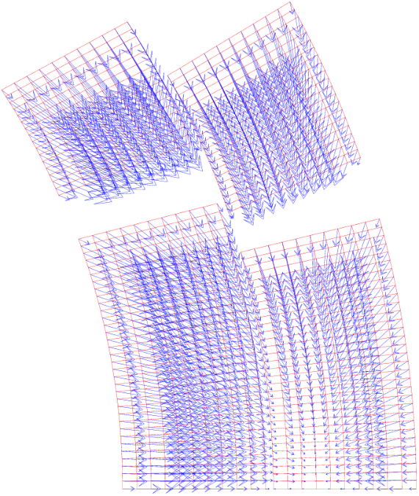
Mechanical study
Mechanical model
CAST3M
Simulation :
Collaring (key)
Insulation creep (20 %)
Cooling
Energisation at 110 % of I_{nom} → Magnetic forces are computed
at each coil node
WP3 - Q4 update - 25 November 2015
| P 10

Slide 11
Mechanical study
Thermomechanical properties of materials
Thanks to Julio for his data on MQM magnet!
20 % loss of pre-stress is assumed after collaring due to insulation creep
WP3 - Q4 update - 25 November 2015
| P 11

Slide 12
Mechanical study
min = 10 MPa
After collaring
After creep
After cooling
At 110 % of nominal current
Azimuthal stress distribution in coil at each main step
WP3 - Q4 update - 25 November 2015
| P 12

Slide 13
Mechanical study
Azimuthal displacement
Radial displacement
Displacement in coil due to magnetic forces
WP3 - Q4 update - 25 November 2015
| P 13

Slide 14
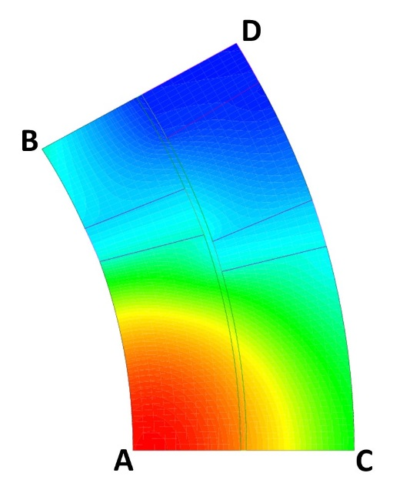
Mechanical study
The self-standing collar solution as mechanical structure is validated
WP3 - Q4 update - 25 November 2015
| P 14

Slide 15
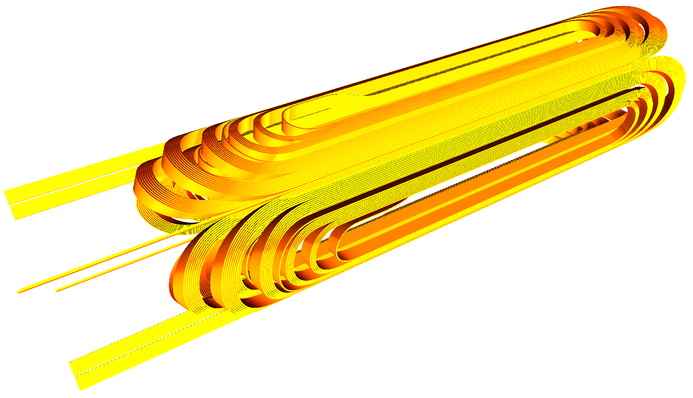
Coil ends
Return end
Lead end
View of a 600 mm long model
WP3 - Q4 update - 25 November 2015
| P 15

Slide 16
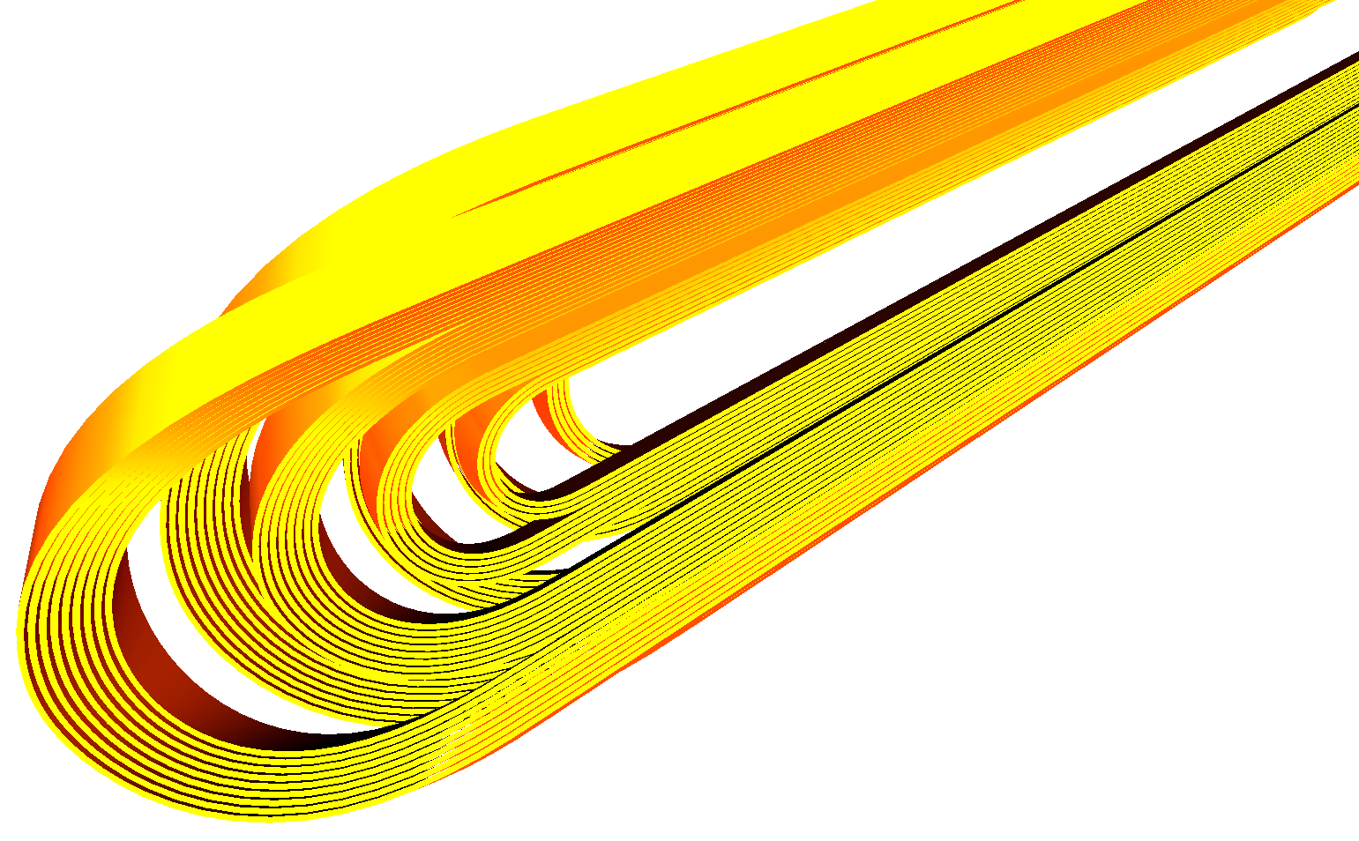
Coil ends
Localization of the peak field (6.5 T i.e. only 1 % higher than in the straight part)
WP3 - Q4 update - 25 November 2015
| P 16

Slide 17
Coil ends
Integrated b6 has been minimized
WP3 - Q4 update - 25 November 2015
| P 17

Slide 18
Cost estimate for the short model test aT CEA
Ongoing effort with Jean-Marc Gheller and Denis Bouziat to establish a cost estimate of the test of the single aperture short model at CEA-Saclay
Mechanical
Cost estimate based on the recovery/modification of existing components
  Top plate
  6 kA current leads
  Current leads insert
Ongoing CAD modeling to assess the required effort to perform:
  The modification of the top plate
  The integration of the current leads
  The addition of a safety valve
  The addition of a central port for magnetic measurements (performed by CERN)
    A flange ISO K DN100 is presently considered => to be discussed with CERN
Limited space on the top plate requires some optimization
DAQ and Magnet Protection
  Assessment of available equipment is ongoing
WP3 - Q4 update - 25 November 2015
| P 18

Slide 19
Magnet in cryostat
4.2 K cold box for the current leads
Cryostat at 1.9 K (23 mbar)
Pre-cooling obtained by LN₂ heat exchanger
WP3 - Q4 update - 25 November 2015
| P 19

Slide 20
Proposal for new Milestones and deliverables FOR short model
N° | Description | Steering committee 04/09/2015 | As of 25/11/2015 Starts in/ Completed in
2.1 | Complete design of the single aperture magnet short model | July 2016 | Aug 2015 /July 2016
2.2 | Winding and polymerization of short coil 0 | December 2016 | Sept/Dec 2016
2.3 | Completion of all coils (1 set + 2 spares in total?) | July 2017 | Jan / April 2017 (~12 weeks)
2.4 | Single aperture magnet short model assembly (instrumentation + collaring + yoking) | September 2017 | March/June* 2017
2.5? | Assembly procedure end of cold mass (quad + correctors) Test of short model | December 2017 | July / Oct 2017
*preliminary assumption
WP3 - Q4 update - 25 November 2015

Slide 21
Q4 update
Thanks for your attention
WP3 - Q4 update - 25 November 2015

