Slide 1


Alarms and Interlocks | Letter | Symbol colour | PRIORITY
Hardware Pressure interlock | PR | Red | Highest Lowest
Full stop interlock (PLC software) | F | Red
Stop interlock (PLC software) | S | Red
Alarm (PLC software) | A | Red
Start interlock (PLC software) | I | No impact
Hardware Global interlock | G | Orange
Hardware Pressure open interlock | pr | Orange
Preventive close | pC | No impact
High threshold warning | H | Orange
Parameter high limit | L | No impact
Data Quality and WARNING | Letter | Symbol colour | PRIORITY
Invalid data | N | Cyan | Highest Lowest
Old (connection with PLC lost) | O
Field object Error Warning | E | Orange
Warning (Feedback <> order or Manual/Force order <> Auto order) | W | No impact
Under Range (HV instrument) | U | Dark Green
MAIN STATUS | Symbol colour | PRIORITY
Not Connected | Grey | Highest Lowest
Invalid/undefined | Cyan
Device Alarm Unacknowledged | Red Blinking
Device Alarm Acknowledged | Red
Warning | Orange
Forced mode | Yellow
Device Under Range (HV instrument) | Dark Green
Device OK | Green
Mask and Block info | Letter | Symbol colour | PRIORITY
Alarm Blocked (PLC) | B | No impact | Highest Lowest
Alarm Masked (only SCADA) | M | No impact
event Masked (only SCADA) | e | No impact
Comment is active
Lock: Device selected by another user (no action allowed)
MODE | Letter | Symbol colour | PRIORITY
Close Enable Mode | CE | No impact | Highest Lowest
Local Mode | L | No impact
Force Mode | F | Yellow
Manual Mode | M | No impact

Slide 2
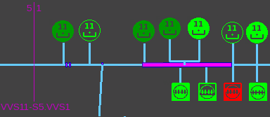
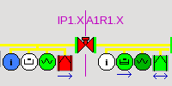
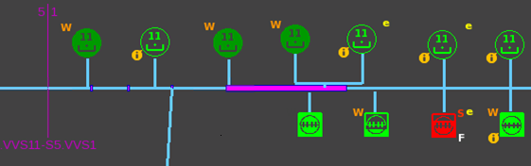
VACUUM SYNOPTIC
UCPC-VAC Compact synoptic
Current synoptic
UCPC-VAC Standard synoptic

Slide 3





Rough Vacuum
Actions:
Laser Alarm
Send SMS Notification
High Limit
Limit value defines in Database can modified on the fly (SCADA)
-- 1 E-06 mbar <-------------------------------------------------------------------------------------
No Action
(If required Alarm can be defined in Database)
Vacuum Vessel Pressure
Parameter Limit
Limit value defines in Database can modified on the fly (SCADA)
-- 1 E-08 mbar <-------------------------------------------------------------------------------------
No Action
Hardware Limit given by the Gauge specifications
-- Under Range --------------------------------------------------------------------------------------
UR is Valid
(database attribute)
Actions:
To be defined
UR is not Valid
(database attribute)
Ultra-High Vacuum

Slide 4


SPARE
WIDGET
ANIMATION

