Slide 1
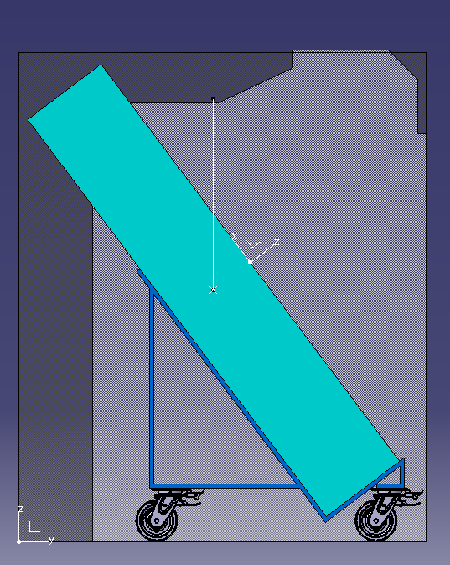
Lift/SPS transport volume integration (Table Top – weight ~7t)
Lift W1950x H2340x L6900
SPS Transport Volume
W1600x H2100/2350

Slide 2
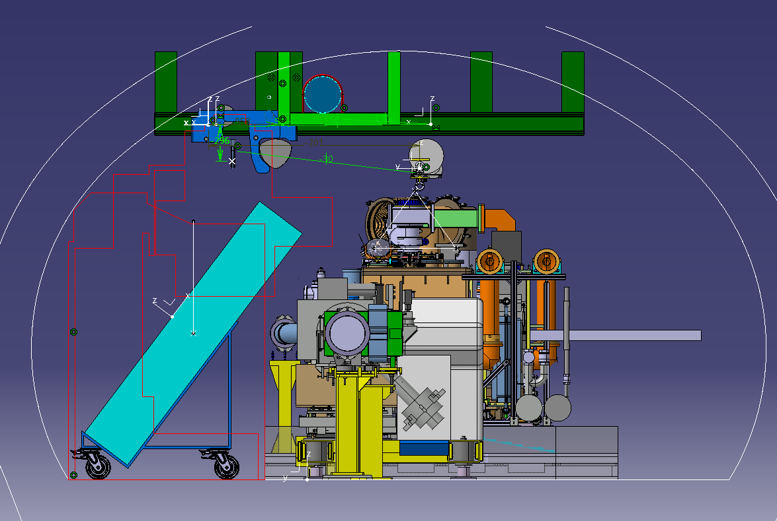
Transfer Table integrated inside the SPS tunnel with rails
(MAX LOAD 2x4t)
Q: The way of installing the transfer table (Table Top) on the support?
Q: How much different the design of the Table Top can be?

Slide 3
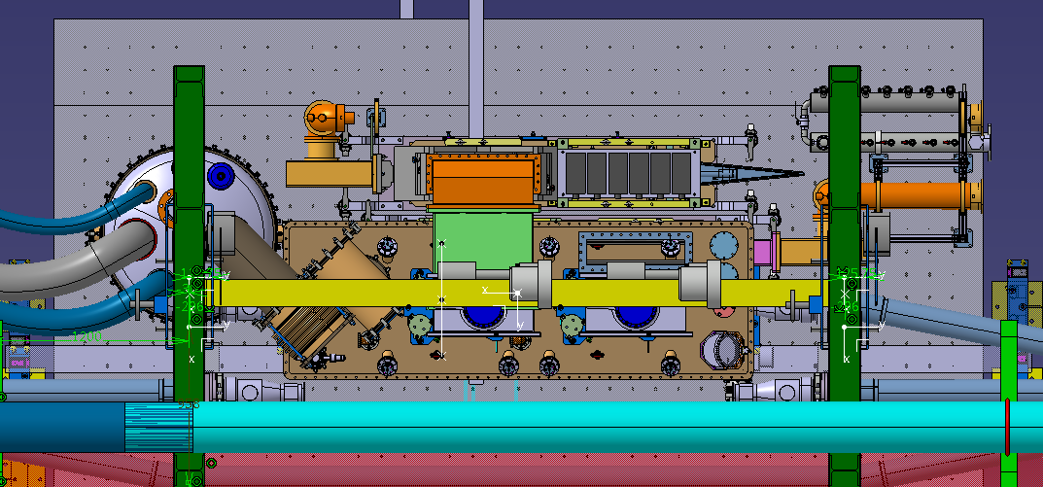
Top view of the integrated rails
Is it possible to integrate into the design the equipment behind the cryomodule?
Can it be placed anywhere on the table and pushed onto the designated place?

Slide 4
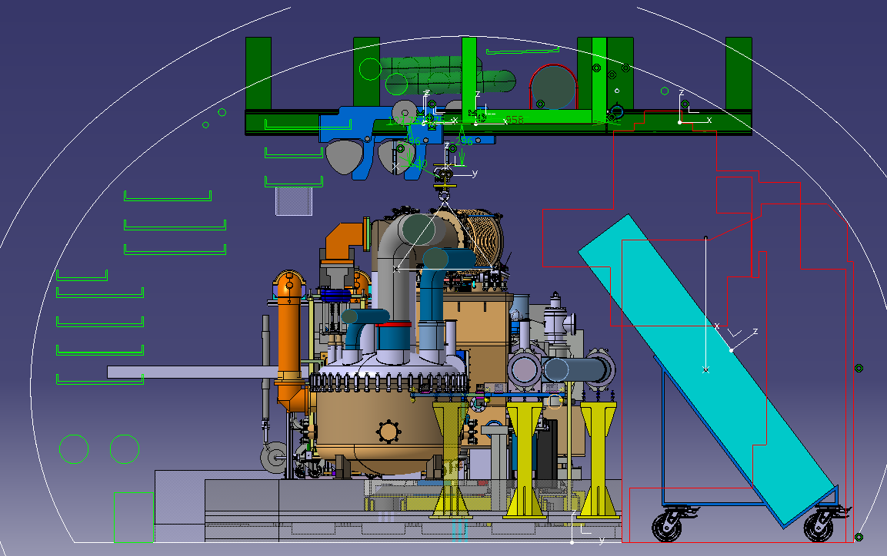
Interference with cable trails !!! ONLY when installing all the equipment behind the cryomodule directly above the final positions.

Slide 5
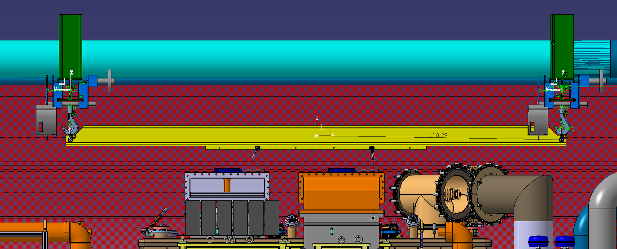
Multi Point Spreader MAX load – 4T
~10cm of clearance in between the highest point of the cryomodule (jumper) and the spreader beam
Other optimization options if still needed

Slide 6
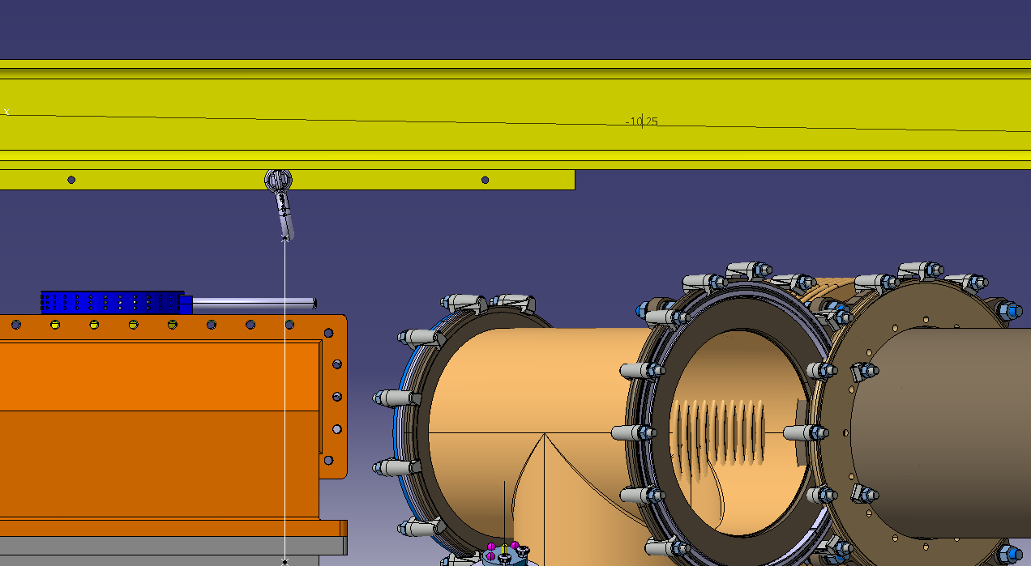
10cm
Multi Point Spreader MAX load – 4T
~10cm of clearance in between the highest point of the cryomodule (jumper) and the spreader beam
Other optimization options if still needed

