Slide 1
Impedance Evaluation for VVSA
(VAT valve DN100)
Thomas Kaltenbacher
with help of P. Kramer, C. Vollinger

Slide 2
Request: ECR 1709399 (SPS)
Request is to install during EYETS2016-2017 11 new sector valves in the SPS (arcs) to improve vacuum sectorization.
Note: one VVSA valve was installed during EYETS2015/2016

Slide 3
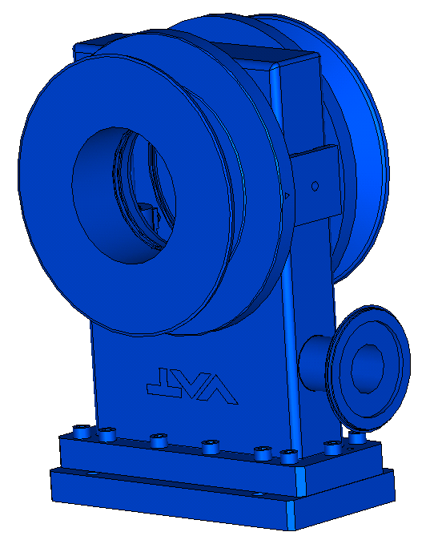
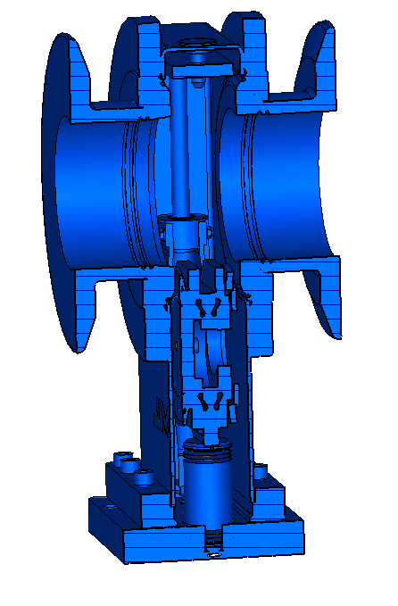
Unshielded VVSA Simulation Model
VVSA exists in shielded/ unshielded versions;
For LHC, installation of shielded version is baseline;
Current ECR requests the installation of the unshielded version;
Already existing VVSAs are all unshielded;
Evaluation of the VVSA for beam impedance through simulations and measurements.
Standard DN100 all-metal valve with bonnet-flange welded for SPS (VVSA)

Slide 4
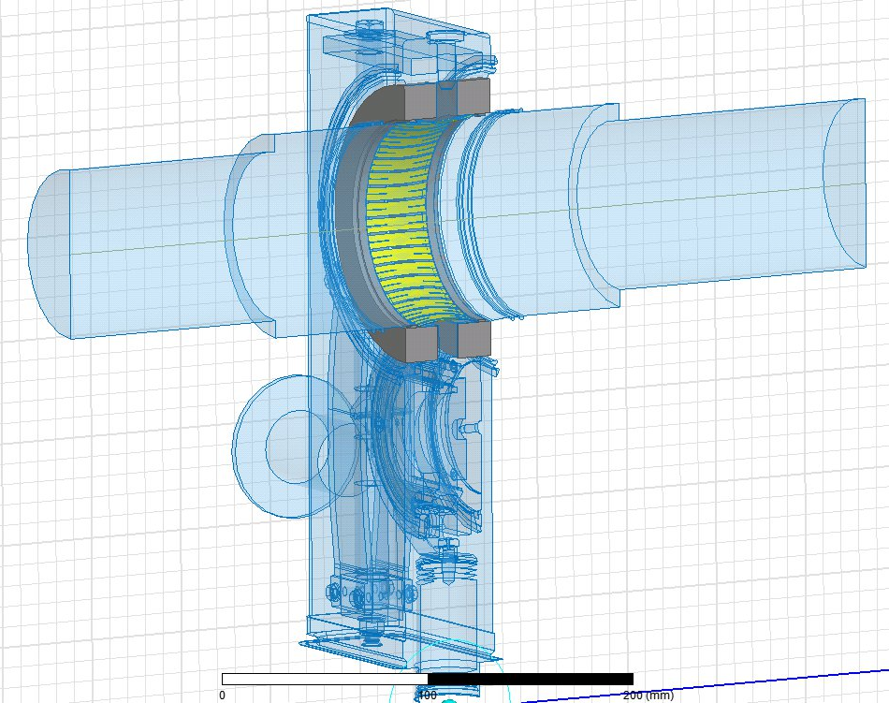
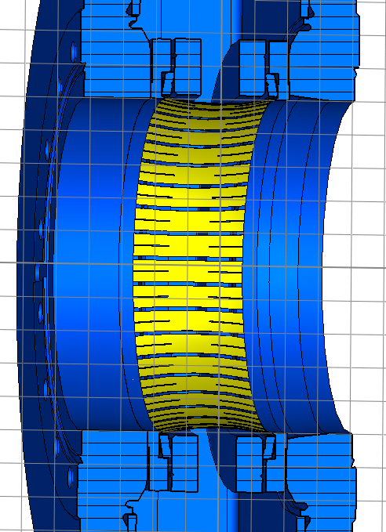
Shielded VVSA Simulation Model
The RF-shield is structurally inserted in the valve and cannot be fitted retro-actively.
RF-shielded DN100 valve

Slide 5
Wire Measurement Vs EIG Simulations
Wire measurement
EIG simulation
f [GHz] | Z_{s} [Ω] | Q_{L} [-] | R/Q [Ω]
0.655* | 271.2 | (95) | 2.9
0.686* | 206.5 | (98) | 2.1
- | - | - | -
1.313 | 1047.5 | (140) | 7.5
1.411 | 471.9 | (109) | 4.3
1.435 | 773.8 | (119) | 6.5
1.830 | 778.2 | (92) | 8.5
1.874 | 2088.4 | (103) | 20.2
- | - | - | -
f [GHz] | Z_{s} [Ω] | Q₀ [-] | R/Q [Ω]
0.608 | 1227.6 | 360 | 3.4
- | - | - | -
1.270 | 7998.4 | 600 | 13.3
1.324 | 2971.0 | 492 | 6.0
1.427 | 712.4 | 528 | 1.3
1.494 | 20.9 | 415 | 0.05
1.797 | 472.4 | 331 | 1.4
1.877 | 78.9 | 418 | 0.2
2.394 | 621.7 | 1179 | 0.5
good agreement
Modes were found but R/Q has limited reliability.
* Split mode was measured but not simulated
Note: data shown for one item

Slide 6
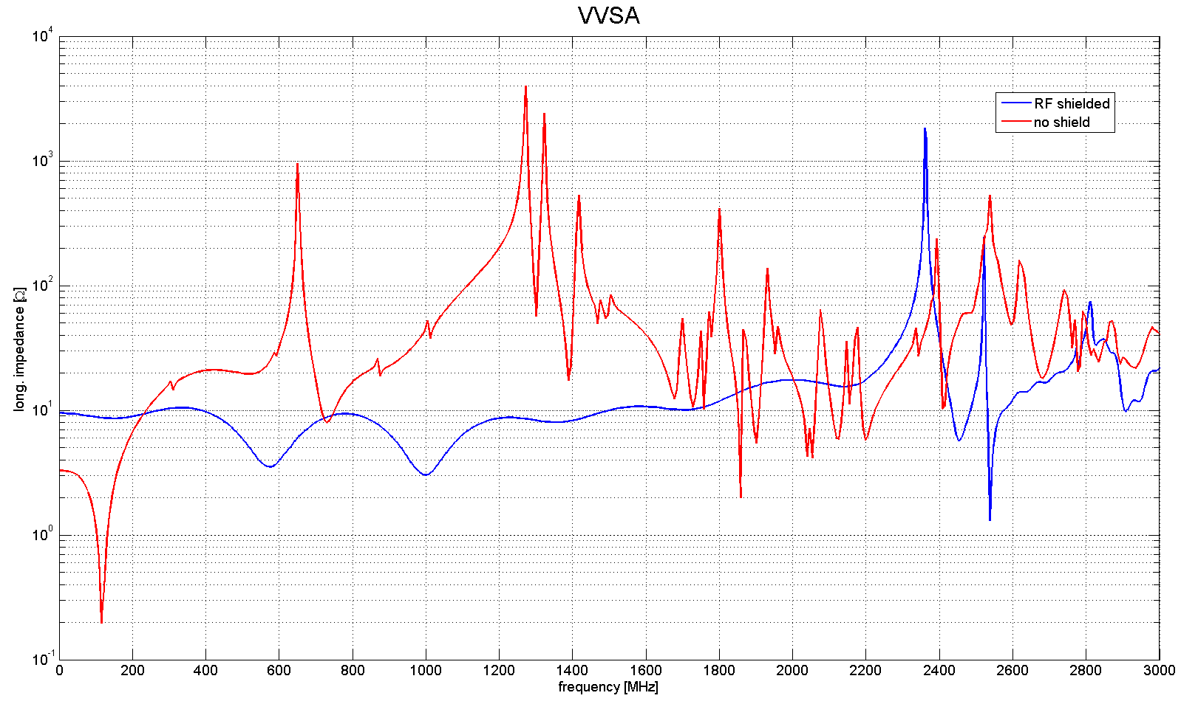
VVSA: Impedance Spectrum
Unshielded - EIG simulation
f [GHz] | Z_{s} [Ω] | Q₀ [-] | R/Q [Ω]
0.608 | 1227.6 | 360 | 3.4
1.270 | 7998.4 | 600 | 13.3
1.324 | 2971.0 | 492 | 6.0
1.427 | 712.4 | 528 | 1.3
1.797 | 472.4 | 331 | 1.4
2.394 | 621.7 | 1179 | 0.5
Shielded - EIG simulation
f [GHz] | Z_{s} [Ω] | Q₀ [-] | R/Q [Ω]
2.373 | 3409.2 | 4443 | 0.8
Note: data shown for one item

Slide 7
Beam Dynamics Simulation
Preliminary Results
Impedance of 12 additional VVSAs reduces the intensity threshold
Further BD studies needed (e.g. which resonances cause a problem)
HL-LHC
Simulations were performed for:
+ RF upgrade 800 MHz: 10 MV, 1 MV (4th harmonic)
+ SPS FT 450 GeV
+ 72 bunches
+ imp. red. of flanges by a factor of 20 (flanges with 4 conv. bellows)
Courtesy J. Repond

Slide 8
Conclusions
+ measurements and simulations are in good agreement
+ the (unshielded) VVSA shows non-negligible long. impedance
+ RF shielded valves show significantly less long. impedance and
should therefore be preferably installed
Input for Impedance Guide-lines: If installation of further valves is required, shielded valves are preferable and their possible installation shall be evaluated.

Slide 9
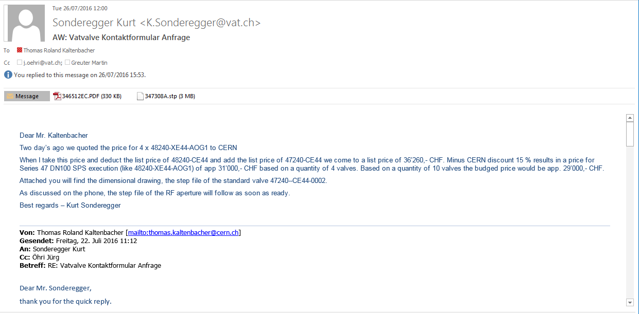
Additional Slide (preliminary price quote for shield valve)
One RF-shielded all-metal gate valve costs about 29 kCHF (quoted for 10 pieces)

