Slide 1




FLUKA: THEORETICAL GROUNDS,
BENCHMARKING, AND WISHED NEW DATA
Francesco Cerutti , Alfredo Ferrari
and M.N. Mazziotta
on behalf of the collaboration
XSCRC2017
Cross Sections for Cosmic Rays @ CERN
2017 Mar 30th

Slide 2
OUTLINE
FLUKA overview
hN, hadron-nucleon interactions
hA, hadron-nucleus interactions
AA, nucleus-nucleus interactions, and (virtual) γA, photonuclear interactions
wish list

Slide 3

THE FLUKA CODE
hadron-hadron and hadron-nucleus interactions
nucleus-nucleus interactions
photon interactions (>100 eV)
electron interactions (> 1 keV; including electronuclear)
muon interactions (including photonuclear)
neutrino interactions
particle decay
low energy (<20 MeV) neutron library
ionization and multiple (single) scattering (including all ions down to 250 eV/u)
combinatorial geometry and lattice capabilities
voxel geometry and DICOM importing
magnetic field
analogue or biased treatment
on-line buildup and evolution of induced radioactivity and dose
built-in scoring of several quantities (including DPA and biological dose)

Slide 4
THE FLUKA APPLICATIONS
Accelerator design
Dosimetry
Particle physics (calorimetry, tracking and detector simulation, …)
Cosmic ray physics
Medical applications, hadrontherapy
Shielding design
Radiation damage
Neutrino physics
Radiation protection
Radiation to electronics effects
ADS systems, waste transmutation
Neutronics

Slide 5
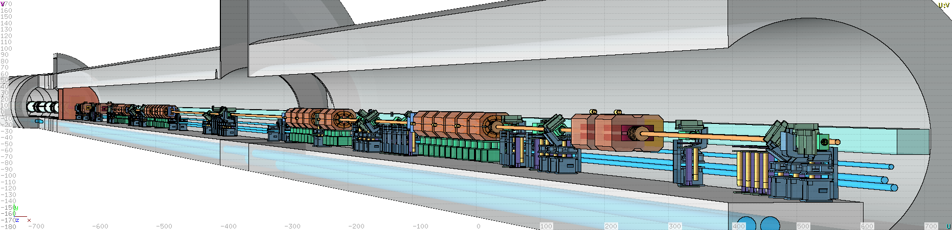
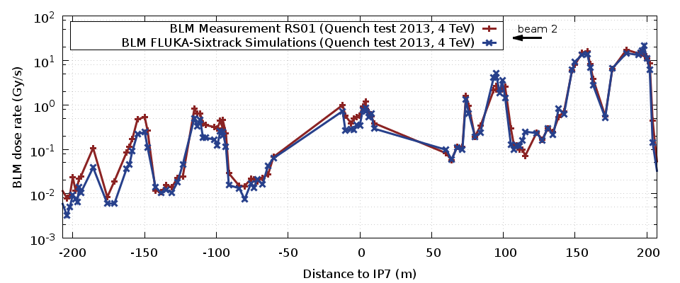
LHC COLLIMATION (4 TeV/c p)
Loss rate: 1 MW on the betatron cleaning insertion collimators
TCP
TCP B1
IP7
Q4
Q5
[E. Skordis]

Slide 6
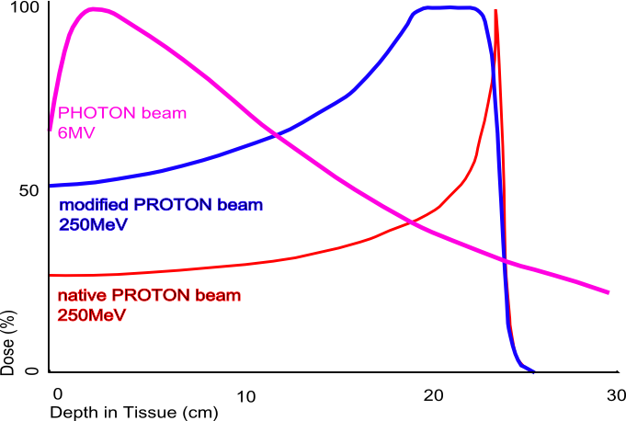
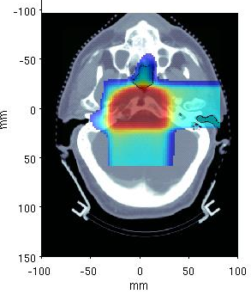
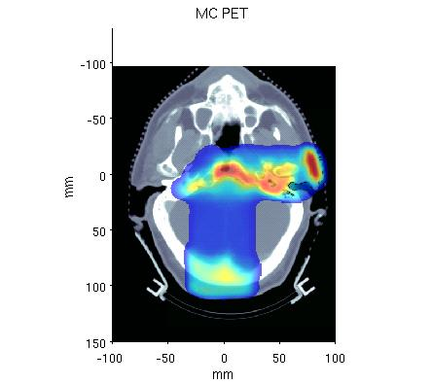
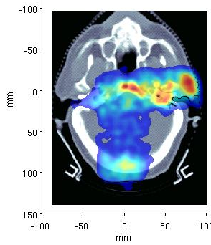
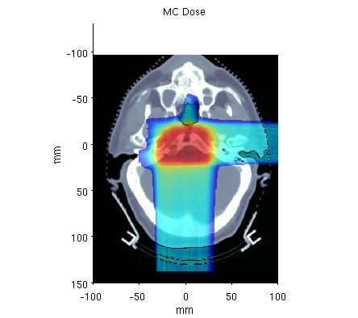
HUMAN MATTER(S)
K. Parodi et al., PMB52, 3369 (2007)
2 Field
1 Field
TP Dose
MC PET
Meas. PET
MC Dose

Slide 7
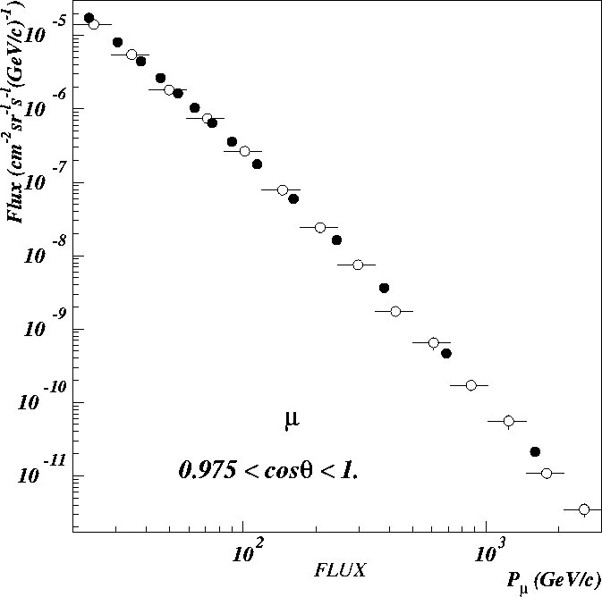
EARTH MUONS
Double differential muon rate
Black circles: L3 data ; Open circles: FLUKA
(S. Muraro, PhD Thesis)
Double differential muon rate
Points: exp. data (O.C. Allkofer et al., NPB 259 (1985) 1) Histograms: FLUKA

Slide 8
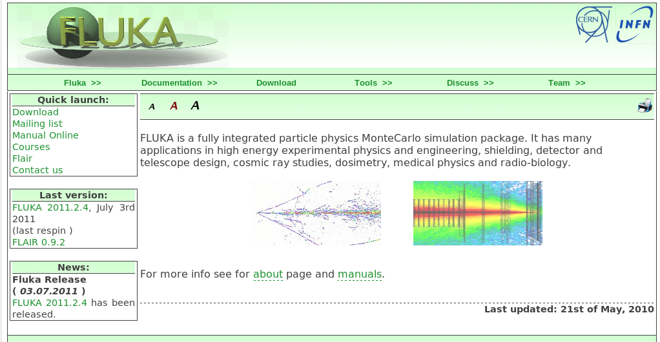
THE FLUKA DEVELOPMENT AND DISSEMINATION
Main authors: A. Fassò, A. Ferrari, J. Ranft, P.R. Sala
Contributing authors: G. Battistoni, F. Cerutti, M. Chin, T. Empl, M.V. Garzelli, M. Lantz, A. Mairani, S. Muraro, V. Patera, S. Roesler, G. Smirnov, F. Sommerer, V. Vlachoudis
http://www.fluka.org
several thousand
registered users
user support through fluka-discuss@fluka.org
18 beginner and 4 advanced courses held up to now
Developed and maintained under an INFN-CERN agreement
Copyright 1989-2017 CERN and INFN

Slide 9
hN
Particle production interactions:
two kinds of models
p-p and p-n cross section
FLUKA and data
total
Those based on “resonance” production and decays,
cover the energy range up to 3–5 GeV
Those based on quark/parton string models, provide reliable results up to several tens of TeV
elastic
Elastic, charge exchange and strangeness exchange reactions:
• Available phase-shift analysis and/or fits of experimental differential data
• At high energies, standard eikonal approximations are used

Slide 10
RESONANCE PRODUCTION
All reactions are thought to proceed through channels like:
h + N → X → x₁ + … + x_{n} → …
h + N → X + Y → x₁ + … x_{n} + y₁ + … y_{m} → …
where X and Y can be real resonances or stable particles (π, n, p, K) directly
Resonances can be treated as real particles: they can be transported and then transformed into secondaries according to their lifetime and decay branching ratios
Resonance energies, widths, cross sections, branching ratios
from data and conservation laws, whenever possible.
Inferred from inclusive cross sections when needed
Dominance of the Δ resonance and of the N∗ resonances
FLUKA: ≈ 60 resonances, and ≈ 100 channels in describing p, n, π, pbar, nbar and K induced reactions up to 3-5 GeV/c

Slide 11
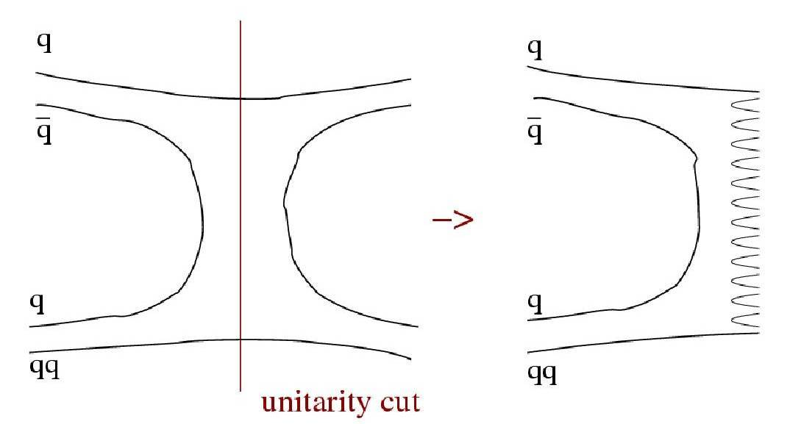
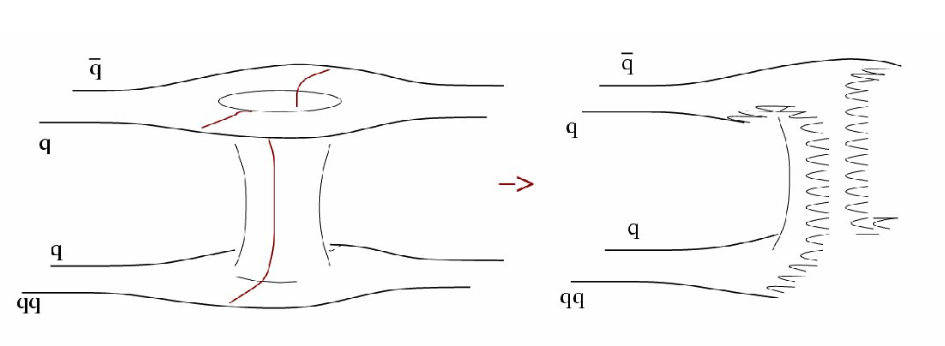
DPM
Parton and color concepts, Topological expansion of QCD, Duality
single chain diagram
Reggeon exchange
- momentum distribution functions
- fragmentation functions
color strings to be “hadronized”
two-chain diagram
single Pomeron exchange

Slide 12
CHAIN EXAMPLES [I]
momentum fraction
Leading two-chain diagram in DPM
for p-p scattering
The color (red, blue, and green) and quark combination shown in the figure is just one of the allowed possibilities
Leading two-chain diagram in DPM
for pbar-p scattering
The color (red, antired, blue, antiblue, green, and antigreen) and quark combination shown in the figure is just one of the allowed possibilities

Slide 13
CHAIN EXAMPLES [II]
Single chain diagram in DPM
for π⁺-p scattering
The color (red, antired, blue, and green) and quark combination shown in the figure is just one of the allowed possibilities
Leading two-chain diagram in DPM
for π⁺-p scattering
The color (red, antired, blue, and green) and quark combination shown in the figure is just one of the allowed possibilities
σ ~ 1/√s

Slide 14
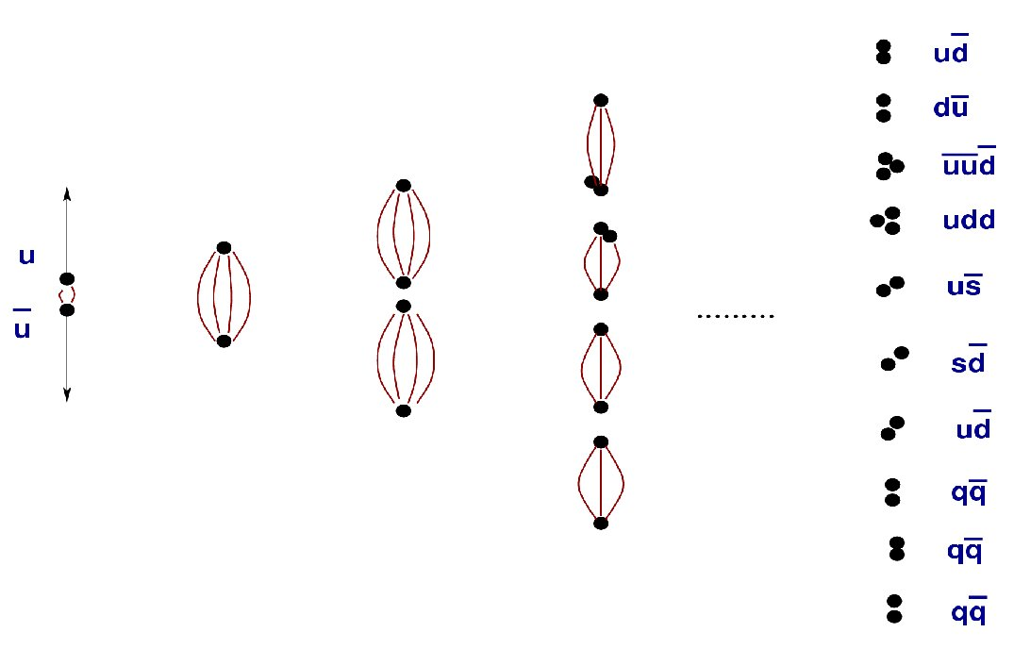
HADRONIZATION EXAMPLE
q-q and qq-qq
pairs generation

Slide 15
PROTON ‒ PROTON
Inclusive pion production
Points: exp. data (C.D. Dermer, Astrophys. J. 307 (1986) 47)

Slide 16
PROTON ‒ PROTON
Double differential pion production
Points: exp. data (Phys. Rev. D 6(11) (1972) 3085)

Slide 17
PROTON ‒ PROTON
p _{l cms} = 0.6 GeV/c
p_{T}²
Double differential pion production
Points: exp. data (PRL23 (1969) 1055 and J. Day, PhD Thesis (1969))

Slide 18
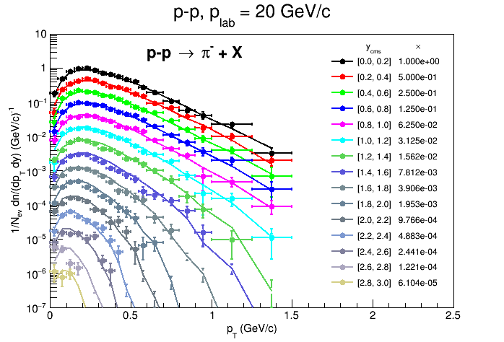
PROTON ‒ PROTON
Double differential pion production
Points: exp. data (N. Abgrall et al., Eur. Phys. J. C 74 (2014) 2794)

Slide 19
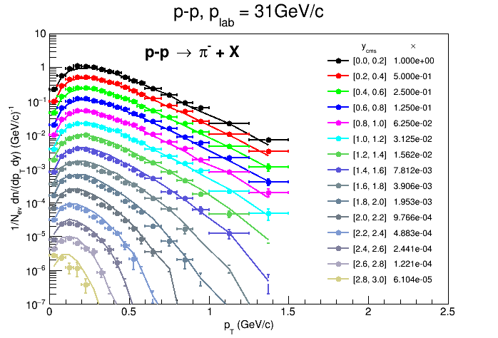
PROTON ‒ PROTON
Double differential pion production
Points: exp. data (N. Abgrall et al., Eur. Phys. J. C 74 (2014) 2794)

Slide 20
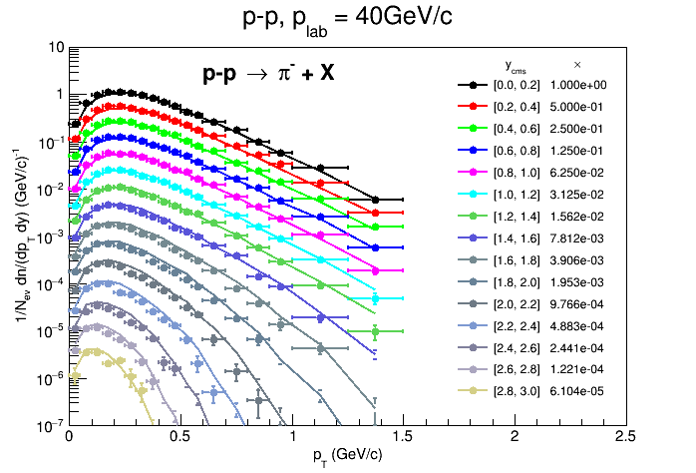
PROTON ‒ PROTON
Double differential pion production
Points: exp. data (N. Abgrall et al., Eur. Phys. J. C 74 (2014) 2794)

Slide 21
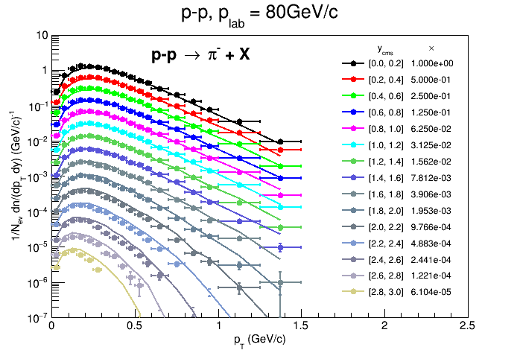
PROTON ‒ PROTON
Double differential pion production
Points: exp. data (N. Abgrall et al., Eur. Phys. J. C 74 (2014) 2794)

Slide 22
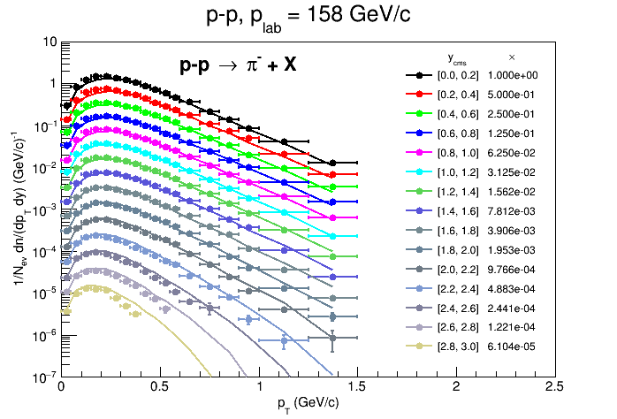
PROTON ‒ PROTON
Double differential pion production
Points: exp. data (N. Abgrall et al., Eur. Phys. J. C 74 (2014) 2794)

Slide 23
PION ‒ PROTON
π⁺ + p → π⁺ + X (6 & 22 GeV/c)
π⁺ + p → Ch⁺/Ch⁻ + X (250 GeV/c)
Positive hadrons X2
Negative hadrons
Connected points: FLUKA
Symbols with errors : DATA
M.E. Law et al., LBL80 (1972)
Histogram : FLUKA
Symbols with errors : DATA
6 GeV/c
22 GeV/c

Slide 24
hA and AA
γA
eA
μA
FLUKA
[even three from BME]

Slide 25
PEANUT [I]
Target nucleus description (density, Fermi motion, etc)
t (s)
10⁻²³
10⁻²²
10⁻²⁰
10⁻¹⁶
Glauber-Gribov cascade with formation zone
Generalized IntraNuclear cascade
Preequilibrium stage
with current exciton configuration and excitation energy
(all non-nucleons emitted/decayed + all nucleons below 30-100 MeV)
Evaporation/Fragmentation/Fission model
γ de-excitation

Slide 26
PEANUT [II]
Some assets of the full GINC as implemented in FLUKA (PEANUT):
  Nucleus divided into 16 radial zones of different density, plus 6 outside the nucleus to account for nuclear potential, plus 10 for charged particles
  Different nuclear densities (and Fermi energies) for neutrons and protons (shell model ones for A≤16)
  Nuclear (complex) optical potential → curved trajectories in the mean nuclear+Coulomb field (reflection, refraction)
  Updating binding energy (from mass tables) after each particle emission
  Multibody absorption for π^{+/0/-} K^{-/0} μ⁻
  Exact energy-momentum conservation including the recoil of the residual nucleus and experimental binding energies
  Nucleon Fermi motion including wavepacket-like uncertainty smearing, (approximate) nucleon-nucleon, and r ↔ E_{f}(r) correlations
  Quantum effects (mostly suppressive): Pauli blocking, Formation zone, Nucleon antisymmetrization, Nucleon-nucleon hard-core correlations, Coherence length

Slide 27
Gribov interpretation OF
Glauber multiple collisions
The absorption cross section is just the integral in the impact parameter plane of the probability of getting at least one non-elastic hadron-nucleon collision, and it is naturally written in a multiple collision expansion
with the overall average number of collisions given by
Glauber-Gribov model = Field theory formulation of Glauber model
Multiple collision terms ⇒Feynman graphs
At high energies : exchange of one or more Pomerons with one or more target nucleons
In the Dual Parton Model language (neglecting higher order diagrams):
Interaction with n target nucleons ⇒ 2n chains
  Two chains from projectile valence quarks + valence quarks of one target nucleon ⇒2 valence-valence chains
  2(n-1) chains from sea quarks of the projectile + valence quarks of target nucleons ⇒2(n-1) sea-valence chains

Slide 28
CHAIN EXAMPLES
Leading two-chain diagram in DPM
for p-A Glauber scattering with 4 collisions
The color (red, antired, blue, antiblue, green, and antigreen) and quark combination shown in the figure is just one of the allowed possibilities
Leading two-chain diagram in DPM
for π⁺-A Glauber scattering with 3 collisions
The color (red, antired, blue, antiblue, green, and antigreen) and quark combination shown in the figure is just one of the allowed possibilities

Slide 29
FORMATION ZONE
Classical INC will never work
J.Ranft applied the concept, originally proposed by Stodolski, to hA and AA nuclear int.
Naively: “materialization" time
Qualitative estimate:
In the frame where p|| =0
Particle proper time
Going to the nucleus system
Condition for possible re-interaction inside a nucleus:

Slide 30
no Glauber, no formation zone
Positive
Negative
π⁺
Positive
Negative
π⁺
Rapidity distributions of charged particles produced in 250 GeV π⁺ collisions on Aluminum (left) and Gold (right)
Points: exp. data (Agababyan et al., ZPC50 (1991) 361)

Slide 31
no Glauber, yes formation zone
Positive
Negative
π⁺
Positive
Negative
π⁺
Rapidity distributions of charged particles produced in 250 GeV π⁺ collisions on Aluminum (left) and Gold (right)
Points: exp. data (Agababyan et al., ZPC50 (1991) 361)

Slide 32
yes Glauber, no formation zone
Positive
Negative
π⁺
Positive
Negative
π⁺
Rapidity distributions of charged particles produced in 250 GeV π⁺ collisions on Aluminum (left) and Gold (right)
Points: exp. data (Agababyan et al., ZPC50 (1991) 361)

Slide 33
yes Glauber, yes formation zone
Positive
Negative
π⁺
Positive
Negative
π⁺
Rapidity distributions of charged particles produced in 250 GeV π⁺ collisions on Aluminum (left) and Gold (right)
Points: exp. data (Agababyan et al., ZPC50 (1991) 361)

Slide 34
PROTON ‒ Al, C
double differential π⁺ production

Slide 35
PROTON ‒ Be
double differential π^{+/-} production
data from BNL910 experiment

Slide 36
PROTON ‒ Be, Au
double differential π⁺ production
cos(θ)
cos(θ)
data from BNL910 experiment

Slide 37
PROTON ‒ Pb, Al
double differential π^{+/-} production

Slide 38
PROTON ‒ C, PROTON
Differential pion and kaon production
Points: exp. data (C. Alt et al., EPJC49 (2007) 897
and T. Anticic et al. (NA49) EPJC68 (2010) 1)

Slide 39
PROTON ‒ C
x_{F}
x_{F}
Double differential pion production
Points: exp. data (C. Alt et al., EPJC45 (2006) 343)

Slide 40
PROTON ‒ C
Differential antiproton production
exp. data from B. Baatar et al., Eur. Phys. J. C 73(4) (2013) 2364
158 GeV/c

Slide 41
LAST STAGE DE-EXCITATION
Evaporation: Weisskopf-Ewing approach
  ~600 possible emitted particles/states (A<25) with an extended formalism
  Full level density formula with level density parameter A,Z and excitation dependent
  Inverse cross section with proper sub-barrier
  Analytic solution for the emission widths (neglecting the level density dependence on U, taken into account by rejection)
  Emission energies from the width expression with no approximation
Fission:
  Γ_{fis} based of first principles, full competition with evaporation
  Improved mass and charge widths
  Myers and Swiatecki fission barriers, with exc. en. dependent level density enhancement at saddle point
Fermi Break-up for A<18 nuclei
  ~ 50000 combinations included with up to 6 ejectiles, considering spin/parity constraints
γ de-excitation: statistical + rotational + tabulated levels
In ALL reaction steps, from first interaction to last γ :
Exact energy conservation
including binding energy and recoil of residual nucleus

Slide 42
Pb ‒ PROTON
Inclusive fragment production
Points: exp. data (T. Enqvist, Nucl. Phys. A 686 (2001) 481)
Data
FLUKA
FLUKA after cascade
FLUKA after preeq
1 GeV/n ²⁰⁸Pb+p

Slide 43
PROTON, GAMMA ‒ C
¹¹C excitation functions
Points: exp. data (EXFOR)
¹²C(p,x)¹¹C
¹²C(γ,n)¹¹C
direct deuteron formation mechanism following the first pn elementary interaction
spin/parity constraints in Fermi break-up

Slide 44
AA event generators
E > 5 GeV/n
Dual Parton Model (DPM)
DPMJET-III (original code by R.Engel, J.Ranft and S.Roesler,
FLUKA-implemenation by T.Empl et al.)
0.1 GeV/n < E < 5 GeV/n
Relativistic Quantum Molecular Dynamics Model (RQMD)
RQMD-2.4 (original code by H.Sorge et al.,
FLUKA-implementation by A.Ferrari et al.)
E < 0.1 GeV/n
Boltzmann Master Equation (BME) theory
BME (original code by E.Gadioli et al.,
FLUKA-implementation by F.Cerutti et al.)

Slide 45
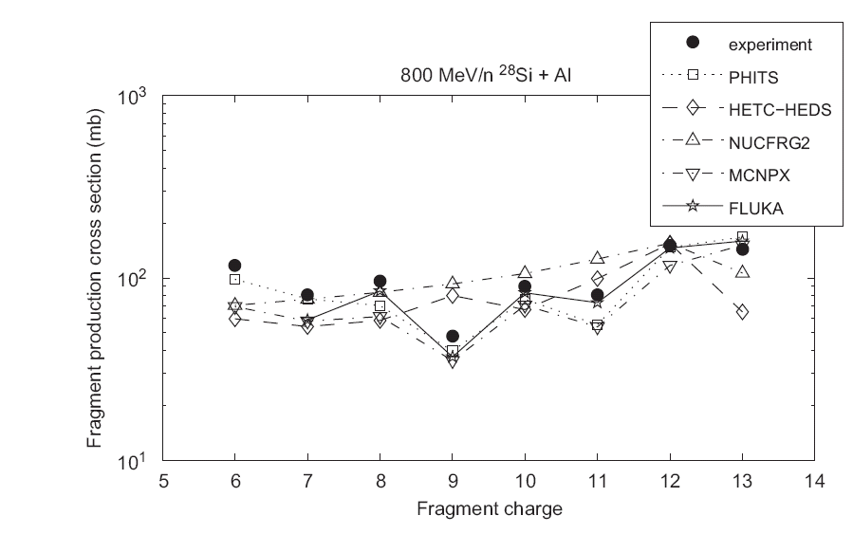
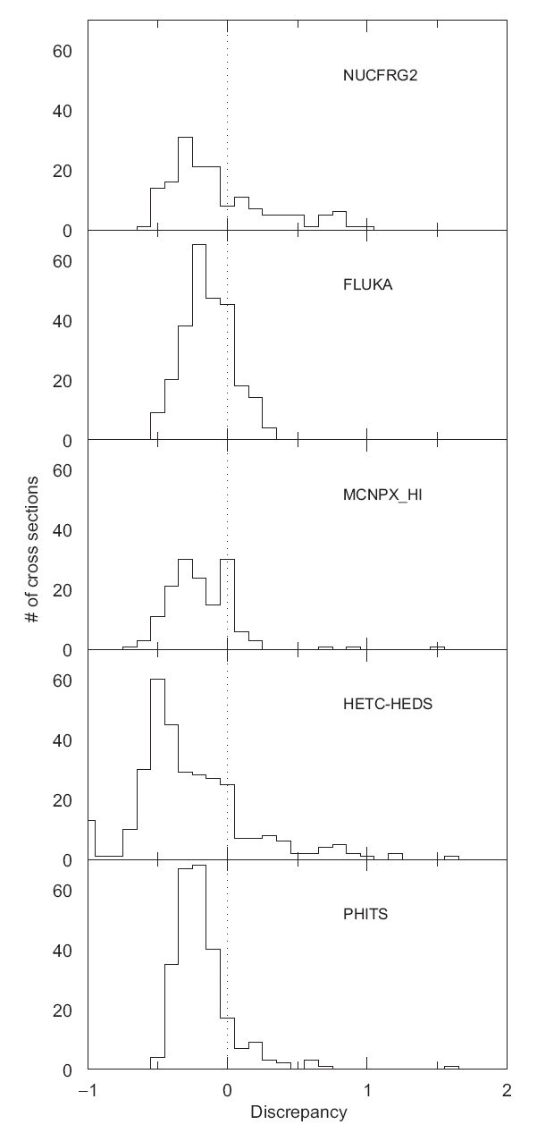
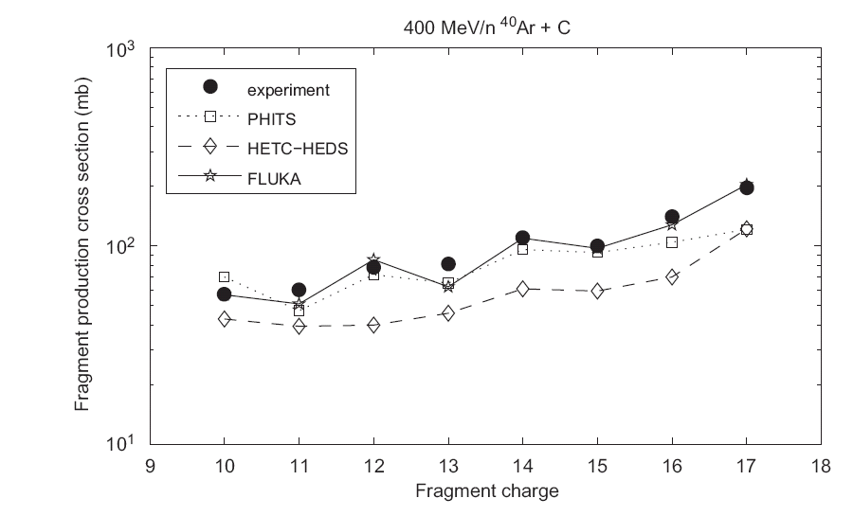
Si, Ar ‒ Al, C
[Acta Astronautica 63 (2008) 865 – 877]

Slide 46
Pb ‒ C, Al, Cu, Sn, Au, Pb
158 GeV/n ²⁰⁸Pb
Inclusive fragment production
Red squares and blue circles: exp. data
Blue histograms: FLUKA EMD; Yellow histograms: FLUKA EMD+hadronic
(Phys. Rev. ST AB 17 (2014) 021006)

Slide 47
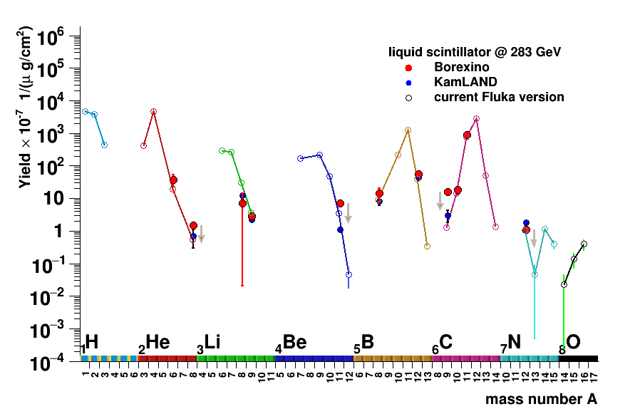
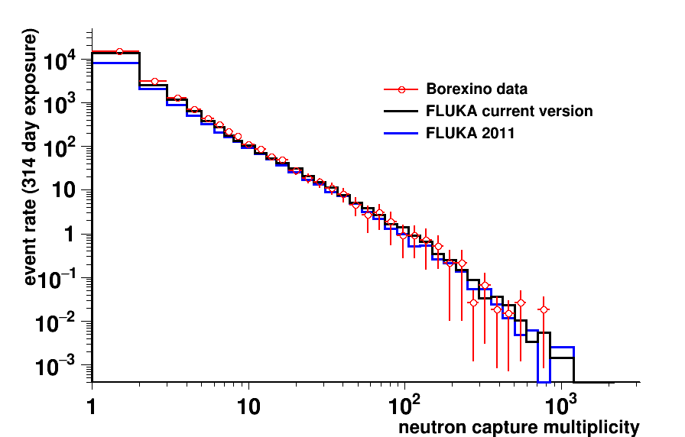
MUON, GAMMA ‒ LIQUID SCINTILLATOR, WATER
at Borexino detector
under the Gran Sasso mountain
Neutron multiplicity distribution
Radioisotope production rate
[A. Empl et al., AIP Conf. Proc. 1672 (2015) 090001]

Slide 48
WISHED DATA
proton diffraction on (C-W) nuclei at 1-50 TeV lab energies
at small (1-x_{F}) (LHC p-Pb at ten thousand TeV lab)
charmed hadron production
LHCb SMOG (how small (1-x_{F})?)
antiproton production
secondary protons from hundred GeV protons on nuclei
double differential yields
exploration of the 1-10 GeV projectile energy range
pion interactions at hundred GeV – several TeV

Slide 49
ADDITIONAL SLIDES

Slide 50
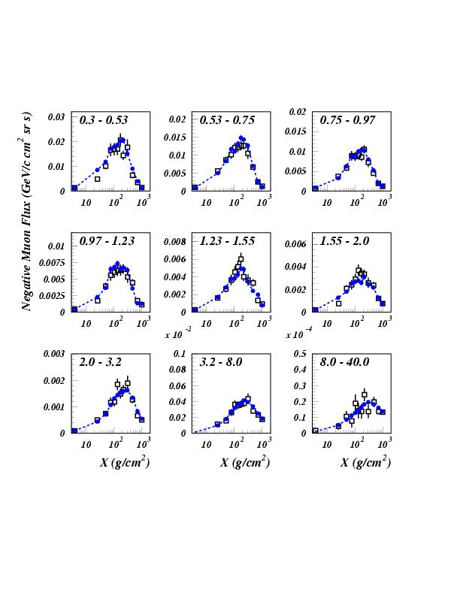
NEGATIVE MUONS AT FLOATING ALTITUDES
Momentum bin (GeV/c)
Open symbols: CAPRICE data
Full symbols: FLUKA
primary spectrum normalization ~AMS-BESS
Astrop. Phys., Vol. 17, No. 4 (2002) p. 477
Atmospheric thickness (g/cm²)

Slide 51
DPMJET
Pseudorapidity distribution of charged hadrons
produced in minimum bias d-Au and p-p collisions at a c.m. energy of 200GeV/A
Exp. data: BRAHMS- and PHOBOS-Collaborations
J.Ranft, in Proceedings of the Hadronic Shower Simulation Workshop, CP896, Batavia, Illinois (USA), 6-8 September 2006

Slide 52
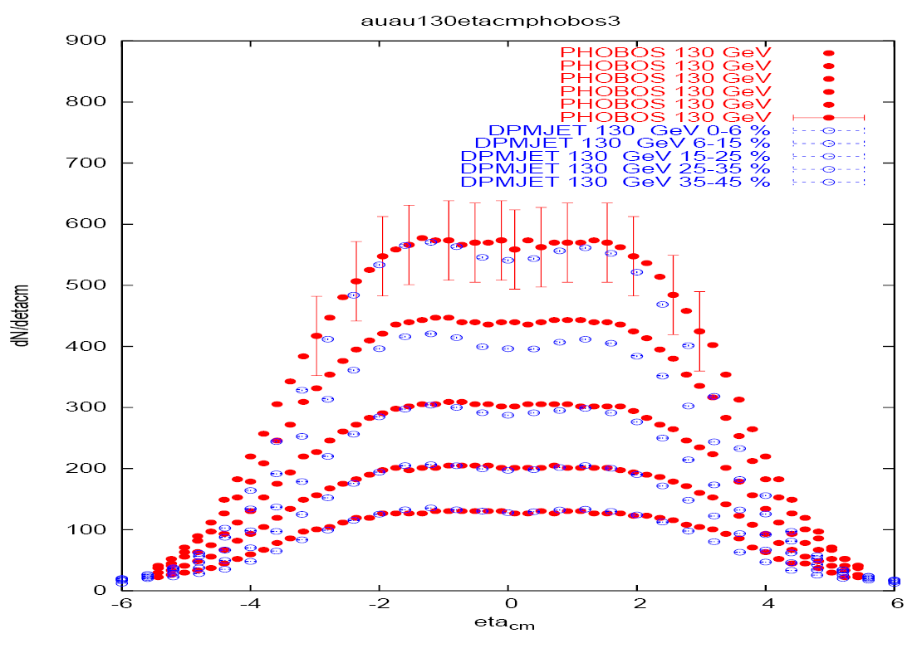
DPMJET
Pseudorapidity distribution of charged hadrons
produced in Au-Au collisions at a c.m. energy of 130GeV/A (left) and 200GeV/A (right)
for different ranges of centralities
Exp. data: PHOBOS-Collaboration
J.Ranft, in Proceedings of the Hadronic Shower Simulation Workshop, CP896, Batavia, Illinois (USA), 6-8 September 2006

Slide 53
GLAUBER MODEL
σ_{hA abs} can be interpreted in terms of multiple collisions of the projectile:
From the impact parameter representation
of the hadron-nucleon reaction cross section
and with P_{rj}(b) ≡ σ_{hNr}T_{rj}(b) = probability to have an inelastic reaction on the j-th target nucleon
Since P_{r} (b) is the probability of getting one specific nucleon hit and there are A possible trials, P_{r ν} (b) is exactly the binomial distribution for getting ν successes out of A trials, with probability P_{r} (b) each

Slide 54
Energy thresholds for chain production
The energy/momentum fractions carried by sea (x_{q}^{sea}) and valence (x_{q}) quarks of the projectile obey in principle to the following distribution for massless partons:
However, a minimum √s is required for the Glauber collisions to occur, and this translate to a minimum requirement on X_{j}^{sea} so that the following condition is satisfied:
Where M_{8/10}^{(*)} and m_{ps/v} are the masses of the lowest octuplet/decuplet baryons and pseudoscalar/vector mesons respectively, corresponding to the selected quark configuration
Obviously a minimum √s must be guaranteed for the valence-valence collision as well
These requirements represent another effective constraint on the onset of the Glauber cascade

Slide 55
PRE-EQUILIBRIUM
The normal (“naïve”) conditions for considering a system equilibrated enough to transition to equilibrium is (n = number of excitons, g=single particle level density, E*=excitation energy):
Veselski (NPA705, 193, (2002)), analyzing heavy ion reactions has proposed that the probability of pre-equilibrium emission for a given reaction stage is evaluated randomly for n<n_{eq}, according to (a=level density parameter, σ in the range 0.2-0.4):
This recipe is physically much sounder than the yes/no of the naïve approach, and it is adopted in FLUKA

Slide 56
FERMI MOTION

