Slide 1
CLIC Design Working Group
D. Schulte for the CLIC team

Slide 2
Introduction
Goals
  Develop conceptual design of the first energy stage
    Design of lattices
    Beam dynamics studies
    Design optimisation with other groups (e.g. module)
    Klystron-based alternative
  Develop concept for the principle of the energy upgrades
    Explore issues arising from upgrades and address important ones
  Experimental activities
    Contribution to experiments
    Evaluation of impact of experimental programme on design
    Explore opportunities of further experiments
  Explore upgrade options based on novel technologies
Deliverables
  Lattice decks
  Specifications
  Layouts
  Reports
Will not cover details of work
Will evolve with results
Mainly give idea of scope and get going on things
Maybe wait with discussions until the end

Slide 3
Baseline
Needs
  Technical expertise from many areas, e.g. beam dynamics and technical systems
  Actual work
    E.g. structure design for injectors
Participation from everyone is appreciated, some people are required to pay attention
  Physics and management
    Lucie, Konrad, Steinar, Roger
  Workpackage leaders from parameters and design area:
    Rogelio, Andrea, Yannis, Lau, Steffen, Michael
  Representation of most critical technologies:
    Walter, Alexej, Igor, Carlo, Nuria, Thibaut, Helene, Kurt, Andrea Jeremie, Stephan, Michele, Jim, John Osborne, …
  Experimental programme:
    Roberto, Erik, Phil
  Some young people
    Edu, Jürgen, …
Roughly one meeting per month
Until the end
Work is done in smaller ad hoc teams and
Presented and discussed in design WG

Slide 4
General Comments
The energy of CLIC will be well established
  Based on structure tests etc.
The cost and power consumption of the first stage is very important
  Try to achieve further reduction
  Need to do quite some work
Still concerns exist concerning the luminosity performance
  E.g. BDS system performance
  Availability
  Dynamic magnetic stray fields
  …
Have to concentrate on key points

Slide 5
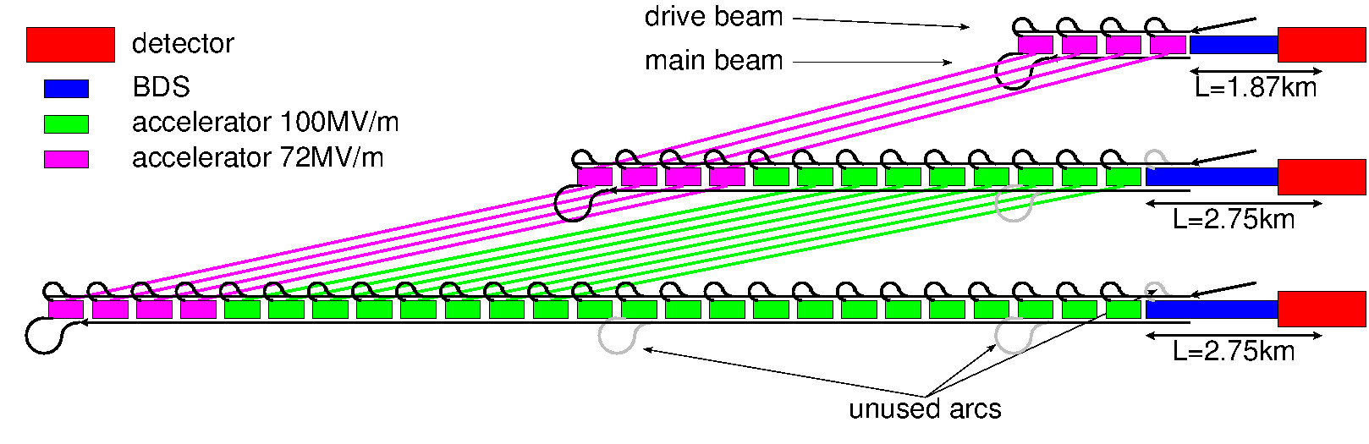
CLIC Energy Stages
  E_{cms}=380Gev, L=1.5x10³⁴cm⁻²s⁻¹, L_{0.01}/L>0.6
For higgs and top production, specified by CLIC physics group
E_{cms}=O(1.5TeV)
Depends on LHC findings
E_{cms}=3TeV, L_{0.01}=2x10³⁴cm⁻²s⁻¹, L_{0.01}/L>0.3

Slide 6
Rebaseline Reminder
Optimised cost and power consumption systematically
Boundaries respected
  Beamstrahlung level consistent with experimental request
  Risk for the structure is slightly less than for 3TeV machine but the same for all designs
  Beamdynamics constraints
    50Hz operation
    Some increase of risk in damping rings mitigated by increased horizontal emittance
    Beam stability in main linac is constant (single and multi-bunch)
    BDS is at the limit for the energy
    Note: some effects are reduced, some are increased but not by large numbers

Slide 7
Basic Parameters
Based on CDR study results and SLC experiences

Slide 8
Drive Beam Structure Choice
 | DB | klys. | DB 244ns | K 244ns | B 244ns
a₁/λ | 0.1525 | 0.145 | 0.1625 | 0.15 | 0.15
a₂/λ | 0.0875 | 0.09 | 0.104 | 0.1044 | 0.1044
D₁/L_{cell} | 0.297 | 0.25 | 0.303 | 0.28 | 0.28
D₂/L_{cell} | 0.11 | 0.134 | 0.172 | 0.17 | 0.17
N_{cell} | 36 | 28 | 33 | 26 | 26
G [MV/m] | 72.5 | 75 | 72 | 79 | 79
P [MW] | 50.9 | 42.5 | 59.5 | 54.3 | 54.3
N [10⁹] | 3.98 | 3.87 | 5.2 | 4.88 | 4.88
Δz [λ] | 6 | 6 | 6 | 6 | 6
n_{b} | 454 | 485 | 352 | 366 | 366
τ_{RF} [ns] | 321 | 325 | 244 | 244 | 244
R_{DB}/N_{DB} | 3.0 | --- | 4.005/4 | 3.69/4 | 3.69/4
P_{wall} [MW] | 217 | 224 | 221 | 222 | 222
C [a.u.] (w. drive beam) | 3.451 | 3.520 | 3.502 | 3.523 | 3.523
C [a.u.] (w. klystrons) | 3.616 | 3.551 | 3.825 | 3.744 | 3.744

Slide 9
Selected 380 GeV Beam Parameters
N | 10⁹ | 5.2
n_{b} |  | 352
f_{rep} | Hz | 50
ε_{x}/ε_{y} | μm/nm | 0.95/30
β_{x}/β_{y} | mm/mm | 8.2/0.1
σ_{x}/σ_{y} | nm/nm | 149/2.9
σ_{z} | μm | 70
L_{total} | 10³⁴cm⁻²s⁻¹ | 1.5
L_{0.01} | 10³⁴cm⁻²s⁻¹ | 0.9
n_{γ} |  | 1.5
δ_{E} | % | 6
The emittances are nominal values at the IP
Draft values for emittances targets are
Exit of damping ring
ε_{x} < 700nm, ε_{x} < 5nm
Exit of RTML
ε_{x} < 850nm, ε_{x} < 10nm
Exit of ML
ε_{x} < 950nm, ε_{x} < 20nm
A limited flexibility exists for the collision parameters O(10%) since the beam size is larger than the minimum that could be achieved
Also the waist shift allows to gain a few percent

Slide 10
380 GeV Beam Parameters
Request of the review committee to have two parameter sets (ultimate and conservative?)
Need to find a good strategy for this
Conservative less, ultimate more luminosity than now?
Can simply add more margin for conservative set
Can use the performance spread to push ultimate set
Static imperfections reduce luminosity
We require 90% likelihood of meeting the goal
For ultimate this could be smaller percentage
Can use reduced emittance growth to push ultimate set
Means more margin in the conservative case
Can use different levels of operational complexity
E.g. tuning bumps
Could consider different hardware
But need a good understanding of how that would work

Slide 11
Note: Change of Tolerances and Specifications
A number of imperfection affect the beam less at 380GeV than at 3TeV
  E.g. same luminosity loss for 3x beam-beam offset
  Or for 40% more misalignment in the main linac
Strategies
  Maintain specifications (minimal changes for energy upgrade, less risk or better performance in first stage)
  Hand-out the respective factors to everyone
  Adjust specifications according to benefit for the project
    If the change leads to technology change, cost reduction etc.
    Case by case decision based on benefit vs. risk/upgradability
Preferred strategy is to handout adjustments on case by case basis
  Substantiated by technical systems, looking at gain and cost for upgrade
  Evaluated by beam dynamics

Slide 12
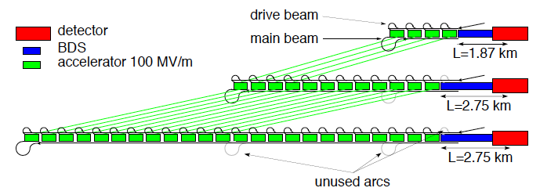
Staged Design
  First stage: E_{cms}=380Gev, L=1.5x10³⁴cm⁻²s⁻¹, L_{0.01}/L>0.6
Second stage: E_{cms}=O(1.5TeV)
Final stage: E_{cms}=3TeV, L_{0.01}=2x10³⁴cm⁻²s⁻¹, L_{0.01}/L>0.3
Develop and optimise staging strategy
how to best deal with different beam parameters?
which energy flexibility is required at each stage?
…
Adapt stages to LHC findings

Slide 13

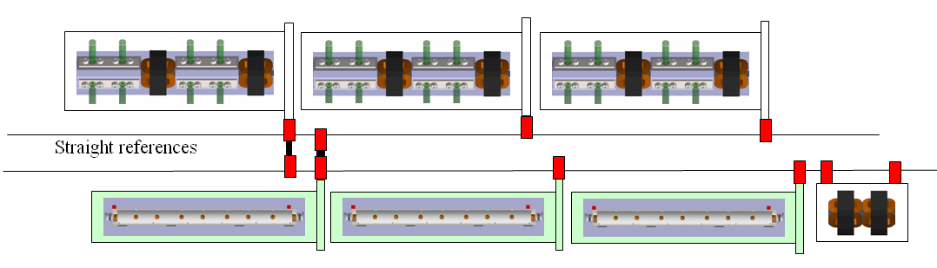
Structure and Main Linac Design
Need to design and optimise new structure
Work is ongoing
Will have to adapt main linac design
Some changes in module length (new structure is longer)
New lattice
Work on better module design

Slide 14
Structure and Main Linac Design
Coupling of main and drive beam structures
This requires quite some work, need to develop a model for the coupling
Static emittance growth should be smaller than at 3TeV
Scaling has been done to ensure same stability, this is tighter scaling
Gain factor 2 for emittance growth (40% larger tolerance, not specification)
Gain on stabilisation, depends on wavelength (factor 6 for independent quadrupole jitter)
Shorter wires since maximum betatron wavelength is shorter?
Temperature changes
Intuitively wires/alignment system are most critical
Should find a way to follow slowly moving modules
Robustness if systems fail
  Wires and alignment components
  Stabilisation
  Structures
Plenty of work

Slide 15
Main Beam Injector Complex
An important cost item (1.2-1.4GCHF in CDR, O(20%) of first stage)
Significant power consumption (>50%,100MW RF power vs. 40MW for drive beam)
Can simplify design strongly be removing longer pulse for low energy running
Agreement of the physics
Would simplify if we can use a 2GHz train from the beginning
For the damping rings to check

Slide 16
Sources and Injector
Adapt to new parameters
  Optimise the linacs for the new parameters
  And timing scheme
Verify positron production and capture efficiency (results available)
  Including target study
Review several other ideas for cost and power improvements
  E.g. use of drive beam to power some linacs, booster ring, …

Slide 17
Damping Rings
The main limitation of SLC
never reached the charge target
Studies of lattice and collective effects show that emittance targets can be reached for 3TeV
Light sources are very similar to CLIC
Great progress over the past years
Update of damping ring studies for 380GeV parameters (larger charge, …)
  More beam loading and collective effects (electron cloud, FBII, impedances, space charge, IBS)
Study if improved design allows single train operation
Simplifies sources, but RF and some collective effects in DR become worse
Adapt to progress in the low emittance rings community

Slide 18
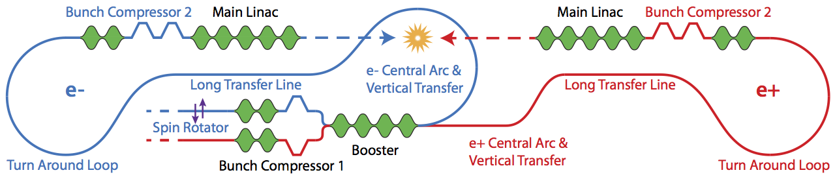
Rings to Main Linac
Transports, accelerates and compresses beam from damping ring to main linac
Energy from 2.86 to 9 GeV, bunch length from 1.6 mm to 70 micron
Has not been fully studied for CDR
Parameters change
More charge increases CSR somewhat
Longer bunch should ease bunch compressors
Review system design, including injection energy into main linac
Continue to verify tolerances and develop/improve alignment and tuning
Can the booset linac be powered by a drive beam? Can it be used in the sources? …

Slide 19
Beam Delivery System
Challenging system, still improving our understanding
Have some 380GeV design
Design ongoing
Great improvements in understanding
  E.g. optimisation of system length for performance after tuning
Should try to add more flexibility (e.g. smaller horizontal betafunction)

Slide 20
Beam Delivery System
Tuning is hard
Focus on (easier) 380GeV to see which performance can be squeezed out
Alignment needs to be made somewhat more realistic
Two-beam tuning has to be addressed
More effects need to be included (motion during tuning etc.)
Need to understand/improve ATF2
May get feedback from there
Some potentially great steps in understanding the effects have just been made
  Can be important for the hardware

Slide 21
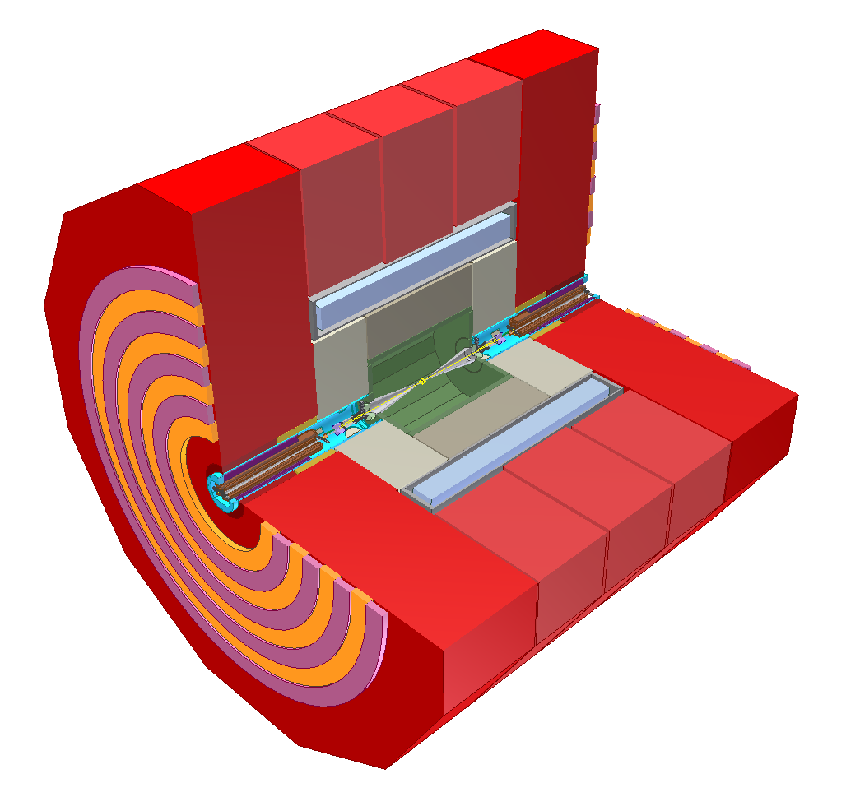
Machine Detector Interface
Good understanding at 3TeV (CDR)
Can deal with machine background
Design is possible
Conceptual solution for quadrupole stabilisation
Updates for 380GeV and 1.5TeV needed (luminosity spectrum, background)
Request to move quadrupole out of the detector (L*=6m)
Better detector performance (angular coverage)
But
More difficult FFS design
Dum line and beam dumps
6 m

Slide 22
Drive-beam Studies
Relatively mature, some remaining issues
Some new questions open (coupling PETS and accelerating structures in main linac)
Update design, including higher efficiency and higher power klystrons, permanent magnets, …
Drive beam energy change from stage to stage?
Operation at different energies (pulse length, gradient range, …), e.g. modulator upgrade
Some design work remains to be done

Slide 23
Operation and Availability
Important for the credibility
  Need some documents with agreed procedures, numbers etc.
Main critical points are drive beam and main linac (+BDS)
  Most specific, least experience elsewhere
Main deliverables
  Urgently (a living) document with preliminary beam start-up procedure for comments etc.
  A fast iteration to identify the most critical failures
    Make a list and identify/work on 5-10 most critical points
    Requires to understand likelihood and impact
  A document summarising operation and availability
    Including start-up and recovery procedures
    Addressing fixing problem vs. degraded performance

Slide 24
Some First Questions
No drive beam experience elsewhere
  Need to study failures, recovery procedures and their impact on the machine availability
  Example: klystron failure in the drive beam accelerator, …
The main linac availability is important
  Breakdown and recovery
  PETS on-off failure
  Magnet power supply failure (addressed for drive beam)
  Alignment system failure
    Mover
    Sensor
    Wire
    …
  Stabilisation system failure
    Maybe a distributed feed-forward is a good idea?
The main linac powered by klystrons should be evaluated

Slide 25
Dynamic Magnetic Stray Fields
Example of magnetic storm
Field variations of nT can impact luminosity
Earth field can vary (probably OK)
Environnemental fields (TGV, …)
Technical equipment induces fields
Develop capabilities to measure fields (and mitigate if required)
Useful for accelerators in general
Study environnemental and technical sources
And find mitigation methods (beam-based, feedback and shielding, one the technical sources, …)
General area where awareness needs to be generated for all technical systems

Slide 26
Klystron-based First Stage
Example RF unit design
(I. Syratchev)
With simple cost model find similar cost than drive beam-based design at 380GeV
Much improved RF unit design
More expensive at 3TeV
1076 units /beam
Develop conceptual linac design to establish cost and make this an option until 2019
Tunnel, choice of structure, module design, …

Slide 27
Conclusion
Focus on key performance improvements/risk reductions
  Integrated drive beam design and study
  Two-beam tuning
  Dynamic imperfections
And key cost and power improvements
  Review main beam injector
  Main linac optimisation
And cover most important updates required for 380GeV
Exploration of key alternatives
  E.g. klystron based option
And upgrade considerations
Reduction of staff resources compared to CDR phase
  Limited ability to supervise students
  Need more support from fellows (or staff)

Slide 28
They Way Forward
Early steps
Fix the requirements from Physics
  Much lower energies probably not needed at high luminosity?
  Do we know the impact of L* on physics performance?
Agree on a strategy for the two parameter sets
Agree on the strategy for the specifications
Module coupling main and drive beam
  Design, model, beam dynamics
First iteration on startup, operation and availability
Will then go through the systems
Answer potential questions from other WGs
Progress on the design

