Slide 1
First comments from physics
What does the physics need?
Note:
This is a fully improvised presentation
On (too) short notice
It needs more proper reflection/discussion
Lucie Linssen, CERN
CLIC meeting, September 16 2016

Slide 2
CLIC physics
High accuracy measurements of known states
Higgs physics
Top physics
Physics beyond the standard model (BSM)
Direct observation of new states
  Possible new discoveries at CLIC
  Possible new states already previously observed at LHC
Indirect observation of BSM physics through precision measurements
  E.g. Z’, composite Higgs, accurate W mass…..
This presentation reflects only on √s (and polarisation)
Note: there could be additional detector calibration issues. Unlikely to strongly influence √s choice, but this was never properly addressed.

Slide 3
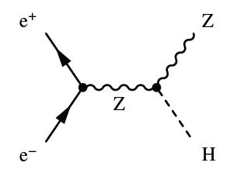
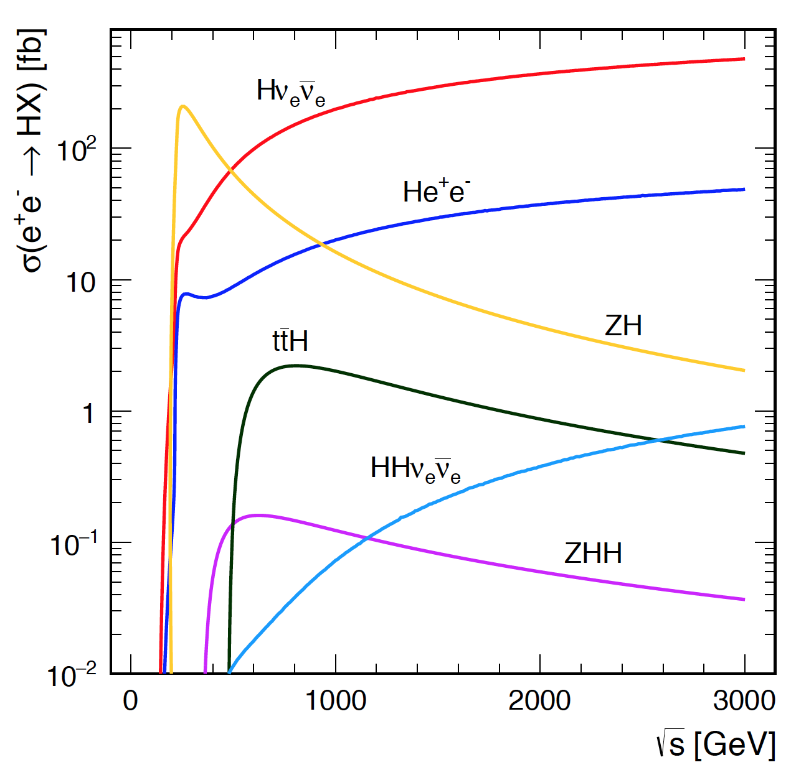
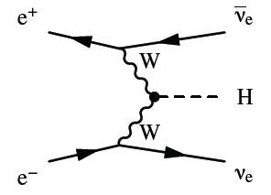
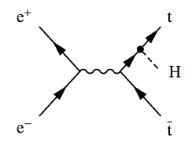
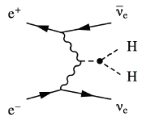
Higgs physics
Crucial at first stage for model-independent Higgs measurement
High statistical accuracy at the high energy stages
Best at ~1.4 TeV, where result is similar to 1 TeV ILC (cross section versus intLumi and event reconstruction)
Best at 3TeV
Flagship measurement for CLIC

Slide 4
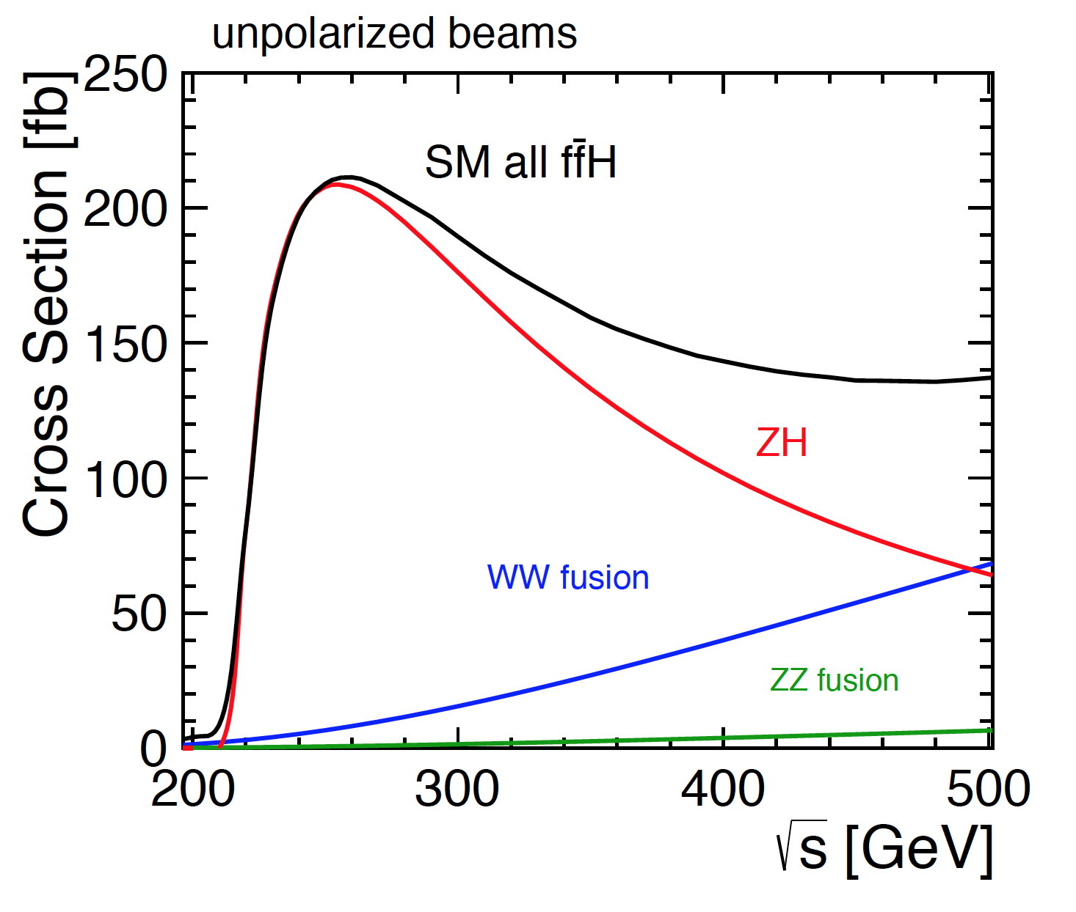
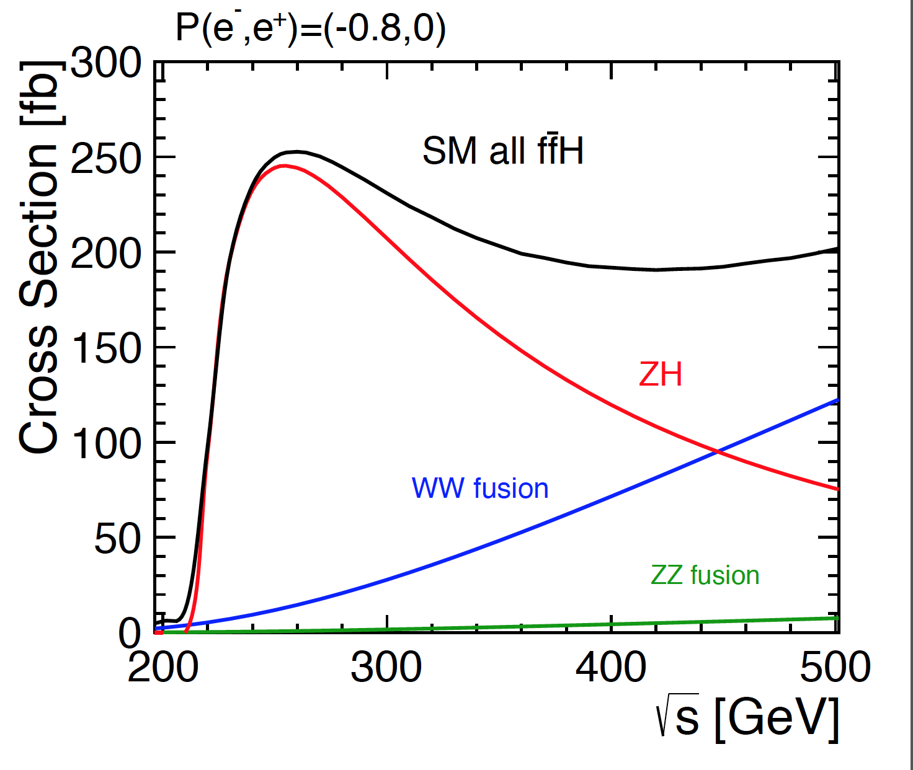
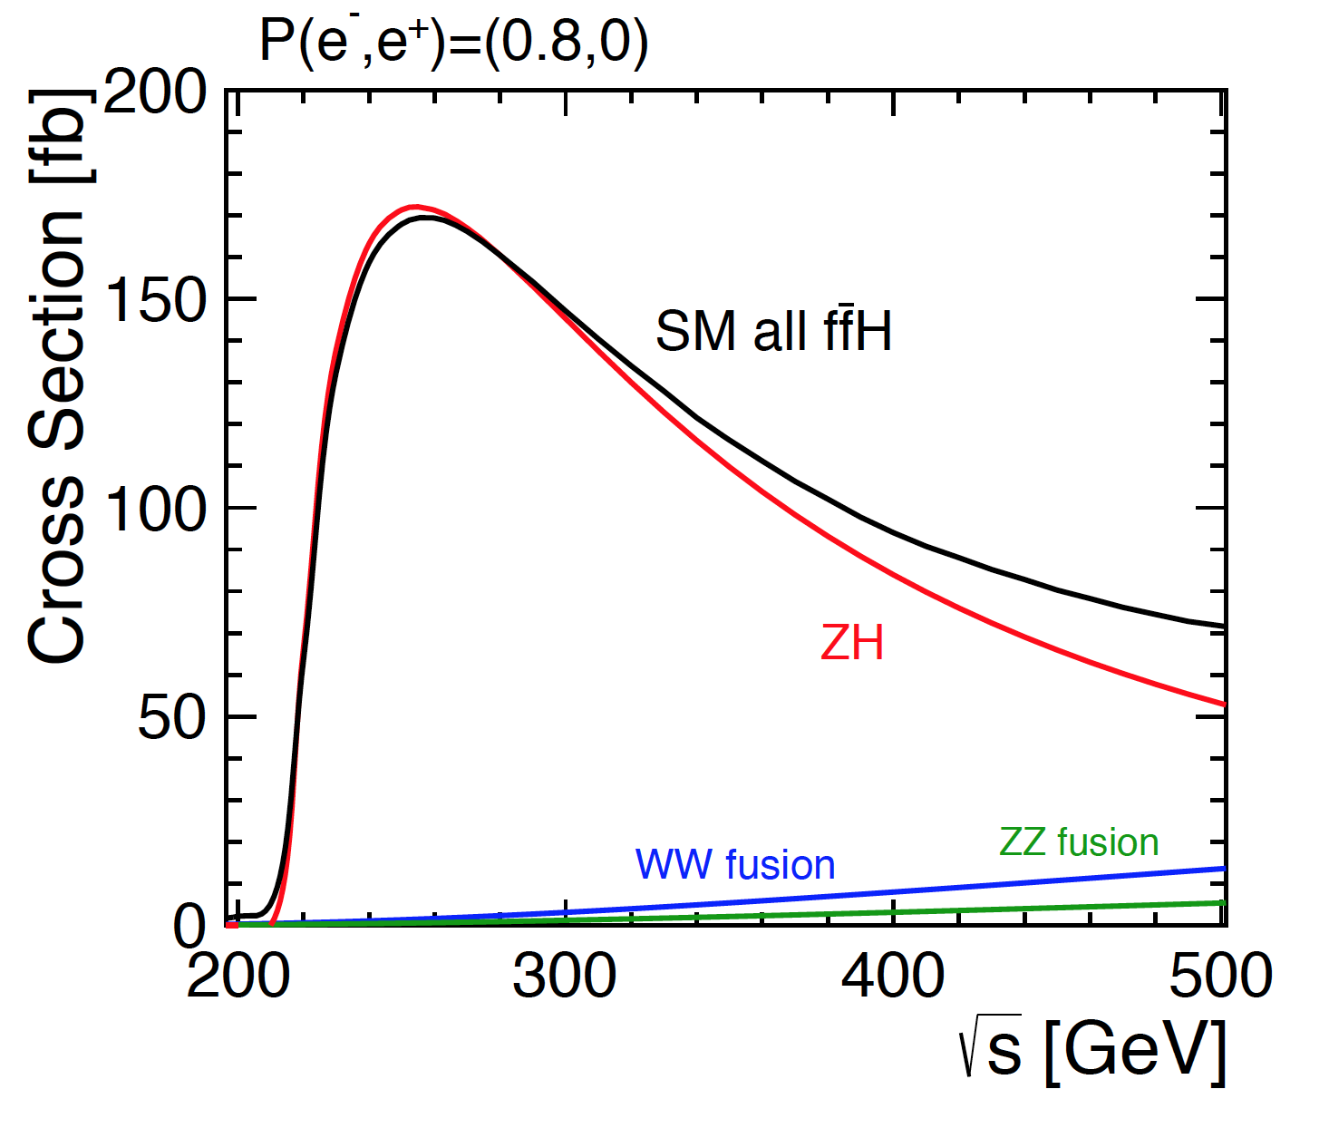
Higgs physics at the first stage
Our choice is to run at 380 GeV
to see HZ and WW-fusion + top physics
Note that -80% electron polarisation enhances WW-fusion
With our present knowledge, we see no good reason to run at 250 GeV.
(note: ILC and CLIC conclusions inconsistent)

Slide 5
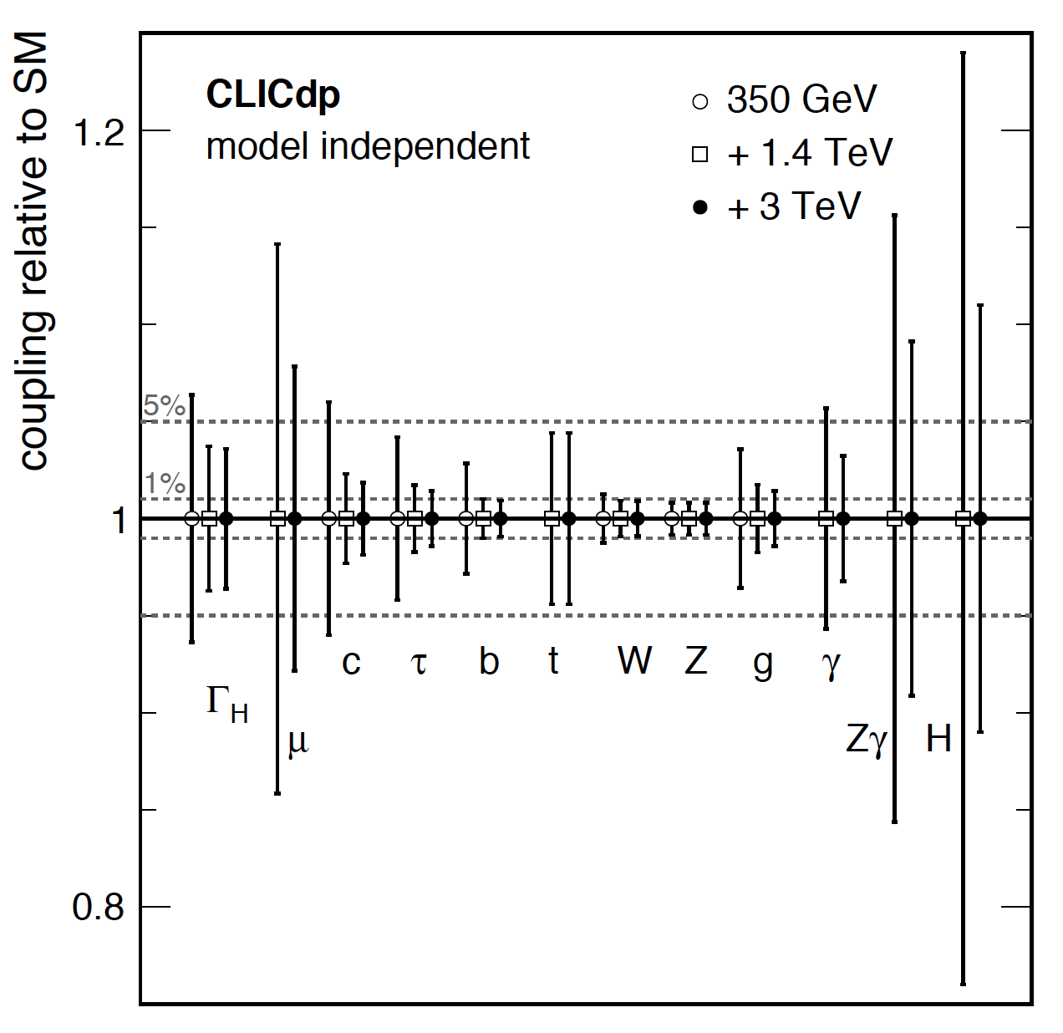
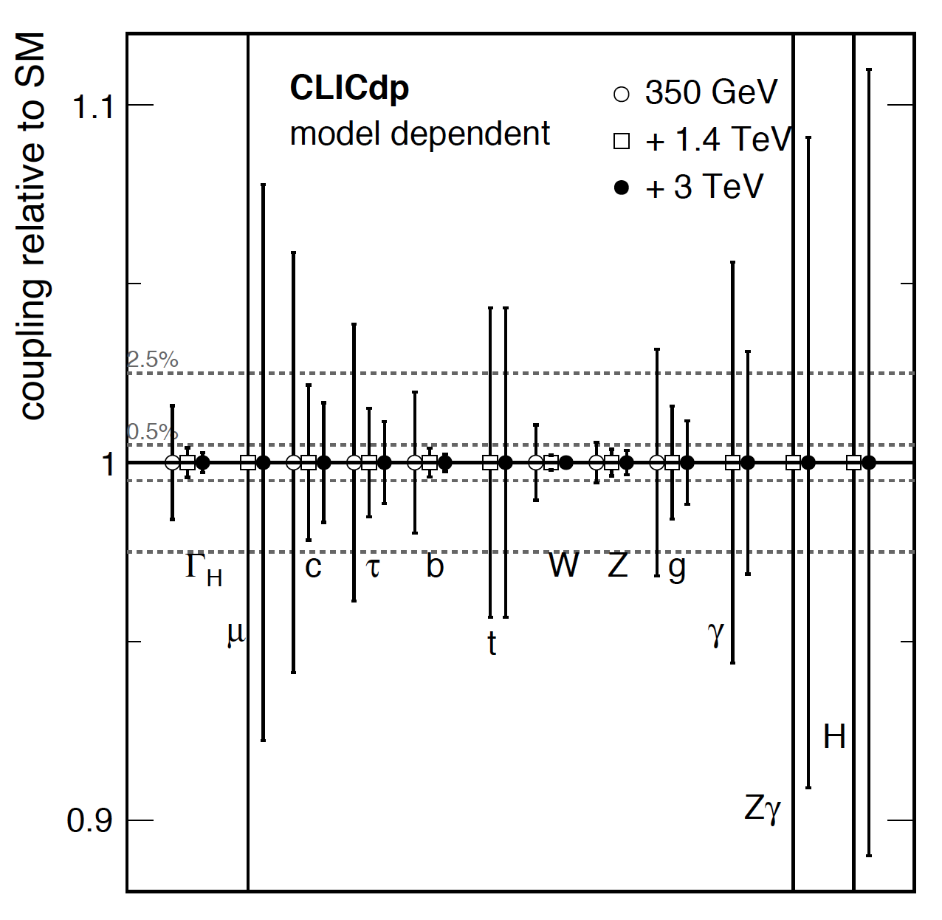
Higgs couplings
General trend of improved statistics when going from ~1.5 TeV to 3 TeV
Certain couplings present only modest gain when going from ~1.5 TeV to 3 TeV
ttH requires ~1.5 TeV (but does not require to tune down to ~1 TeV or so)
HH self coupling requires the highest energy of 3 TeV

Slide 6
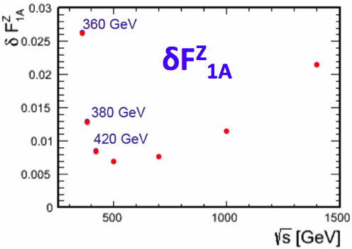
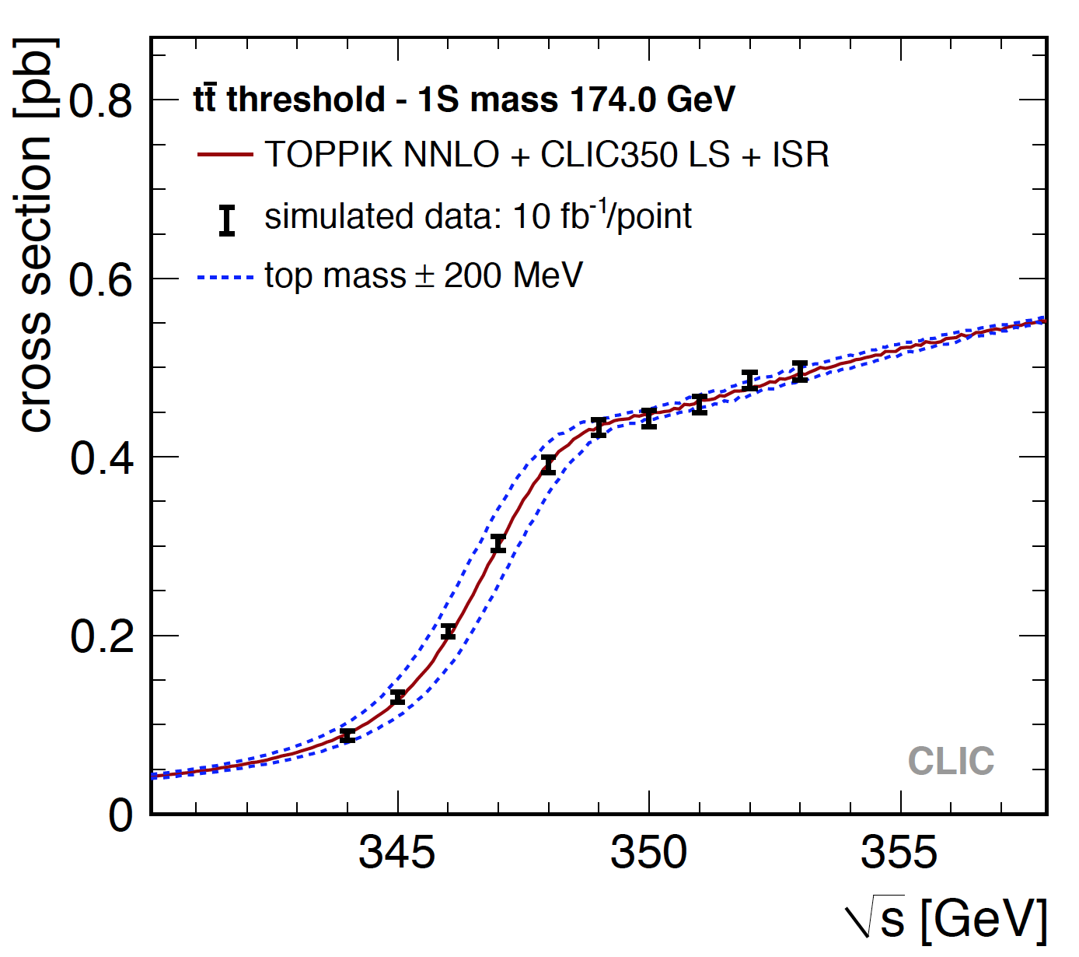
Top physics
tt or single top events as a probe for new physics:
A_{FB}^{t}, A_{LR}^{t} => e.g. top quark couplings to γ, Z
Search for FCNC top decays (e.g. t → cH, t → cγ)
V_{tb} from eγ → tbν_{e} (at high energies, no bkg from tt evts.)
ttH: top Yukawa coupling, Higgs CP properties
Light stop quark search with boosted tops
Work ongoing => CLICdp overview paper foreseen for 2017
World average top mass:
~173. 2 GeV
=> Lowest √s for CLIC scan would be ~340 GeV

Slide 7
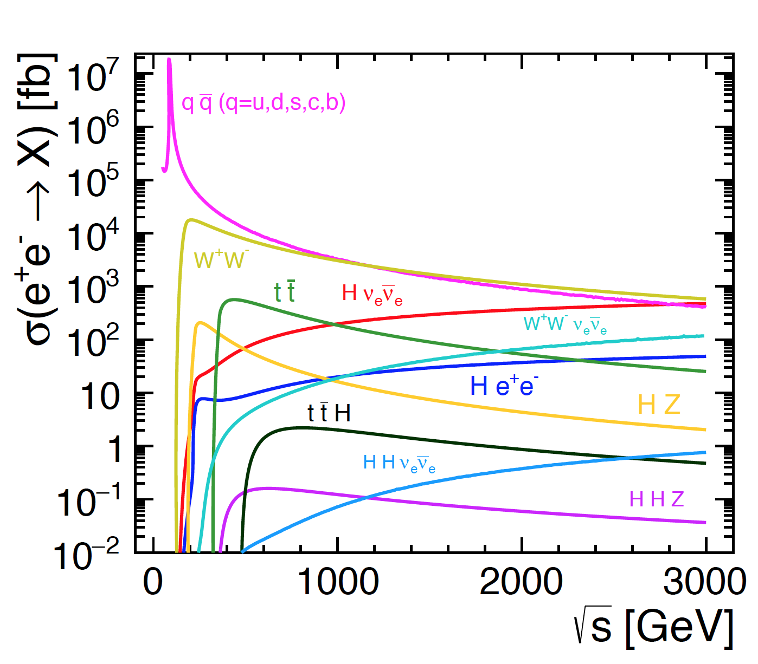
e⁺e⁻ processes
Simply looking at the “known” physics, it took us some years to work out the CLIC potential and the corresponding running preferences.
What about the “unknown”?

Slide 8
Backup slides

Slide 9
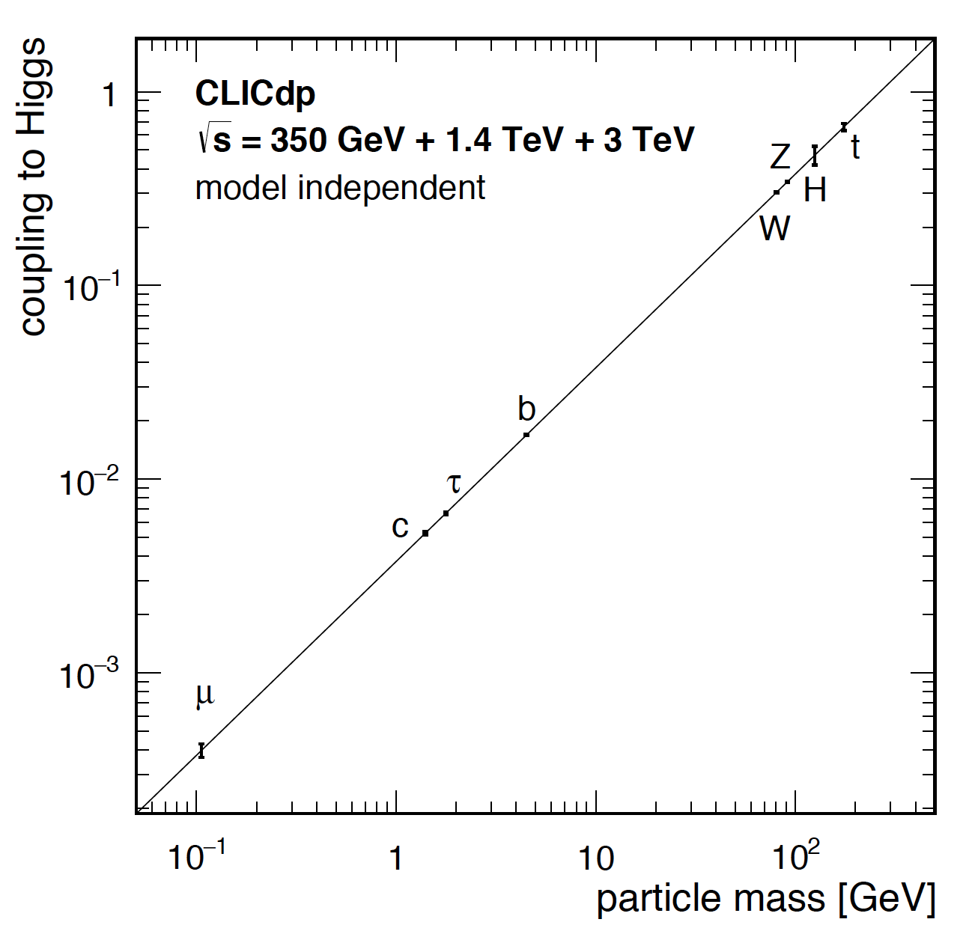

Published collaboration-wide documents
Higgs Physics at the CLIC Electron-Positron Linear Collider
40 pages, 123 authors
CLICdp collaboration paper
>25 independent full simulation Higgs analyses !
  arXiv:1608.07538 on 29/8/2016
  Submitted for publication in EPJC
Updated Baseline for a Staged Compact Linear Collider
57 pages, 517 authors, 63 institutes
CLIC and CLICdp collaboration paper
  Published as a CERN yellow report CERN-2016-004
arXiv:1608.07537 on 29/8/2016

Slide 10
CLICdp documents in preparation for next European Strategy
CLICdp reports serving as ingredients for a CLIC summary report:
Updated Baseline for a Staged Compact Linear Collider (380 GeV, 1.5 TeV, 3 TeV) ✔
  arXiv:1608.07537, CERN-2016-004
  Higgs Physics at the CLIC Electron-Positron Linear Collider ✔
  arXiv:1608.07538, CLICdp-Pub-2016-001 and submitted to EPJC yesterday
The new optimised CLIC detector model CLICdet ✔
  CLICdp note in preparation https://edms.cern.ch/document/1572676/
An overview of CLIC top physics
  CLIC top physics publication in 2017
Extended BSM studies (hopefully also motivated by LHC discoveries)
  CLIC BSM publication by 2017/2018.
CLIC R&D report => with main CLIC technology demonstrators
  Summary publication(s) in 2017+2018
Plan for the period ~2019-2025 in case CLIC would be supported by next strategy
  2017/2018, note to be included in CLIC summary report for the Strategy

