Slide 1
Welcome and introduction

Slide 2
Plan
Summer conferences
Highlights of 2016/02
Papers
Summer shutdown
Commissioning and operations
Moving forward
CM46

Slide 3
Summer conferences
Welcome and introduction

Slide 4



Slide 5
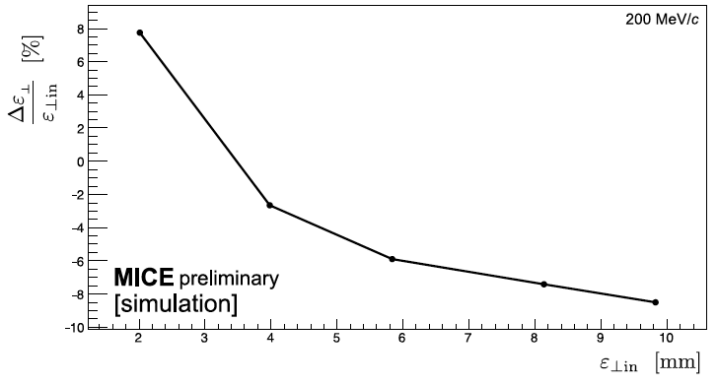

Slide 6
A successful summer!
Presentations of uniformly high quality:
  ICHEP:
    Parallel-session presentation: Steve Boyd (Warwick)
    Posters: Victoria Blackmore (Imperial) and Tanaz Mohayai (IIT)
  NuFact:
    Parallel-session presenters: Francois Drielsma (Geneva), Ryan Bayes (Glasgow) and Yordan Karadzhov (Geneva)

Slide 7
Highlights of Cycle 2016/02
Welcome and introduction

Slide 12
Papers
Welcome and introduction

Slide 13
Papers in progress
Pressure:
  Complete present publications
  Bring forward technical contributions from last Cycle
    Beam-based alignment
    Verification of channel optics
  Keep balls in the air for the field-on scattering programme

Slide 14
Summer shutdown
Welcome and introduction

Slide 15
Summer shutdown
Planned work and prioritisation tracked at:
  http://micewww.pp.rl.ac.uk/projects/operations/wiki/_StepIV_Shutdown_Summer_
Principal items:
  Separation of demin and inhibited water circuits:
    Complete, but:
      Issues remain in cold-water supply from water system “on the roof”
  Maintenance of Linde refrigerator:
    Complete, but:
      Compressor maintenance caused an air-leak into He circuit
      Contractor (HPC) accepted responsibility and expedited remedial work
    Dksoln now cold once more
  Further remedial work on magnet power systems:
    Complete
Controls and monitoring:
  Issues:
    Communications with equipment:
      A. Oates (DL) visit next week; seek to develop M. Courthold (RAL) as local expert
    Run Control and Alarm Handler:
      Operating for experiment
      Some improvements to be made;
      “Robustification” for smoother operation and ease of maintenance
    A. Kurup (Imperial) has joined P. Hanlet to help with the software development

Slide 16
Commissioning and operations
Welcome and introduction

Slide 17
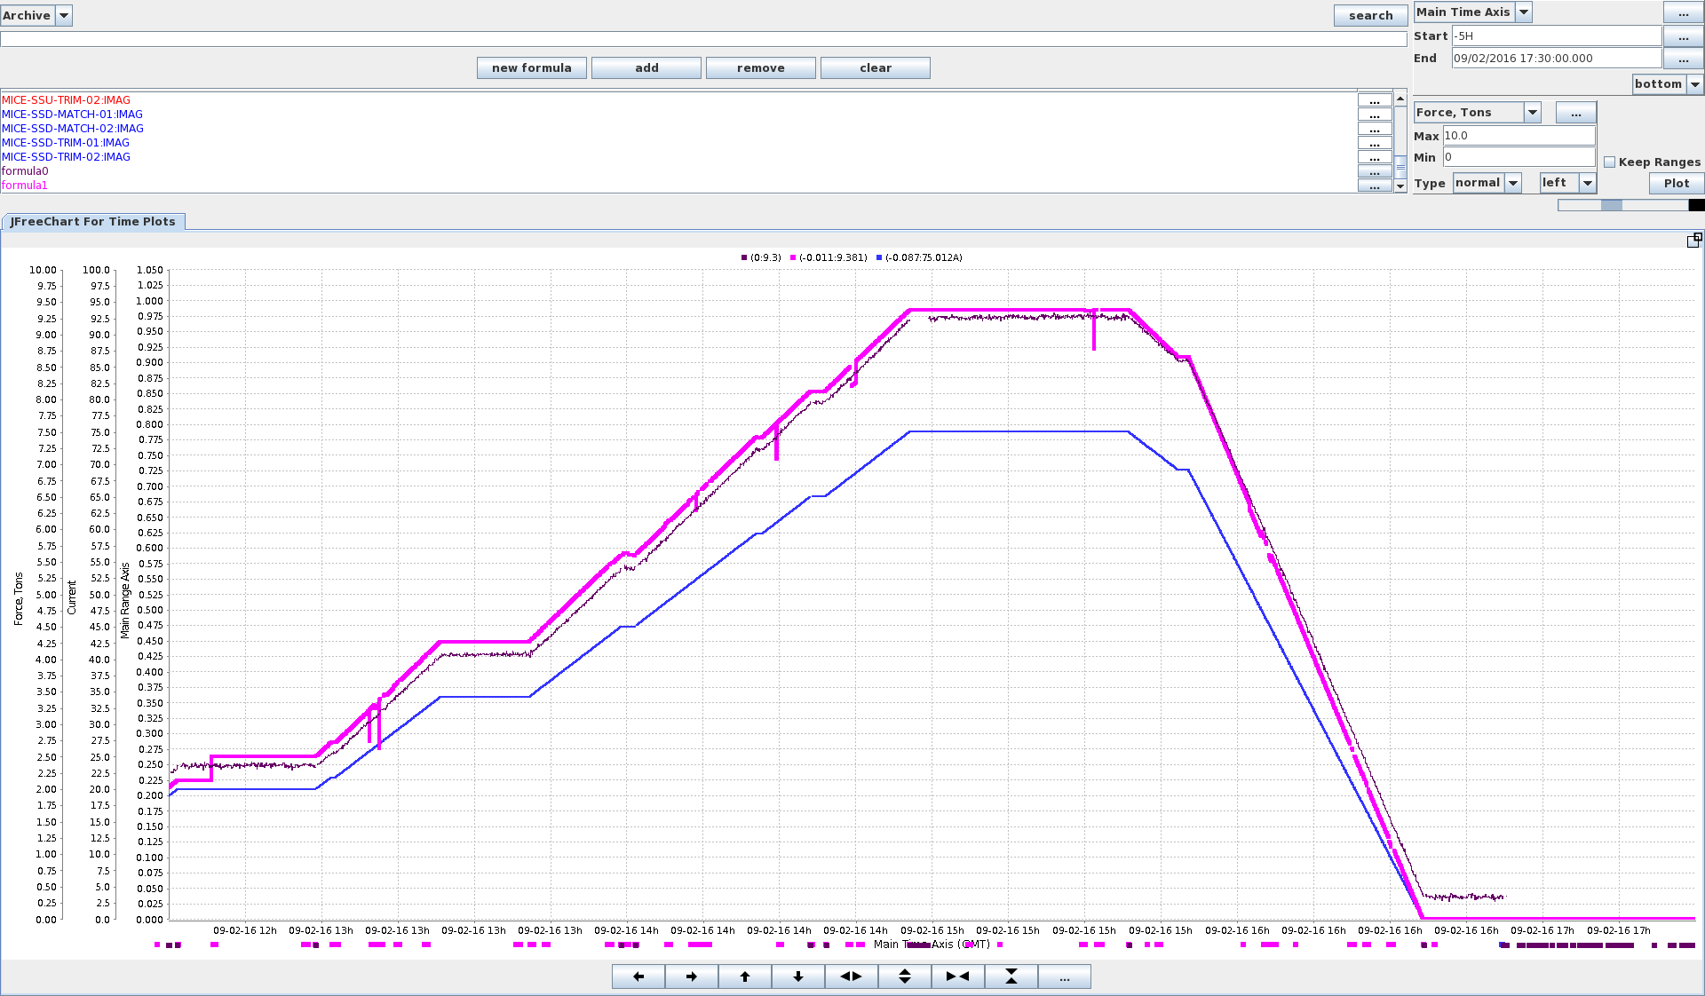
Magnet commissioning
Combined operation of SSU and FC established, 02Sep16:
  Demonstrated that forces are “OK” in the case of an asymmetric quench
Combined operation of SSU, FC and SSD established, 16Sep16
  Configuration typical of those required for Step IV scattering programme

Slide 18
Magnet commissioning continued
Down-stream spectrometer solenoid:
  Successful test performed without “end” coils
    And without M2
  During commissioning a resistive path to ground developed that caused noise in one of the voltage taps
    With this additional path to ground, can not run E-coil power supplies as they have a 100 Ohm path to ground
  Presently excludes operation of end coils on SSD
48-hour soak test of magnetic channel (22-24Sep16):
  SSD[ECE(3T), M1, M2] + FC + SSD[ECE(3T)]
  Stable operation almost to the end
  Trim supply to E1 ramped to zero:
    Target current reset to 0A
    Exposed issues in:
      Stability of trim power supply:
        Possibly connected to the communications issue
      Handling of state changes/alarms in the CAM system`:
        Being addressed as part of the robustification
Decision:
  Operate without trims in SSU
  Minor impact on measurement (see A.Dobbs)

Slide 19
Operations
Cycle 2016/03 (14Sep—28Oct 2016):
  Priority given to completing field-on, LiH scattering
  Run plan posted at:
    http://micewww.pp.rl.ac.uk/attachments/7308/2016-08-25_run-settings-v6.pdf
    Continuing to take a conservative approach:
      Commission to current/force sufficient for next measurement
    Implies absorber change around 10Oct16
Cycle 2016/04 (15Nov—16Dec 2016):
  Keep LiH absorber in place
  Complete scattering programme or move to study of reduction of normalised emittance
    Requires settings that will generate larger forces
    Decision to be taken over the coming month

Slide 20
Moving forward
Welcome and introduction

Slide 21
Scientific programme
LH₂

Slide 22
Execution of Step IV
Underway!
  Primary focus:
    Developing procedures, experience
    Successful!
Scattering programme:
  LiH:
    Field off:
      First paper in preparation;
      Much more data to publish than in the ICHEP/NuFACT contributions
    Field on:
      Empty-channel data being taken now
  LH2:
    Will start Jan17
Study of normalised emittance reduction:
  Requires “more aggressive” focussing
  Balance of gain versus risk

Slide 23
Towards a descoped cooling demo
CB consensus at CM45:
  Seek to create conditions that will allow a descoped cooling demonstration to proceed
MICE-UK not funded for (descoped) cooling demo:
  But, allocation to Laboratories and grants to universities now being put in place
International collaboration:
  Bulgaria have made application for additional support
  NIKHEF have offered to construct precision tracker
  UNIST (Korea) have confirmed continued interest
  …
What if analysis …
  Move efficiently to descoped cooling demo should the need arise
    Tacit permission to explore from UK OsC [Paul Soler]

Slide 24
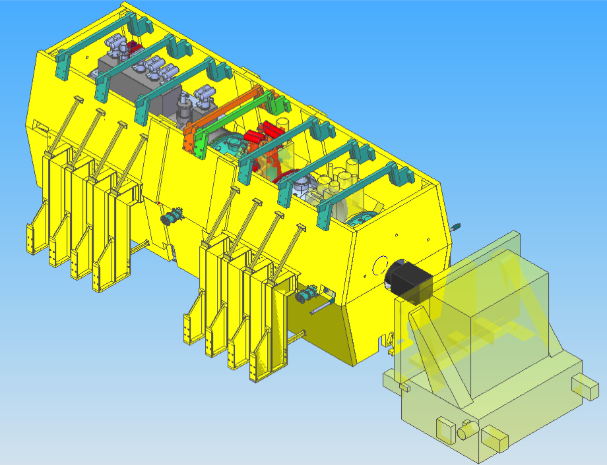
J. Tarrant
http://micewww.pp.rl.ac.uk/documents/177

Slide 25
Descoped cooling demonstration
Study performance, cost, schedule and risk:
  Be ready to open discussion ~Jan17
Appropriate priority:
  Execution of Step IV top priority
  Study of descoped demo by exploiting work on Step IV
Consider “affordable” preparatory steps:
  Hardware preparations?
  Distribution of resources across collaboration

Slide 26
CM46
Welcome and introduction

Slide 27
CM46
Very much looking forward to our meeting …

