Slide 2
Linac4 Vacuum Interlocks system
Jose de la Gama
CERN, Technology Department
Vacuum, Surfaces and Coatings Group
26th August 2016

Slide 3
General view
Linac4 Interlock system is based in LHC interlock system.
Linac 4 BIS
  Linac 4 internal Interlock.
  Linac 4 valve’s Interlock.
  Linac 4 to BIS
  Linac 4 User’s alarm.
Pirani gauges gives interlock to the penning and this gives to VPI controller.
Each valve is interlocked by four devices
If a valve is closed a signal is transmitted
to the BIS
VPI controller gives alarms for the users.

Slide 4
Internal interlock.
  Penning gauges give a start interlock for the VPI controllers.
Condition:
IF (Penning gauge signal OK) THEN (Ion Pumps can operate )
Output A1 5e-6 mbar
Ion Pump
Penning
Ion Pump
Output A1 8e-3 mbar
Pirani

Slide 5
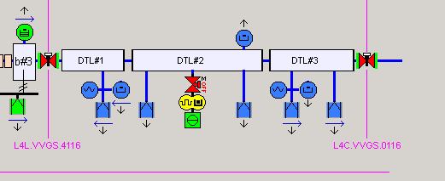
Valve Interlock
Linac4 valves Interlock system is based in LHC interlock system.
  Each VVS is controlled by 4 devices (VPI controller or TPG300) that can give the interlock signal.
  A sector valve can be opened if ALL devices are ready.
  A sector valve is closed when there is an interlock trigger of 3 of the 4 devices
  The VVS-1 and VVS+1 will be closed.
  In this way two sectors are isolated and a signal is transmitted to the BIS to dump the beam.
VRP 1e-6 mbar
Lev1A
Output A1 1e-6 mbar
Output A1 1e-6 mbar
Ion Pump
Penning
Penning
RF Valve
RF Valve
RF Valve
VRP 1e-6 mbar
Lev1A
VRP 1e-6 mbar
Lev1A
VRP 1e-6 mbar
Lev1A
Ion Pump
VRP 1e-6 mbar
Lev1A
Ion Pump
Ion Pump
Ion Pump

Slide 6
User alarms.
  Users receive the alarms from penning gauges and VPI controller like a dry contact.
  Analog output from penning are used for their accuracy. But in no case can be used as an alarm or an interlock.
  RF conditioning required digital output from penning gauges and a serial output configuration in the VPI controllers for the PIMS. Threshold are set up to 5e-6 mbar.
  The final configuration will be in parallel and we will use the penning analogue output to have a first approach
  Linac 4 RF System.
Analog Output
Penning
Ion Pump
Ion Pump

