Slide 1
PC Interlock:
Recent updates and status
A. Calia,
K. Fuchsberger, M.-A. Galilee, J. Makai, M. Schaumann, Delphine Jacquet, Georges-Henry Hemelsoet, TE-MPE-SW Team

Slide 2
Outline
Introduction to PC Interlock
Interlocking strategies
Phase Advance Interlock
Result

Slide 3
Previous Presentations and Material
M. Schaumann, “PC Interlock status, next steps and feasibility of optics interlocking”, MPP 19/02/2016
  https://indico.cern.ch/event/495744/contributions/2016024/attachments/1231246/1805016/MPP_QuadrupoleInterlocking.pdf
Marc-Antoine Galilee, “Optics Interlocking within PcInterlock”, TE-MPE-TM Group Meeting 30/06/2016
  https://indico.cern.ch/event/544818/contributions/2219877/

Slide 4
Introduction

Slide 5
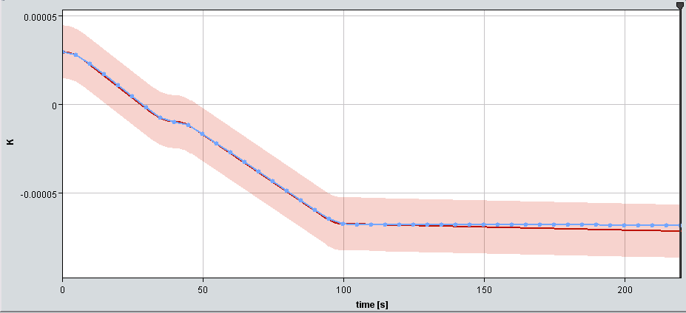
PC Interlock - Principle
Principle: Subscribes to Power Converters (PC) and compares measured current to reference functions ± tolerances (1 Hz).
Example: RCBYVS4.L8B2 (Orbit corrector) during COLLISIONS Beam Process:
Blue: k from measured current.
~ 100 µrad
Red: Reference Function ±15µrad tolerances
Slide from “PC Interlock – status, next steps and feasibility of optics interlocking”
Author Michaela Schaumann
https://indico.cern.ch/event/495744/

Slide 6
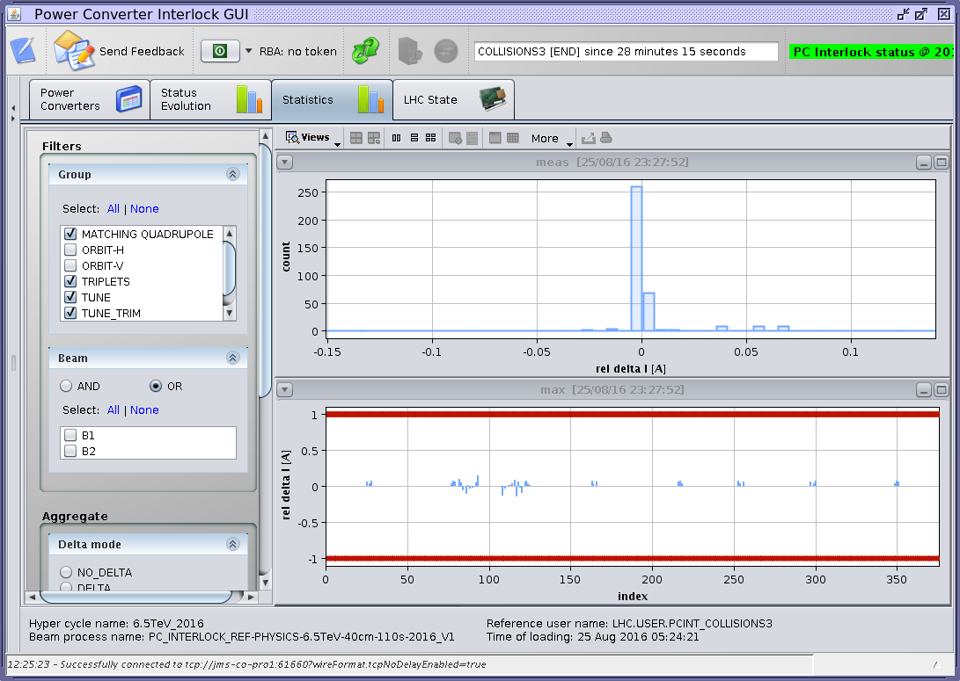
PC Interlock - Principle

Slide 7
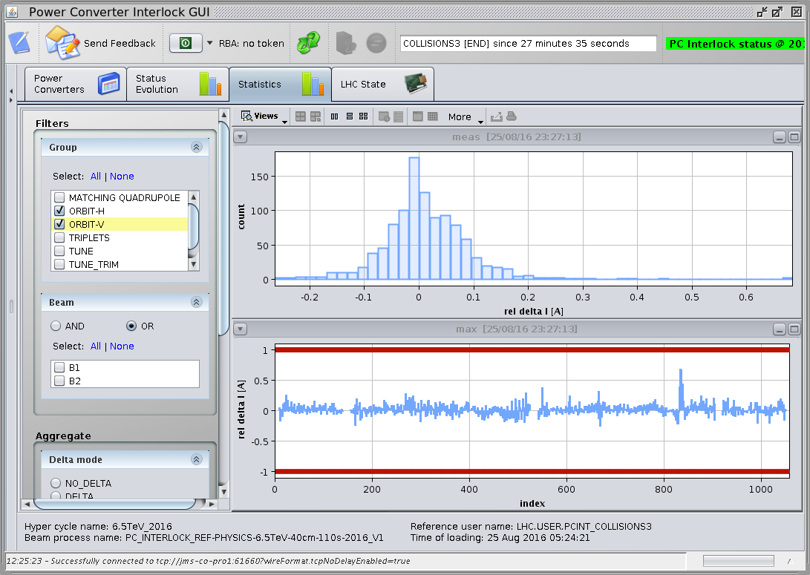
PC Interlock - Principle

Slide 8
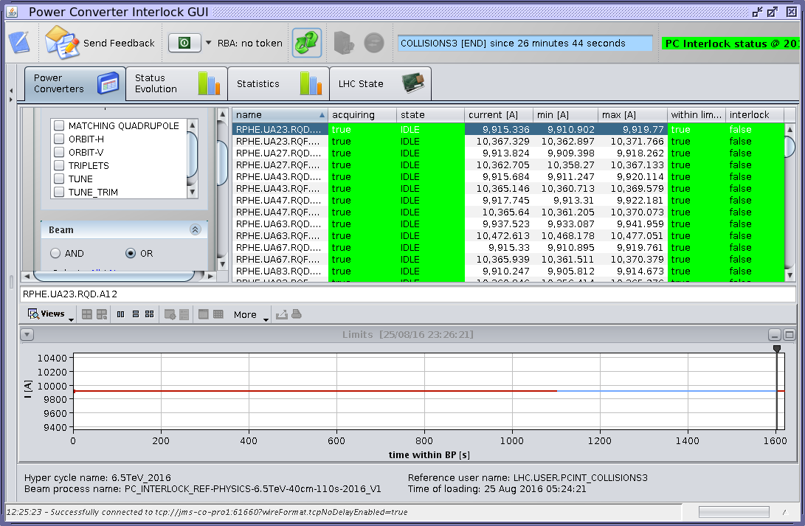
PC Interlock - Principle

Slide 9
Power Converter States
3 interlocking states of a Power Converter are defined:
  Ok: Not interlocking, current is within limits (or PC is in any other state than STANDBY, IDLE, ARMED and RUNNING)
  Warning: Trigger warning when current is 70% of interlock limit
  Interlock: Trigger interlock when current is 100% of interlock limit

Slide 10
The PC-Interlock ecosystem
PcInterlock GUI
Global and individual
PC statuses
LSA
SIS
PcInterlock server
Intensity
tolerances
(“Itol”)
Interlocks
&
warnings
Intensities
Timing
events
XTIM
PC
PC
PC
PC
Slide from “Optics Interlocking within PcInterlock”
Author Marc-Antoine Galilee
https://indico.cern.ch/event/544818/contributions/2219877/
Notes:
Explicit LSA role of translating KTOL to ITOL, explicit role of XTIM

Slide 11
Interlocking strategies

Slide 12
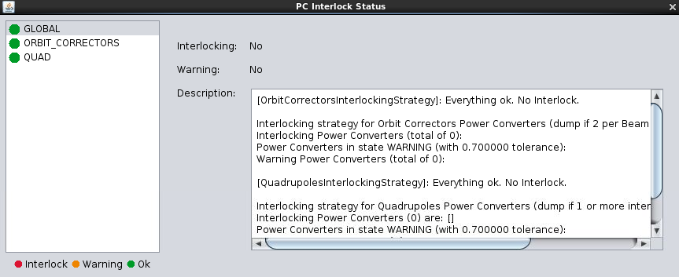
Interlocking Strategy
Strategy for deciding if an interlock should be triggered.
Analysis of one or more Power Converter groups.

Slide 13
Power Converter Groups
Set of Power Converter logically connected:
  Orbit correctors
  Matching Quadrupoles
  …

Slide 14
Orbit correctors interlocking strategy
Interlocks when:
  >= 2 PCs per beam and plane are in interlock state
Warning when:
  1 PC per beam and plane is in warning state

Slide 15
Quadrupoles interlocking strategy
Interlocks when:
  >= 1 PCs is in interlock state
Warning when:
  1 PC is in warning state

Slide 16
Interlocking strategy example
isOk = True
isOk = True
isOk = False
isWarning = False
isWarning = True
isWarning = True
PC1
PC3
PC1
PC3
PC1
PC3
PC2
PC4
PC2
PC4
PC2
PC4
Example using Quadrupole interlocking strategy

Slide 17
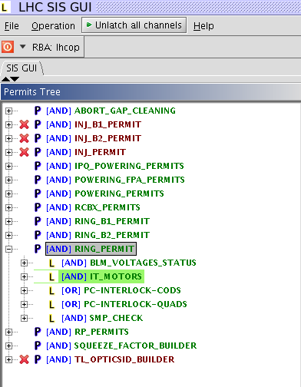
SIS Channel per strategy

Slide 18
Latest improvements
Multiple interlocking strategies
SIS: publish additional interlocking status per strategy
Full quadrupole circuits support to allow for phase advance interlocking
New handling of tolerances in the LSA parameters (K_TOL and I_TOL)

Slide 19
Phase Advance Interlock
Prevent damage of tertiary collimators (TCT) and triplets in the event of an asynchronous beam dump (dump kicker (MKD) fires when beam passes).
For protection, a phase advance between the MKD and TCTs in IP1 and IP5 should be kept within Δμ ≤ 30°.

Slide 20
Phase Advance Interlock
An unwanted increment on the Power Converter current may produce a phase advance on the orbit.
Phase Advance Interlock uses tolerances on the Power Converter current to avoid this behaviour.
Generated tolerances are based on simulations of the closed-orbit phase using MADX

Slide 21
Tolerance Generation
A tool was developed to automatically produce accurate limits, Ktol, in terms of magnet strength (k).
After user confirmation the Ktol values are written to LSA. A make rule generates the corresponding Itol (current) limits.
Ktol values are based on MADX simulations and the maximum allowed phase advance change, Δμ, provided by collimation team.

Slide 22
Tolerance Generation Families
For easier configuration, the Tolerance Generation tool has a concept of families.
A family is a set of magnets that will share the same Ktol.
For example, the same type of magnets.
The concept of families let the user decide the granularity of the tool according to needs.

Slide 23
Tolerance Generation Ranges
In order to prevent damage in the TCTs in IP1 and IP5, we have to take into account 4 ranges of the LHC ring, starting from the dump location (IP6):
  From IP6 to IP1 and IP5 per Beam
The simulations of the phase advance are done per range individually.

Slide 24
Tolerance Generation Ranges
Relevant ranges for Beam 1
R61B1: IP6 → IP1
R65B1: IP6 → IP5
B1
IP5
IP6
IP1
Image from “PC Interlock – status, next steps and feasibility of optics interlocking”
Author Michaela Schaumann
https://indico.cern.ch/event/495744/

Slide 25
Tolerance Generation Ranges
Relevant ranges for Beam 2
R65B2: IP6 → IP5
R61B2: IP6 → IP1
B2
IP5
IP6
IP1
Image from “PC Interlock – status, next steps and feasibility of optics interlocking”
Author Michaela Schaumann
https://indico.cern.ch/event/495744/

Slide 26

Tolerance Generation
The allowed Δμ budget is distributed over all families.
$$∆μ_{budget}>\sum_{families}{∆μ_{budget,family}}$$
At the moment defined families are:
MQ, MQT, Matching quads, Triplets, Warm quads.

Slide 27



Tolerance Generation
The magnet phase response is the ratio of phase change over a segment resulting from a small strength increment.
$$r_{m,range}=\frac{{∆μ}_{range}}{∆k}$$
$$∆k=1.0e−5$$
The resulting family phase response consists of the sum of the member’s phase response. The absolute value is used for taking into account the worst case scenario.
$$R_{family,range}=\sum_{family magnets}{\left|r_{m}\right|}$$

Slide 28

Tolerance Generation
The Ktol is then the ratio of the Δµ family budget over the family phase response.
$$k_{family,range}^{tol}=\frac{∆μ_{budget,family}}{R_{family,range}}$$
The Ktol is calculated per range and the resulting family Ktol corresponds to the minimum.
$$k_{family}^{tol}=min⁡(k_{family,R61B1}^{tol}, k_{family,R65B1}^{tol},k_{family,R65B2}^{tol},k_{family,R61B2}^{tol})$$

Slide 29
Makerules
Ktol values belong to magnets.
The Itol value of the corresponding Power Converters is calculated using a Makerule in LSA.
For most magnets it is a standard Makerule from K to I.
Triplets are special due to their configuration (Itol_nested).

Slide 30
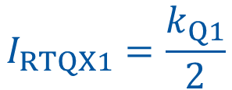

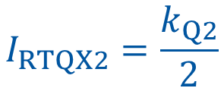
Makerule: Itol_nested
$$I_{RQX}=min⁡(\frac{k_{Q1}}{2},\frac{k_{Q2}}{2}, k_{Q3})$$
$$I_{RTQX1}=\frac{k_{Q1}}{2}$$
IRQX
$$I_{RTQX2}=\frac{k_{Q2}}{2}$$
IRTQX1
IRTQX2
KQ1
KQ2
KQ3

Slide 31
Latest Improvements
Ktol Generation Tool
Make rule (including Itol_nested for the triplets)

Slide 32
Results

Slide 33
The PC-Interlock ecosystem
PcInterlock GUI
Global and individual
PC statuses
LSA
SIS
PcInterlock server
Intensity
tolerances
(“Itol”)
PC properties
Interlocks
&
warnings
Ktol
Generation
Tool
Kick
tolerances
(“Ktol”)
Intensities
Timing
events
XTIM
PC
PC
JMAD
PC
MAD-X
PC
New component
Slide from “Optics Interlocking within PcInterlock”
Author Marc-Antoine Galilee
https://indico.cern.ch/event/544818/contributions/2219877/
Notes:
Explicit LSA role of translating KTOL to ITOL, explicit role of XTIM

Slide 34
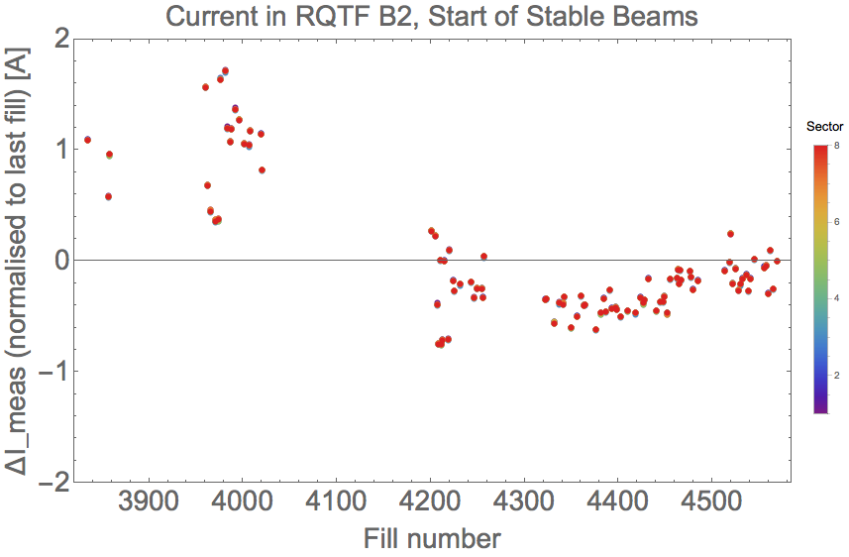
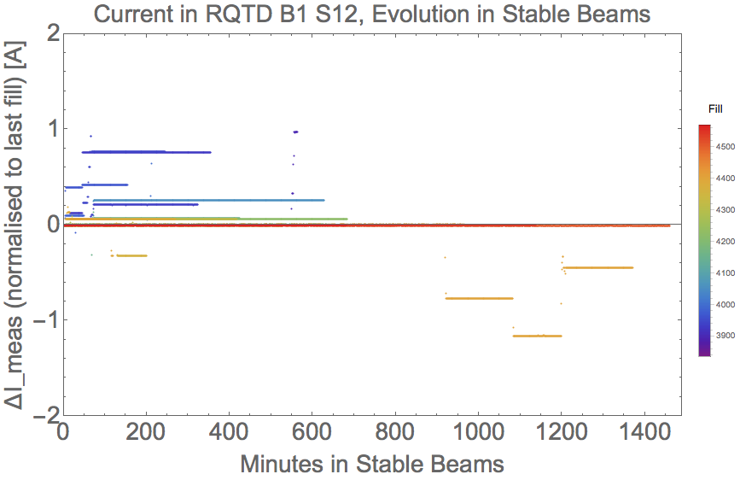
Current Fluctuation in Stable Beams
from fill-to-fill
Current variations ranges:
  From fill-to-fill ~ ΔI ≈ ±3A
  During Stable Beams ΔI ≈±1.5A
during Stable Beams
Slide from “PC Interlock – status, next steps and feasibility of optics interlocking”
Author Michaela Schaumann
https://indico.cern.ch/event/495744/

Slide 35
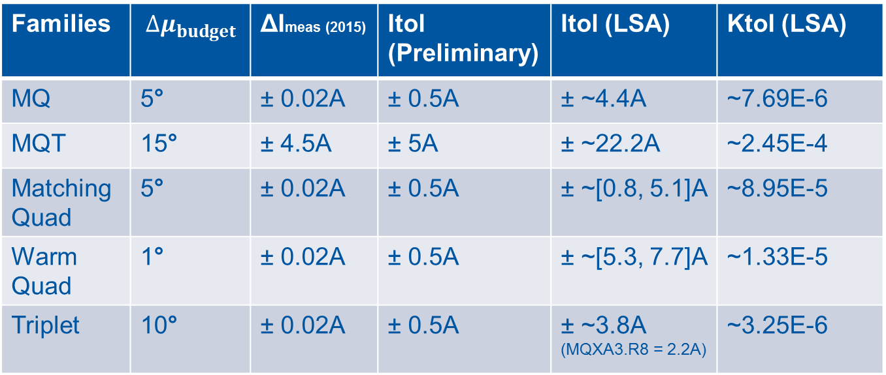
Families | $$∆μ_{budget}$$ | ΔImeas (2015) | Itol (Preliminary) | Itol (LSA) | Ktol (LSA)
MQ | 5° | ± 0.02A | ± 0.5A | ± ~4.4A | ~7.69E-6
MQT | 15° | ± 4.5A | ± 5A | ± ~22.2A | ~2.45E-4
Matching Quad | 5° | ± 0.02A | ± 0.5A | ± ~[0.8, 5.1]A | ~8.95E-5
Warm Quad | 1° | ± 0.02A | ± 0.5A | ± ~[5.3, 7.7]A | ~1.33E-5
Triplet | 10° | ± 0.02A | ± 0.5A | ± ~3.8A (MQXA3.R8 = 2.2A) | ~3.25E-6
ΔImeas largest current variation found in 2015 Stable Beams data.
Requirement to avoid unnecessary beam dumps: Itol > ΔImeas.
Ktol values per family are equal, while Itol values can be different, because of the magnet’s calibration curves.
Optics used to generate the Ktol R2016a_A40C40A10mL300

Slide 36
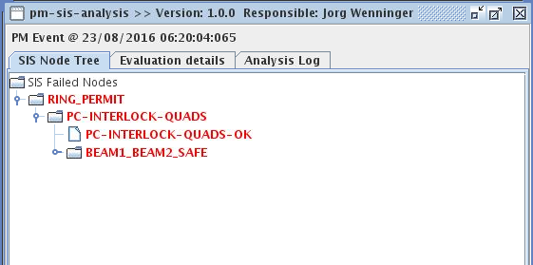
Phase Advance Interlock Quadrupole
On Quadrupole RQT4.L7
Strategy: Quadrupole Interlocking Strategy
2016.08.23 @ 06:20:04 (MD)

Slide 37
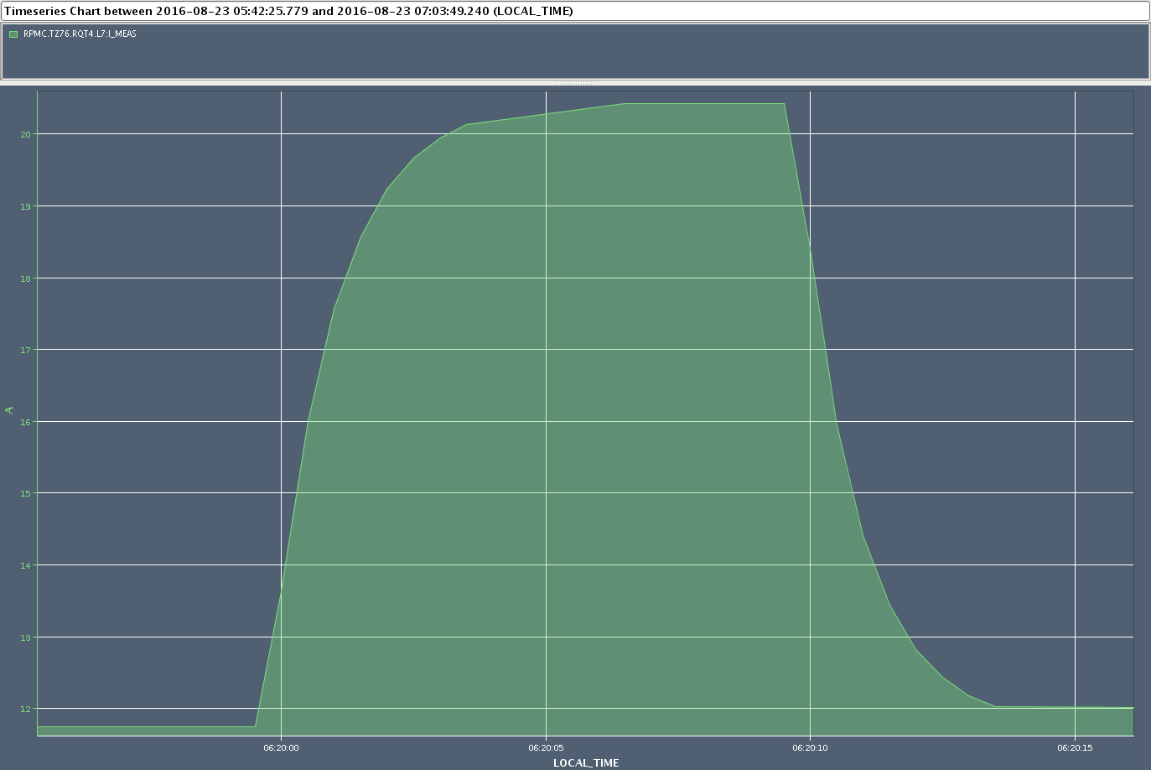
Phase Advance Interlock Quadrupole

Slide 38
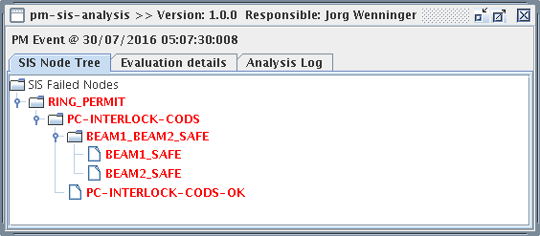
Phase Advance Interlock COD
On RCBYHS4.L1B1 and RCBCH7.R5B1
Strategy: Orbit Correctors Interlocking Strategy
2016.07.30 @ 05:07:30 (MD)

Slide 39
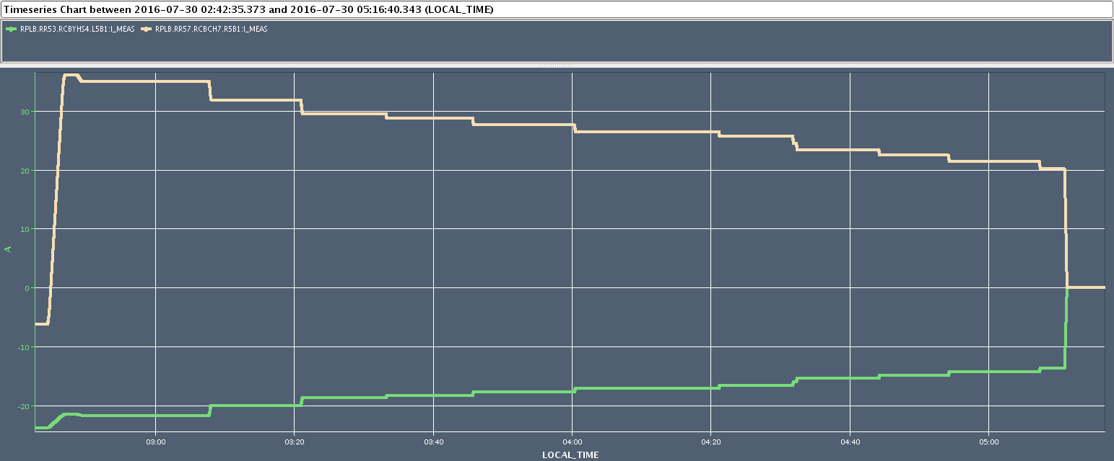
Phase Advance Interlock COD
~11A
~9.9 A

Slide 40
Conclusions
Everything is implemented and deployed.
PCInterlock on quadrupoles is running since spring 2016
Since 9th Aug. the SIS channel was un-masked.
No interlocks occurred during PHYSICS.
Interlocked correctly several times during MD.

Slide 41
Thank you
Do you have any question?

Slide 42
References for Java Classes
Strategies configuration
  /lhc-pcinterlock-core/src/java/cern/lhc/pcinterlock/conf/pcinterlock-strategies-beans.xml
PC groups
  cern.lhc.pcinterlock.domain.enums.PcInterlockPcGroup
Interlocking strategies
  cern.lhc.pcinterlock.service.manage.impl.AbstractInterlockingStrategy
  cern.lhc.pcinterlock.service.manage.impl.OrbitCorrectorsInterlockingStrategy
  cern.lhc.pcinterlock.service.manage.impl.QuadrupolesInterlockingStrategy
PC state evaluator
  cern.lhc.pcinterlock.service.decide.impl.WarningEvaluator
  cern.lhc.pcinterlock.service.decide.impl.InterlockEvaluator

Slide 43
References for Java Classes
Make rules (lsa-core-cern)
  LHCNestedItolMakerule
  LhcKTol2IRefTolMakeRule
Lhc-pcinterlock-tolgeneration project
  svn+ssh://svn.cern.ch/reps/acc-co/trunk/lhc/pcinterlock/lhc-pcinterlock-tolgeneration

