Slide 1
IAEA and ADS
Stefano Monti – Section Head
Nuclear Power Technology Development
Department of Nuclear Energy
International Atomic Energy Agency
EuCARD² – Status of Accelerator Driven Systems
Research and Technology Development
7-9 February 2017

Slide 2
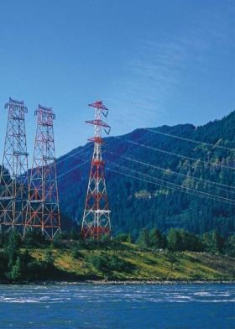
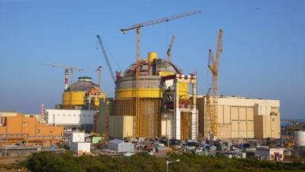
IAEA Statute
“…accelerate & enlarge contribution of atomic energy
to peace, health and prosperity…”
Notes:
Article 2 of our Statute says that the IAEA shall “seek to accelerate and enlarge the contribution of atomic energy to peace, health and prosperity throughout the world…”
and do it in a safe, secure and sustainable way.
For understanding of how we do it, let me give you an overview of our organization.

Slide 3
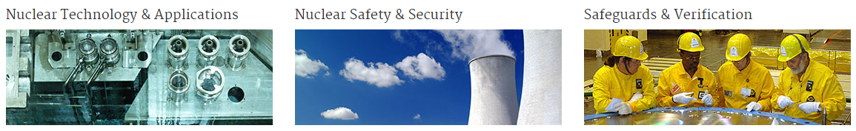
IAEA: Main work areas
Nuclear Energy
Nuclear Sciences & Applications
Technical Cooperation
Nuclear Safety & Security
Safeguards
Notes:
Nuclear Technology & Applications,, Nuclear Safety & Security,, and Safeguards & Verification are the 3 main areas of the IAEA:
We have 3 departments that promote the peaceful uses of nuclear technologies: [CLICK] The Department of Nuclear Energy,,, [CLICK] the Department of Nuclear Sciences & Applications,,, [CLICK] and the Department of Technical Cooperation… These 3 departments help countries use nuclear and isotopic techniques to achieve sustainable development goals in energy, agriculture, human health, water resources, marine environment and industrial applications.
[CLICK] The second area focuses on helping and guiding Member States for a strong and sustainable global nuclear safety and security framework. Basically it is for protecting people and the environment from the harmful effects of ionizing radiation. The Department of Nuclear Safety & Security takes the lead on this.
The third area is probably more famous than the first two: The IAEA is the world’s nuclear inspectorate. [CLICK] Our colleagues in the Department of Safeguards play an indispensable role in global efforts to stop the spread of nuclear weapons.

Slide 4
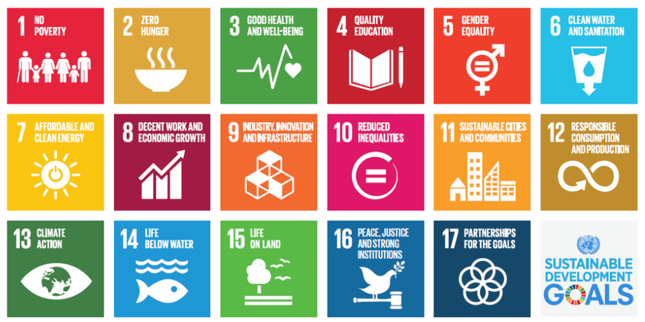
IAEA & SDGs
Notes:
The 17 Sustainable Development Goals adopted last September are ambitious. But this ambition is needed, for the good of the millions of people. Majority of these 17 SDGs relate to our work. But there is one that actually fuels all the others. Goal 7, ”access to affordable & clean energy” will help us realize the others.
Then there is Goal 13, “climate action”; Goal 8, on economic growth; Goal 9, on industry, innovation & infrastructure; Goal 11, on sustainable cities; goals 16-17 on sharing of experiences,,, and the list goes on… They are all very much related to clean energy production.

Slide 5
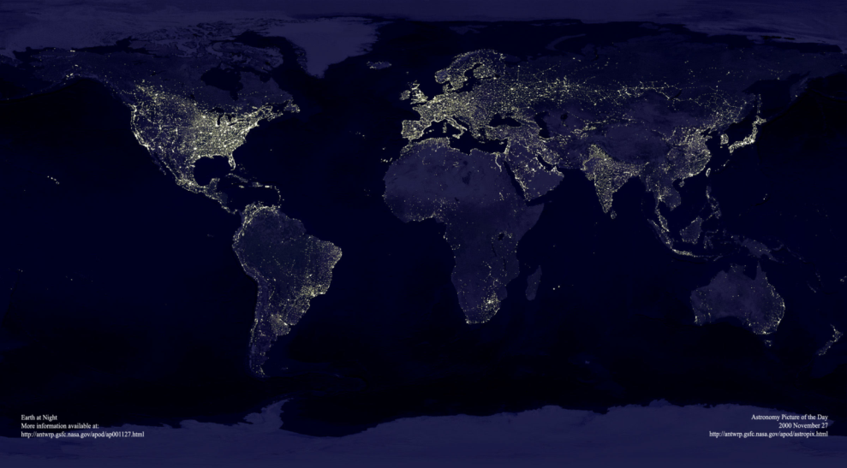
Energy 2016
1.1 B people
no access to energy
2.6 B people
rely on biomass
1 B people
no health care
due to energy poverty
Notes:
More than a billion people woke up today having NO access to electricity… that is 1 out of 7 of the world population. More than 600 million of those are in sub-Saharan Africa,, and more than 300 million are in India alone.
That means no health care, no education, no running water. But while we enlarge the access to electricity (in support of UN SDG#7), we should also take care of the planet.
Add to this the concerns about energy security…

Slide 6
Energy challenge
Population
Energy demand
Energy security
Environment
Climate change
Notes:
So our current challenge is:
How do we meet the ever-increasing energy demand,,,
while handling the consequences to the environment and need for energy security?

Slide 7
Nuclear power is a low-carbon energy source
Life cycle GHG emissions from electricity generation
Median value
Interquartile range
Notes:
Indeed, hydropower, nuclear power and wind based electricity are the lowest CO₂ emitters, when emissions over the entire life cycle are considered. Direct GHG emissions from nuclear power plants are negligible.
Nuclear power currently produces 11% of the world’s electricity but this corresponds to more than a THIRD of the world’s low carbon electricity production.
And fact is that nuclear power is a key low carbon technology that is available TODAY in LARGE CAPACITIES,,, and that can be deployed on a wide-scale basis to help meet the climate–environment-energy challenge.

Slide 8
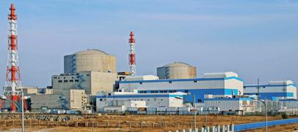
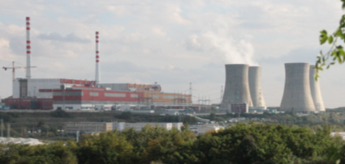
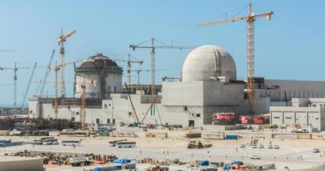
NP Reactors
(as of 30 January 2017)
449 in operation
392 GW(e) Capacity
60 under construction (2/3 in Asia)
Notes:
As of 30 January 2017, there are 449 operational reactors in 30 countries, with over 392 GW(e) installed generating capacity globally.
In 2016 and 2015 , twenty new reactors were connected to the grid (10+10). These were the levels of the 1980s.
There are 60 reactors under construction. The highlights here follow the trend of the last few years:
- Most growth is in expanding programmes, and
- 2/3 of the reactors currently under construction continue to be in Asia:

Slide 9
2030 Projections
Decommissioning…
Climate…
SDGs…
Notes:
Now, what are the trends? Every year, the IAEA makes low and high projections (Energy, Electricity and Nuclear Power Estimates for the Period up to 2050):
Our latest projections that we are about to publish very soon show that the world's nuclear power generating capacity will continue to grow by 2030, especially in Asia…
. The low projection indicates a 2% growth in world total nuclear power capacity by 2030. And the high projection suggests about 56% growth. [In other words, growth is expected to continue, but at a rate lower than estimated before the Fukushima Daiichi nuclear accident.] Probably 2 things are worth to note here:
- The low case seems as if nuclear power capacity will stagnate. But what we need to take into account here is the large figure of capacity that will go away due to many reactors that reach their end of life and that need to be decommissioned. So we are still looking into a heavy new build schedule.
- Also, we are hearing increasing reference from the Member States to the decarbonisation of the electricity sector to help fight climate change,,, and to nuclear power’s role in reaching the Sustainable Development Goals.

Slide 10

NP Development
in Different Regions
Current Capacity
Low Estimate
High Estimate
Notes:
But every region has different projections for nuclear power development. Largest growth is likely to be in Asia.
This region, Latin America, has modest prospects for growth…
Most of the 30 countries that already have operating NPPs have some form of expansion plans.
A similar number of “newcomer” countries are showing interest in introducing nuclear power to their energy mix. Some are more advanced in their programme, some are still studying. Two countries, the UAE and Belarus, are already constructing their first nuclear power plants.
And we hear 3 reasons for why nuclear power remains an important option for many countries::: Improving energy security,,, reducing the impact of volatile fossil fuels prices,, and mitigating the effects of climate change.

Slide 11
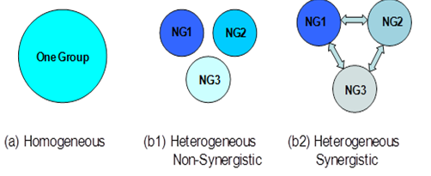
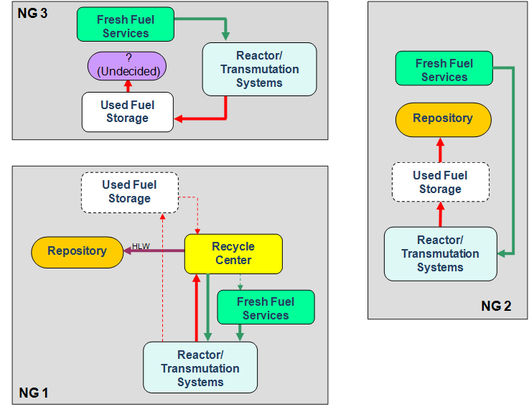
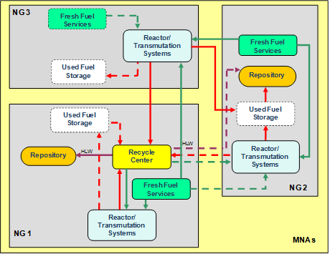
International Project on Innovative Nuclear Reactors and Fuel Cycles
“Global Scenarios”: Heterogeneous world model introduced in GAINS
Non-personified, non-geographical groups of countries with different policies regarding the fuel cycle back end:
NG1-recycling strategy;
NG2-direct disposal/reprocessing abroad strategy
NG3- looking for minimal NFC infrastructure: disposal or reprocessing abroad
CP on SYNERGIES and ROADMAPS
Notes:
These heterogeneous NE scenarios at the IAEA are studied by the International Project on Innovative Nuclear Reactors and Fuel Cycles - INPRO
INPRO develops collaborative projects that carry out complex studies of regional and global multinational cooperation to enhance the sustainable development of Nuclear Energy Systems including open and closed fuel cycles.
The analysis framework was originally developed under the “GAINS” collaborative project, which is « Global Architecture of Innovative Nuclear Energy Systems Based on Thermal and Fast Neutron Systems Including a Closed Fuel Cycle ».
SYNERGIES and ROADMAPS address the scenarios for enhancing global Nuclear Energy Systems sustainability, specifically, through cooperation among technology holder and technology user countries, including newcomer countries
“Synergistic nuclear energy regional group interactions evaluated for sustainability” (SYNERGIES)
“Roadmaps for a Transition to Globally Sustainable Nuclear Energy Systems” (ROADMAPS)

Slide 12
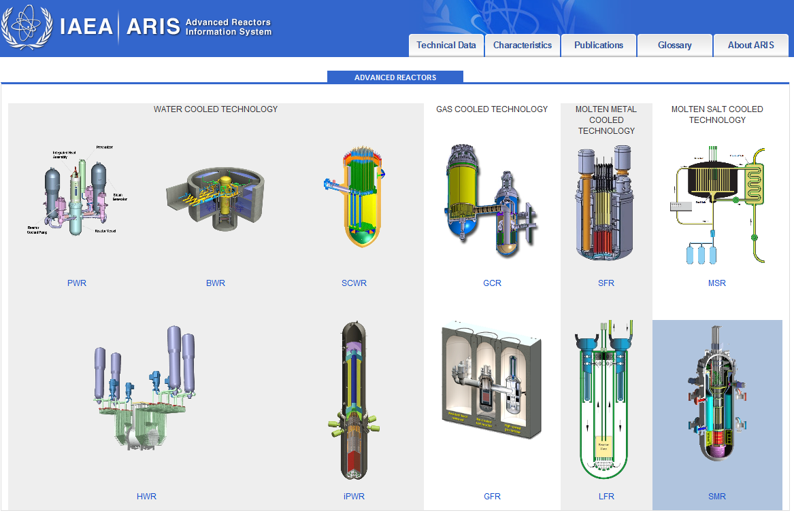
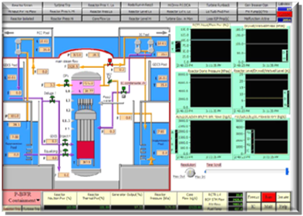
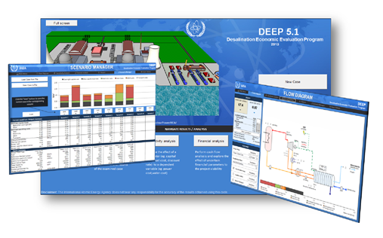
Advanced Technologies
ARIS Database
Reactor Technology Assessment Methodology
Non-electric applications
Notes:
In all these long-term scenarios it is clear that advanced nuclear systems and technologies are supposed to play, at least in perspective, a major role.
This trend has recently received a new impulse due to the need for promoting, developing and deploying – as soon as possible – more sustainable low carbon energy sources.
The IAEA has been providing up-to-date information and tools to its Member States on advanced reactor technologies and non-electric applications
Our Advanced Reactor Information System, ARIS, provides an overview and design descriptions of evolutionary and innovative reactor technologies that are being developed and deployed worldwide

Slide 13
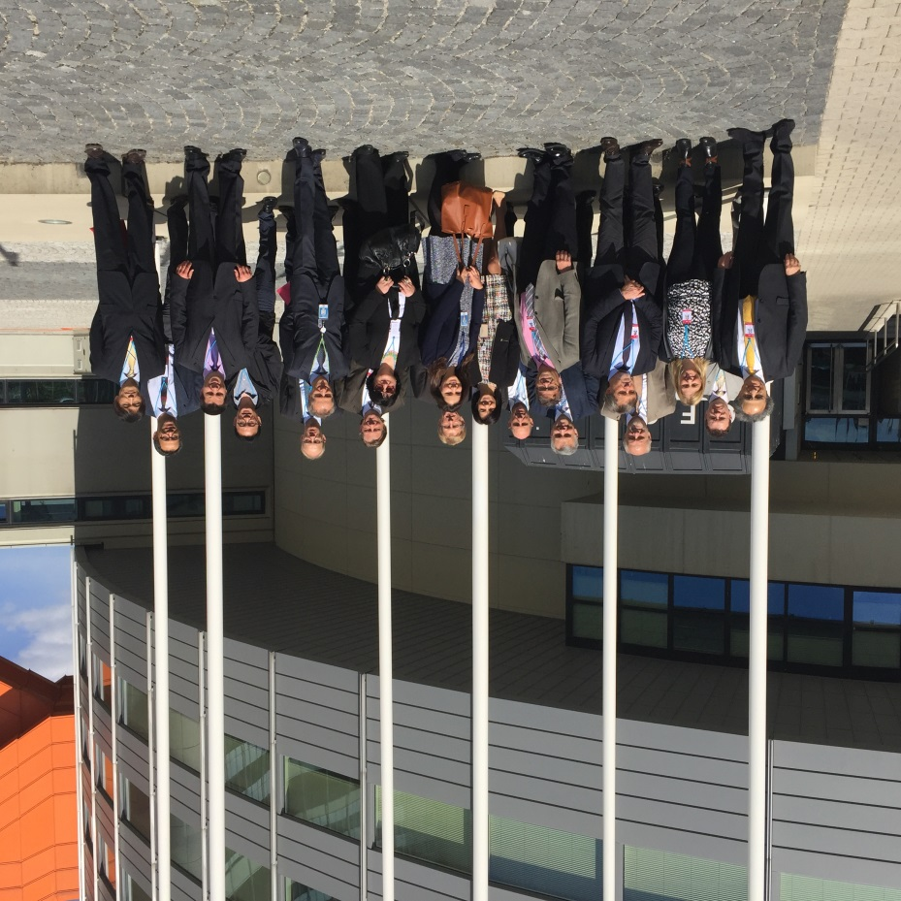
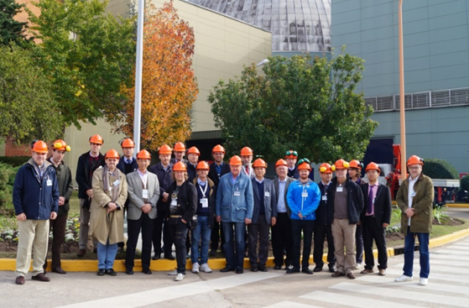
Technical Working Groups related to P&T and FNS:
  Group of experts from MSs that advises the IAEA on the definition and implementation of programmatic activities
  TWG-NFCO: focuses on nuclear fuel cycle options: innovative fuel cycles and nuclear materials management
  TWG-FR: fast spectrum systems, both critical and subcritical, for energy production and transmutation of long-lived radionuclides
  Vienna, April 2016
  Buenos Aires, May 2016

Slide 14
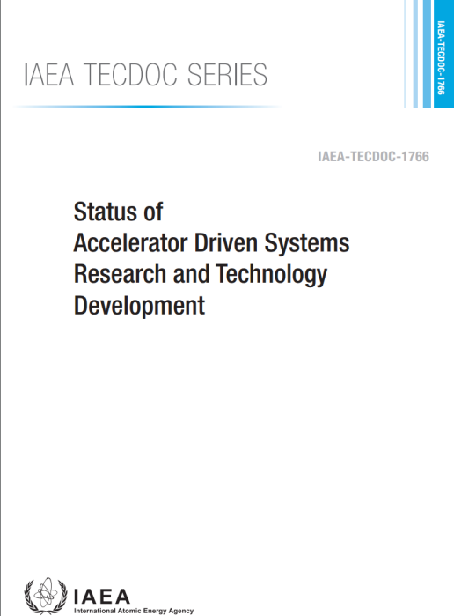
TECDOC: Status of the Accelerator Driven Systems Research and Technology Development
Update of the IAEA-TECDOC-985 published in 1998
Content of the document:
  Description of the different ADS concepts under development
  State of the art of research and technological development
  National and international programmes and projects
350 pages document, with 100 contributors.
Published in 2015 and available online
http://www-pub.iaea.org/books/iaeabooks/10870/Status-of-Accelerator-Driven-Systems-Research-and-Technology-Development

Slide 15
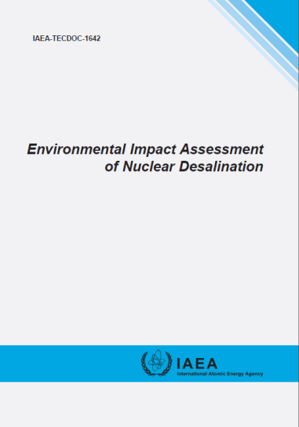
CRP on Analytical and Experimental Benchmark Analysis of Accelerator Driven Systems
&
Use of LEU in Accelerator Driven Subcritical Systems both carried out from 2005 to 2010
  Knowledge and understanding about existing or proposed ADS facilities
  8 benchmark analytical and experimental exercises on ADS
  Perform additional studies on physics and operational characteristics of ADS facilities
  Investigate options for carrying out ADS research using low enriched uranium (LEU) fuel
Expected to be published in July 2017
TECDOC
TECDOC
      Use of Low Enriched Uranium Fuel in ADS
      Analytical and Experimental Benchmark Analysis of ADS

Slide 16
CRP on “Accelerator Driven Sub-critical Systems (ADS) and Use of Low Enriched Uranium (LEU) in ADS”
Main Objectives
Focus on Developing LEU ADS Systems
Continue Development of Analytical Techniques
  Experimentation in facilities
  Benchmarks against analytical results
  Development of new measurement techniques
  Sensitivity studies between various cross section libraries
Application Development and Demonstration
  Spent fuel transmutation
  Radioisotope production
  Material irradiation
  Thorium fuel cycle development
CRP started in December 2015 with 24 participants from 14 MSs

Slide 17
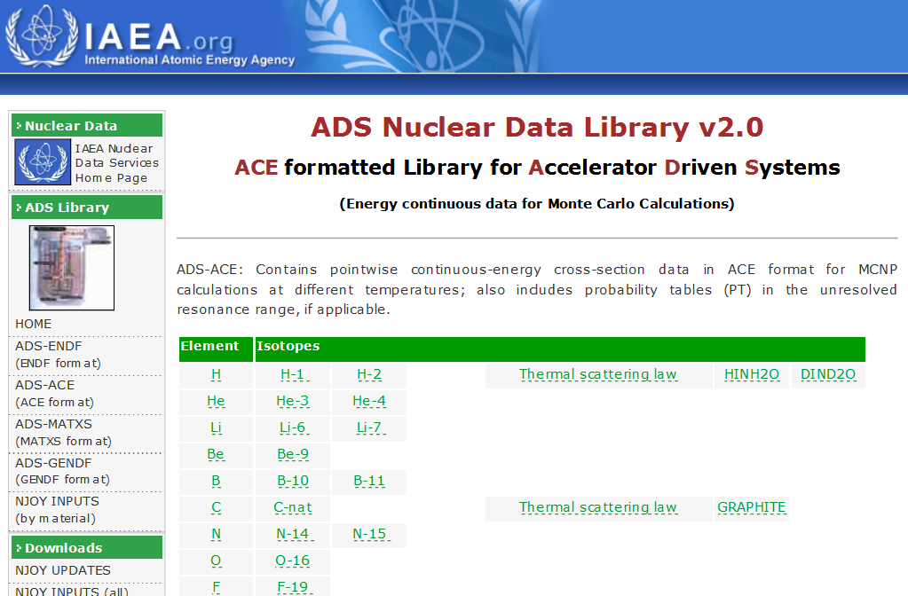

Slide 18
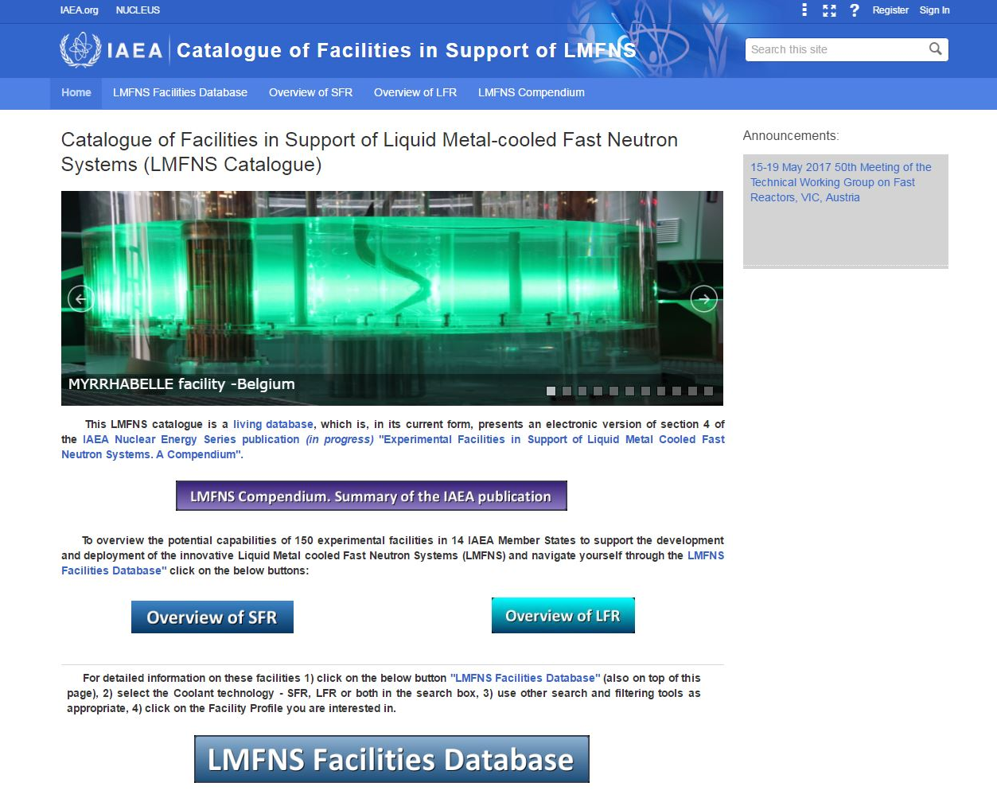

Slide 19
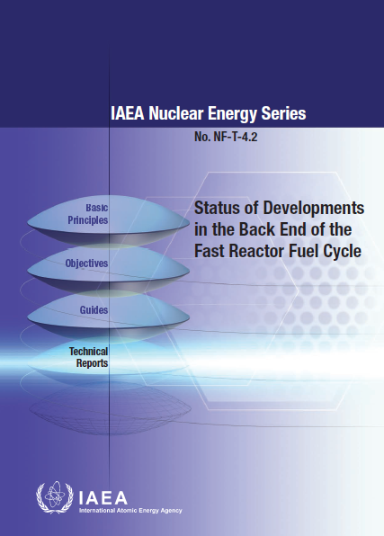
Innovative Fuel Cycles
TM on “Challenges in Reprocessing Used Fast Reactor Fuels” , Vienna, June 2015
TM on “Advanced Fuel Cycles for Waste Burden Minimisation”, Vienna July 2016
France, China, Hungary, India, Japan, Republic of Korea, Russia Federation and USA
To be published soon
Status and Trends in Pyroprocessing of Spent Fuels
ACTIVITY RECENTLY LAUCHED
Technical document on different strategies and advanced technologies for waste burden minimisation in order to enhance nuclear power sustainability
Technical Meeting on “Advanced Fuel Cycles to Improve the Sustainability of Nuclear Power through the Minimization of High Level Waste”,
17-19 October 2017, IAEA, Vienna

Slide 20
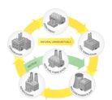

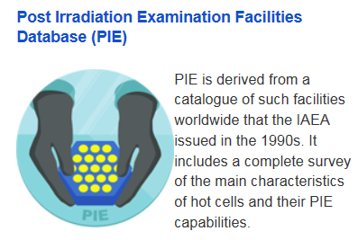
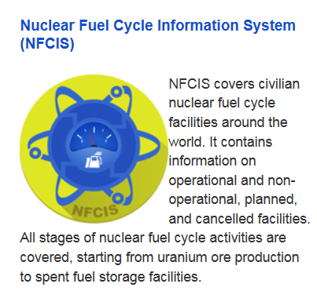
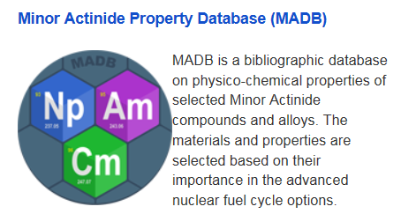
Integrated Nuclear Fuel Cycle Information System
http://infcis.iaea.org

Slide 21
Forthcoming IAEA Emerging Technologies Workshops:
Trends and Implications for Safeguards
Vienna, 13-16 February 2017
Objectives: increase the Safeguard Department’s awareness and preparedness for addressing emerging technologies (nuclear and non-nuclear) that are expected to impact IAEA safeguards implementation work in the coming years.
Priority themes: transportable reactors, Generation IV reactors, transmutation systems, laser technologies, additive manufacturing, etc.
Example → ADS Facilities
      No critical mass → no criticality test
      Challenges:
        Estimation of the quantity of fissile material in the core;
        Identification of misused targets in the core/blanket (if present);
        Power depends from the neutron source and not only from the quantity of fissile material in the core
      New SG approaches/methods may be needed to verify ADS

Slide 22
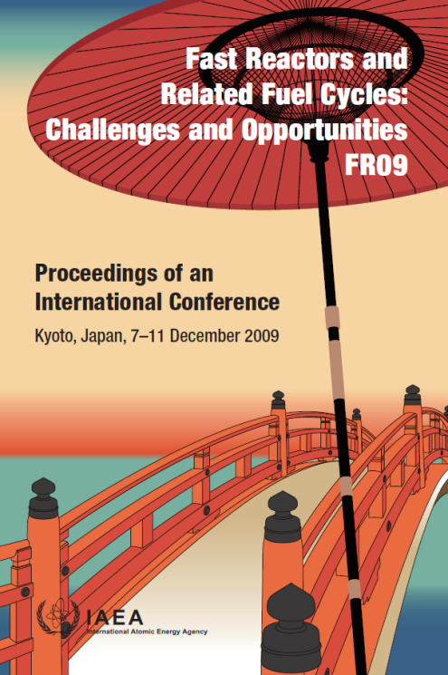
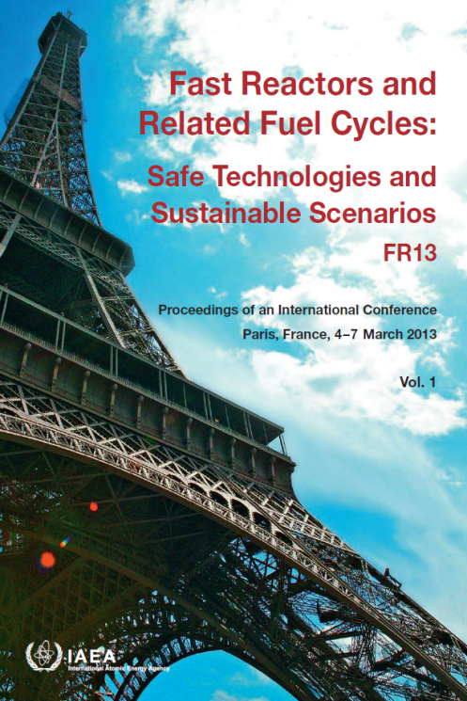
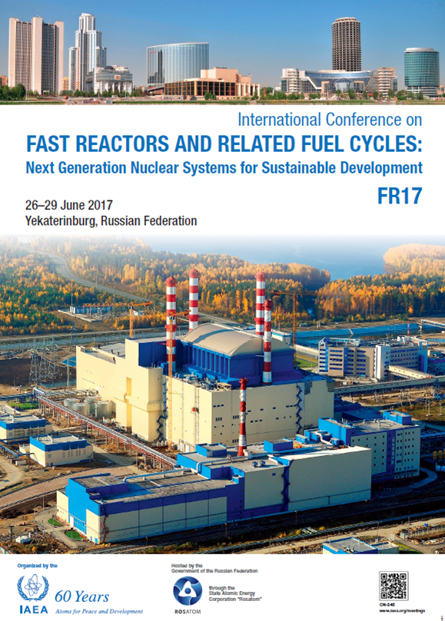

3rd International Conference on Fast Reactors and Related Fuel Cycles (FR17) Yekaterinburg, RF, 26-29 June 2017
BN-800

Slide 23
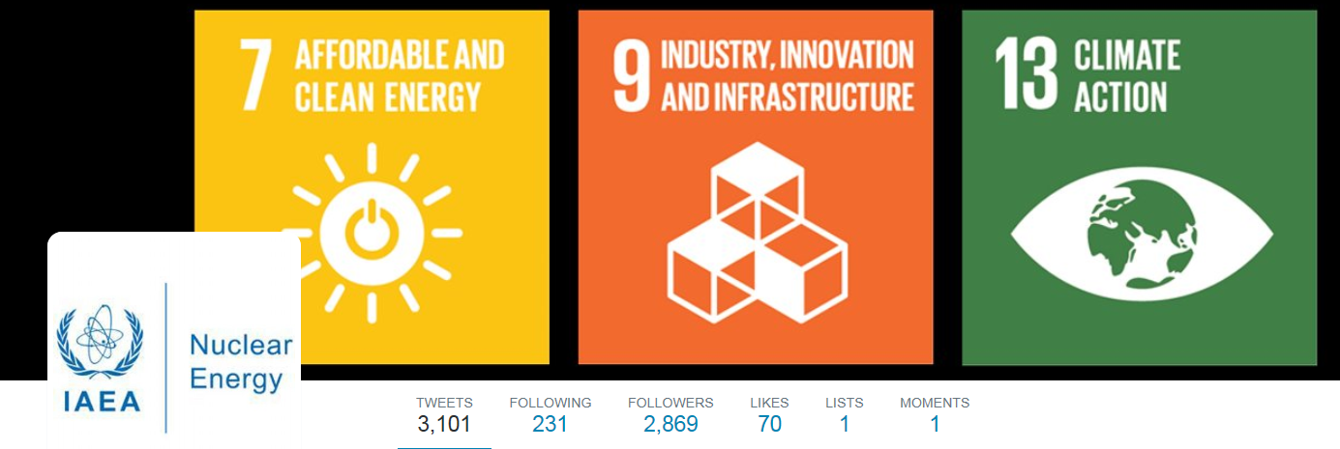
Thank you!
@IAEANE
s.monti@iaea.org
Notes:
This year, the IAEA is turning 60... We are proud to serve our 168 Member States in the whole range of fuel cycle, for the benefit of their people.
I am happy to hear your comments or questions.
Thank you

