Slide 1
Beam Window Design for ADS system in JAEA
Takanori SUGAWARA
Japan Atomic Energy Agency

Slide 2
Introduction
JAEA has investigated 800MWt LBE cooled Accelerator-Driven System (ADS) to transmute minor actinides (MA).
Many inherent issues
  Design of beam window
  Accelerator reliability
  LBE technology
  Reactor physics with MA fuel
  ・・・
Beam window will be used in the following severe condition
  heat generation by proton beam
  external pressure by LBE
  creep deformation at high temperature
  corrosion in LBE
  irradiation damage

Slide 3
Previous study*
Ellipse model
  235mm radius and 2mm thickness at the top
It’s feasible, but more feasible concept (hemisphere, thicker) is required → to mitigate the design condition
*: T. Sugawara, et al., JNST, 47 (10), 2010

Slide 4
Purpose
To mitigate design condition of beam window
Heat generation ↓
Proton beam current ↓
How?
A: Subcriticality Adjustment Rod (SAR) is installed
Burnup reactivity ↓
To realize the small burnup reactivity, subcriticality adjustment rod (SAR) is introduced to the ADS
  Burnup analysis
  Particle transport analysis
  Thermal hydraulics analysis
  Structural analysis
  → More feasible beam window concept

Slide 5
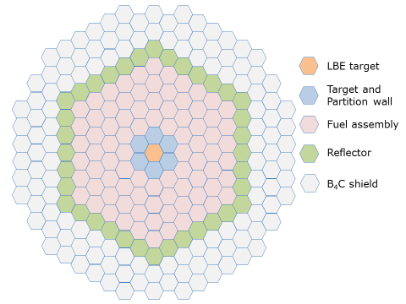
Calculation condition
Thermal power | 800 MWt
Coolant | LBE
Inlet temperature | 300°C
Coolant velocity | 2.0 m/sec
Upper limitation of keff | 0.97
Operation period | 600 EFPDs
Number of fuel assemblies | 84
Pitch | 233.9 mm
Width | 232.9 mm
Number of fuel pins per assembly | 391
Composition | (MA+Pu)N+ZrN
Pin outer diameter | 7.65 mm
Thickness of cladding tube | 0.5 mm
Pin pitch | 11.48 mm
Active height | 1000 mm

Slide 6
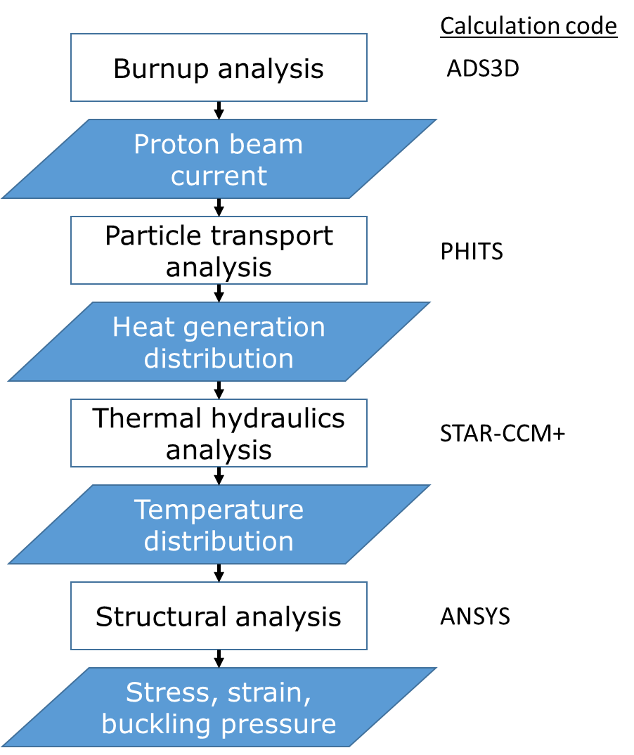
Calculation flow

Slide 7
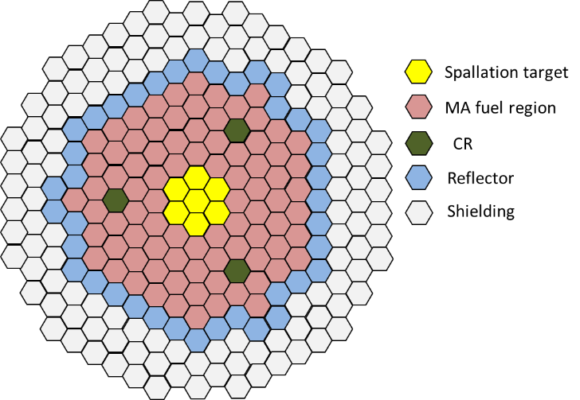
Burnup analysis
ADS3D code* was employed
  Neutron transport in 3D geometry (deterministic method) and burn-up calculation were performed
Calculation condition
  3 SARs (B₄C type) were placed in fuel region
  To prevent the SAR drawing, tungsten block was added to the SAR.
  All SARs were drawn 20cm by each 100days during the operation
SAR
*: T. Sugawara, et al., JNST, 53, 12, 2016

Slide 8
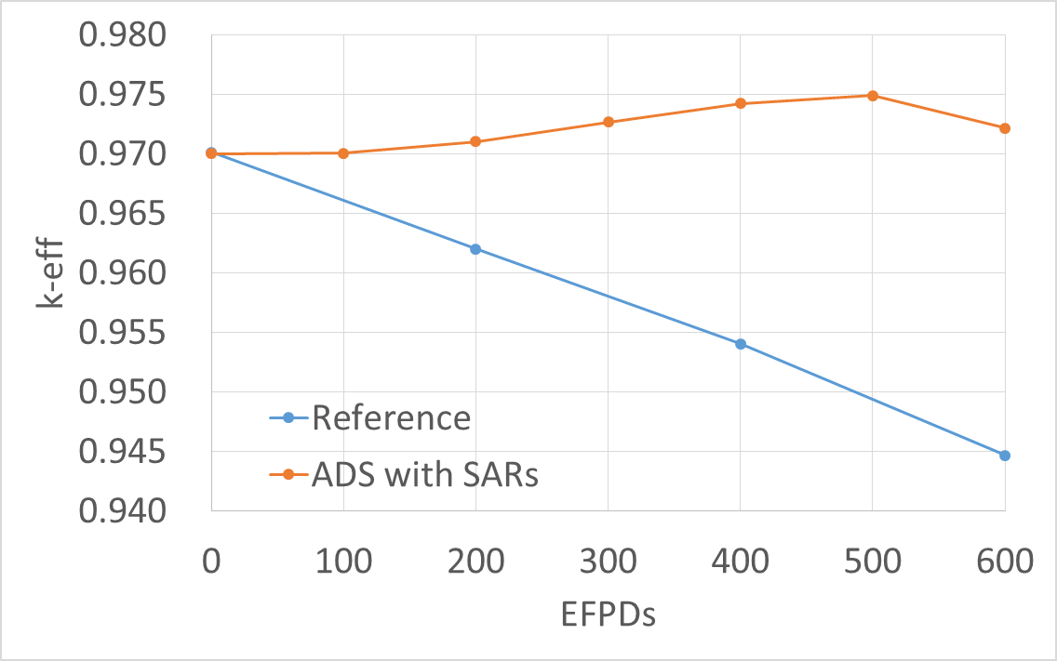
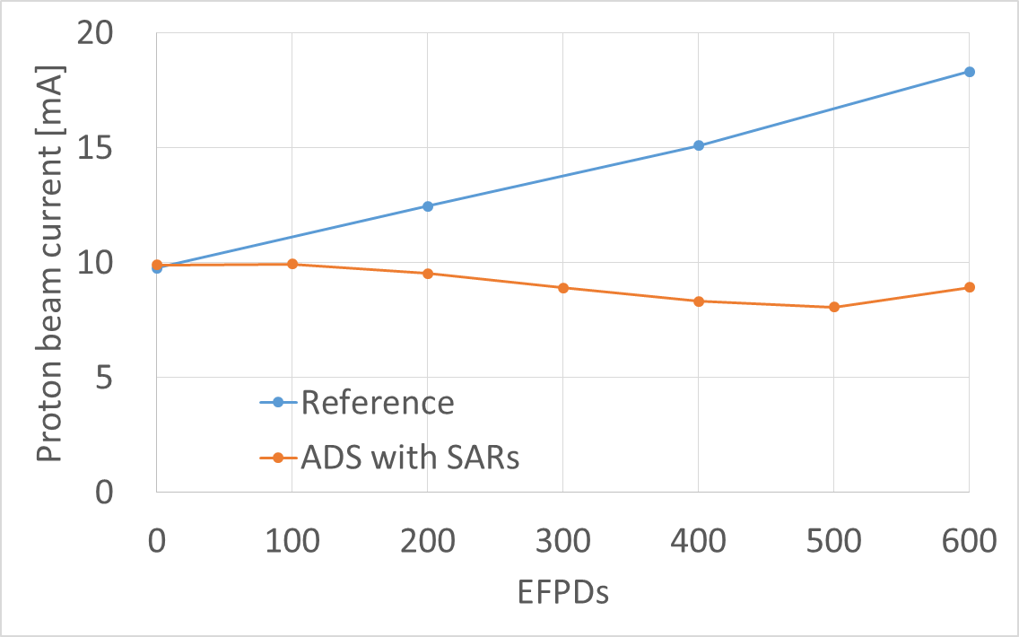
Results
Fig. Change of the k-eff value
Fig. Change of the proton beam current
The k-eff value would be maintained 0.97 during the cycle because it is possible to move SARs by mm/sec unit.
This concept could maintain the proton beam current about 10mA (20mA in the previous study)

Slide 9
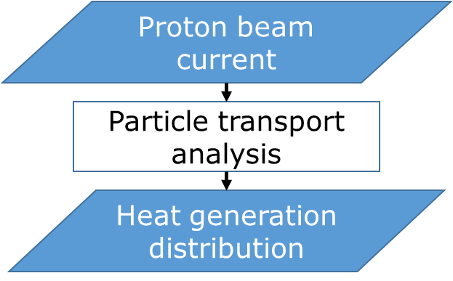
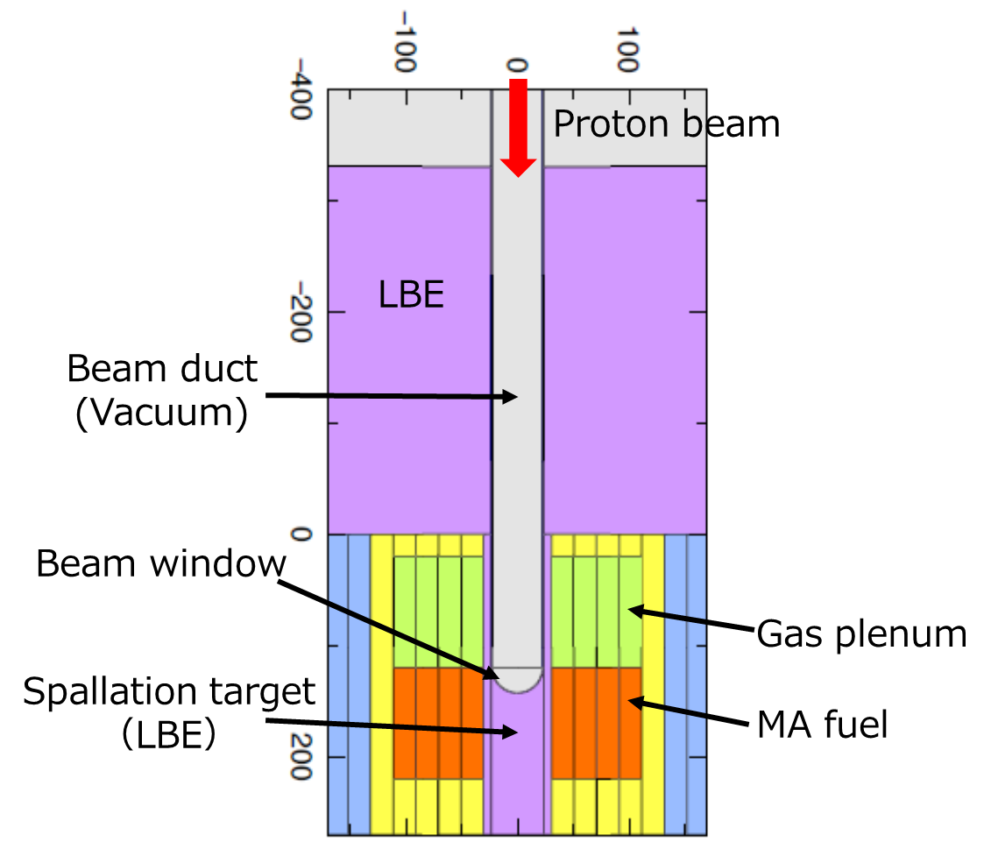
Particle transport analysis
PHITS code was employed.
Gaussian profile was assumed.
 | Previous study | This study
Proton beam energy [GeV] | 1.5 | ←
Proton beam current [mA] | 20 | 10
Beam duct radius [mm] | 235 | ←
Shape of beam window | Ellipse | Hemispherical
Thickness of beam window at top [mm] | 2.0 | ←
Thickness of beam duct [mm] | 10.0 | ←
1σ of Gaussian profile for proton beam [mm] | 111.6 | ←

Slide 10
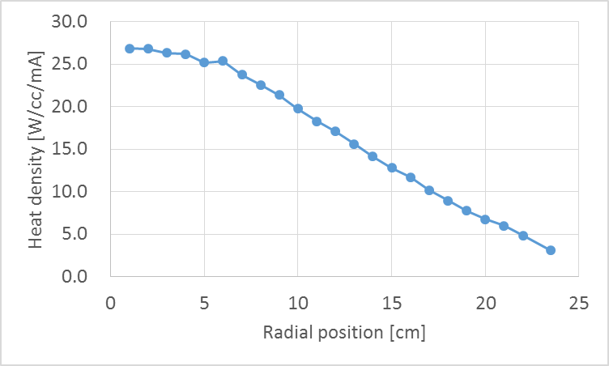
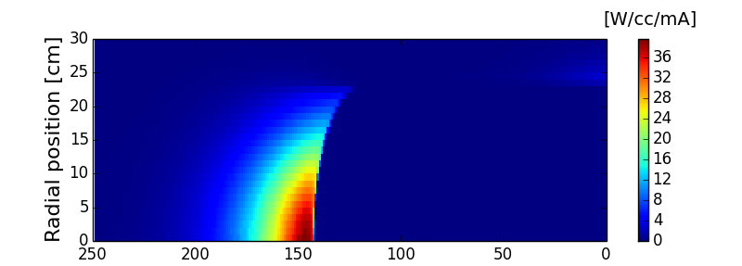
Results
Fig. Heat generation distribution in target region
Fig. Heat generation distribution in beam window
The maximum heat density was about 40 W/cc/mA in the spallation target
The heat density at the top of the beam window was 27 W/cc/mA

Slide 11
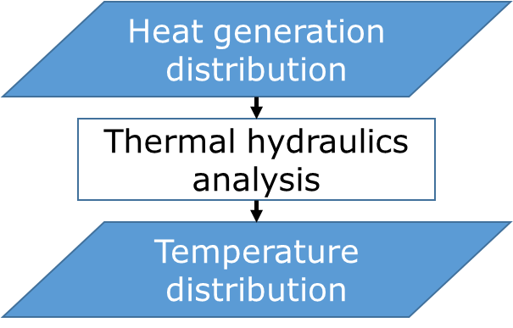
Thermal hydraulics analysis
STAR-CCM+ code was employed
LBE velocity at the inlet | 2.0 m/sec
LBE temperature at the inlet | 300 ℃
Turbulence model | k-ε model
Material of beam window | T91 steel

Slide 12
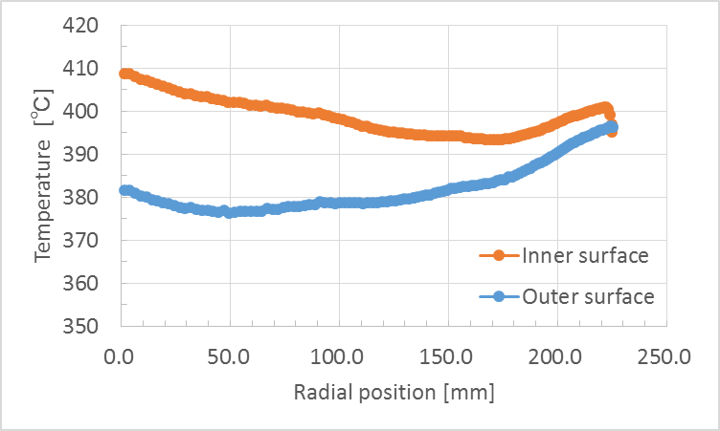
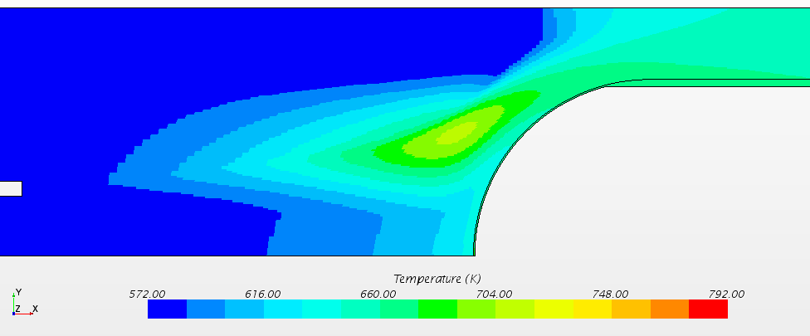
Results
Fig. Temperature distribution in spallation target region
Fig. Temperature distribution in beam window
The maximum temperature in the beam window was 409℃ (516℃ in previous study)
The maximum difference of the temperature in the beam window was 27 ℃ （55℃ in previous study）

Slide 13
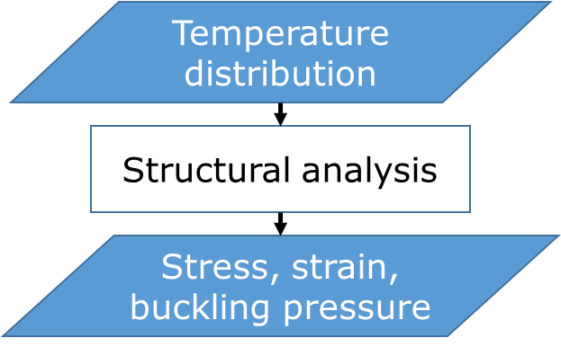
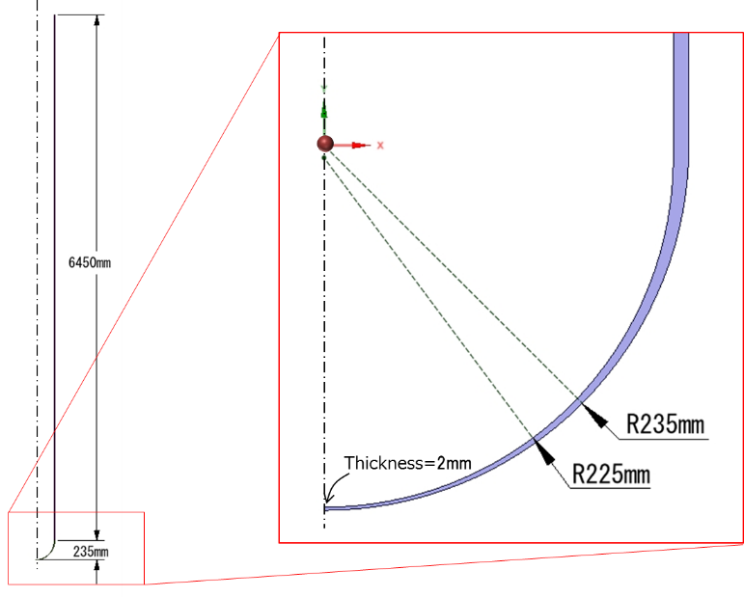
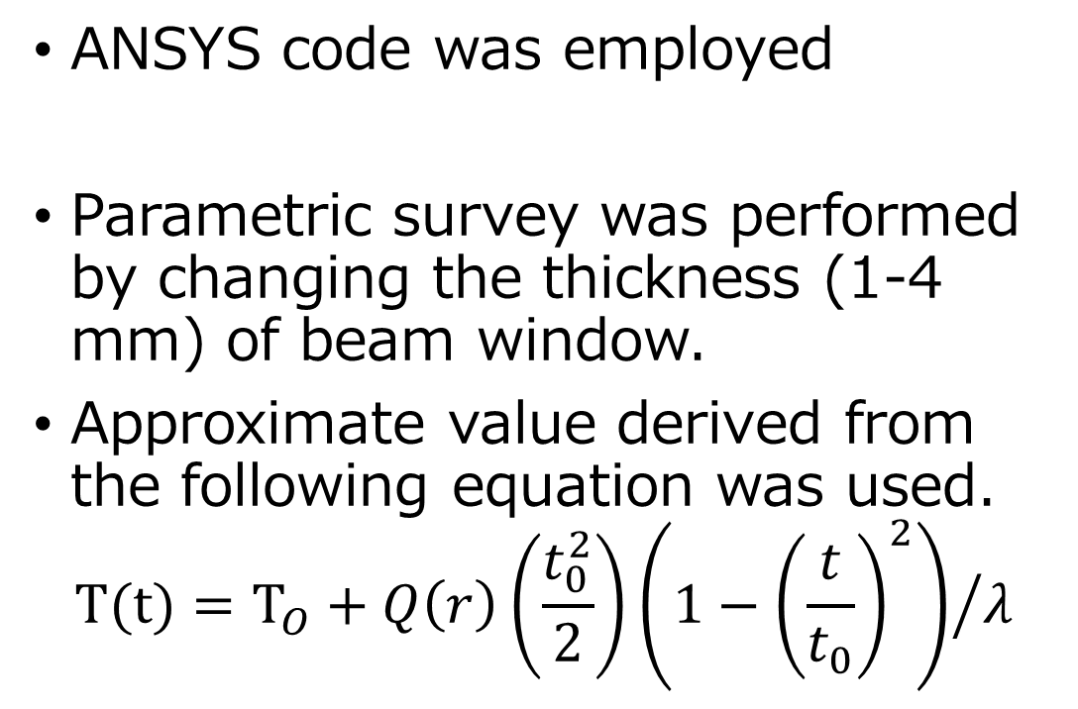
Structural analysis
ANSYS code was employed
Parametric survey was performed by changing the thickness (1-4 mm) of beam window.
Approximate value derived from the following equation was used.
$$T(t)=T_{O}+Q\left(r\right)\left(\frac{t_{0}^{2}}{2}\right){\left(1−{\left(\frac{t}{t_{0}}\right)}^{2}\right)}/λ$$
T: Temperature at thickness t, To: Temperature at outer surface
Q(r): Heat generation density at r, t₀: Thickness
λ: Thermal conductivity

Slide 14
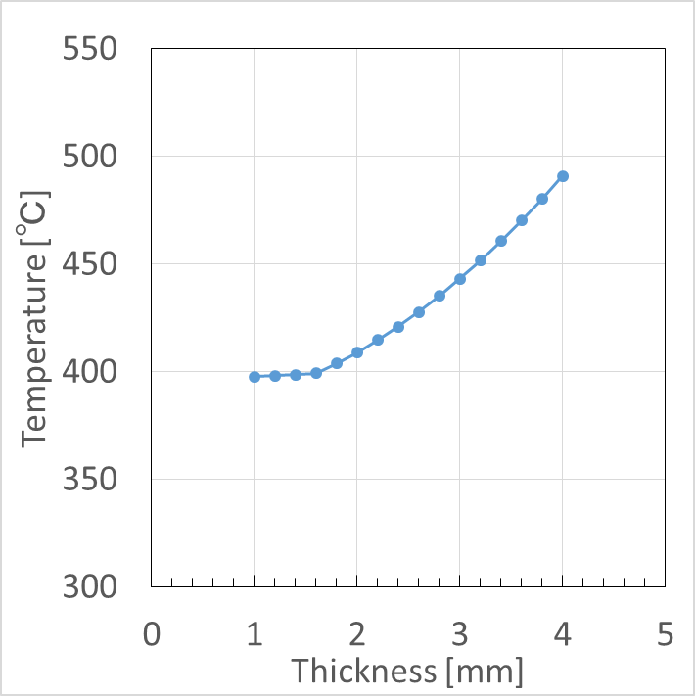
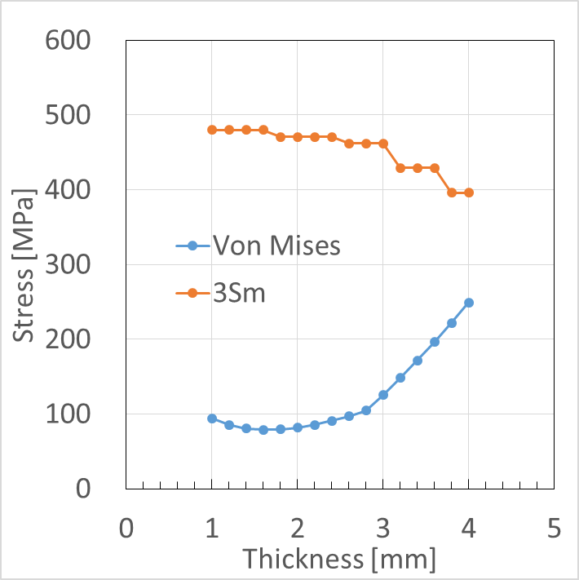
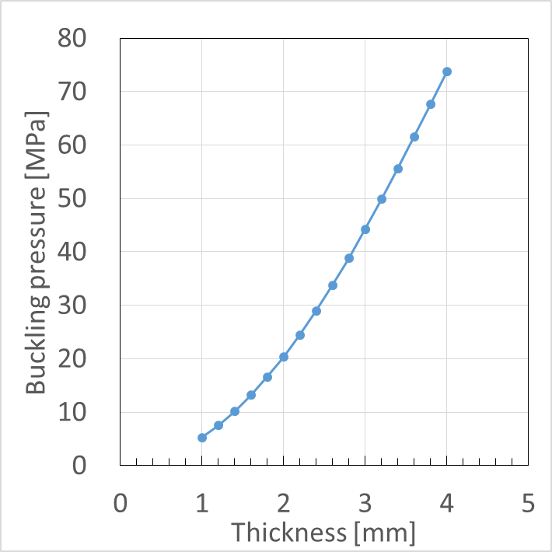
Results
Maximum temperature was less than 500℃ even if t=4 mm
Von Mises stresses of all cases satisfied the criteria 3Sm
The buckling pressure with 4 mm thickness was 3.6 times larger than the value with 2 mm thickness
→ Non-liner buckling analysis is required as the future work

Slide 15
Summary
 | Previous study | This study
Proton beam energy [GeV] | 1.5 | ←
Proton beam current [mA] | 20 | 10
Number of SAR | - | 3
Beam duct radius [mm] | 235 | ←
Shape of beam window | Ellipse | Hemispherical
Thickness of beam window at top [mm] | 2.0 | 4.0
Buckling pressure | 4.1 [MPa]* | More than 3.6 times larger**
*: by non-liner buckling analysis
**: by liner buckling analysis

Slide 16
Concluding remarks
To realize the small burnup reactivity, subcriticality adjustment rod (SAR) is introduced to the ADS.
Maximum proton beam current was reduced from 20 to 10 mA by the use of 3 SARs.
Through the coupling analyses, more feasible beam window concept (hemispherical shape, 4 mm thickness) was presented.
Acknowledgement
A part of this study is the result of “Research and development to solve the engineering issues for transmutation system using accelerator-driven system” carried out under the Innovative Nuclear Research and Development Program by the Ministry of Education, Culture, Sports, Science and Technology of Japan

