Slide 1
Overview of achieved coupling experiments on zero-power FACILITIEs
F. MELLIER
CEA/Nuclear Energy Division
Cadarache, France
EuCard², Status of ADS Research and Technology Development, CERN, 7-9 Feb. 2017

Slide 2
Overview of achieved coupling experiments on zero-power FACILITIEs
Needs and interest for coupling experiments on ZPR
Brief review of worldwide initiatives
The very first tests (1994-1998) : FEAT, MUSE 1 & 2
MUSE-3
The MUSE-4 /GUINEVERE/FREYA suite
The YALINA-B experiment
Activities in KURRI/KUCA
Others programs
Conclusions
Out of scope: experiments involving accelerators and heavy metal blankets (U, Pb, W, ...) (with the exception of FEAT)
And sorry for the oversights if any !

Slide 3

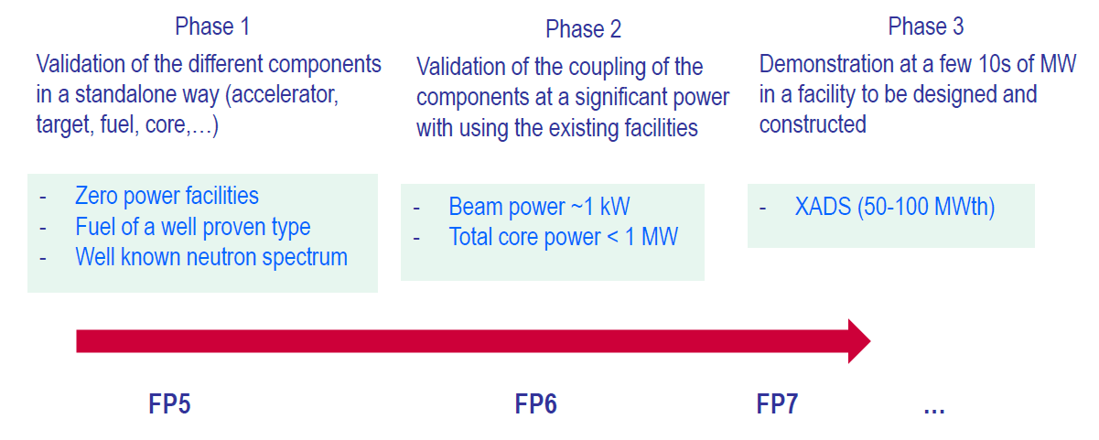


NEEDS & Interest for COUPLING experiments on ZPR
Background
ADSs present many challenges
- accelerator,
- spallation module,
- subcritical core, fuel and fuel cycle,
- operation, safety, licensing
Roadmap for developing ADSs in EU

Slide 4
NEEDS & Interest for COUPLING experiments on ZPR
Interest of zero power facilities
Flexibility
- many cores arrangements possible
- moving from one configuration
to another needs some days/weeks
Very low power
- absence of thermal effects
- no consumption of fuel
- no major radioprotection issues
- no build-up of fission products
- no pressurized fluid circuits
parametric studies
well mastered experimental conditions
easy to instrument (the fissile
zones too)
wide range of measurements
appropriate for validation of
both nuclear data and
calculation methods
also relevant for evaluation of
new experimental techniques
and analysis methods
Limited maintenance and
operating costs

Slide 5
NEEDS & Interest for COUPLING experiments on ZPR
Main physics concerns of ADSs that can be addressed
on ZPRs
Proton beam/Spallation target device
- properties of radiation fields around the target depending on the beam energy, the materials of the target (Pb, Pb-Bi, W, Ta, U), its geometry, …
Coupling of external neutron source with the subcritical core
- spatial and energy distribution of neutrons into the core,
- time evolution of neutron population depending on the position
- source importance as a function of neutron energies, source position, …
Safe operating of the system
- reactivity calibration at core loading and beginning of cycle
- monitoring of the reactivity during operation
Improvement of nuclear data (neutron cross sections > 20 MeV)
- reaction rate distribution
Evaluation/validation of calculation methods
- benchmarking on codes and ND libraries

Slide 6
Brief review of initiatives world-wide

Slide 7
Brief review of initiatives world-wide
Opportunity Study
- Czech: LA-0 project
- Russia: ADS facility at Institute of Nuclear Research
- U.K.: Reconversion of CONSORT reactor
Project outline
- Brazil: Proposal of a National Program on ADS R&D including coupling experiments at IPEN-MB-01 reactor
Large project stopped prematurely
- Italy: TRADE plus project
- Russia: SAD project
- USA: RACE project
Very first test
- Switzerland (FEAT), France (MUSE-1/2)
Low power experiment achieved
- Belarus (YALINA-B), Belgium (GUINEVERE/FREYA), Brazil (IPEN-MB 01),
China (VENUS-1), France (MUSE-3/4), India (Purnima-BRAHMMA), Italy (RACE-T
experiments), Japan (experiments at KURRI/KUCA & FCA), USA (RACE-LP)

Slide 8
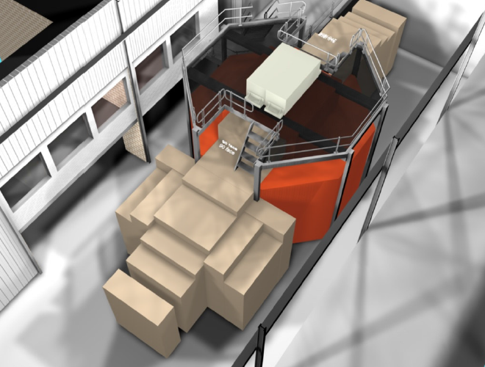
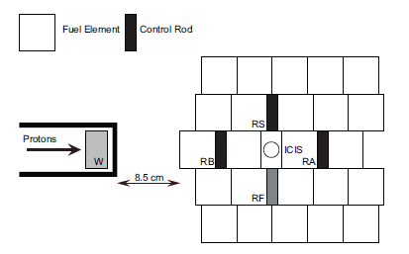
Brief review of initiatives world-wide
Opportunity study / Project outline
- Czech Republic: Proposal for a molten fluoride salt experimental loop in the LR-0 research reactor and further coupling with protons and a W target (LA-0 project, mid 1990s)
- Russia: Proposal of an ADS stand of ~5 MWth using INR linear proton accelerator (300-600 MeV, some 100 μA), W or Pb-bi targets, LEU, (early 2010s)
- United Kingdom: Reconversion of CONSORT reactor (100 kW) in an experimental subcritical facility (early 2010s)
Schematic drawing of the subcritical driven core
CONSORT reactor

Slide 9
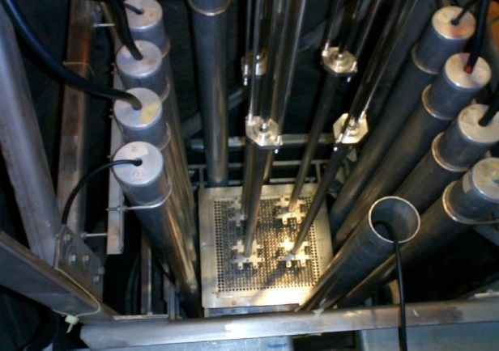
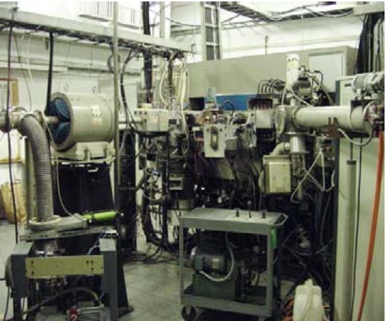
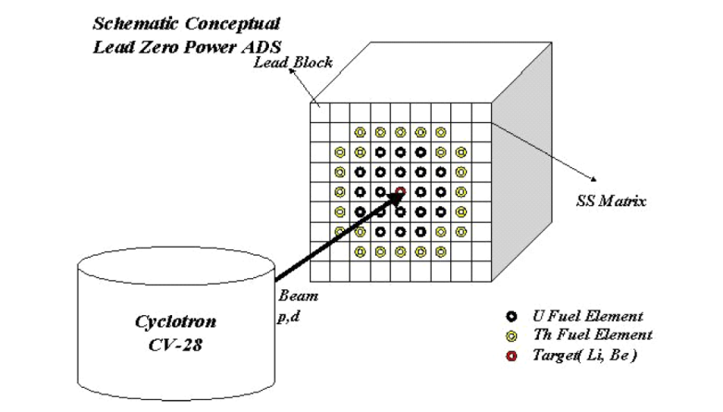
Brief review of initiatives world-wide
Opportunity study / Project outline
- Brazil: Sketch of a National ADS R&D Program (early 2000s)
Idea of coupling IPEN-MB 01 critical assembly with
1- a D-D/D-T neutron generator developed by Lawrence Berkeley
National Laboratory)
2- a cyclotron (IPEN CV-28) delivering 24 MeV protons impinging a Be target
Conceptual design of a lead subcritical core using U/Th fuel
View of IPEN-MB-01 core
View of IPEN CV-28

Slide 10
Brief review of initiatives world-wide
Large project stopped prematurely
Italy / TRADE plus
Russia / SAD
USA / RACE-HP
Core powers in the range 20 – 100 kW for all
k_{eff} ranging from 0,95 to 0,99
Abandoned by lack of funding
Intermediate power coupling experiments
Necessary for gaining experience with the operating of ADSs

Slide 11
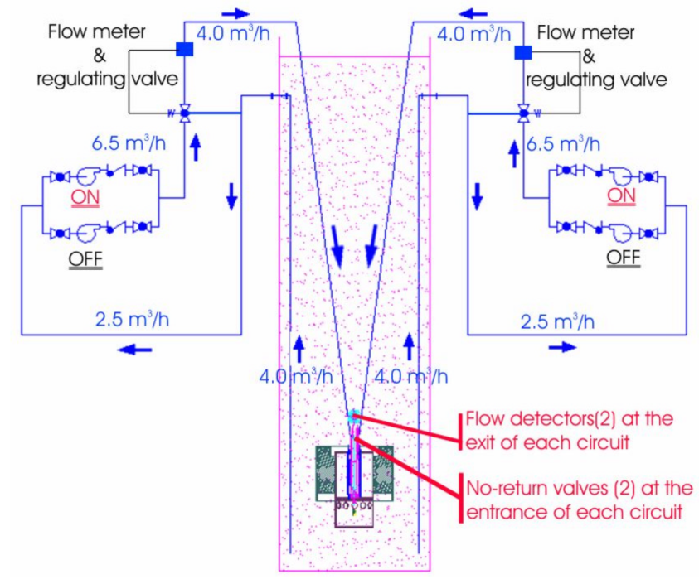
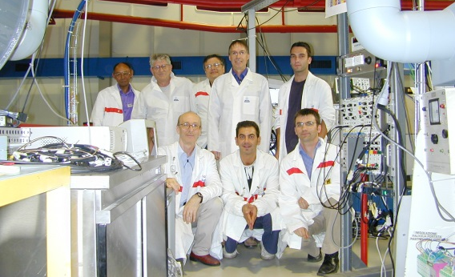
Brief review of initiatives world-wide
Project stopped prematurely
- Italy / TRADE plus project (2001 - 2005 / FP6 IP-Eurotrans)
- 150 MeV protons (cyclotron) (0.1 mA beam current)
- Ta target
- EXISTING thermal core (ENEA RC-1 TRIGA reactor)
- Pre-TRADE experiments achieved
using Am-Be source and D-D/D-T
generator (2004-2006)

Slide 12
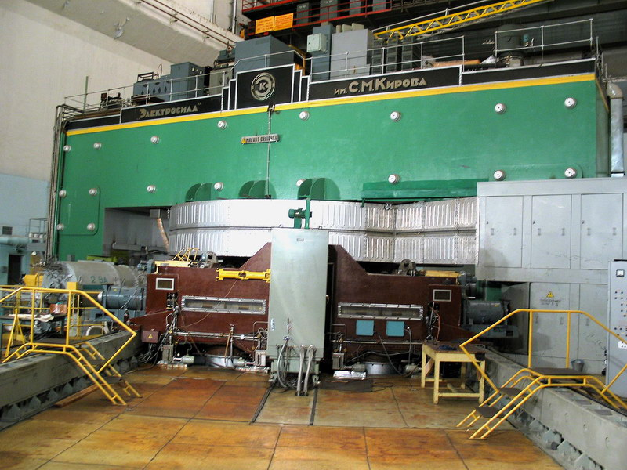
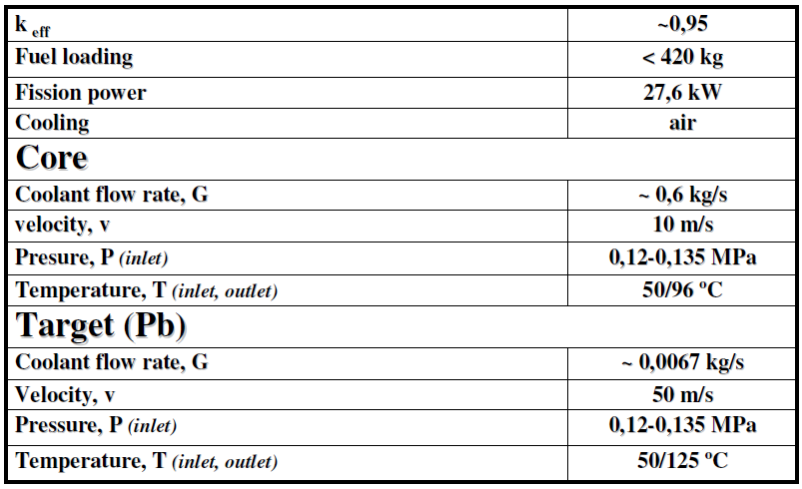
Brief review of initiatives world-wide
Project stopped prematurely
- Russia / SAD project (2000 – 2006 / ISTC#2267 + support of EU partners)
- EXISTING 660 MeV protons from JINR-Dubna phasotron (some μA)
- Pb target (air cooled)
- fast subcritical core (MOX fuel),
SAD closest system from power ADS
SAD Basic data
Dubna proton accelerator

Slide 13
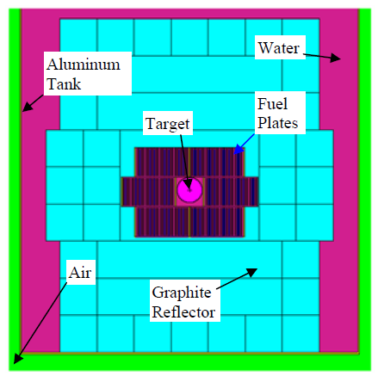
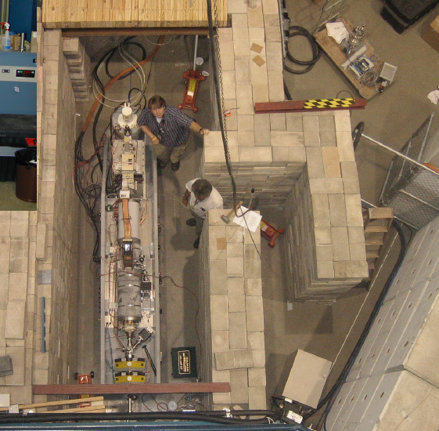
Brief review of initiatives world-wide
Project stopped prematurely
- USA / RACE-HP (High power) (2003 - 2007 / AFCI + Mou IP-Eurotrans)
- EXISTING 20 MeV electrons (portable LINAC)
(80-100 mA beam current => 2 kW max.)
- Prototype W-Cu target (water cooled)
- EXISTING thermal cores (UT NETL & TAMU TRIGA) reactors
IAC full core configuration
- zero power experiments achieved at ISU-IAC (RACE-LP).
Main outcome: PNS techniques are applicable with an e⁻ LINAC
- very preliminary experiments at UT-NETL at low core power
(< 100 W) (many operationnal problems to solve)
LINAC in place at UT NETL TRIGA

Slide 14
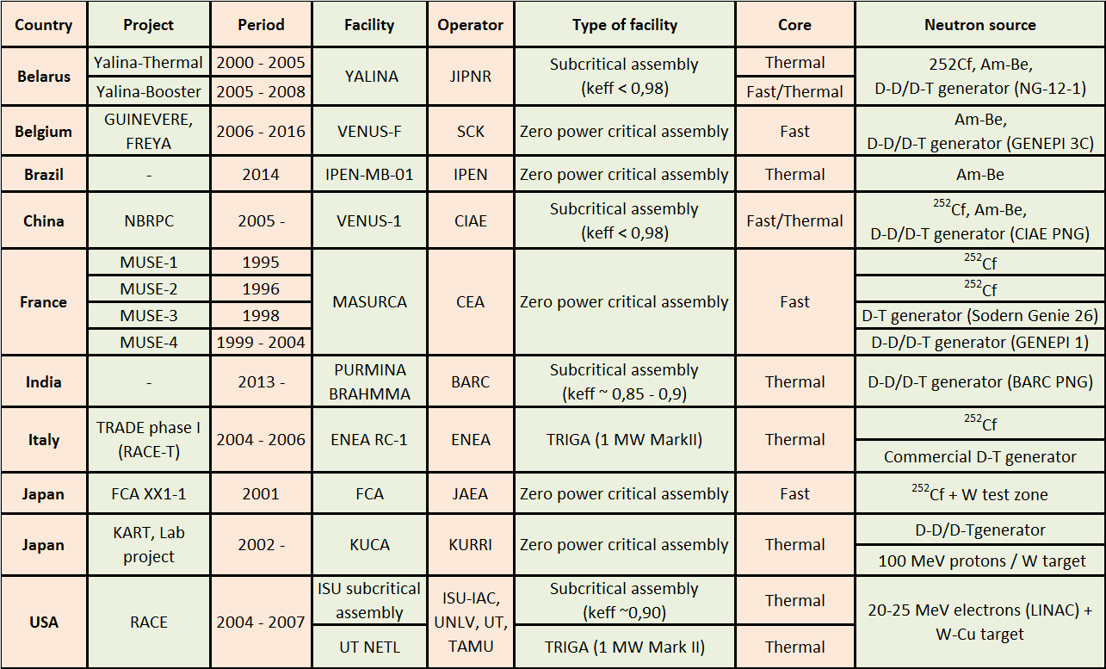
Brief review of initiatives world-wide
Low power experiments completed

Slide 15
achieved Coupling experiments
The very first tests : FEAT, MUSE-1 & 2
MUSE-3
The MUSE-4/GUINEVERE/FREYA suite
The YALINA-B experiment
Activities IN KURRI/KUCA
Others programs

Slide 16
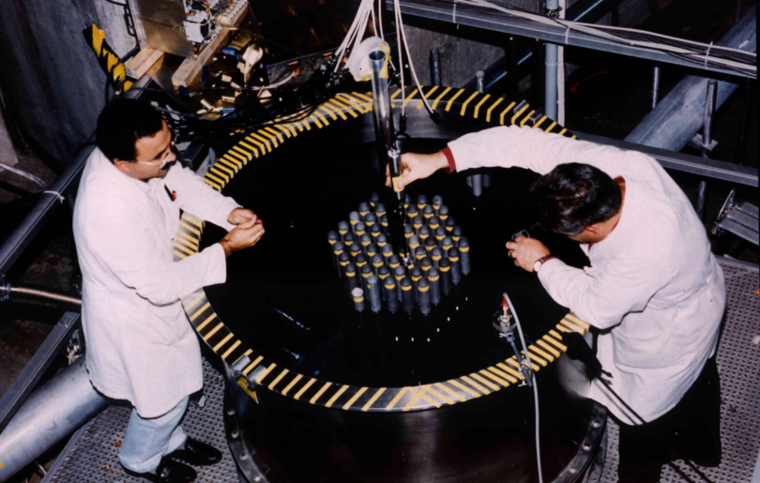
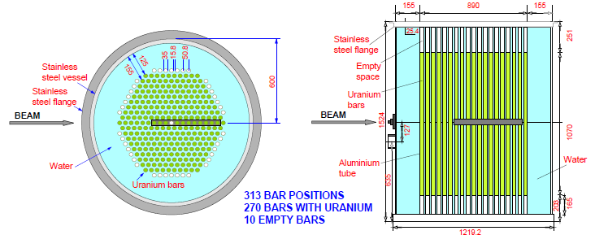
The beginnings : FEAT, MUSE-1/2
  FEAT : First Energy Amplifier Test (1994 / CERN)
  - Objectives:
  Study the Energy gain as a function of proton energy
  Validate Monte Carlo simulation
    - Set-up:
  3.5 tons of U_{nat} immerged in water
  k∞ = 0.97, k_{source} ~ 0.91
  Proton beam from CERN PS accelerator
  Proton energy in the range 0.5 - 3 GeV, 10⁸ p/s
  Beam power ~ 1W
  Target : Pb, W
« Demonstration of an Accelerator-Driven System for the Destruction of Nuclear Waste »
Y. Kadi, J.-P. Revol – Workshop, Trieste, September 2001 »

Slide 17
The beginnings : FEAT, MUSE-1/2
  FEAT : First Energy Amplifier Test (1994 / CERN)
  - Objectives :
  Study of the ratio ‘’Energy produced in the device / Beam energy’’ (Energy gain as a function of proton energy)
  Monte Carlo code validation
    - Main results
  Optimum proton
  energy at ~900 MeV
  Phenomena well
  predicted
  by MC simulation
S. Andriamonje & al., “Experimental determination of the energy generated in nuclear cascades by a high energy beam”, Physics Letter B, Volume 348, Issues 3-4, 6 April 1995, Pages 697-709

Slide 18
The beginnings : FEAT, MUSE-1/2/3
  MUSE-1 & 2 : first parametric studies (1995-1996 / CEA+CNRS)
    - Short tests (2 weeks & 2 months) taking advantages of fast cores loaded in the MASURCA facility at CEA /Cadarache for programs underway at that period (Mox fuel, Pu content ~24.5%)
    - Neutron source = ²⁵²Cf (7.6 10⁷ & 6.1 10⁷ n/s) at different axial positions (mid core plane, +15 cm , +25 cm)
    - Two different diffusing materials (sodium, steel) placed around the source
    - Measurements of : reactivities (standard method used for critical reactors), ²³⁵U fission rate distributions, source importance
    - Main results
      - feasibility of measurements at deep subcritical levels confirmed
      - demonstration the source effect/importance (more “peaked” distributions as expected)
      - good agreement between calculations and experiments (deterministic and MC simulations)

Slide 19
The MUSE-3 EXPERIMENT AT MASURCA Facility
  MUSE-3 experiments (1998 / CEA+CNRS+EDF+FRAMATOME)
    - Enlargment of collaboration between french institutes (GEDEON research network)
    - Several subcritical cores (k_{eff} = 0.995, 0.99, 0.985, 0.95)
    - Neutron source = SODERN genie 26 D-T pulse generator at core center (3, 10⁸ n/s)
    - Two different diffusing materials (sodium, lead) placed around the source
    - Measurements of : reactivity (standard method, PNS/fit method), ²³⁵U fission rate distributions, source importance
    - First Pulsed Neutron Source measurements and first difficulties with the analysis of data
    Main outcome of the program
      - need for a dedicated neutron generator with improved performances (in terms of quality of the pulse and source intensity)
        ➔ GENEPI (GEnerator of NEutrons Pulsed & Intense)
        - Designed and built by CNRS
Pulsed neutron source measurements in MUSE-3 at different subcritical levels

Slide 20
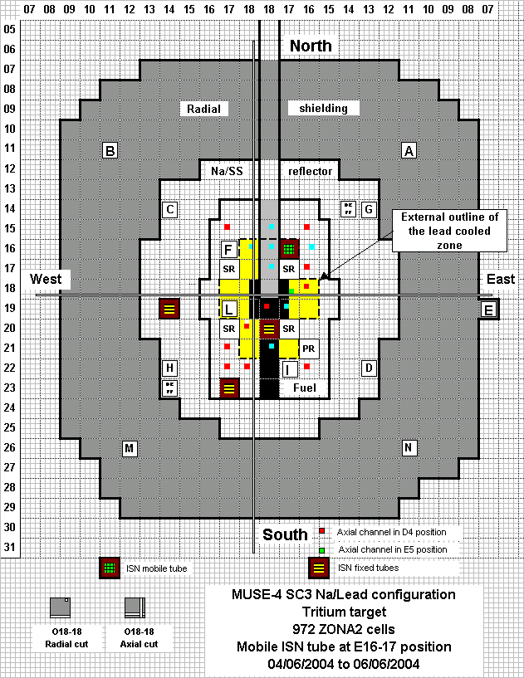
THE MUSE-4/GUINEVERE/FREYA suite
MUSE-4 project (2000-2004 / Euratom FP5 )
  - international collaborations (FP 5 /12 partners; bilateral collaborations with DOE, PSI and JAERI)
  - fast Mox core especially designed for the program (lead zone simulating a spallation target)
  - horizontal beam line
  - licencing of the experience more time consuming
  due to the presence of GENEPI and the physics of
  a coupled systems (first of a kind for our safety
  authorities)
  - Five phases : critical, SC0 (0,994), SC2 (0,97),
  SC3 (0,97), SC3 Na/Pb (0,965)
  - extensive characterization of the cores
  - not only ²³⁵U fission rate distributions; also : ²³²Th,²³⁸U,
  ²³⁷Np, ^{239, 240, 242}Pu, ²⁴¹Am …, a number of dosimeters , ..
  - measurement of kinetics parameters

Slide 21
THE MUSE-4/GUINEVERE/FREYA suite
MUSE-4 project (2000-2004 / Euratom FP5)
  - much time and effort devoted to the reactivity control issue (without a priori for their applicability)
More than 10 methods

Slide 22
THE MUSE-4/GUINEVERE/FREYA suite
MUSE-4 project (2000-2004 / Euratom FP5)
  - several theoretical developments in support of analysis :
  - derivation of Feynman-a functions considering a pulsed source
  - development of a new kinetics model based
  on the neutron inter-generation lifetime
  distribution (the k_{promt} method),
  Main outcome
  - a proposal of strategy for the control and monitoring of the reactivity based on :
  - PNS measurements for the control of reactivity at BOC (and a selection of most appropriate methods : area method, k_{prompt} method, fit methods),
  - continuous monitoring of the beam current/flux ratio (monitoring of source to be implemented in next programs)
  - intermediate cross checking, during operation, taking advantage of regular and short beam interruption)
  ➔ New specifications for next external neutron source
  ➔ Base for futur experimental program to be performed in FP 6 IP-EUROTRANS
S. Chabod & al., "Reactivity Measurement at GUINEVERE Facility Using the Integral kp Method, PHYSOR 2014, Kyoto, Japan, Sept. 28th–Oct. 3rd

Slide 23
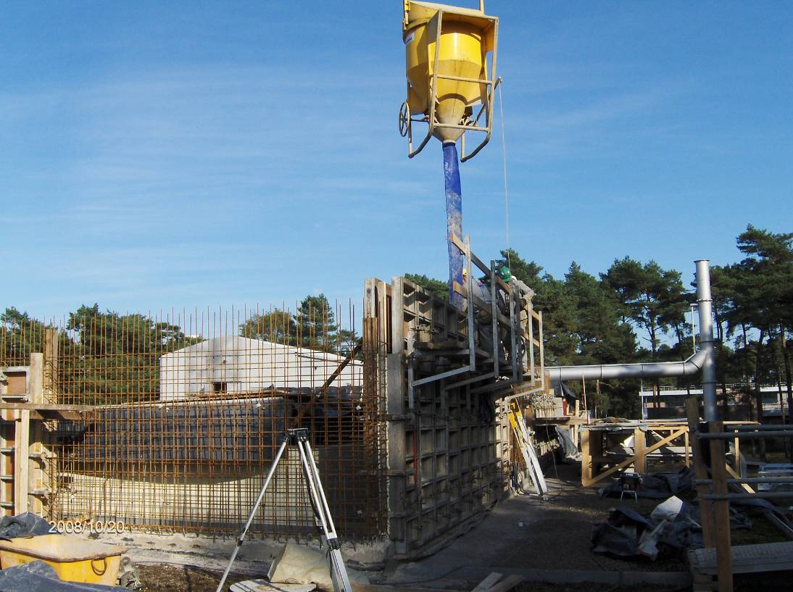
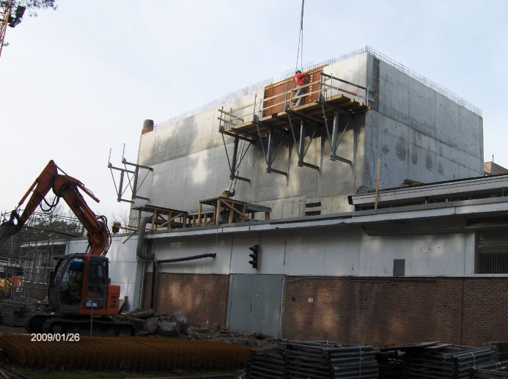
THE MUSE-4/GUINEVERE/FREYA suite
GUINEVERE (2005-2010 / Euratom FP6 – IP Eurotrans)
  - facing with abandoning of TRADE plus project, SCK-CEN proposed to host the continuation of MUSE-4 in the VENUS facility
  - only preparatory work could be achieved during FP 6 time window:
  - transformation of the VENUS facility (initially devoted to light
  water reactor studies) into a fast critical assembly VENUS-F
P. Baeten, “The GUINEVERE project at the VENUS-F facility”, Proceedings of the International Conference on the Physics of Reactors - PHYSOR 2008, Interlaken, Switzerland

Slide 24
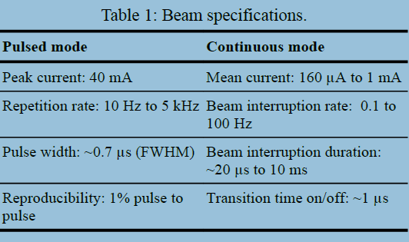
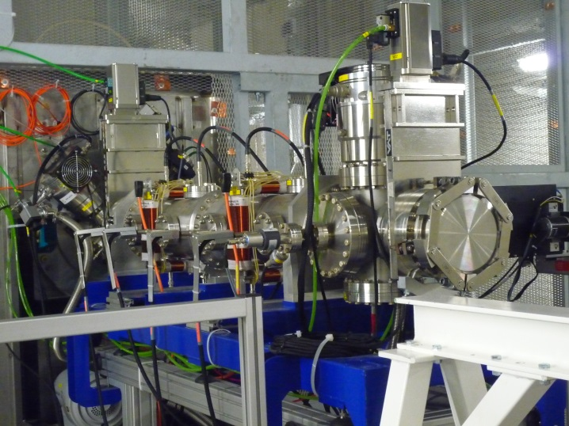
THE MUSE-4/GUINEVERE/FREYA suite
GUINEVERE (2005-2010 / Euratom FP6 – IP Eurotrans)
  - facing with abandoning of TRADE plus project, SCK-CEN proposed to host the continuation of MUSE-4 in the VENUS facility
  - only preparatory work could be achieved during FP 6 time window:
  - transformation of the VENUS facility (initially devoted to light
  water reactor studies) into a fast critical assembly VENUS-F
  - development of a new generator able to operate in continuous
  wave, pulsed and beam trip modes
M. Baylac, “The GENEPIC-3C accelerator for the GUINEVERE project”, International topical meeting on nuclear research applications and utilization of accelerators; Vienna (Austria); 4-8 May 2009

Slide 25
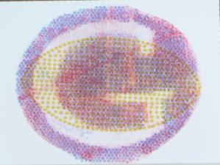
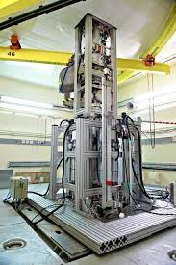
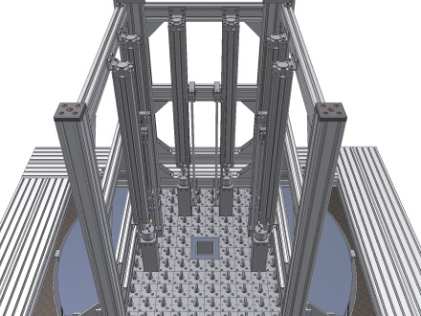
THE MUSE-4/GUINEVERE/FREYA suite
GUINEVERE (2005-2010 / Euratom FP 6 – IP Eurotrans)
  - facing with abandoning of TRADE plus project, SCK-CEN proposed to host the continuation of MUSE-4 in the VENUS facility
  - only preparatory work could be achieved during FP 6:
  - transformation of the VENUS facility (initially devoted to light
  water reactor studies) into a fast critical assembly VENUS-F
  - development of a new generator able to operate in continuous
  wave, pulse and beam trip modes
  - design & building of a brand new core,
  preparation of safety file, licencing
  - first criticality on february 2011
  - experimental program to be conducted in next program (FREYA / FP 7)

Slide 26
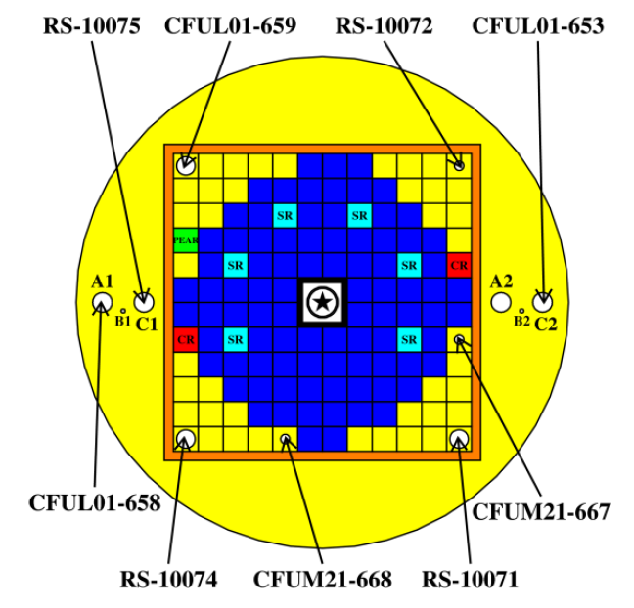
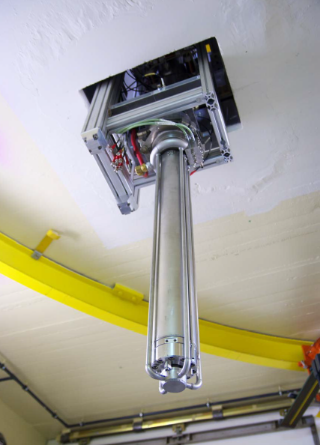
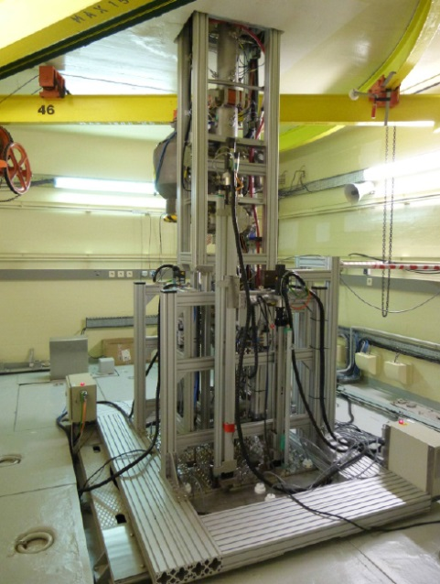
THE MUSE-4/GUINEVERE/FREYA suite
FREYA (2011-2016 / Euratom FP7 )
  - better representativity of ADS : a full fast lead system (core+reflector) , an axial beam line, an external source allowing to operate in CW mode and with short beam interruptions, most of detectors out-core
  - experimental program in the line of MUSE-4 and also taking into account the outcomes and lessons from YALINA-B
  - extensive measurement program in the three modes (pulsed, CW, BT) of neutron generator

Slide 27
THE MUSE-4/GUINEVERE/FREYA suite
FREYA (2011-2016 / Euratom FP7 )
  - again much effort devoted to the reactivity calibration and monitoring issue
  - most of detectors out of core
  - results compared to a robust reference established in critical configuration (as it was also in MUSE-4)
  - reactivity calibration:
  confirmation of accuracy and robustness of area method
  confirmation of potential of k_{prompt} method for short time measurements
  - reactivity monitoring:
  detailed and successfull analysis of beam trip experiments
J.L. Lecouey & al., “Estimate of the reactivity of the VENUS-F subcritical configuration using a Monte Carlo MSM method”, Annals of Nuclear Energy 83 (2015) 65-75
T. Chevret, ‘’Mesure de la réactivité de réacteurs sous-critiques pilotés par accélérateur
par l'analyse d'expériences d'interruptions de faisceau programmées’’, 2016, Thesis

Slide 28
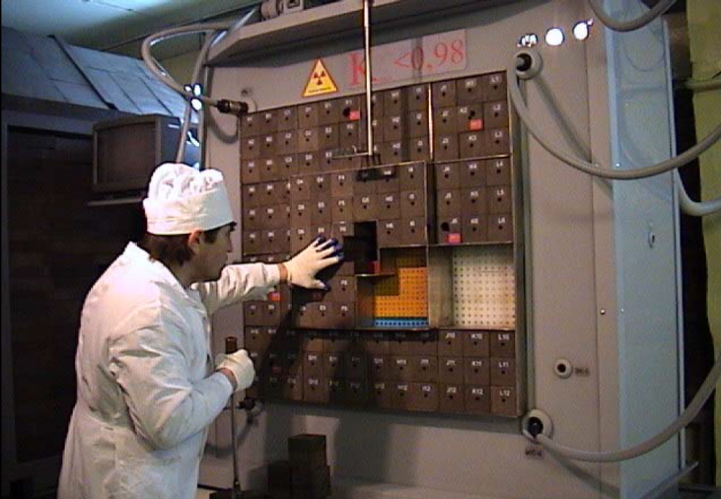
The YALINA-Booster experiments
YALINA (‘’spruce’’ in Belarus langage)
- subcritical facility (k_{eff} < 0,98),
- purpose : investigate the static and dynamics
behaviour of ADS and properties of MA
transmutation reactions
- ²⁵²Cf, Am-Be, D-D/D-T generator (up to
1,5 10¹² n/s with rotating TTi target device)
- first operation in the early 2000s
Initially, thermal core using LEU (10%)
New configuration Yalina-Booster (2005-2006)
- more representative of ADS neutron spectrum (central fast zone)
  - first experiments with beam trips (nevertheless polluted by electromagnetic interference)
  - appreciation of reactivity measurement results accuracy remains difficult due to the lack of reference
  - participation of IP EUROTRANS partners to the experiments and further analysis
V. Becares, Evaluation of reactivity monitoring techniques at the Yalina – Booster subcritical facility, 2014, Thesis

Slide 29
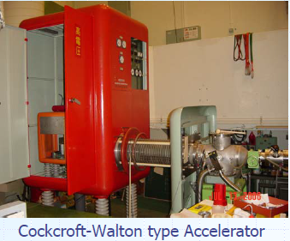
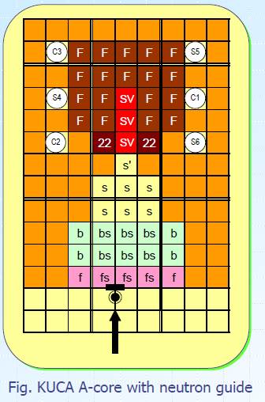
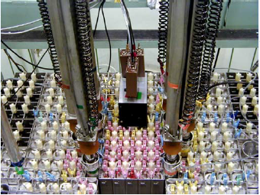
Activities At KUCA (Kyoto University Critical Assembly)
Critical facility (100 W max.)
  - Enriched uranium core moderated and
  reflected by high density polythen (A core)
2002: launch of the KART project (five years) with the aim of
  - Constructing of a FFAG (Fixed Field Alternating Gradient)
  - Coupling it at KUCA A core
  - First experiments with 14 Mev neutrons from D-T generator
KUCA A, B, C
Accelerator Complex

Slide 30
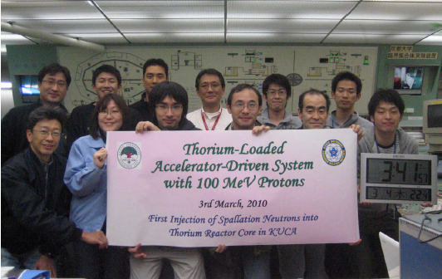
Activities At KUCA (Kyoto University Critical Assembly)
2008 : first extraction of 100 MeV protons from the FFAG
March 2009 : first injection of 100 MeV (3 pA) protons onto a W target located at the periphery of KUCA A core
March 2010 : first injection of 100 MeV (30 pA) protons onto a W target located close a ²³²Th assembly
Since : further studies with different spallation targets + D-T generator, various Th cells and fuel, several sucritical levels + critical states, different target positions, …, many publications

Slide 31
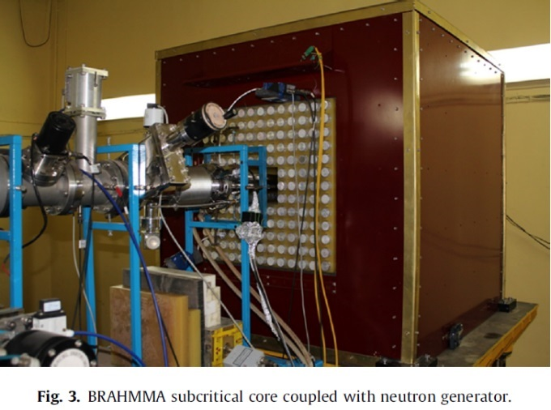
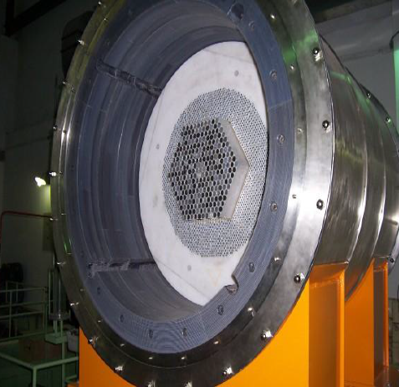
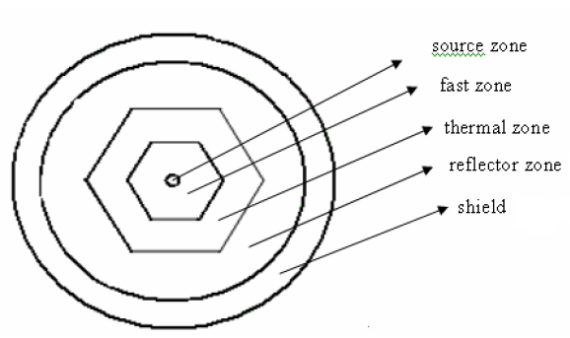
OTHER PROGRAMS
BRAHMMA experimental facility (India/BARC, 2013)
  - subcritical facility, Made in India D-T generator
  - natural uranium core moderated by high
  density polythen + Be0 reflector
  - series of PNS and source jerk experiments
  with keff in the range [0.89 ; 0.95]
  - analysis with point kinetics without any added
  correction; few results published
VENUS-1 experimental facility (China, 2005)
  - Subcritical facility (keff < 0.98)
  - Coupled fast/thermal zones, CH₂ reflector
  - CIAE Pulsed Neutron generator
  - first coupling in 2005, five keff
  - PNS experiment analysis work in 2007
  - PNS simulation work in 2011
Venus-1

Slide 32
OTHER PROGRAMS
Programs that used only radioactive neutron sources
FCA XXI-1
- FCA (Fast Critical Assembly), similar to MASURCA, operated by JAEA
  - FCA XXI-1 core devoted to investigations on measurement of deep subcritical levels
  - ²⁵²Cf + W test zone at core center
  - FCA design serves as a reference for TEF-P
Experiments at IPEN-MB-01
  - Critical facility for light water cooled reactor studies
  - Tests with an Am-Be neutron source for investigating a new experimental approach for the determination of subcritical levels using the ‘generalized reactivity kinetic model’ (A. Gandini & al., Journal of Nuclear Science and Technology 39 6 pp 673-686)

Slide 33
EXPERIMents AND MANY OTHER THINGS
Education, training
Collaborations
Development of new
calculation routines
Instrumentation (Detectors, DAQ)
Experiments
Simulations
Benchmarks
Theoretical developments
Reporting, publications
Extensive Monte Carlo simulations (much less in the early 90’s)
New approaches and kinetics models developed for the determination of subcritical levels (standard PK model is no more valid !)
Much work on noise methods (ex : derivations of Feynman-α formulae considering PNS)

Slide 34
Conclusions
For more than 20 years, coupling experiments on ZPR have been motivating many teams worldwide,
Different realizations (of unequal size) were carried out although some aspects (fuel and neutron spectrum in particular) were not always representative of a power ADS.
Some experiments combining the three main components of ADS (high energy protons, a heavy metal target, a subcritical core) could be achieved
The control and monitoring of reactivity is a shared key issue that concentrated most effort in EU initiatives and valuable progress have been made in this field (R&D conducted on this item is also relevant for critical reactors),
Further advances will need higher power experiments (core power of several tens/hundreds of kW). They remain a major objective.

Slide 35

Conclusions
Next steps
  - MYRTHE project in Belgium
  - follow-up of FREYA in VENUS-F facility, next step forward MYRRHA
  - funded by HORIZON 2020 EU Research and Innovation Program
  - Commissioning of NSC KIPT ADS in Ukraine
  - CLEAR-0 facility and associate experimental programs in China (more information in the upcoming presentation)
Beyond !
The future is the result of chance, of will and necessity
(Jacques Lesourne / French econosmist engineer)

Slide 36
Direction de l’Energie Nucléaire
Département d’Etudes des Réacteurs
Service de Physique Expérimentale
Laboratoire des Programmes Expérimentaux
Thanks for
your attention
| PAGE 36
CEA | 10 AVRIL 2012
Commissariat à l’énergie atomique et aux énergies alternatives
Centre de Cadarache| 13115 Saint-Paul-les-Durance Cedex
T. +33 (0)4 42 25 79 62 | F. +33 (0)4 42 25 78 76
Etablissement public à caractère industriel et commercial | RCS Paris B 775 685 019
8 février 2017

