Slide 1

Single Stage Cyclotron for an industrial ADS demonstrator
P.Mandrillon and M.Conjat
AIMA-DEVELOPPEMENT * with the contribution of J.Mandrillon
* Partner in the CYCLADS Proposal
Eucard2 Meeting, CERN February 8th 2017
Notes:
I am going to present a high intensity single stage cyclotron, proposed by the AIMA company in the framework of the CYCLADS proposal.
The CYCLADS Proposal will be presented by Marcello Losasso later in this conference

Slide 2
The requirements for an industrial ADS Demo
Beam Energy: in the 600 to 800 MeV protons to produce neutrons via spallation.
Beam Power: 5-10 MWatt.
Beam losses: internal losses < 200 Watt.
Reliability (beam trips)
Optimized Energy efficiency: η=P_{beam}/P_{grid}
Costs.
2
Notes:
Actually, The goal of an ADS driver is to reach a 600 to 800 MeV energy range and a 5 to 10 Mwatt power range, with a high reliability and a the highest yield, and of course the accelarator needs to be as cheap as possible

Slide 3
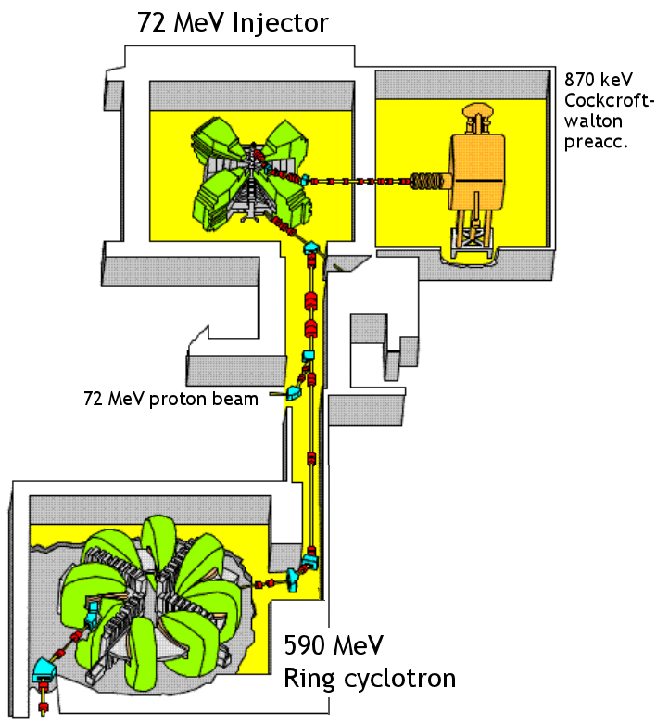
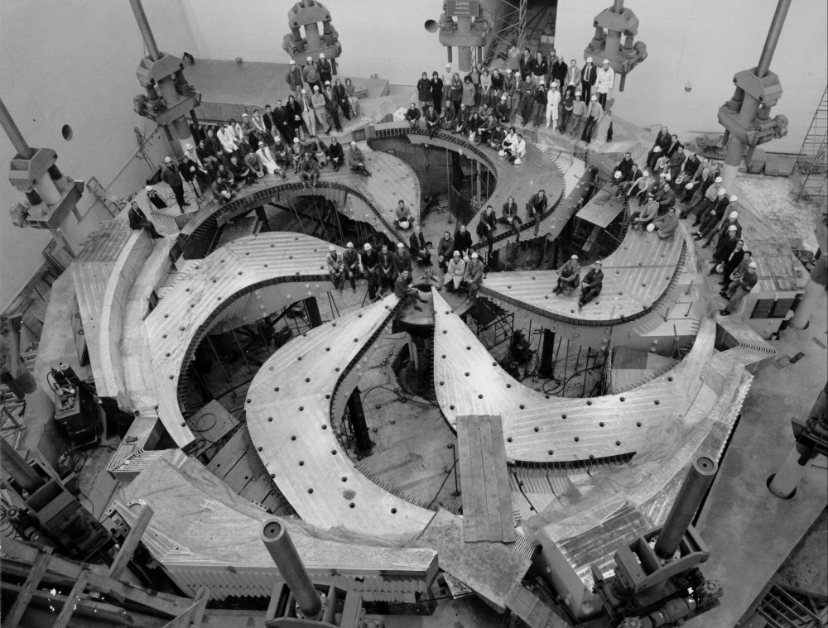
High intensity Cyclotrons:
The lessons from the pioneers:
PSI – H⁺ 590 MeV
Multi stage cyclotron based on single turn extraction
TRIUMF – H⁻ 520 MeV
Single stage cyclotron based on
stripping extraction
3
Notes:
Let’s say a few words about the 2 pionners in the domain of high intensity cyclotrons:
PSI, which is operating a 2 stages cyclotron, accelerating H+ particles up to 590 MeV
And Triumf, with its single stage cyclotron, stripping H- particles at 520 MeV

Slide 4
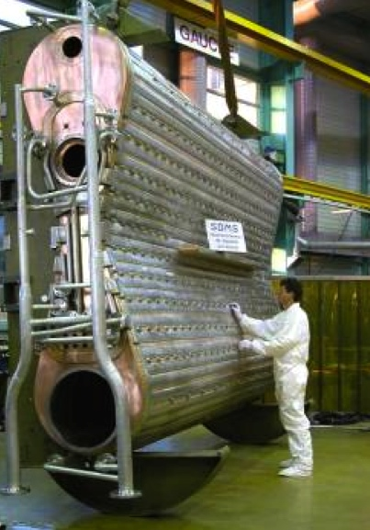
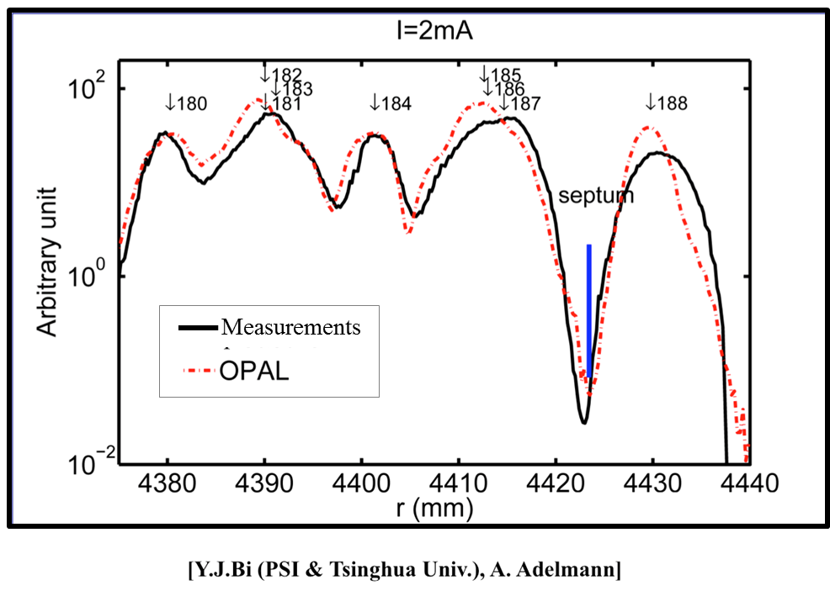
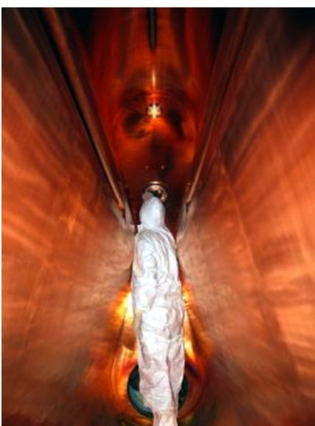
1) PSI: Single turn extraction
Excellent agreement simulations/measurements
> Increasing the separation δ between turns
δ=R/N*(γ/(γ+1))/ν_{r}²
> Reducing the number of turns N with
High power new RF copper cavities.
4
Notes:
The PSI team showed that we can achieve a good turn separation at extraction, which allows using an extraction channel with a septum with a higher yield (almost 99.98% in the PSI machine). On most of the other machines, there are some residual losses on the channel, which reduce its lifetime and mostly increase the activation.

Slide 5
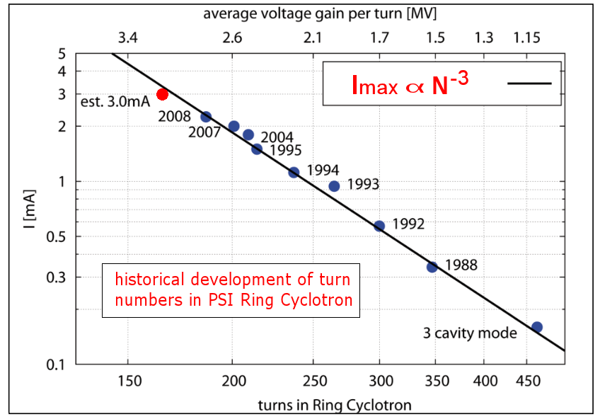
The successful Werner Joho law for intensity !
5
Notes:
Just a reminder to show the relation between the overall intensity and the number of turns in a cyclotron. It should be mandatory to reduce the number of turns

Slide 6
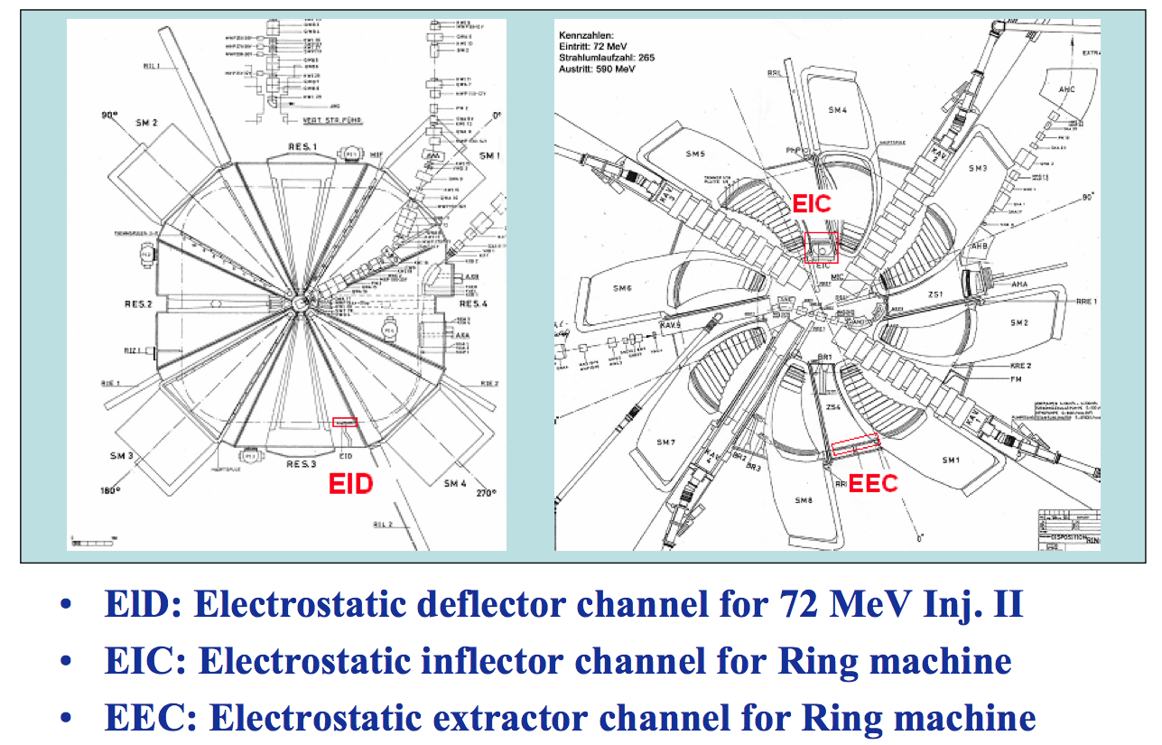
The injection/extraction devices
of the multi-stages solution
The PSI 2 stages geometry : a 72 MeV Injector and the 590 MeV Booster ring.
→ various injection and extraction channels
6
Notes:
Here you can see the different electrostatic devices of the PSI chain, at the exit of the 72 MeV injector, and at injection and extraction of the final Ring machine.
The problem of multiple electrostatic devices designs is that they are responsible of a significant amount of breakdowns, as we will see later, and they require regular maintenance

Slide 7
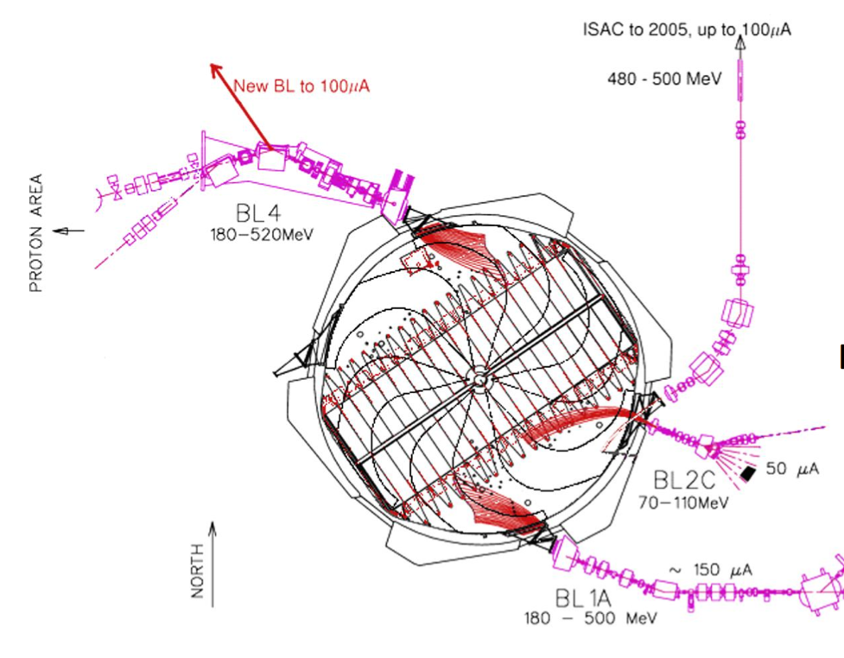
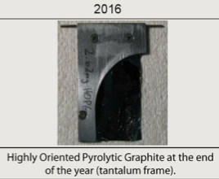
The overlapping turns extraction at TRIUMF by H- stripping
[R.Baartman]
500 mA*hours
The outstanding stripper foil lifetime !
Courtesy from Yuri Bylinskii
Well known method (low energy cyclotrons):
Drawback: The relativistic electromagnetic stripping of H- (0.754 eV)
➔ For 520 MeV, Bmax in the sectors 6 kGauss ➔ Large machine for 600 MeV
7
Notes:
A solution to avoid electrostatic devices break-downs is to extract by stripping, so the single turn extraction is not useful anymore, such as in the Triumf Machine. The advantage is that the extraction efficiency is generaly higher than an extraction by septum. But at this energy, there is a problem with H-: the electromagnetic stripping of H-, which is significant above 450 MeV. It can be avoided with a low magnetic field, this is why the Triumf accelerator has such a large radius. The Vaccum must be good also, to avoid disruption of H- by collisions. Actually the lifetime of a stripper foil gets longer and longer, thanks to new generation graphite, such as the ones used in Triumf

Slide 8
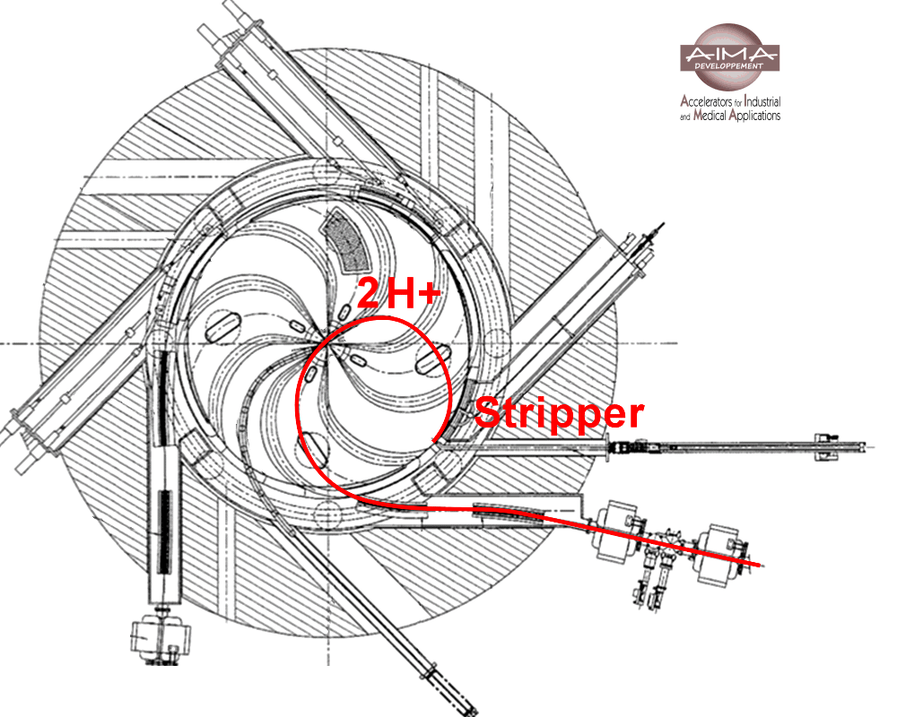
H2⁺ acceleration and inwards extraction of H⁺ by stripping
Important advantages of H2+ over H-:
Reduced space charge at low energy
High electron binding energy: 2.8 eV➔ High B
2 stripped protons/H2+ with half momentum
e- thermal load per proton on the stripper: divided by 4
L.Calabretta and D.Rifuggiatto
ECPM, Groeningen, 1997
e.g. Trade driver proposal (ENEA - AIMA)
to deliver 2mA-110 MeV protons
by stripping of 1mA, 220 MeV H2+
8
Notes:
Another way of producing H+ is the H2+ acceleration, which is a principle developped by Luciano Calabretta about 20 years ago. The advantage of this method is that it produces 2 H+ particles, coming from 1 H2+ accelerated particle, and the thermal load on the stripper is divided by 4.
A drawback of this kind of acceleration is that the H+ stripped trajectory is inwards the cyclotron, so the trajectory can be complex, due to magnetic sectors, for example. We also need to avoid hitting the central region.

Slide 9
Other examples of high power Cyclotrons:

Slide 10
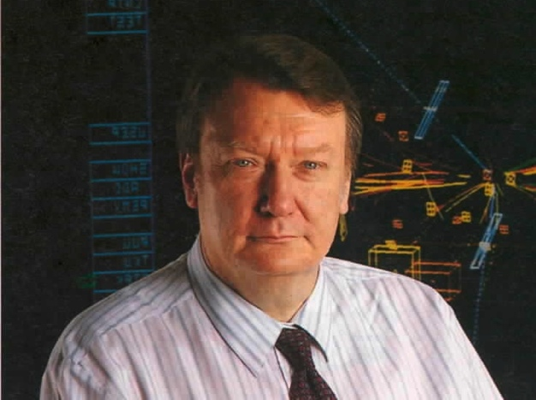
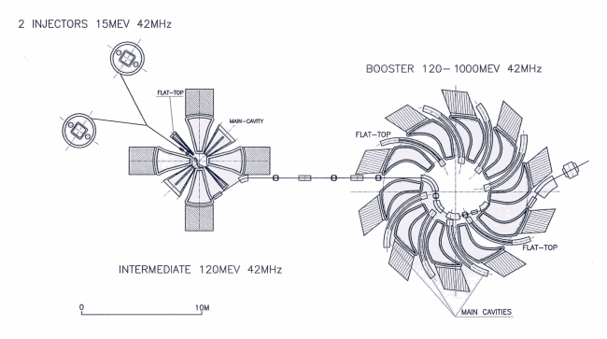
1995: Inspired by PSI the early proposal for driving
the Energy Amplifier with a 1 GeV 3 stages Cyclotron
N.Fiétier and P.Mandrillon, Beam Dynamics and Space Charge aspects in the design of the accelerators for the Energy Amplifier, Proc. of the 14th ICC, Cape Town, 1995
12 sectors- 6 Monogap cavities- 2FT cavities
H⁺
H⁻
4 sectors-2 delta cavities
1 Flat-top cavity
10
Notes:
Another example of High intensity cyclotron is this multi-stage accelerator, proposed to drive the Rubbia Energy Amplifier, 2 injectors are used together, one with H+ and the other one with H-, so the space charge effects between each bump in the injection line are reduced.

Slide 11
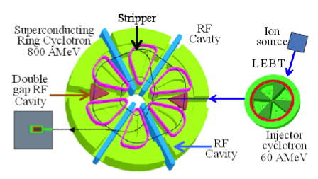
The Daeδalus two-stages H2+ 800 MeV/n Cyclotron
Catania group Design: L.Calabretta et al.,www.jacow.org, EPAC 2000, p. 918
A.Calanna et al., The Cyclotron complex for the Daedalus experiment, Proc. Of Cyclotrons 2013, Vancouver.
Magnet: 6 Sectors superconducting coils (Riken type)
RF: 4 Single gap RF Cavities (PSI Type)+2 double gap cavities
Extraction: stripping of H2+
11
Notes:
The Daedalus project. It accelerates H2+ ions, which allows a factor 2 on the extracted proton beam intensity owing to the stripping.
Except the particular case of the Triumf Single stage H- design, all these multi-stage accelerators could meet the ADS driver requirements. But If we plan to fully respond to ADS driver specificities, we should also take into acount compactness.

Slide 12
Single Stage Cyclotron Driver (S2CDTM)
based on the Reverse valley B-field
Option A: 600 MeV-10 mA protons
Option B: 1600 MeV-5 mA H2+ → 800 MeV-10 mA protons
Notes:
The Single Stage Cyclotron Driver, whose acronym is a trademark of the AIMA company
2 options have been considered…

Slide 13
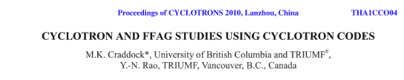
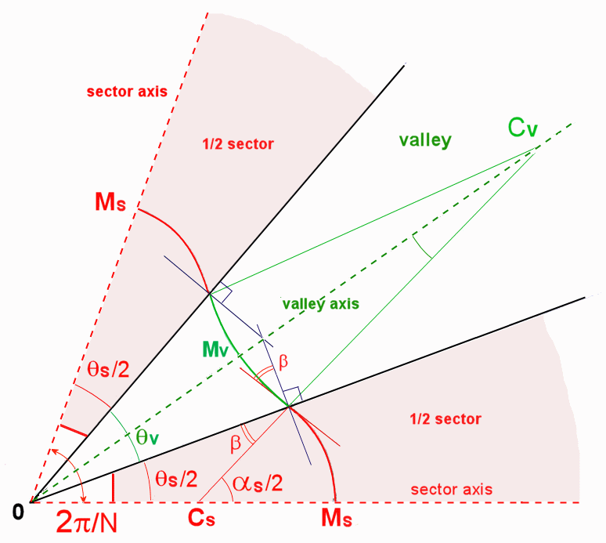
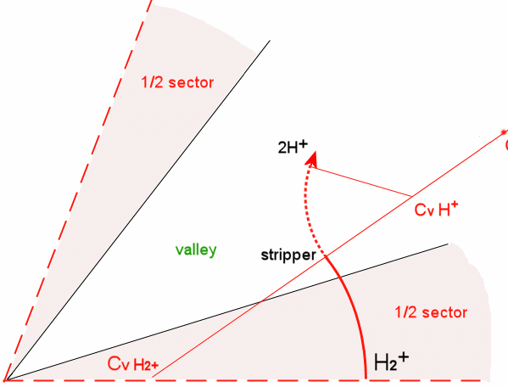
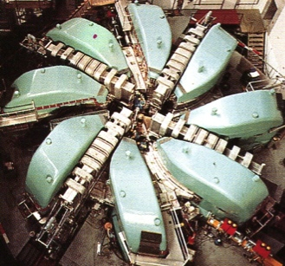
The reverse valley bends Cyclotron
isochronism:
> positive radial gradient of <B>
> strong vertical defocusing:
Δν_{z}² = -(γ²−1) = - (d<Β>/dr)r/<B>
> edge and spiral focusing
ν_{z}² =-(γ²−1)+F²(1+2 tan²ζ)
F²= Field Flutter = (<B²>-<B>²)/<B>²
ζ= spiral angle of the sector
2-A separated sector with reverse valley B:
→ Stronger Flutter ➔ No Spiral needed
Proton Extraction is more simple
by stripping of H2+ > very short !
by a bump, i.e. « Septum free extraction »
13
Notes:
First of all, obtaining isochronism at high energies is challenging: isochronism implies a positive radial gradient of the average B-field
resulting in a strong vertical defocusing: this could be overcome by edge and spiral focusing.
With a negative field in the valleys, the flutter gets so high that a spiral sector is not required anymore. We have made such calculations with a realistic magnetic field, as I’ll show you later

Slide 14
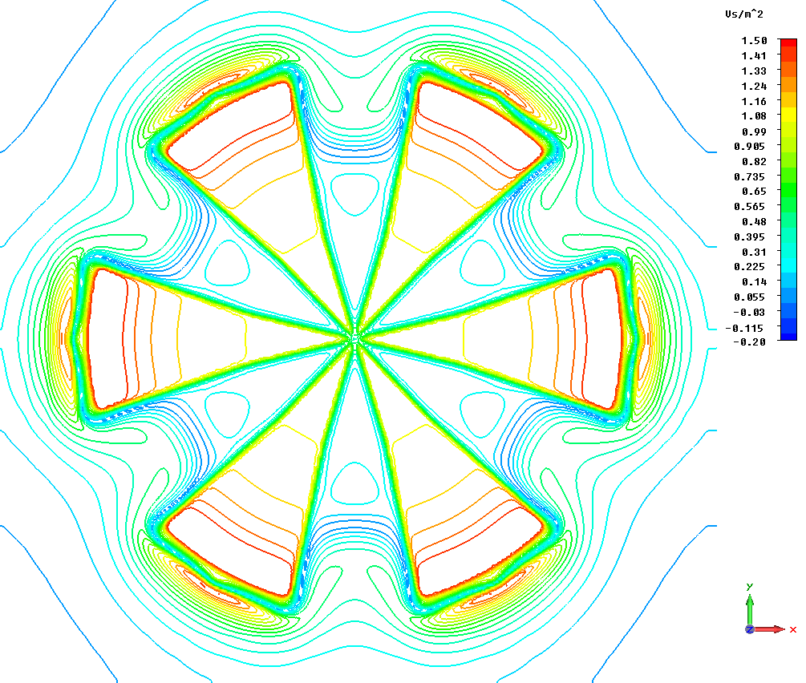
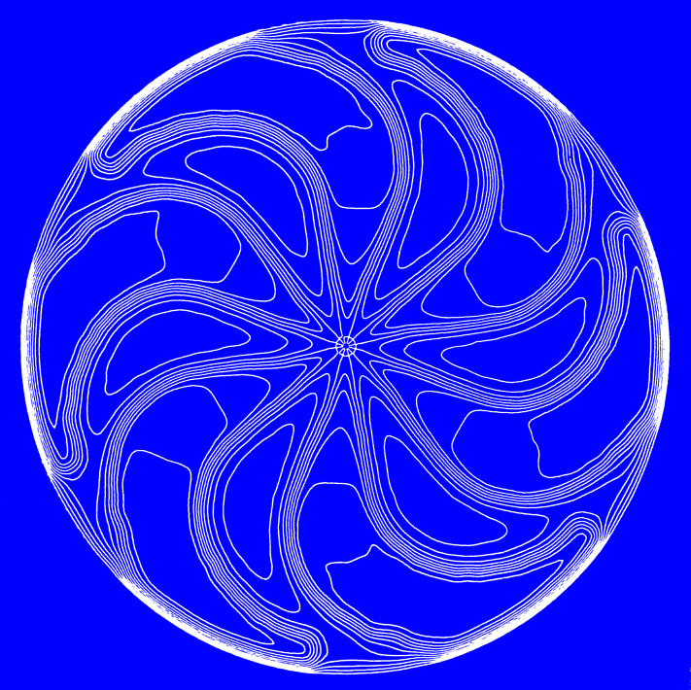
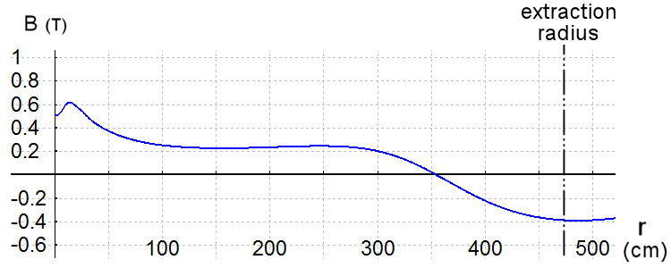
Single stage Cyclotrons Magnetic Fields
S2CD-600 MeV H+
With reverse Bv field
TRIUMF-520 MeV H-
10m
15m
B on the valley axis
14
Notes:
You can see the magnetic field along a valley, which shows the negative part close to the extraction, so the movement of the particles is reversed.
In the central region, there is magnetic field, which allows accelerating particles directly from an ion source, as we will see in the following slides.
A 600MeV H+ accelerator is somewhat smaller than the H- TRIUMF machine.

Slide 15
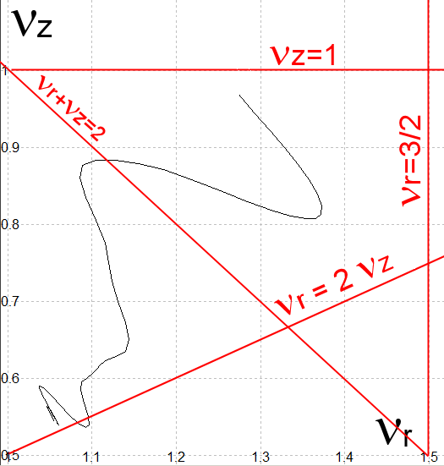
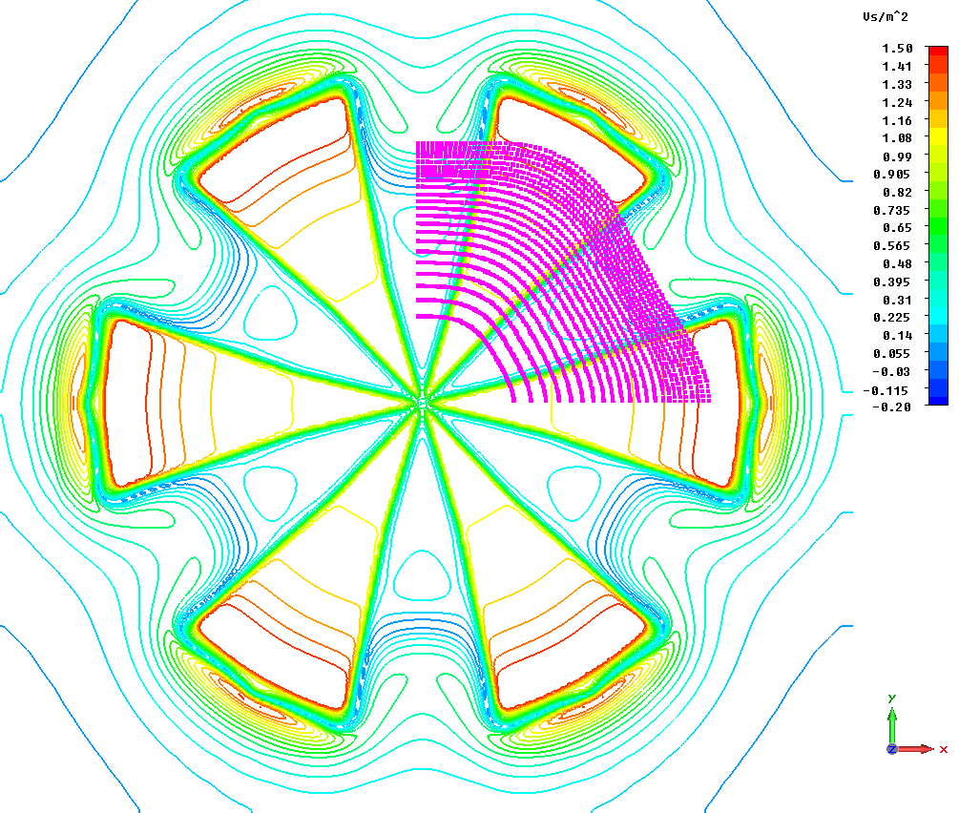
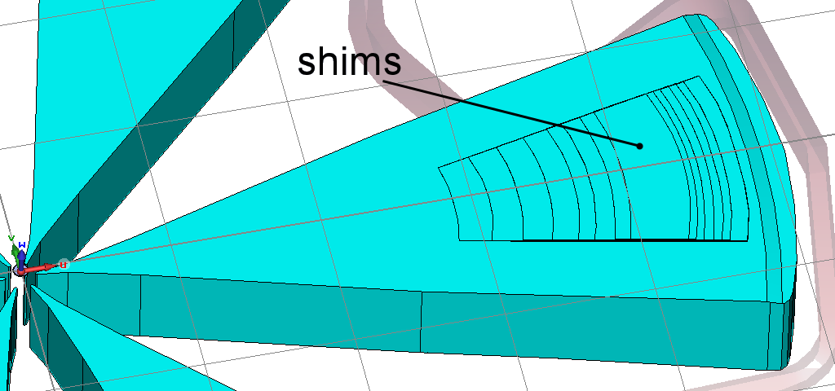
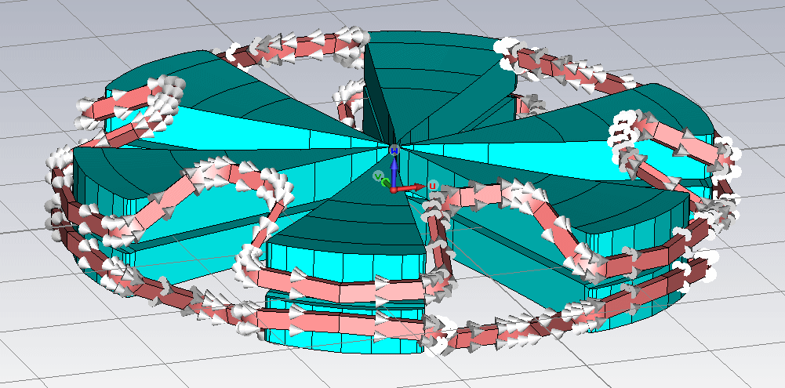
The 600 MeV proton S2CD
> Large complex Coils: 1.1 MAturns/coil
. Rmin: 3.6 m Rmax: 5.1m
. Total length ~48m
. Superconducting coil: Section: 130 mm * 280 mm Current density 31 A/mm²
. Water cooled Copper coil: Section 220* 470 mm Current density 10 A/mm²
15
Notes:
This is the 3D design of the S2CD, which shows H+ accelerations turns on the 1st quadrant, from 50 to 600 MeV. The Nuz equals 1 resonnance is avoided.
The sectors are flat, above the median plane, so this allows shimming quite easily.
The drawback of this design is that the coils are quite complex, with a total length of about 50m. The characteristics of such coils will be discussed with ASG, our partner in the CYCLADS project.

Slide 16
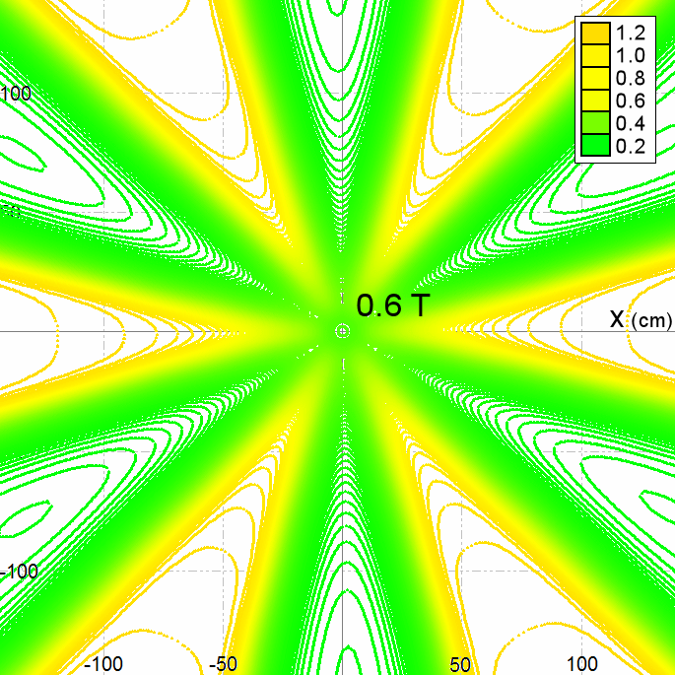
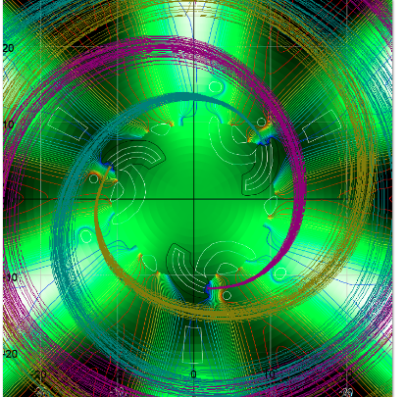
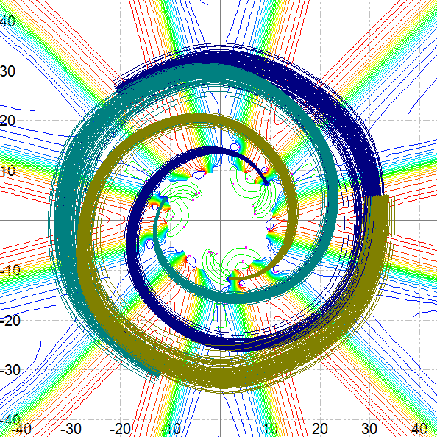
Triple injection central region
major advantage: low B-field in the central region
> 3 axial injections
➔An injector cyclotron is not needed anymore !
40° of phase acceptance
3 separated beams up to 1.8 MeV
16
Notes:
The advantage of this design, is that the central magnetic field is quite low, so we can house 3 axial injection lines with 3 different inflectors, at 60 kV each.
Using 3 different sources allows reducing the beam trips, and it is also useful for tuning the final intensity.

Slide 17
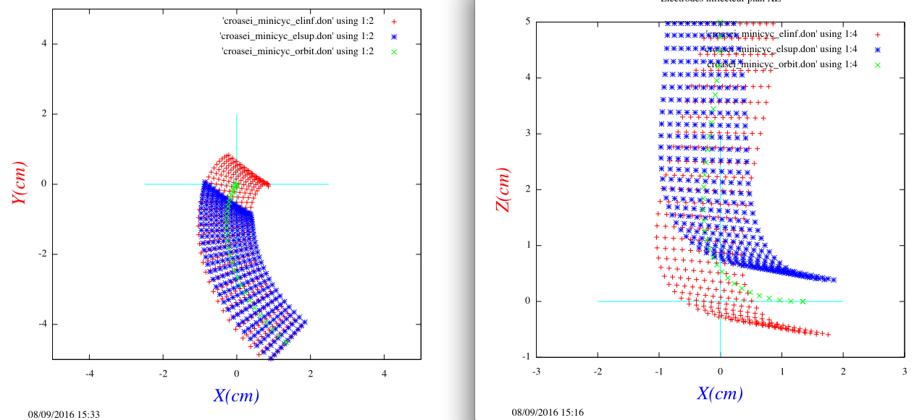
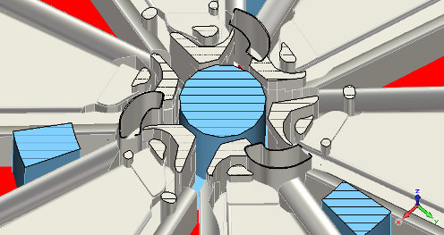
A single HV Platform for 3 Ion sources feeding 3 axial injections with spiral inflectors
Median plane
Vertical plane
E_{inj}= 60 KeV
E=20 KV/cm
k=0.6
k’=-0.15
The crowded Central region
The 60 KV platform
17
Notes:
These are the preliminary studies for the inflectors. We have made a rough design for the High voltage cup housing the 3 sources, but this remains to be further developped. The blue part is non magnetic pieces used to support the weight of the poles.

Slide 18
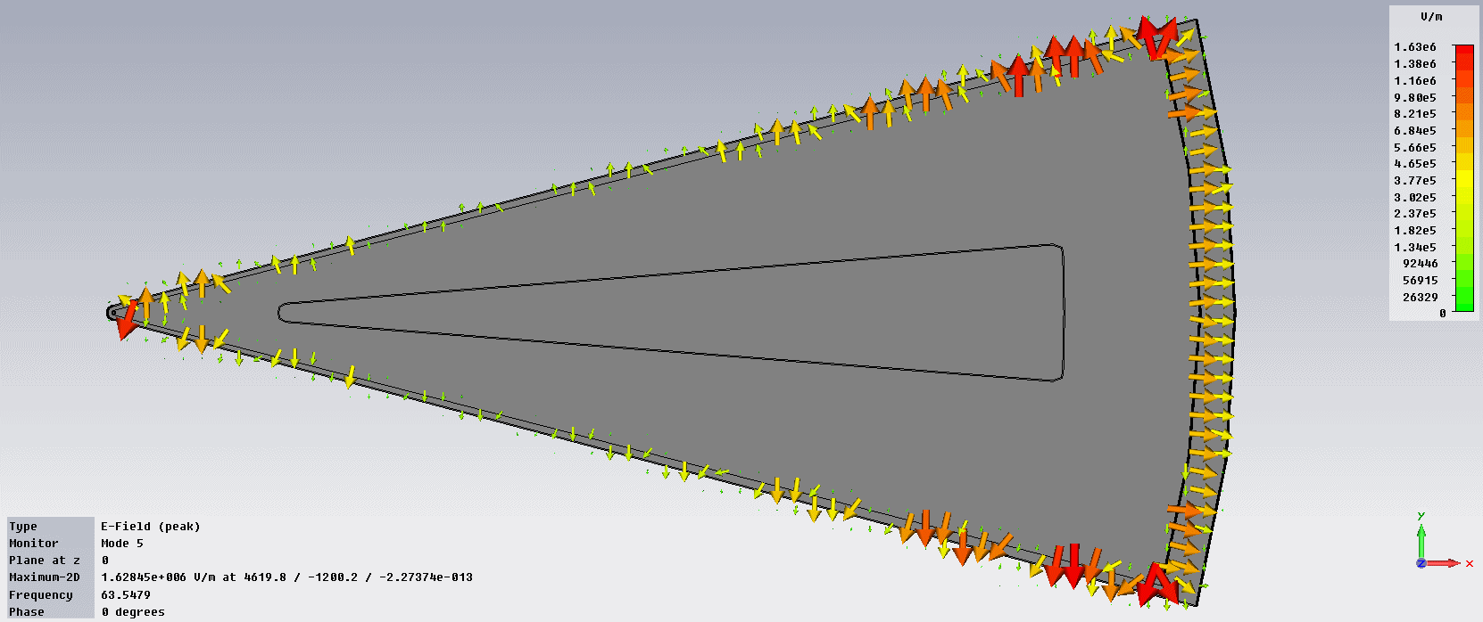
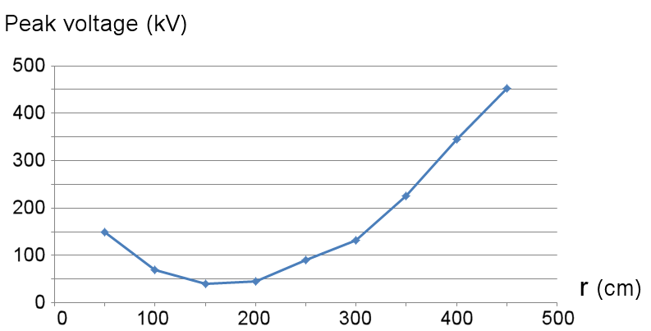
RF Delta double gap tapered walls cavities
From CST
6 cavities at 49 MHz (Option H+)
1000 KW beam power /cav + 350 KW losses /cav
2 RF coupling loop/window
2 amplifiers (electron tubes)/cavity
Large stem allows to install pumping
Notes:
This is the preliminary design of one of the 6 classical double gap cavities, each with a large stem, which allows housing the pumping tools, mandatory to reach a high vaccuum in order to minimize the losses at high energy. The acceleration voltage goes from 150 kV at injection up to 450 kV at extraction, so, with the 12 acceleration gaps, this gives about 5 MeV/ turn. This can be an advantage if we extract with a magnetic bump.

Slide 19
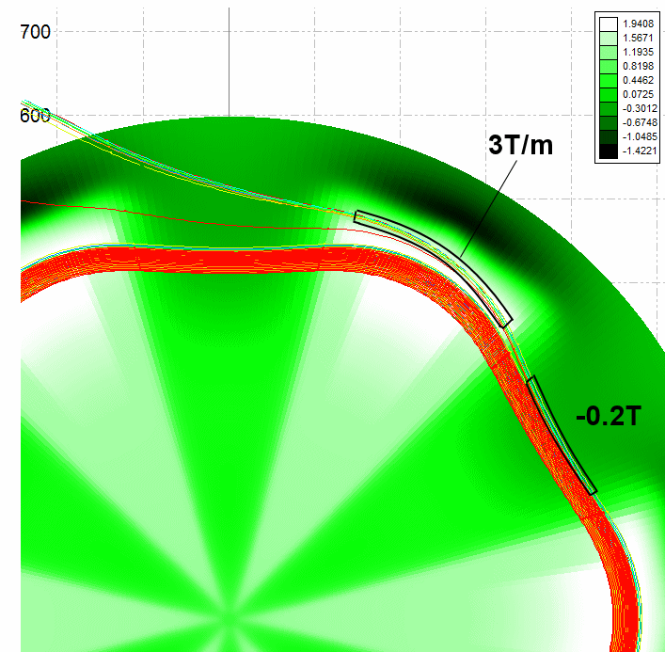
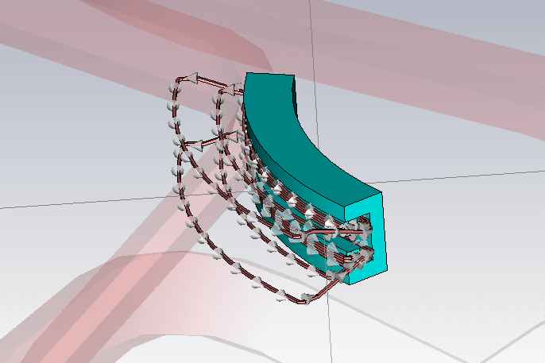
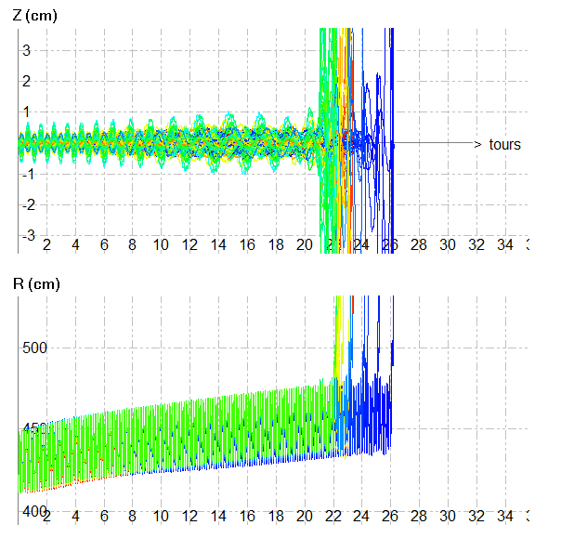
The septum free Extraction (H+)
2 channels:
1st) Bump Channel: -2 kG to increase the -2 kG valley field
2nd) Foc. Channel: + 3T/m in the sector field.
19
Notes:
So in order to eliminate the electrostatic channels, for the H+ Option, we could use a negative field bump in the valley ,and a gradient corrector in the downstream sector.
Such an electromagnetic device is currently under studies, mainly to reduce the stray field inside the cyclotron and to reduce the vertical losses during the extraction process. Of course, the higher turn separation under the bump, the higher extraction yield. The most difficult is to reduce the collisions if we don’t achieve a single turn extraction.

Slide 20

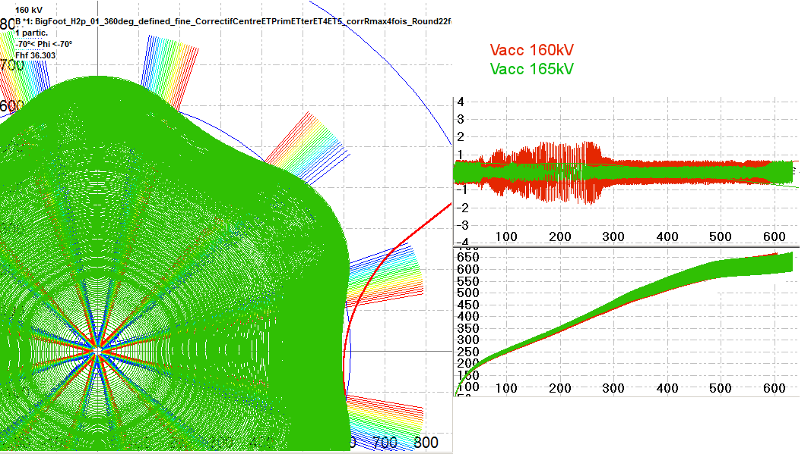
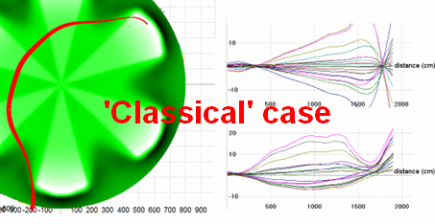
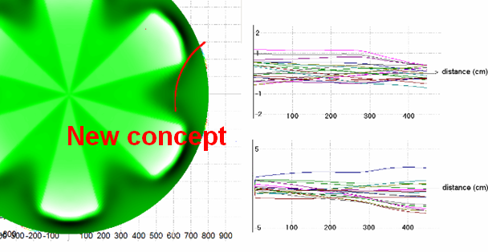
H2+ Extraction
short trajectory, no focusing elements, no complexity
H2+ acceleration
Proton extraction
@796 MeV
Initial condition:
5mm vertical amplitude @ 155MeV
Shorter trajectory if the stripping foil is located in a valley: leads to a smaller extracted beam
20
Notes:
The classical extraction of H2+ has a high efficiency, by stripping of H2+ into 2 H+ particles, but with a positive B field, the trajectory move inwards the accelerator (such as daedalus), with a somewhat complex horizontal and vertical movement. With a reverse valley field, the extraction trajectory of H+ is much more simple, and shorter, with a low vertical dispersion

Slide 21
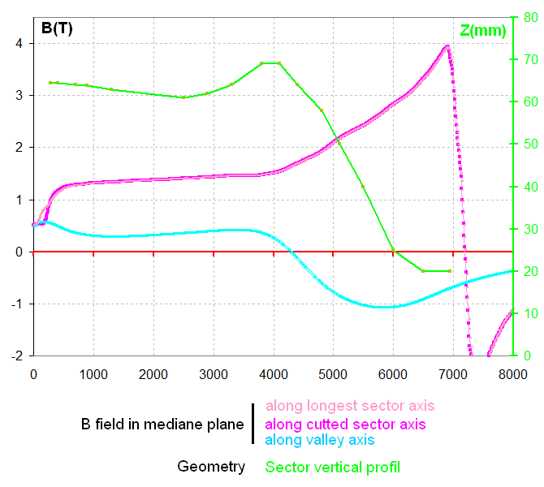
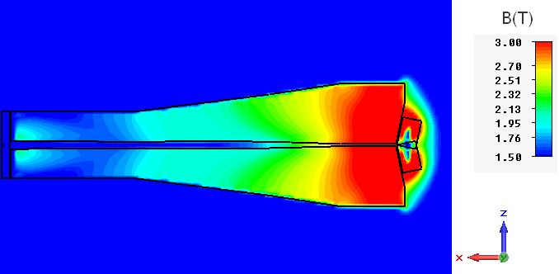
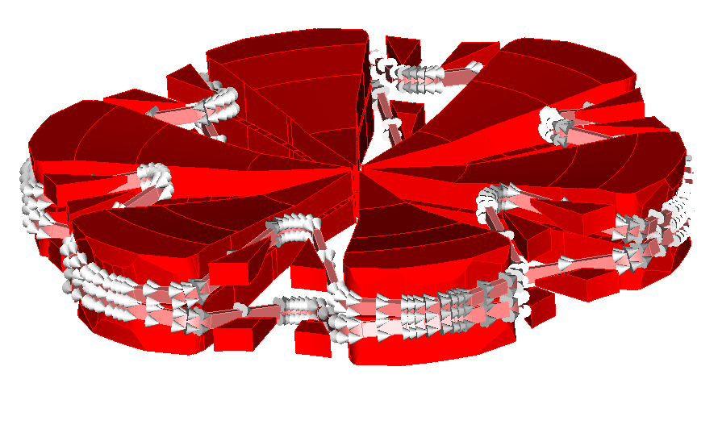
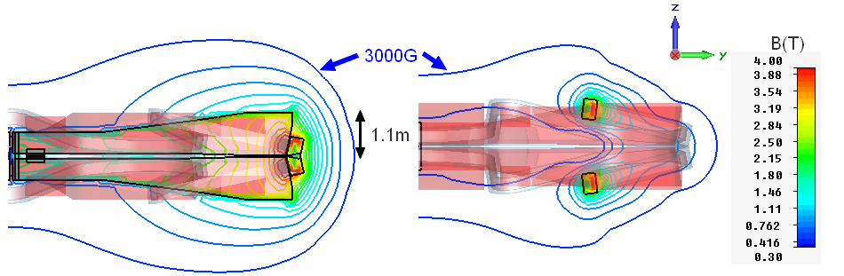
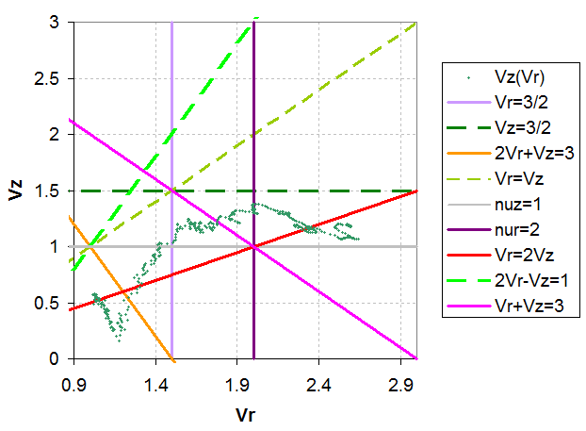
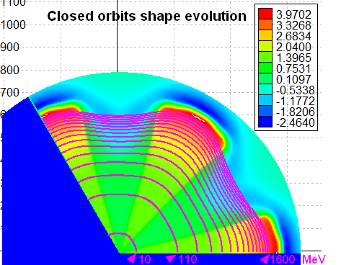
The 1600 MeV H2+ option
> 6 straight hill sectors (14 tons)
> 12 small valley sectors
> Superconducting Coils
. Rmin: 4.2m Rmax: 7.1m
.Total length ~50m
.Section: 160 mm * 310mm
.Current density 55 A/mm²
21
Notes:
This is the 1600 MeV H2+ machine, a bit larger than the H+ accelerator. For this design, we have also used 12 small valley sectors in order to decrease more efficiently the field in the valley.
In these 2 designs, a single stage has a quite long coil (up to 50 m), so the design of the cryogenic tools would be critical. Actually, We use a superconducting coil, but we could use a more simple hot coil, but bigger and for which water pumping should be complicated.

Slide 22
Conclusions

Slide 23
Industrial constraints for ADS driver
1
Easy to maintain and repairable system
Low beam losses in the different stages
Low number of components
Easy access to components (RF cavities, RF amplifiers, injection and extraction devices, ion sources…)
2
Easy to implement successive phases to raise up the beam power of the prototype
3
Beam stability: choice of Ion source with multiple injection systems (to reduce beam trips)
4
Investment and runing costs
5
Failures and repair rates of the competitors (Linacs and cyclotrons) should be carefully analysed with proven industrial methods (MTBF, …)
>> Single stage cyclotron is an attractive solution
Notes:
A remainder of the different constraints for an industrial ADS driver
It must be easy to maintain and repair, so the losses should be quite low with a low number of components. We must access easyly and fast to the different elements.
The machine must be simple, to raise up efficiently the beam power of the prototype
We need a stable current, and a low cost machine. In order to find a proven and competitive solution, we should study carefully the breakdown issues of the different competitors.

Slide 24
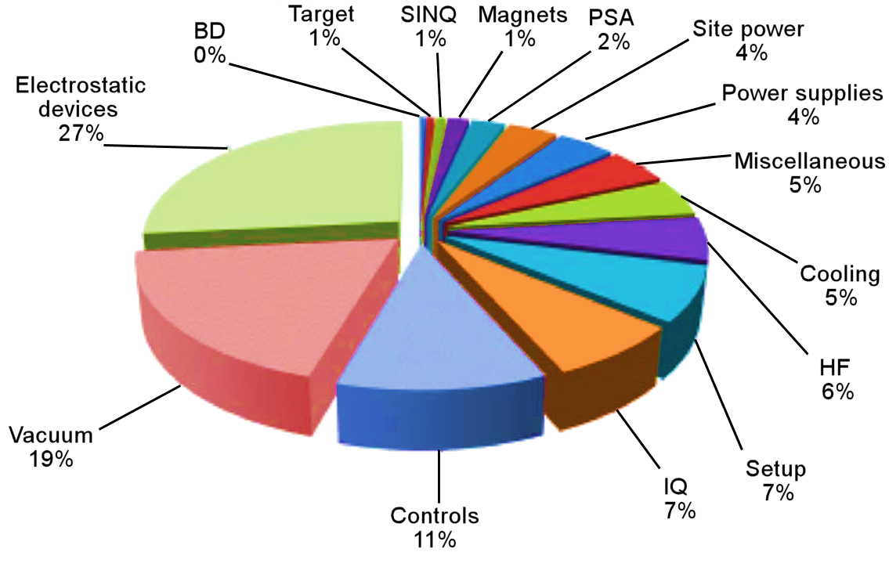
The main causes of beam trips in a multi-stages cyclotron
1
2
4
3
1+2+3 = 57%
26000 beam trips per year in 1999
From M.Seidel PSI in 2009
Notes:
Here are the different causes of downtime in a multi-stage cyclotron (statistics provided by PSI) The Vaccuum is an important issue, especially in a high energy and intensity cyclotron. The computer and control devices are quite critical also, if there are many stages, but the main problems are due to the electrostatic devices. In a multi-stage cyclotron, such as the PSI chain, there are many electrostatic devices, which should be as efficient and reliable as possible
2 further observations from this pie chart:
1+2+3 really connected with multi-stage concept
4 IQ is the Ion source. This value can be reduced with our parallel injection system based on 3 ion sources and 3 injection lines.
These 4 points represent ~2 thirds of the beam trips in 1 year

Slide 25
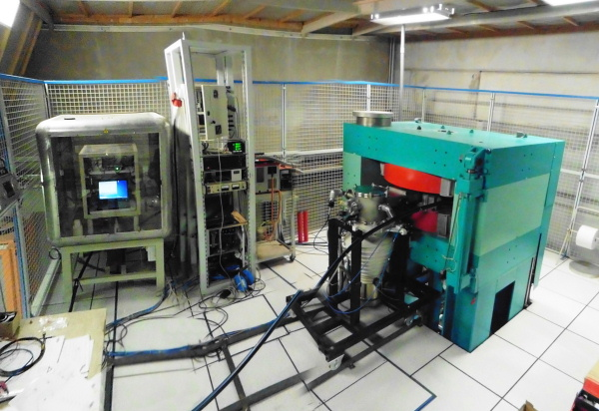
Critical Issues of Single Stage designs
1-Large superconducting coils (role of the ASG partner in the CYCLADS Proposal):
- Mechanical design of a complex shape with bends
- Possibility to use MgB2 for a cryo-free cooling system ?
=> Tests and prototypes are needed
2-High power RF cavity design to handle 1.4 (H+)-1.6(H2+) Mwatt :
- 2 RF Windows + 1 Amplifier/window
- relation between cavity & extraction system
3-Multi Injection :
- a single HV platform to house 3 ion sources will be investigated
4-H2+ acceleration :
- interaction with residual gas: High vacuum is needed (cf. Daedalus)
- Dissociation of the vibrational states producing high energy protons (according to experience,
filament-based multicusp ion sources could be more relevant)
- stripping foil lifetime: 500 mA.hours outstanding performance achieved at TRIUMF with oriented
pyrolic Graphite (courtesy of Yuri Bylinskii)
5- High intensity beam dynamics (role of the PSI partner in the CYCLADS Proposal):
Non linear beam dynamics models for halo characterization…
Notes:
Most of these points will be investigated by the 8 partners of the CYCLADS proposal, which will be presented by M. Losasso tomorrow

Slide 26
The pro of the single stage cyclotron solution (1)
Single stage accelerator
  Compact system - low construction budget and Low operational cost
  Less components than traditional solutions → high reliability
  No transport / no matching issues between stages
3 sources + axial injection lines
  redundancy
  reliability
  Intensity Flexibility:
    8 mA protons>4mA H2+: 2 Ion sources on + 1 Ion source in Stand-by
    12 mA protons>6mA H2+: 3 Ion sources on
  Simplified Extraction system : No Septum required
  Increasing reliability
  less activation => easier maintenance
Notes:
So finally a single stage cyclotron driver is a compact solution with high reliability
The parallel sources allows a high redundancy and flexibility
And the magnetic configuration can lead to a simple extraction system, without septum for a stripping solution > easier maintenance.

Slide 27
The pro of the single stage cyclotron solution (2)
Global yield could approach 31 % (e.g. H+ 600 MeV – 10 mA)
Driving Beam Power | 6 MW
Total RF Power | 16 MW
Total magnet Power | ~1 MW
Triple injection Platform | ~0.5 MW
Extraction channel | ~0.5 MW
Anciliary equipts | ~1 MW
Total Power | ~19 MW
Estimated global yield | ~ 31 %
A single stage 600MeV H+ or 1600 MeV H2+ cyclotron
with Reverse Valley Field:
a good candidate for an industrial ADS demonstrator.

Slide 28
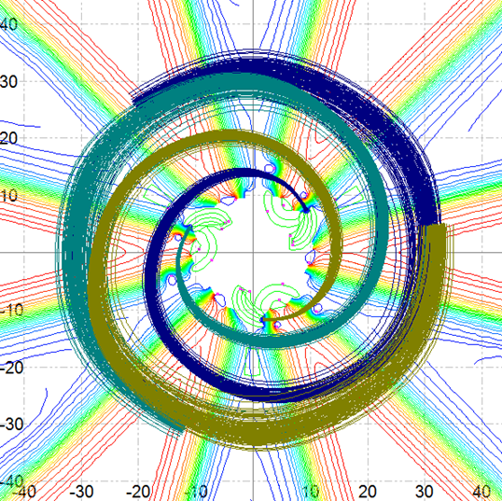
Thank you for your attention

Slide 29
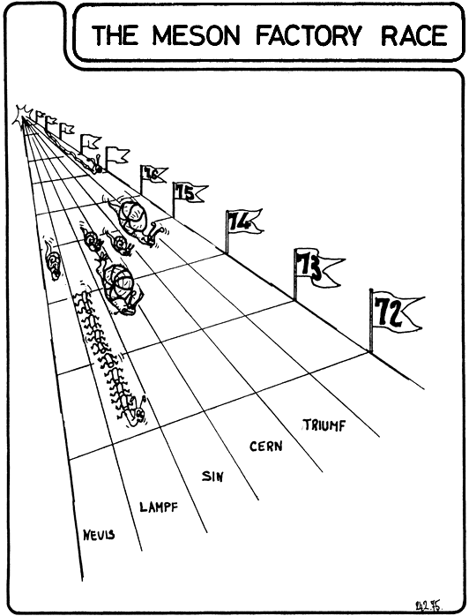
ICC 1975 in Zurich !
1st Single stage with
Stripping Extraction of H⁻
PSI - 1st multi-stages
Single turn Extraction
As seen by Ernst Michaelis
2
Notes:
Let’s talk about the Meson factory race, which took place in 1975, here in Zurich. The purpose was to determine which kind of accelerator was the most appropriate to reach high energy and high intensity (power) to produce mesons. The Los Alamos Linac won the race, but it appeared that cyclotrons, such as Psi or Triumf, were good competitors to linac to reach such specifications.

Slide 30
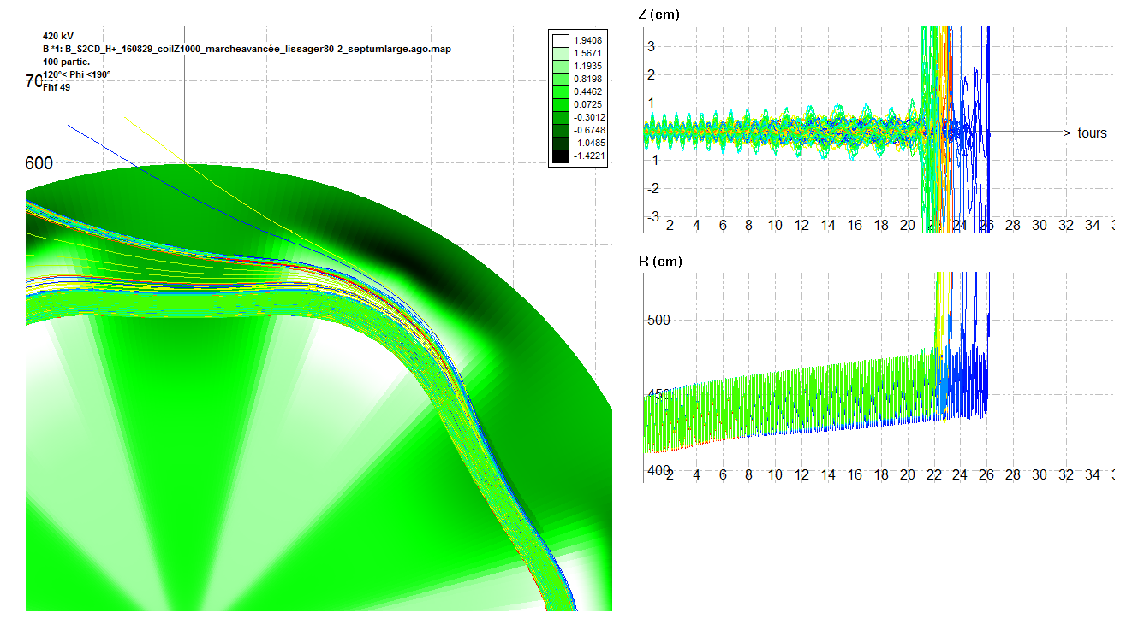

Slide 31
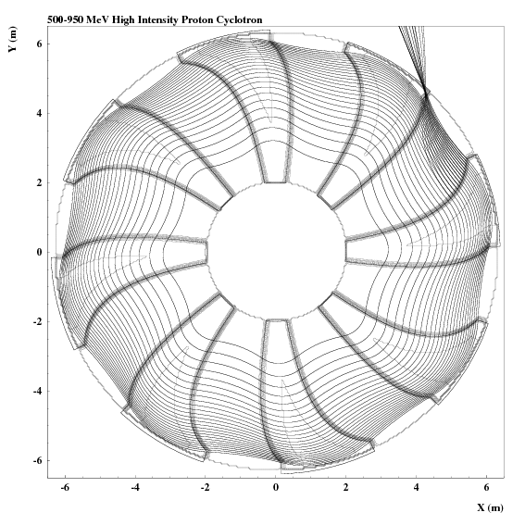
[C. Baumgarten]

Slide 32
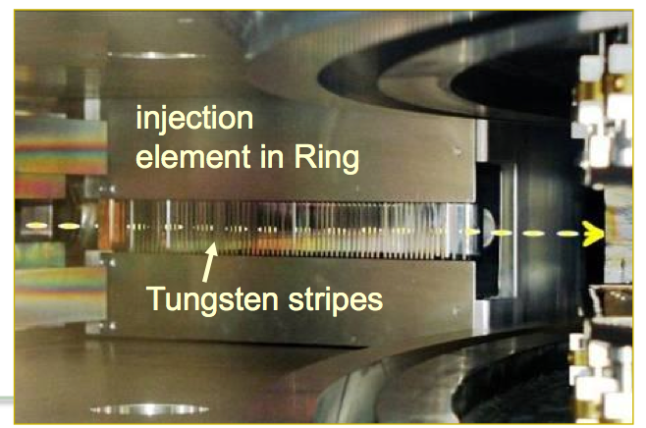
The High-Tech injection/extraction electrostatic channels
Emax = 90 KV/cm
8
Notes:
Of course, with new-Technology elctrostatic devices, the efficiency gets higher and higher.

Slide 33

S2CD Equipment Costs
8
Notes:
Of course, with new-Technology elctrostatic devices, the efficiency gets higher and higher.

Slide 34

800 MeV Superconducting Strong-Focusing Cyclotron
High current proton driver for ADS
Texas A&M University
Two Stages Cyclotron: 100 MeV SF injector + 800 MeV SF booster.
Stack of 3 Cyclotrons in //
Booster: 12 Flux coupled stack of dipole magnet sectors
10 Superconducting 100 MHz RF cavities providing a 20 MeV Energy Gain/turn
Large turn separation allowing to insert superconducting focusing beam transport channels made of Panofsky Qpoles (G=6T/m)
14
Notes:
Also in order to reduce the space charge effects and the beam trips, a parallel concept has been developped by the TAMU team, with this Superconducting Strong Focusing multi-stage cyclotron, which is a stack of three separate proton beams, allowing a factor 3 on the final intensity. A big issue of this design is probably the complex superconducting cavity.

Slide 35

Median Plane view and principle of H2+ Extraction
Max Energy (H2+/P) | 240/120 MeV
Nominal Extr. Intensity | 3 mA proton (1.5 mA H2+)
External diameter | 4.4 m
# of spiral sectors | 4
Current density in SC coil | 44 A/mm2
#/type of RF cavities | 4/delta-2 gaps
Peak Voltage (Inj/Extr) | 70/200 KVolts
RF Power Losses | 280 KWatt
H+
H2+
Stripper

Slide 36


Slide 37





RF-delta double gap cavities
Peak Voltage versus radius
RF cavities H=6 / 36.3MHz
Must be inserted in the magnet
We need 1e-8 mbar:
- pumping through the stem
- Possibility to use cryogenic panels inside the delta electrode
6 cavities, 12 accelerations / turn:
- Possibility to insert the stripper support through the stem
150 KV in the center up to 450 KV at extraction
Q = 6200 ->Total losses 3MW

Slide 38


The PSI Layout
1984: Towards Higher intensity
The new separate sectors Injector
Old injector
72 MeV
6
590 MeV

Slide 39


