Slide 1
SPC meeting

Slide 2
Agenda
Review of Nufact2016 organization: Jacques Dumarchez (10min)
Nufact2017 at Uppsala proposal, official decision: Mattias Blennow (10min)
  new WG conveners from Asia
Report in International Neutrino Summer School (10min)
Discussion on the Nufact Workshop
  Scope
  Name & logo of workshop
  committees etc...
  Relation with International Neutrino Summer school
  frequency, following workshop.
AOB?

Slide 3
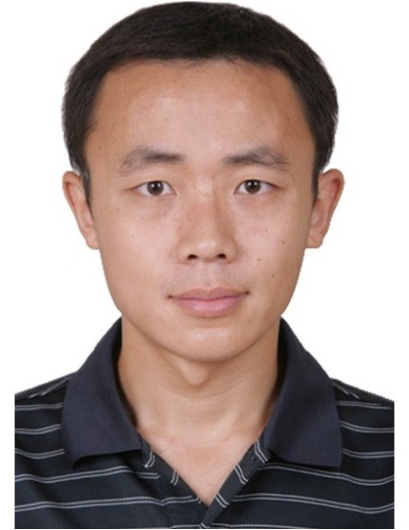
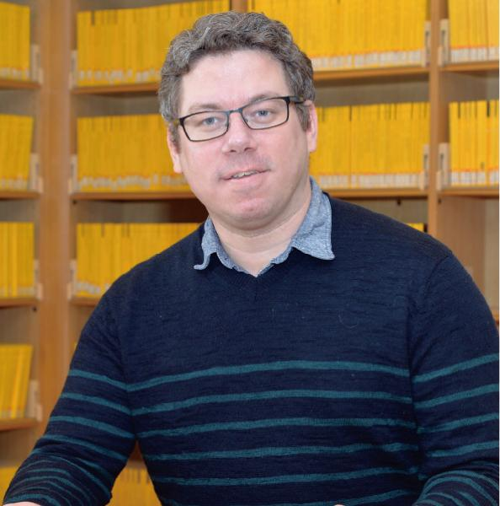
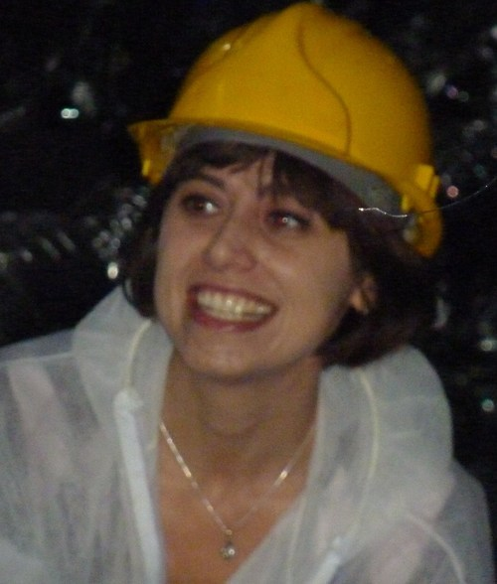
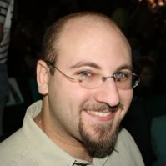
WG1: Neutrino oscillations
WG conveners
  Mark Hartz (Kavli IPMU/TRIUMF)
  Francesca Di Lodovico (QMUL)
  Alex Himmel (Duke)
`
Proposal from IHEP
Miao He (何苗)

Slide 4
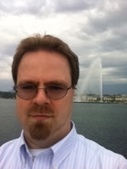
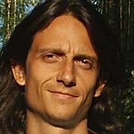
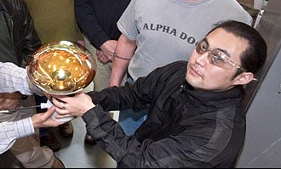
WG2: Neutrino scattering phyisics
Gabriel Perdue (FNAL)
Marco Martini (CEA-Saclay)
Hide Tanaka (ICRR)
`

Slide 5
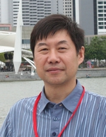
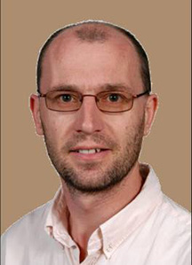
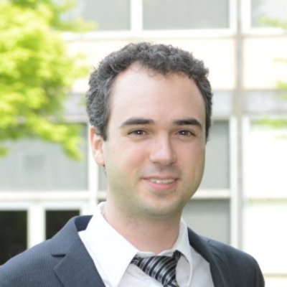
WG3: Accelerator
Jingyu Tang (IHEP)
Chris Densham (STFC/RAL)
Ben Freemire (Illinois Inst. of tech)
`
From KEK?

Slide 6
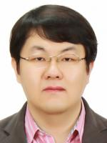
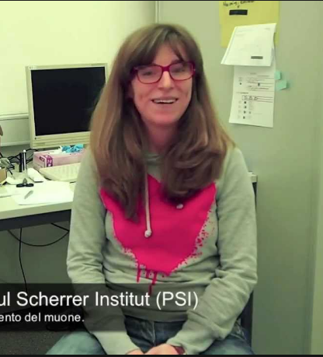
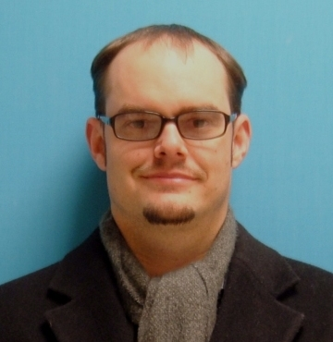
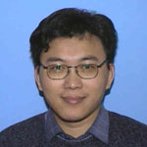
WG4: Muon
Angela Papa (PSI)
Robert Craig Group(Virginia/FNAL)
Hai-Bo Li (IHEP)
`
MyeongJae Lee
CAPP, Institute for Basic Science, Daejeon, S. Korea, COMET

Slide 7
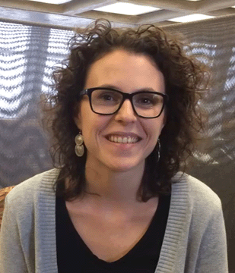
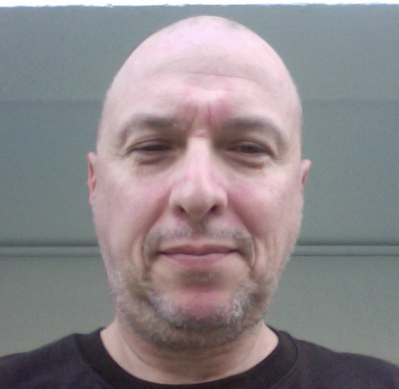
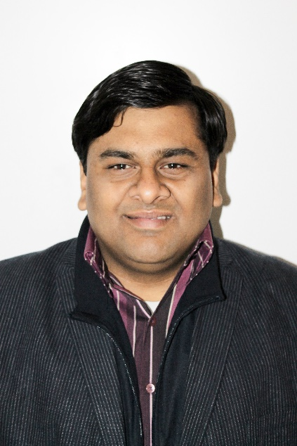
WG5: Neutrino beyond PMNS
Pilar Coloma (FNAL)
Sanjib Kumar Agarwalla (Inst. Of Phys., Bhubaneswar)
Walter Marcello Bonivento (INFN Cagliari)
Continue!

Slide 8
Frequency (and scope) discussion
160825
NuFact2016
@Qui Nhon, Vietnam
Takashi Kobayashi
KEK/J-PARC

Slide 9
Important discussion during this NuFact
Frequency: Yearly? Once/2years?...
Important discussion topics in recent NuFact SPC meeting
There are reasonable arguments for keeping/reducing frequencies
We (SPC) decided to decide during this NuFact 2016, in the SPC meeting scheduled on Friday Lunch time
  NuFact2017 is already decided to be held.
  Discussion is on after NuFact2017, whether we have NuFact2018?
Frequency discussion closely related to the scope of the WS (and the name)
  Need to discuss in parallel
We would like to hear your thought during this meeting
  Come to talk to us
  Send us e-mail
  Will have special discussion session on this issue
    Aug.25Thu, 17:00
    All participants of NuFact are invited

Slide 10

NuFact
The Rencontres du Vietnam on
NuFact 2016
is the eighteenth in a series that started in 1999 as an important yearly workshop with emphasis on future neutrino projects.
The main goals of the workshop are to review the progress on studies of future facilities able to improve on measurements of the properties of neutrinos and charged lepton flavor violation as well as new phenomena searches beyond the capabilities of presently planned experiments. Since such progress in the neutrino sector could require innovation in neutrino beams, the role of a neutrino factory within future HEP initiatives will be addressed.
The workshops are not only international but also interdisciplinary in that experimenters, theorists and accelerator physicists from the Asian, American and European regions share expertise with the common goal of designing the next generation of experiments.
The NuFact16 workshop is divided into five Working Groups covering the following topics:
Working Group 1: Neutrino Oscillation Physics
Working Group 2: Neutrino Scattering Physics
Working Group 3: Accelerator Physics
Working Group 4: Muon Physics
Working Group 5: Neutrinos Beyond PMNS
Unique opportunity to discuss
PHYSCS AND TECHNICAL CHALLENGES
of future accelerator-based neutrino&muon experiments

Slide 11
Scope of this workshop
Future Accelerator-based experiments Using Neutrino beams & muon beams,
  including beam dump and collider searches for heavy neutrinos and LFV processes
Covering both
  theoretical aspects
  supporting measurements
And technical challenges to realize the future projects mainly on accelerator & beam
  Detector focused meeting is NNN
Reasonable mixture of
  Review of present cutting edge experiments
  Next generation experiments
  Future projects → Decreasing

Slide 12
Scope of these Workshops
Review of theoretical studies of neutrino and muon physics.
  current status
  future directions
Review of current experimental studies of neutrino physics.
  accelerator-based neutrino experiments
  associated beam dump and collider searches
Review of current experimental studies of muon physics.
Preparations for near-future experimental studies of neutrinos and muons
  Design of conventional super-beams
  Design of associated detectors
Preparation for future muon-sourced neutrino facilities
  Accelerator and beam design
  Detector considerations
  Associated R&D program

Slide 13
Special Characteristics of the Workshop
Rotation across world regions (Europe, Americas, Asia)
Continuity of questions addressed :
list of questions is transmitted from one year to the other
Format encourages original and new contributions
Emphasizes common issues among various experiments and fields
of expertise accelerator, experimental and phenomenological
aspects are shared.
Continuity of Working group conveners
rotating assignment on a 3-year basis
Written proceedings
These features lead to very creative workshops

Slide 14
Important good (recent?) feature: Questions
List of questions are given at the beginning of the WS
  Mostly homework from the last NuFact
Discussion try to answer questions
Discussions on the questions will be reported at the end
New/Updated questions for the next NuFact (Homework)

Slide 15
Nufact history
2016(Vietnam) 123
2015(Rio) 123
2014(Glasgow) 124
2013(IHEP) 149
2012(W&M/J-lab) 143
2011(CERN/Geneva) 191
2010(Tata) 149
2009(FNAL/IIT) 197
2008(Valencia) 163
2007(Okayama) 148
2006(Irvine) 179
2005(Frascati) 187
2004(Osaka) 154
2003 (New York) 170
2002 (London) 161
2001 (Tsukuba) 165
2000 (BNL) 161
1999(Lyon) 120
DUNE/LBNF developed
HK development
θ₁₃ large
CPV w/ conv. Super beam
Neutrino factory for 1e-5 θ₁₃
“untimate” CPV
→ Nufact WS
Huge detector for CPV
HK, UNO, LBNE, LAGUNA, DUNE,
→ NNN WS
Oscillation discovery

Slide 16
# of participants

Slide 17
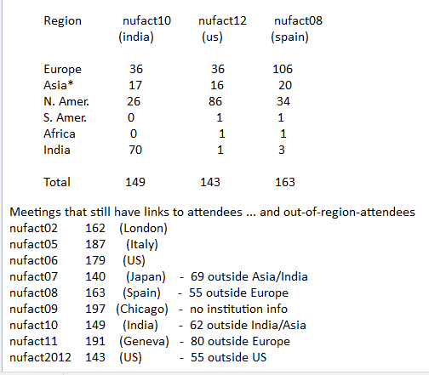
Jeff Nelson’s analysis

Slide 18
Related conferences
Neutrino conference
  ~1week/2years
  Accelerator-based, telestrial, astroparticle
  Main focus on physics results
  Future program is secondary
WIN
NuFact
  ~1week/year
  Future, accelerator-based neutrino experiments
  Both technical challenges & physics
Neutrino oscillation workshop (NOW)
  ~1week?/2year?
  Neutirno oscillation (acc, telestrial, …)
Next generation Nucleon decay and Neutrino detector (NNN)
  ~4days/year
  Main focus on Next generation large detectors
    Cover accelerator & non-accelerator, astroparticle
    Also focus on technology development

Slide 19
Related conferences
Large neutrino infrastructure
  2days/2014,2015,2016
  Future projects with large infrastructure (accelerator/detector)
NuInt
  ~4~5days/18month
  Neutrino interactions
Neutrino beam instrumentation workshop (NBI)
  3~5days/ (2014/2012/2010/2006/2005/2003/2002/2000/1999)
High Power Targetry Workshop (2014, 2016, 2018,..)
  “brings together scientists and engineers from the international community for particle accelerator targets. Applications include neutrino facilities, neutron facilities, muon facilities, radioactive ion beams (RIBs), materials irradiation facilities and precision experiments for rare processes.”
The international workshop on future potential of high intensity accelerator for particle and nuclear physics (HINT)
  Yearly so far
  http://j-parc.jp/pn/HINT2016/
  Intensity frontier flavor physics (μ, ν, K, n, Nucl., B, tau)
  Technical challenges (targetry, …)

Slide 20
Name&Logo?
we changed the scope of the meeting significantly to focus on ‘superbeams’
but it is clear that the name remaining the same has got a number of people confused.
  ➔ May need to change the name to reflect the change of scope better ?
Neutrinos at Future Accelerators (NuFaC) etc.. etc…
  ➔ not using the pi-mu-nu logo anymore. Need to find a new one.
  ➔ alternatively advertise officially the change of scope in international bodies
  ➔ or organize a merger with NNN workshops? (not trivial, overlap only is Long Baseline beam)

Slide 21
4. Relations with International bodies: Meeting was initially endorsed by international committees such as ECFA or ICFA
I remember going to ECFA every year to report and getting re-endorsed.
This ceased to be with the NUFACT scoping study in 2006
→ should we re-instate sponsoring by these bodies?
→ can the ICFA neutrino panel be of some help in this?
5. Advisory committee : Nufact meetings till 2005 (6,7?) had an Advisory Committee in addition to the program committee
This body was unresponsive and did not serve at giving advice
However it ensured official recognition and once in a while a proposal of a speaker.
➔ I would suggest re-instating an advisory committee among the well known
physicists, connecting to NEUTRINO international committee etc..
Involving lab directors and neutrino collaboration leaders, but also *independent* high level scientific personbalities.
6. Organize meeting further ahead in time As Tord Ekelof commented ‘you are late!’

Slide 22
Headline of arguments
Reduce
  Many neutrino related workshops and schools
    “Bamboo shoots after rain 雨後の筍(1998)”
    Sharing role with other workshops/conferences?
Keep
  Provide unique precious opportunities to discuss future accelerator-base experiments with theorist/experimentalist/accelerator/beam
  With present scope, fields are rapidly developing

Slide 23
Concerning the frequency of the meeting:
Some (not all) possible options
  continue yearly
  reduce frequency to once every 18 months
  reduce to once every two years in opposition of phase with Neutrino conference.
different opinions in the SPC on this subject:
  some concerned that yearly frequency is too high to be sustainable
  some concerned that switching to two years repetition will endanger the meeting without answering the reasons for loss of attendance.
the mission of NUFACT is very differerent from that of the neutrino conference. It is focused on new ideas concerning neutrino experiments with accelerators
  The meeting should continue to see ahead in this field.
Present organization is very efficient, based on 3yr rotating mandate of conveners.
  What would be the impact of changing frequency of nufact?

Slide 24
Open for discussion!
Opinons on
  Scope
  Structure (WGs)
  Operation
  Frequency
  Whatever!
We like to hear opinions from audience

Slide 25
Spare

Slide 26
Proposal for WG5
The nufact15 ‘legacy paper’ recommends that
-- that Nufact continues its role as craddle of ideas for accelerator based neutrino sources
-- discusses the creation of a 5th working group to attract new theoretical ideas
e.g. Enrique Fernandez suggested a «theory» working group
more discussions with Enrique and others have led to the suggestion of a working group on
‘Neutrinos Beyond PMNS’
In the tradition of the NUFACT meetings this would involve experimenters as well as theorists

Slide 27
WG5, ‘Neutrinos Beyond PMNS’
TOPICS and QUESTIONS *could* cover the following :
-- general discussion, motivation and, possibly, rationalization of models beyond PMNS
-- experimental searches for right handed neutrinos
-- nuclear decays and galactic emissions (no emphasis)
-- short baseline oscillations
-- observation of neutral decays in beam dump experiments and neutrino beams
-- observation in e+e- Z and Higgs factories (or e-e- -> W-W-?)
-- observation at hadron colliders LHC, HL-LHC and SppC and FCC-hh
-- unification of interpretation framework
-- other beyond PMNS, NSI, etc.

