Slide 2
AVAILABILITY MODELLING WORKSHOP
OVERVIEW, OUTCOME AND PLANS
Andrea Apollonio and Odei Rey Orozko
Workshop follow-up meeting
CERN, August 25th, 2016

Slide 3
  Index
  Availability Modelling Workshop overview.
  Comparison of different software packages.
  Update of AvailSim project.
  Future Plans.

Slide 4
- AVAILABILTY MODELLING WORKSHOP OVERVIEW-

Slide 5







PARTICIPANTS

Slide 6
OBJECTIVES AND AGENDA
Morning session
Introduction, R. Schmidt
Increasing interest and effort invested into reliability and availability studies
RAMI STUDIES
The performed and on-going RAMI studies in the accelerator domain were presented
Identify the needs that arise when performing such a study in different projects.
LUNCH BREAK
Afternoon session
SOFTWARE PACKAGES & SYNERGIES
Understand the functionality of each software, advantages and limitations.
Discussion
Discuss synergies for collaboration

Slide 7
RAMI STUDIES
1. AVAILABILITY STUDIES FOR FCC, ARTO NIEMI (CERN)
The LHC model was presented.
State based chain model together with Faults trees.
Elmas simulation software is used to model the LHC and its operational modes.
Future work: the study of the FCC based on scaling up the LHC and injector chain.
Cryogenics FT can be used for other accelerators…. MYRRHA
Use model to define availability budgets for sub-systems.

Slide 8
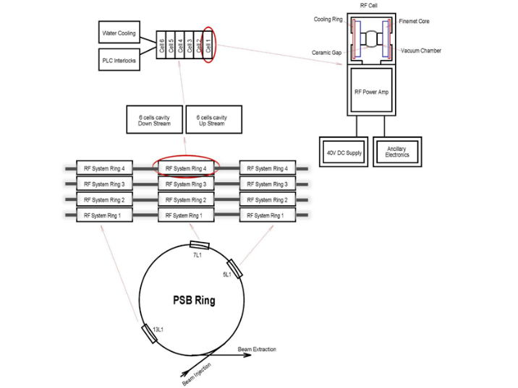
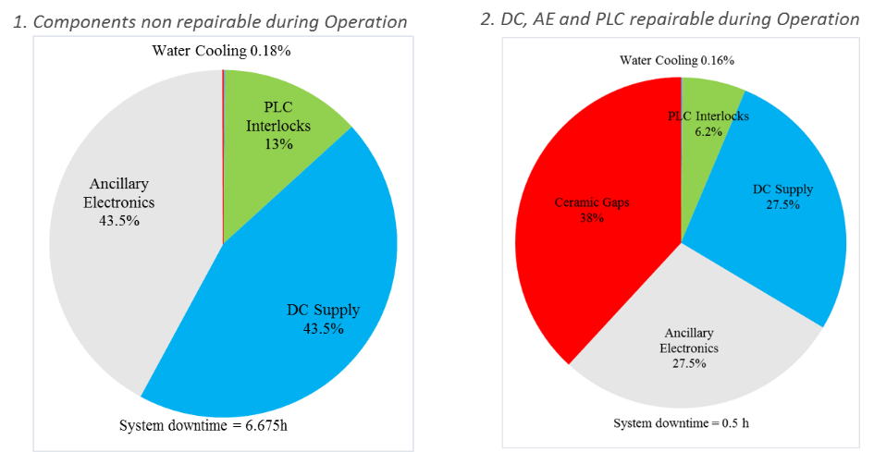
RAMI STUDIES
2. PSB RF SYSTEM UPGRADE AVAILABILITY STUDIES, ODEI REY (CERN)
An overview of the PSB RF System was given.
Two dependability studies performed and compared: Monte Carlo Simulations and Analytical methods.
The PSB RF System is modelled in Isograph by Reliability Block Diagrams (more than 5000 components).
Interesting to compare the execution time of the simulations in different tools.
Common failures need to be considered to get correct results.
Extension using ISOGRAPH to a large machine (CLIC) difficult, since so many components.

Slide 9
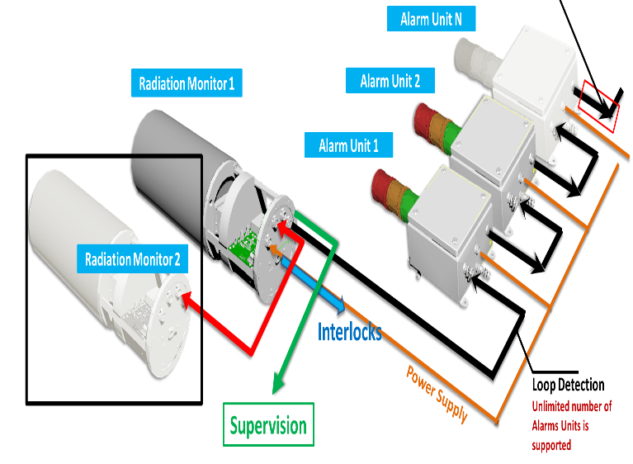
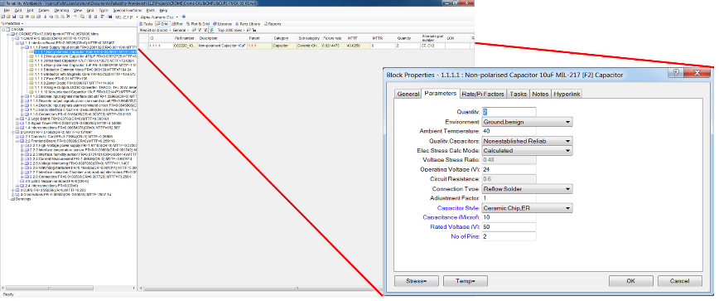
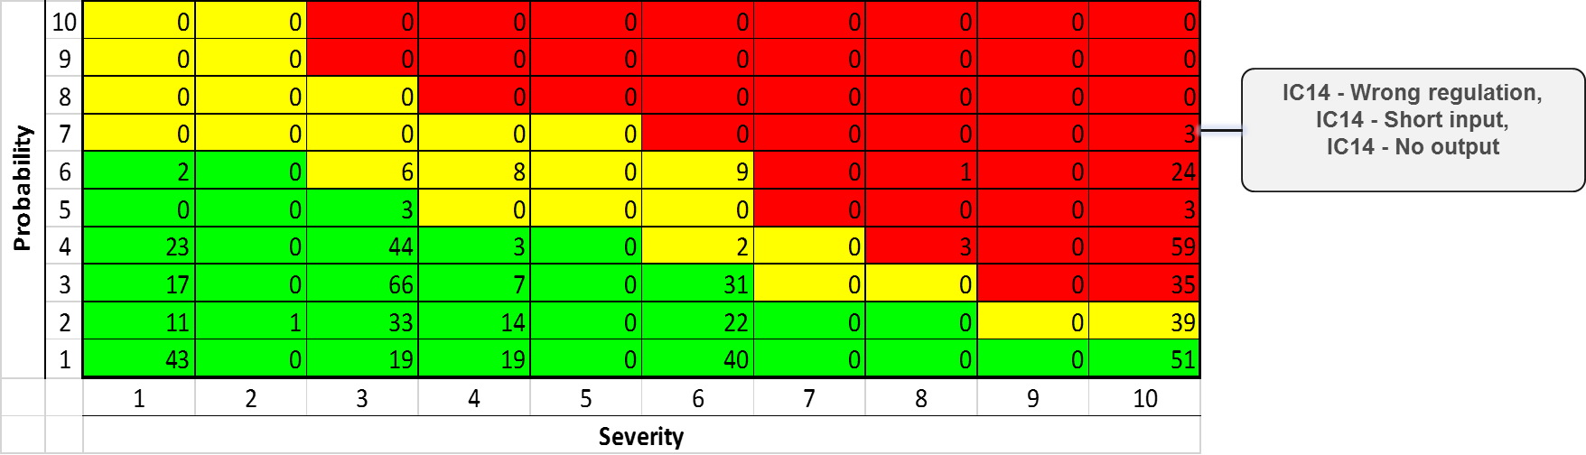
RAMI STUDIES
3. RELIABILITY ANALYSIS OF RADIATION PROTECTION MODELS, SASKIA HURST (DE)
CROME radiation Monitoring System structure and functional analysis was presented.
The study aims to assess if the required SIL2 for CROME is achieved.
CROME system MTTF calculated with Isograph Prediction tool.
An FMEA had been performed in Isograph and RPN assigned
to each component.
The calculated MTTF and assigned RPN for each component
were presented in a Risk matrix.
Focus not only on components also on interfaces between components ( cabling, connectivity)

Slide 10
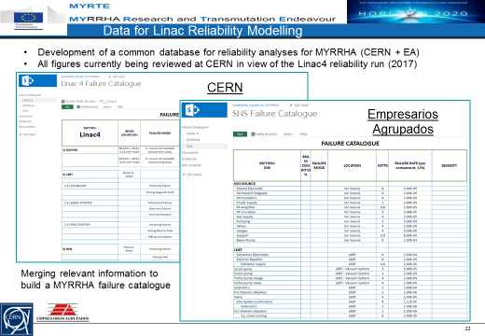
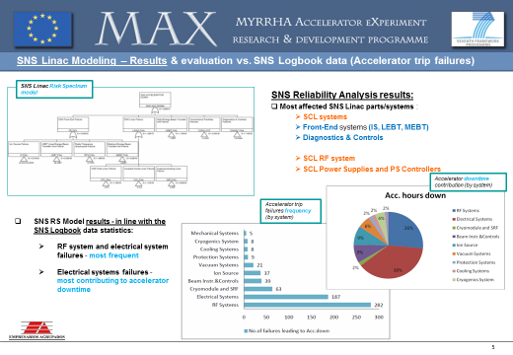
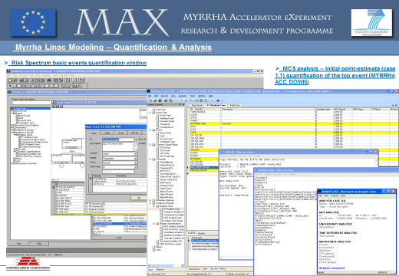
RAMI STUDIES
4. AVAILABILITY STUDIES FOR MYRRHA, ADRIAN PITIGOI (EA)
MYRRHA – long term supporting research facility for Accelerator Driven Spallation System.
SNS Linac modelled in RiskSpectrum. Results in line with the SNS logbook.
MYRRHA reliability model built in Risk Spectrum (Fault Tree solved analytically). .
Reliasoft’s BlockSim software tool will be used for further RAMI studies of MYRRTHA.
Failure database for MYRRHA developed from SNS and Linac4 failure catalogue.
Ideas for most dependable architecture to be discussed.
Maintenance phases not possible to model in RiskSpectrum.

Slide 11
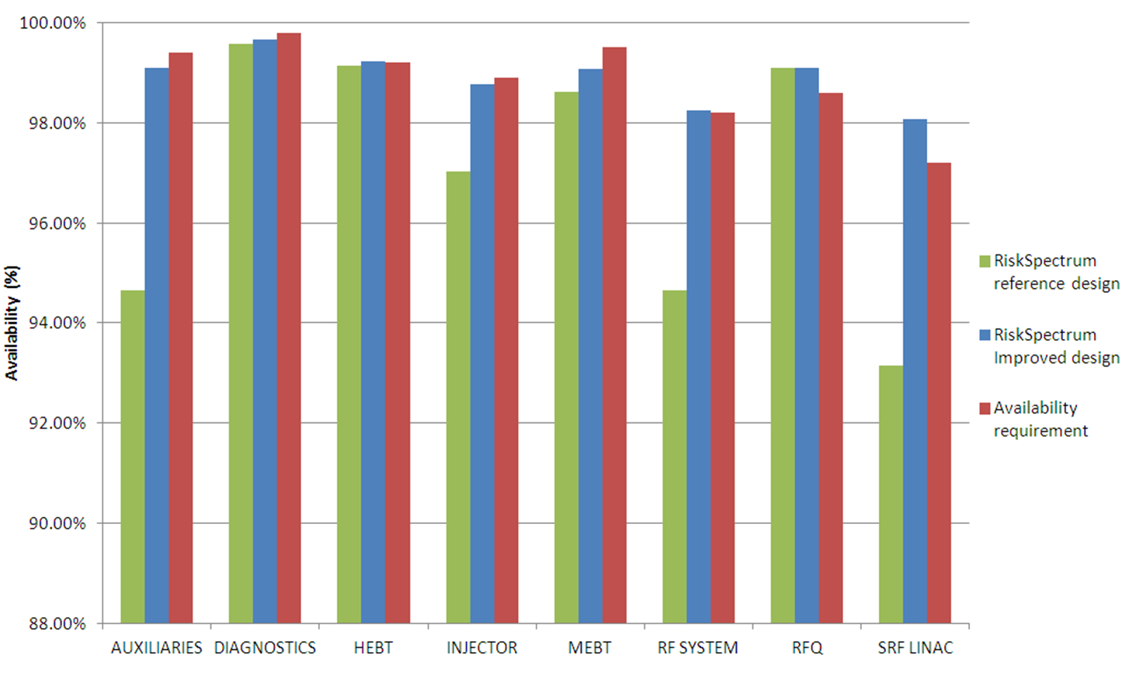
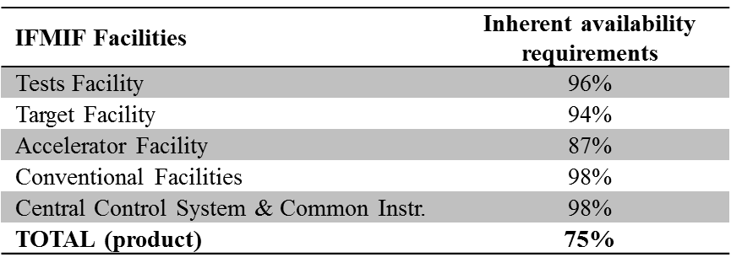
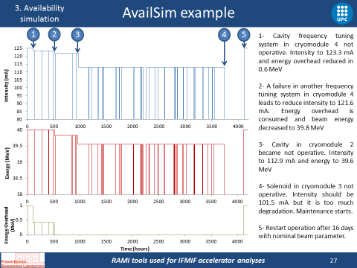
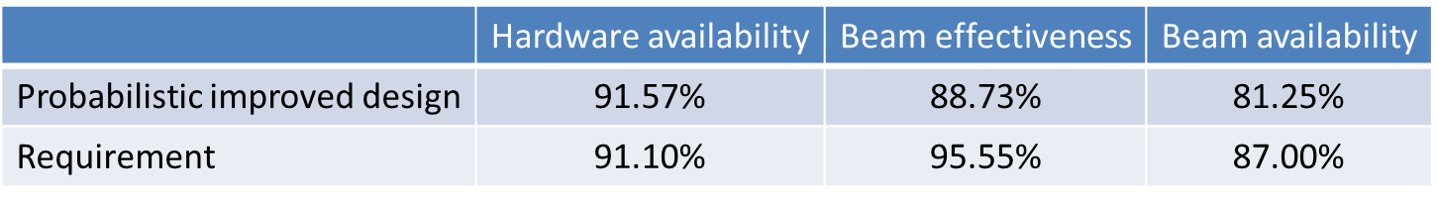
RAMI STUDIES
5. IFMIF Accelerator Facility RAMI analyses, Enric Bargalló (ESS)
International Fusion Materials Irradiation Facility challenges and requirements presented.
RAMI studies performed to analyse different design options and propose changes in the machine.
Analytical calculations were done using RiskSpectrum (Fault trees). Results compared to HA requirements.
Decision to adopt AvailSim 2.0 software for availability modelling.
Definitions of terms needed for availability allocation: Hardware Avail, Beam Effectiveness and Beam Avail.
Some components failures and degraded operation can be modelled.

Slide 12
SOFTWARE PACKAGES
Isograph, Andrea Apollonio (CERN)
ELMAS, Jussi-Pekka Penttinen (Ramentor)
AvailSim, Enric Bargalló (ESS)
Realist IMA Modelling tool, Thomas Herzig (DE)
SOFTWARE FEATURES MATRIX

Slide 13
SYNERGIES FOR COLLABORATION
Software-features matrix development.
Use Linac4 as a use-case for AvailSim 3.0.
Collaboration with ESS under discussion.
Possibility to model Linac4 with the different software packages (under discussion):
  Input data: Linac4 reliability run.
  Compare modelling process.
  Compare results and performance.
  Find similarities.
Activity possibly followed up in the RASWG.
Proposal for a common input format of the models.
Isograph
Results
Elmas
Results
Common format
Intermediate Translators
Compare and validate
AvailSim
Results
Realist
Results

Slide 14
- COMPARISSON OF DIFFERENT SOFTWARE PACKAGES-

Slide 15
SOFTWARE FEATURES MATRIX I

Slide 16
SOFTWARE FEATURES MATRIX II

Slide 17
SOFTWARE FEATURES MATRIX III

Slide 18
- UPDATE OF AVAILSIM PROJECT-

Slide 19
AVAILSIM 3.0
AvailSim: Simulation open source software for RAMI Analysis.
  AvailSim 1.0: Developed by Stanford University (Tom Himel and his team). MatLab.
  AvailSim 2.0: Adaptation of the software for IFMIF RAMI Analysis. MatLab.
  AvailSim 3.0: Software being exported to Python at ESS in collaboration with SLAC.
Core to be ready beginning of September.
Possible collaboration with ESS in the development and debugging of the software.
To be applied to Linac4 and CLIC availability studies.

Slide 20
- FUTURE PLANS-

Slide 21
FUTURE PLANS
Reliability
Availability
Provide forum and support for:
Reliability specifications for individual systems.
Evaluation of system architectures.
Calculation of failure rates according to standards (e.g. MIL).
Failure Mode Effects and Criticality Analysis.
Maintenance Plans.
Use of software tools (templates, guidelines,…).
Provide forum and support for development of:
  LHC and HL-LHC models
  Models for future machines (CLIC, Linac4, FCC, MYRRHA)
Based on inputs from existing availability tracking tools.
Identify strengths and weaknesses of different software packages.
Validate results with different software packages.
Standardize inputs for simulation.
Testing
When requested, provide support for:
Planning and execution of reliability runs. (e.g. Linac4)

Slide 22
Thanks a lot for your attention!
25/08/2016

