Slide 1
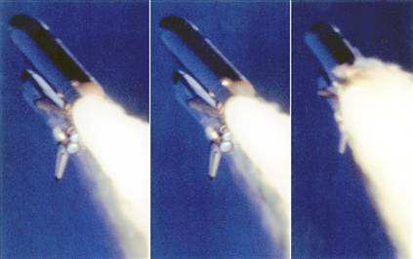
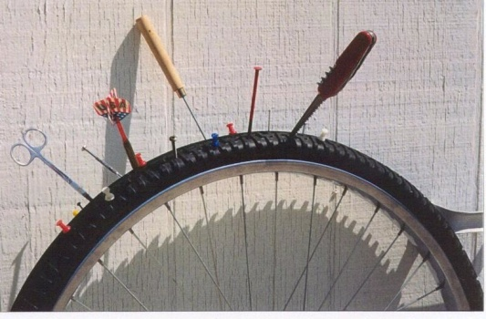
Leak Detection Tutorial
Paul Cruikshank & Giuseppe Bregliozzi, CERN
CAS, Vacuum for Particle Accelerators, 6-16 June 2017

Slide 2
Leak Detection – Today’s Agenda
  14:30 ‘Introduction to leak detection’ - part 1
  15:00 Practical 1 – Working with MS leak detector
    2 groups of 8 students rotating between stands
  15:40 ‘Introduction to leak detection’ - part 2
  16:00 Practical 2 - Leak testing of manifolds
    3 groups of students on 3 similar stands
  16:30 Break
  17:00 Discussion on practicals
  17:10 Leaks in NEG coated systems with demonstration
  17:50 Leak exercises
  End of tutorial

Slide 3
Leak Detection – Part 1
  Leak units, Variation f(T, p, gas species)
  Common methods & their limits:
    Over pressure
    Under vacuum
  Leak detection with mass spec leak detector

Slide 4
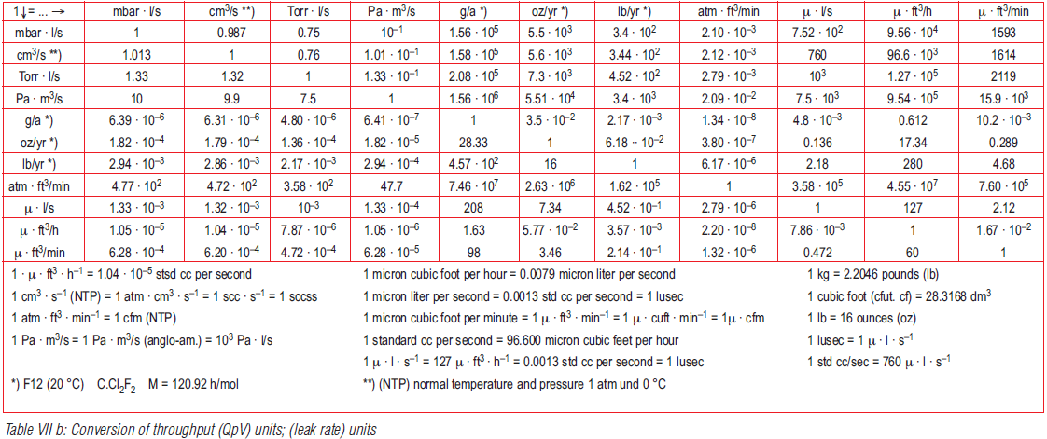
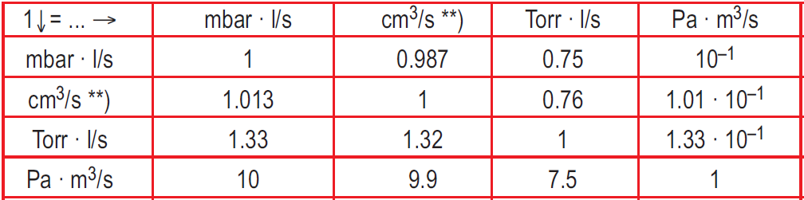
Leak Units
Insert table of equivalent units
atm·

Slide 5
Units
A leak is a throughput, normally given symbol q_{L}
Common units are:
  mbar.l/s atm.cc/s torr.l/s Pa.m³/s (SI unit)
  With a leak rate of 1 mbar.l/s a volume of 1 litre will change in pressure by 1 mbar in 1 second.
  Units of mbar.l/s almost equivalent to atm.cc/s
    Eg bubble test in water:
    A leak of 1 atm.cc/s would produce a bubble of 1 cm³/s
    A leak of 10⁻³ atm.cc/s would produce a bubble of 1 mm³/s

Slide 6
Units
…. flux through a leak will be different depending on the prevailing conditions (temperature, pressure, gas type)
Unless otherwise stated, a ‘standard helium leak rate’ in mbar.l/s implies:
  Helium as tracer gas,
  Under vacuum test,
  Helium at 1 bar_{abs} and 100% concentration
  System at 20 °C.
Any other conditions must be stated

Slide 7
Leak flux…
Variation of pressure
Variation of temperature
Variation of gas type

Slide 8
Leaks – variation of pressure
λ ≪ d
λ > d
P₁
q_{L}
P₂
      If P₂ is vacuum, flow dominated by molecular regime
      q_{L} ∝ (P₁-P₂) = C (P₁-P₂)
      q_{L} ∝ P₁ since P₁ ≫ P₂
      If P₂ is increased or leak is big, flow dominated by laminar regime
      q_{L} ∝ (P₁²-P₂²)
      q_{L} ∝ P₁² if P₁ ≫ P₂ (until flow is choked at inlet)
    Rule of thumb at RT:
      Leak > 10⁻⁴ mbarl/s – laminar flow
      Leak < 10⁻⁵ mbar.l/s – molecular flow
    Testing at elevated pressure increases leak signal
    Induced mechanical strains may also enhance leak size/signal
viscous intermediate molecular
turb laminar

Slide 9
Leaks – variation of gas type
In molecular flow regime:
      In literature as 2.67 for air mixture N₂, O₂, Ar, etc
      Testing with helium gives conservative results
        ie wrt an air leak we measure ~ 3 times higher signal
In laminar flow regime:
      As dynamic viscosities differ by only % for helium and air at room temperature, fluxes can be considered as equivalent.

Slide 10
Leaks – variation of temperature
In molecular flow regime
      Conductance ∝ √T
In laminar flow regime
      Big viscosity & density effects
For helium gas:
If q_{L} = 1 mbar.l/s at 293 K
then
q_{L} = 10 mbar.l/s at 80 K
q_{L} = 100 mbar.l/s < 20 K

Slide 11
Leak detection -Common methods
TEST METHOD
Flux in atm.cm³/s or mbar.l/s
Bubble test
Over pressure
Pressure
variation
Over pressure
Under vacuum
Sniffing
halogens or H₂N₂
Over pressure
Helium mass
spectrometer
Over pressure (sniffing)
Under vacuum
Residual gas
analyser
Under vacuum
10²
10¹
10⁰
10⁻¹
10⁻²
10⁻³
10⁻⁴
10⁻⁵
10⁻⁶
10⁻⁸
10⁻¹⁰
10⁻¹²

Slide 12
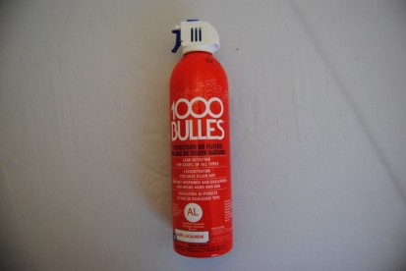
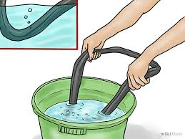
Overpressure methods (1)
Bubble test/Soap spray:
  Milles Bulles (Thousand Bubbles!)
  Visual test for big leaks
  Immersion (eg bicycle tyre) not practical for some applications
  System must be able to support overpressure
    Above 1.5 bar (absolute) safety rules apply
  Can be employed on complex pipe work
    Remember 1 mbar.l/s ~ 1 atm.cm³/s
    Pressurised gas is emerging to make bubbles at 1 atm, so 1 bubble of 1 mm³/s would be 10⁻³ atm.cm³/s
    Detection limit ~ 10⁻⁴ mbar.l/s

Slide 13
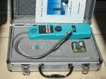
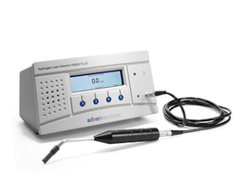
Overpressure methods (2)
Sniffing – determine if different types of gas are escaping from pressurised volume:
  Helium
    Using helium leak detector - see later
  Halogen (refrigerant circuits)
    Detection via ionisation of gas
  SF₆ (arc suppression gas)
    Electron capture detector
  H₂N₂ mixture (5/95)
    Hydrogen reaction with palladium…to change electrical characteristics.
    H₂ is diluted with N₂ to make the it safe (x 20 loss of sensitivity)
    H₂N₂ mixture is cheaper than helium
Useful detection limit is ~ 10⁻⁶ mbar.l/s

Slide 14
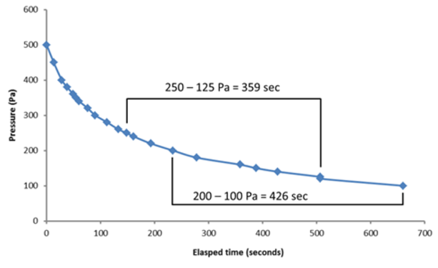
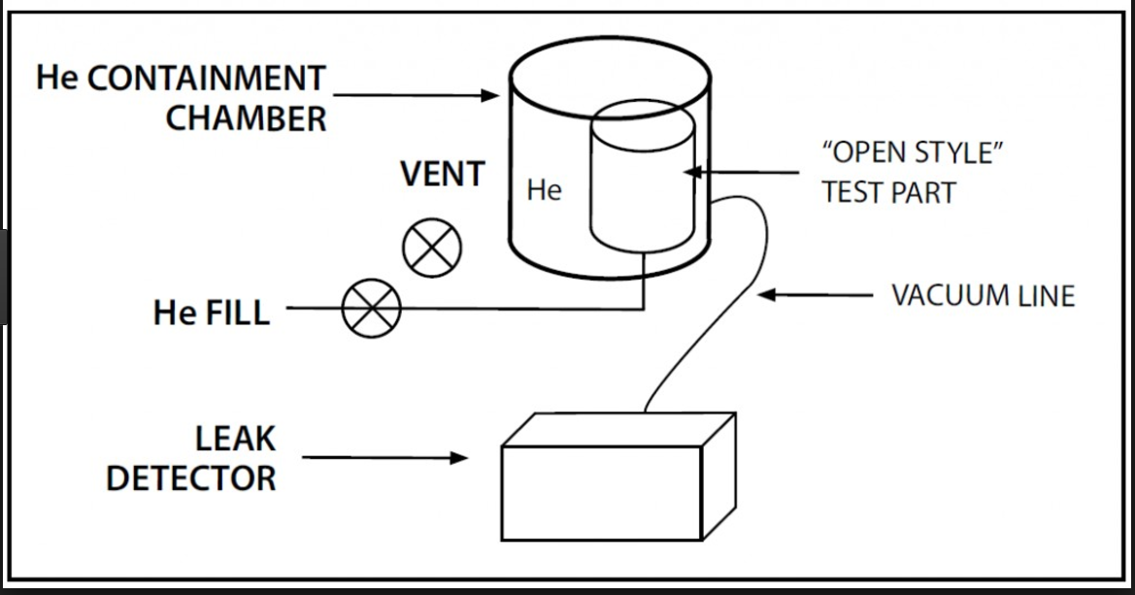
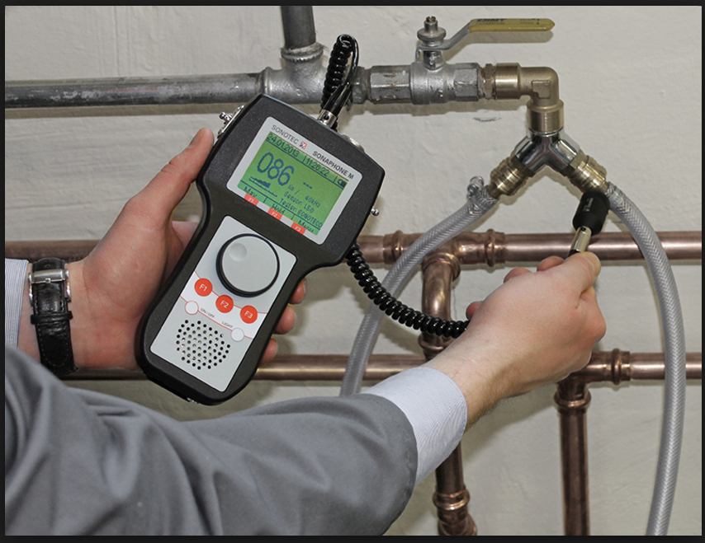
Overpressure methods (3)
Pressure variation:
  Measure rate of pressure loss in closed volume
  Used as first step in complex systems eg cryo circuits
    Eg Are all flanges closed/welds complete
Bombing:
  ‘Soak’ object at high pressure, then leak test under vacuum – often used on small, series components
Ultrasound:
  Gas expansion at leak orifice produces kHz signal
  Limit ~10⁻³ mbar.l/s

Slide 15
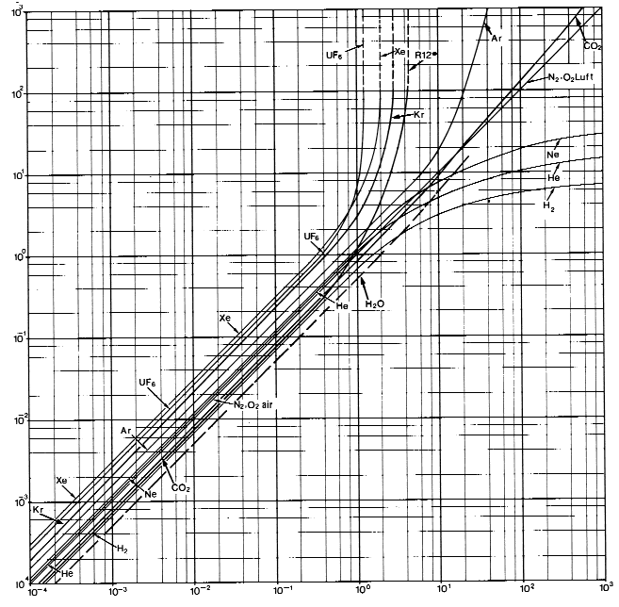
Under vacuum methods
Total pressure gauge
  Pressure rise
    For large leaks only
    But, must know outgassing load from measurement or comparison with previous tests
  Change of gauge reading – gauges are gas dependent
    Thermal conductivity effect for Pirani gauge (when in measuring range),
      With N₂ as reference
      Gauge reading when spraying Ar ↘, He ↗, Alcohol ↗
      Qualitative method to determine the presence of a leak
      Sensitivity will depend on leak, pump and gauge position
    Ionisation probabilities for ion gauge - hot (SVT) or cold (Penning) cathode types
      Relative ionization probability for N2 = 1, Ar = 1.2, He = 0.15
      Gauge reading when spraying Ar↗, He↘
      Qualitative method to determine the presence of a leak
      Sensitivity will depend on leak, pump and gauge position
    Can be useful techniques to keep in mind if helium leak detector is not available or can’t be connected to system.

Slide 16
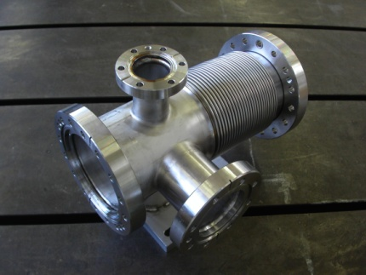
Under vacuum methods(2)
Total pressure gauge
  Change of gauge reading due to (temporary) plugging of the leak
    Alcohol
    Vacuum grease (not recommended)
    Mastic (not recommended)
    Varnish (temporary repairs)
Helium leak detector – see next
Partial pressure gauge - Residual gas analyser
  Fixed or added in vacuum system, sensitivity 10⁻¹²mbarl/s
  Mass 4 as helium leak detector
  Signature for air leaks Ar, O₂, etc.
  Leak testing with neon
    LHC cryomodules already contaminated with helium
    If NEG present – use gauge sensitivity and conductance effects for leak localisation

Slide 17
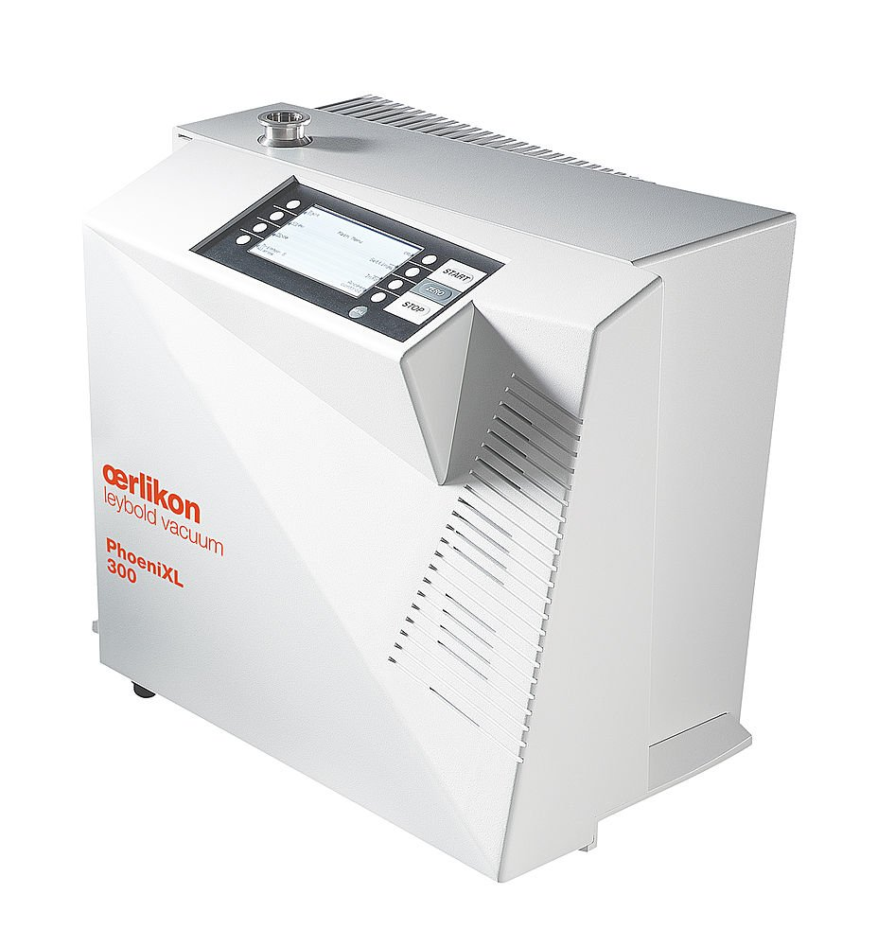
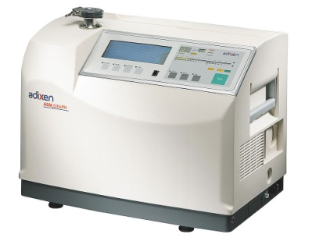
The mass spectrometer leak detector (MSLD)…
An expensive, mobile, ‘black box’ that evacuates the chamber to be tested and reads helium signals!

Slide 18
WHY HELIUM AS TRACER ?
He
F
H
Ne
Ar
Low concentration in air (5 ppm)
Inert gas
Non-toxic
Acceptable Cost
Small molecule
Mobility (v_{rms} ∝ √M⁻¹)
Mass 4 identification in MS
1% in air & welding gas
O
Kr
Xe
N
At
Cl

Slide 19
Basic set-up of under vacuum method
Hélium
Vacuum
Q
Part
to test
Helium
pistol
q = helium flux in mbar. l/s
He
Leak Detector

Slide 20
Basic setup of overpressure method - sniffing
Sniffer
in helium
cloud
He
5 bar
He
Leak Detector

Slide 21
Helium leak detection
Different ways the MS leak detector can be employed
A B C D E
INVERSE
UNDER
VACUUM
INVERSE
UNDER
VACUUM
HELIUM SPRAY
OR POCKET
Localisation Yes Yes Partial Partial No

Slide 22
Leak detection -Common methods
TEST METHOD
Flux in atm.cm³/s or mbar.l/s
Bubble test
Over pressure
Pressure
variation
Over pressure
Under vacuum
Sniffing
halogens or H₂N₂
Over pressure
Helium mass
spectrometer
Over pressure (sniffing)
Under vacuum
Residual gas
analyser
Under vacuum
10²
10¹
10⁰
10⁻¹
10⁻²
10⁻³
10⁻⁴
10⁻⁵
10⁻⁶
10⁻⁸
10⁻¹⁰
10⁻¹²

Slide 23
Leak detection accessories
Helium bottle & pressure regulator,
Fine control spraying pistol,
Sniffer,
Chart recorder (laptop/internal storage),
Calibrated leak,
KF connection pieces, flexible hoses, etc.
A mobile pumping group,
And…training, experience & patience….

Slide 24
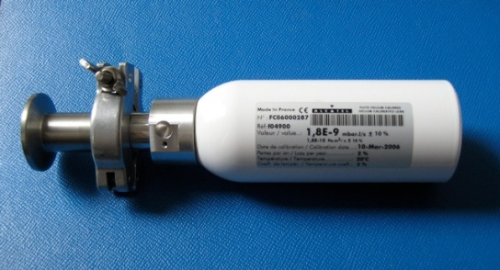
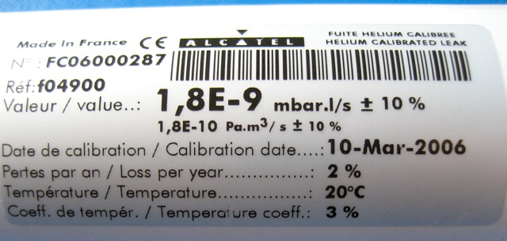
Refererence leaks
… are used extensively to check and adjust leak detectors
… are used to check system calibration
Construction
  Depending on the leak rate, can be based on orifice, sintered material or quartz membrane
    Quartz membrane normally used in range 1.10⁻⁹ to 5.10⁻⁷ mbar.l/s
    Reservoir is filled with air-helium mixture
    Correction for temp and age

Slide 25
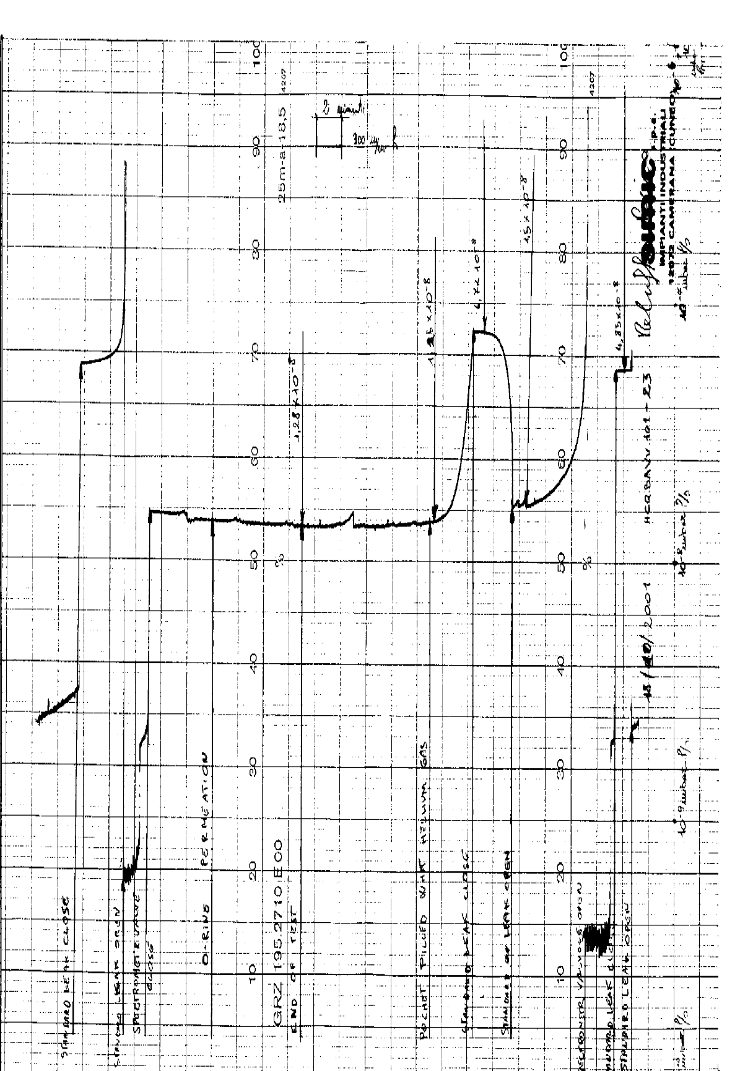
The leak signal…determining the size
Need to apply corrections to the observed leak signal to determine the leak size
  Subtract the residual signal
  Apply coefficient for helium concentration
  Apply correction for detector response to an external calibrated leak
Leak size

Slide 26
Typical Leak Test Sequence
Leak detector warm-up
Calibration
(int or ext)
Connect LD to item to test
Stabilization of LD signal
Analysis of test set-up behaviour
Test with helium
Analysis of signal behavior
Documentation of the result
Where to start ??
1.Detector connections
2.Highest point on chamber
Most likely cause ??
1.Demountable seals,
2.Welds/brazing,
3.Thin wall eg bellows,
4. Chamber walls,

Slide 27
PRACTICAL 1
  2 Groups of 8 students
  4 x ~10 minutes
  Test stand 1 – Get acquainted with LD & He bottle
  Test stand 2 – Get acquainted with LD & calibration/acquisition
  Test stand 3 – Leak detection on bellows
  Test stand 4 – Leak detection on serpentine tube
  Discussion

Slide 28
Leak Detection – Part 2
  Inside the leak detector….
  The leak signal…..
  (Further details and reading)
  Practical 2

Slide 29
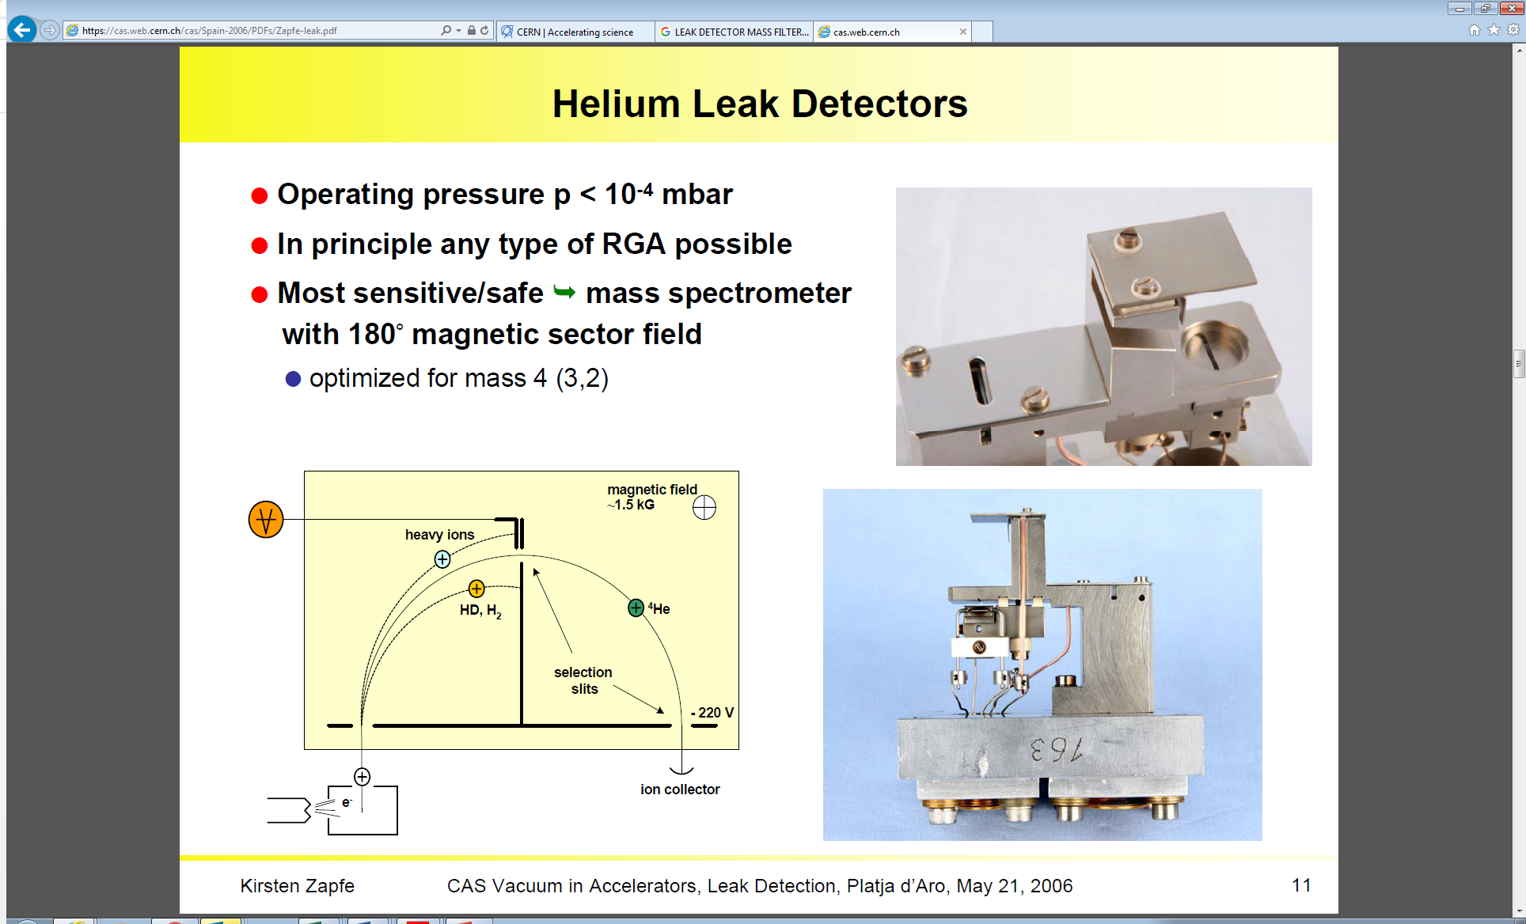
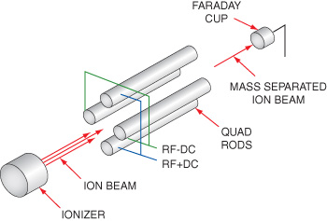
Helium leak detector
Mass spectrometer works at relatively high pressure ≤ 10⁻⁴ mbar
180° magnetic sector field mass spectrometer.
More common than quadrupole: higher
robustness to contamination & high pressure,
optimised for mass 4, simpler electronics
Quadrupole mass spectrometer

Slide 30
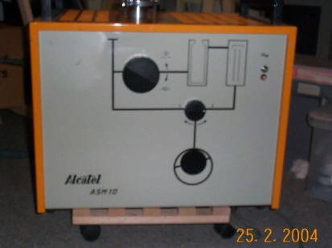
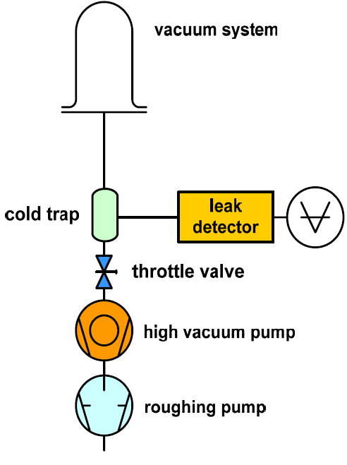
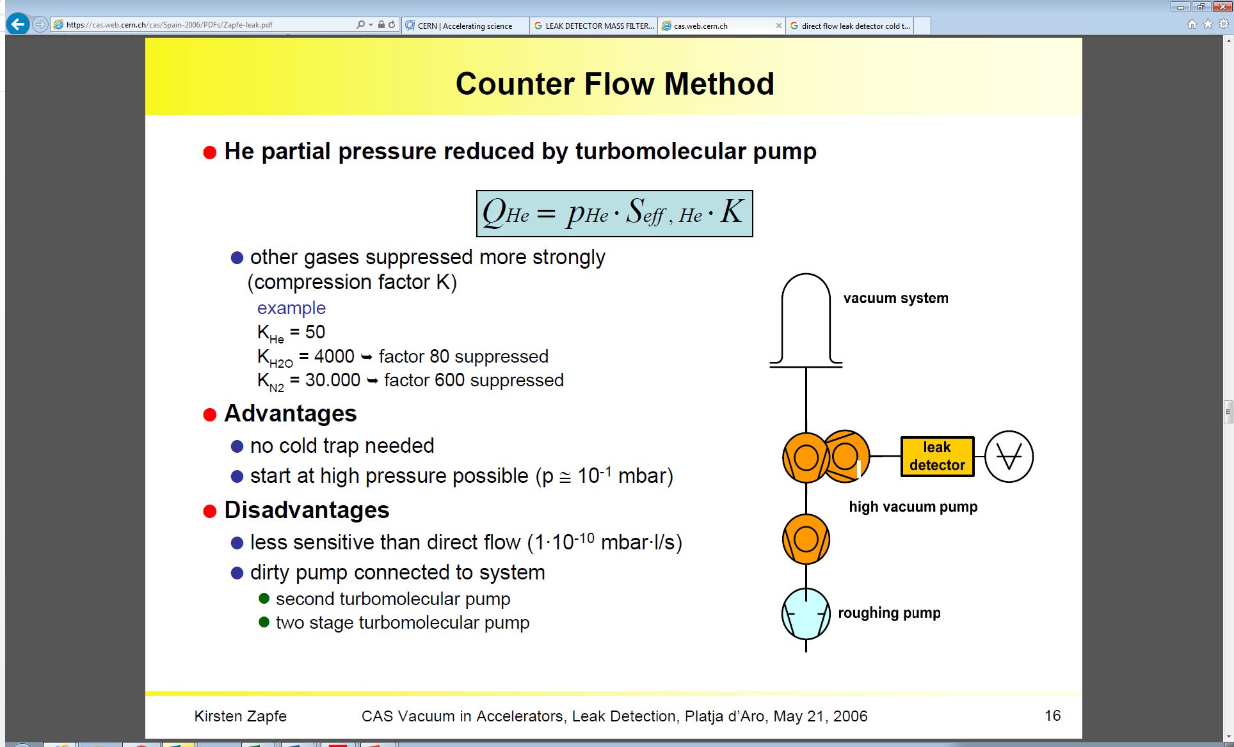
Helium leak detector
Turbo pump
in front of
mass spec.
Cold trap
in front of
mass spec.
Direct-flow LD
Counter-flow LD
MS
MS

Slide 31
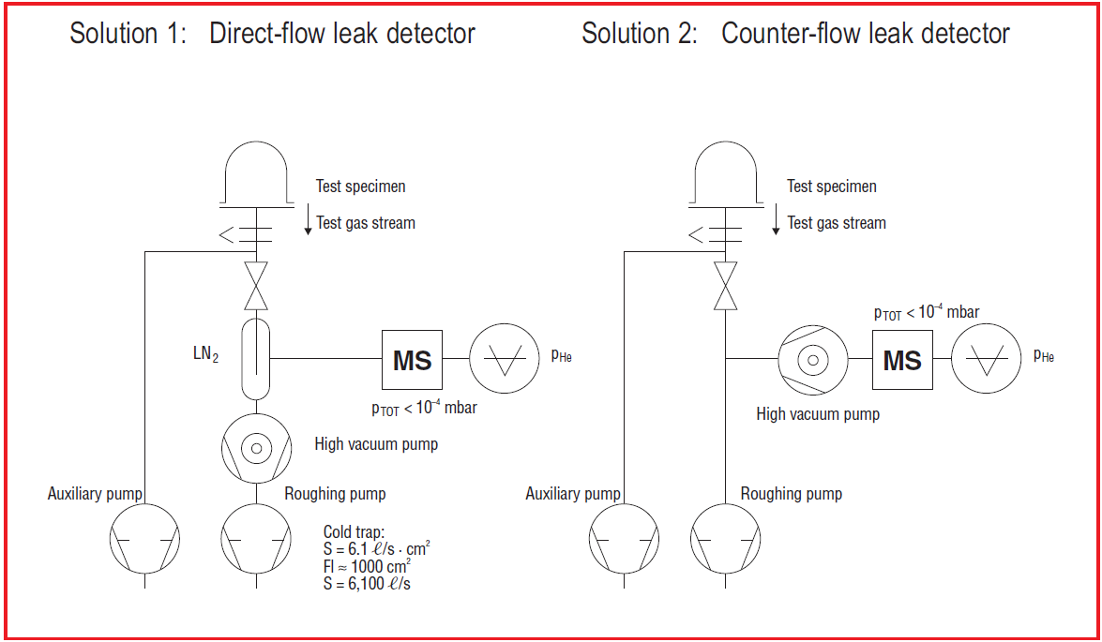
Helium leak detector
Low S_{he} will maximise P_{he} at MS = sensitivity
But need correct S_{eff} to maintain MS < 10⁻⁴ mbar
+ Low detection limit
+ Tune S_{HVP} to max sensitivity
+ LN₂ stops oil backstreaming
- Experienced operator
- LN₂ logistics
+ Very mobile, no LN₂
+ Now industry standard
+ User friendly/robust
- Oil backstreaming !
- Black box !

Slide 32
Typical leak detection characteristics
Counter flow now industry standard
Detection limit 1 E⁻¹¹ mbar.l/s
  Fine and big leak modes
Portable 20-50 kg !! (primary pump size)
User friendly
Typical S_{he} 1-4 l/s
Max Throughput 1 -10 mbarl/s
Primary pump
  oil sealed or dry (latter avoids he retention)
  4-40 m³/hr
Sniffer port
Calibrated leak integrated – auto calibration at startup
Auto tuning to mass 4 (⁴He) peak - also mass 2 (H₂) and 3(³He)
Outputs 0-10V, RS 232, etc.
Continuous improvements for internal data storage
Auto venting for series production – beware !
Floating zero-point !
Sensitive to high helium environment & helium contamination
Requires regular maintenance (contaminants, collector filament, valves)

Slide 33
Basic setup of overpressure method - sniffing
Sniffer
in helium
cloud
He
5 bar
He
Leak Detector

Slide 34
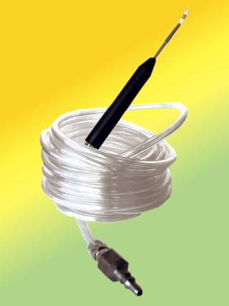
Overpressure methods
Helium Sniffing:
  Principle to detect an increased helium concentration at the leak with respect to a background signal
  The background is due to the natural 5 ppm helium in air (in cryo environments this can be higher).
  The sniffer is directly sampling the gas mixture in the ambient air via a sintered plug, and an increase in helium concentration is seen in the leak detector cell.
  Typically 2 to 5 m tube length
  Sniffing is a localisation method, often employed once a leak is known to exist.
  System must be able to support overpressure
    Above 1.5 bar (absolute) safety rules apply
  Can be employed on complex geometries
  The detection limit depends of the sniffer pumping speed and the sensitivity of the detector cell
    Detection limit for direct sniffing ~ 10⁻⁵/10⁻⁶ mbar.l/s
  The detection limit can be greatly improved by accumulation of the leaking helium in a pocket
    Detection limit for sniffing with accumulation ~ 10⁻⁹ mbar.l/s

Slide 35
The leak signal…
Exponential decay
of a leak signal
Exponential rise
of a leak signal

Slide 36
Pumping
Time constant
Same applies for helium partial pressure

Slide 37
The leak signal ..response & recovery
Helium signal growth when leak testing
Time constant
Remember
e⁻¹=0.37 e⁻²=0.13 e⁻³=0.05
S_{eff,He} for typical LD is ~ 1 l/s !
So if V is 1 litre
3τ= 3 s
but if V is 1000 liters
3τ= 3000 s ~ 1 hour !
95%=3τ=response time
Recovery…!

Slide 38
Testing big volumes
q
q
q
V=1
V=1000
V=1000
S_{He=1}
S_{He=1}
S_{He=100}
LD
LD
T
S_{he,LD=1}
LD
3τ=3 s
3τ=3000 s
3τ=30 s
Auxiliary turbo is used to reduce system time constant for leak testing
      The turbo group is there anyway for UHV systems (evacuation time, cleanliness, ultimate pressure, system conditioning, etc)
      For elastomer sealed systems, helium permeation occurs ~ 300 s

Slide 39
Testing small conductances
q
q
q
V=1 litre
C=1 l/s
V=1
C=1
V=100
C=0.01
S_{He=1}
S_{He=100}
S_{He=100}
LD
T
T
LD
LD
S_{eff,He} =0.5 l/s
3τ=6 s
S_{eff,He} =0.99 l/s
3τ=3 s
S_{eff,He} ~ C=0.01 l/s
3τ=30000 s
Turbo of limited use.
In long pipelines the time constant can be very big – be careful, adapt configuration.

Slide 40
System calibration
System is in equilibrium and ready to leak test
Use reference leak to check:
    Leak detector is connected to system - helium signal is seen
    Reference leak amplitude is as expected (no partial flow)
      Detector can be adjusted to read reference value
    System time constant is acceptable and as expected
      Response time < permeation time
Ref leak
V=1000
S_{he,100}
T
LD
Chart

Slide 41
High background signal
Due to leak detector:
  Polluted detector (He contaminated oil, seals, collector, etc)
  Calibration of detector
  Malfunctioning of detector
  Leaks in internal connections
Due to system under test
  Leaks (5 ppm helium in air)
  Virtual leaks
  Permeation through elastomer seals
  High helium environment (> 5ppm)
  Materials in system retaining helium (oil, grease, etc)

Slide 42
Leak test reporting
Typical leak test form
  Contract & spec
  Part identifier
  Test equipment used
  Calibrated leak info
  System calibration
  Leak test measurements
  Conformance (or not)
  Signatures.
  +
  graph with annotated steps

Slide 43
PRACTICAL 2
  3 Groups of 5 or 6 students, 3 similar test stands
  40 minutes
  Leak testing of manifold
    Localise the biggest leak
      Show reasoning.
      Fix it & understand the cause.
    Localise & determine size of other leaks (no repair)
    Document the results
    Discussion during/after coffee break

Slide 44
PRACTICAL 2 - discussion
  Leak testing of manifold
    Localise the biggest leak:
      Show reasoning
        Signal on detector high & drops when isolated
        Pirani goes quickly over-range when isolated
        Pirani response to helium jet – signal increase.
      Fix it & understand the cause.
        Damage to flange face and seal on sealing line
    Localise & determine size of other leaks (no repair):
      Check calibration and apply correction
      Use jet to localize then helium pocket
      2 further leaks ~ 1 E-5, ~ 1 E-7 mbar/s
    Document the results
      Short summary of what was done and observed.
      Can use std reporting sheet & graphical output

Slide 45
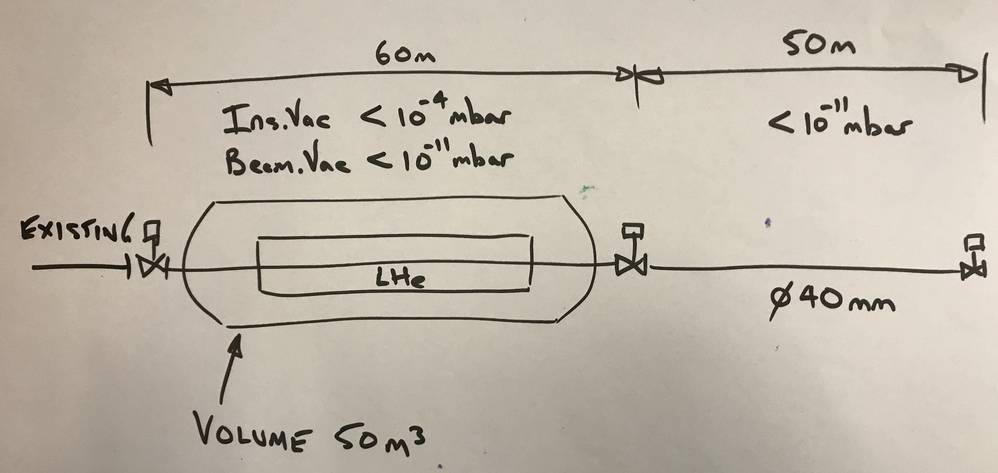
Presentation for tutorial closeout (Group 5)
  The vacuum system shown is in design phase.
    Propose the pumping system and instrumentation based on the required target pressures.
      With and without beam induced desorption effects
    Define the admissible gas loads and/or leak rates for:
      RT beam vacuum, cold beam vacuum and cryostat.
    Propose the leak testing strategy/methodology during;
      Construction, installation and operation.
    Propose a leak test setup for:
      the cryostat vessel and liquid helium enclosure before assembly of the cryostat
      the 60 m RT zone during its installation.
    For each of the above, justify the reasoning for your choices and possible alternatives

Slide 46
Further slides…….

Slide 47
Signal correlation with air
Systems may have several air leaks after assembly
In the case that the biggest leak is limiting the equilibrium pressure
P_{ult} = q_{L}/S
Then assuming 5ppm helium in air, the detector signal should rise a factor of ~10⁵ times when helium is presented at the biggest leak (maintained for time ~ τ)
  If it doesn’t, then you haven’t found the biggest leak yet!
  Alternative to avoid system contamination is to shield leak with nitrogen or alcohol – signal will fall
q_{L}
5ppm, 100%, 0%

Slide 48
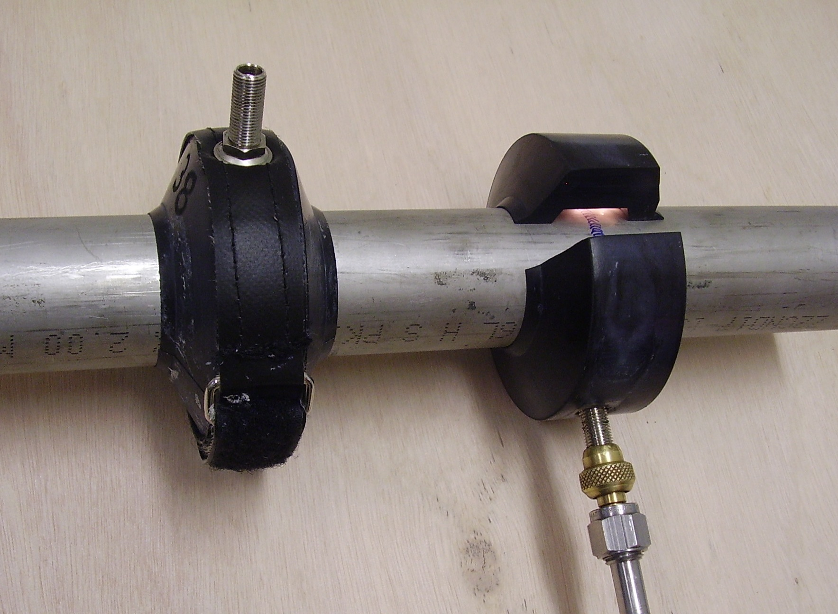
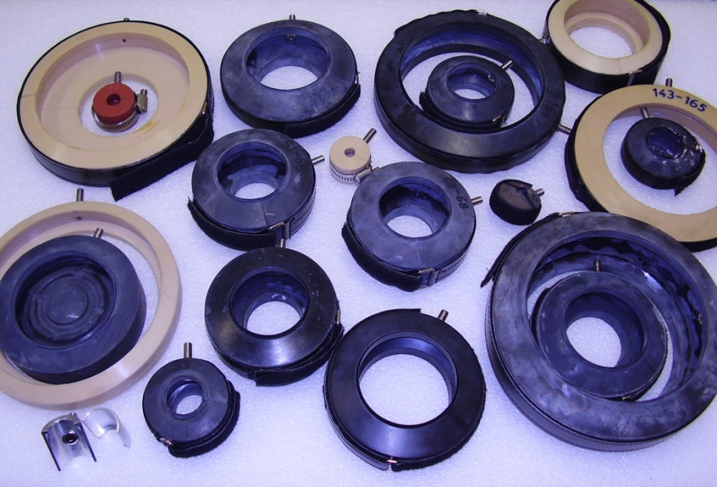
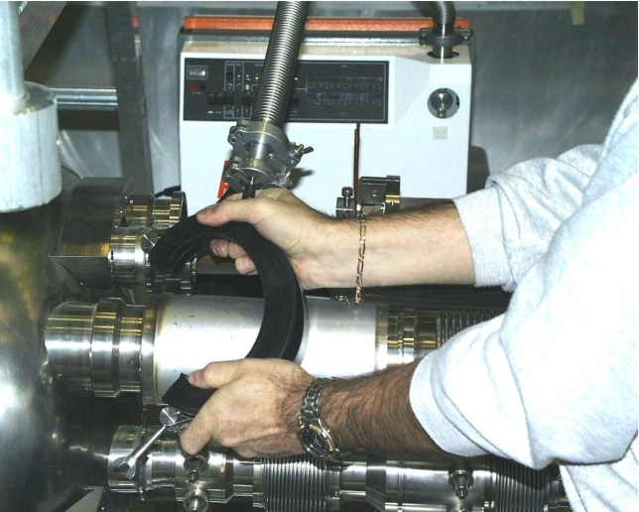
Clam shell tools
~20 diameters and diameter combinations for LSS standalones
NBR, polyurethane, silicone rubber, metal+mastic

Slide 49
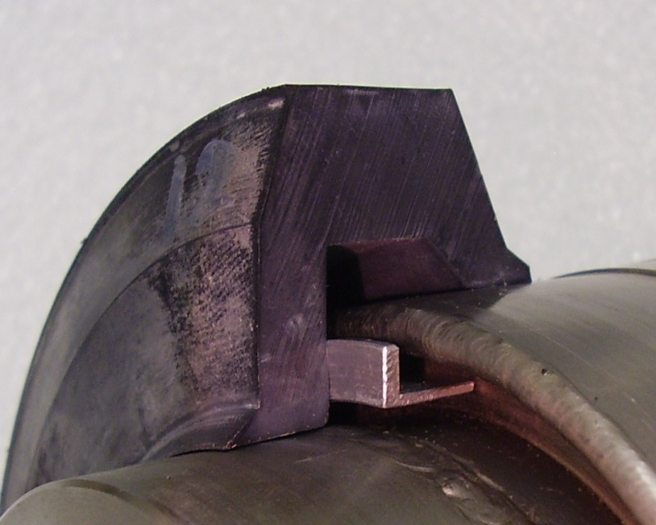
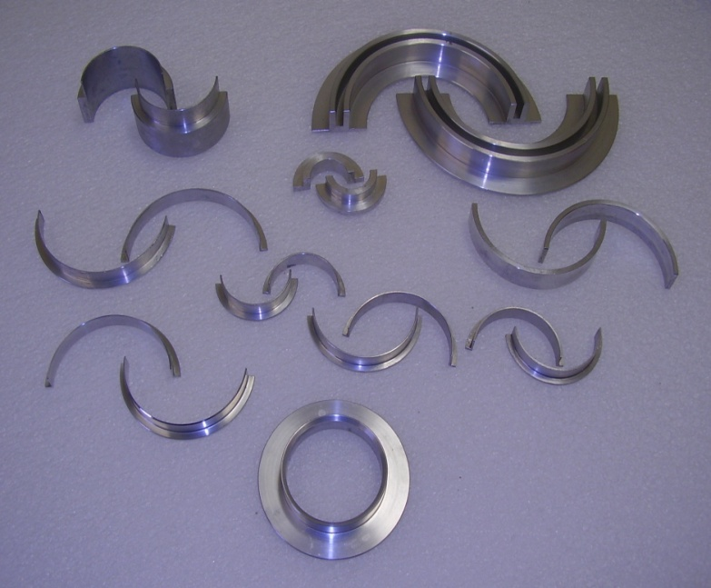

Clam shells
Support rings for asymmetrical models
Sealing on non-perfect tube surfaces:
  alcohol for small defects to allow a E-8 mbar.l/s residual signal to reduce to E-10 range
  mastic for bridging gaps
  vacuum grease for intermediate defects (e.g. surface scratches)
Same space as orbital welding machine
Clam shells retain He – do not store in He atmosphere

Slide 50
Standards
EN1330-8 Non-destructive testing – terminology – Part 8:Terms used in leak tightness testing
EN1518 Non-destructive testing – Leak testing – Characteristation of mass spectrometer leak detectors
EN1779 Non-destructive testing – Leak testing – Criteria for method and technique used
EN1593 Non-destructive testing – Leak test – Bubble emmision techniques
EN13184 Non-destructive testing – Leak testing – Pressure change method
EN13185 Non-destructive testing – Leak testing – Tracer gas method
EN13192 Non-destructive testing – Leak testing – Calibration of reference leaks for gases
EN13625 Non-destructive testing – Leak testing – Guide to the selection of instrumentation for the measurement of gas leakage

Slide 51
Tightness Requirements?
No system can be perfectly leak tight, or need be.
Consider requirement for application,
Under what conditions of p, T, gas species,
Allocate to System, Subassembly, Component
Baking of components, thermal cycles ?
Any safety factor included ? Strategy agreed? Spec agreed?
    Eg
    i) ∑ subassy leak rates ≤ operational leak tightness/k
    ii) subassy leak rate = ∑ components leak rates
    iii) determine and allocate component leak rate
    Conservative approach, but necessary for
    complex systems.
    Testing each time at < 1.10⁻¹⁰ mbar.l/s is not
    always possible.

Slide 52
Design strategy ..prevention is better than cure
Minimise the risk of leaks by design:
No hidden welds, trapped volumes, etc
Use proven technologies when possible
No liquid helium to beam vacuum welds
  Partial penetration of wall thickness
All welded cold envelopes
  No cold metal/ceramic junctions on helium circuits
Correct material choices for application
  Specify and analyse - grain size, inclusion, forging, chemical composition, physical properties,
Correct joining techniques
  weld and braze qualification, samples and series sampling
No halogenated fluxes – only vacuum brazing
No dye-penetrant testing on vacuum envelopes

Slide 53
Testing strategy
With a complex system the testing strategy needs to be consistent, agreed, communicated and followed
Definition of tightness values, responsibilities, testing steps, hold points, etc.
Test procedures should written and agreed.
Using LHC example:
RT beam vac eg chambers, sector valves, etc
  components/assemblies leak tested before and after bakeout, prior to tunnel installation
Cold beam vac eg beam screens, BPM buttons, cold bore
  Components/assemblies with helium interface were leak tested before and after a thermal cycle, prior to tunnel installation
  Combined pressure and leak tests
Insulation vacuum eg cryostat vessels, magnet coldmass,
  Heavy objects (25T) tested in industry, prior to delivery
  Minimum transformation of helium envelopes after delivery to CERN and never at inaccessible zones
  Combined pressure and leak tests

Slide 54
Baking UHV Components
Component/assemblies for RT beam vacuum systems are systematically baked and leak tested before installation
Baking (including firing at 950 C) is a cleaning process and may reveal leaks that are blocked by water vapour
The thermal cycle may reveal weaknesses in the chamber construction
It’s cheaper to test and repair in lab than in the tunnel !
But…wasn’t possible for big LHC objects and wasn’t performed on cold beam vacuum components

Slide 55
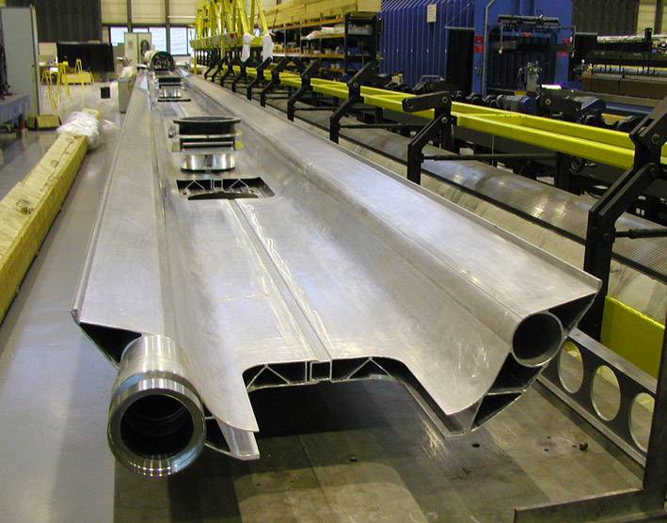
Working with industry
Tightness requirements were part of LHC tech specification and the supplier was fully responsible for achieving the tightness requirement.
In industry, CERN:
Approves the leak test procedure
    Iterations by email or meetings
Approves the test set-up - factory visit(s)
    Check equipment layout, configuration, pumping speeds, environment, co-activities,
Witnesses the execution at startup - factory visit(s)
    Agree in advance what you want to see
    observe time constant, system calibration, competence
Defines how the test results must be presented
    result sheet, chart recording with annotation
Approves test results before shipment (hold point)
    info sent by fax, email, or upload to CERN edms

Slide 56
Types of leaks
Demountable connections
  metal seals, elastomer seals
Permanent connections
  Welded, brazed, glass/metal, ceramic/metal, bonded
Flaws in wall material
  Thin walls – bellows, flexible hoses
  Changes of x-section
  Cracks, inclusions, porosity, corrosion, fatigue…
  Damage – shocks, TIG arc,
Many more….
Priorities in leak search could follow order above but get info on history – previous test (who, when, how), recent modifications, transport, thermal cycles, pressure cycles, flux, storage, etc.

Slide 57
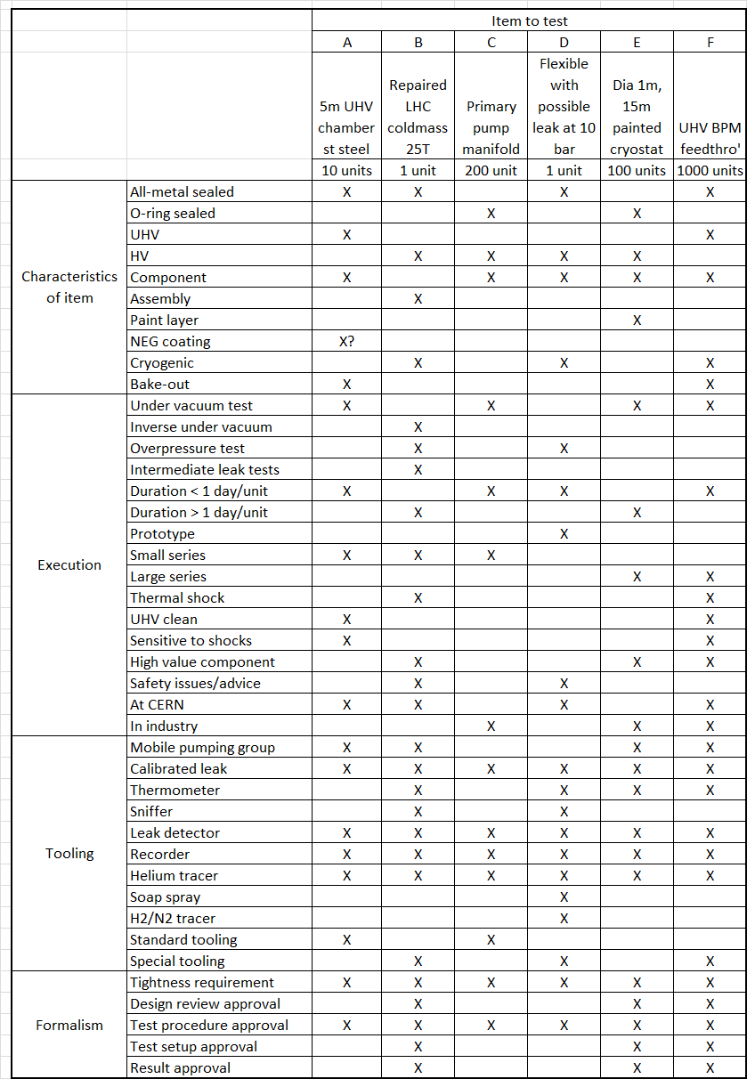
Considerations & preparations for leak testing

Slide 58
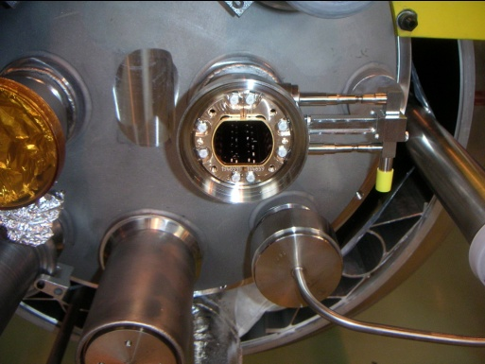
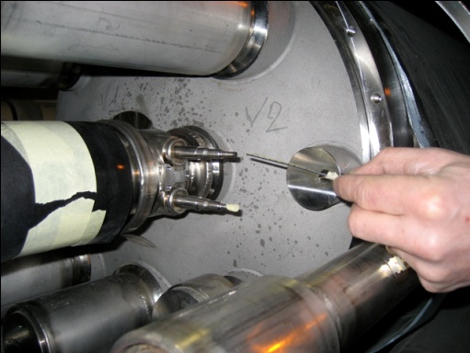
Helium to beam vac leak
Leak localised over 2.8km to one dipole using technique used on insulation vacuum
Beam screen cooling tube
q
Beam vacuum
q
N₂
He feed in
plastic
capillary
Beam vacuum
Nitrogen flow suppresses helium signal.
When He capillary extremity reaches leak
position, helium signal is immediate.
Localisation to within mm.

Slide 59
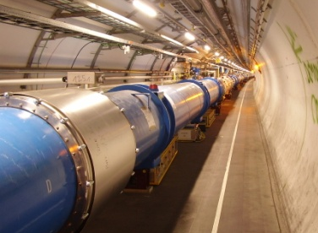
Which LHC interconnect ?
An under vacuum leak test in molecular flow conditions, using 2 turbomolecular pumps, mass spectrometer leak detector and helium as tracer gas.
⇨ Longitudinal leak localization in long pipelines
Assume linear conductance of cryostat, so C ∝ 1/L (with & without MLI)
⇨ For S >> C1 or C2: q1/q2 ∝ C1/C2 ∝ L2/L1
For LHC cryostats, S ~ C so apply correction for effective pumping speed

