Slide 1




Onedata
Eventually Consistent Virtual Filesystem for Multi-Cloud Infrastructures
Michał Orzechowski (CYFRONET AGH)

Slide 2

Supported by:

Slide 3
PROBLEMS ADDRESED BY ONEDATA
Multi-protocol transparent access to data “[…] but we want POSIX”
Heterogeneity of storage technologies
Replica Management
Easy Data Sharing and publication (DIO)
Metadata Management Integrated with Data Management Platform
Flexible authentication and authorization
Easy integration using API with external services
High-throughput data processing
1
2
3
4
5
6
7
8

Slide 4
PROBLEM 1: MULTI-PROTOCOL TRANSPARENT ACCESS TO DATA IN MULTI-CLOUD ENVIRONMENTS
Transparently access and create data in multi-cloud environments
Care less about data locality, all your data are accessible wherever you go
Use many protocols to access the same data

Slide 5







ONEDATA for ONEWORLD
Onezone
SAML
(in prep.)
Entry
GUI
OIDC
REST APIs
NO TRUST
OAI-PMH
Kademlia
DHT (in prep.)
NO TRUST
Ceph
S3
Swift
POSIX
POSIX
CDMI
GridFTP
(in. Prep)
Data Mgmt. GUI
REST APIs
FTP / SFTP (in prep.)
WebDAV
(in prep.)
NO TRUST

Slide 6
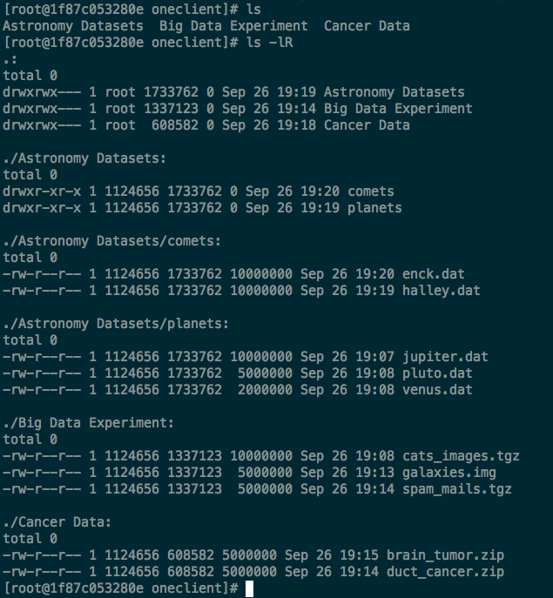
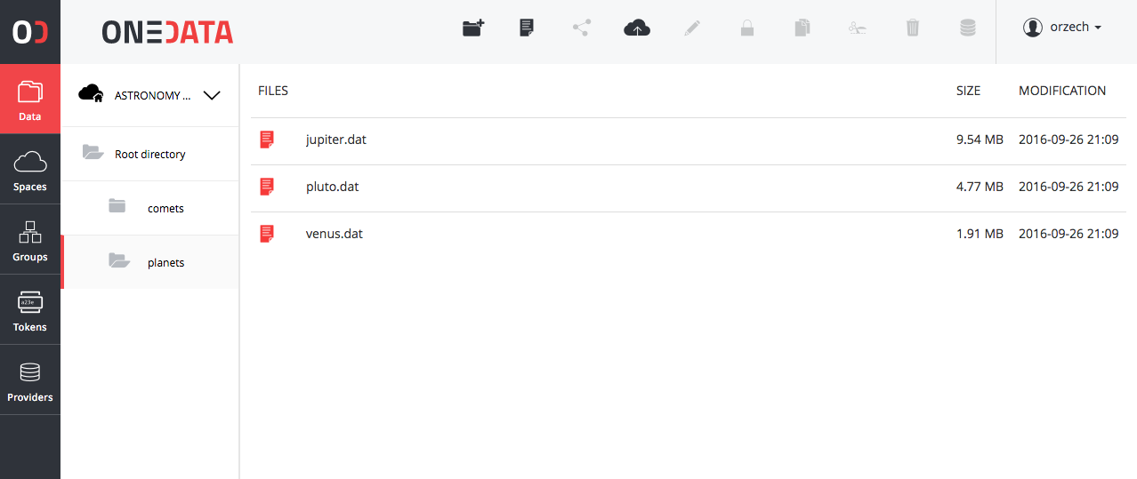
[…] BUT WE WANT POSIX
Support for most of the POSIX operations on globally distributed virtual file system
All data accessible via a unified file system mountable on virtual machines, Grid worker nodes and containers

Slide 7



PROTOCOL HANDLERS (PLUGINS)
FUSE Client
Oneclient
Onezone
POSIX
Entry
GUI
CDMI
HTTP GUI REST
Data Mgmt. GUI
FUSE Client
Kademlia
DHT (in prep.)
FUSE Client
REST APIs
FTP / SFTP
(in prep.)
HTTP GUI REST
WebDAV
(in prep.)
FUSE Client

Slide 8
PROBLEM 2: Heterogeneity of storage technologies
Use the data protocols of your choice to access data wherever you go
Minimize the problems of selection right storage technology to data centres operators
Avoid cloud vendor locking

Slide 9
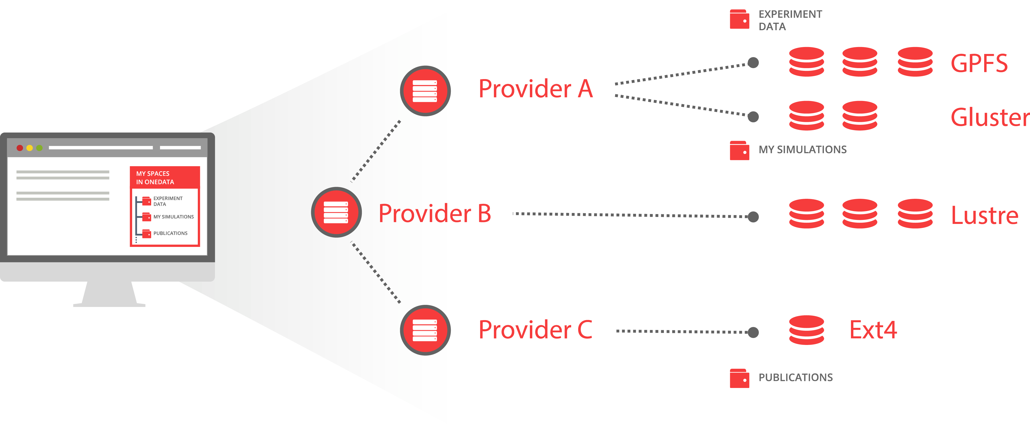
Different types of storages virtualized
S3
POSIX
Ceph
OpenStack Swift

Slide 10
STORAGE SYSTEMS DRIVERS (PLUGINS)
FUSE Client
Oneclient
Onezone
POSIX
Ceph
S3
Swift
Entry
GUI
GridFTP
(in. Prep)
HTTP GUI REST
FUSE Client
Kademlia
DHT (in prep.)
FUSE Client
HTTP GUI REST
FUSE Client

Slide 11
PROBLEM 3: REPLICA MANAGEMENT
Replicate files on demand and on the fly without any additional effort
Migrate data between sites on demand with simple API interface
Easily check location of your data using GUI or API

Slide 12
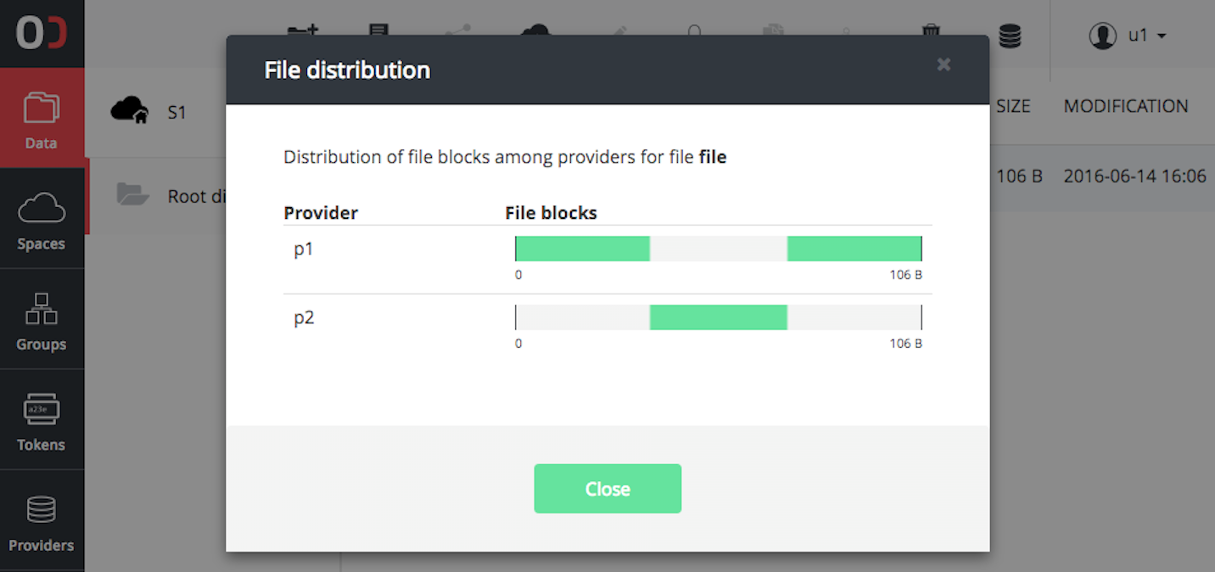
Replicas Management SIMPLIFIED
Manage files not Replicas
File distribution between storage locations is underneath the file structure
Replicas management on a chunk basis
Missing chunks delivered on the fly
API for replica management for pre-staging and implementing external data policy management

Slide 13
PROBLEM 4: EASY DATA SHARING WITHOUT BORDERS
Share large scale data collections with other communities
Enable your data to be shared in cross-federation scenarios
Bring your data and tools as building blocks to European Open Science Cloud

Slide 14
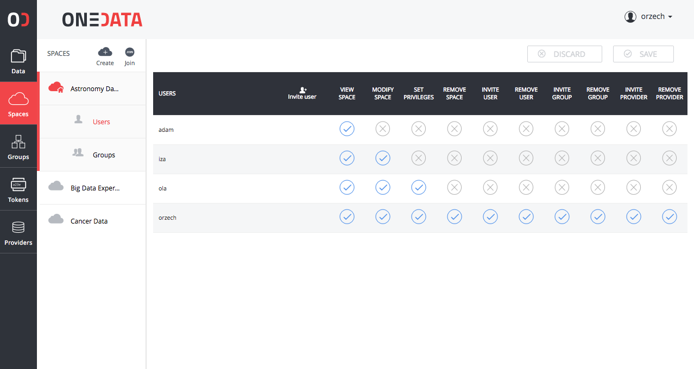
EASY DATA SHARING
Team-sharing
  For groups
  For individuals
  Token based
Cross-community data sharing
Instant and ad-hoc data sharing
Thanks to effort supported by EGI Engage:
  Open Data Publication
  Handles (DOI) support
  OAI-PMH

Slide 15
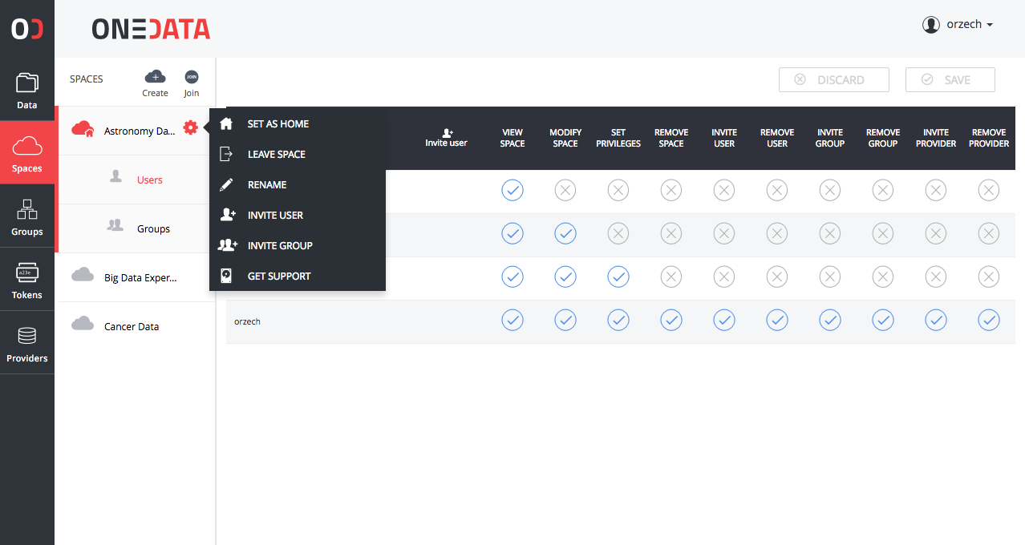
EASY DATA SHARING
Team-sharing
  For groups
  For individuals
  Token based
Cross-community data sharing
Instant and ad-hoc data sharing
Thanks to effort supported by EGI Engage:
  Open Data Publication
  Handles (DOI) support
  OAI-PMH

Slide 16
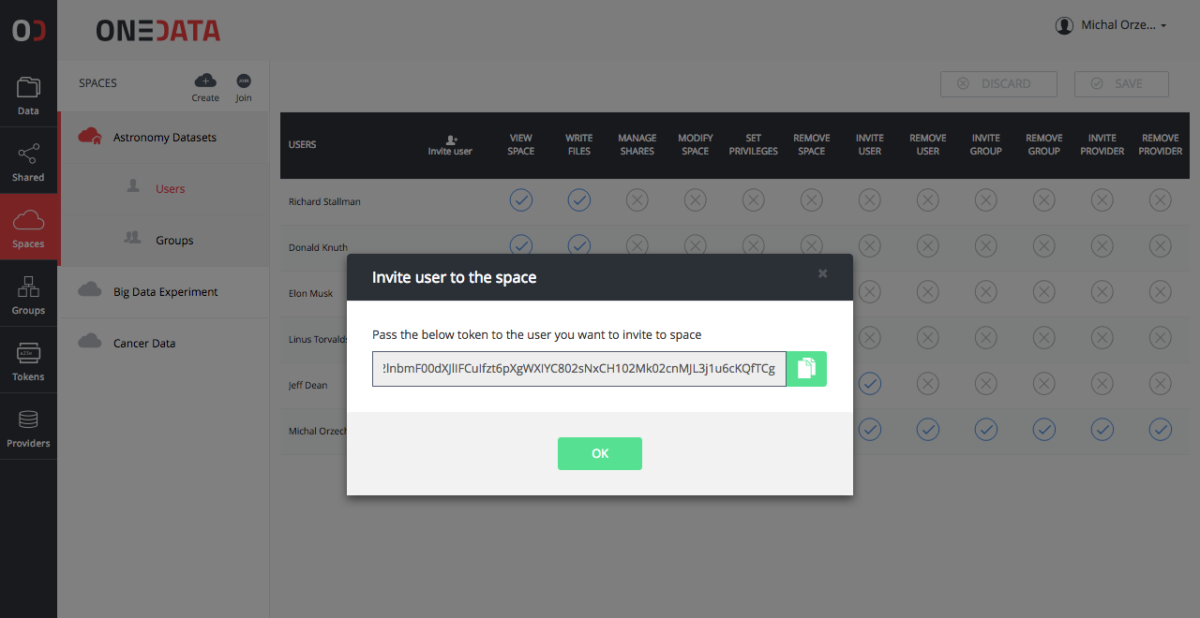
EASY DATA SHARING
Team-sharing
  For groups
  For individuals
  Token based
Cross-community data sharing
Instant and ad-hoc data sharing
Thanks to effort supported by EGI Engage:
  Open Data Publication
  Handles (DOI) support
  OAI-PMH

Slide 17
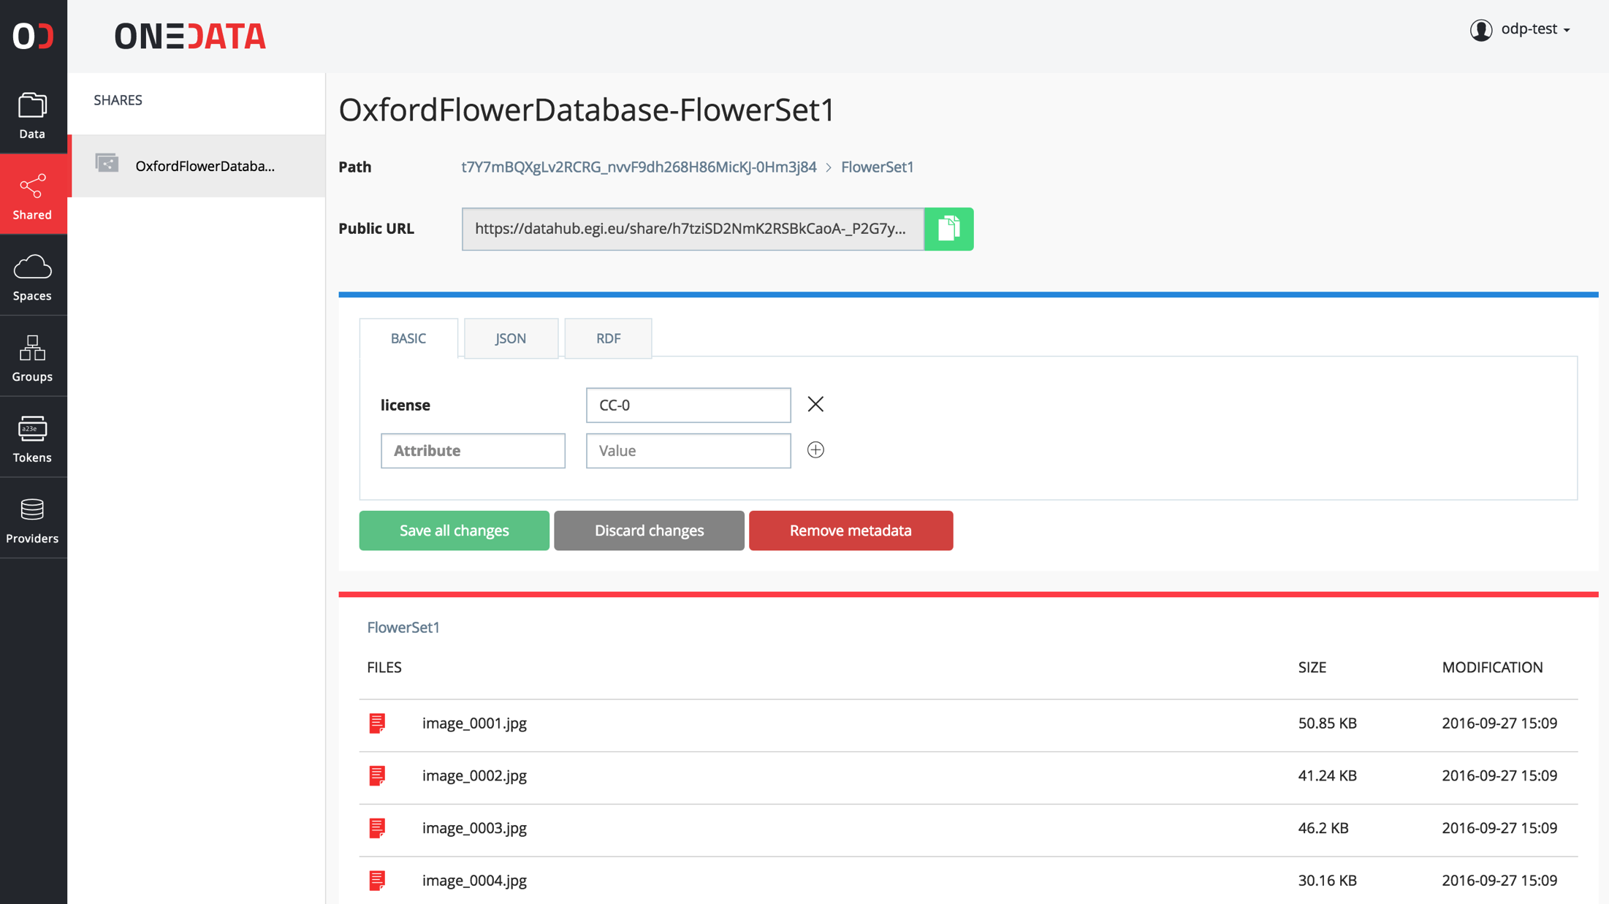
Open Data Platform workflow

Slide 18










Open Data Platform workflow
Public Services
For Data Discovery
Register identifier (e.g. DOI)
Discover data set
Expose share metadata over OAI-PMH
View data set preview in browser using DOI
Share of
Dataset
Copy data set
Create a share from
folder or file with
Metadata in DC
Lazy Replication
Dataset
Copy of
Data-set-1.1
Private Resources
Private Resources

Slide 19
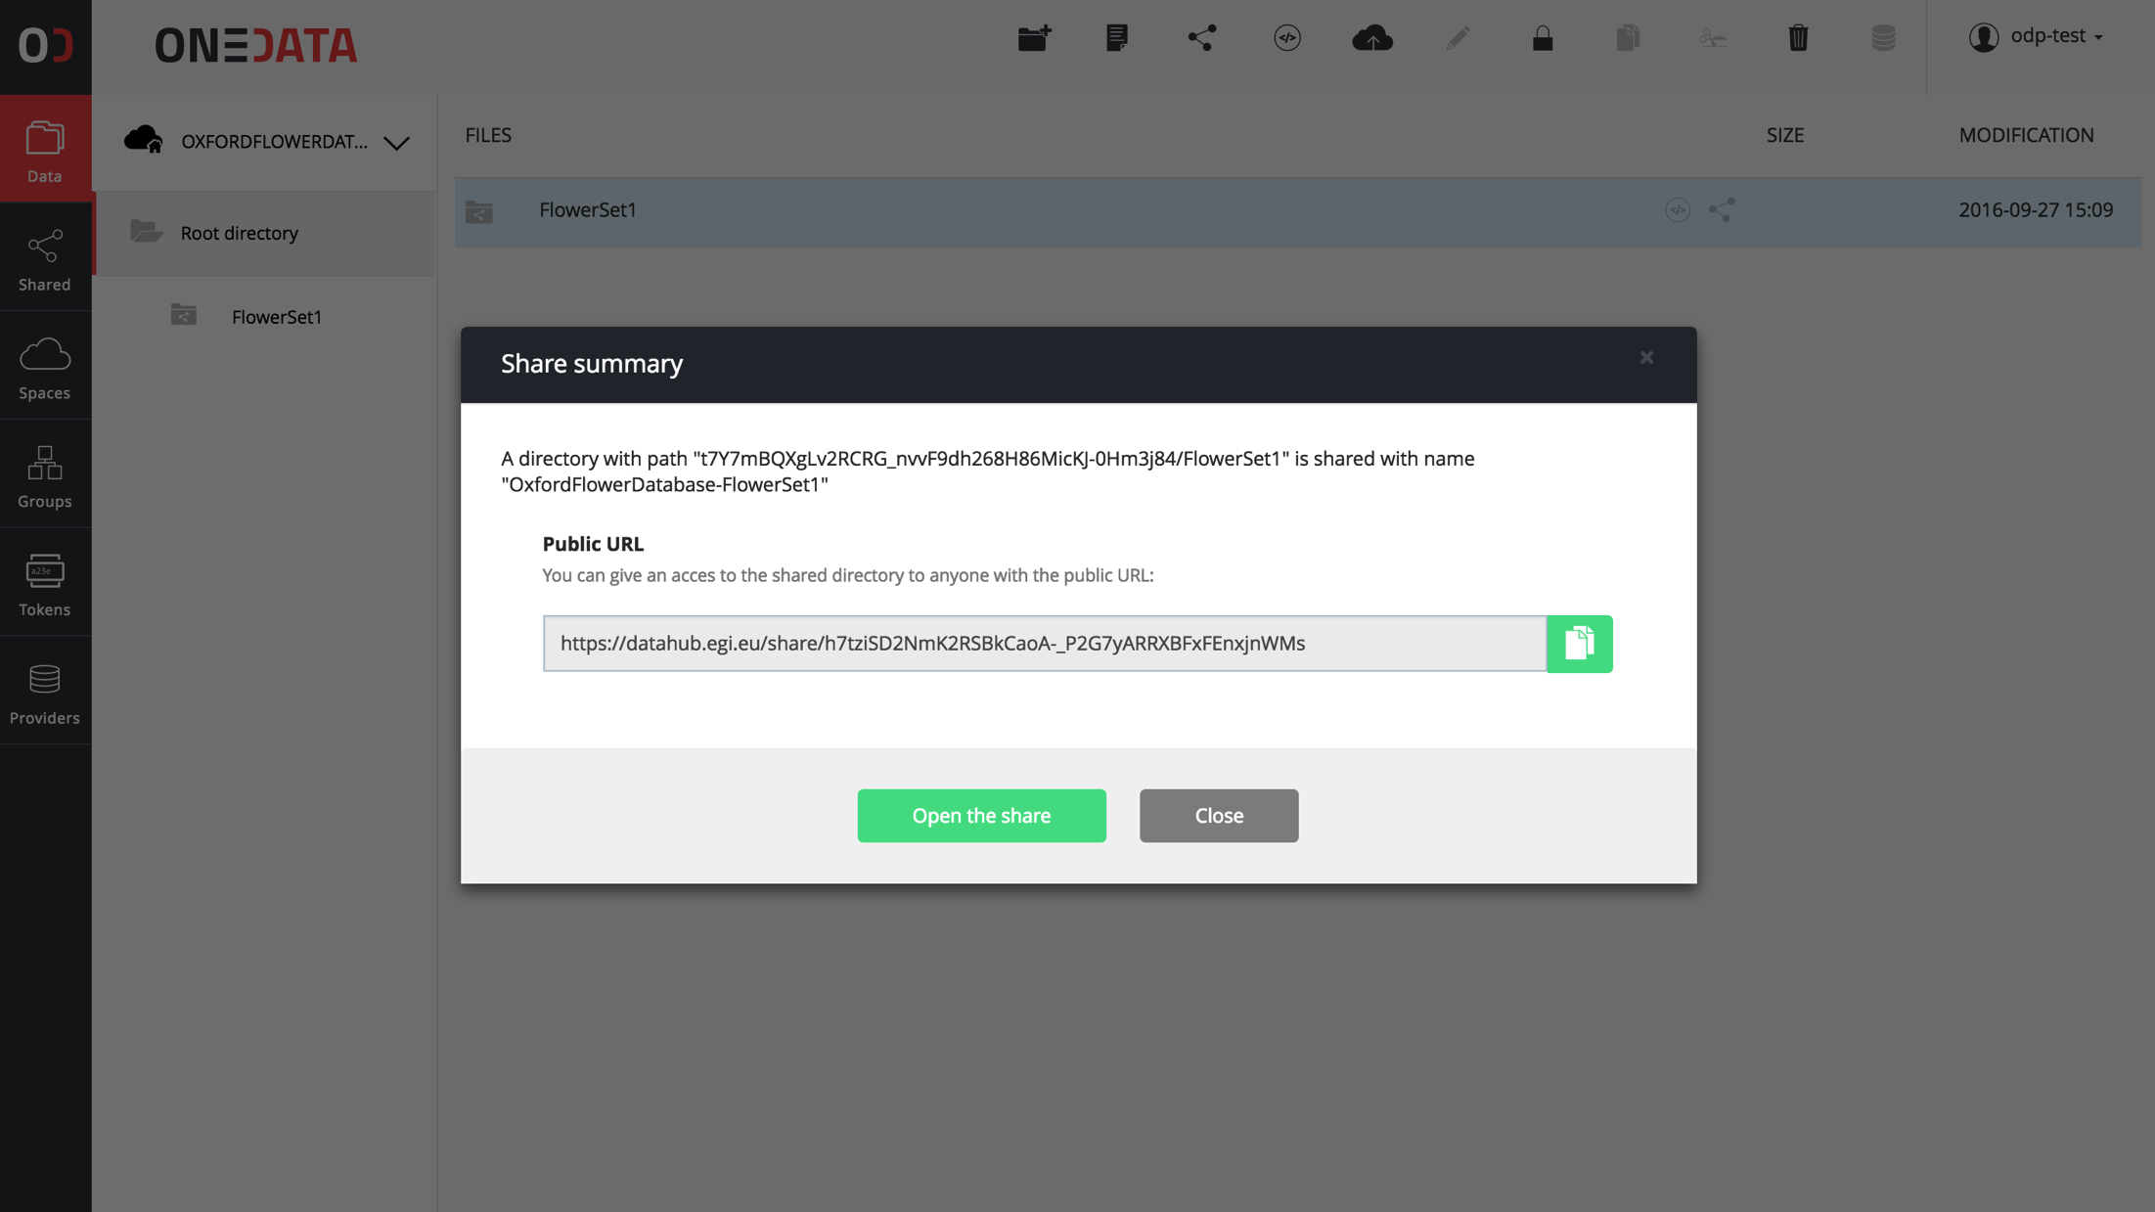
Open Data Platform workflow

Slide 20
Open Data Platform workflow
Public Services
For Data Discovery
Register identifier (e.g. DOI)
Discover data set
Expose share metadata over OAI-PMH
View data set preview in browser using DOI
Share of
Dataset
Copy data set
Create a share from
folder or file with
Metadata in DC
Lazy Replication
Dataset
Copy of
Data-set-1.1
Private Resources
Private Resources

Slide 21
Open Data Platform workflow

Slide 22
Open Data Platform workflow
Public Services
For Data Discovery
Register identifier (e.g. DOI)
Discover data set
Expose share metadata over OAI-PMH
View data set preview in browser using DOI
Share of
Dataset
Copy data set
Create a share from
folder or file with
Metadata in DC
Lazy Replication
Dataset
Copy of
Data-set-1.1
Private Resources
Private Resources

Slide 23
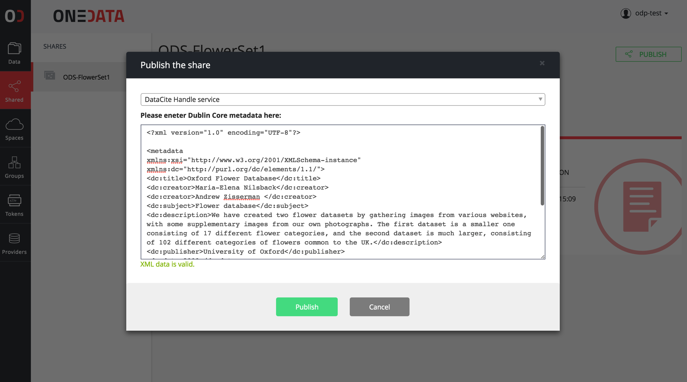
Open Data Platform workflow

Slide 24
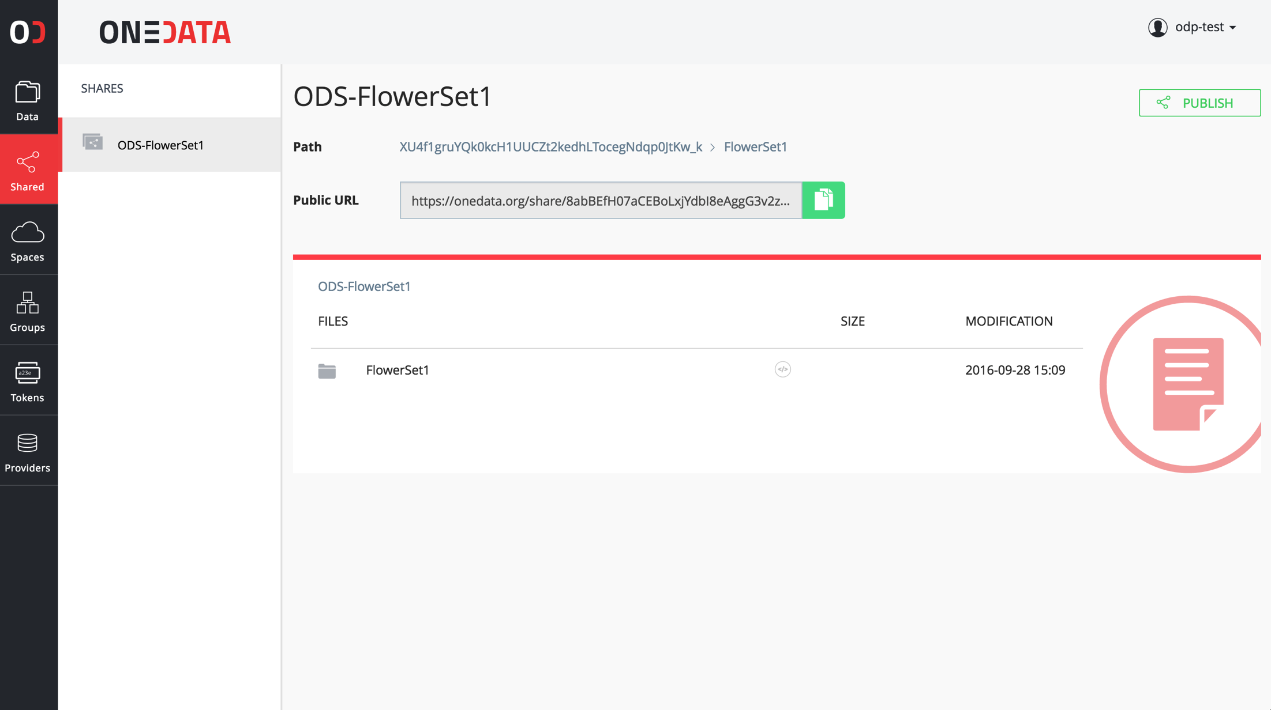
Open Data Platform workflow

Slide 25
Open Data Platform workflow
Public Services
For Data Discovery
Register identifier (e.g. DOI)
Discover data set
Expose share metadata over OAI-PMH
View data set preview in browser using DOI
Share of
Dataset
Copy data set
Create a share from
folder or file with
Metadata in DC
Lazy Replication
Dataset
Copy of
Data-set-1.1
Private Resources
Private Resources

Slide 26
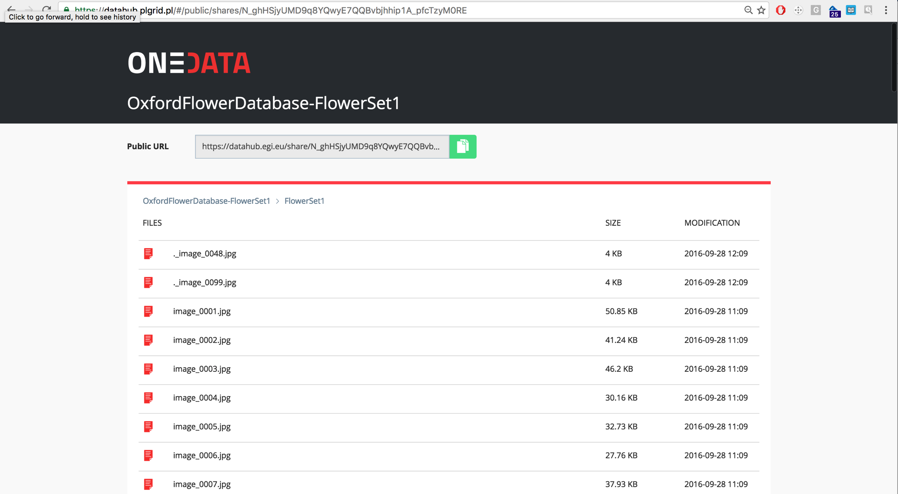
Open Data Platform workflow

Slide 27
Open Data Platform workflow
Public Services
For Data Discovery
Register identifier (e.g. DOI)
Discover data set
Expose share metadata over OAI-PMH
View data set preview in browser using DOI
Share of
Dataset
Copy data set
Create a share from
folder or file with
Metadata in DC
Lazy Replication
Dataset
Copy of
Data-set-1.1
Private Resources
Private Resources

Slide 28
PROBLEM 5: METADATA MANAGEMENT INTEGRATED WITH
DATA MANAGEMENT PLATFORM
Work with data and metadata in one system – avoiding problems of consistency
Monitor metadata data changes trough API in order to feed external custom systems
Advanced data discovery capabilities based on metadata

Slide 29
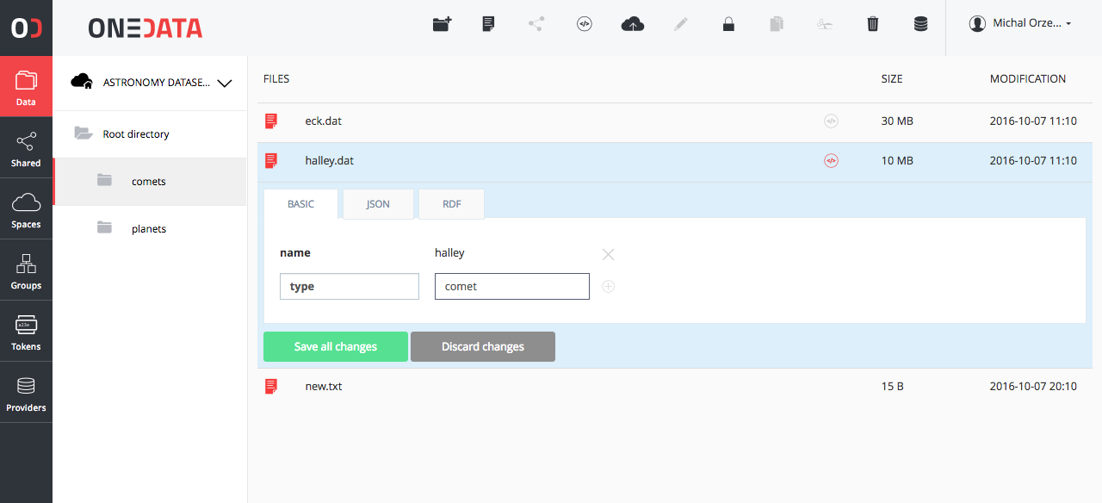
Integrated metadata managment
All files and directories can have a custom user metadata
API for metadata management
API for data discovery based on metadata
Virtual Folders based on metadata tags
Metadata formats:
key-value, JSON, RDF

Slide 30
PROBLEM 6: FLEXIBLE AUTHENTICATION AND AUTHORIZATION
Control who knows about your data
Control who can access data on a single file level

Slide 31
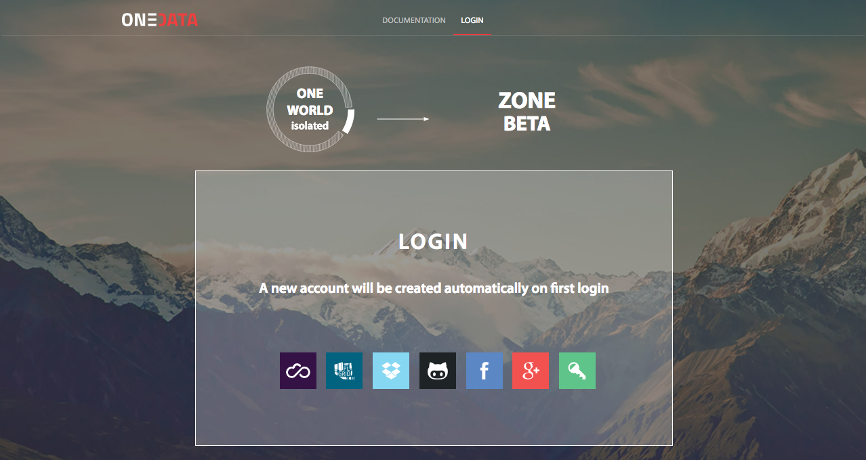
authentication and authorization
Pluggable methods of authentication per zone
Multiple levels of access control
ACL on files and directories
Group management
Token based authentication (macaroons)
X.509 in prep.

Slide 32
authentication and authorization
Pluggable methods of authentication per zone
Multiple levels of access control
ACL on files and directories
Group management
Token based authentication (macaroons)
X.509 in prep.

Slide 33
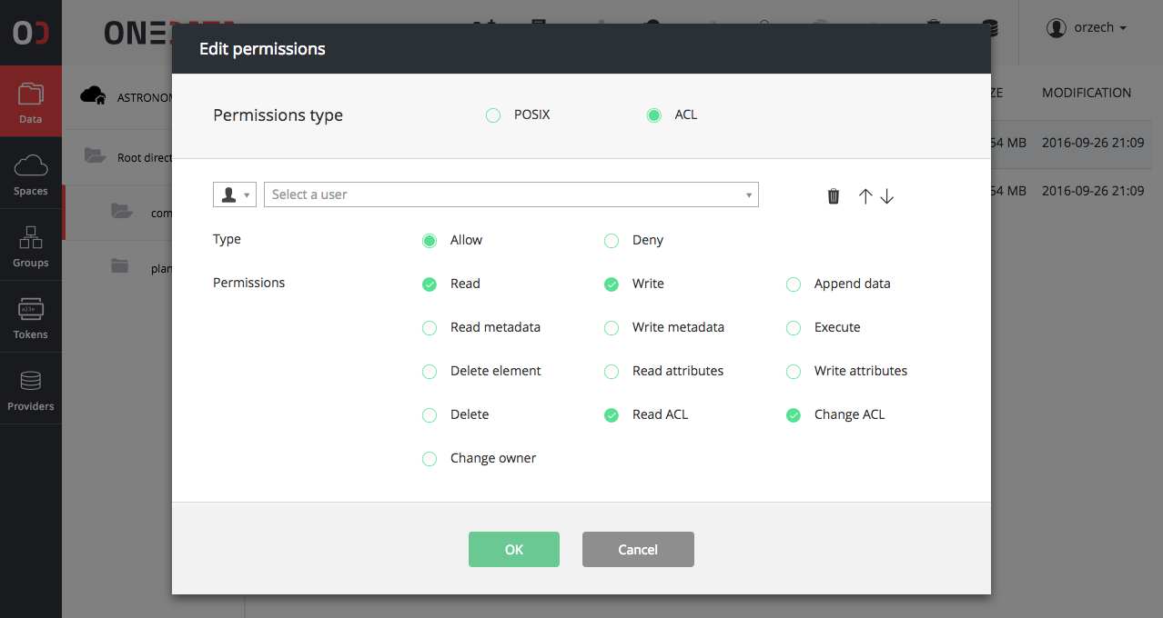
authentication and authorization
Pluggable methods of authentication per zone
Multiple levels of access control
ACL on files and directories
Group management
Token based authentication (macaroons)
X.509 in prep.

Slide 34
PROBLEM 7: EASY INTEGRATION USING API WITH EXTERNAL TOOLS
Integrate external tools using rich API interfaces with data management platform and build more complex environments for data processing

Slide 35
RICH COLLECTION OF APIs
APIs for all operations
Flexible permission checking for APIs
APIs for full eventually consistent integration with external systems
API fully described using Swagger for generation of clients based on API specification
Easy to use simple command line clients for REST API

Slide 36





PROBLEM 8: High-throughput processing
Protocols CDMI
Protocols S3
Protocols POSIX VFS
P2P
Control,
Remote Data Access
CDMI API
Storage Access
P2P
Direct Access
if possible
P2P
Parallel Processing Nodes using POSIX oneclient, CDMI or REST
Ceph
S3
SWIFT
Lustre

Slide 37
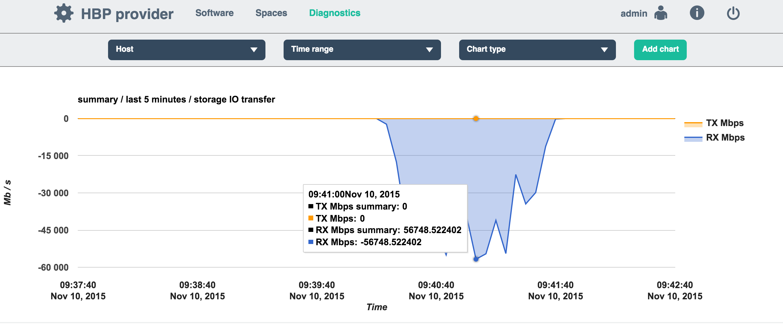
THROUPUT TESTS
55Gbit/s
On single node
5 parallel streams

Slide 38
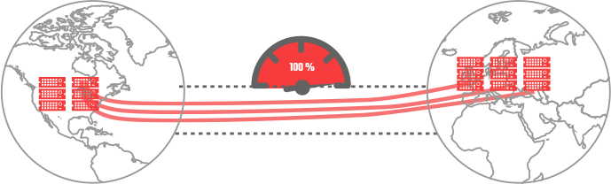
High-throughput transfers
Distributed Priority Queue
For cluster to cluster transfers
WAN
Transfer started by:
User in GUI
API-s
Policy
Access to Rmt. Data
Block-based transfer:
Remote Data Access on the fly
Pre-staging
Data Migration
Data Replication

Slide 39
EXAMPLE USECASE

Slide 40
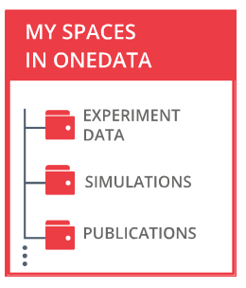

Multi-Cloud Earth Observation Image Processing PoC
JOB QUEUE
EOProc SatCat PROCESSOR
FUSE Client
Oneclient
EO-PoC Spaces
JOB CREATION
JOB LOCATION REASONING
Sentinel 1
APPLICATION COMPSITION AND DEPLOYMENT WITH DOCKER COMPOSE
Sentinel 2
JOB DEPLOYMENT
Results
VM MNG. API
CLOUD ORQUESTRATOR
CESNET
Cyfronet
IPT Poland
AWS
Parts of Sentinel 1 & 2 Data
Parts of Sentinel 1 & 2 Data
Parts of Sentinel 1 & 2 Data
Parts of Sentinel 1 & 2 Data
DATA LOCATION API
DATA REPLICATION, PRE-STAGINING, ON DEMAND TRANSFER

Slide 41
FUTURE PLANS

Slide 42
TOPICS ON ROADMAP
Further improvements in GUI interface:
  Visual data transfers
  Monitoring
  Storage support promises
  Custom limited tokens for clients and APIs
QoS and data management plans
Data discovery through Elasticsearch
Cross-zone integration (Kademia DHT)
Docker volume plugin
onedata-cli for platform management from command line
Windows and OSX clients
Dropbox-like Space sync
Exposing external data as Onedata Space

Slide 43
QUESTIONS?
Please visit:
www.onedata.org
Michał Orzechowski (CYFRONET AGH)

