Slide 1
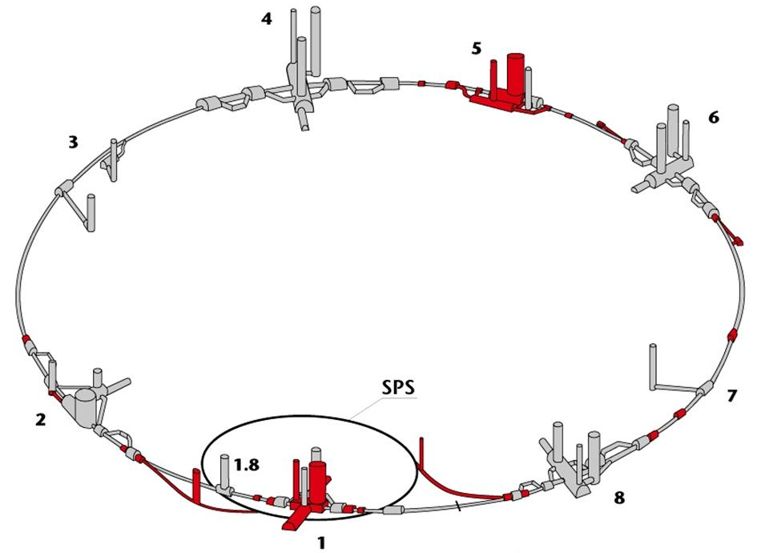
Access modes and patrols along HC periods
Result of discussions…
Open points
Comments, critics and suggestions are welcome!
Acknowledgments: B.Bellesia – J.Coupard - M.Gruwe - M.Pojer – L.Ponce - R.Shmidt - A.Vergara – M.Zanetti
M.Solfaroli
07/04/2009

Slide 2
Access modes and patrols along HC periods
Why did we decide to use the access
system during Hardware Commissioning?
To commission it
To HELP on keeping safety

Slide 3
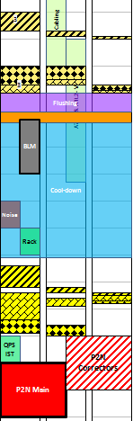
Access modes and patrols along HC periods
ElQA @ warm
ADI

Slide 4
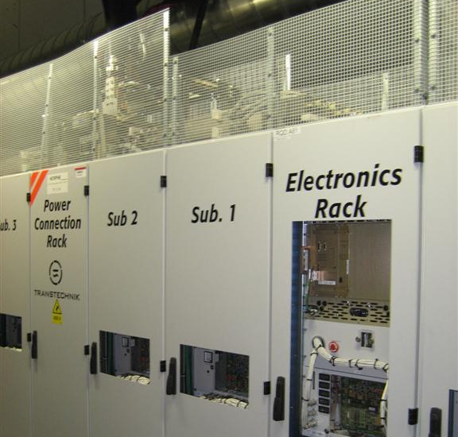
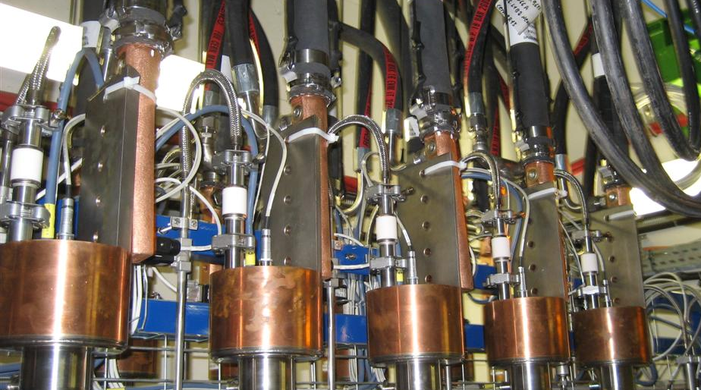
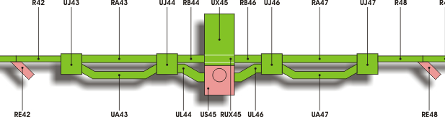
Access modes and patrols along HC periods

Slide 5
ElQA @ warm
Signalization in the UAs where a danger could be created
only in case of a short to ground throughout instrumentation
(no risk if no work)
No strict control necessary because of presence of involved
people in sensitive points (i.e. DFBs) – no patrol!
Close of the external envelope
Setting Restricted Mode on the access point/s
Special work could be allowed during the Low Voltage phase

Slide 6
Access modes and patrols along HC periods
ElQA @ warm
BTW ElQA & ElQA

Slide 7
BTW ElQA and ElQA
The second cool-down is not consider dangerous
for people (this argument doesn’t apply to sector 34)
Power converters are still locked
2 Possibilities:
Maintain the Restricted Mode for keeping the
control of the ongoing Hardware Commissioning
Passing in General Mode with restricted list (as done for
S34) updated via ADI if manpower cannot cope with accesses

Slide 8
Access modes and patrols along HC periods
ElQA @ warm
BTW
ElQA & ElQA
ElQA @ cold

Slide 9
ElQA @ cold
Signalization in the UAs where a danger could be created
only in case of a short to ground throughout instrumentation
(no risk if no work)
No strict control necessary because of presence of involved
people in sensitive points (i.e. DFBs) – no patrol!
Close of the external envelope
Setting Restricted Mode on the access point/s
Special work could be allowed during the Low Voltage phase

Slide 10
Access modes and patrols along HC periods
ElQA @ warm
BTW
ElQA & ElQA
ElQA @ cold
Phase I

Slide 11
Access modes and patrols along HC periods

Slide 12
Phase I
In the UAs risks only if working on the Power Converters or
on the QPS racks. Surfaces access points in General Mode
In the tunnel:
  Cryogenic risks have been excluded (low energy stored)
  Only electrical risks
  Access system in Restricted Mode
  Patrol vs no patrol??

Slide 13
Phase I
Patrol
PRO | CONTRA
More control | Less flexibility and more dead time
In case of a door forced, control of the sector would be lost but, given that there are no cryogenic risks (while in phase I), is a patrol really necessary?
People entering and working are doing so without Avis D’Intervention AND/OR forcing doors!!

Slide 14
Access modes and patrols along HC periods
ElQA @ warm
BTW
ElQA & ElQA
ElQA @ cold
Phase I
Phase II

Slide 15
Phase II
High cryogenic risks
High electrical risks
Both tunnel and UAs (experiments?) in
Closed Mode and patrolled

Slide 16
General points
Sectors | Phase I-II | Access status | Door forced | LOCK | Key taken | Alarm
S 12 | 1 | Restricted | N | N | Y
S 23 | 2 | Restricted | N | N | N
S 34 | 1 | Restricted | N | N | N
S 45 | 2 | Closed | N | N | Y
S 56 | 2 | Closed | N | Y | Y
S 67 | 2 | Closed | N | N | N
S 78 | 1 | Restricted | Y | N | N
S 81 | 2 | Closed | N | N | N

Slide 17
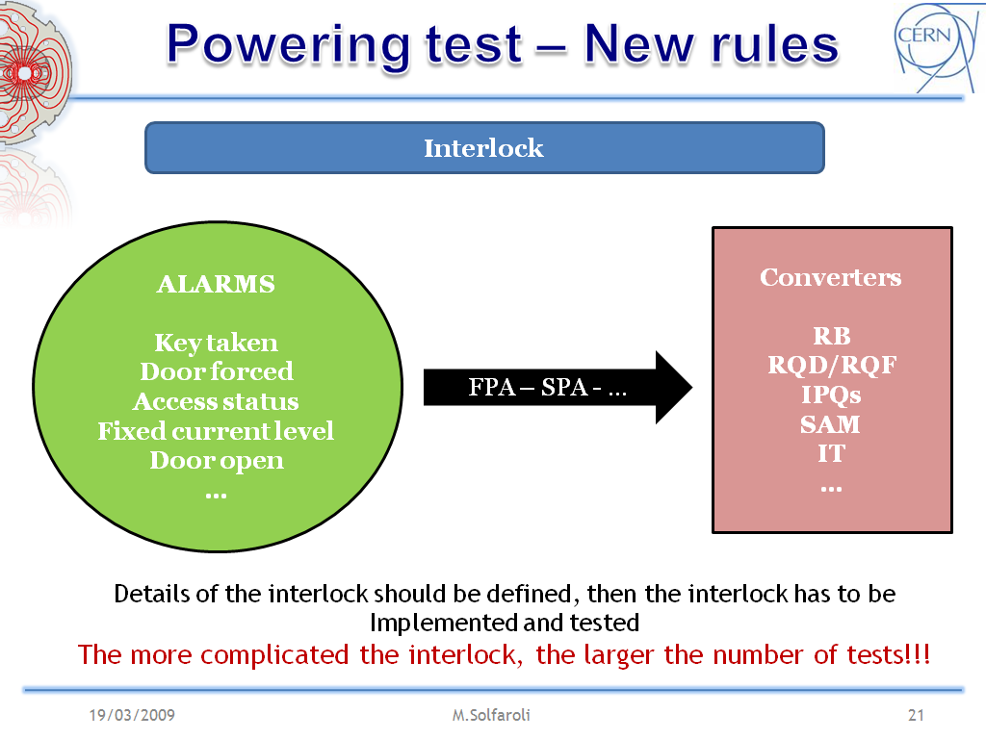
General points
?

