Slide 1
Planning and discussions
Access restrictions of the LHC machine
Some Examples
General Schedule with Powering Tests

Slide 2
What is not detailed
Safety rules
Electrical lock-out
Hardware commissioning coordination
  ADI
Experiment access
Access system (only general overview)

Slide 3
Access restrictions of the
LHC machine
From Shutdown coordination
to Hardware commissioning coordination

Slide 4
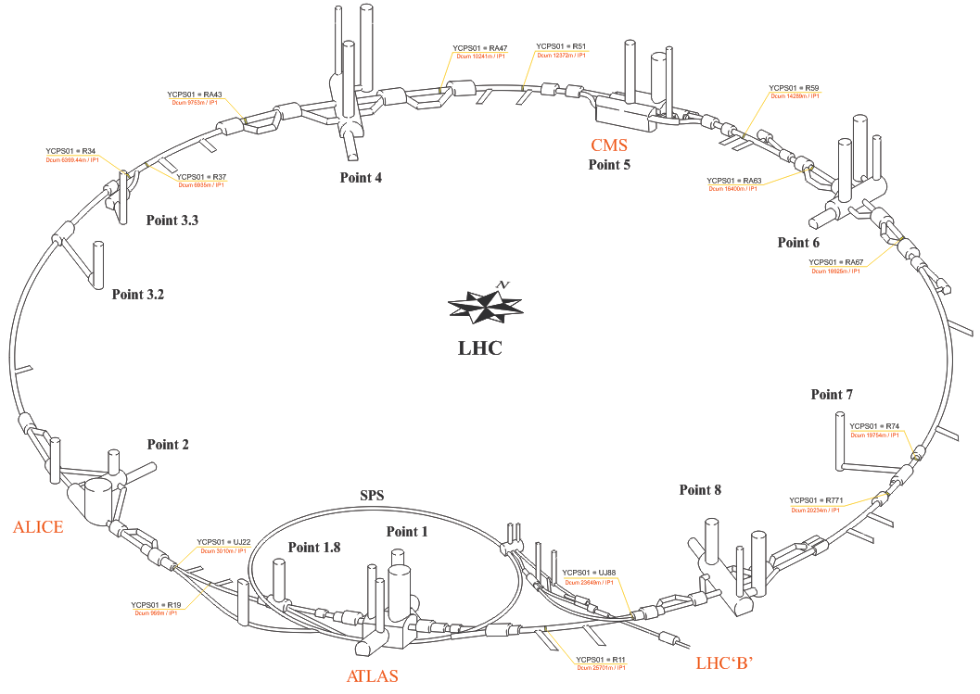
The LHC machine
UX451
UJ47
UL55
UJ43
PM56
PZ33
UJ63
PM45
PZ45
CMS
UP63
PM65
16 tunnel sectors
6 service areas (point 1, 2, 4, 5, 6, 8)
4 Experiments
UJ67
PM25
UJ27
ALICE
PM85
PM76
PM15
LHCb
UJ23
ATLAS
UJ83
UJ17
PM18
UJ13
UJ87

Slide 5
Typical schedule evolution
Shutdown (installations, consolidations, maintenances)
  General access
Hardware commissioning
  General/Restricted access (ADI)
  Restricted/CLOSED for Powering Tests
    Phase 1 concerns tunnel
    Phase 2 concerns tunnel + service areas
See Matteo’s slides
1st ELQA
PT

Slide 6
Sector 12 and 23
For examples

Slide 7
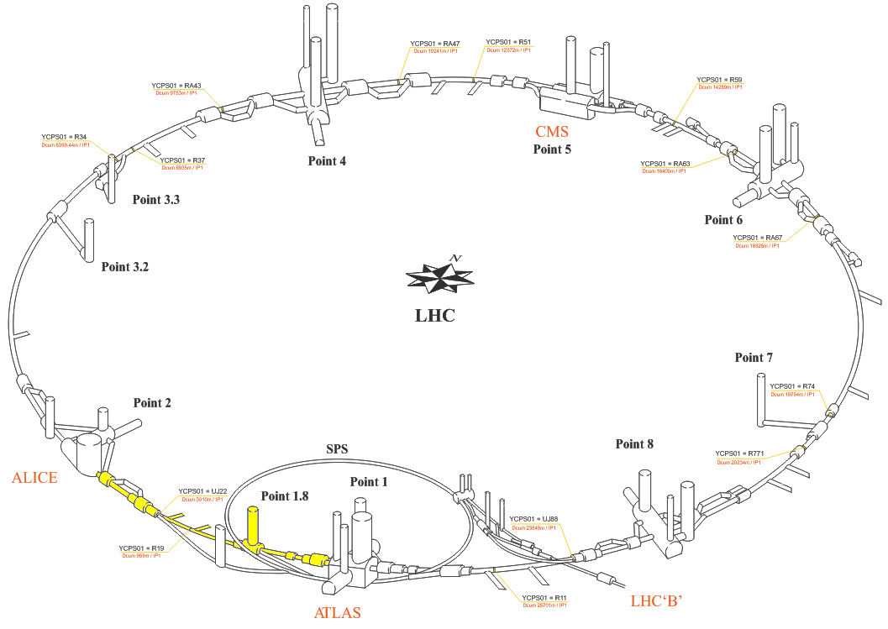
Sector 12 – from 1st ELQA
For example
UX451
UJ47
UL55
UJ43
PM56
PZ33
UJ63
PM45
PZ45
CMS
UP63
PM65
UJ67
PM25
UJ27
ALICE
PM85
PM76
PM15
LHCb
UJ23
ATLAS
UJ83
UJ17
PM18
UJ13
UJ87

Slide 8
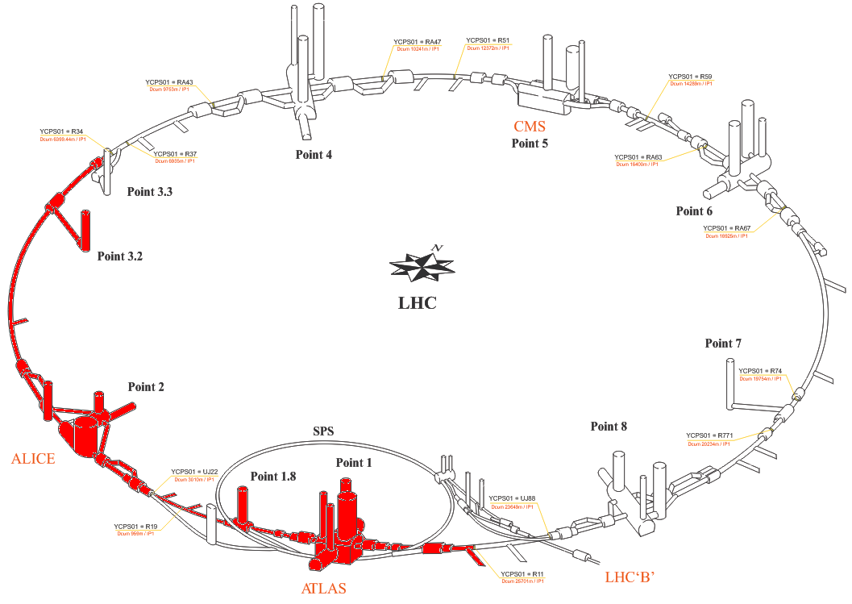
Sector 12 – from PT phase 2
For example
UX451
UJ47
UL55
UJ43
PM56
PZ33
UJ63
PM45
PZ45
CMS
UP63
PM65
Waiting for safety rules
UJ67
PM25
UJ27
ALICE
PM85
PM76
PM15
LHCb
UJ23
ATLAS
UJ83
UJ17
PM18
UJ13
UJ87

Slide 9
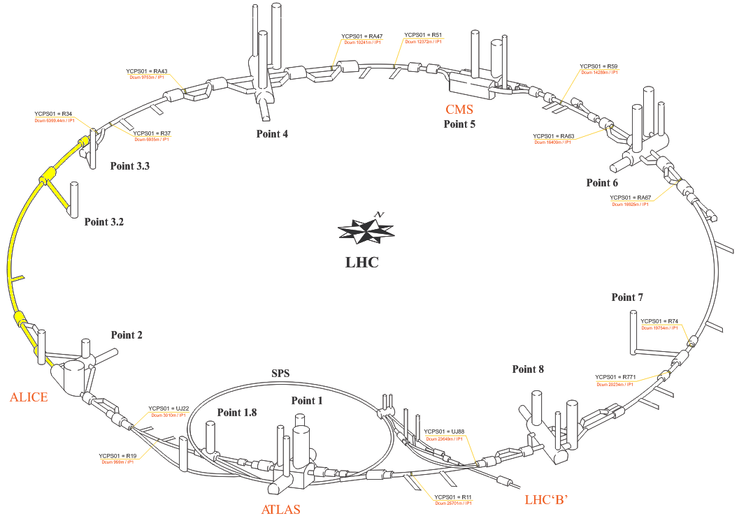
Sector 23 – from 1st ELQA
For example
UX451
UJ47
UL55
UJ43
PM56
PZ33
UJ63
PM45
PZ45
CMS
UP63
PM65
UJ67
PM25
UJ27
ALICE
PM85
PM76
PM15
LHCb
UJ23
ATLAS
UJ83
UJ17
PM18
UJ13
UJ87

Slide 10
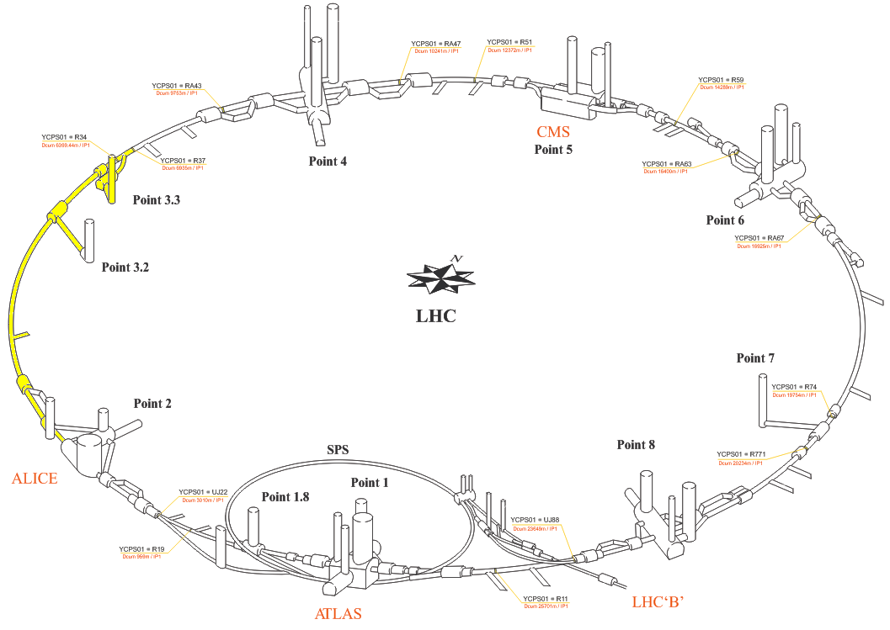
Sector 23 – from PT phase 1
For example
UX451
UJ47
UL55
UJ43
PM56
PZ33
UJ63
PM45
PZ45
CMS
UP63
PM65
UJ67
PM25
UJ27
ALICE
PM85
PM76
PM15
LHCb
UJ23
ATLAS
UJ83
UJ17
PM18
UJ13
UJ87

Slide 11
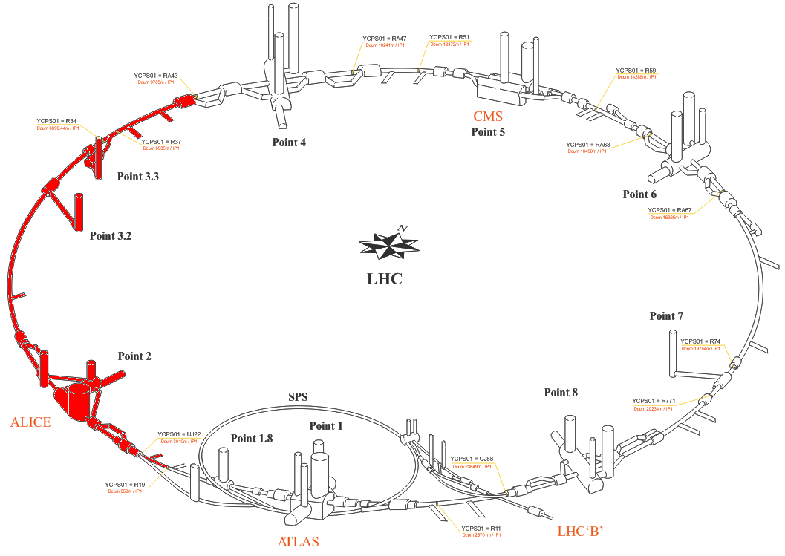
Sector 23 – from PT phase 2
For example
UX451
UJ47
UL55
UJ43
PM56
PZ33
UJ63
PM45
PZ45
CMS
UP63
PM65
Waiting for safety rules
UJ67
PM25
UJ27
ALICE
PM85
PM76
PM15
LHCb
UJ23
ATLAS
UJ83
UJ17
PM18
UJ13
UJ87

Slide 12
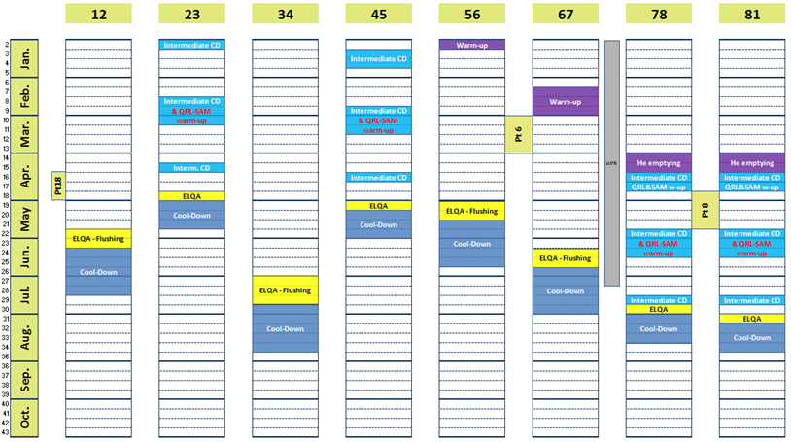
Starts of restricted access
Sector 12 – week 22
Sector 23 – week 18
Sector 34 – week 27
Sector 45 – week 19
Sector 56 – week 19
Sector 67 – week 24
Sector 78 – week 30
Sector 81 – week 31

Slide 13
General Schedule with Powering Tests
Schedule under discussion
New Draft in work

Slide 14
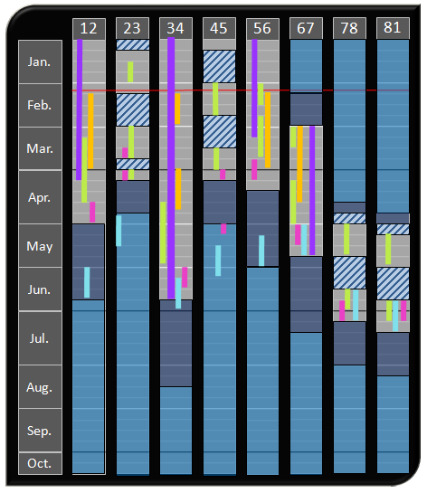
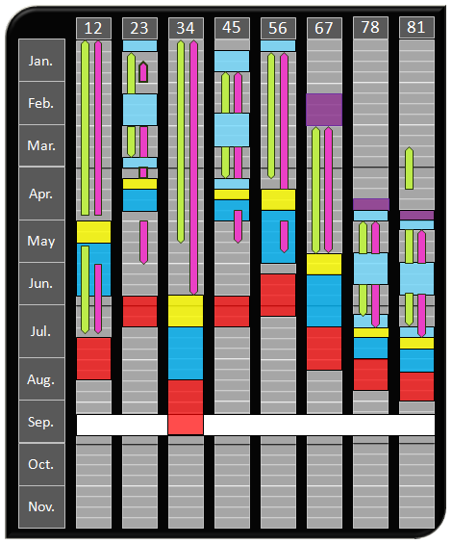
General overview – February09
Start on week 24
End on week 38
  15 weeks
BUT :
  No details of the Powering Tests
  No details of the ELQA
  nQDS racks were available end of April
LHC workshop – Chamonix09

Slide 15

General overview – March09
Racks mid of June
Start week 26
PT
PT
PT
PT
14 weeks
PT
PT
PT
PT
End week 39

Slide 16
General overview – last week
Racks end of June
Start week 28
PT
PT
PT
PT
PT
14 weeks
PT
PT
PT
End week 41 !!

Slide 17
Target = gain time !
How to gain time :
  Starting as soon as possible
  Performing all what can be performed instead of waiting to do all at the same time
  Finding more human resources
      Works in parallel
      2 or 3 shifts

Slide 18
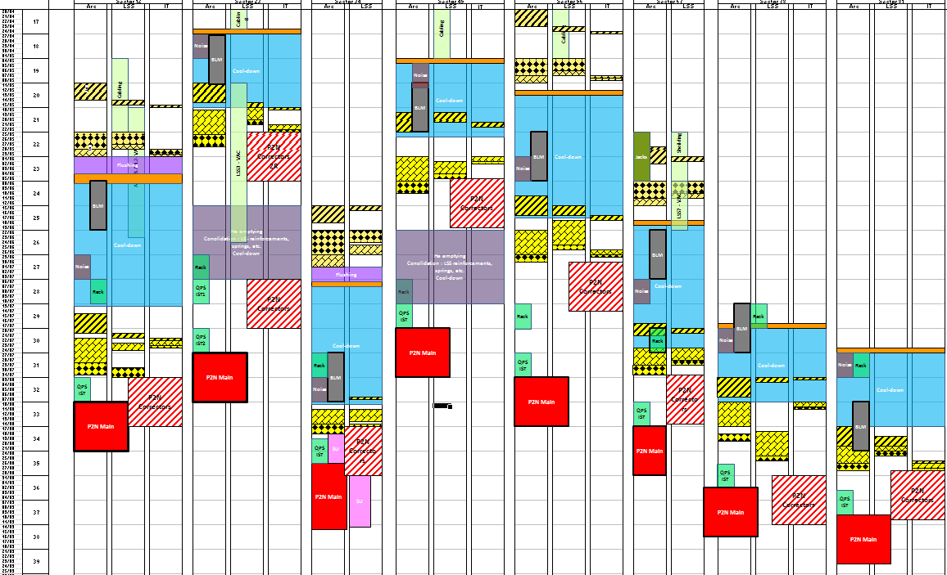
New detailed draft – in work
Start week 22
End of May
Racks end-June
18 weeks
will need 3 shifts
(24h/24h 7d/7d)
+ week-end
End week 39

