Slide 1
FCC-ee beam instruments
B. Holzer, K. Oide, J. Wenninger, F. Zimmermann

Slide 2
Instruments
Measurement devices that will be covered:
Beam position
Tune
Beam current
Emittance
Beam loss
Bunch length
Luminosity and IP
Beam polarization*
This is a first attempt to put together specs – everything is open for discussion !
*: not part of core instrumentation?

Slide 3
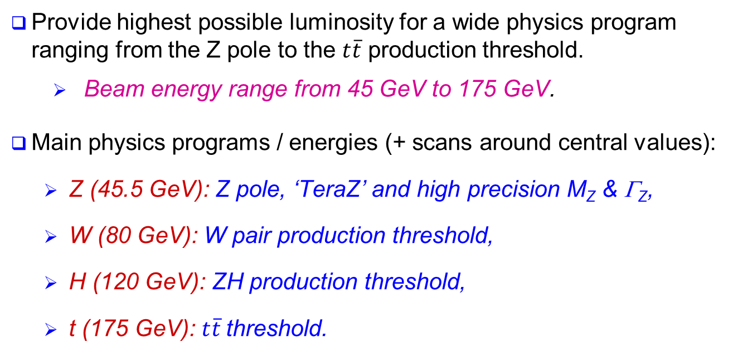
FCC-ee physics goals
Provide highest possible luminosity for a wide physics program ranging from the Z pole to the $t\overline{t}$ production threshold.
  Beam energy range from 45 GeV to 175 GeV.
Main physics programs / energies (+ scans around central values):
  Z (45.5 GeV): Z pole, ‘TeraZ’ and high precision M_{Z} & Γ_{Z},
  W (80 GeV): W pair production threshold,
  H (120 GeV): ZH production threshold,
  t (175 GeV): $t\overline{t}$threshold.
In direct competition with ILC…

Slide 4
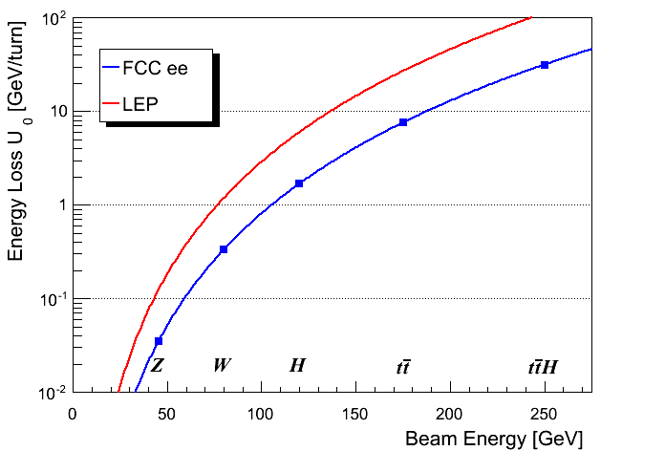
Synchrotron radiation
The maximum synchrotron radiation power P_{SR} is set to 50 MW per beam – design choice ⇔ power dissipation.
  ⇒ defines the maximum beam current at each energy, I ∝ 1/E⁴.
  ρ = 3.1 km
V_{RF} ~35 GV
V_{RF} ~10-11 GV
  ρ = 11 km

Slide 5
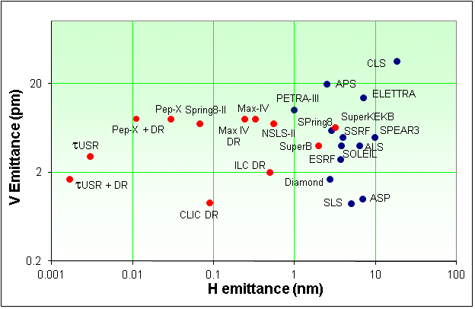
Emittances
FCC-ee is a very large machine, scaling of achievable emittances (mainly vertical) is not straightforward.
  Coupling, spurious vertical dispersion
Low emittances tend to be more difficult to achieve in colliders as compared to light sources or damping rings – beam-beam !
Limits for FCC-ee baseline parameters:
  ε_{y}/ε_{x} ≥ 0.001 ,
  ε_{y} ≥ ≈2 pm
LEP2
FCC-ee
→ Drives terrific alignment tolerances
R. Bartolini, DIAMOND

Slide 6
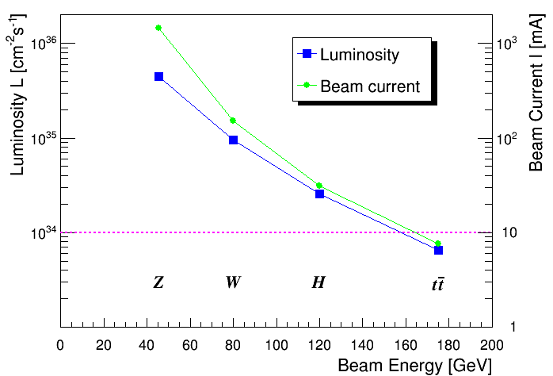
Luminosity
Number of bunches: up to ~90’000 at 45 GeV ⇒ ~100 at 175 GeV
The large number of bunches at Z, W & H requires 2 rings
Bunch population range : 10¹⁰ – 2×10¹¹ charges, min 10⁹ ?
Luminosity per IP

Slide 7
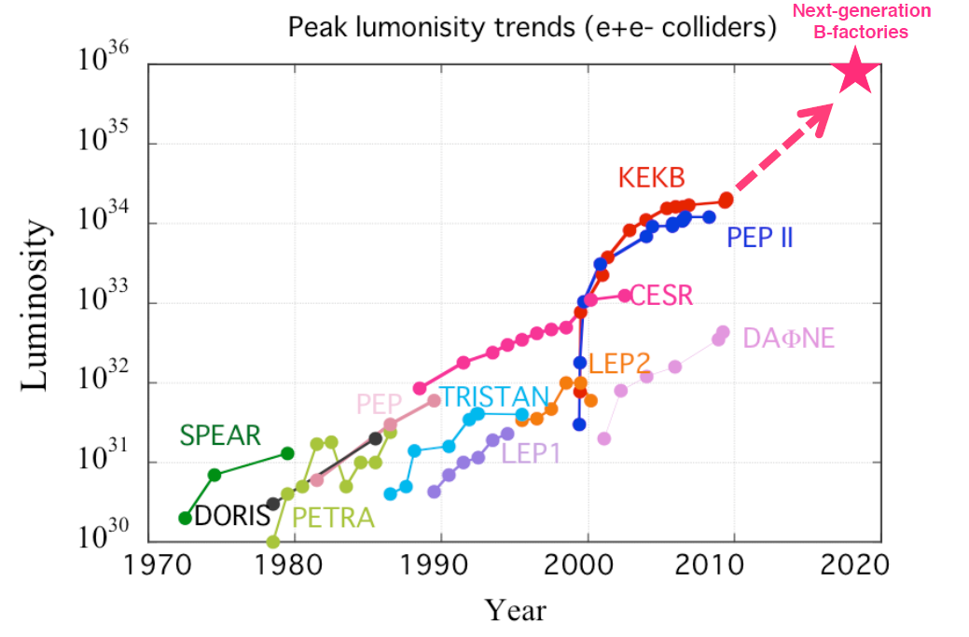
Lepton collider luminosities
SuperKEKB
FCC-ee
Z
Y. FUNAKOSHI
6th TLEP Workshop
W
H
t

Slide 8
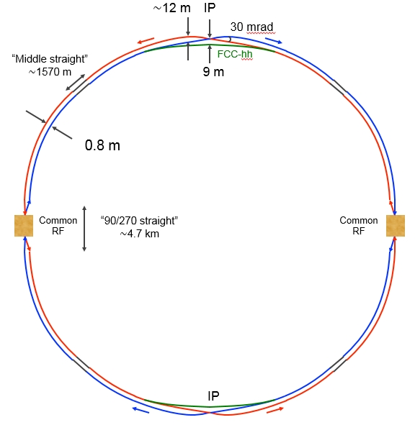
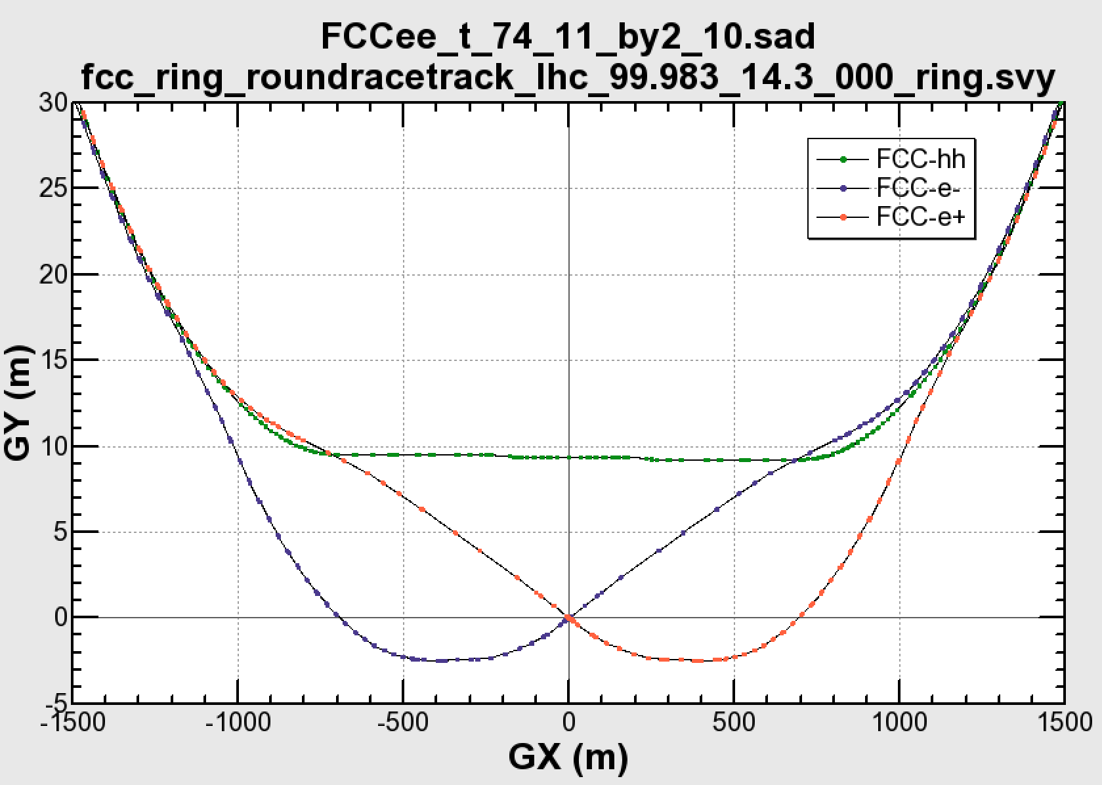
Layout
The layout follows the one of FCC-hh with ‘minor’ deviations.
There are 2 separate rings.
The IRs for the experiments are asymmetric to minimize the synchrotron radiation from the incoming beam.
The machine is operated at constant energy (top-up mode). A booster is in design – in the same tunnel.
There are currently 2 experiments (even if some would like to see 4…).

Slide 9
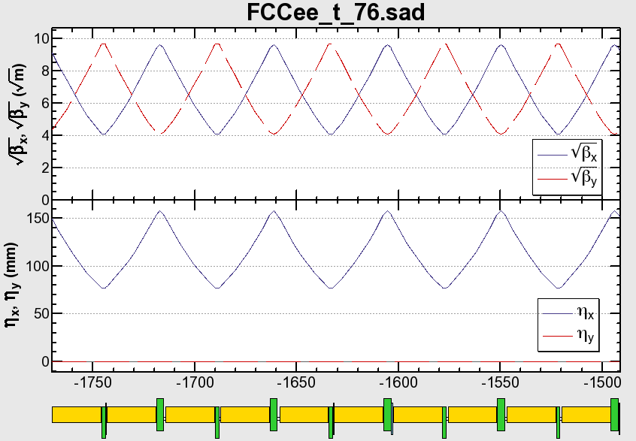
The Arc Cell
K. Oide
Basically a 90/90 degree FODO cell.
The quadrupoles QF/QD are 3.5 m/1.8 m long, respectively, to reduce the synchrotron radiation. They also depends on the design of quads and the beam pipe (A. Milanese, F. Zimmermann).

Slide 10
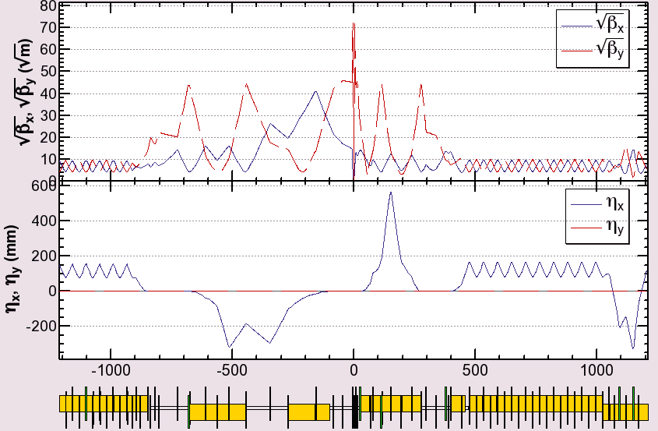

Interaction Region
Local chromaticity correction
+ crab waist sextupoles
Local chromaticity correction
+ crab waist sextupoles
RF
RF
K. Oide
Beam
IP
The optics in the interaction region are asymmetric.
The synchrotron radiation from the upstream dipoles are suppressed below 100 keV up to 450 m from the IP.

Slide 11
Final focus
Lout* = 2.9 m
177.2 T/m
1.6 m
no cavity structure
40 mm
40 mm
98.2 T/m
3.2 m
Lin* = 2.2 m
26 mm

Slide 12

Beamstrahlung
Hard photon emission at the IPs, ‘Beamstrahlung’, can become a lifetime / performance limit for large bunch populations (N), small hor. beam size (σ_{x}) and short bunches (σ_{s}) .
e
γ
e
ρ : mean bending radius at the IP (in the field of the opposing bunch)
η : ring energy acceptance
Lifetime expression by V. Telnov
To ensure an acceptable lifetime, ρ×η must be sufficiently large.
  Flat beams (large σ_{x}) !
  Bunch length → beamstrahlung may significantly lengthen the bunches → BI !
  Parameter optimization.

Slide 13
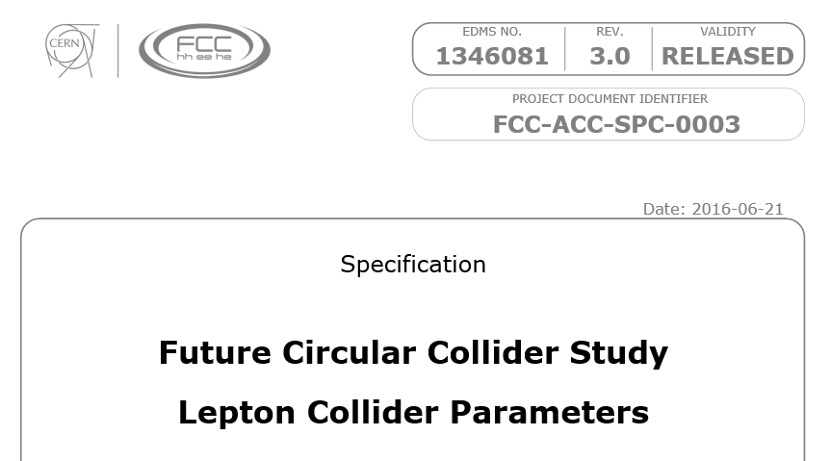
Parameters
The latest official parameters – accurate enough for you !

Slide 14
Parameter table
 | Z | Z | W | H | tt
Circumference [km] | 100
Bending radius [km] | 11
Beam energy [GeV] | 45.6 |  | 80 | 120 | 175
Beam current [mA] | 1450 |  | 152 | 30 | 6.6
Bunches / beam | 30180 | 91500 | 5260 | 780 | 81
Bunch spacing [ns] | 7.5 | 2.5 | 50 | 400 | 4000
Bunch population [10¹¹] | 1.0 | 0.33 | 0.6 | 0.8 | 1.7
Horizontal emittance e [nm] Vertical emittance e [pm] | 0.2 1 | 0.09 1 | 0.26 1 | 0.61 1.2 | 1.3 2.5
Momentum comp. [10⁻⁵] | 0.7 | 0.7 | 0.7 | 0.7 | 0.7
Betatron function at IP Horizontal b* [m] Vertical b* [mm] | 0.5 1 | 1 2 | 1 2 | 1 2 | 1 2
Horizontal beam size at IP s* [μm] Vertical beam size at IP s* [nm] | 10 32 | 9.5 45 | 16 45 | 25 49 | 36 70
Crossing angle at IP [mrad] | 30
Energy spread [%] Synchrotron radiation Total (including BS) | 0.04 0.22 | 0.04 0.09 | 0.07 0.10 | 0.10 0.12 | 0.14 0.17
Bunch length [mm] Synchrotron radiation Total | 1.2 6.7 | 1.6 3.8 | 2.0 3.1 | 2.0 2.4 | 2.1 2.5
Energy loss / turn [GeV] | 0.03 |  | 0.33 | 1.67 | 7.55
SR power / beam [MW] | 50
Total RF voltage [GV] | 0.4 | 0.2 | 0.8 | 3 | 10
RF frequency [MHz] | 400
Longitudinal damping time [turns] | 1320 |  | 243 | 72 | 23
Energy acceptance RF [%] | 7.2 | 4.7 | 5.5 | 7.0 | 6.7
Synchrotron tune Q_{s} | 0.036 | 0.025 | 0.037 | 0.056 | 0.075
Polarization time t_{p} [min] | 11200 |  | 672 | 89 | 13
Interaction region length L_{i} [mm] | 0.66 | 0.62 | 1.02 | 1.35 | 1.74
Hourglass factor H (L_{i}) | 0.92 | 0.98 | 0.95 | 0.92 | 0.88
Luminosity/IP for 2IPs [10³⁴ cm⁻²s⁻¹] | 207 | 90 | 19.1 | 5.1 | 1.3
Beam-beam parameter Horizontal Vertical | 0.025 0.16 | 0.05 0.13 | 0.07 0.16 | 0.08 0.14 | 0.08 0.12
Luminosity lifetime [min] | 94 | 185 | 90 | 67 | 57

Slide 15
Instrumentation - introduction
The current FCC-ee design has ‘few’ isolated bunches at high energy and huge currents and closely packed bunches (~ ns spacing) at the Z.
Similar to the case of RF, this may be far from ideal for beam instrumentation due to the two very different regimes.
Bunch-bunch and turn-by-turn capabilities of the instruments will be an essential feature of some instruments.
Machine protection aspects have not been studied in detail. They are added with tentative requirements. To be followed up.
While some of the numbers in the following tables can be estimated, some are our personal guesses. Other numbers require more work or a more advanced design to be specified more accurately (for example machine protection aspects).

Slide 16
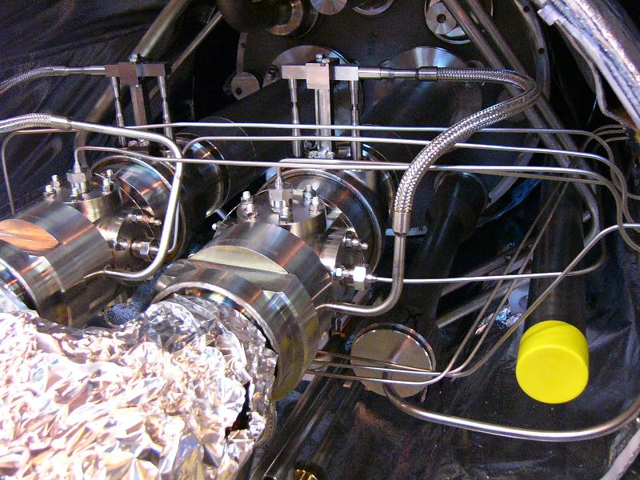
Beam position
Beam position monitors are among the most important instruments.
They are used to measure:
  Injection trajectories, closed orbits, dispersion, coupling, optics (via phase advance), resonance driving terms etc
From the LHC (++) and LEP (--) experience I recommend to install dual plane (H+V) BPMs at every quadrupole, in particular with 90 degree lattices. Since the electrodes will probably be out-of-plane →2 planes ~ for free.
We will need ~ 4000 BPMs.
LHC button BPMs
The majority of the BPMs will be installed in the arcs, where the full aperture will be around 70 mm. Special designs will be required in some IRs, most likely with smaller aperture.
To achieve the desired vertical emittances the machine must be aligned to < 50 μm → stringent limits on BPM alignment & accuracy.
LHC button BPMs

Slide 17
Beam position
Functionality:
The BPMs must be able to measure the closed orbit (i.e. average over N turns, typically a 50 Hz) and provide turn-by-turn data for injection oscillations, optics measurements…
  The closed orbit data should be integrated into a real-time orbit and radial position feedback.
The BPMs should also foresee a machine protection functionality in the form or a beam abort signal in case the orbit / trajectory excursions exceed a pre-set threshold.
A few special BPMs should provide high resolution (μm) bunch-by-bunch and turn-by-turn data for special purposes (instability observations etc) – similar to the ADT for LHC.

Slide 18
Beam position
Performance: for lattice BPMs – specs for the low beta section BPMs could be harsher !
Parameter | Target | Beam | Comment
Alignment wrt quadrupole (and electronic offsets) | ≤ 40 um |  | Combined quad+BPM alignment
Short term closed orbit resolution | ≤ 0.1 um | few bunches | ~minutes, vertical dispersion measurement with 0.1% dp/p, radial control at Z (energy)
Medium term closed orbit resolution | 1 um | few bunches | ~ hours
Closed orbit accuracy | 10 um | few bunches | ~ weeks, stability and accuracy over time scale of week(s)
Turn by turn resolution | 10-100 um | 1 - few bunches | with AC-dipole excitation, to be checked with R. Tomas (wrt LHC)
Interlock resolution | 10-20 um | few bunches
Interlock response | 10 turns | few bunches | maximum reaction time for interlock functionality. Should be checked wrt the time constants of electrical circuits. 10 turns could be a good start.
Interlock threshold | 500 um | few bunches | see above
Bunch by bunch and turn-by-turn orbit resolution for special BPMs | ≤ 1 um | any | for a few BPM channels only - should be sufficient. No need to have bunch by bunch on all BPMs
Few bunches = ~ 10-20 ~nominal bunches (few x 10¹⁰ charges)

Slide 19
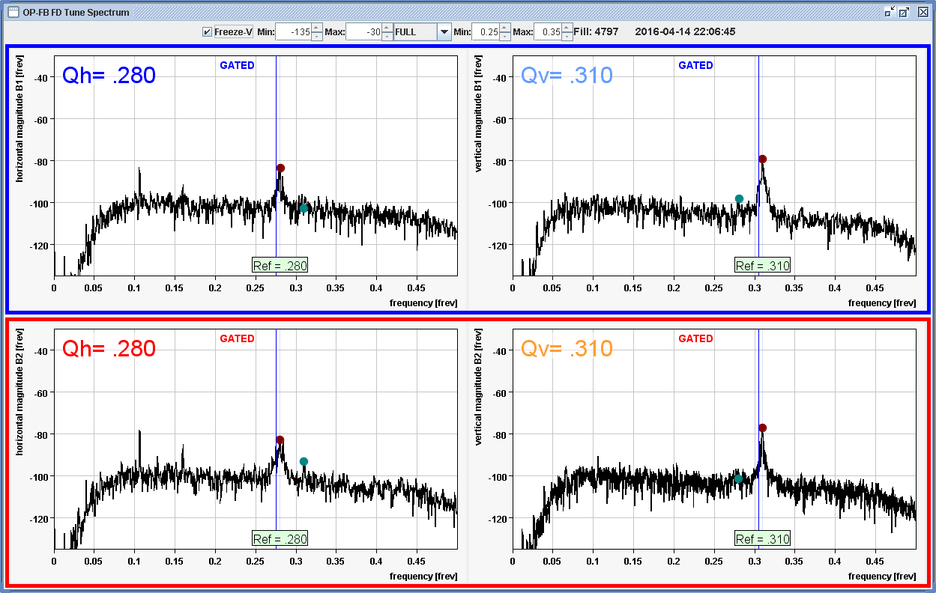
Tune measurement
Tune measurements, like beam position measurements, are based on high sensitivity BPMs and the associated electronics.
The tune measurement system must also provide a phased-lock loop (PLL) tune tracking functionality.
Similar to the orbit case, the tune data should prepared to be fed into a tune feedback system (~1 Hz is probably sufficient, one probably get a high bandwidth for free with a PLL).

Slide 20
Tune measurement
Performance:
Parameter | Target | Beam | Comment
Tune resolution (FFT-like) | 10-4 | few bunches
PLL tune resolution | 10-5 | few bunches

Slide 21
Beam current
The beam current measurement must determine the total DC current as well as the individual bunch currents.
Loss rates (lifetimes) must be provided on a bunch by bunch basis.
The individual bunch currents must be transmitted to the top-up injection system to control the refill rate and stabilize the currents.
The total bunch current must also be used for machine protection purposes and trigger a beam abort when the total loss rate (for the entire beam) is too high.

Slide 22
Beam current
Performance:
Parameter | Target | Beam | Comment
Range | 0.01 – 2000 mA | full | Multiple ranges possible (according to energy and intensity limit)
Resolution | 0.1-1 uA | bunch | Multiple ranges possible (according to energy)
Lifetime / loss rate |  | bunch
Interlock threshold | 0.1-1%/s | full | Fast interlock functionality – threshold in terms of total beam current (at Z).
Interlock response | 10-100 turns | full | First guess, to be checked with real circuit parameters
Bunch number: from ~100’000 (2.5 ns !) to ~100.
Lowest bunch intensity ~10⁹ – ish charges.
Highest bunch intensity ~2×10¹¹

Slide 23
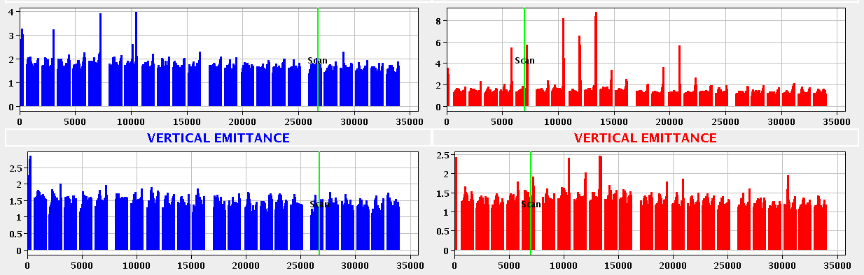
Transverse emittance
Beam emittance measurements (rather beam size that is converted to emittance through optics info) must be provided bunch by bunch.
  The measurement of all bunches of the beam must be available on a ‘time scale of minutes’.
Given the high intensity of the beam the device must be non-interceptive → use synchrotron light.
Cross-calibration devices for low current operation (typical wire scanners) could be considered.
LHC bunch by bunch emittance from the synchrotron light monitor (2220 bunches)

Slide 24
Transverse emittance
Performance:
Parameter | Target | Beam | Comment
Vertical emittance resolution | < 1 pm | bunch | Target emittance is 1 pm
Horizontal emittance resolution | ~ 1 pm | bunch
At a location with β = 500 m the beam size for an emittance of 1 pm is 22 μm.

Slide 25
Bunch length
The bunch length will be important to monitor the strength of the Beamstrahlung at the IP and for energy calibration (energy spread). It may also be used to monitor collective effects (head-tail instabilities).
Similar to the transverse emittance, the measurement must be available bunch by bunch. A full beam measurement should be available on the time scale of ‘minutes’.
The required precision is completely dominated by the requirements of energy calibration (for energy spread determination).
Performance:
Parameter | Target | Beam | Comment
Accuracy | ~2-20 μm | bunch | For a bunch length of 1-7 mm - again at Z for energy calibration
Relative accuracy | 0.1-0.5% | bunch | see above

Slide 26
Beam loss
Beam loss monitors (in the sense of ionization chambers, diamond or Si detectors, scintillators) should be available near aperture restrictions – for example next to collimators (not designed yet).
They should provide turn-by-turn and for some devices possibly bunch-by-bunch data.
Concerning a global BPM system based on devices that are not sensitive to the synchrotron radiation (HERA-like PIN-diodes), they should be studied, requirements must be clarified.

Slide 27
Luminosity & beamstrahlung
The experiments will install high precision luminometers close to the IP (~2-3m).
A coarse machine luminometer to optimize beam overlaps should be provided. No absolute normalization, just (good) rate counters. Not clear where it should be located → to be studied within MDI WG.
A photon detector to observe the beamstrahlung (same device??) should be installed downstream of the IP on both beamlines.

