Slide 1
Dr. OMC or How we stopped worrying and started loving the Amplitude dependent closest tune approach
Tobias Persson

Slide 2
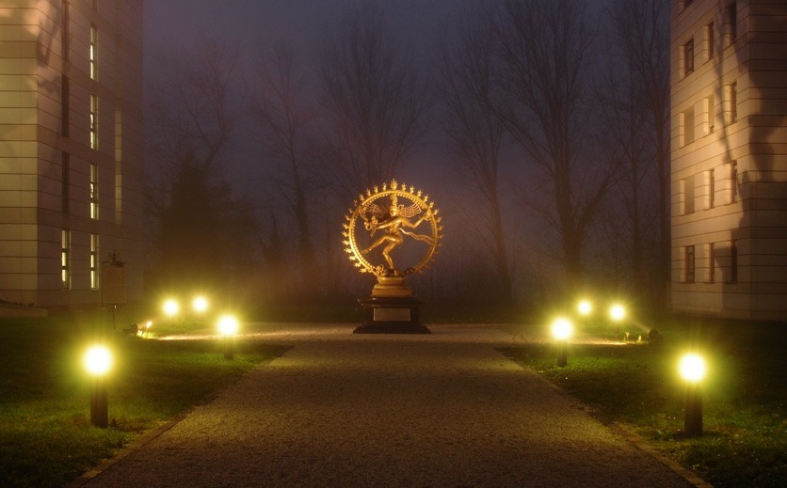
It all began during a night
in 2012...
The collimators were retracted and we kicked with the aperture kicker.

Slide 3
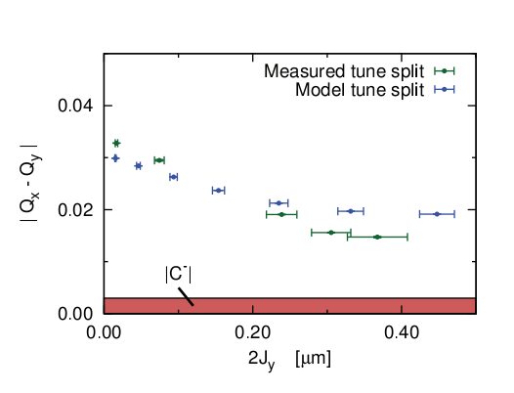
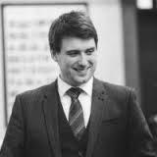
A very careful and motivated PhD student analysed the results and found (it wasn't me so you can guess who it was )
We don't reach the Cminus!!

Slide 4
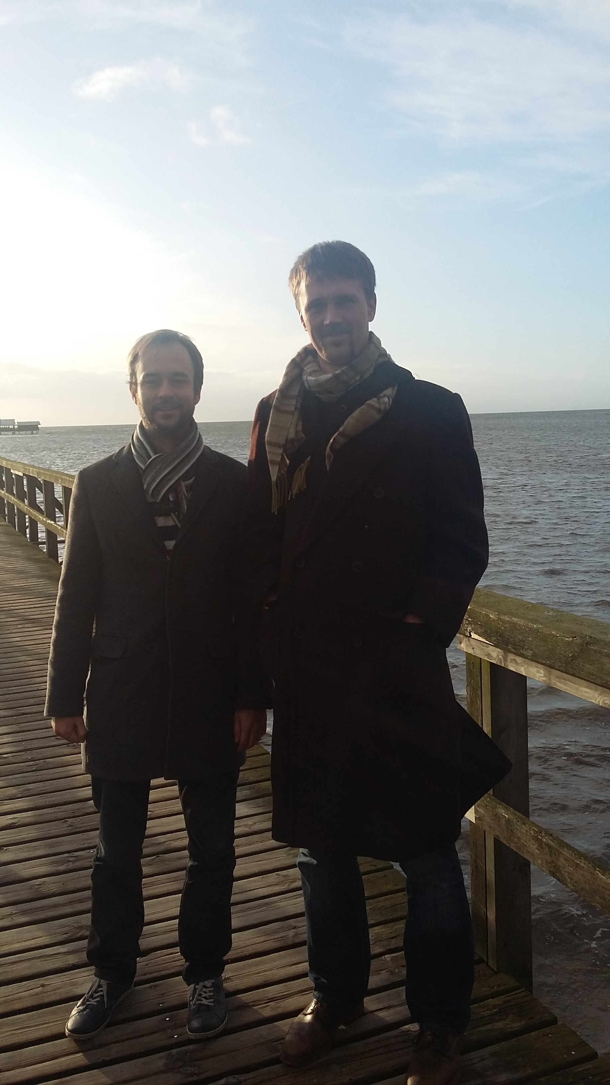
The years went by...
Ewen, Yngve and I started running simulations..
And I am not short.. Yngve is just very tall!!

Slide 5
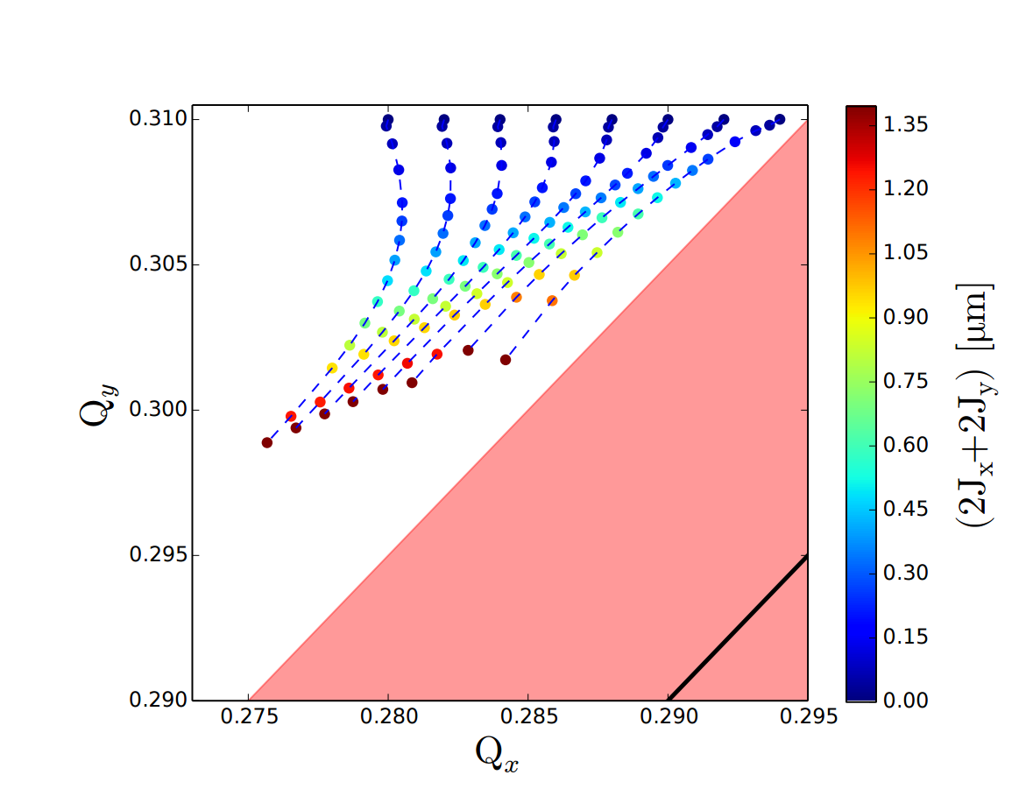
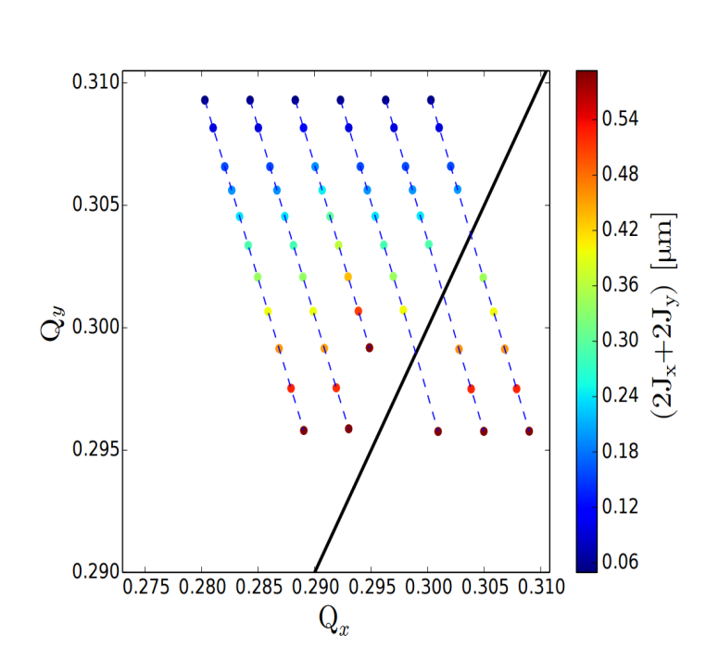
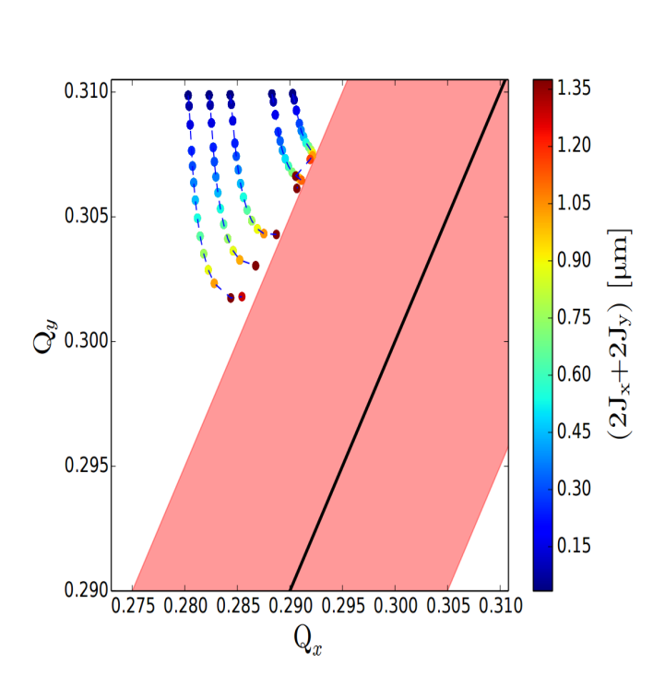
Many findings!
MOF oposite ploarity compared
to MOD -> h1111 ~= 0
Only octupoles
Octupoles and coupling
Modifies the landau damping

Slide 6
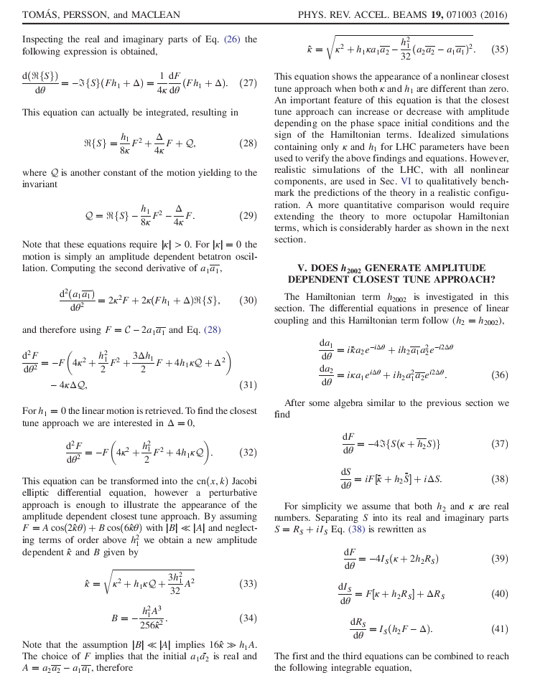
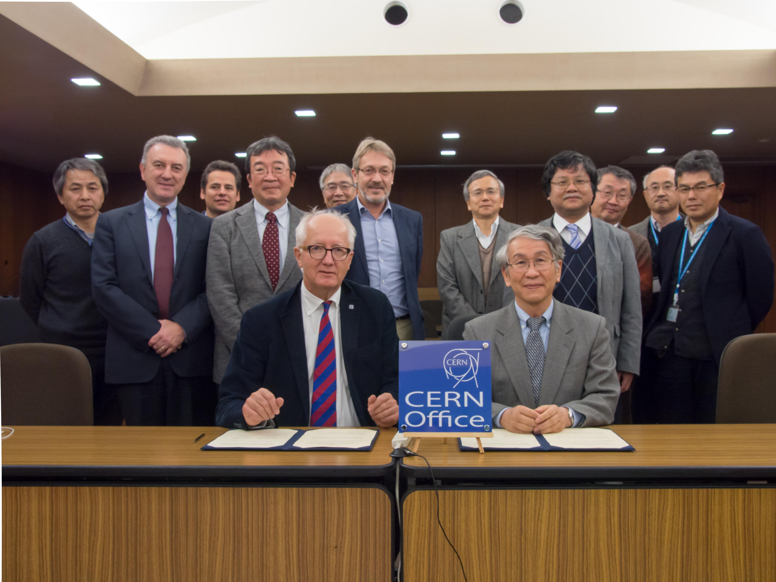
Rogelio developed a theory..
We also had fruitful discussions with Andrea Franchi

Slide 7
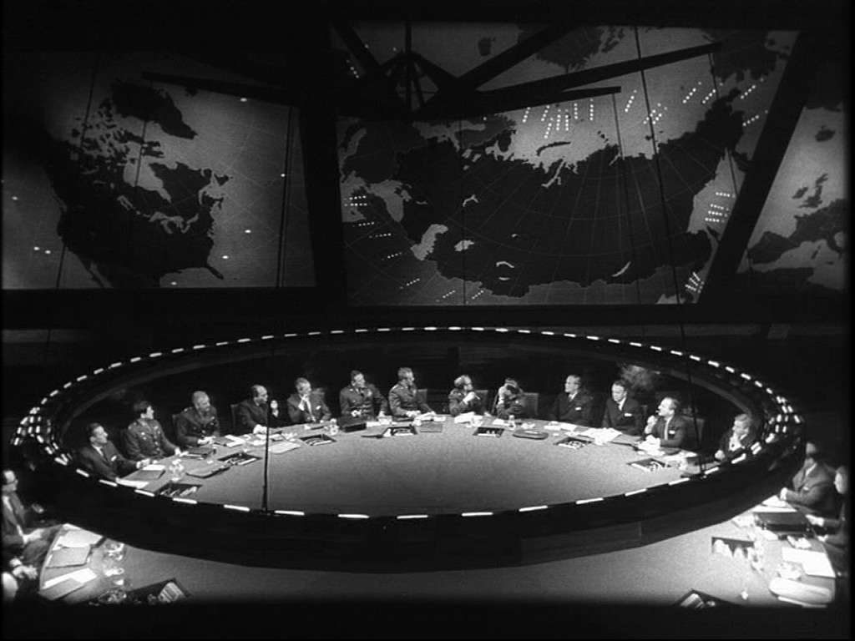
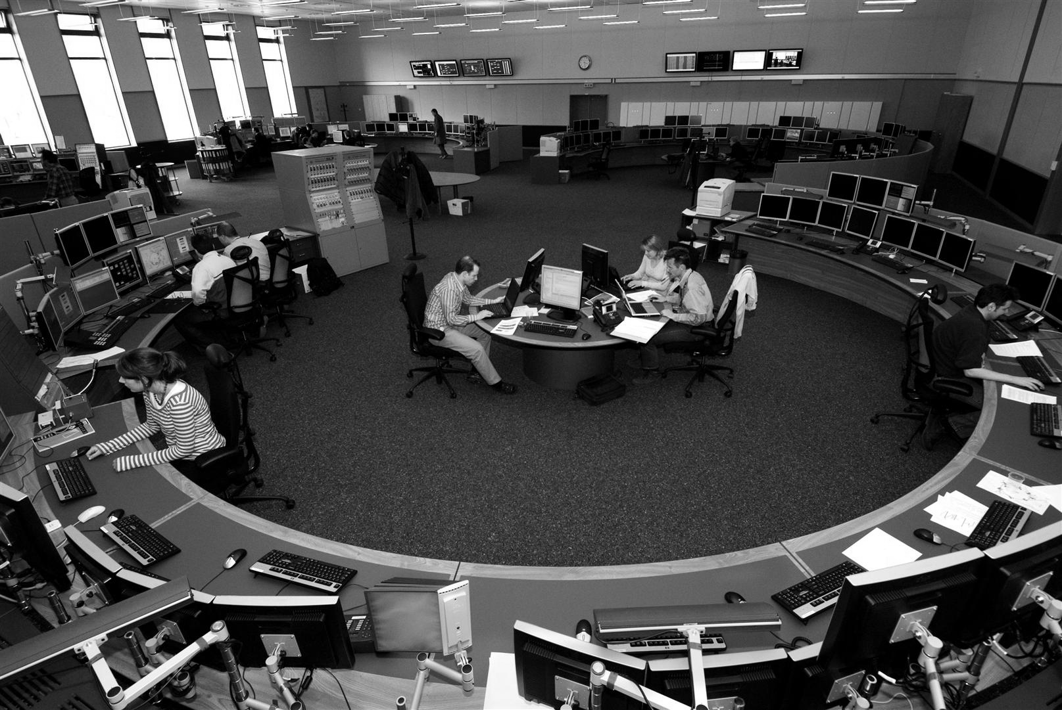
So to the MD...

Slide 8
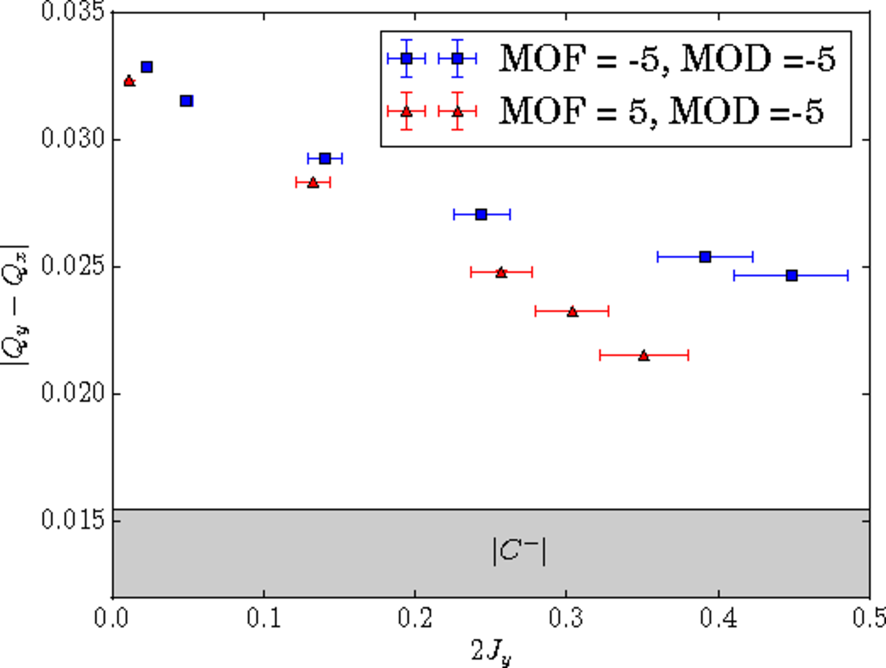
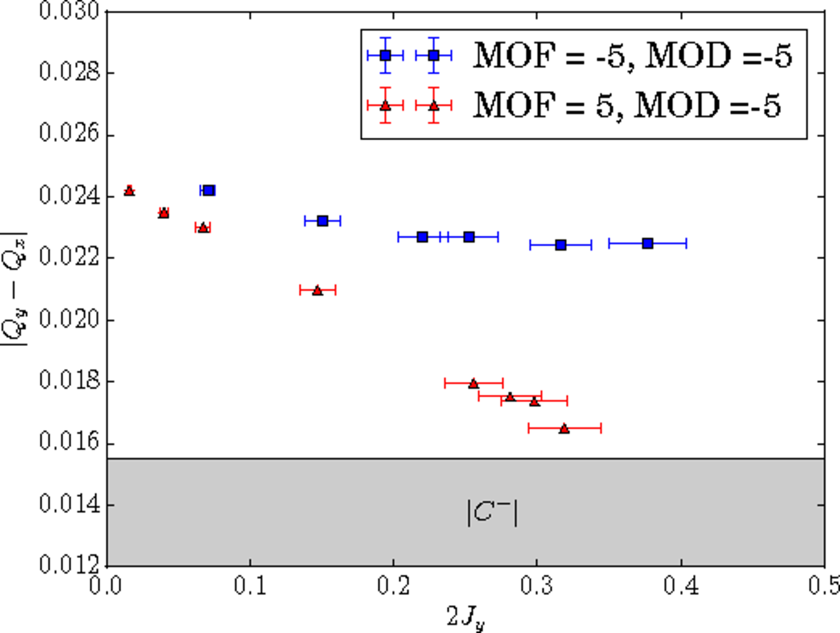
We can approach much closer to the C- if we have opposite polarity

Slide 9
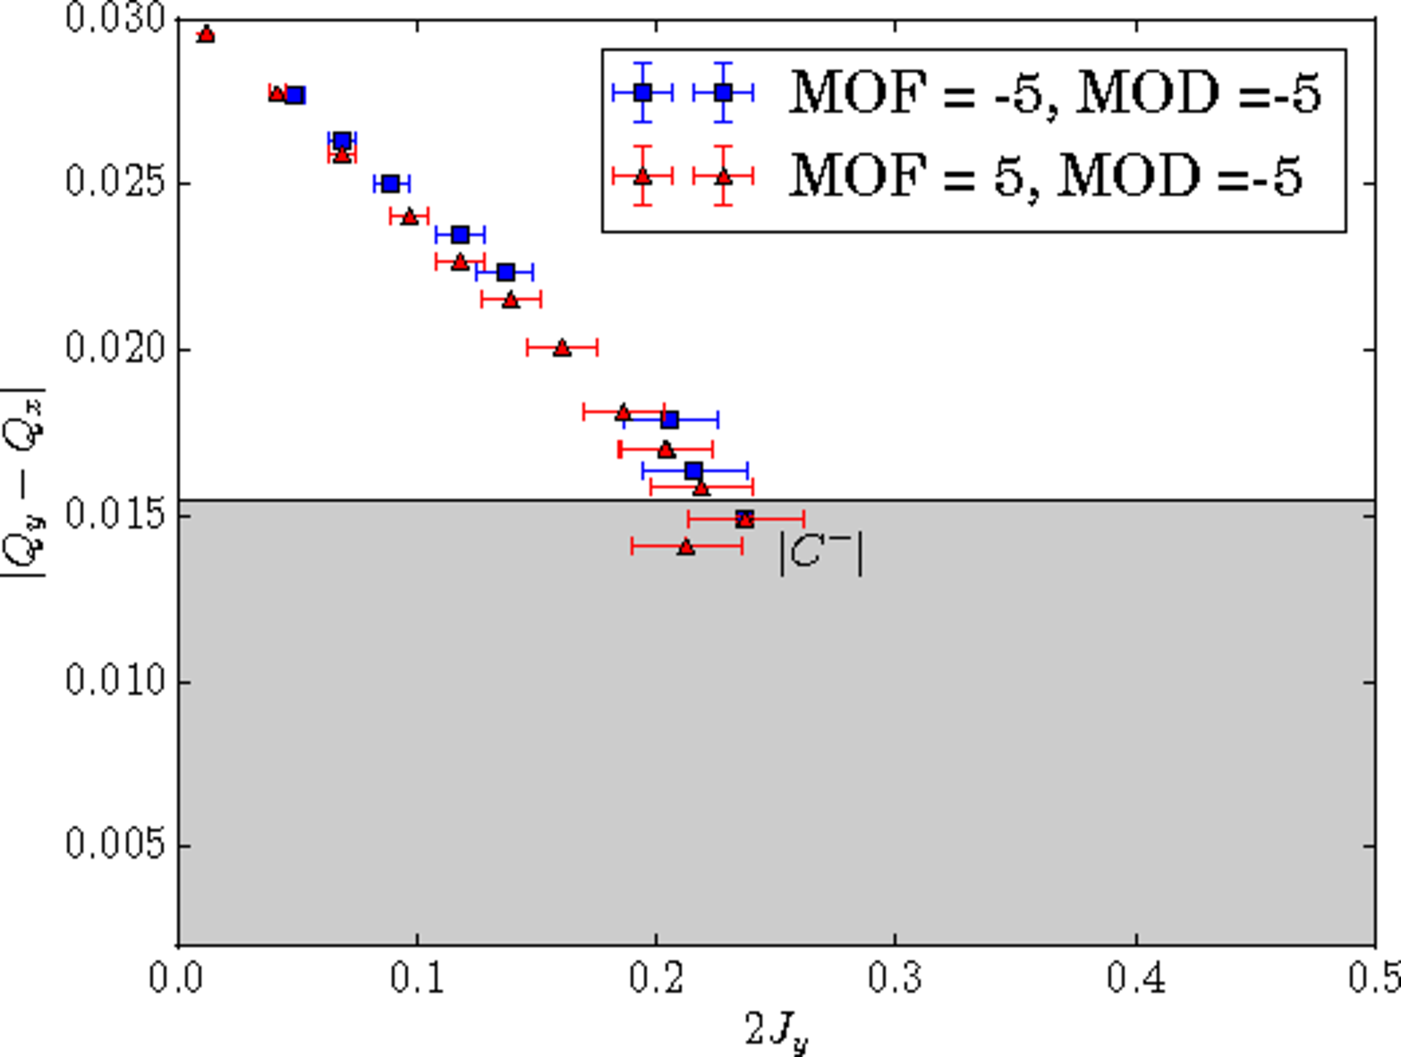
Ac-dipole kicks..
To be verified but if it is correct we need to check with simulations...

Slide 10
Conclusion outlok
Very impressive results and an very nice example of team work!
Within the same team we managed to:
  Observe a new effect
  Reproduce it in simulation
  Develope an analytical theory to describe it
  Also demonstrate a mitigation strategy
AC-dipole data is still to be understood

