Slide 1








Digital SPAD Scintillation Detector Simulation Flow to Evaluate and Minimize Real-Time Requirements
Marc-André Tétrault, Audrey Corbeil Therrien, William Lemaire,
Réjean Fontaine, Jean-François Pratte
Pico-Second Workshop, Kansas City, September 2016

Slide 2
Outline
Overview for PET and time of flight PET
  Basic PET principles and why time-of-flight matters
  Review detector chain towards time of flight
Precise timing resolution detector design
  Photodetector
  DAQ
  Compromises for real-time embedded microsystem

Slide 3
Positron Emission Tomography
Molecular Imaging Modality
  Tracer distribution (positron emitter)
    Hot spot on the left side
  Positron Annihilation
  Collinear 511 keV particles
  Line of response
Notes:
Why 10 ps TOF
Near positron range limit
No iterative reconstruction required

Slide 4
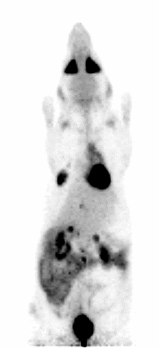
Image Quality Figures of Merit
Contrast to Noise Ratio from detector’s
  Spatial resolution
  Energy resolution
  Timing resolution
Sensitivity or Noise Equivalent Counts
  Detector dead time
  Optimized with real-time processing

Slide 5
Image improvement avenue
  Spatial resolution limit is positron range
    About 0.5 mm for mainstream tracers
  Improve contrast with time of flight
  1.5 mm on the LOR needs 10 ps FWHM in coincidence
  Real time image reconstruction (no iterative engine required)

Slide 6
Sensitivity Improvement with TOF
Excerpt from Lecomte, "Evolution of Data Acquisition and Processing in Medical Imaging with Radiation“, Real Time Conference 2016
40 cm Object
Δt = 600 ps
4 cm Object
Δt = 60 ps
Budinger TF. Time-of-Flight Positron Emission Tomography: Status Relative to Conventional PET. J Nucl Med 24(1):73-78, 1983.

Slide 7
Crystal-based detectors flow chart
Scintillator-based detectors

Slide 8
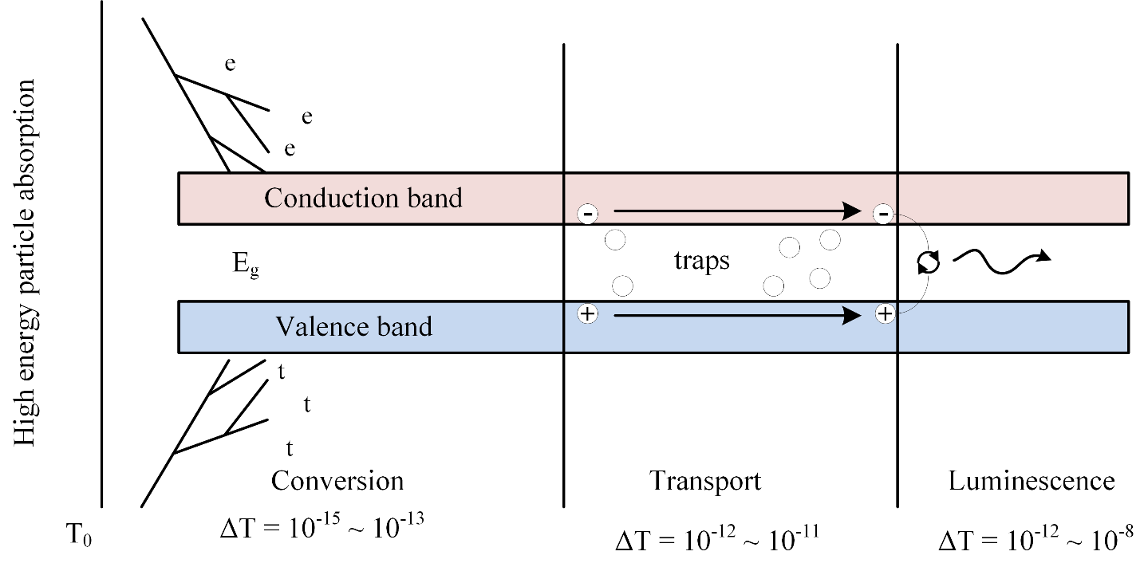
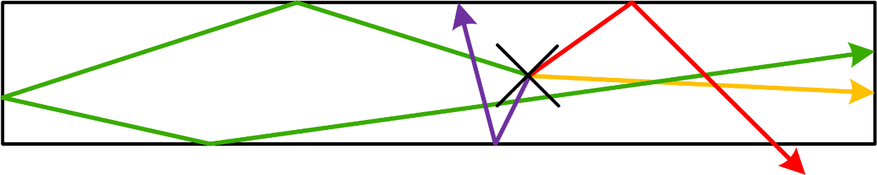
Scintillation brief overview
  Factors affecting timing^{1,2}
    Light yield
    T_{rise}, T_{decay}
    Crystal size/length
  Fast TOF Scintillators³
    LSO, LuAG, LuAP, LaBr₃
  With an ideal photodetector the
  1st photon has best timing¹
    LSO 1st photon has theoretically
    ~35 ps FWHM in coincidence
Weber et al, NIM 2004; Mikhailin et al, NIM 2002
1- Derenzo et al, PMB 2014
2- Gundacker et al, NIM 2016
3- Conti et al, TNS 2009

Slide 9
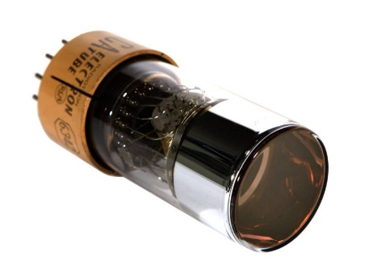
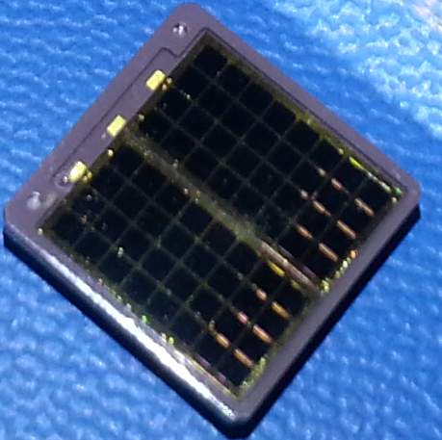
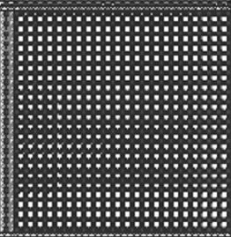
Photodetectors
PMT
  ☺ High gain, fast timing
  😐 block detector, many pixels, medium count rate
  ☹ Bulky, sensitive to magnetic fields
APD
  ☺ High PDE, immune to magnetic fields
  ☺ Pixelated detector, high count rate
  ☹ noisy, limited gain, average timing
SiPM (Geiger-mode APD, MPPC)
  Array of Single Photon Avalanche Diodes (SPAD)
  ☺ High gain, very fast timing
  ☺ Single photon sensitivity
  ☺ Pixelated, high count rate, immune to magnetic fields
www.fireflysci.com
> 10 mm
8 x 8 array
10 mm
1 mm

Slide 10
Timing performance
Where are we?
  Experimental measurements with LYSO
 | Systems | Table setups
PMT | 473 ps FWHM (1) | 234±20 ps rms (5)
APD | 6.6 ns FWHM (2) | 1.9 ns FWHM (6)
Analog SiPM | 385 ps FWHM (3) | 85±4 ps FWHM (7)
Digital SiPM Frach et al, 2009 | 212 ps FWHM (4) | 177 ps FWHM, (8)
 |  | 120 ps FWHM, (9)
1- Wong et al, TNS 2015 5- Peng et al, TNS 2013
2- Bergeron et al, TNS 2009 6- Leroux et al, TNS 2009
3- Levin et al, TMI 2016 7- Nemallapudi et al, PMB 2015
4- Degenhardt et al, NSS-MIC 2012 8- Somlai-Schweiger et al, J. Inst. 2015
9- van Dam et al, PMB 2013

Slide 11
Analog Front End
Analog front-end
  Adapted to photodetector
  Typically fast and low-noise preamplifiers
    Anghinolfi et al, TNS 2004
    Olcott et al, TNS 2005
    Callier et al, NSS-MIC 2009
    Powolni et al, TNS 2011
    De Medeiros Silva et al, TCS 2014
    … and many more

Slide 12
DAQ systems
Real Time Data Acquisition
  Pulse systems : Lecomte et al, TNS 1990, Young et al, NSS-MIC 1999
  Modern digital systems :
    Free running ADC : Streun et al, NIM 2002, Fontaine et al, NSS-MIC 2004
    Hybrid ADC and TDC : Wang et al, Real Time 2009
Going forward, the key DAQ component for timing
  Time to Digital Converters (Henzler, S., Springer, 2010)
    Low power with 45 ps resolution → Perenzoni et al, Elec. Lett. 2015

Slide 13
Towards 10 ps time of flight
1.5 mm on the LOR needs 10 ps FWHM in coincidence
  Scint : High light yield, fast rise and decay times
  Opto : High photodetection efficiency
  DAQ : Single-shot timing with ps resolution and low jitter → σ(t)
  DSP : Individual photon distinction would enable better signal processing
Excellent measurements with SiPM photodetector
  Why?

Slide 14
SiPM principles
With non-ideal detector, first few photons have
best timing information
  SiPM can see that!
Detection efficiency ∝ Bias
Noise ∝ Bias

Slide 15
Analog vs Digital SiPM
Passive quench SiPM
Active quench SiPM
Digital SiPM
Very simple
Variable cell response
Noise suppression
Temp. invariant signal
Uniform cell response
No external analog front-end
Generic devices, many companies
Nolet et al, NSS-MIC 2014
For PET: Frach et al, 2009
Braga et al, 2014

Slide 16
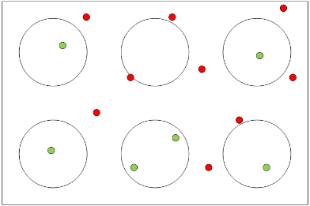
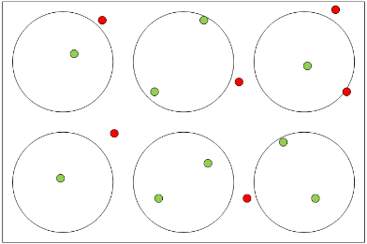
Optical Fill Factor
35% fill factor
53% fill factor
Detection efficiency ∝ Optical Fill Factor
Analog or digital ? Same timing with same SPAD arrays for LYSO
  Gundacker et al, NIM 2015

Slide 17
Vertical Integration for Digital SiPM
Back-side illumination
  Infra-red wavelengths
  Zou, Bronzi, 2014, SOI on CMOS
  Pavia et al, JSSC 2015, Dual-CMOS
Front-side illumination
  Tétrault et al, TNS 2015
    Test chip in assembly
    Prelim results at NSS-MIC 2016

Slide 18
Digital SiPM microsystem design
Implementation boundaries
  1 TDC per scintillator
    First observed photon to reach TDC
    No post-processing required, excellent real-time performance
  1 TDC per cell (400 cells per mm²)
    Maximum Likelihood Estimator (MLE)
      Gundacker et al, 2013, van Dam et al, 2013, Venialgo et al, 2015
Is there a middle point providing the best of both worlds?

Slide 19
Digital SiPM Microsystem Model
Simulator will be officially released at NSS 2016! See talk N38-4 by
A. C. Therrien
Photon Statistics
Light Transmission
Efficiency
Geant4 toolkit
Special thanks to
Marco Pizzichemi
Fill factor
Quantum efficiency
Avalanche probability
Noise not considered
QC dead time
QC jitter
Therrien et al, TNS 2014
Skew and jitter for
-Clock tree
-Trigger tree
*This work, Python models
TDC LSB
TDC Jitter
TDC Sharing
Single TDC
Multi-TDC + MLE
Notes:
Light transmission efficiency

Slide 20
Simulation parameters
LYSO
SPAD array
TDC
40 000 / MeV
1.1 x 1.1 x 3 mm³
T_{rise} = 70 ps
T_{decay} = 40 ns
Effective PDE = 18% @ 420 nm
1.1 x 1.1 mm²
484 cells, 50 micron pitch
Dalsa CMOS HV doping profile
20 ns quench/recharge dead time
Programmable precision
Programmable resolution
Programmable SPAD:TDC ratio
Many parameters to consider, needs deep knowledge of entire detector to fully configure

Slide 21
Simulation Outcomes (LYSO)
What is the coincidence timing resolution (CTR) lower limit?
What is the performance gain between one and many TDCs?
How many TDCs are actually needed?
  Will determine real-time load and silicon real-estate for TDCs
  Faster real time → lower dead time → better sensitivity
Subset of full simulation results
σ(t)_{Cell}² = σ(t)_{SPTR}² + σ(t)_{QRC}²
σ(t)_{Cell} = 30 ps FWHM
σ(t)_{TDC} = 30 ps FWHM or variable
TDC resolution : 1 to 50 ps LSB
Figure of merit : coincidence timing resolution (CTR)

Slide 22
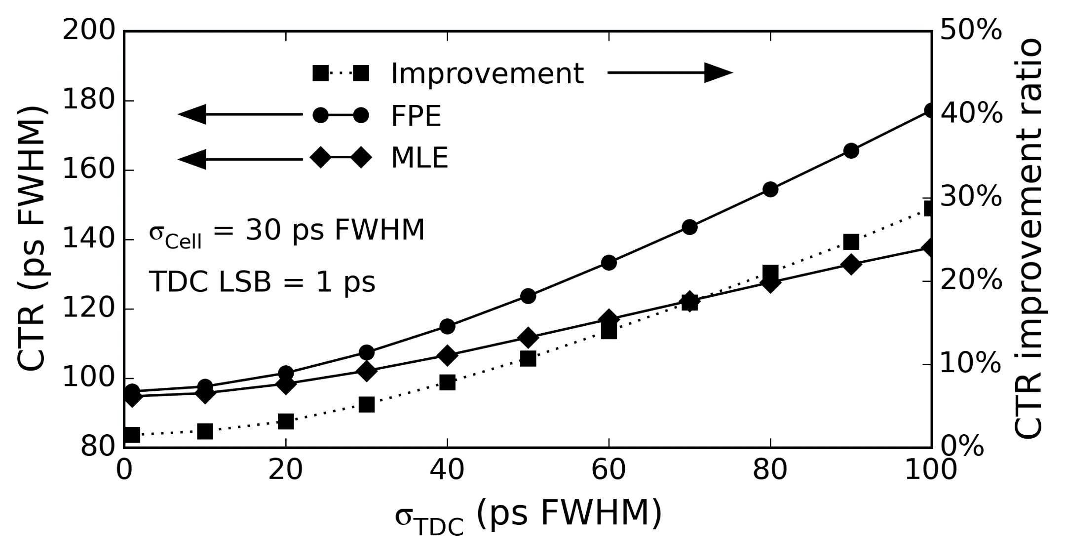
Full TDC array LYSO results
1- Lower limit
2- Multi-TS improvement
5-35%
~90 ps FWHM
Notes:
Lower bound near experimental 85 ps, difference in scintillator, SiPM, operating point, etc can explain the difference

Slide 23
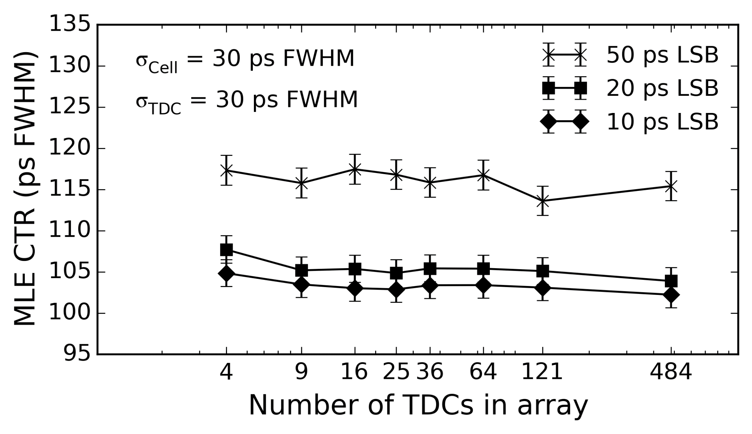
Impact of sharing TDC LYSO
How many TDC?
1:4 Ratio
1:1 Ratio
Notes:
Small jitter = less improvement from MLE
At these levels of jitter, Measurements can almost
correctly capture photons in order.

Slide 24
LaBr₃
Substituted LYSO parameters for
  Absorption
  Refraction Index
  Wavelength emission
  Light yield = 60 000 / MeV
  Rise time = 150 ps
  Decay time = 15 ns
H. T. van Dam, S. Seifert et al, "Optical Absorption Length, Scattering Length, and Refractive Index of LaBr₃:Ce³⁺", IEEE TNS, vol 59, no 3, 2012
J. Glodo, W. W. Moses et al., "Effects of Ce concentration on scintillation properties of LaBr3:Ce“, IEEE TNS, vol. 52, no. 5, 2005

Slide 25
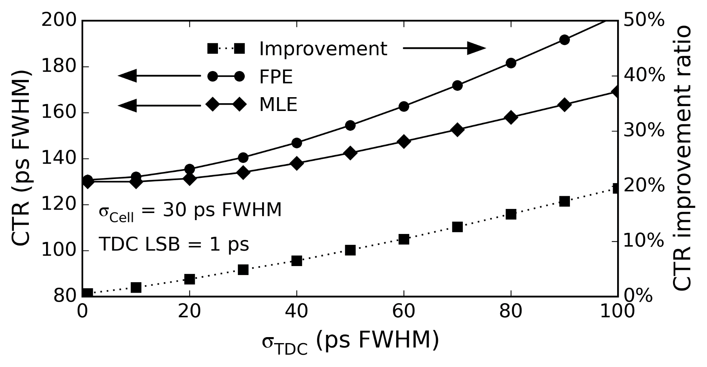
Full TDC array LaBr3 results
Geant4 model needs a review
Should change SPAD profile for lower wavelength

Slide 26
How to reach 10 ps?
10 ps beyond current scintillator limit
Crystal designers have ideas
  Improve prompt photon yield
    Cherenkov
    Intra-band luminescence
    Nano crystals
    Cqwells
      Lecoq et al, TNS 2016
  Expected light yield
    Unknown
  Model approximation
    Second scintillation component
    Light Yield = 1000 / MeV
    T_{rise} = 0.1 ps
    T_{decay} = 5 ps
  Observed time-stamped prompts
    About 25 in photopeak events
Weber et al, NIM 2004; Mikhailin et al, NIM 2002

Slide 27
Simulation Outcomes (Prompts)
What is the timing lower limit?
What is the performance gain between one and many TDCs?
How many TDCs are actually needed?
  Will determine real-time load and silicon real-estate for TDCs
  Faster real time → lower dead time → better sensitivity
Subset of full simulation results
σ(t)_{Cell}² = σ(t)_{SPTR}² + σ(t)_{QRC}²
σ(t)_{Cell} = 15 ps FWHM
σ(t)_{TDC} = 10 ps FWHM or variable
TDC resolution : 1 to 5 ps LSB

Slide 28
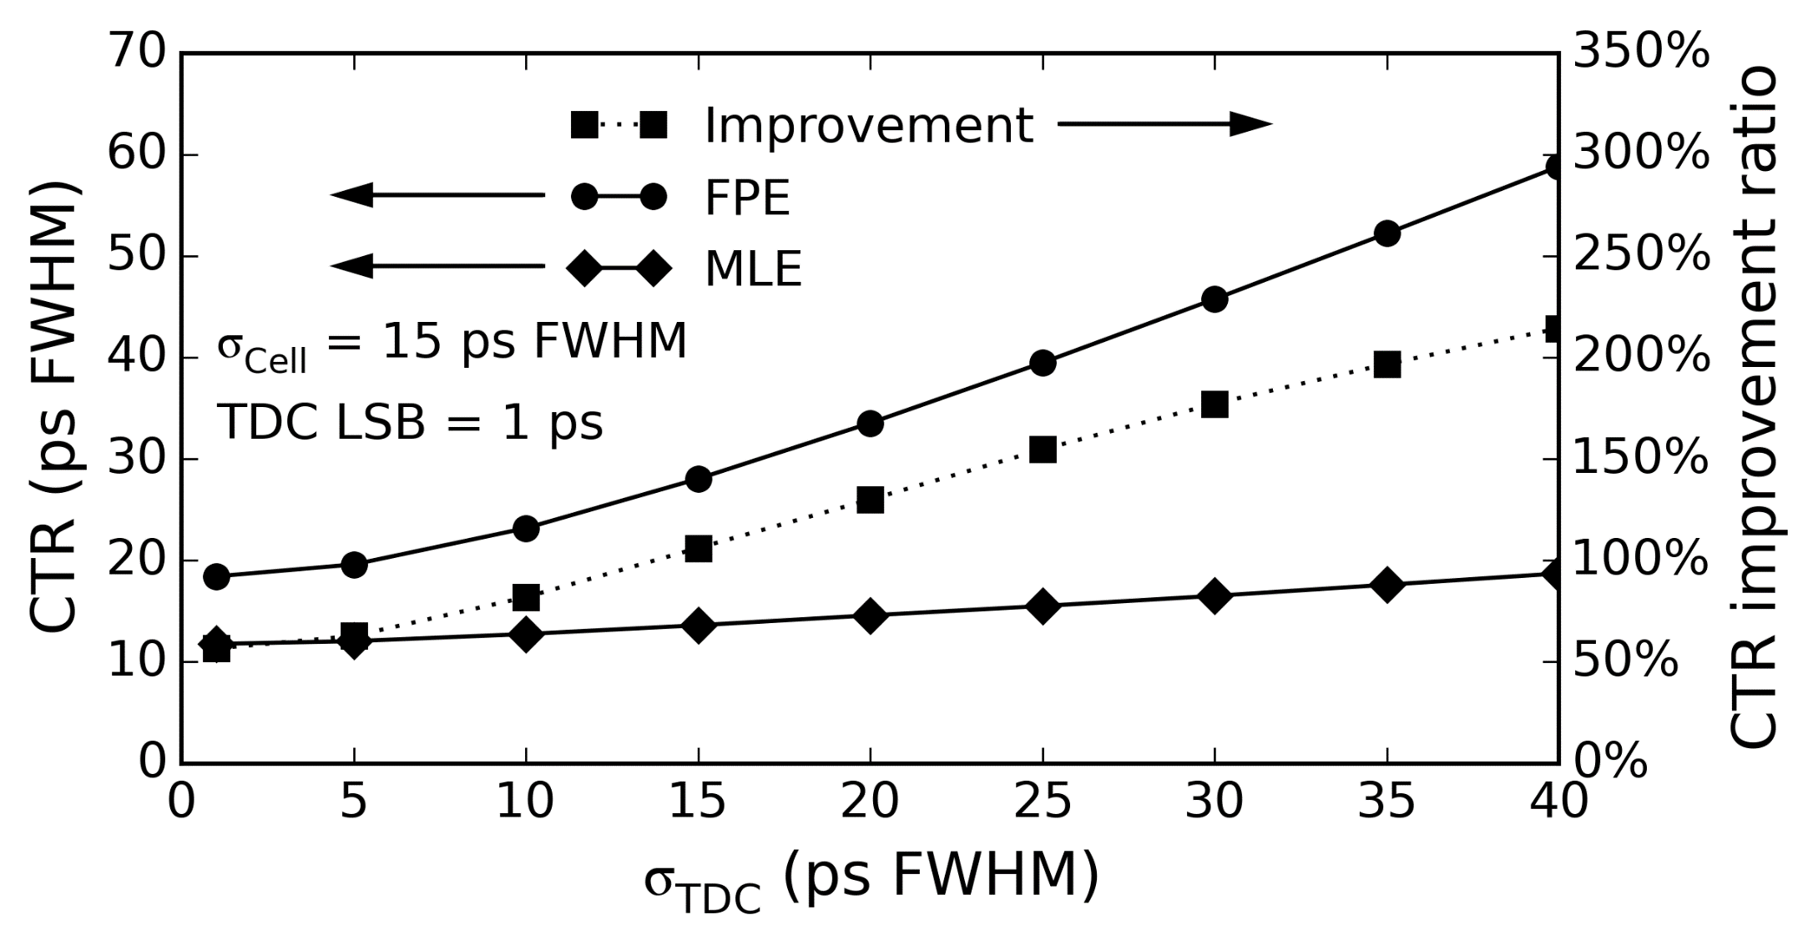
Full TDC array Prompts results
1- Lower limit
2- Multi-TS improvement
60%-210%
~11-14 ps FWHM

Slide 29
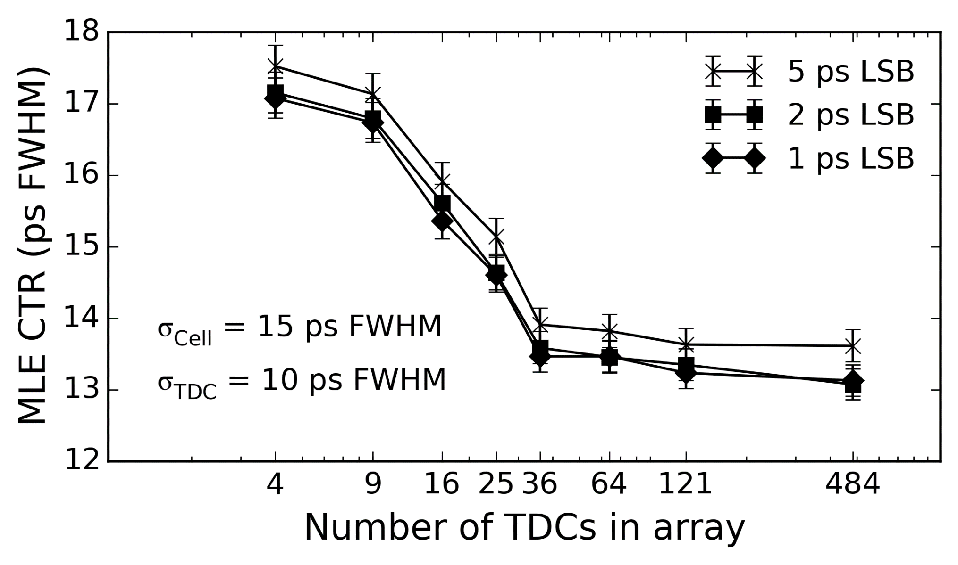
Shared TDC Prompts Results
How many TDC?
1:4 Ratio
1:1 Ratio

Slide 30
Outcomes
Current Scintillators
Future Detector Crystals
Not likely to reach 10 ps FWHM CTR
Moderate gain from multi-TDC MLE
  Need only a few TDCs to be effective
Use real-estate to embed other
real time tasks
  MLE calculation
  Energy discrimination
  Crystal identification
Can theoretically reach 10 ps FWHM CTR
Good gain from multi-TDC MLE
  Needs several TDCs for optimal timing
Compromise between embedded real time features and number of TDCs
  Simulation flow can guide designers

Slide 31
Where are we?
Latest Sherbrooke TDC prototype in in 65 nm CMOS
  Vernier ring approach
  Better than 10 ps FWHM jitter / 10 ps LSB
  Less than 40 x 40 um²
  Low power
  Preliminary results presented at NSS-MIC 2016
    SP2-4, J-F Pratte, "3D Digital SiPM for Precise Single Photon Timing Resolution"

Slide 32
Conclusion
To reach 10 ps timing resolution
  Crystal light output is a major player
  Jitter and precision are important, but not sufficient
  The number of TDCs per pixel also major player
The real time microsystem complexity is dependant on the potentially reachable timing resolution
The simulation tool can help predict the overdesign threshold
  Reduce un-needed real-time burden
  Dedicate otherwise redundant real-estate to other real-time tasks

