Slide 1
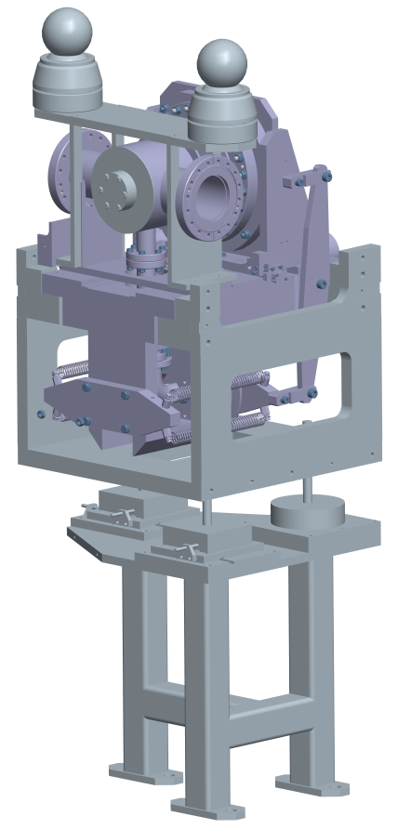
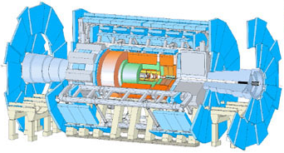
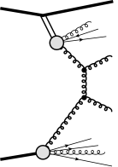
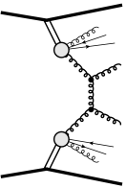
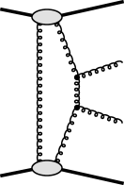
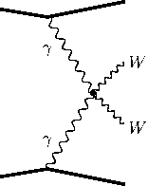
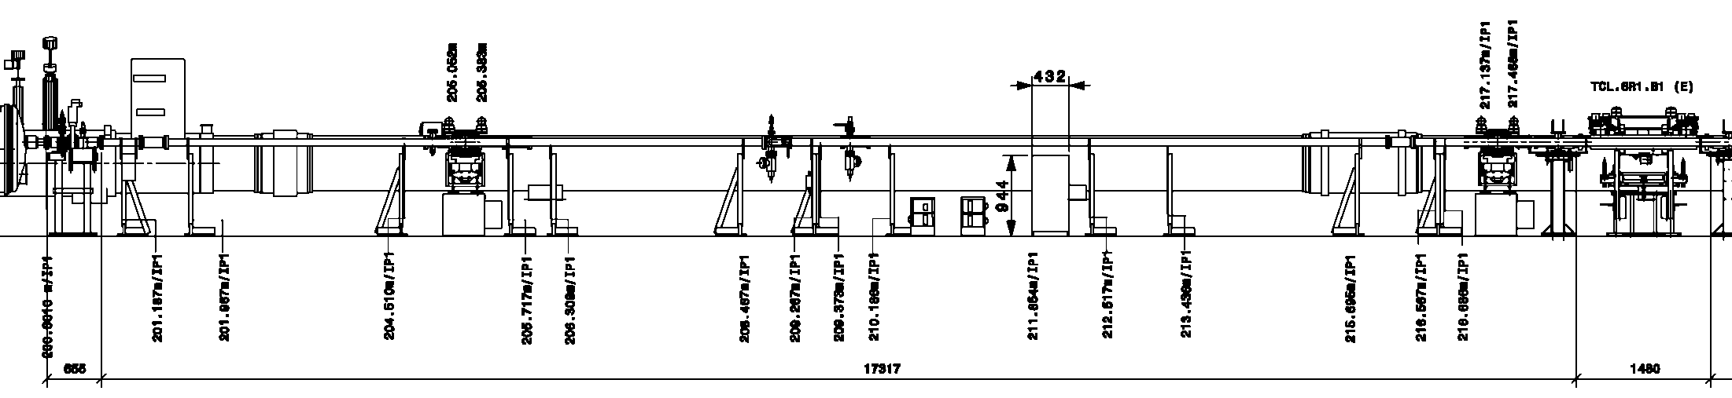
ATLAS Forward Proton Project and Fast Timing
ATLAS-AFP Collaboration
2016
2017 →
γγ→
W,Z,γ
SD
DPEjj
CEPjj
200m
W,Z,γ
! INSTALLED !
XRP-NEAR205 m
PatchPanel
212 m
XRP-FAR
217 m

Slide 2
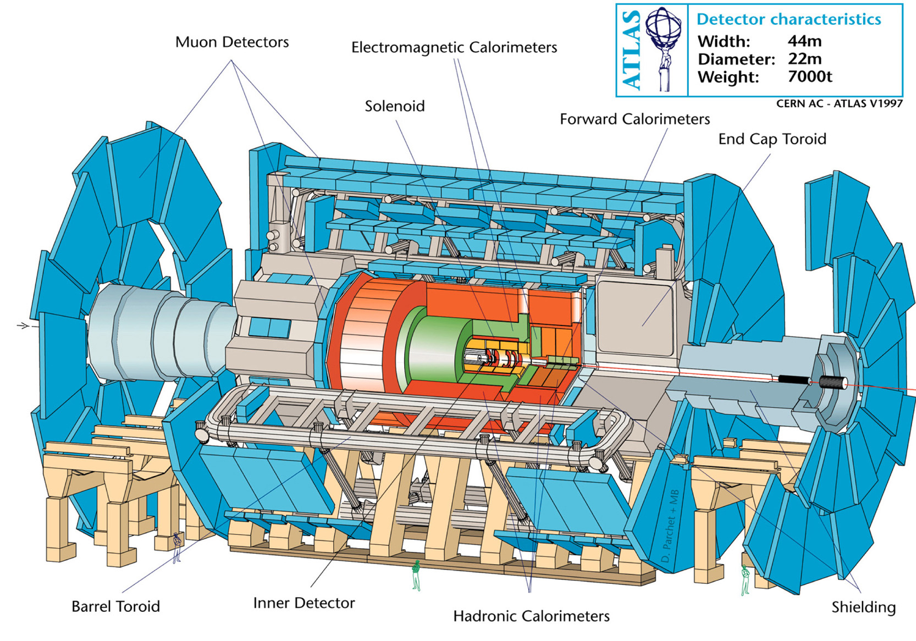
The ATLAS Detector
to AFP right arm
(200m)

Slide 3
AFP Goals
A two-forward-proton measurement for each ATLAS event :
  forward proton energy and momentum (use ξ≡1 – E_{p}/E_{beam}, θ or t, ϕ)
    excellent tracking (<10 µm) and two stations/arm with 12 m lever arm
    use 3D pixel sensors (50 µm × 250 µm pixel size) with FE-I4b readout
  identify the vertex of origin (remove single-diffraction
  pileup) by proton time-of-arrival t_{L}, t_{R} measurement
    if both protons come from a single vertex: z_{vtx} = (t_{R} – t_{L})/2c
    excellent proton time resolution needed: ≲10 ps for µ≲50
  Note: some rare processes do not require timing:
    E.g. pp → p_{L}+X+p_{R}, X = γγ, WW, ZZ is almost background-free
    by requiring kinematic match between (p_{L}p_{R}) measured in AFP
    and the system X measured in central ATLAS
Low Luminosity (low-µ) runs:
  Single diffraction studies (single Pomeron studies)
  Double Pomeron Exchange studies
CEPjj
γγ→
W,Z,γ
W,Z,γ
SD
DPEjj

Slide 4
Ultra-Precise Time-of-Flight
AFP is looking for pp → p_{L}+X+p_{R}
  p_{L(R)} is a forward proton in the Left (Right) arm of AFP
  X ≡ WW, ZZ, jj, γγ, ...
in ATLAS we have 20-60 interactions/BX: “Pile-up”
  avg number of interactions per BX (pile-up) in 2016: <µ>40
  15% of these have a forward proton (Single Diffraction)
    a SD proton has a 20% acceptance in AFP
    At high µ, any ATLAS trigger (high p_{T} lepton, jet, photon)
    is often accompanied by two forward
    protons in AFP from pile-up
  A measurement of “t₀” with ATLAS
  could provide pile-up rejection even when vertices overlap …
Precise time-of-arrival measurement will help reject pile-up protons:
  if the two protons come from the same vertex (vtx), then: z_{vtx} = c(t_{L} – t_{R})/2
  if z_{vtx} measured by AFP can be matched with a vertex of interest in ATLAS, then the process may be of the type we’re looking for …
  resolution is crucial: δz_{vtx}=(c/√2)δt; for δt=10 ps ➔ δz_{vtx}= 2.1 mm
    z_{vtx} distribution has rms=40 mm, so fake matches increase with δt and with µ
γ
p_{L}
p_{R}
z_{vtx}
0
γ
γ
p_{L}
p_{R}
z_{vtx}
0
γ

Slide 5
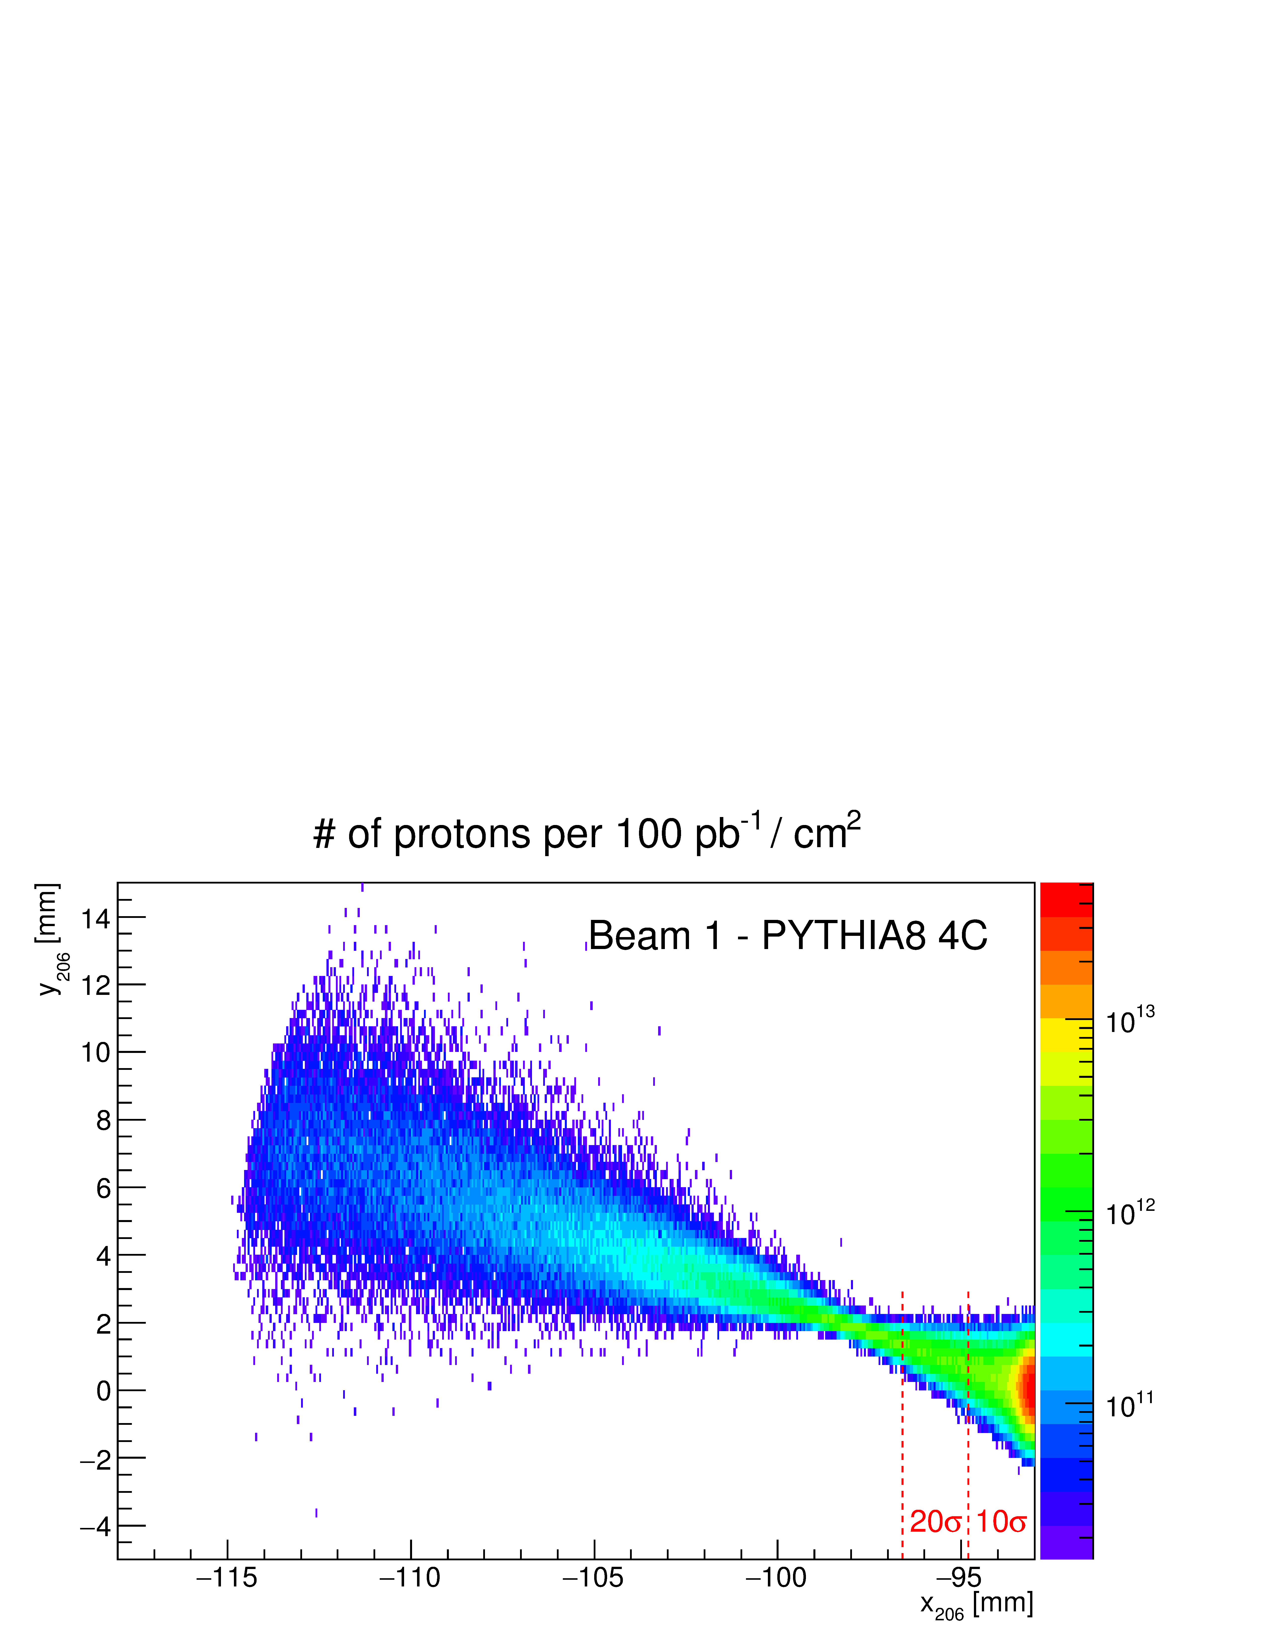
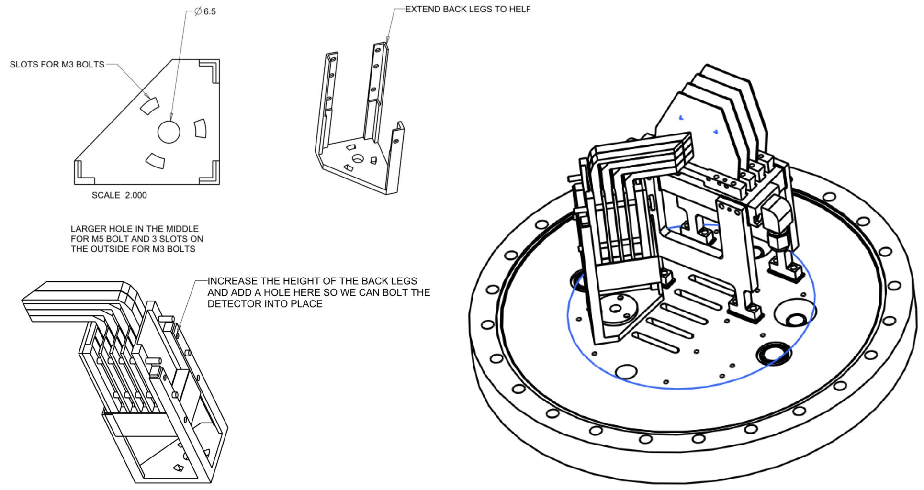
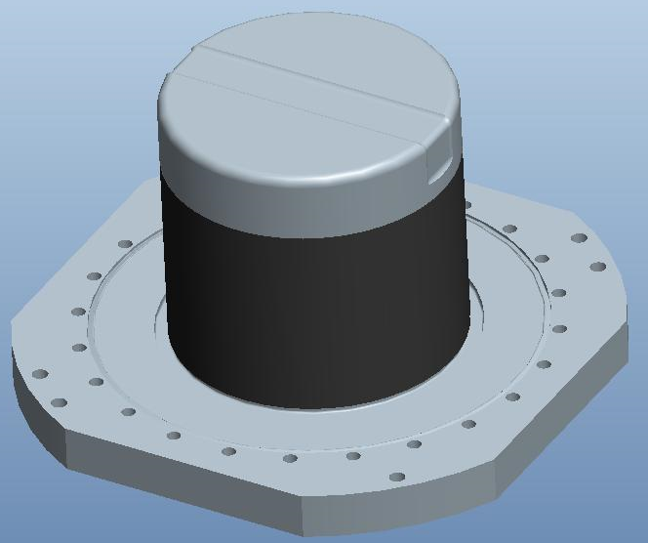
Forward Protons …
Hit pattern at ~210 m for protons with 2% to 15% energy loss is determined by the LHC optics (AFP TDR)
For β*=0.55 m:
  upward tilt for protons with
  energy loss is caused by
  vertical crossing angle in Point 1
must get close to the
beam
  Roman Pots à la TOTEM – CMS-PPS
  insert in LHC aperture
  detectors inside pots
p/cm²/100 fb^{–1}
p
thin window
AFP Roman pot

Slide 6
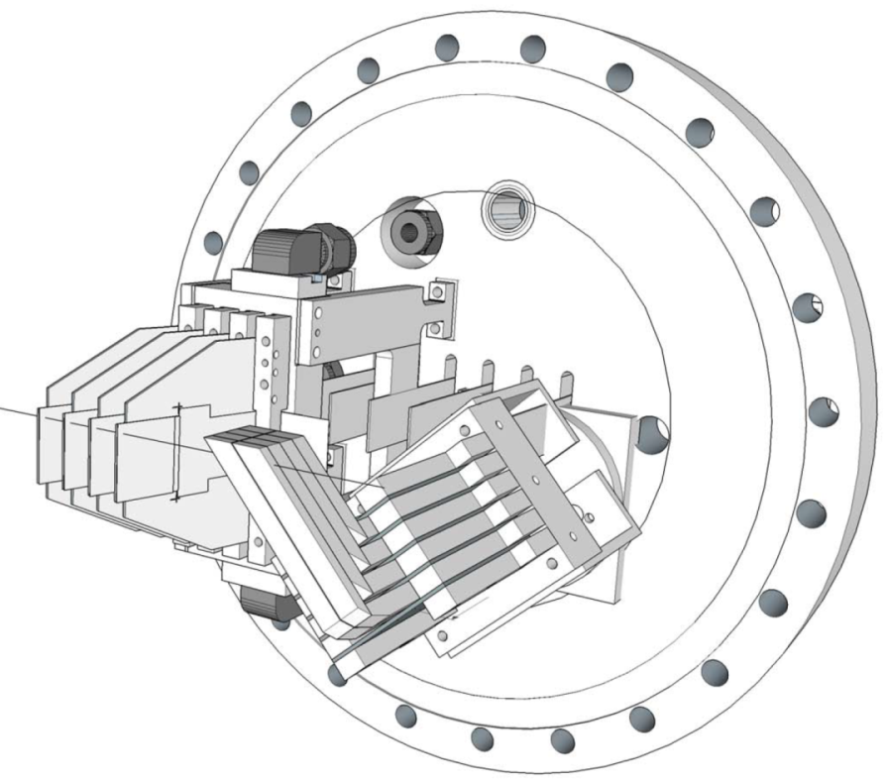
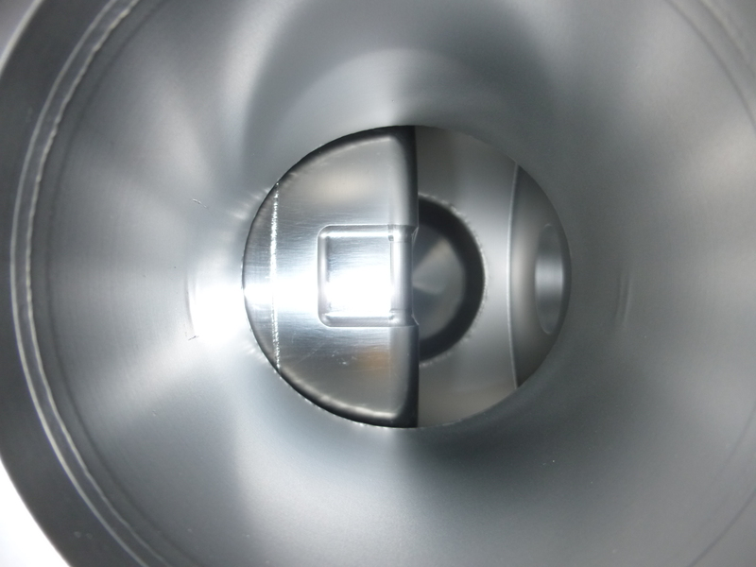
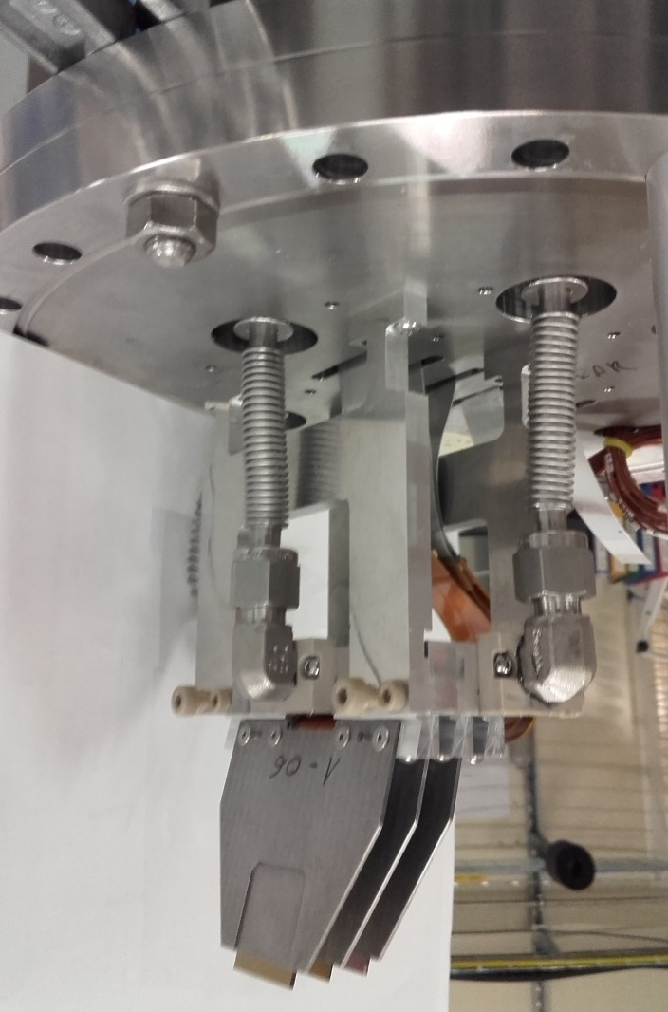
Roman Pot with Detector
3D silicon pixel detectors
size 50μm (x) × 250μm (y)
➔ Design of the tracker plus Time-of-Flight system mounted on a feedthrough flange for a Roman pot …
First silicon tracker before mounting inside the Roman pot at 205 m
Beam view: looking downstream through the beam pipe at a fully inserted Roman pot

Slide 7
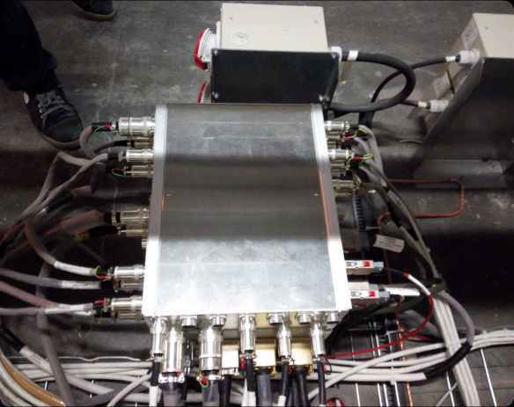
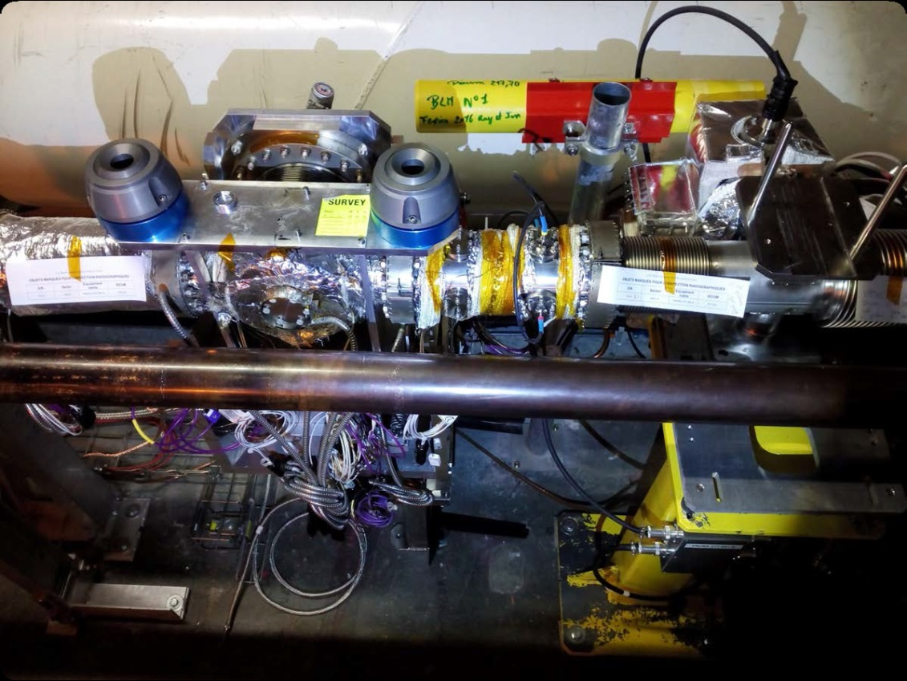
AFP in 2016 – RP Installation
Two stations validated on 13 Jan’16
Cabling:
  Fast Cabling finished for both arms
  Control cables finished for both arms
  All C-side cables connectorized and tested
Services:
  Compressed air for Cooling
  Secondary Vacuum
  BPM, BLMs connected
Installation done, connected
to Beam Pipe, pump-down and
bake-out done …
Pot Motion calibrated in tunnel:
  Survey of slide vs motor position,
  vs switches and LVDT 20 Feb’16
Patch Panels & LV Regulators at 211 m
station at 217 m, BPM, BLM, TCL6

Slide 8
Status Detectors
NEAR Station: 3 3D pixel detector layers; 50µm×250µm/pixel
FAR Station: 4 3D pixel detector layers – HV short on 1st layer but still 95% efficient
  modules are tuned and timed
Trigger (each station): 2-out-of-3 layers with HitOR ON
  Local Trigger Board (HitBUS chip) ➔ Air-core Cables ➔ CTP
  AFP is within the (last BX of the) ATLAS Latency !
Readout:
  Tunnel (FE-I4➔HitBUS chip➔Optoboard) ➔ USA15 (HSIO2/RCE system) ➔ ROS
Note: the new batch of 3D pixel sensors are much superior to the existing sensors – will be installed during the EYETS

Slide 9
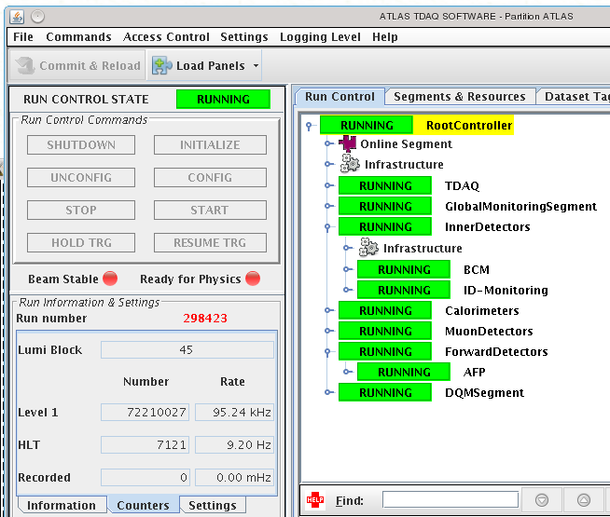
TDAQ & DCS Status
AFP TDAQ integration
  AFP running smoothly in ATLAS partition
  for all combined runs during 5-13 May
  Since 13 May AFP-ATLAS TDAQ integration:
    Collaboration with ATLAS and IT
    TDAQ experts
    Integrated running since July 2016
DCS integration
  Ongoing integration in ATLAS DCS
  (coordinated with central DCS)
  Work by the AFP DSC team and ATLAS DCS Experts
AFP insertions at high luminosity:
  13 May: 600b, 1:14 hr AFP inserted + 0:50 hr TCL6 closed
  Triggers enabled in AFP calibration stream with pre-scale 1000 ➔ ~300 Hz
    HLT_calibAFP_L1AFP_C_ANY and …_AND
Successful Low-µ special AFP+ATLAS run on Aug 2, 2016

Slide 10
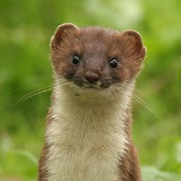
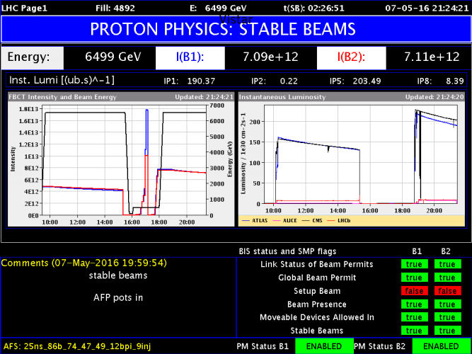
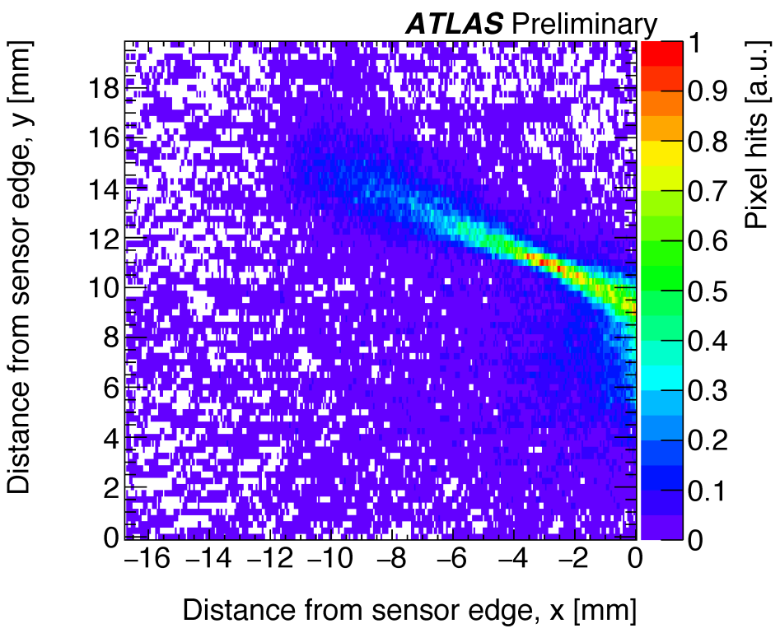
AFP Insertions
Date Fills TDAQ Mode
19-22 April Beam-Based Alignment and Loss Maps (6 & 3 hrs) Stand-alone
23 April 3b: 2nd fill (no 3rd fill) Stand-alone
24-25 April 12b: 2nd + 3rd fill Stand-alone
29 April – 5 May Weasel break ➔ TDAQ integration
7 May 49/86b: 2nd + 3rd fill; 8.1pb^{–1} Integrated
9 May 300b: 4th fill (2nd+3rd ended before AFP in); 7.9pb^{–1} Integrated
13 May 600b: 2nd fill (1:14h); 9.3pb^{–1} Integrated
Total (TCL6 and/or AFP in):
  42 h
  34 pb⁻¹
BBA @5.5σ
Preliminary

Slide 11
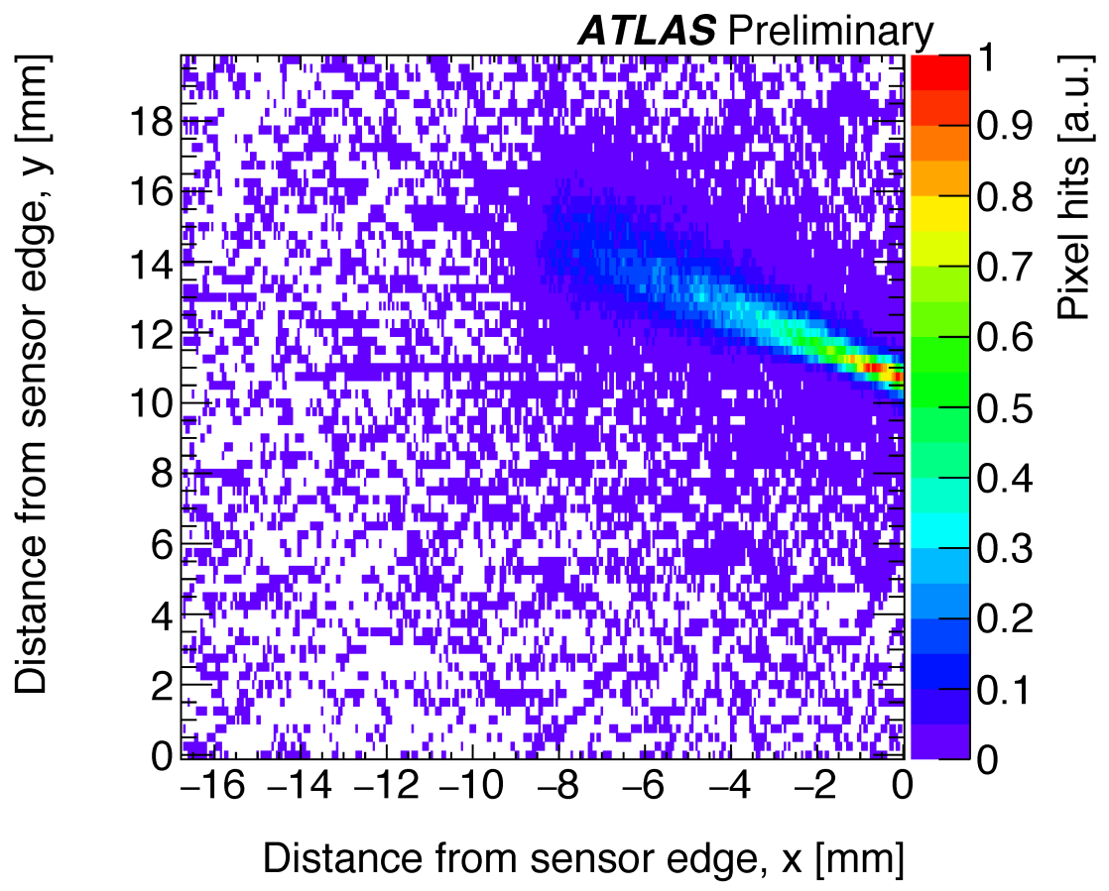
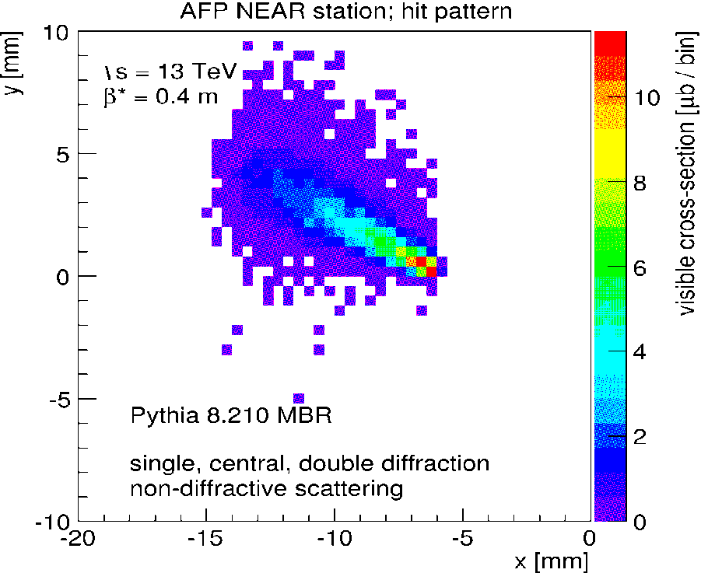
Preliminary Performance Plots
300 b fill #4906, AFP readout but triggered by ATLAS
Hit pattern first plane of NEAR station
●
Pythia MC
expected “band” of diffractive protons
μ≲26, 2:16 hrs
Caution: hit pattern and MC plots are in somewhat different coordinate systems …

Slide 12
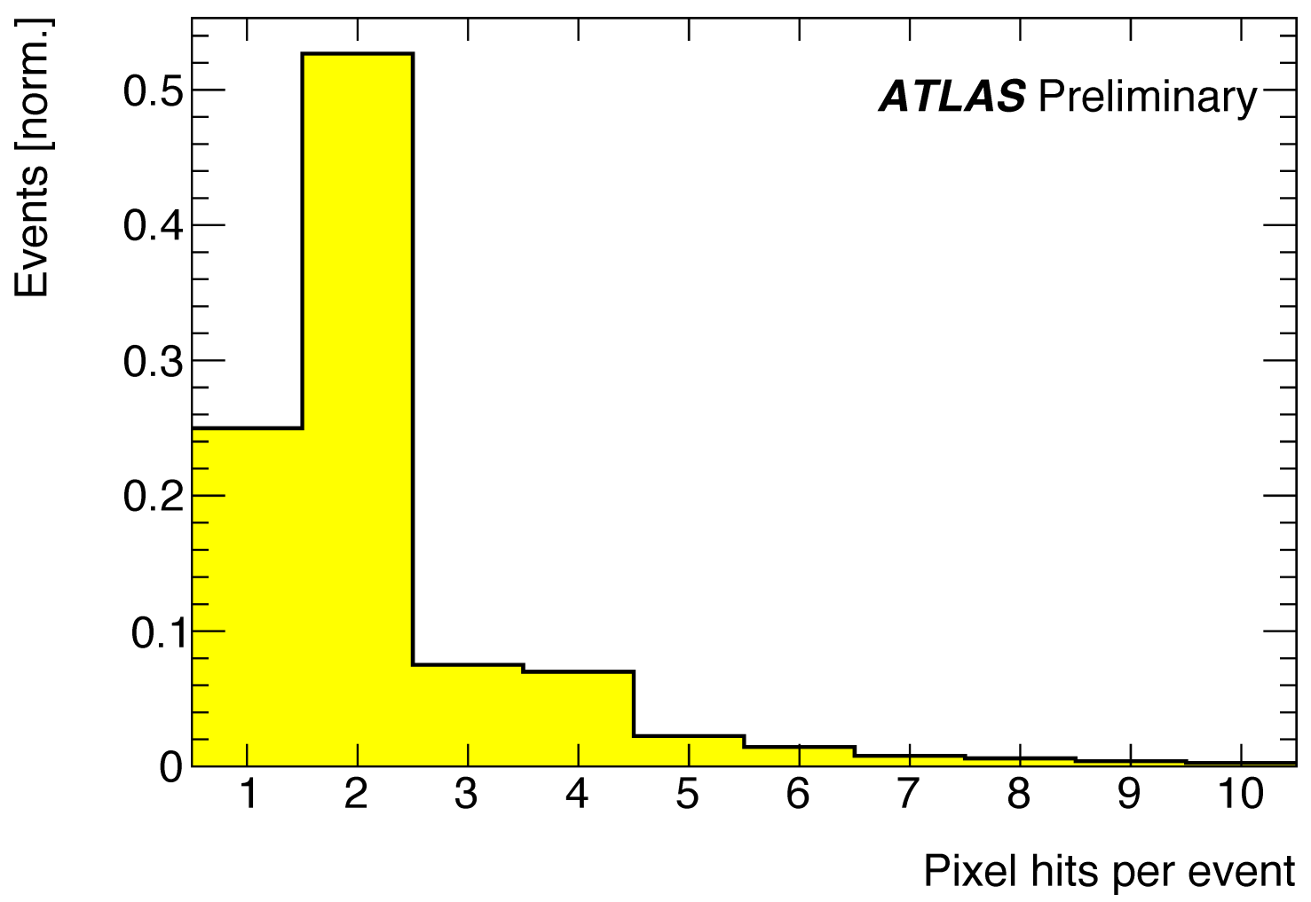
Preliminary Performance Plots
300 b fill #4906, AFP readout but triggered by ATLAS
87.7% of events have no hits (in this plane); remainder is mostly single “tracks”:
Note:
we expect ~2 pixels per “hit” because of the 14° tilt of the 3D sensors
➔mostly single particle tracks!

Slide 13
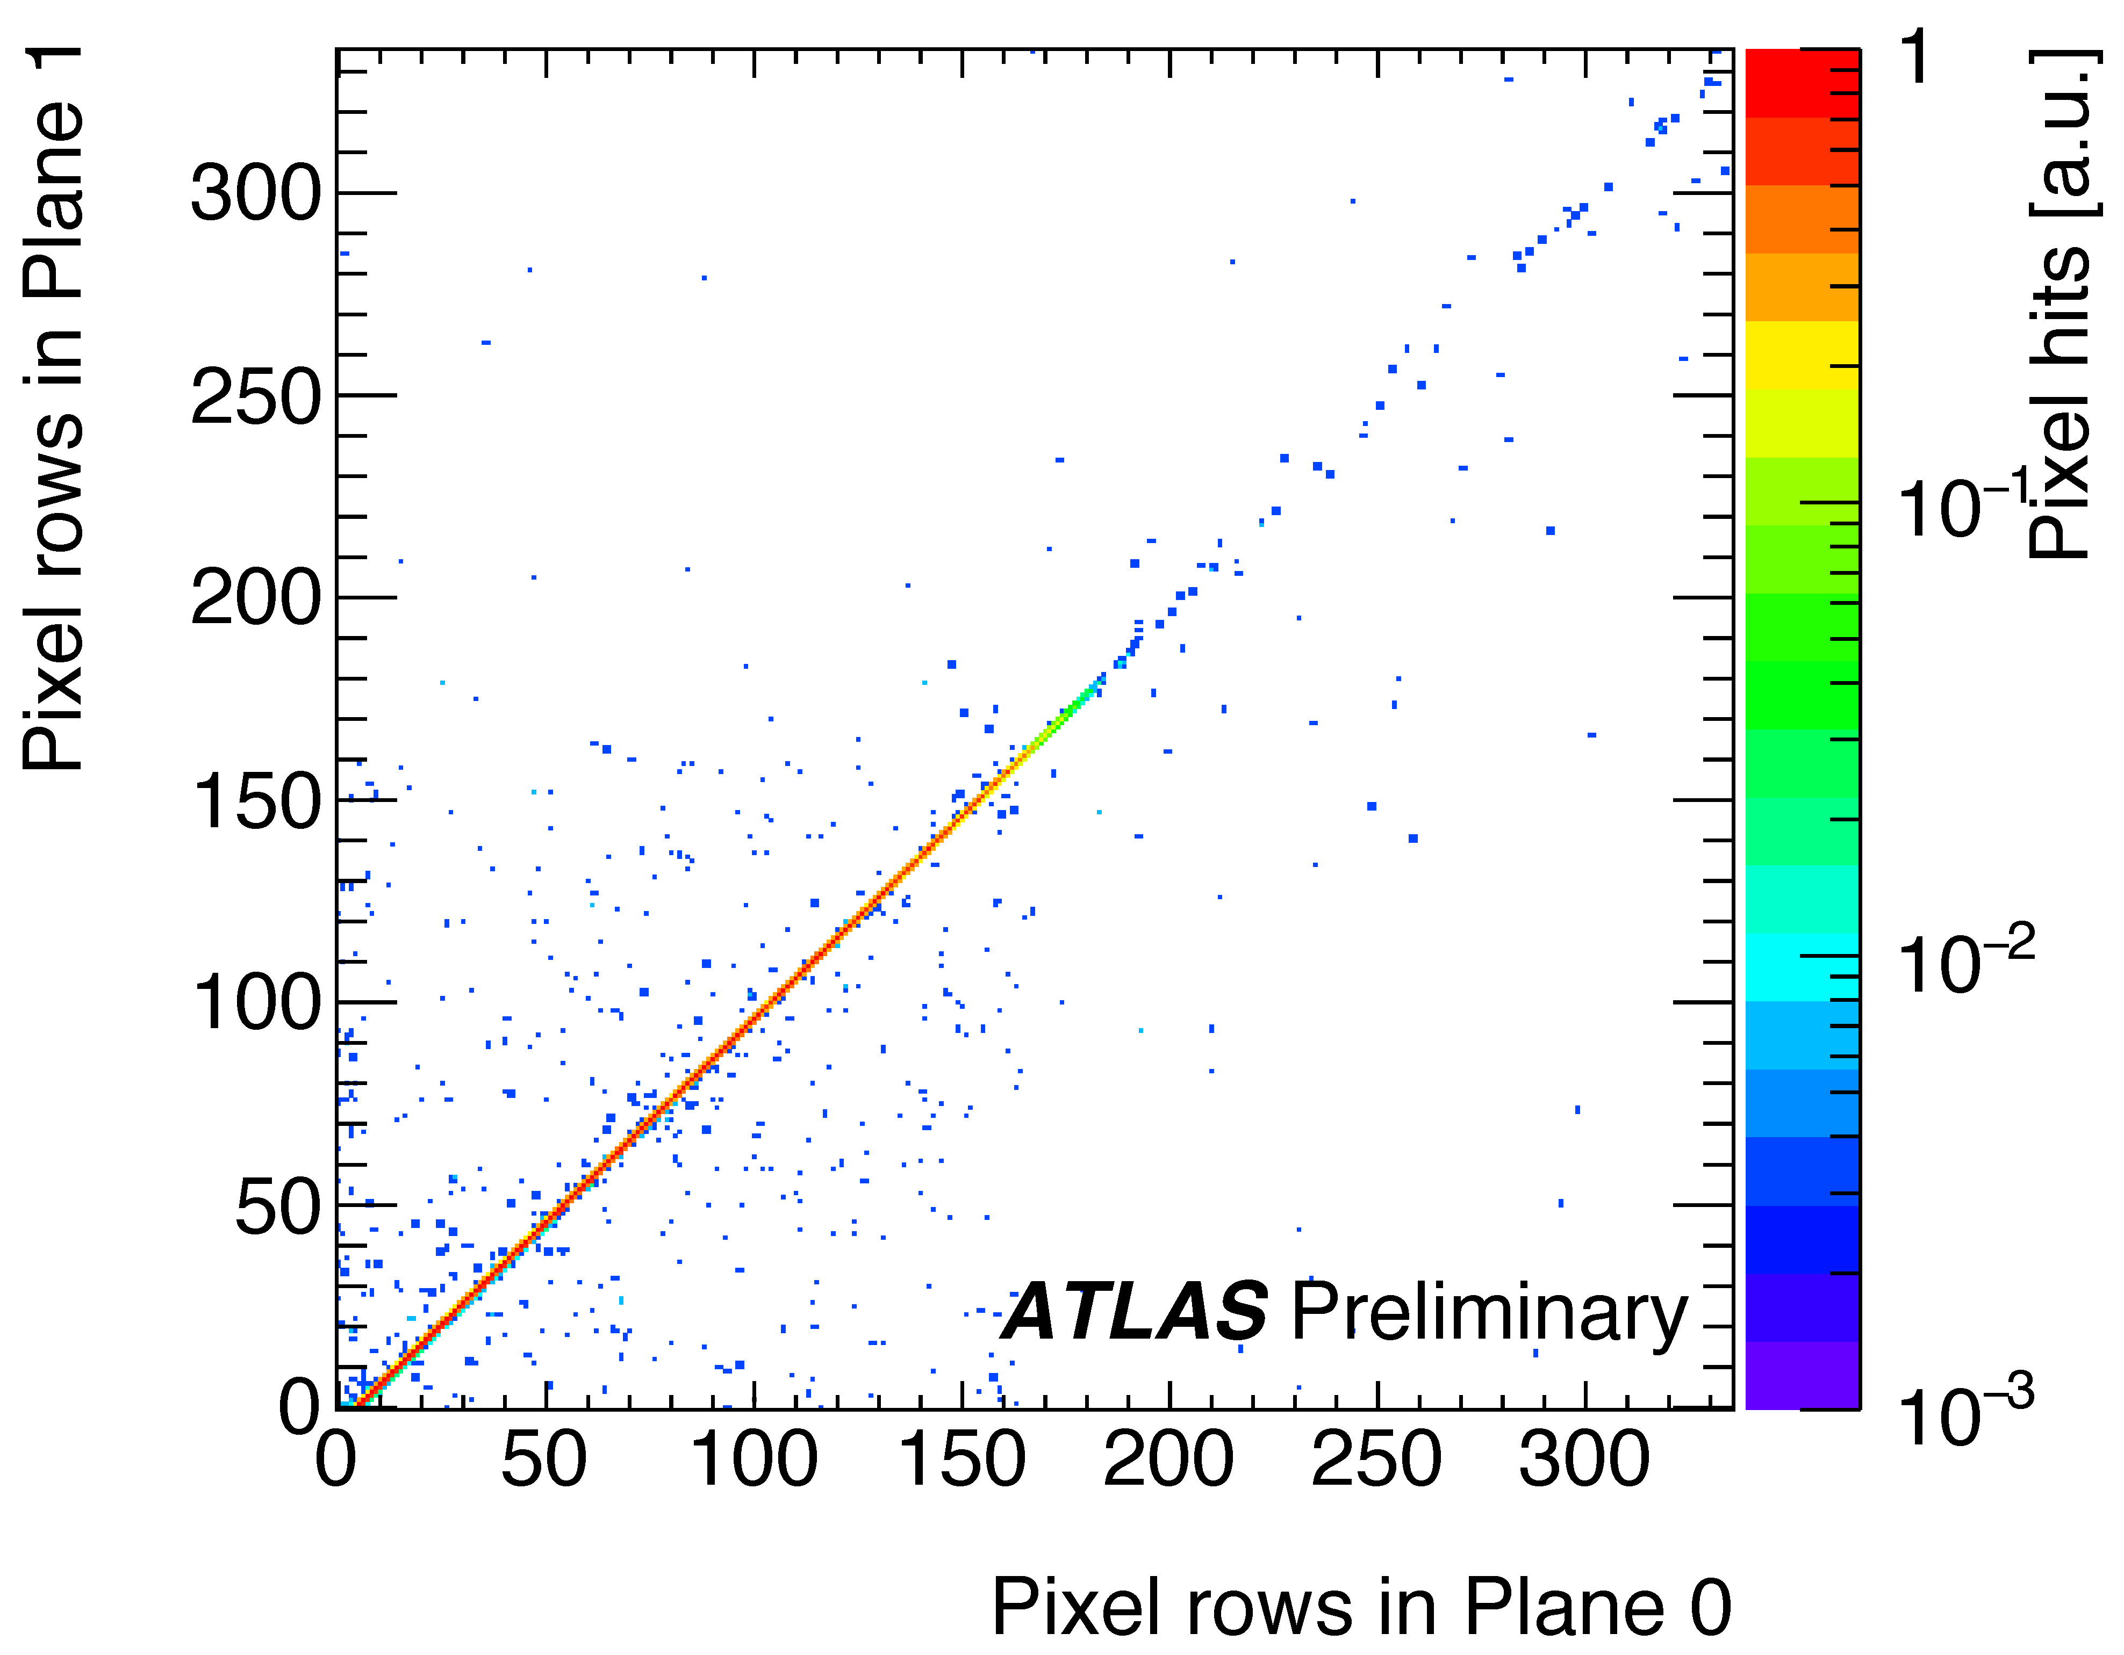
Preliminary Performance Plots
300 b fill #4906, AFP readout but triggered by ATLAS
Correlation of hit pixel row (x) in Plane 0 vs. hit pixel row (x) in Plane 1:
  strong correlation
  indicates mostly good,
  parallel tracks
  mostly single tracks
  smattering of
  non-correlated hit pairs
  from additional tracks?
Started work on hit
reconstruction,
tracking, alignment, etc.

Slide 14
AFP – ALFA Insertion conflict
When AFP runs at standard luminosity (high-µ):
  TCL4 and TCL5 must be opened to give large-ξ acceptance to AFP
  TCL6 (after AFP) must be closed to 20σ to protect Q6 and downstream
    this increases the radiation levels at ALFA by a factor ~10
    ALFA electronics is NOT radiation-hard
    ALFA still needs its large β*=2500 m run (Sept 2016), and possibly a follow-up early in 2017 …
AFP will limit its insertions in 2016 to 0.25 pb–1
ALFA & AFP are considering shielding to protect ALFA electronics
  studies by the FLIUKA team are encouraging: already a factor 3-4 reduction in dose
  further studies are ongoing
  expect a result and proposal (+ECR) in September

Slide 15
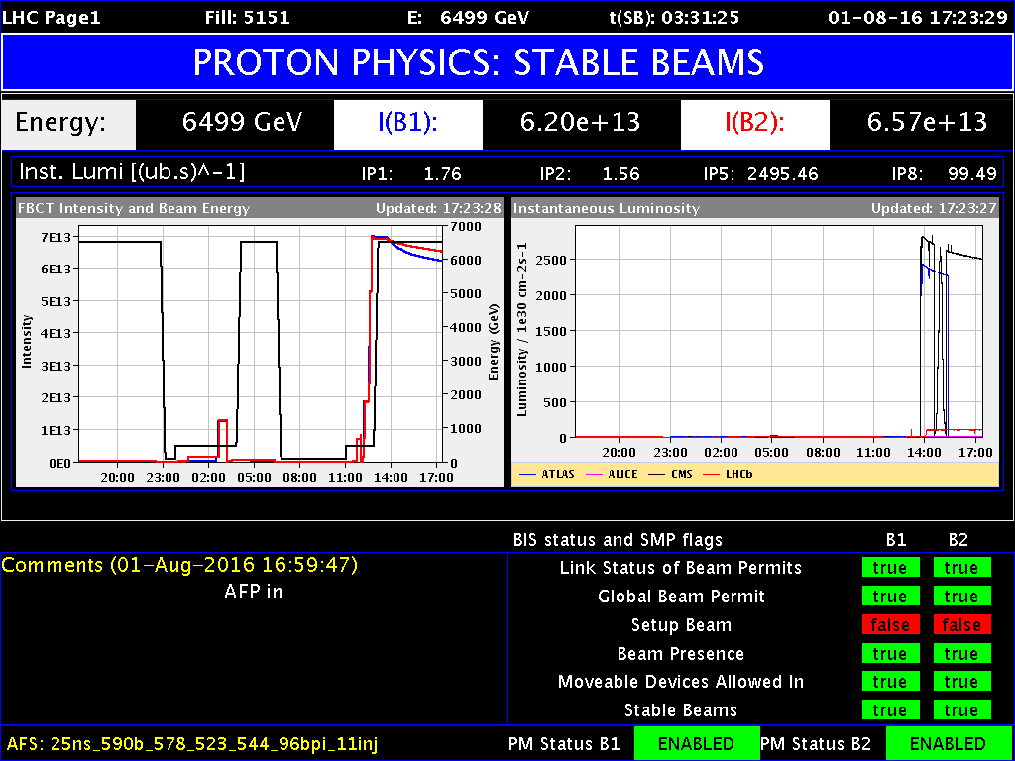
2016 Low-μ Special Run for AFP
600b fill on 01.08 (fill 5151, run 305359)
  Filling scheme: 25ns_590b_578_523_544_96bpi_11inj
  15:20 Start to separate beams
    15:24 beams at 5 σ_{H}* separation; ➔ µ_{peak}=0.26
  15:30 beams adjusted to peak µ_{peak}=0.13, <µ>~0.03; lumi=2.7e30;
  beam separation: σ_{H}*=5, σ_{V}*=2.5
  15:35 Start to insert RPs
  15:42 AFP inserted!
    AFP at 20 σ,
    TCL4/5/6 at 15/35/20 σ
Total time in beam: 4h37;
after Pre-Scale adjustments:
3h58
  Integrated luminosity: 0.033 pb^{–1}
Next low-µ run: after TS2
(~23 Sep)

Slide 16
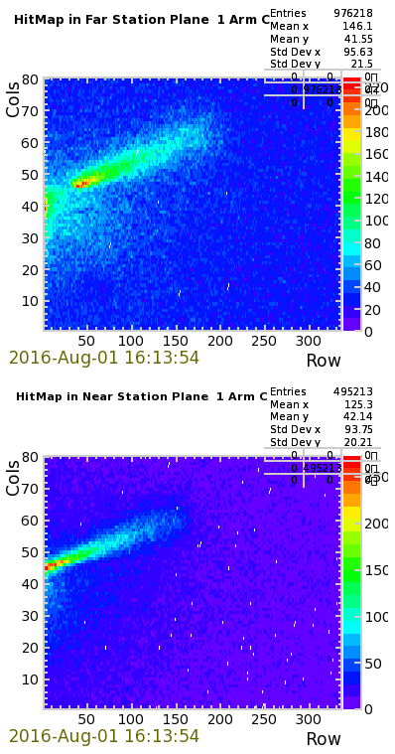
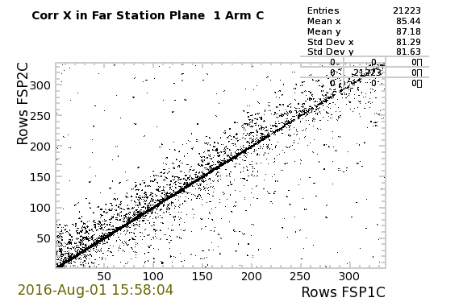
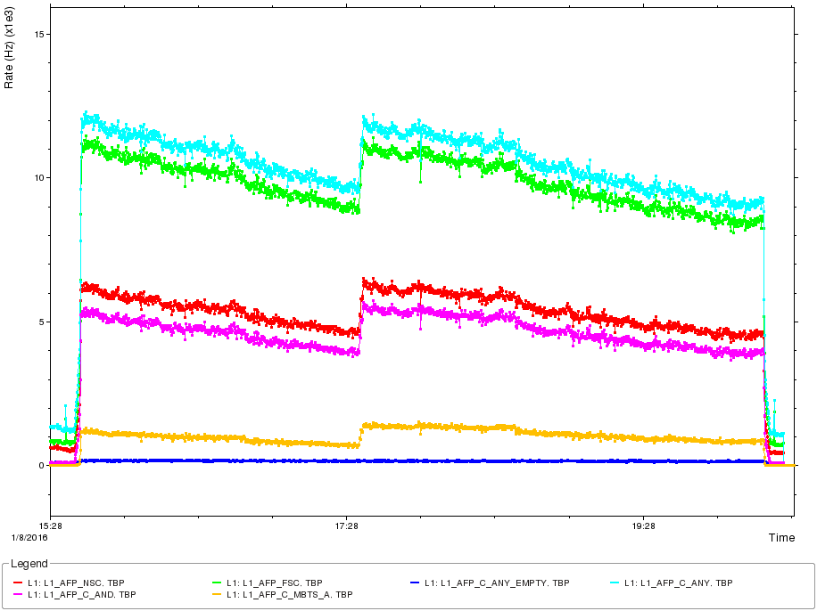
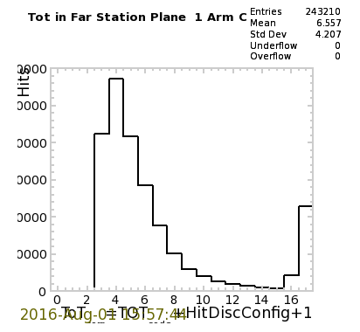
Low-µ Special Run
Predict per hour using Pythia :
  7M Soft SD events (proton rate in AFP 2 kHz)
  15k SDjj evts with p_{T}>20 GeV
500 SDjj evts with p_{T}>50 GeV
O(5) SD+W evts
Analysis ongoing …
Far Station
Correlation between row pixels in two layers
Any
10 kHz
Far
Near
Near Station
And
Time-over-Threshold

Slide 17
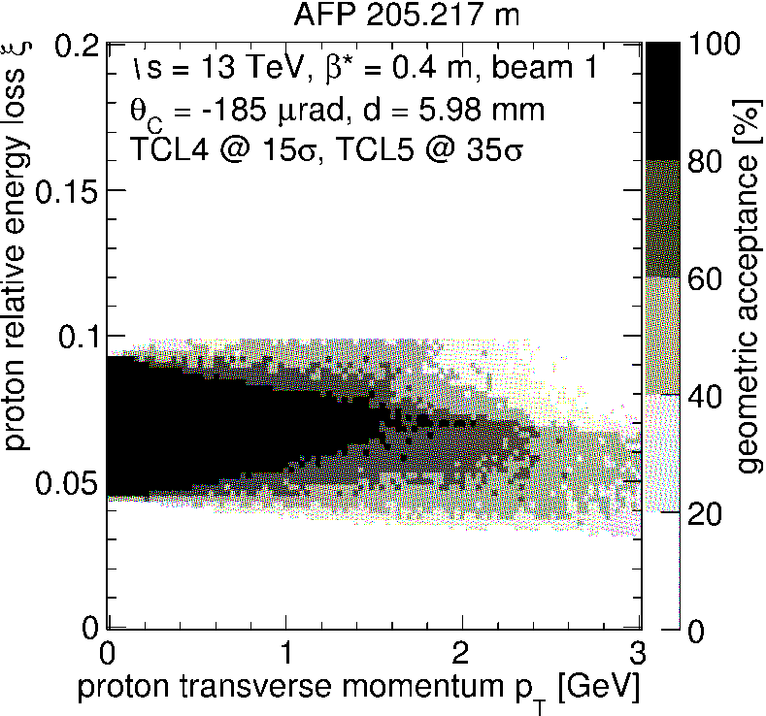
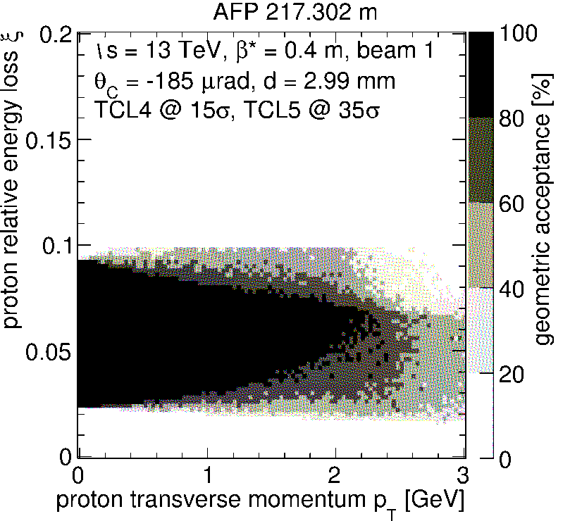
Physics with Low-μ Single-Arm AFP
Predict using Pythia and AFP acceptance at β*=55cm:
  for μ=0.1, nb=300, standard bunch density, 1 hr:
    7M Soft SD events (proton rate in AFP 2 kHz)
    15k SDjj evts with pT>20 GeV
    500 SDjj evts with pT>50 GeV
    3 SD+W evts
Acceptance in ξ and p_{T}:
From R.Staszewski see: https://indico.cern.ch/event/492863/ 2 Feb’16

Slide 18
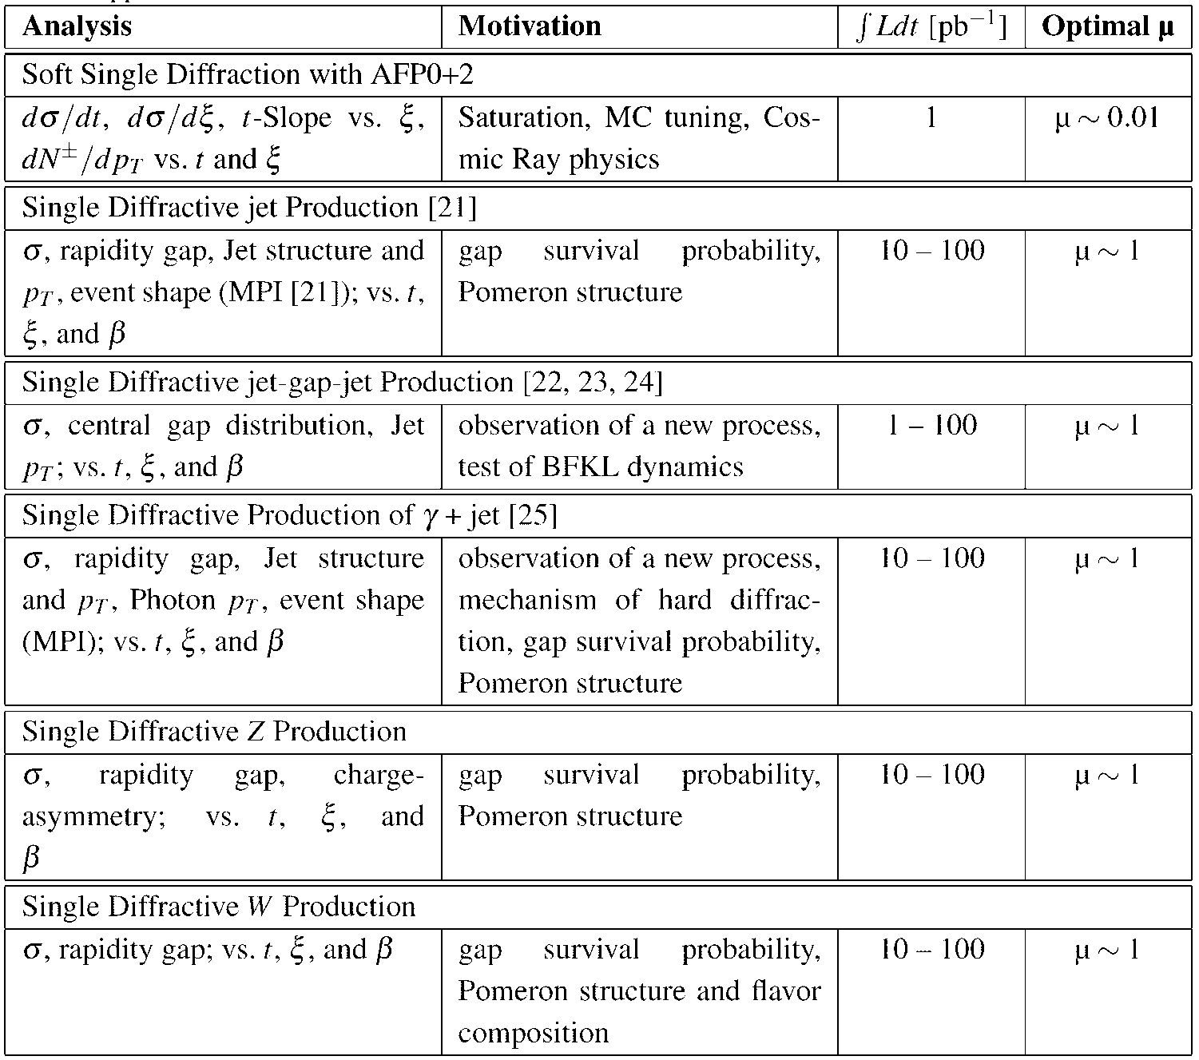
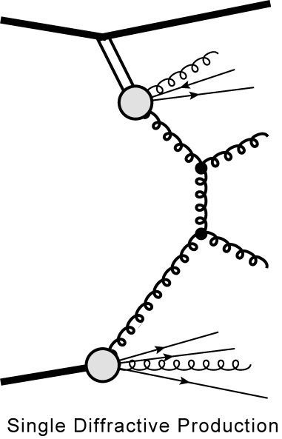
Summary of Single p-Tag Processes
t
p
disappears down the beam pipe
β
x
p
ATLAS Forward Proton
Technical Design Report, CERN-LHCC-2015-009
ATLAS-TDR-024-2015

Slide 19
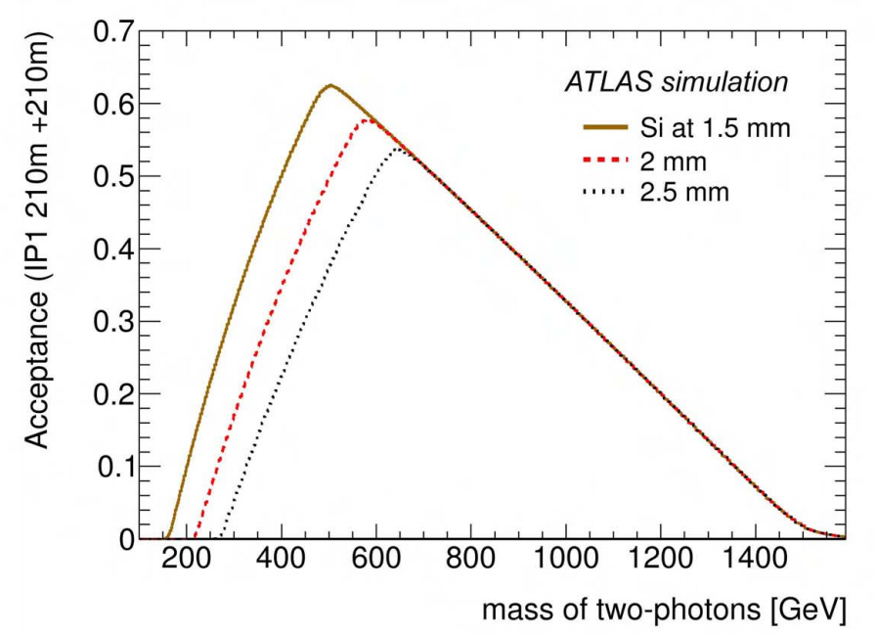
Preparing for the 2nd AFP Arm
AFP has excellent two-proton missing mass acceptance:
  e.g. for an object produced by pp→p+X+p, X→γγ :
14 TeV, β*=55 cm

Slide 20
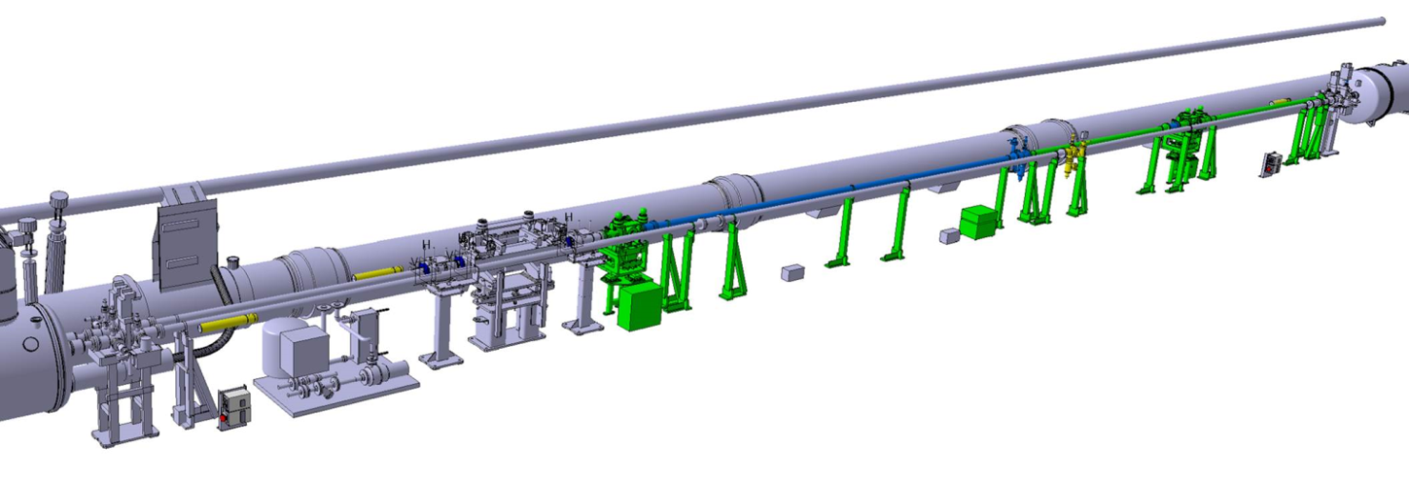
Preparing for the 2nd AFP Arm
ECR 2nd Arm (6L1):
in circulation …
  TE-VSC-BVO started the production of the beam pipe elements
  BLMs, BPM(s): have BPM; notified BLM group
Cabling:
  tunnel cabling was all done
  Must complete cabling in USA15
TCL6
ATLAS
Cooling:
  Compressed-air Vortex Tube cooling with regulators, pressure sensors
  “AirCoolers” by CTU, Prague
Secondary Vacuum:
  pump system
  available, must be
  installed in RR13

Slide 21
2nd AFP Arm – the ToF
Time-of-Flight detector is the CRUCIAL component here!
  very non-trivial! prototype holder design ready
  beam tests (H6, June & September) are critical: R&D is not finished!
  electronics is crucial: CFD, HPTDC, Trigger, Clock
Chris Ng, Tomas Sykora, Libor Nozka

Slide 22
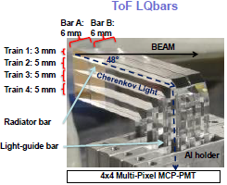
AFP ToF Detector
Detector: (see talk by Libor Nozka at this Workshop)
  Quartz bars (~6×5 mm cross section) at the 48° Cerenkov angle, reflecting into the MCP-PMT (“LQbars”)
  up to 4 bars in series – limits the time resolution requirements per channel …
MCP-PMT:
  10/6µm pore MCP mini-Planacon (4×4 pixels) by PHOTONIS
    Reduced MCP-Anode gap distance for reduced inter-pixel cross talk!
    Atomic Layer Deposition on MCP for long life
      needed for 10x increase in lifetime (and possibly better gain)

Slide 23
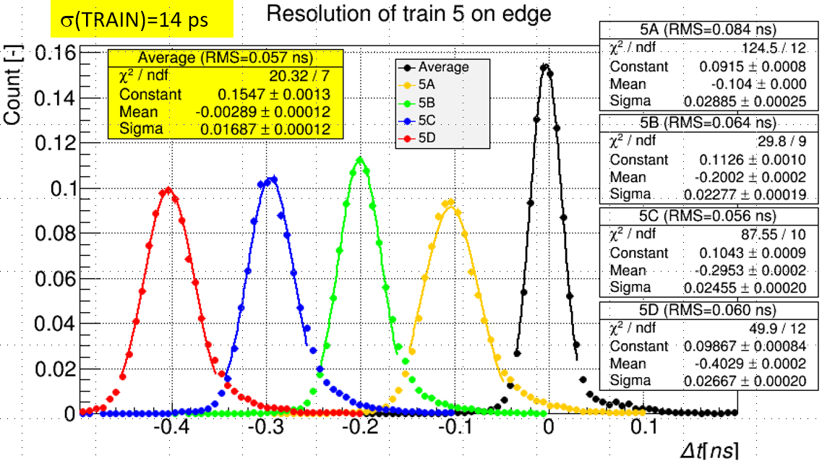
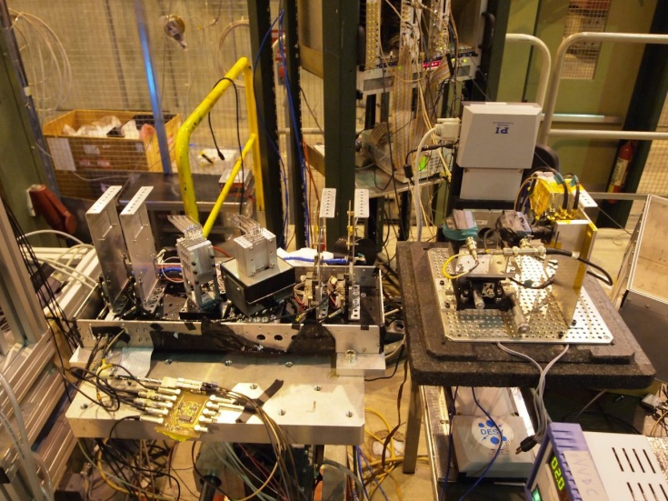
ToF Performance in Beam Test
Test Beam 2014 & 2015: J. Lange et al., submitted to JINST
  Very good tracker performance: σ_{x}(track)≲3 µm
Test Beam in June 2016 (2 weeks):
  Characterization and optimization of the ToF front-end: radiator bars, cross talk, MCP-PMT, CFD delay and threshold …
  Excellent performance of the new 10 µm pore MCP-PMT
  Early results shown in ICHEP Poster
Test Beam Sep’16: optimize ToF back-end electronics (HPTDC, Trigger)
PHOTONIS MCP-MA-PMT with reduced MCP-anode distance to reduce cross talk
Libor Nozka, this Wkshp

Slide 24
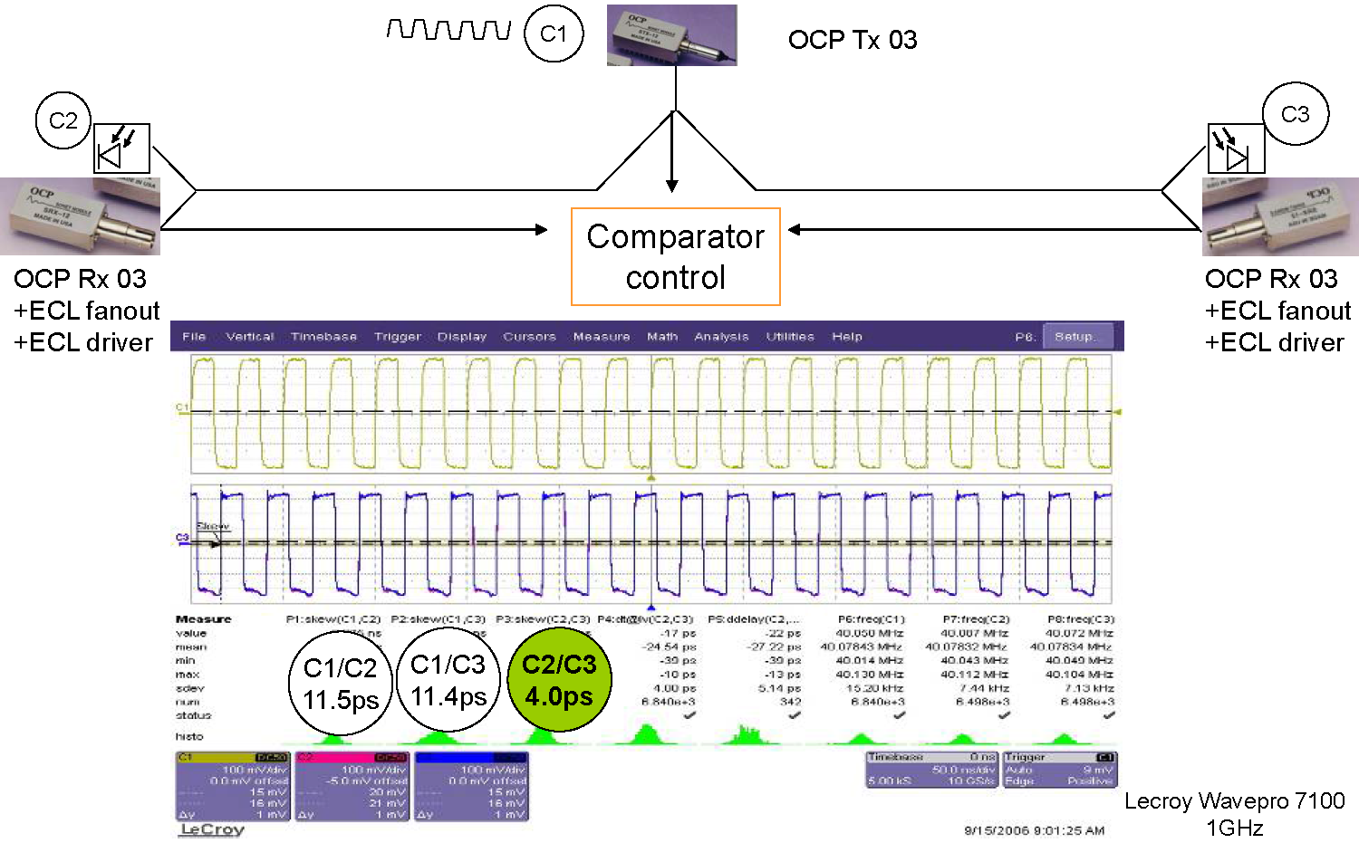
TTC derived Reference Clock
  Use 40.078 MHz BX clock to synchronize the detectors in the two arms
  Tested in SR1 with older receivers last week: 6.5 ps
Sophie Baron, FP420 Collaboration Meeting, 2008

Slide 25
Physics in 2017 and Beyond
In Dec 2016: AFP and Pb+p? Discussions between HI and AFP communities ongoing …
AFP aims to continuously be in the ATLAS standard luminosity running
  provide a double-proton tag with vertex matching to ATLAS
  must resolve problems of cohabitation with ALFA !
Special low-μ (μ~1) runs
  continuation of diffraction program:
Plans to run after LS2
  currently under discussion within AFP
  will depend on AFP physics results before LS2 !
  must be reviewed by ATLAS before going to an TDR and LHCC

Slide 26
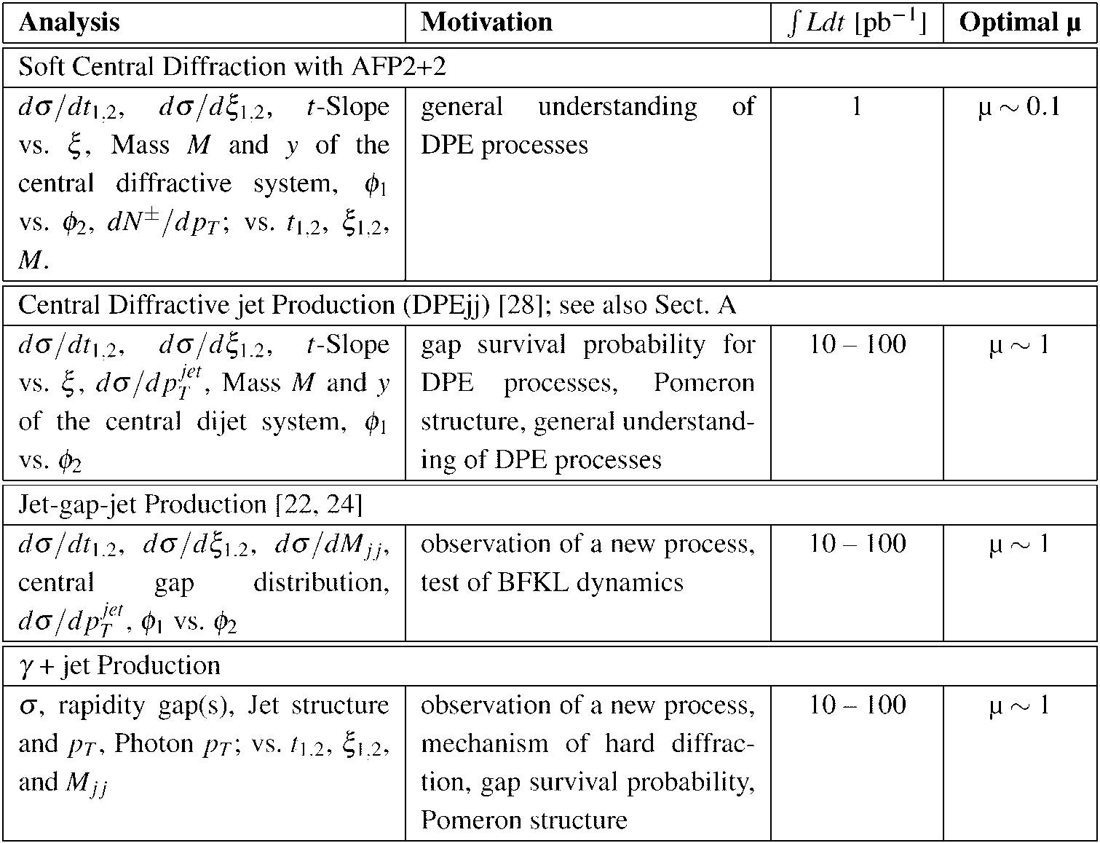
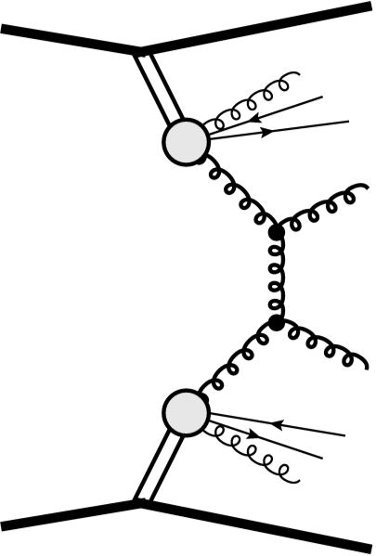
Summary of Double p-Tag Processes
DPE jet-jet
t₁

Slide 27
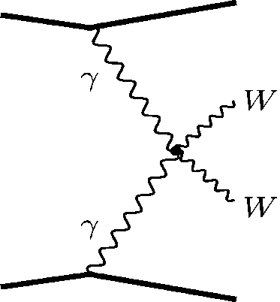
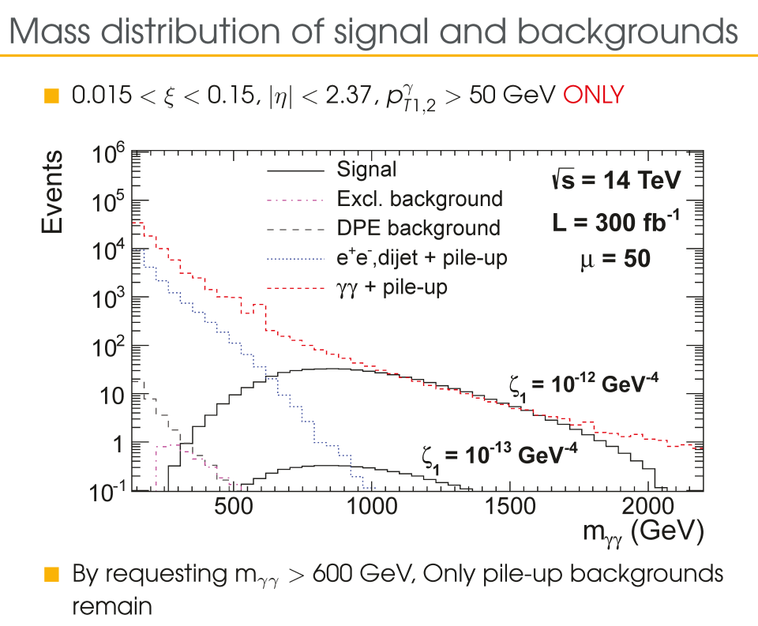
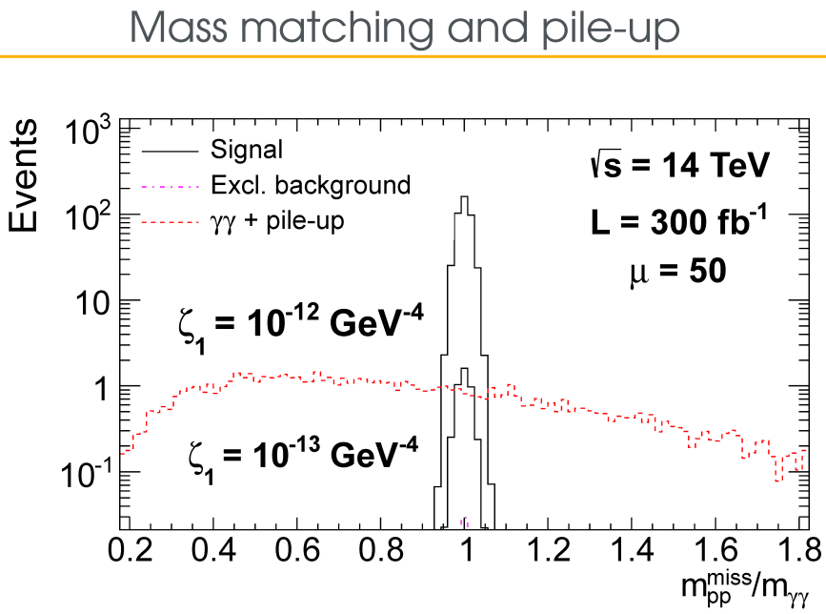
Anomalous Quartic Couplings
p
p
Low Cross sections: ~few fb
  AFP has a Missing-Mass resolution (from the proton measurements) of 2-4 %
Match with invariant central
object mass is efficient: (Z→ee, γγ)
  powerful rejection of
  non-exclusive backgrounds
Much interest in this from theory side
  e.g. LHC Forward Physics WG (C. Royon et al.)
“Probing anomalous quartic gauge couplings using proton tagging at the Large Hadron Collider”, M. Saimpert,
E. Chapon, S. Fichet, G .von Gersdorff, O. Kepka, B. Lenzi, C. Royon;
23/05/2014
W, Z, γ
W, Z, γ
p
p
for γγγγ
γγγγ:

Slide 28
Summary
ATLAS Forward Proton project:
  AFP is installed in one arm and fully operational
  AFP DCS & TDAQ integrated, AFP is within standard ATLAS latency
  data taking at high-pileup (~35) was successful
    intensity qualification up to n_{b}=600 (to limit radiation dose on ALFA) ☹
    background seems low and environment very clean ☺
  Low-μ data taking: 4hrs, and 4hrs more to come …
  Rich physics program of soft and hard diffraction!
Preparation for second AFP arm (6L1) underway
  ECR approved
  Time-of-Flight is the critical item
  2 H6 Beam tests:
    June: 15ps/4 LQbars (w/o HPTDC !) ☺
    September: ongoing; optimize the HPTDC + Trigger
  Production of other critical items is well underway

Slide 29
Backup
Note: older slides with detector details

Slide 30
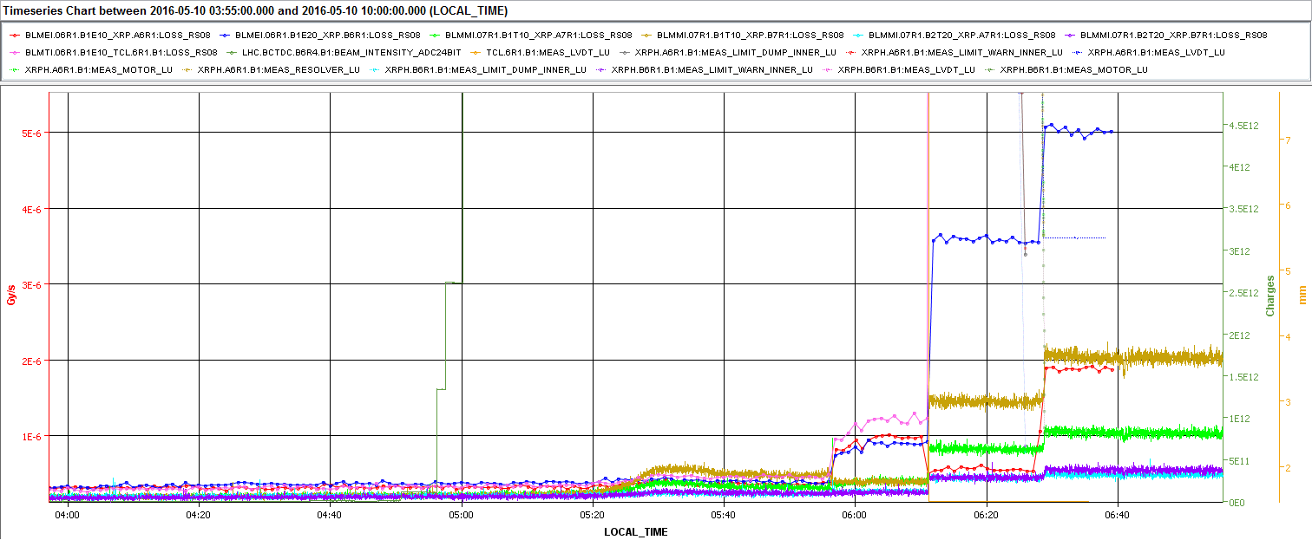
Irradiation of ALFA Electronics
Fill 4906: Radiation pedestal and Nominal level with beam are well measurable:
Gy/s
BLM TCL6
BLM AFP FAR
5E-6
ALFA FAR B1, BLMMIU.07R1.B1T10_XRP.B7R1:LOSS_RS08
ALFA NEAR B1, BLMMIU.07R1.B1T10_XRP.A7R1:LOSS_RS08
ALFA FAR B2, BLMMIU.07R1.B2T20_XRP.B7R1:LOSS_RS08
ALFA NEAR B2, BLMMIU.07R1.B2T20_XRP.A7R1:LOSS_RS08
4E-6
TCL6
RS08: 0.66 s integration time; no difference with integration time RS09 (1.3 s)
3E-6
POTS
2E-6
BLM AFP NEAR
1E-6
Pedestal
Stable Beam
TCL6 In
TCL6 & AFP In

Slide 31
Radiation Dose to ALFA
Worry: Radiation to non-rad hard ALFA electronics
Measure in
Fill 4919, 601 b:
  Stable beam
  12-13 May 2016
  TCL6 & AFP in:
  ~10× increase
  in dose to ALFA
  FAR station …
limit AFP insertion at high-μ to
0.15 fb^{–1} in 2016
n_{b}≲600

Slide 32
Radiation Dose to ALFA
Fill 4906, 313 bunches, Stable Beam @ 10.05.2016 06:02
discussed with ALFA colleagues and ATLAS RC
FILL 4906 |  |  | BLMEI.06R1.B1E10_XRP.A6R1:LOSS_RS09 | BLMEI.06R1.B1E20_XRP.B6R1:LOSS_RS09 | BLMMI.07R1.B1T10_XRP.A7R1:LOSS_RS09 | BLMMI.07R1.B1T10_XRP.B7R1:LOSS_RS09 | BLMMI.07R1.B2T20_XRP.A7R1:LOSS_RS09 | BLMMI.07R1.B2T20_XRP.B7R1:LOSS_RS09 | BLMTI.06R1.B1E10_TCL.6R1.B1:LOSS_RS09
start | end | type | AFP NEAR | AFP FAR | ALF NEAR | ALF FAR | ALF NEAR2 | ALF FAR2 | BLM TCL6
5/10/16 3:57 | 5/10/16 4:35 | Pedestal | 2.87E-07 | 3.08E-07 | 1.72E-07 | 1.71E-07 | 1.71E-07 | 1.60E-07 | 2.69E-07
 | NDF= 38 | rms | 1.26E-08 | 1.69E-08 | 4.42E-09 | 4.37E-09 | 3.37E-09 | 4.03E-09 | 1.56E-08
5/10/16 6:02 | 5/10/16 6:10 | Stable Beam | 9.38E-07 | 8.52E-07 | 3.62E-07 | 3.56E-07 | 2.37E-07 | 2.19E-07 | 1.15E-06
 | NDF= 8 | rms | 1.81E-08 | 3.71E-08 | 3.57E-09 | 5.49E-09 | 2.10E-09 | 3.54E-09 | 3.82E-08
5/10/16 6:12 | 5/10/16 6:25 | TCL6 In | 5.22E-07 | 3.48E-06 | 7.70E-07 | 1.38E-06 | 4.00E-07 | 4.07E-07 | 3.40E-05
 | NDF= 13 | rms | 1.63E-08 | 5.22E-08 | 5.88E-09 | 8.92E-09 | 4.39E-09 | 2.71E-09 | 1.48E-07
5/10/16 6:29 | 5/10/16 6:47 | AFP in | 1.82E-06 | 4.87E-06 | 9.80E-07 | 1.95E-06 | 4.43E-07 | 5.00E-07 | 3.55E-05
 | NDF= 18 | rms | 5.85E-08 | 5.42E-08 | 1.22E-08 | 2.56E-08 | 3.63E-09 | 5.48E-09 | 4.81E-07
Standard dose with 300b |  | SB'=SB - Pedestal | 6.50E-07 | 5.44E-07 | 1.89E-07 | 1.84E-07 | 6.64E-08 | 5.98E-08 | 8.82E-07
Increase with TCL6 |  | (TCL6-SB)/SB' | -6.39E-01 | 4.84E+00 | 2.15E+00 | 5.54E+00 | 2.45E+00 | 3.14E+00 | 3.73E+01
Increase with TCL6 & AFP |  | (TCL6&AFP-SB)/SB' | 1.35E+00 | 7.40E+00 | 3.26E+00 | 8.66E+00 | 3.09E+00 | 4.70E+00 | 3.90E+01
uncertainties ≲3%
Expected 2016 ∫Ldt: 25 fb^{–1}
To limit ALFA Dose Increase to 10%: ➔ AFP insertion limited to 0.29 fb^{–1}
Agreed with ALFA & RC: stop at 0.15 fb^{–1} ➔ AFP stops Intensity Qualification at 600 b
(Note: so far ~0.034 fb^{–1} accumulated with TCL6 & AFP in)

Slide 33
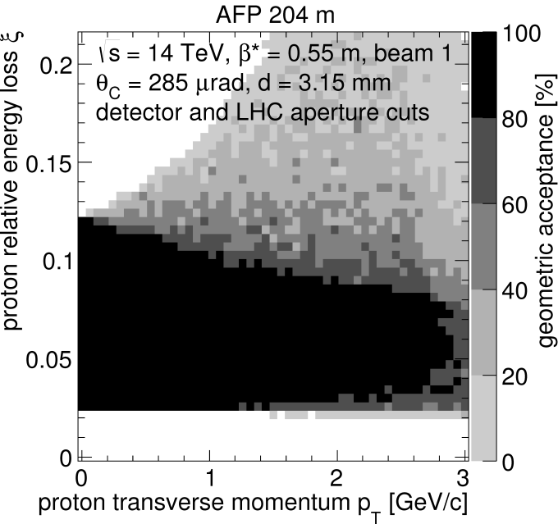
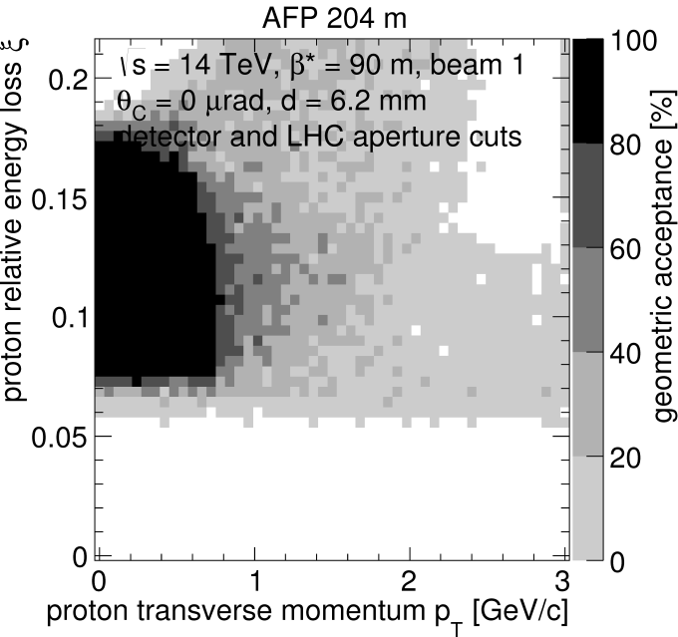
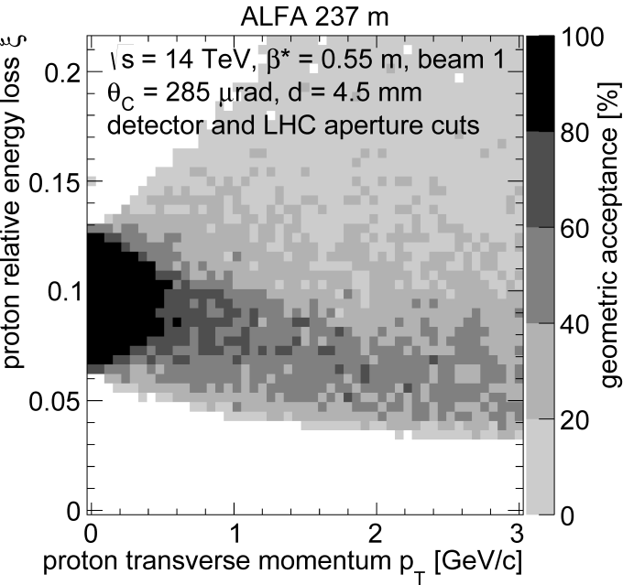
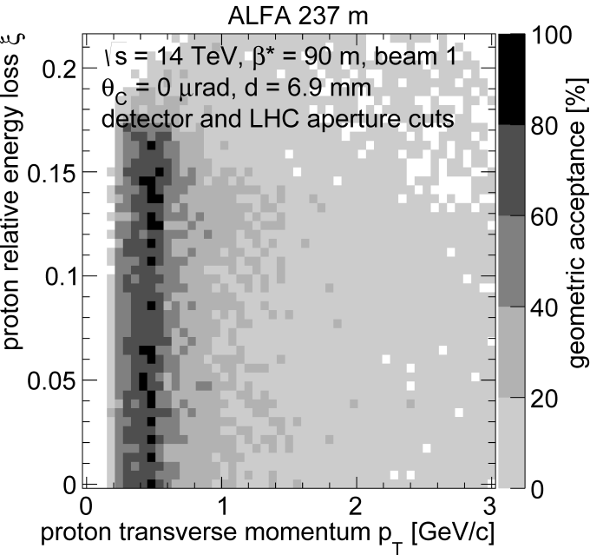
AFP and ALFA: Complementarity
AFP – Horizontal Pots:
large t acceptance
ξ range shifts with optics
high β* and low β*=0.5 m
ALFA – Vertical Pots:
limited t acceptance
ξ =0 acceptance for β*≥90,
elastics
only low-Luminosity,
high β* runs

Slide 34
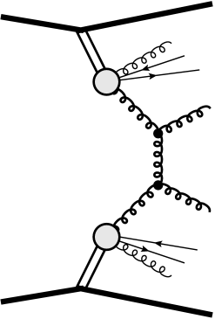



Benchmark: DPEjj Processes
  Fast & Full simulation of AFP + ATLAS, including pile-up
    generator: PYTHIA 8.165 with POMFLUX = 1, 5(MBR)
    100 h (1 wk); 2808 bunches, μ=1
  Event Selections:
    p_{T}(jet)> 20, 50, 100 GeV
    double proton tag in AFP
    matching with AFP vertex
    from timing (σ_{t} = 30 ps)
    single vertex in ATLAS

Slide 35


Anomalous Quartic Couplings WWγγ
Sensitivities predicted at the LHC (P. J. Bell, ArXiV:0907.5299): around a few 10^{–4} GeV^{–2}
Sensitivities predicted with AFP:
improvement by a factor ~100
over non-AFP measurements
30 fb^{–1}
200 fb^{–1}
M. Saimpert, E. Chapon, S. Fichet, G. von Gersdorff, O. Kepka, B. Lenzi, C. Royon, “Probing anomalous quartic gauge couplings using proton tagging at the Large Hadron Collider”, Trento,16 April 2014.
C. Royon, O. Kepka, Phys. Rev. D 78 (2008)
E. Chapon, C. Royon, O. Kepka, Phys. Rev. D 81 (2010)

Slide 36

3-D SiT & ToF Beam Test
Setup in test beam Nov 2014 CERN SPS
Trigger:
  AND of 3 planes (FE-I4 HitOR)
DAQ:
  RCE-based (AdvancedTCA)
  used for IBL stave testing
  worked VERY well in test beam!
Performance:
  Efficiency ≥98%/plane
  98% single track events,
  0.4% empty triggers
  Track CoG resolution:
  σ_{x}=7 μm, σ_{y}=36 μm
Production Status:
  Sensors cut, Under Bump Metallization done
  FE-I4 in house, to be sent for UBM
  Flexes designed, prototype available ⬅ critical path
  Sensor card and holder designed and produced

Slide 37




Beam Test: Time-of-Flight Detector
  Sit-ToF correllation: excellent (but some X-talk) ToF efficiency: >99%
  Resolution: ~30 ps (Oscilloscope)
1A 1B
2A 2B
4A 4B
3A 3B
A B (6 mm)

Slide 38


AFP in 2016 - Detectors
11 Silicon 3D detector assemblies produced at IFAE (more in coming months)
  7 assemblies are operational
  Assemblies precision-mounted on Al-CF carrier cards (Bergen)
  FLEX (Oslo)
  Heat Exchanger holds Tiltbars (Bergen)
  –40 C air from AirCooler (Stony Brook)
Installation: this week
  leak testing Mo-Tu
cooling in/outlets
signal feedthrough
trial assembly with 2 bad assemblies (20.02.2016)
heat exchanger

Slide 39

Maria Manna, Sebastian Grinstein, IFAE

Slide 40
Other Items for the 2nd Arm
Stations:
  stations are in production at Vakuum Praha – expect by mid-June/July
  pedestals & supports all done by ATLAS TC
  small parts (done)
Roman Pots:
  2 production Pots: Alberta – June/July
Detectors:
  Tracker:
    new wafers look very good (next slide)
    Al-CF carrier cards (ordered)
    heat exchanger (in production)
    other holder parts (done by Bergen)
Other Infrastructure:
  LVregs for ToF (Milano)
  Local crates for ToF electronics & trigger (PA-b, Trig, CFD, HPTDC)
  Patch panels & local cables

Slide 41

Backup – ToF MCP-PMT
MCP-PMT Life Time and Rate

Slide 42

Summary of Single p-Tag Processes
t
p
disappears down the beam pipe
β
q
x
W/Z/γ
p
q⁽'⁾

Slide 43


Summary of Double p-Tag Processes
DPE jet-jet
t₁

Slide 44




Backup – Radiation Levels
Radiation levels for 100 fb^{–1}
  inputs: ALFA and TOTEM measurements
  AFP Full simulations in minbias events (below)
  early FLUKA calculations (A Mereghetti, 2009)

Slide 45
Irradiation of AFP Electronics
estimates for 100 fb^{–1} (need update!) | 5 cm from beam @214 m | Tunnel floor @214 m | RR13 @beam level
Electronics exposed: | PA-a | PA-b, Trigger | CFD, HPTDC, Clock
High-Energy hadrons | 5·10¹²/cm² | 10¹⁰/cm² | 5·10⁹–10⁸/cm²
1 MeV-equiv. neutrons | 5·10¹¹/cm² | 5·10¹⁰/cm² | 10⁹/cm²
Integrated dose | 5000 Gy | 50 – 10 Gy | 1 – 0.1 Gy
HiRad protocol:
  Neutrons or HE protons: 10¹² – 10¹³ /cm²; γ: 1 – 10 kGy.
MedRad protocol:
  Neutrons or HE protons: 10¹¹ – 10¹² /cm²; γ: 10 – 1 kGy.
PA-a chips (PSA4-5043+): HiRad
PA-b boards & trigger: MedRad
NINO chips (trigger): MedRad
CFD daughter boards: MedRad
HPTDC chips: MedRad
Cfr. ALFA radiation dose LHC Run1 measured over 2010–2013 (~30 fb^{–1}): ~20-30 Gy in each pot (≥10 cm from beam)
See: K.Hiller, S.Jakobsen, S.Franz, ALFA General Meeting, Cracow, June 5-7, 201.

Slide 46

Irradiation – Sep 2013
Irradiated at LANL Sept 2013; S. Seidel et al. (UNM), K. Gray (UTA):
800 MeV p, ~7 cm from direct beam; passive
  dose: 6.5-8.7×10¹² p/cm², 2.3-3.1 kGy
  for 100 fb^{–1}: ~expected for PA-a; ~50× expected
  for PA-b and CFD
  devices are all operational after irradiation!
Feed
through
AFP2
crate
RR13 ?
crate
USA15
crates
Quartic
Trigger (LMR600)
PA-b
CTF
Trigger
64× Signal
(SMA)
LE
TDC
ToT
PA-a
Att
CFD
ToT
(50 Ω)
Signals
Opto
Board
Data
BOC-ROD
or RCE
LV
+6V 5A
LV
+6V 20A
DCS
DCS
DCS
8× Temp
(uD)
DCS
2× Pressure
DCS
iseg
HV
8× HV
(32 ch REDEL-HV)
214 m
214 m
240 m
0 m

Slide 47

Irradiation @ LANSCE – Jan 2014
LANSCE Beam
PA-a
4×
PA-b
Att
4×
CFD
4 HPTDC
chips
1→4
–6 dB
2 HPTDC chips: 1×10¹² p/cm²
2 HPTDC chips: 1×10¹³ p/cm²
–20
dB
+5V
+5V
+3.3V
+1.3V
–5V
30 m
Data
Pulse
LMR400
Ref CLK
Trigger
CFD
CTP
(NIM)
CFD-LV
(NIM)
HPTDC
(NIM)
Safe Area
PA-b
NIM LV
±6V 3A
Jan 31- Feb 2 irradiation at LANSCE
Protocol:
  Active irradiation
  up to 1.0×10¹³ p/cm², in 10 steps of 1×10¹² p/cm²
  i.e. 10 pulses of 10¹¹ protons per step
PA-a
Beam View

Slide 48
January 31- Feb 2 Irradiation
People: Tim Hoffman (UTA); Sally Seidel, Martin Hoeferkamp (UNM)
Protocol: Active irradiation – keep voltages on!
  up to 1.0×10¹³ p/cm², in 10 ‘steps’ of 1×10¹² p/cm²; verify operation before & after each step.
  i.e. 1 ‘step’ equals ~10 pulses of 10¹¹ protons/pulse, 1 Hz, ~1 cm Ø
Early results:
  HPTDC readout did not work (cable too short) ➔ 2 Channels were monitored on scope; all 4 channels were powered throughout the run.
  Irradiation to 2.2×10¹³ p/cm², 7.8 kGy
  2 monitored channels were still operating at the end of the run
Next:
  Wait for cool-off and return of parts (any time now … )
  Pre-Amps, CFDs: Re-test performance and compare with non-irradiated parts
  HPTDC chips: mount on HPTDC board and check operation

