Slide 1



Slide 2
4th edition TEDxCERN (proposal)
TEDxCERN
Date: Saturday November 5th
Location: CERN main auditorium + viewing parties around the world*
Time:
  First Session - 14:00 -15:45 – 1:45’
  Break - 15:45 -16:30 – 0:45’
  Second Session – 16:30 -18:15/30 – 1:45’ or 2:00’
Language: English with at least one talk in French + other language to be translated???

Slide 3
Pre-event – Debate among few CERN speakers
When: Friday November 4^{th;}
Time: 17:30 to 19:00
Where: Globe of Science and Innovation
Format: 10 minutes seated presentation by four TEDxCERN speakers + 50 minutes panel debate on the ethics behind the topics
Moderator: Olivier Dessibourg, Science journalist - Le Temp
Questions: system: to be defined and managed by Arnaud Massolier
Speakers: Marcus Gary on artificial intelligence, Jun Wang Genetic on sequencing on big scale, Denis Lo on liquid biopsy and Eleonore Pauwels on CRISPR and governance of genomic technologies
Audience: all external guests of TEDxCERN + a link for public + CERN community submission
Language: English with simultaneous translation to French

Slide 4
Schedule Estimate
Jan/Feb/Mar - Phase l Project Planning (scope, requirements, WBS, resources)
  Presentation Internal Sponsors (Management and Section leaders ECO)
  Presentation Supporting Experts
  Presentation Team
  Presentation Speakers Selection Committee – next week
  Presentation ECO group - April 7th
Apr/June - Phase ll Content Development - Research speakers, invite speakers, engage institutes, develop program
July/October - Phase lll Executing – Curate talks, develop AV materials, stage design, production logistics, communication strategy
November/December - Phase lV Closing – Event day, post-production of talks, publicize talks, final report

Slide 5
Stakeholders
Internal Sponsors (Management, ECO, Speaker Committee)
Supporting Experts (procurement, finance, Site Management, It, Health and Safety, HR, etc)
Team (coordination, interns, members of ECO)
Volunteers
Institutes associated to CERN
Suppliers (42 Prod, Lumens8, Novae, Boyle lighting, etc)
Speakers and Coaches
CERN community
Guests
Sponsor (Rolex)

Slide 6
Internal Sponsors
Stakeholder | Contact at CERN
Management | Charlotte Warakaulle
Strategic Planning | Laure Esteveny, James Gillies
ECO | Kate Khale, Rolf Landua, Arnaud Marsolier, Sasch Schmeling, Bernard Pellequer, Paola Catapano and Fabienne Marcastel
Speaker Committee | Charlotte Warakaulle, Claudia Marcelloni, Rolf Landua, Pippa Wells, Michael Doser, Oliver Bruning and Michelangelo Mangano (TBC)

Slide 7
Supporting Experts
Group | Contact at CERN
(IPT) Procurement | Fatima Najeh (Sarah Pamelard, Nordine Azizi, Adam Horridge)
(FAP) Finance | Lorraine Jacksic - Travel et reimbursement Christophe Marme - Account Payable
SMB Site Management and Buildings | Didier Constant (SMB-DI) - Security and External Registration Veronique Sogno (SMB-SIS) – Site Services (Hotel, Cleaning and Transportation) Patrick Muffat and Claudia Bruggman (SMB-SC) - Supply Chain such as external reception and internal distribution of goods Christophe Martel (Air conditioning)
IT CDA - Collaborative Devices and Applications | Thomas Baron and Loic Lavrut - AudioVisual and Collaborative Services
HSE Health,Safety& Environment Protection Unit | Laetitia Michele Wohlgemuth - Event Safety Support Yann Lechevin - Fire Brigade Veronique Fassnacht - Medical Service
HR Talent Acquisition | Sybille Salter and Adriana Weronika Bejaoui‎
Partnership and Fundraising | Matteo Castoldi
Legal | Jonathan Drakeford

Slide 8
Work Packages (WBS)
Project Management – Organize (propose project, plan, develop, implement) & Track of budget and other administrative issues
Volunteer - Recruit, engage, motivate and manage volunteer to tasks
Speakers: Curation (Define content of programme, Invite speakers and define message talks) & Liaison with speakers (travel, accommodations and schedule)
Audience: Invite an audience of CERN’s scientists and professionals from multiple cross-cutting domains as guests
Production: Create stage and lighting set up & Manage video and photo caption & post- production
Viewing parties: Engage institutes and other TEDx to organize a viewing party of TEDxCERN
Logistic Events@CERN: Provide all logistic aspects to welcome guests to event and post event @CERN
Visual Identity: Create an unique visual to 4th edition of TEDxCERN coherent with all platforms
Editorial: Announce Event, Theme, Speakers and satellite events on all online platforms, website and social media included
Media Coverage: Promote the event @CERN and institutes worldwide among members of the media

Slide 9
TEAM TEDxCERN 4th edition
Work Package | Title | Contact
01 - Project Management | Organizer Administrative Officer | Claudia Marcelloni Marika Flygar
02 - Volunteers | Volunteer Coordinators | Nikos Kasioumis and Christos Lazaridis
03 -Speakers | Curator Speaker Liaison Speaker Liaison assitant | Claudia Marcelloni Bettina Hamoudi Przemysław Kwiatkowski
04 -Audience | Guest Liaison | Andrew Tzekas
05 -Production | Production Supervisor Production Assistant Technical Production Assistant Video Capture Coordinator Photographer Stage Manager | Neal Hartman Emma Ward Chris Thomas Jacques Fichet Max Brice Alex Brown
06 – Satellite Events | Satellite Events liaison | Valerie Seguin and Teodora Nikolova
07- Logistics Events at CERN | Logistic Coordinators App Coordinator | Laurianne Trimoulla, Erwin Mosselmans,Francois Briard and Eva Tolosa Harris Tzovanakis
08- Visual Identity | Graphic Designers | Fabienne Marcastel, Cinzia de Melis
09 -Editorial | Editors Social Media Coordinator Webmasters | Sarah-Charley and Kathryn Porteous Clara Nellist Maria-Athanasia Pachou, Nikolaos Papoutsis and Nefeli Kousi
10 -Media Coverage | Media Liaison | Joanna Iwanska

Slide 10
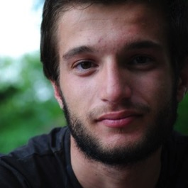
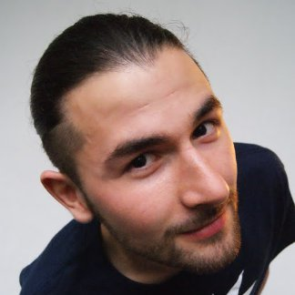
Project Management
Introducing…
Andrew Tzekas
TEDxUniversityofMacedonia Speakers Liason
TEDxCERN Guest Liaison
Przemysław Kwiatkowski
(Tshemek)
TEDxCERN Guest liaison team 2015
TEDxCERN speaker liaison team 2016

Slide 11
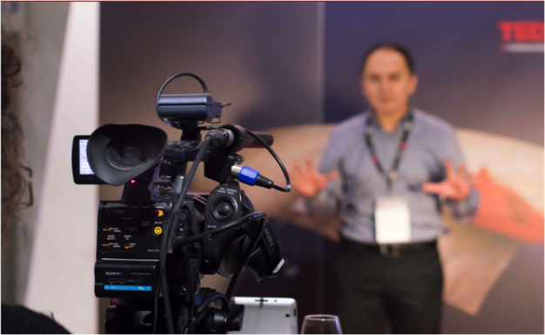
Sponsorship
Rolex is confirmed participation
Mazda is interested in sponsoring the event based on interactive experience. However no car will be allowed in their stand

Slide 12
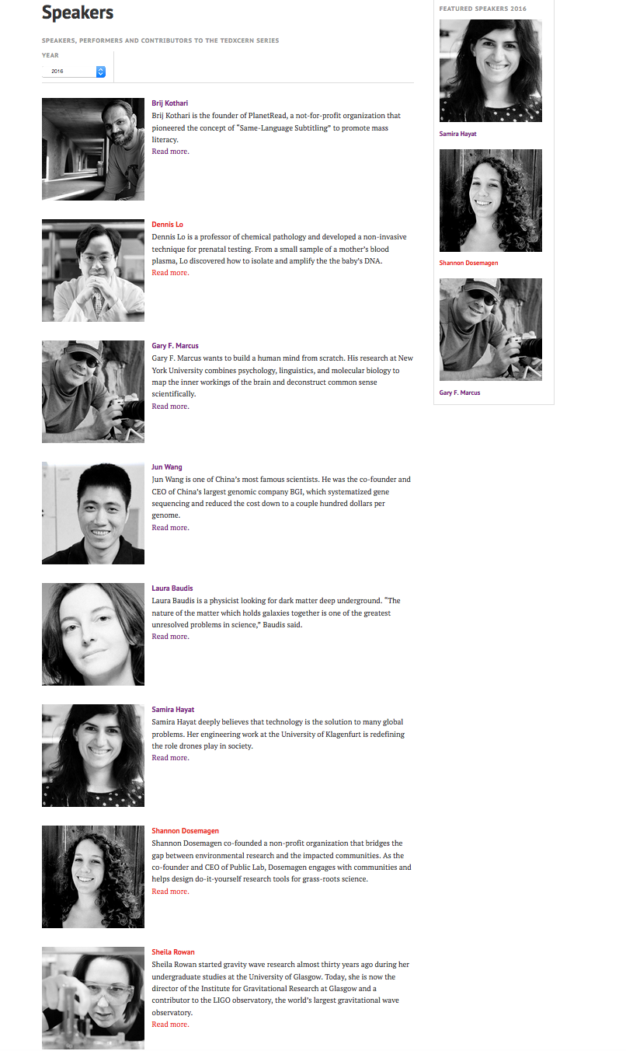
Speakers
8 on TEDxCERN
2 new confirmed
3 pending
First coaching session done with all the 8 confirmed and few more booked in the next couple of weeks
NEXT
Finalized the line-up
Transportation and accomodations
Give a description of the design requirements

Slide 13
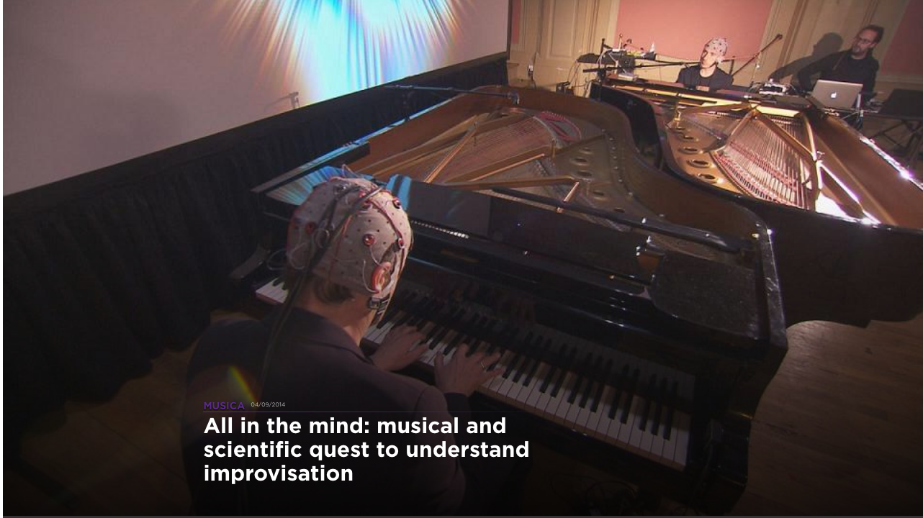
Agalma – Music and Mind (Neuroscientists Nathan and Musicians Richard and Orazzio)

Slide 14
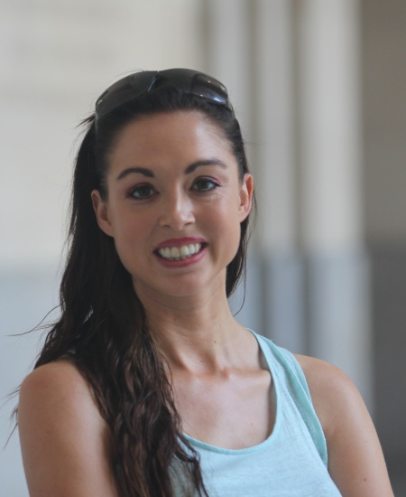
Eleonore Pauwels
Eleonore Pauwels is a Senior Program Associate and Scholar with the Science and Technology Innovation Program at the Woodrow Wilson International Center for Scholars. Her primary focus is a comparative and critical analysis of the EU and US approaches towards the societal governance of genomic technologies. She is also examining the challenges that new forms of biotechnology pose for political and public policy organizations, and the regulatory innovations that emerge alongside developments in cutting edge technologies.

Slide 15
TED-Ed animation
12 easy steps to discover a new particle
Do you want to find a new particle, like the Higgs boson? Get the Nobel prize? This lesson shows how to make a discovery by following 12 steps from the idea for a new collider experiment to the conclusive findings - and what keeps 3000 scientists busy for more than 20 years.
What can you do with a whole lot of nothing?
To the ancient Greeks, the concept of a vacuum – or empty space – seemed unnatural. Since then, scientists have gone a long way to understanding particles invisible to the human eye, and ways to pump them out to create vacuums similar to what exists in intergalactic space. Understanding vacuums can teach us a lot about physics: from thermodynamics, particle physics and quantum mechanics to the invisible dark energy that might dominate our Universe. Making vacuums doesn’t come easy either. Scientists created incredible new technology to generate ultra-high vacuums. This has opened a whole new door for accelerator physics, cryogenics, solar panels and thermal insulation. Turns out you can do quite a lot with a whole lot of nothing.
Two proposals made so far, waiting for feed-back from TED-Ed to see if possible to produce at least one before event
Not sure if any will be made available by TED before the event!

Slide 16
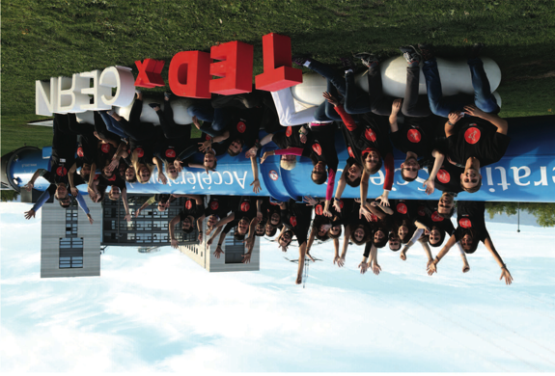
Volunteers
* 46 registered volunteers
* 4 backup volunteers
* Optional IdeaSquare recruiting event
* Task planning sheets for coordinators

Slide 17
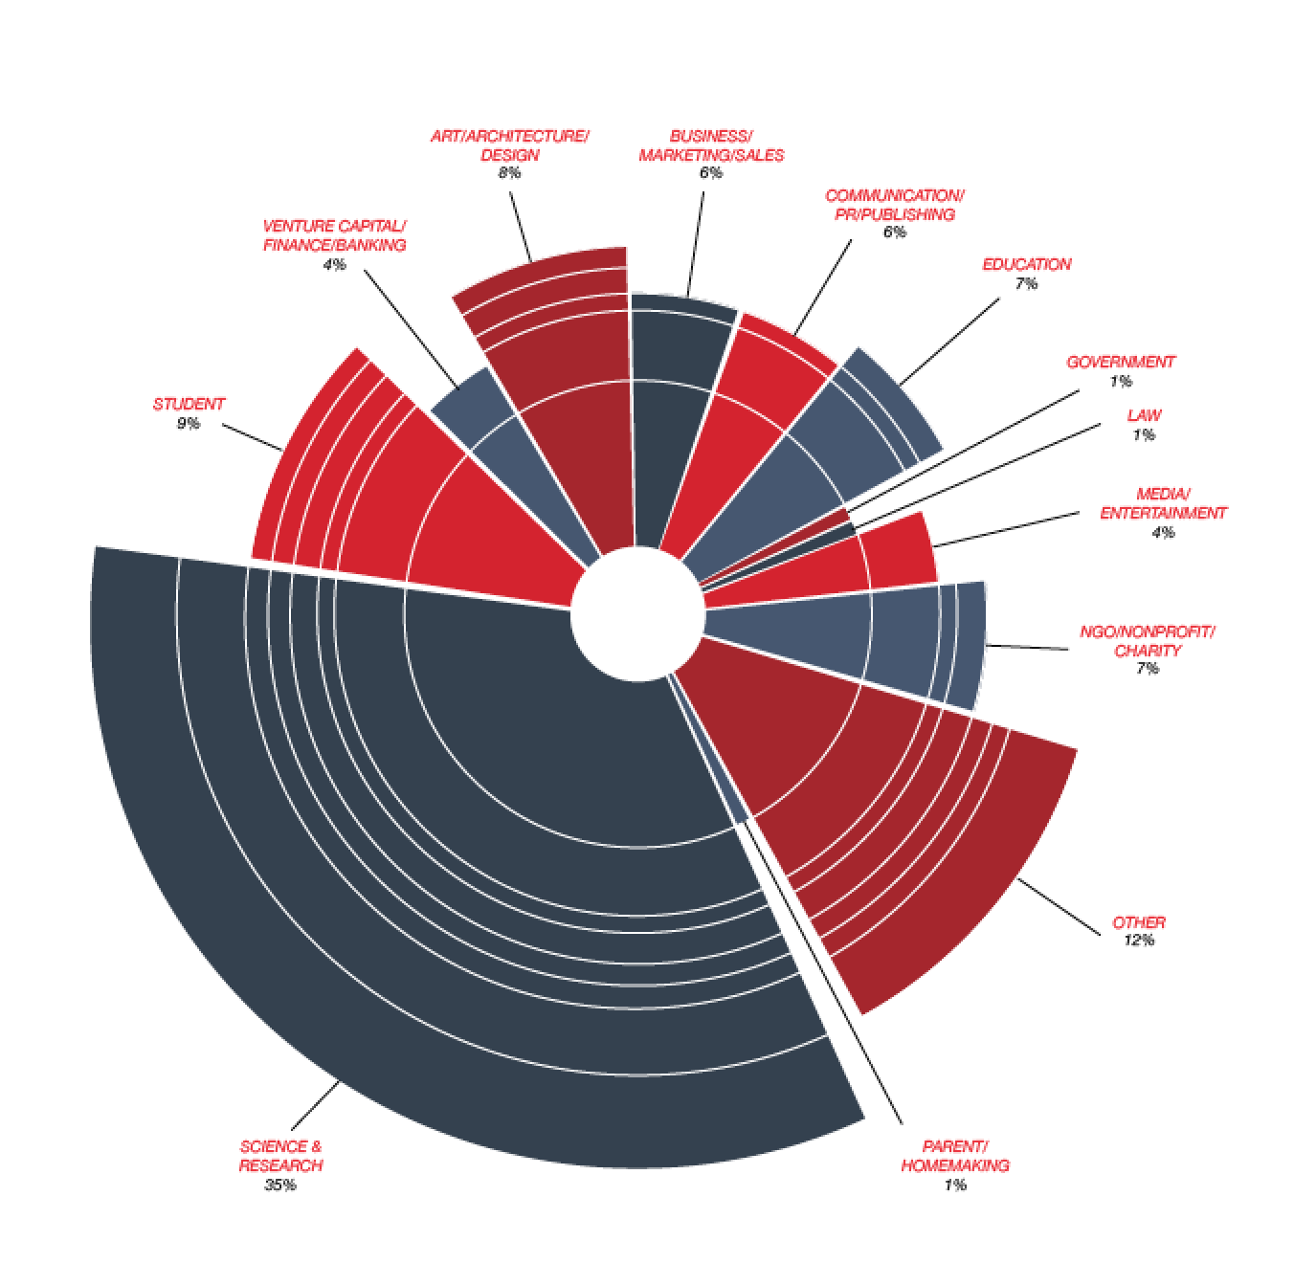
Audience
380 seats + 20% Overbooking + (Volunteers /2)
50 – 50 Policy
  Self Submitted CERN & Public – Random Selection Algorithm
  Tickets distributed by CERN – Directors, Heads of Dep. & Heads of ECO
Team & Volunteers no extra Invitations… sorry!

Slide 18
Audience cont.
Ticketing
Platform: Eventora (iOS & Android for Mobile)
Invitations and Applications start tomorrow (hopefully)
Friday’s Panel – 2nd round of Selection (200 seats)

Slide 19
Production
There will be only 380 seats!
Speakers Interviews
  We need to organize interviews with speakers during the break and cocktail for both social media and webcast content.
  Where will it take place?
  The background has to have the Rolex LOGO on it!
Can we have a makeof video from previous events?
Intro for the talks/videos

Slide 20
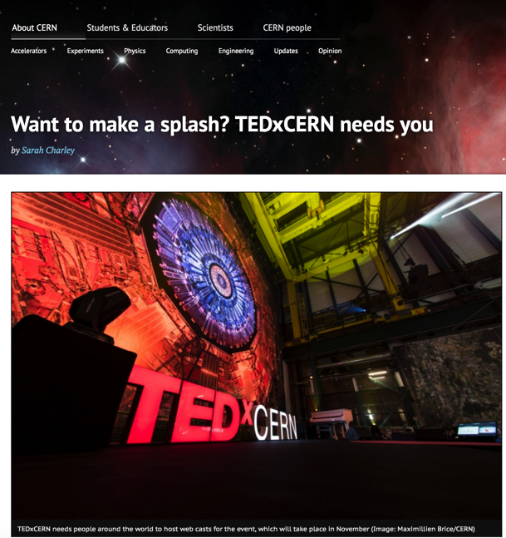
Webcast Partners
Great feed back from the article on the CERN homage with 30 interested directly
We have contacted groups such as:
LOG, IPPOG, EXCITE, LIBRARIES, IMPACT HUBS AND TECH PARKS
Confirmed: University of Geneva, Ars Electronica, etc.

Slide 21
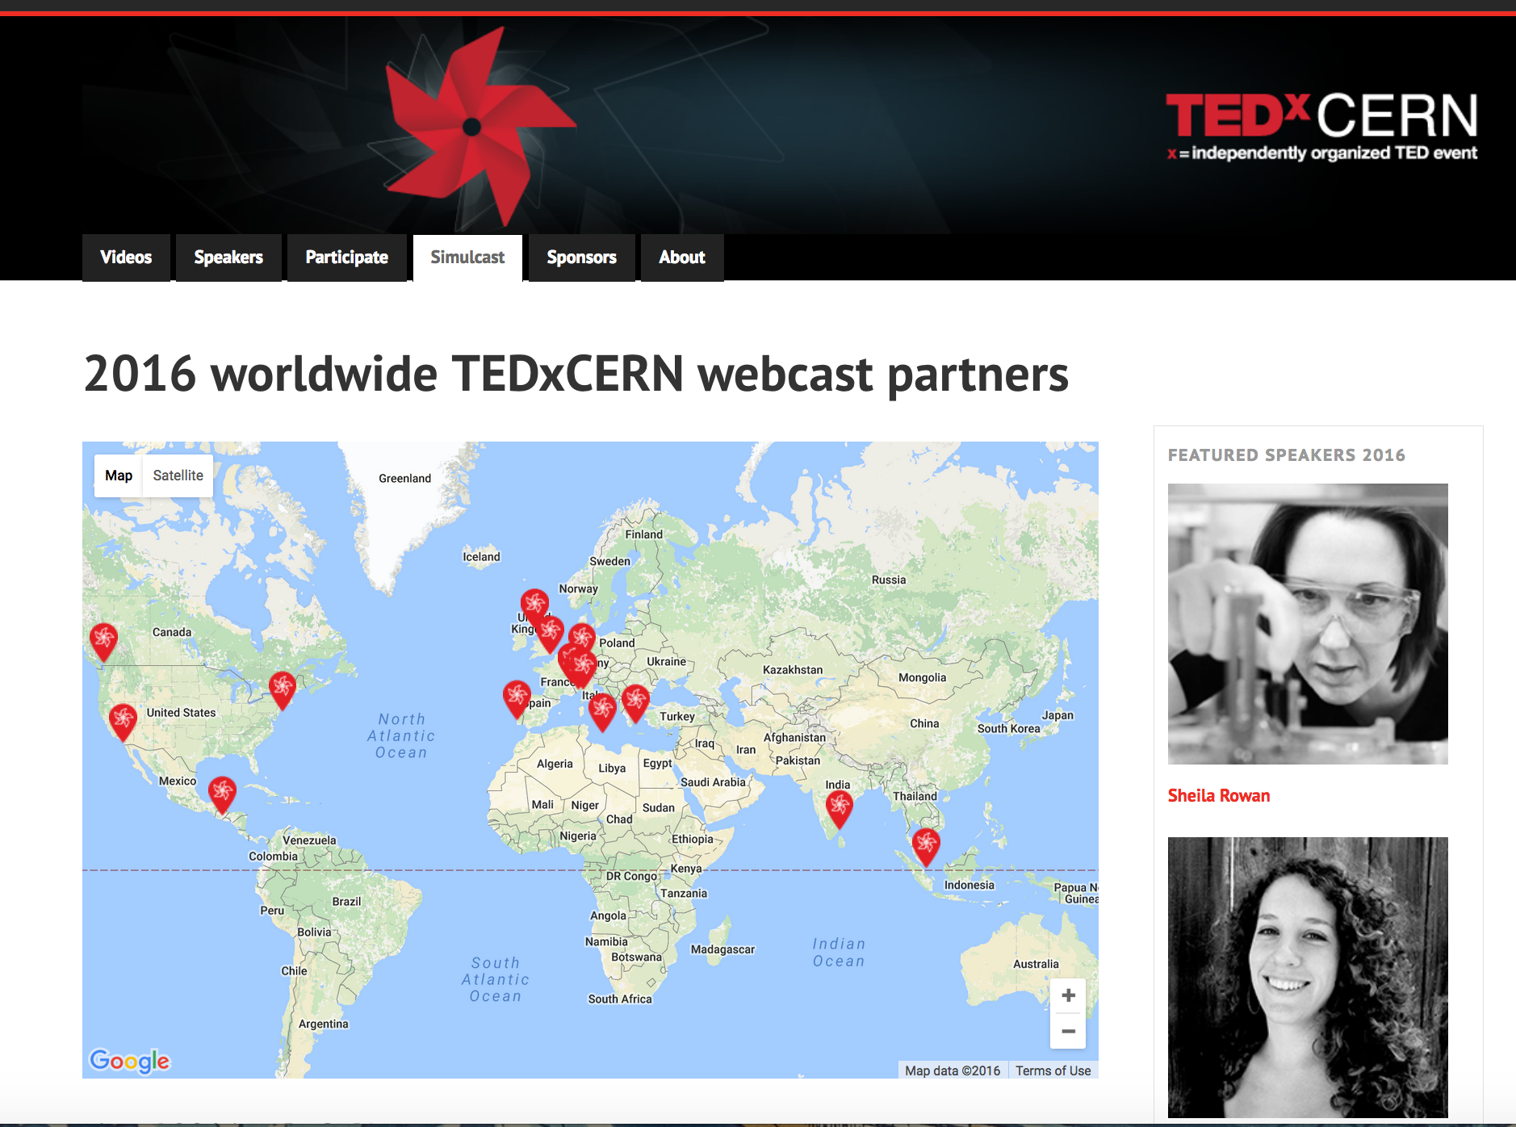

Slide 22
Logistics
See Lauriane’s slides
APP demonstration
Activities:
  Bookstore
  PhotoBooth
  Be a TEDxCERN speaker for 1’
  Show and Tell: prototype, DYI kit and Drones

Slide 23
Visual Identity

Slide 24
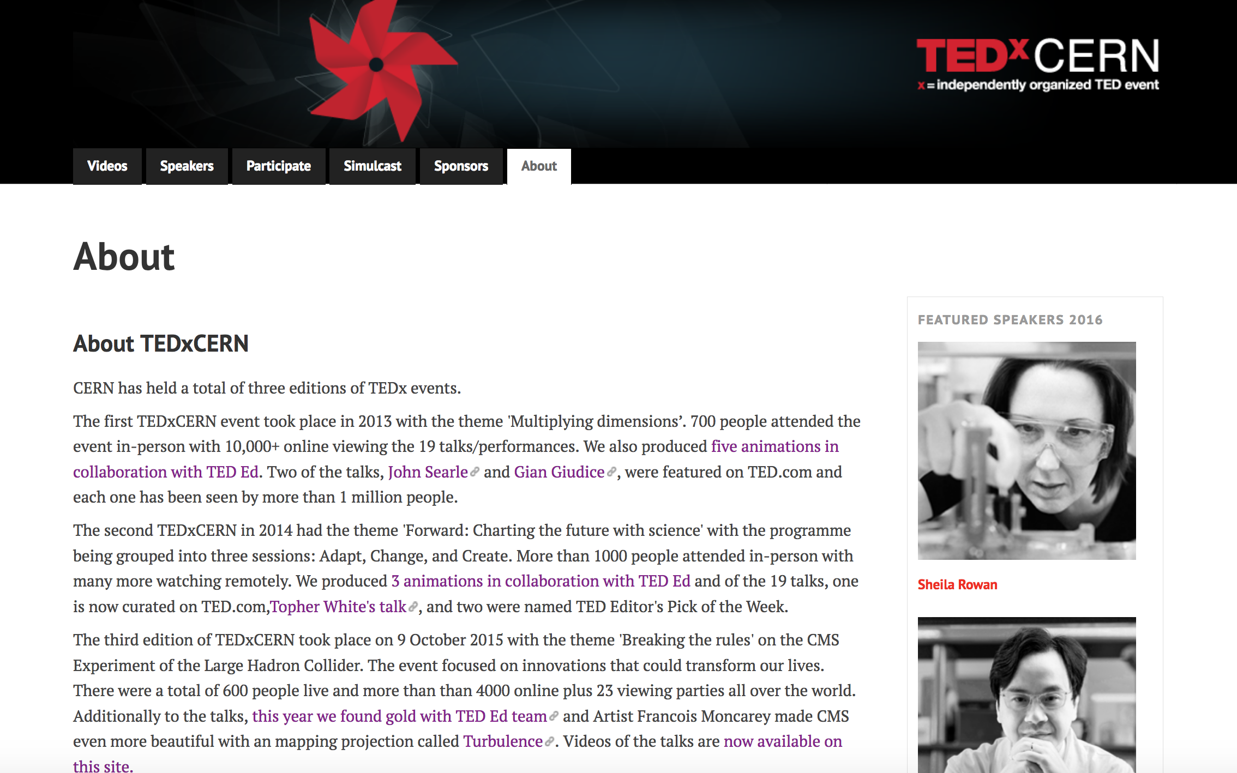
Website

Slide 25
Social Media
Promote speakers now
The speaker participation
Quotes of speakers from Sarah
Updates on what they are up to
FORMAT:
Reddit to promote the content of the webcast
Stream from Facebook and Twitter?
How can we tap on Webcast
CONTENT:
Behind the scenes the day before
Coverage of event on the 4th
Interviews with speakers during break and cocktails
WHO CAN HELP OUT?

Slide 26
Stakeholder | Communication
Management | Monthly report
ECO | Feb - presentation for section leaders followed by monthly updates April - presentation to ECO
Speaker Committee | March - One day Brainstorm wish list of big names April - Weekly meeting main batch of names May on – Followed by weekly updates in person/email
Team (coordination, interns, members of ECO) Everyone Welcome! | March – Overview Presentation March until August – monthly meeting September/October – weekly meeting
Volunteers | June – Gathering of first batch of volunteers September on biweekly gathering for team building
Supporting Experts (procurement, finance, HR, It, safety, security, GS) | March – Overview presentation June and September – Update overview email followed by meetings as required
Institutes associated to CERN | May/June and Sep/Oct - Skype calls with curator on project presentation and curation strategy
Suppliers (42 Prod, Lumens8, Novae, Boyle lighting) | As requested
Sponsor (Rolex) | March – Overview presentation June and September – Update overview email followed by meetings as required
Speakers and Coaches | April/May – invitation June/July/August- message and draft of idea September – final draft October – presentation rehearsals
CERN community | Feb - Update on CERN homepage April - asking input on speakers and participation as volunteer September – Make link to apply for a ticket public
Guests | September - Send first batch of invitations October – Second batch of invitations

Slide 27
Next
When: Every other Thursday at 16:00
September 01, 15, 29 – October 13, 27 and 31 at 17:00 for Photo, Tetras, etc Whole team!
Where: TBD (help)
What: Update on your WBS updated including estimate of time schedule
How: 30 minutes update, 30 minutes breakdown into groups
… followed by a cake! Volunteer bakers?

Slide 28


