Slide 2
Logistics update
01 September 2016

Slide 3
0702 Speakers Visits
On schedule
2 guided visits booked on 4 November for 12 people each
One group at 10:00-11:30, the other one at 15:00-16:30
The visit itinerary will be : SC + CCC

Slide 4
0703+0705 Pre-event activities
Conference with 3 TEDxCERN speakers on hot topic questions
Moderator: Olivier Dessibourg (Le Temps)
Opened to the public, registration mandatory
Speakers:
  Marcus Gary: Artifical Intelligence
  Jun Wang: Genetic Sequencing
  Denis Lo: Liquid Biopsy
  Eleonore Pauwels: Genomic Technologies
Format:
  17:30 short talk by speakers (4 x 10’)
  18:10 panel debate + Q&A (50’)

Slide 5
0704 Event Activities (Eva + Maria)
On schedule
Potentially 4 speakers confirmed:
  Laura Baudis: prototype of her detector
  Samira Hayat: drone (location tbc)
  Michael Grätzel : solar cells tbc
  Shanon Dosemagen: activity tbc
SA exhibition space has been booked
Photo booth combined with a "Share your idea" panel tbc
“Be a TEDx speaker for 1 min” being discussed, need follow-up
Table decoration: in progress with Cinzia and Daniel
Activities requirements to be provided on 1 October
Book store: upstairs

Slide 6
0706 Catering
On schedule
Call for tender sent, 3 short-listed within budget
Tasting done this week with Novae, Ô en Bouche, Mets Plaisir
Possibility to split between multiple caterers
Budget: ca CHF 20k incl. Volunteers party, excl. some speakers lunches
Deadline: caterer(s) picked 5 September

Slide 7
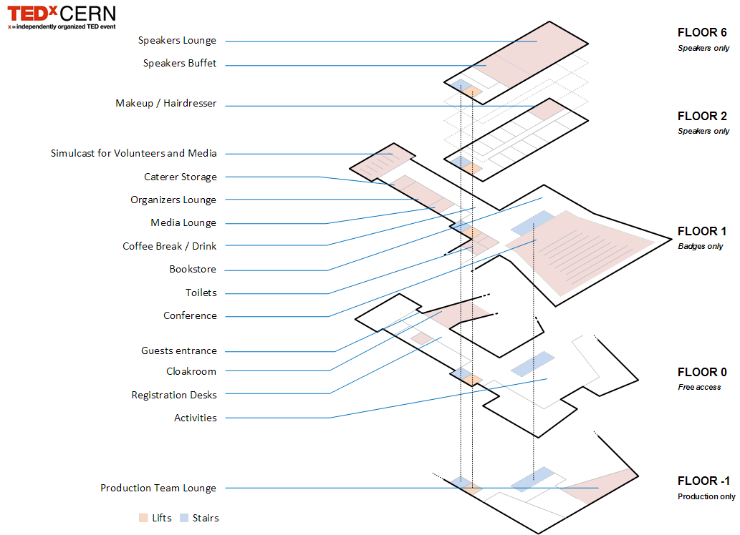
0707 Spaces
On schedule
All spaces blocked
Room D for storage
2>4+6>7 Novemberc

Slide 8
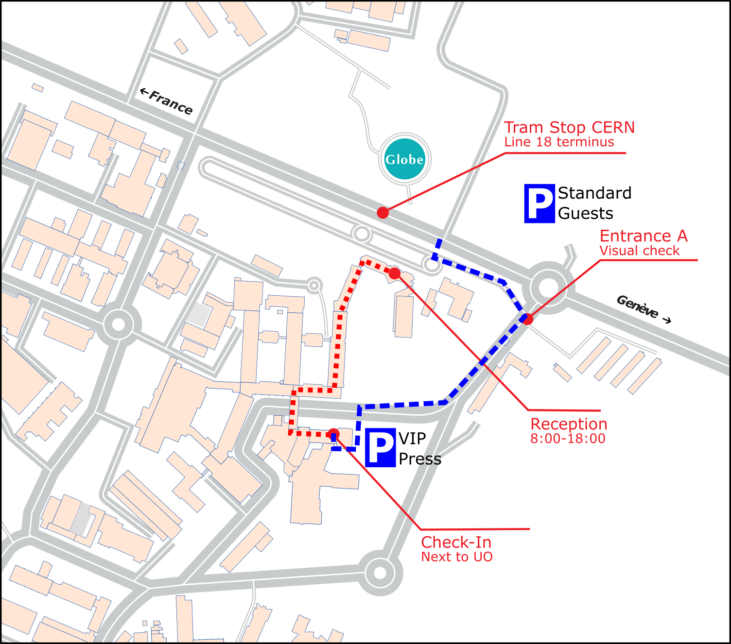
0708 Access (Erwin)
On schedule
Meeting was organised on
23 June with Didier Constant
to finalise paths and blocked
areas
Plan is:
  Favourable weather: guests
  enter and exit via Gate A,
  cars parked at Globe
  Unfavourable weather: VIP &
  media enter and exit via Gate A;
  standard guests via Reception
  Final decision taken on Wed. 2 November

Slide 9
0709 Signage, maps, info screens
On schedule
Info screens booked (3 guaranteed, asking for 5)
IdeaSquare container inventory next week
Graphic Design wants all requirements by 17 October

Slide 10
0710 Check-in
On schedule
Eventora confirmed for ticketing system
Check-in with 15 smartphones
More flexible solution in case check-in is at Reception
Looking for smartphone providers (Swisscom or CERN)

Slide 11
0711 Safety / Emergency
On schedule
Production held a meeting with HSE early July.
Document shared with Neal 22 July
HSE asked for update

Slide 12
0712 Transports
On schedule
2 vans rented for speakers with Sixt through CERN Mobility
Drivers must have V access authorization
Nikos and Christos?

Slide 13
0713 External Contractors
On schedule
DAI requested to Marika for Cloakroom
Who takes care of hairdresser and makeup ?

Slide 14
0714 Cleaning
On schedule
Ticket opened with SMB
Awaiting feedback
Extra rubbish bins ordered

Slide 15
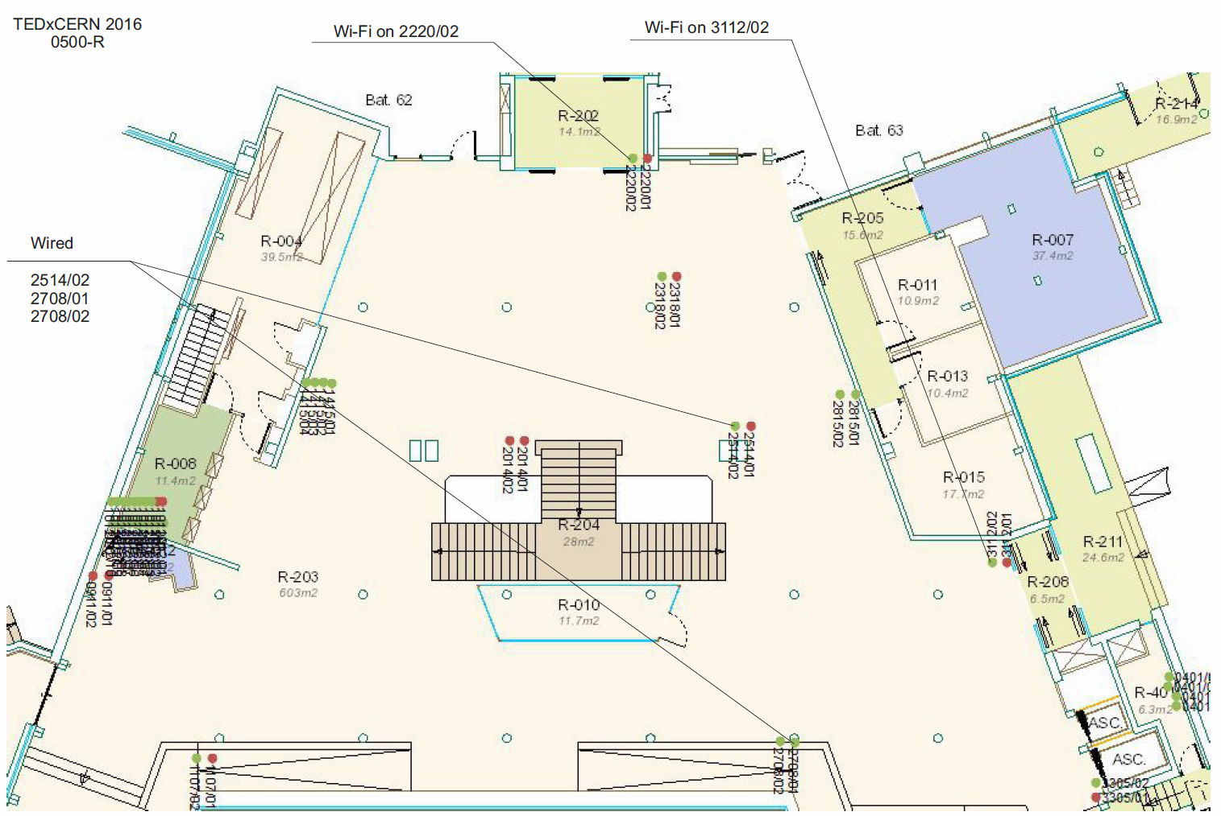
0715 Communications
On schedule
Wi-Fi: requested extra coverage
12 August (5 points for CHF 1000)
Cable (50 CHF / point): TBD
Reserved 10 TETRAs

Slide 16
0716 Technical support during the event
On schedule
Need to contact CERN service to check need / conditions
  Cooling and ventilation
  Lifts
Cleaning team ordered

