Slide 1
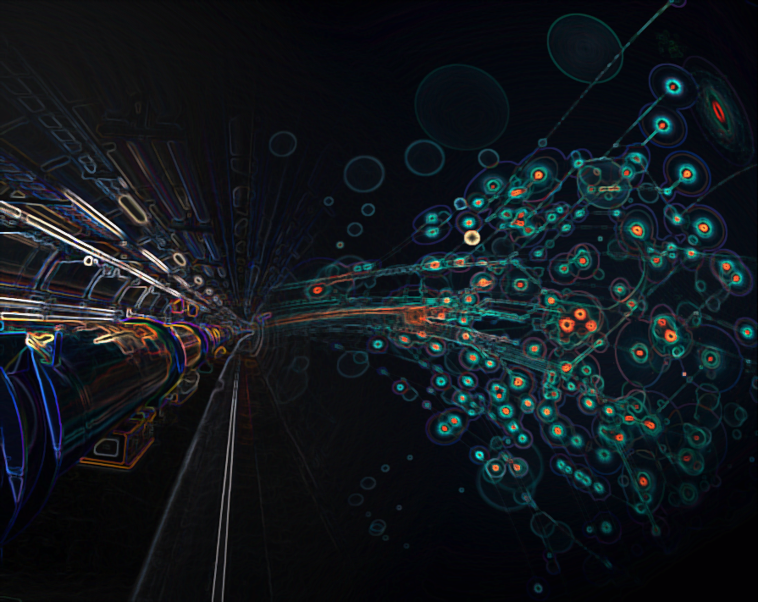

FCC-Saclay Meeting
R. Aleksan
Saclay
September 08, 2016
General News

Slide 2
Informations générales
Réunion Générale FCC 2016 à Rome
11-15 avril
> 450 personnes (des demandes d’inscription ont dû être refusées)
Collaboration FCC inclue 74 labos (ayant signé un MoU)
Les études avancent vraiment bien
  Voir l’agenda et les présentations
  https://indico.cern.ch/event/438866/overview
  Ceci est particulièrement vrai pour les machines FCC-hh et ee où on rentre dans certains détails techniques
Prochaine Réunion Générale FCC à Berlin
29 mai - 2 juin 2017

Slide 3
Informations générales
EuroCirCol 1st « official » Period Review (EC deliverable)
7-10 November 2016 in ALBA (Barcelona)
Preliminary Baseline Design (Machine Parameters, Arcs, IR…) defined
FCC-ee Detector design and phenomenology workshop
23-25 November 2106 @ CERN
FCC Physics week
16-20 January 2017 @ CERN

Slide 4
Informations générales
Stage Marina Beguin se termine ( see talk)
Nouveau Stagiaire Aimane Aid-Ahmed a démarré début Aout 2016
Etude H->μμ @FCCee et impact sur le système de Tracking (see talk)

Slide 5
Informations générales (sans connexion directe avec FCC)
Lancement par le CERN d’une réflexion sur « Physics Beyond Colliders »
1er Workshop a eu lieu du 6-7 septembre 2016 au CERN
https://indico.cern.ch/event/523655/timetable/#all.detailed
Objectif rapport en 2018 pour la mise à jour de la stratégie Européenne

Slide 6
Additional slides

Slide 7

hadron collider parameters
parameter | FCC-hh |  | SPPC | HE-LHC* | (HL) LHC
collision energy cms [TeV] | 100 |  | 71.2 | >25 | 14
dipole field [T] | 16 |  | 20 | 16 | 8.3
circumference [km] | 100 |  | 54 | 27 | 27
# IP | 2 main & 2 |  | 2 | 2 & 2 | 2 & 2
beam current [A] | 0.5 |  | 1.0 | 1.12 | (1.12) 0.58
bunch intensity [10¹¹] | 1 | 1 (0.2) | 2 | 2.2 | (2.2) 1.15
bunch spacing [ns] | 25 | 25 (5) | 25 | 25 | 25
beta* [m] | 1.1 | 0.3 | 0.75 | 0.25 | (0.15) 0.55
luminosity/IP [10³⁴ cm⁻²s⁻¹] | 5 | 20 - 30 | 12 | >25 | (5) 1
events/bunch crossing | 170 | <1020 (204) | 400 | 850 | (135) 27
stored energy/beam [GJ] | 8.4 |  | 6.6 | 1.2 | (0.7) 0.36
synchrotr. rad. [W/m/beam] | 30 |  | 58 | 3.6 | (0.35) 0.18
*tentative

Slide 8
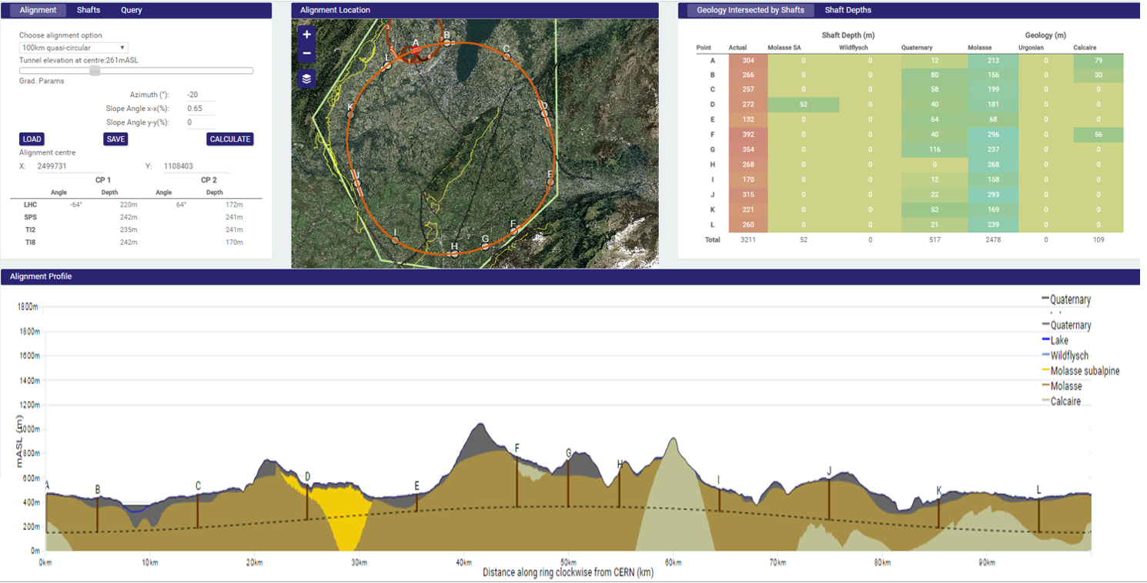
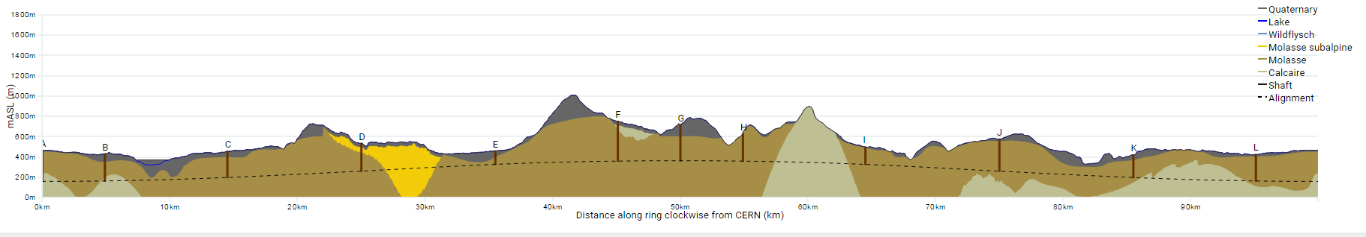
Progress on site investigations
90 – 100 km fits geological situation well
Review confirmed focus on 100 km, planar version
LHC suitable as potential injector
The 100 km version, intersecting LHC, is being studied now in more detail
Notes:
Use the latest slides from John/Charlie.
100 km machines, possibly with both versions intersecting and non-intersecting?

Slide 9
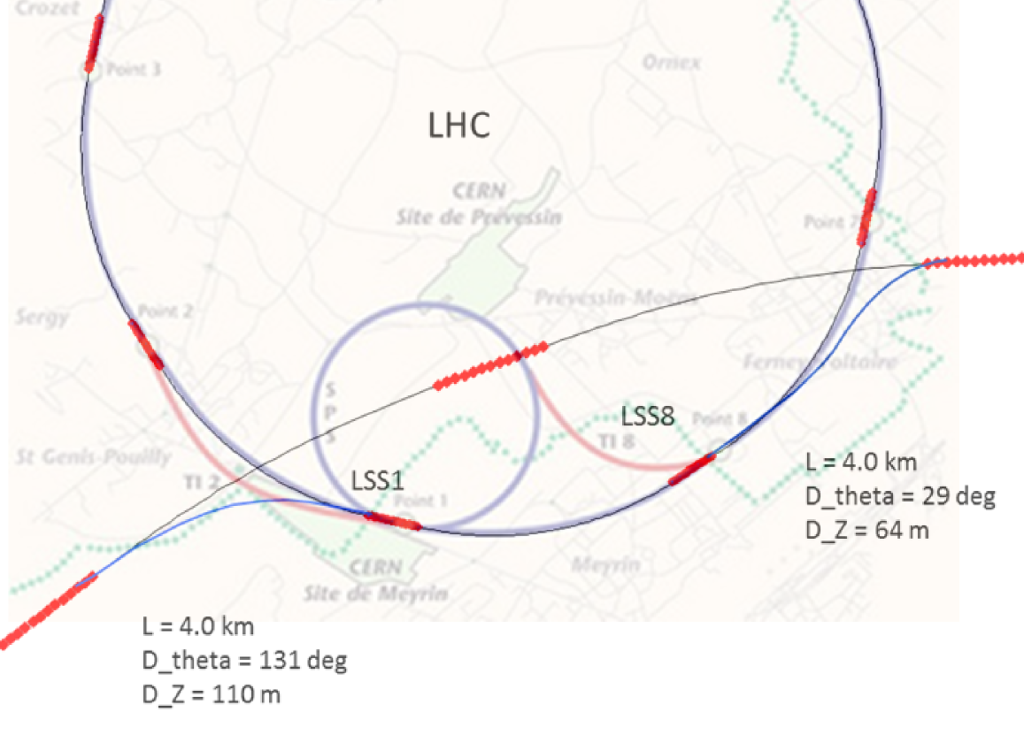
FCC-hh injector studies
Injector options:
SPS → LHC → FCC
SPS/SPS_{upgrade} → FCC
SPS -> FCC booster → FCC
100 km intersecting version
Current baseline:
injection energy 3.3 TeV LHC
confirmed by review
Alternative options:
Injection around 1.5 TeV
compatible with: SPS_{upgrade}, LHC, FCC booster
Notes:
See talk of Oliver on injection energy
Several options, present baseline is 3.3 GeV
Ínjection at 1.5 TeV studied as alternative, potentially compatible with SPS upgrade

Slide 10
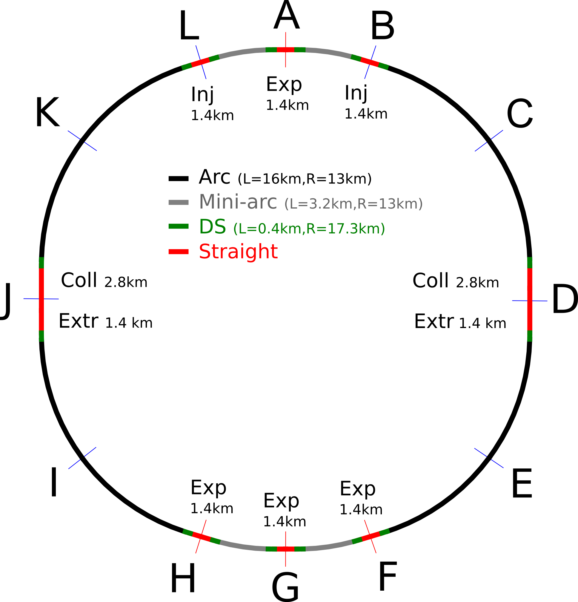
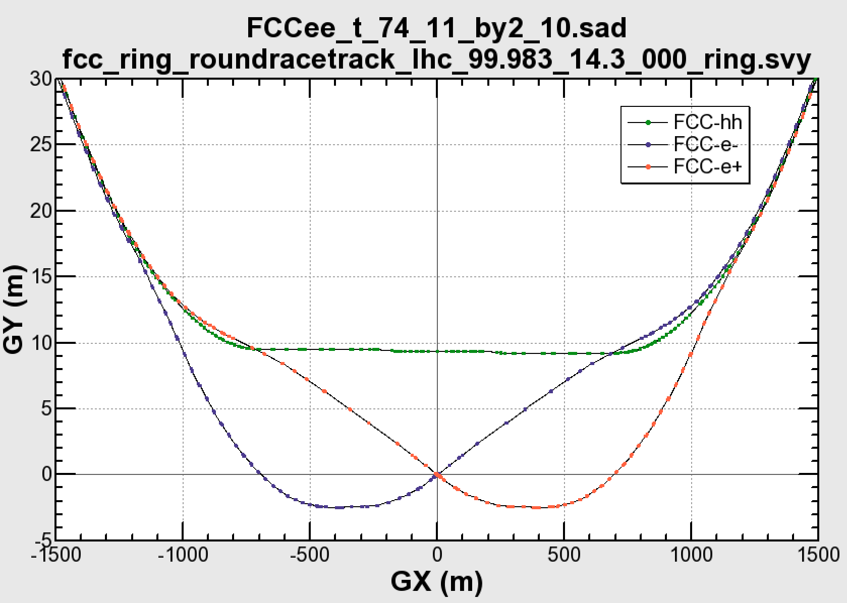

Common layouts for hh & ee
FCC-ee 1, FCC-ee 2,
FCC-ee booster (FCC-hh footprint)
11.9 m
IP
30 mrad
FCC-hh/
ee Booster
9.4 m
0.6 m
Lepton beams must cross over through the common RF to enter the IP from inside.
Only a half of each ring is filled with bunches.
FCC-hh
layout
Common
RF (tt)
Common
RF (tt)
Max. separation of 3(4) rings is about 12 m:
wider tunnel or two tunnels are necessary around the IPs, for ±1.2 km.
2 main IPs in A, G for both machines
asymmetric IR optic/geometry for ee to limit synchrotron radiation to detector
IP
Notes:
Check with Katsunobu to have latest layout.
Check with detector people if 9 m offset is acceptable for ee detector

Slide 11
lepton collider parameters
parameter | FCC-ee (400 MHz) |  |  |  |  | CEPC | LEP2
Physics working point | Z |  | WW | ZH | tt_{bar} | H
energy/beam [GeV] | 45.6 |  | 80 | 120 | 175 | 120 | 105
bunches/beam | 30180 | 91500 | 5260 | 780 | 81 | 50 | 4
bunch spacing [ns] | 7.5 | 2.5 | 50 | 400 | 4000 | 3600 | 22000
bunch population [10¹¹] | 1.0 | 0.33 | 0.6 | 0.8 | 1.7 | 3.8 | 4.2
beam current [mA] | 1450 | 1450 | 152 | 30 | 6.6 | 16.6 | 3
luminosity/IP x 10³⁴cm⁻²s⁻¹ | 210 | 90 | 19 | 5.1 | 1.3 | 2.0 | 0.0012
energy loss/turn [GeV] | 0.03 | 0.03 | 0.33 | 1.67 | 7.55 | 3.1 | 3.34
synchrotron power [MW] | 100 |  |  |  |  | 103 | 22
RF voltage [GV] | 0.4 | 0.2 | 0.8 | 3.0 | 10 | 6.9 | 3.5
identical FCC-ee baseline optics for all energies
FCC-ee: 2 separate rings CEPC, LEP: single beam pipe

Slide 12
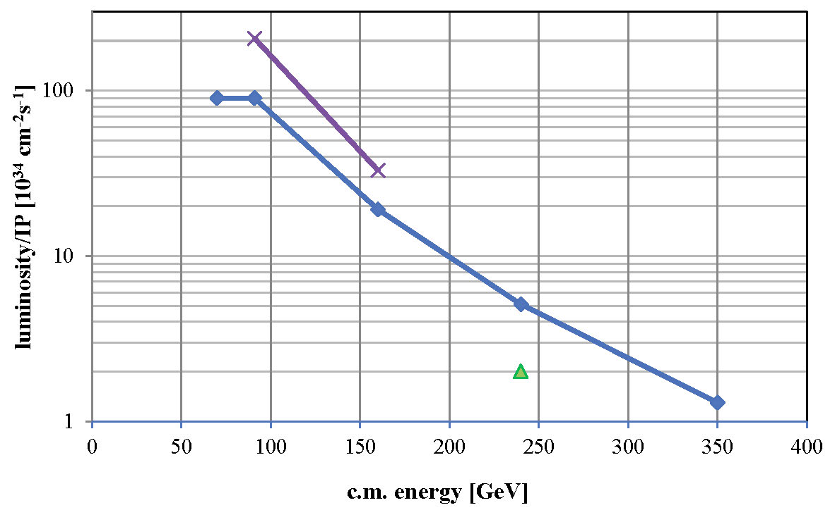

FCC-ee luminosity per IP
Further increase with squeeze to β_{y}*=1 mm, β_{x}*=0.5 m
new baseline crab waist with 2 IPs
β_{y}*=2 mm, β_{x}*=1 m
solid baseline with functioning optics, space for improvement, esp. at Z and W
α_{QED}
Z
WW
HZ
$$t\overline{t}$$
?
CEPC

