Slide 1
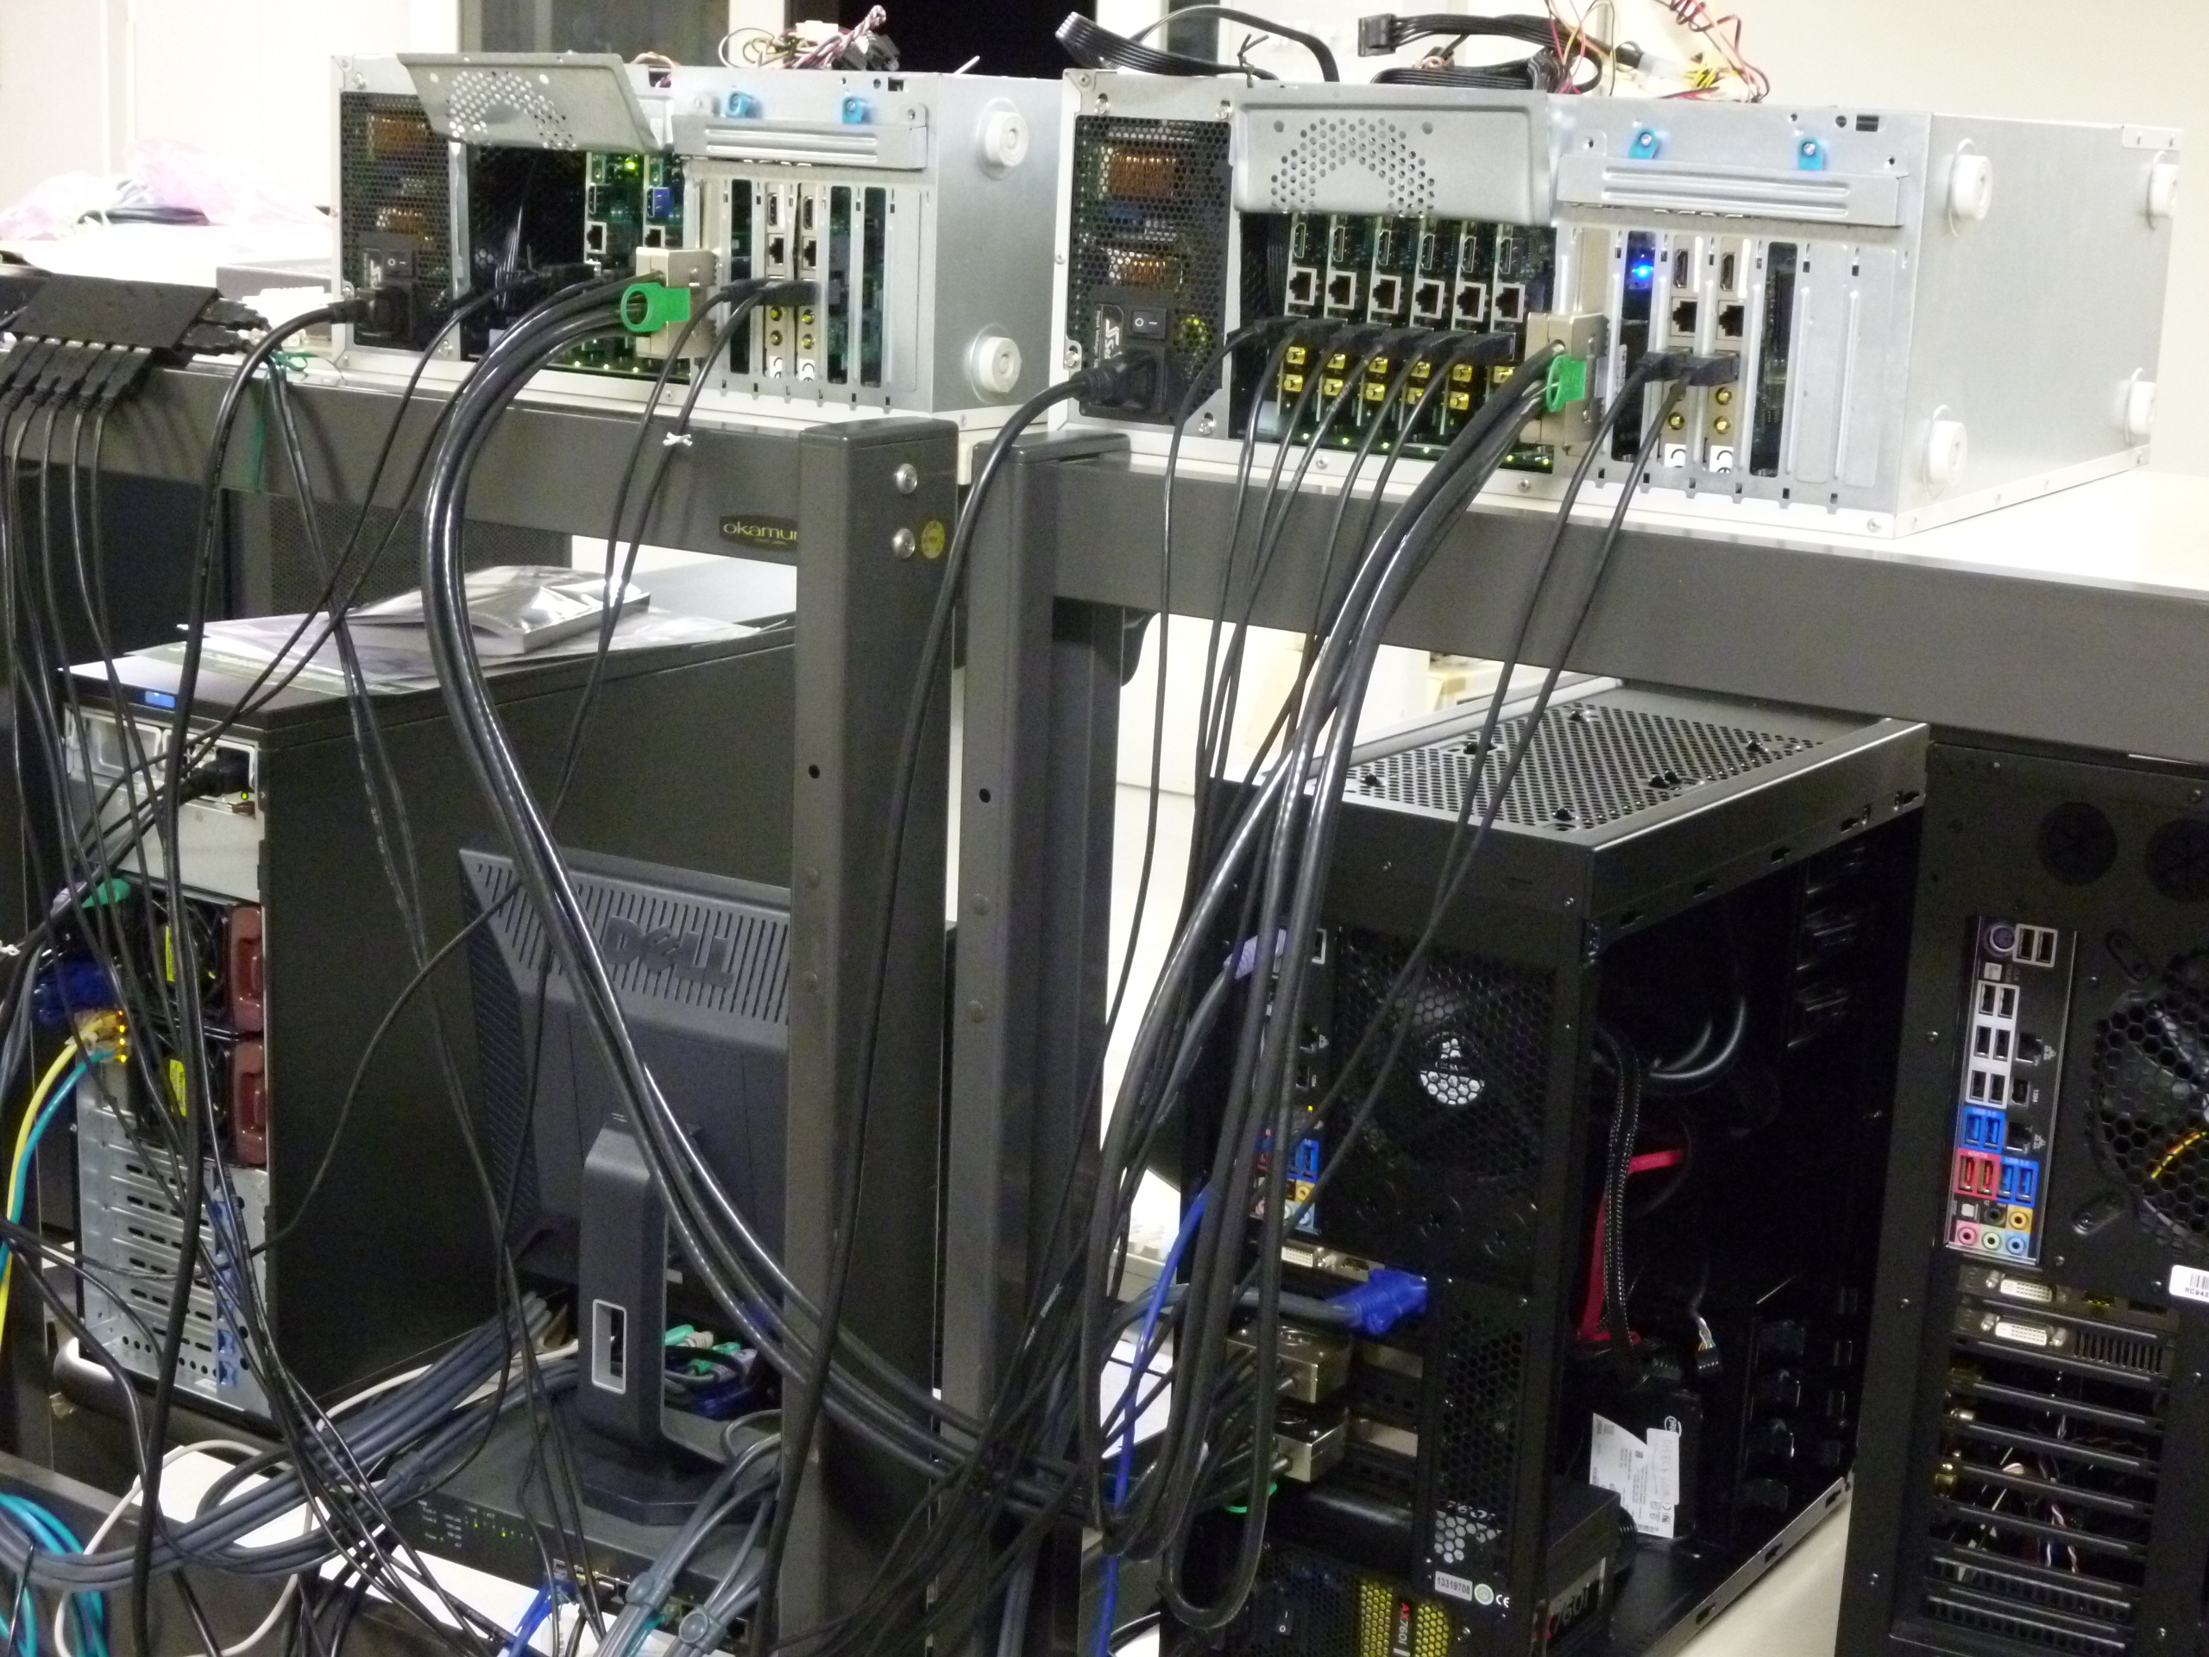
A development of an accelerator board dedicated for multi-precision arithmetic operations and its application to Feynman loop integrals II
Hiroshi DAISAKA(Hitotsubashi University)
Naohito NAKASATO(University of Aizu)
Tadashi ISHIKAWA(KEK)
Fukuko YUASA(KEK)
Keigo NITADORI(RIKEN/AICS)
2017/8/24 ACAT2017 Trac3@washington university
Notes:
My name is hiroshi daisaka, from hitotsubashi university.
Here is title of my talk and collaborators..
英語サンプル
progam needs to be done in kind of machine code called VHDL
we have a problem in accuracy.
accuracy is not so small, actually, it is one or two-digit
according to a report of program (QD-pack)
GPU were flexible than GRAPE
but two problems
prgamming, optical way needs special knowledge to memory and hardware structure
even hen done in CUDA
consume much more energy per TeraFlopls
new paradigm , use FPGA
platform

Slide 2
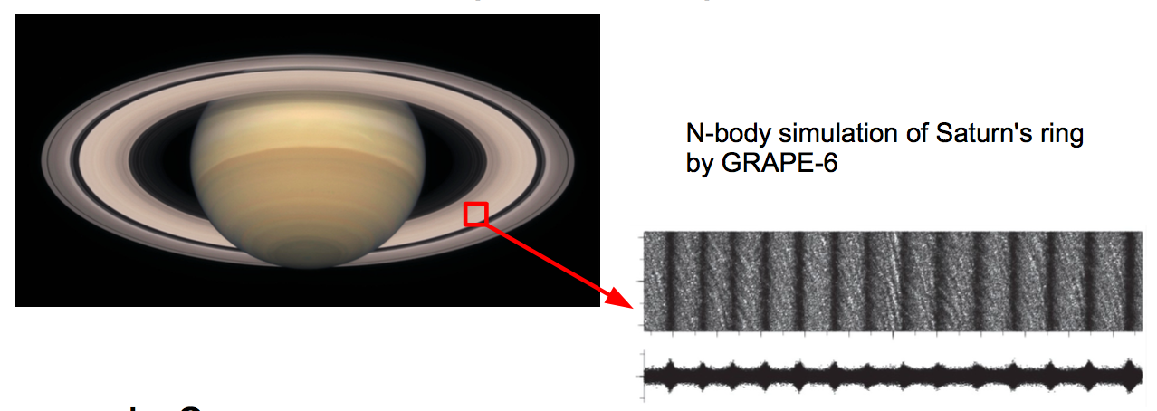
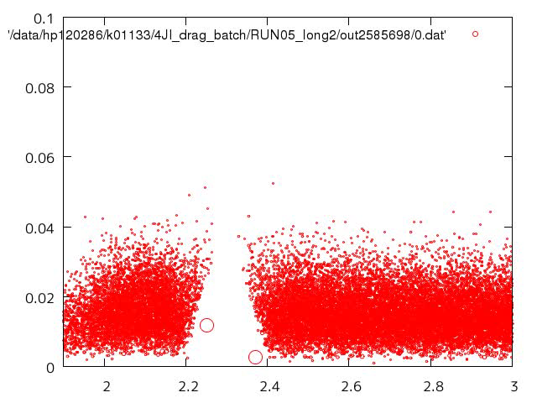
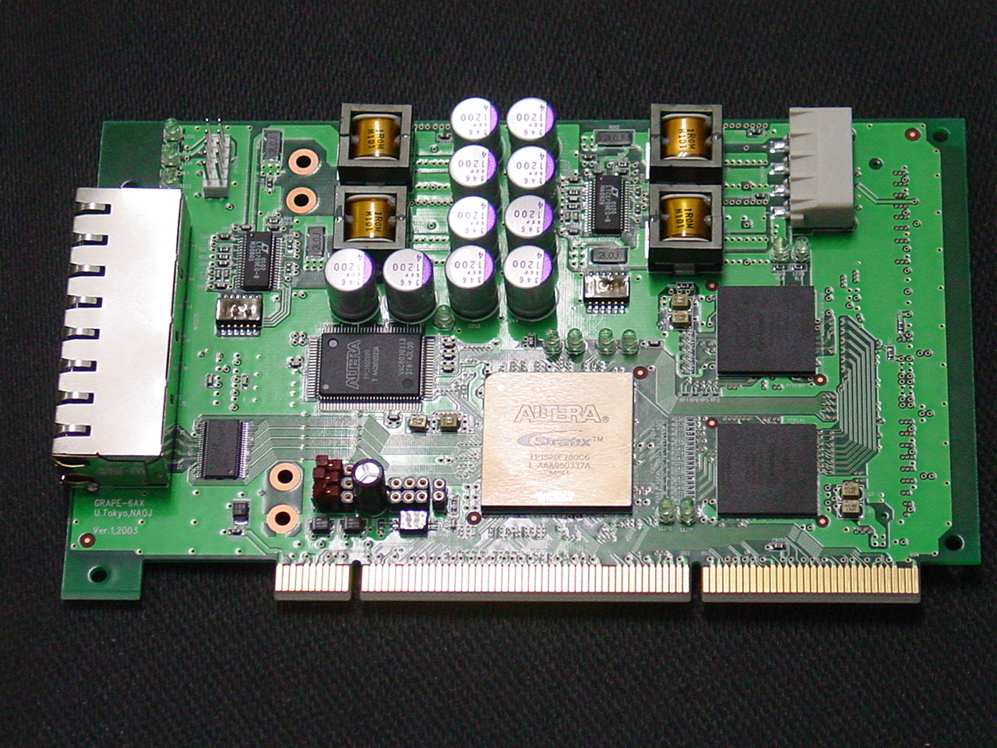
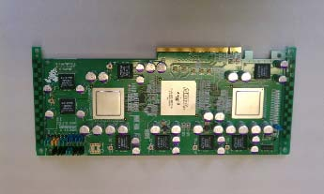
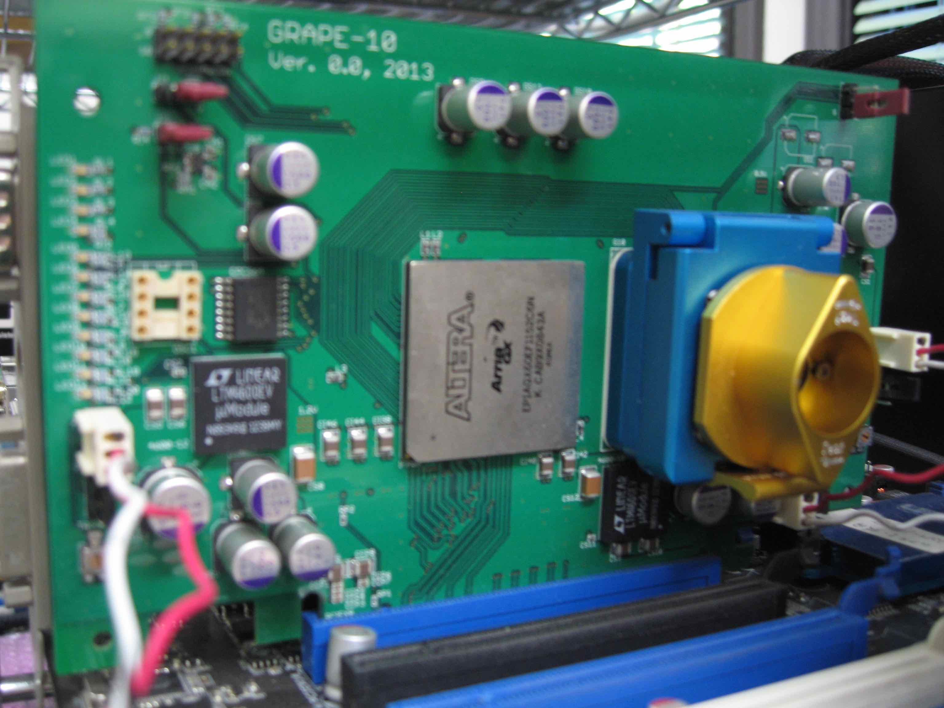
about myself
original major: planetary sciences, astronomy
  N-body simulations of planetary rings, plant formation, etc
e.g. Daisaka et al. 2001
Kominami, Makino, Daisaka , Fujimoto (2016)
GRAPE development
GXHIB
GRAPE-8
GRAPE-10
GRAPE technique is being utilized for calculation of Feynman loop integrals.
Notes:
Let me start with my brief introduction.
My original major is planetary science and astronomy.
N-body simulation of planetary rings, planet formation and so on.
This is one of my simulation results of Saturn’s ring, we can see structure formation,
and this is an animation of planet formation, we can see migration of proto planets by gravity effect of surrounding particles
And I was also involved in GRAPE development as well
Here is pictures of hardware I have developed so far.
Grape technique is being ustilized for calculation of Feynman loop integrals
I was involved in GRAPE development as well

Slide 3
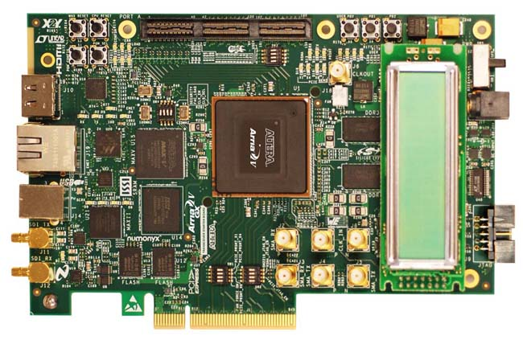
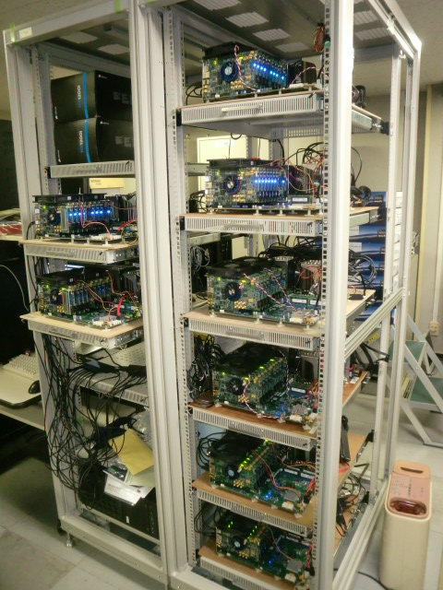
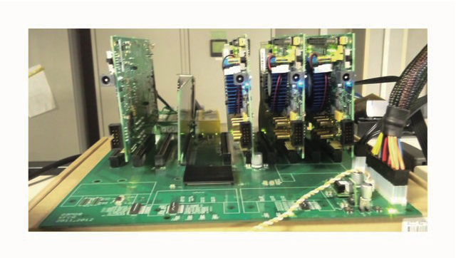
abstract
We have been developing an accelerator system dedicated for multi-precision arithmetic operations (GRAPE9-MPX).
  Processor elements (PE) with arithmetic logic units for quadruple/hexuple/octuple precision
  implemented on multiple FPGA(Field Programmable Gate Array) boards
  compiler system (LSUMP, Goose)
We report :
  progress of our system
4 FPGA Boards in ACAT2014
64 FPGA Boards in ACAT2017
evaluation of 3-loop selfenergy in a massive case with various masses
Notes:
So , We have been … をよむ
we developed PE with …, and PE are implemented on FPGA board
We also developed our own compilers in order to use our system easily
here we report progress and the detailed implementation of our system.
This is previous system presented in acat 2014, and this is current system.
We also report an application, evaluation of 3-loop selfenergy in a massive case with various masses

Slide 4
Outline
Introduction
Hardware and software of current GRAPE9-MPX system
Application to 3-loop integral
Summary
Notes:
This is outline of our talk
Let’s move on to introduction
This is outline of our talk.
First we start with the introduction,
followed by an explanation of hardware and software of our current system.
Next I will show the application to 3-loop integral, and
then last part is summary.

Slide 5
Outline
Introduction
Hardware and software of current GRAPE9-MPX system
Application to 3-loop integral
Summary
Notes:
let us move to introduction

Slide 6
Evaluation of Feynman Integrals
Analytical Approach
Analytical + Numerical Approach
Fully Numerical Approach
easy to treat arbitrary multi masses
needs huge computing resource
  6, 7-dimensional integrations
  high precision in some cases
Notes:
One of the things we want to do is to evaluate Feynman integrals
For the evaluation, there are three approaches, one is analytical approach, second one is analytical + numerical approach, and third one is fully numerical approach
Each approach has merit and de-merit
our choice is fully numerical approach
one of the reason of our choice is that it is easy to treat arbitrary multi masses.
But, one of demerit is that this approach it needs huge computing resources
because we need 6,7 dimensional integrations, and needs high precision in some cases

Slide 7
Feynman loop integral and DE-DCM
Feynman loop diagram with number of loop L, number of lines inside N (scalar integral)
Need fully numerical evaluation for auto calculation
  our method : DE-DCM(Direct Computation Method)
    use Double Exponential Formula(DE) and trapezoidal rule for numerical integration
    extrapolation by Wynn’s epsilon algorithm
Notes:
This is an equation we calculated numerically.
Our numerical method is DE-DCM
In this method, we use Double exponential formula and trapezoidal rule for numerical integration
Also we use extrapolation by Wynn’s epsilon algorithm.

Slide 8
Difficulties in DE-DCM
need huge CPU power for numerical integrations
  more than 6D integrations
    furthermore , there are wide variety of loop configurations, mass parameters, and physical parameters
need calculation with high precision
  numerical instability appears in double precisions calculation (Yuasa et al. 2007)
  need further huge CPU power to realize high precision calculation in ordinary CPUs
  e.g. addition in QD needs 40 double-double operations
solution : use an accelerator
  GPU
  FPGA
Notes:
However, there are some difficulties in DE-DCM.
One is we need huge CPU power ….
This is because, the integrations become more than six-dimensional integration,
Also we need calculation with high precision,
because numerical instability appears in …as in Yuasa et al two thousand seven
also we need further huge CPU power to realize high precision …
the solution is to use an accelerator
such as GPU, and FPGA
here we use FPGA
どれだけの精度が必要？
ソフトウェア実装では計算時間が問題
here we consider a feasibility of FPGA

Slide 9
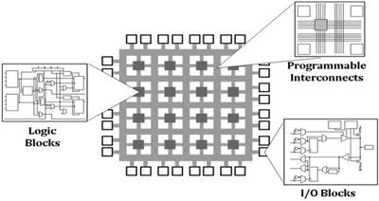
Field Programmable Gate Array
http://www.ni.com/tutorial/6097/ja/
designed to be configured with any logic functions
an accelerator with an appropriate hardware design
  use technique that was used in GRAPE
Notes:
This is an image of FPGA
FPGA contains logic blocks, programmable interconnects, and I/O blocks.
This is designed to be ….
So it can be an accelerator ….
Here we use technique that was used in GRAPE
fpga からgrape

Slide 10
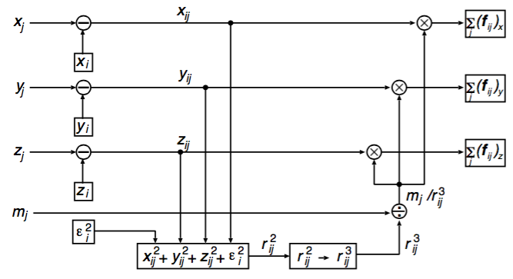
Concept of GRAPE(GRAvity PipElines)
(Sugimoto et al., Nature 345, 1990)
Data required
for calculation
Host
computer
GRAPE
Result
accelerator connected to a host computer
computes only computationally intensive part in N-body simulations
  mutual force calculation
dedicated pipelines
Notes:
This slide shows the concept of GRAPE
GRAPE is an accelerator connected to a host computer.
GRAPE computes only computationally intensive part in N-body simulation.
That is mutual force calculation.
To do so, dedicated pipelines, like this figure, are implemented on GRAPE
This is a concept of traditional grape.
After that, GRAPE-DR was developed.

Slide 11
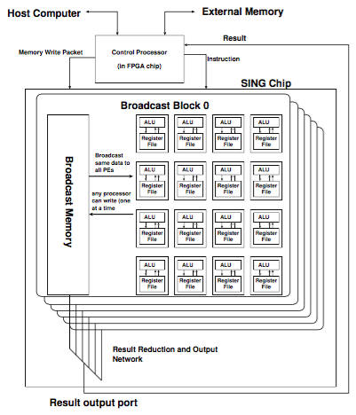
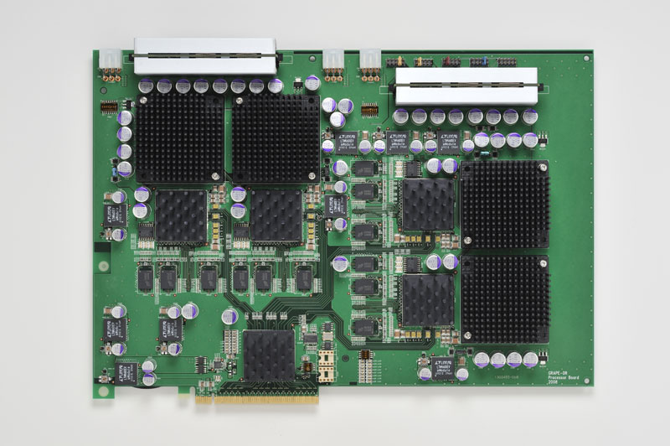
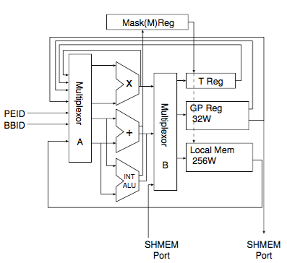
GRAPE-DR
GRAPE-DR was adopted as programmable processor elements instead of the dedicated pipelines
possible to carry out any calculation like LINPACK (DGEMM)
  top of little GREEN top 500, 2010
    Makino et al., Procedia Computer Science 4 (2011)
We extend PE to have arithmetic units for quadruple/hexuple/octuple precision → GRAPE-MPX architecture
Notes:
GRAPE-DR was ….
This is block diagram of PE, processor, and GRAPE-DR board.
GRAPE-DR is possible to carry out any calculation like LINPACK
DR cluster got the top of little GREEN top 500
We expend this PE to have artimetic units for qudruple/hexuple octuple precision.
We call it GRAPE-MPX artchiteture

Slide 12
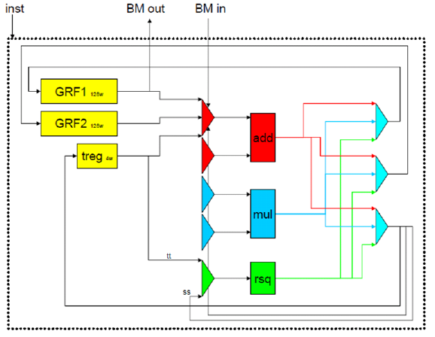
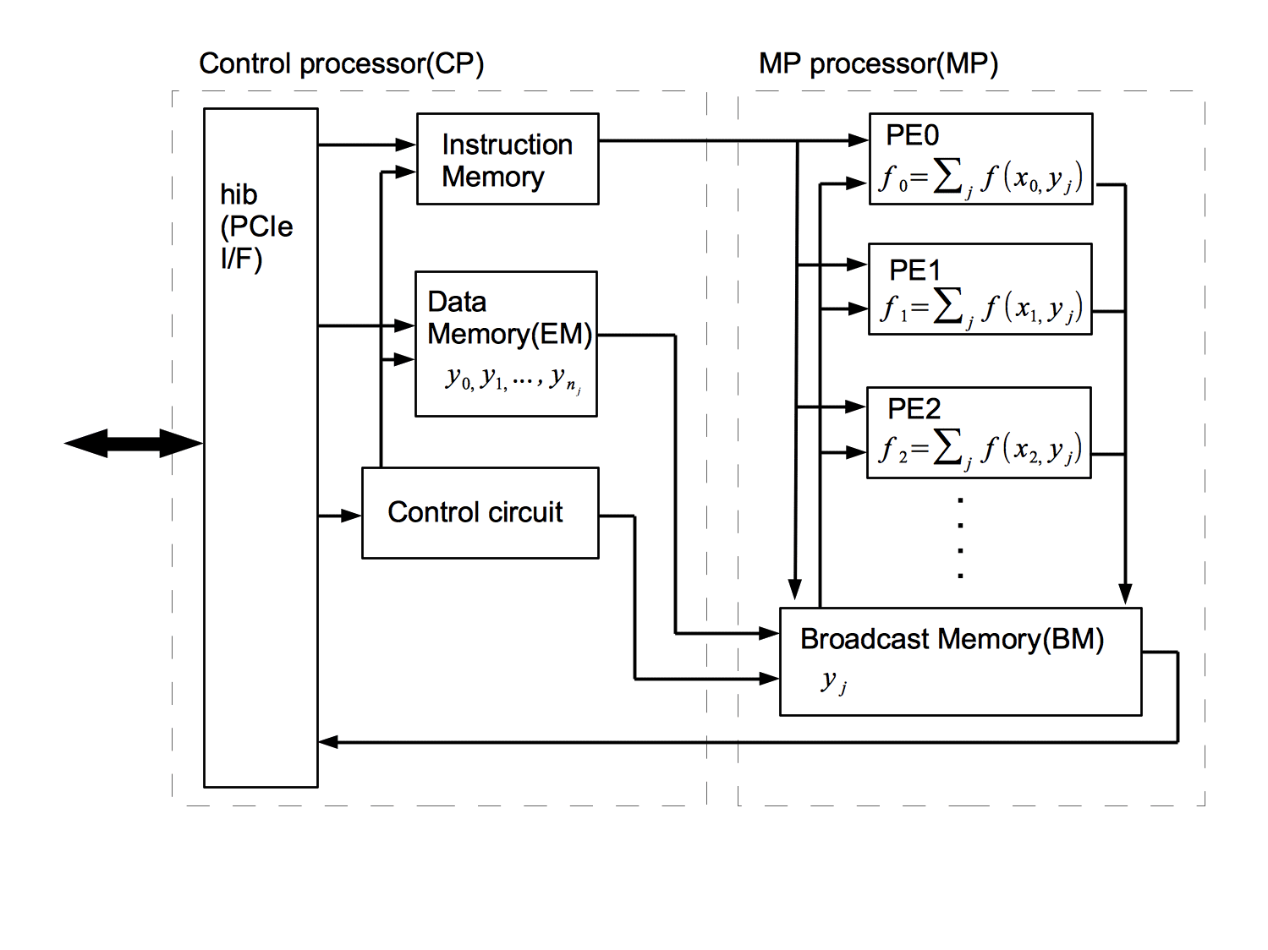
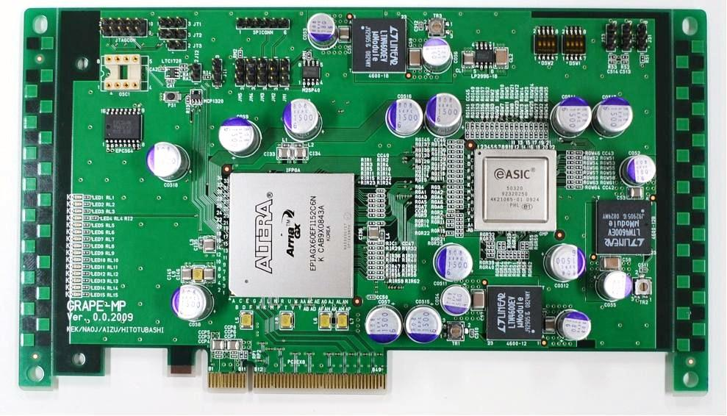
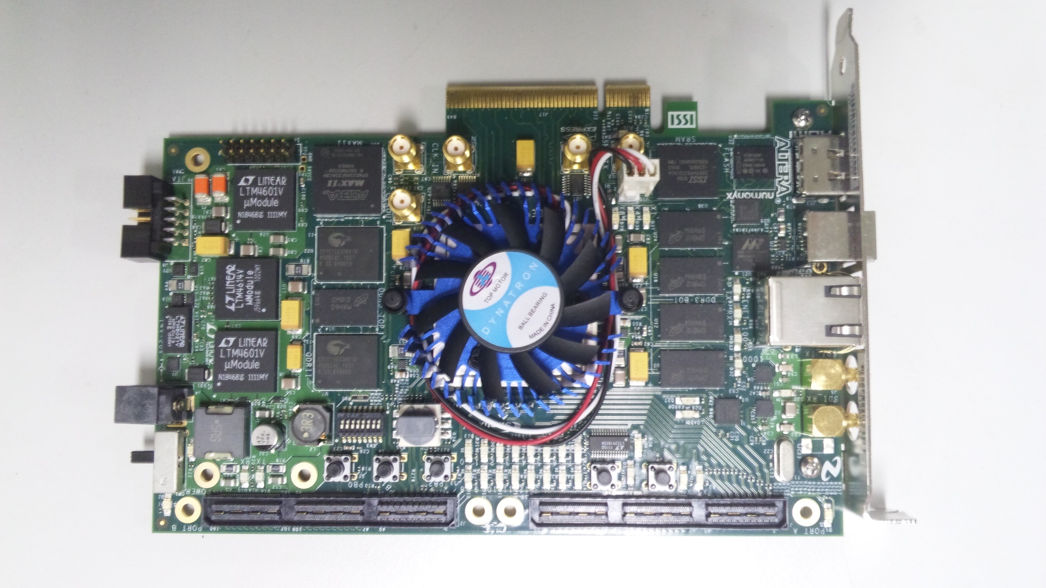
Our developed accelerators
GRAPE-MP(2011)
Structured ASIC
6PE, quadruple
GRAPE-MPX(2012)
Altera StratixIV
16PE,quad/hex/oct
GRAPE9-MPX(2014-)
Altera ArriaV
quad/hex/oct
Notes:
here is accelerators we have developed.
We designed dedicated processer and implemented it on a structured Asic and FPGAs
Next we will explain the details

Slide 13
Outline
Introduction
Hardware and software of current GRAPE9-MPX system
Application to 3-loop integral
Summary
Notes:
let us move to hardware and software of current system

Slide 14
GRAPE9-MPX cluster system
64 FPGA boards (Altera ArriaV) on 8 host computers
  8 FPGA boards per host
  connected via PCIe
Peak performance
  422 Gflops for quadruple
  185 Gflops for hexuple
  96 Gflops for octuple
specifications of host PC
  Intel Xeon 2687W v3(6 hosts)
  2687w v4 (2hosts)
  128GB mem
  SuperMicro X10DRX
  GbE for host connection
Notes:
Here is a picture of GRAPE9-MPX cluster system in KEK.
It has 64 FPGA boards on 8 host computers.
FPGA boards are connected via PCIe interface.
The peak performance of the system is the following.
Here is specification of host PC.

Slide 15
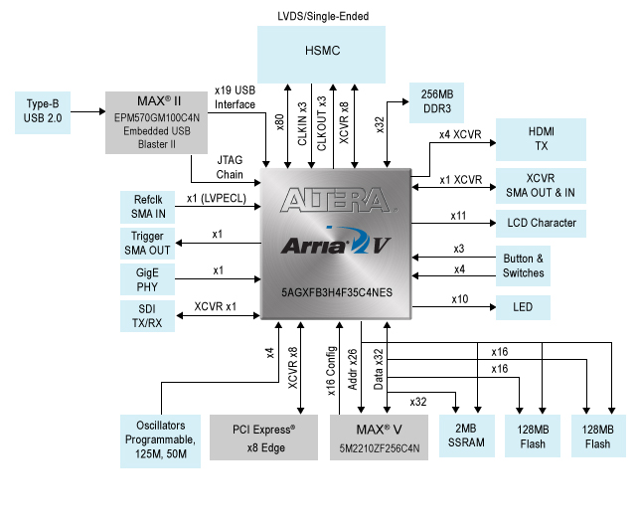
FPGA board
use Altera(Intel) ArriaV GX starter kit
https://www.altera.co.jp/products/boards_and_kits/dev-kits/altera/kit-arria-v-starter.html
  good cost performance (850 USD, 120000 JPY), rich resources
Main equipment
  ArriaV GX (5AGXFB3H) ALM/MEM/DSP=136880/1726/1045
  DDR3 SDRAM (256MB), SSRAM(2MB)
  Interfaces (PCIe x8, GbE, etc)
  config unit, power supply unit
Notes:
This is a FPGA board we use
We use board of Alter ArriaV Gx start kit
This board has good cost …
Here is main equipment of the board,
FPGA chip, DDR memory, PCI-express IF, and so on.

Slide 16
block diagram of processor
MP processor
  PEs + BM
  PEs: execute same instructions (SIMD)
  BM: 128 w x 2(in/out) (260-bit width)
Control processor(CP)
  MEM+control unit+IF
  Instruction mem:
  4k w (on chip)
  16M w (on DDR)
  if < 4k , use on chip
  EM: 32k w (256-bit width)
  x4 Gen I PCIe (GPCIe from KFCR)
Notes:
This is a block diagram of our processor implemented on the FPGA
our processor consists of two parts, MP processor and Control processor.
MP processor consists of many PE and Broadcast memory.
PEs behave as SIMD operations
On the other hands, Control Processor consists of memory units for instruction and data, its control unit, and IF.
CP sends data and instruction to MP processor, then MP carries out calculation,
and CP gets results from MP and sends the results to host PC via PCIe interface
one of the memoy unit is instraction memory
it has 4k words on chip memory, and 16M words on DDR memory.
if number of instruction is less than 4k words, we use only onchip memory
another memory is for data memory, named as EM which has 32 words
For connection to host computer, we use times 4 Generation I PCIe interface, provided by KFCR

Slide 17
Block diagram of PE
arithmetic units(add, mul, rsq)
+ registers + selector units
add, mul
  quad/hex/oct precision
  operate independently
rsq
  used for initial guess of div
  exp 19-bit, man 32-bit
regs
  128 w for GRF1 and GRF2
  4 w for treg
1 clock for throughput and
4 clocks for latency
  → 4 “logical” pipelines to hide latency
Notes:
This is a block diagram of PE
PE consist of …
here
add is to adder umit, and mul is multiplier unit.
These units have quad/hex/oct precision.
This is the key of our hardware.
These unit can operate independently
rsq uniti is to perform root-square calculation,
which is used for initial geuss of division
and has appropriate accuracy
PE has one clock for throughput, 4 clock for latency
so we use as 4 logical pipelines to hide latency
rsq (x^-0.5) exp 19-bit, man 32-bit

Slide 18
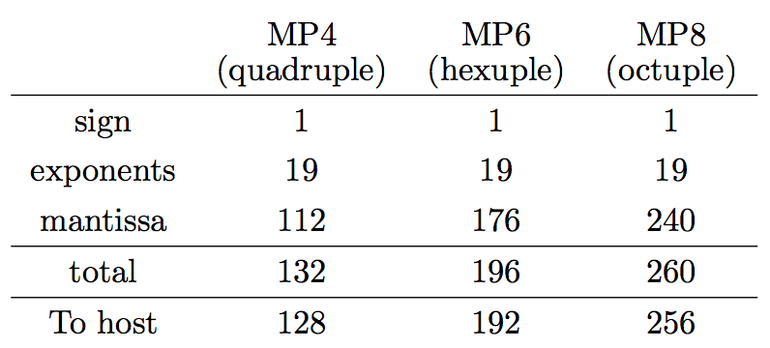
Numerical format used in PE
use 19-bit exponents for IEEE754(2008)binary256 format
truncate 4 bits when sending to host (CP)
  from exp in MP4 -> binary128 format
  from mantissa in MP8 -> binary256 format
Notes:
Here we show numerical format used in PE
here is format of quarduple, hexuple, octuple, we call as Mp4, MP6, MP8
We should note we use 19-bit exponent in order to corresponds to IEEE format.
We truncate 4 bits when sending to host (or CP)
If it is from exponent in MP4, it becomes binary 128 format.

Slide 19
Calculation efficiently accelerated
interaction type
set x_{i} in register files of i-th PE
broadcast y_{j} to all PE
calculate f(x_{i}, y_{j}) and sum up
large n_{j} for reducing communication overhead
examples
  mutual gravitational force
  multi dimensional integration of Feynman loop diagrams
    need loop fusion (expansion) for efficiency
Notes:
Our system is possible to carry out any calculation but,
there is a type of calculation efficiently accelerated.
That is a interaction type.
Here is the procedure of calculation.
we set xi in register files in i-th PE
Then we broadcast yj from BM memory to all Pes,
and PE calculate the function with x_i and yj and sum up.
It is important to take large nj for reducing communication overhead.
one of examples is mutual gravitational force calculation.
Another one is a multi dimentional integration of Feynman loop diagrams.
It it crutial that we use loop fusion technique for efficienty

Slide 20
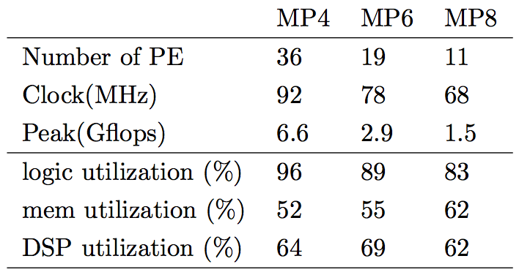
Logic synthesis
Our processor is written in VHDL
  easy to implement on any FPGAs
Synthesis tool needed for implementation
  Altera FPGA needs QuartusII (here we used ver. 13.1)
  generates binary code for FPGA
  transfers to FPGA
prepare binary codes for MP4, MP6, MP8 individually
Notes:
Here is logic synthesis
Our procesoor is …
Synthesis tool is needed for implementation
for altera FPGA, it is quarutsII
It genertes …
and trasfers to FPGA
We prepare binary code …
this table is the synthesis result.
here is values for MP4, MP6, and P8
each of the number of PE are 36, 19, 11
the clock speed are 92, 78, and 68.
and peak speed are 6.6 , 2.9 and 1.5 Gflops
The bottom three lines show the utilization parcentage of logic resourses.

Slide 21
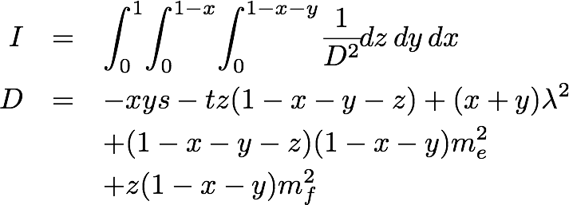
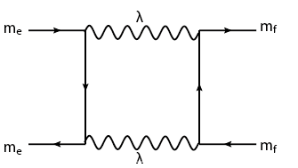
How to use GRAPE9-MPX
    plus pragma to C/C++
one-loop box diagram
#pragma goose parallel for loopcounter(ixy, iz)
for(ixy = 0; ixy < ni; ixy++) {
sumzG[ixy] = 0.0;
for (iz = 0; iz < nj; iz++) {
xx = dev_xx[ixy];
yy = dev_yy[ixy];
zz = x30_1[iz] * dev_cnt4[ixy];
d = - xx * yy * s
tt * zz * (one - xx - yy - zz) +
(xx + yy) * lambda2 +
(one - xx - yy - zz) * (one - xx - yy) * fme2+
zz * (one - xx - yy) * fmf2 ;
sumzG[ixy] += gw30[iz] / (d * d);
}
}
#pragma goose parallel for loopcounter(ixz, iz)
accelerate !
Notes:
Here we show how to use our system.
It’s very simple, just plus pragma to a C/C++ program and recompiling.
Here is a case of one-loop box diagram, this is integral and this is a source code in C corresponding to loop calculation
All we have to do is to add this pragma into the code.
By this, we can accelerate this code by using GRAPE9-MPX

Slide 22
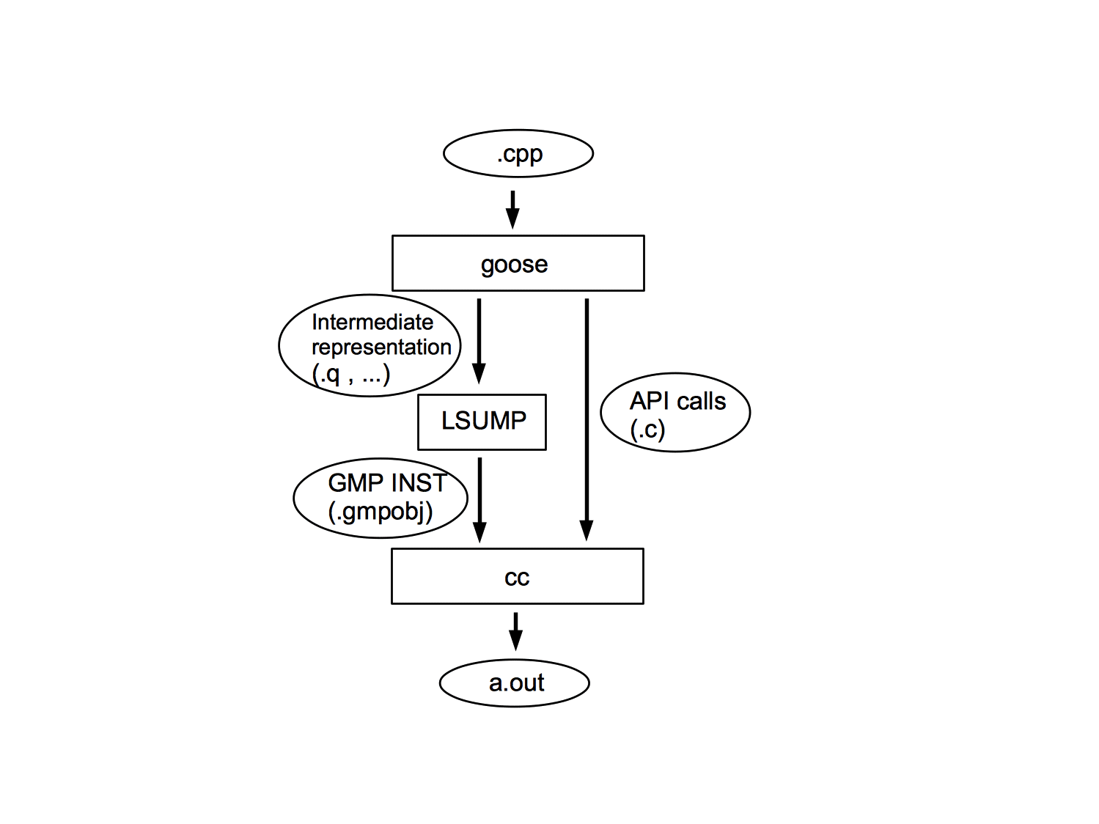

Goose and LSUMP
realized by Goose and LSUMP
Goose compiler
  directive type compiler like OpenMP
  generates kernel code for LSUMP
  inserts communication APIs.
  Goose:
  http://www.kfcr.jp/goose-e.html
LSUMP
  generates the assembler code for GRAPE9-MPX
currently supports MPI/GPU(OpenCL)/PEZY-SC(PEZY-CL)
(please ask to KFCR, if you want to use.)
Notes:
Such a easy programing model is realized by Goose and LSUMP.
Goose is a directive type compiler like OpenMP.
goose analyzes source code, then,
generates kernel code for LSUM and
insterts communication APIs in C/C++ source code
For more information, please go to this website.
LSUM is our DSL compiler which generates the assember code for …
goose currlenty suport MPI/GPU and PEZY-SC

Slide 23
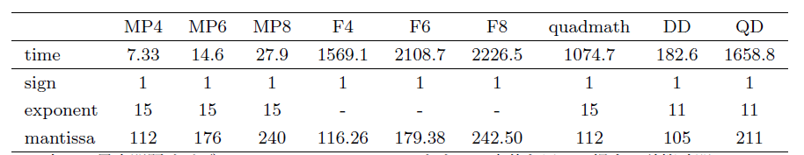
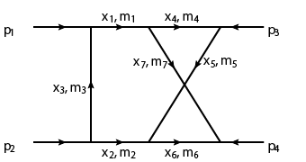
Comparison to software implementations
214 times
faster
144 times
faster
146 times
faster
25 times
faster
226 times
faster
80 times
faster
case of 12 FPGA boards
compare the execution time for this diagram
Condition for software implementations
  Host: Xeon E5 2687W 16 threads
  Use MPFR C++ (F4, F6, F8 correspond to quadruple, hexuple, octuple precision)
6D integration
N=64⁶
Notes:
Here we show performance of our system, comparing to software implementations
here is the case of 12 FPGA boards
We compare the execution time for calculation of this diagram with the same number of integral points.
Here is condition for software implementation, we use 8-core 16 threads Xeon CPU
This table shows the result.
Here is values of our system, here is values of Software
This is result of comparison
we can see the our system is much faster than software implementation

Slide 24
Outline
Introduction
Hardware and software of current GRAPE9-MPX system
Application to 3-loop integral
Summary
Notes:
Lets move on to application to 3-loop integral

Slide 25
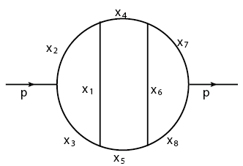
previous applications
We have already used our system to evaluate Feynman loop diagram in a massive case
  3-loop self energy with m=1 for all mass
S. Laporta , Int.J.Mod.Phys.A15:5087-5159,2000
  2-loop box cross with m=1 for all mass
  S. Laporta , Int.J.Mod.Phys.A15:5087-5159,2000
  F. Yuasa et al. CPC vol.183, no.10, pp.2136-2144 2012.
E. de Doncker et al., J. Phys.: Conf. Ser. 523 (2014) 012052
  2-loop box cross with masses from Yuasa et al. (2012)
    unphysical region
Here we evaluate 3-loop self energy diagram with various masses
Notes:
We have …
One is 3-lloop
next one is 2-loop box crosse,
and another one is 2-lopp box cross with …
and 2-loop cross with masses from Yuasa et al, of unphysical region.
Here we evaluate 3-loop….
Ghinculov, Phys. Lett. B 358 (1996) 279-283

Slide 26
3-loop self energy in a massive case
1
3
6
8
5
2
7
4
mass assignment
same as used in Ghinculov 1996
Ghinculov, Phys. Lett. B 358 (1996) 279-283
evaluate the integral by changing manderstum variable s
Notes:
Now I show you a diagram and equation we calculated as an application
here is mass ssignment, which is the same as used in Ghincoulv 1996.
We evaluate the integral by changin manderstam variables s
Ghinculov--analytical + numerical (combine)
計算条件ほか、は our setting とか

Slide 27
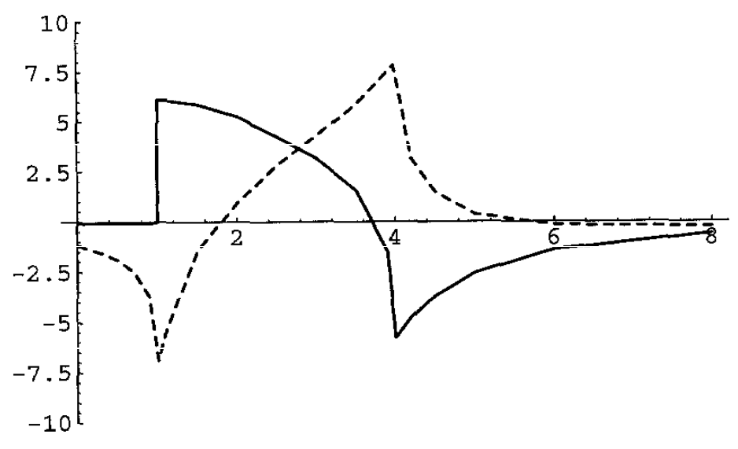
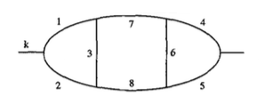
Result of Ghinculov 1996
IMAGINARY part
REAL part
features
unphysical region for s² < 1
diverse at s²=1, 4
sign change at s² ~2, 5.5 for RE, at 3.5 for IM
convergence to zero for large s²
Notes:
Here we show the result of Ghinculov 1996
this axis is s-square and this is value of integral
There are features to note.
one is unphysical region for s-square less than one
…
It seems to be in his paper, Im part should be Re part, and Re part should be Im part,
because of behavior of unphysical region.
ReとImが逆のように見える
unphysicacl でIm がない
In Ghinculov, it explains that solid line is imaginary and dashed one real part.
But, It seems to reverse

Slide 28
Our settings
unphysical region (s² < 1)
  ρ=0 (fixed, no extrapolation)
  N=25 ( 25⁷ = 6103515625 total )
  h=0.3
  1 board of ArriaV, MP4 mode (36PE, 92MHz)
  elapse time per point of s ~ 300 sec
physical region (s² > 1)
  ρ=1.15^{β}, β={-50, -51,..,-80,-81 } for extrapolation
  N=64 ( 64⁷ total )
  h=0.0875, 0.117187
  64 board of ArriaV, MP4 mode (36PE, 92MHz)
  elapse time per point of s ~ 11 hours(including 24 β’s)
  integrate both Re part and Im part with 8 different values of β (16 integrations at the same time)
    C/D are common and can be reused
Notes:
Here is our setting
let me skip detail but I would like to point out we use quadruple precision in calculation.
8 beta 計算していることを説明するスライドはバックアップで用意のこと
in order to use Wyns’s epsilon algorithm,
we evaluate the integrals with different values of epislon for fixed value of s
enouth rich for regsters in PE to store the results obtained by reuse of C/D,
and possilble to increase efficienty
once C/D are calculated, since they are common even if epsilon is different,
C/D can be reused in the integration

Slide 29
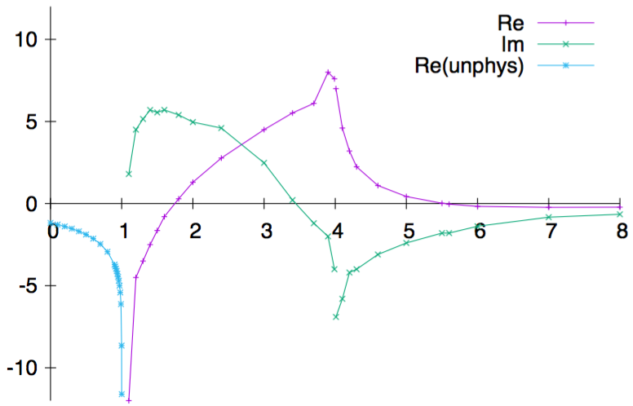
Our （preliminary）result
11 hours for each point
64 FPGA boards
64⁷ grids
24 integrations for extrapolation
300 sec for each point
1 FPGA board
25⁷ grids
no extrapolation
unphysical region for s² < 1
diverse at s²=1, 4
sign change at s² ~2, 5.5 for RE, at 3.5 for IM
convergence to zero for large s²
Notes:
This is our preliminary result
This is very similar to previous work, unphysical region here, diverse here and here
We should note the computational time.
For physical region, it took 11 hours to calculate each point of s-square
under these conditions.
For unphysical region, and it took 300 sec.

Slide 30
Outline
Introduction
Hardware and software of current GRAPE9-MPX system
Application to 3-loop integral
Summary
Notes:
Let me move on to the summary

Slide 31
Summary
We have been developing an accelerator system dedicated for multi-precision arithmetic operations (GRAPE9-MPX).
  Processor elements (PE) with arithmetic logic units for quadruple/hexuple/octuple precision on FPGA
  compilers (LSUMP, Goose)
  current system : 64 FPGA boards with 422/185/96 Gflops for MP4/MP6/MP8
  compiler also supports MPI/GPU(OpenCL)/PEZY-SC(PEZY-CL)
We showed evaluation of 3-loop selfenergy in a massive case with various masses
  possible to carry out 7 dimensional integration with quadruple precision within acceptable time
    11 hours per point of s in physical region with 64⁷ grids
  also possible to carry out calculation with hexuple/octuple precision
Notes:
Here is summary
We have been ….
We showed …
This is end of my talk
thank you very much.
We would like to use our system to evaluate various kinds of Feynman loop integrals in the future.
sixty four to the seventh grids

Slide 32
backups

Slide 33
Detail analysis

Slide 34
example : one-loop box diagram
#pragma goose parallel for loopcounter(ixy, iz)
for(ixy = 0; ixy < ni; ixy++) {
sumzG[ixy] = 0.0;
for (iz = 0; iz < nj; iz++) {
xx = dev_xx[ixy];
yy = dev_yy[ixy];
zz = x30_1[iz] * dev_cnt4[ixy];
d = - xx * yy * s
tt * zz * (one - xx - yy - zz) +
(xx + yy) * lambda2 +
(one - xx - yy - zz) * (one - xx - yy) * fme2+
zz * (one - xx - yy) * fmf2 ;
sumzG[ixy] += gw30[iz] / (d * d);
}
}
#pragma goose parallel for loopcounter(ixz, iz)
Notes:
Here is an example of how to use goose
sample code is one-loop box diagram.
only thing we have to do is to add this pragma into the code, and re-compile by goose, that it.
by this, we can accelerate this code by using G9MPX

Slide 35
How to realize high precision
Software implementation
  ARPREC, GMP, MPFR, MPFUN90, QD/DD, quadmath on gcc, etc
  Easy to use, but performance is …
    Add with Double precision -> 1 operation(cpu has dedicated logic)
    Add with QD -> 40 operations (combination of operations with double-precision)
Hardware implementation
  No consumer products ….
  Series of our dedicated hardware

Slide 36
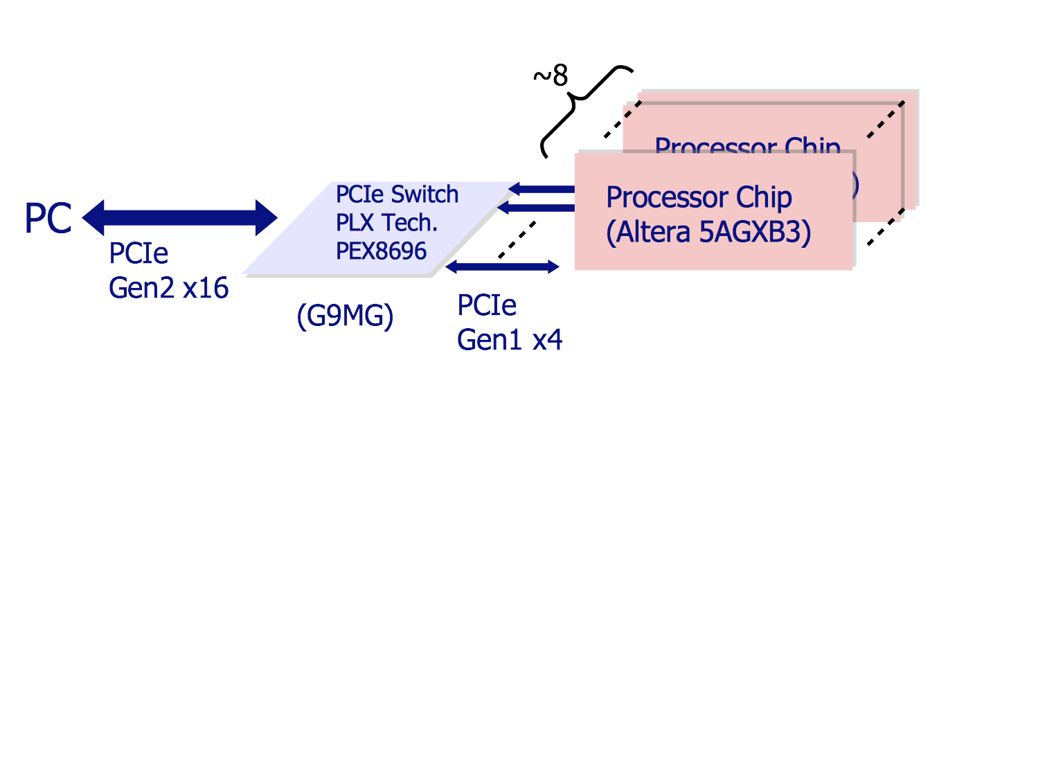
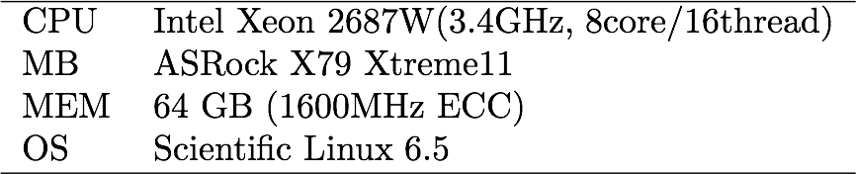
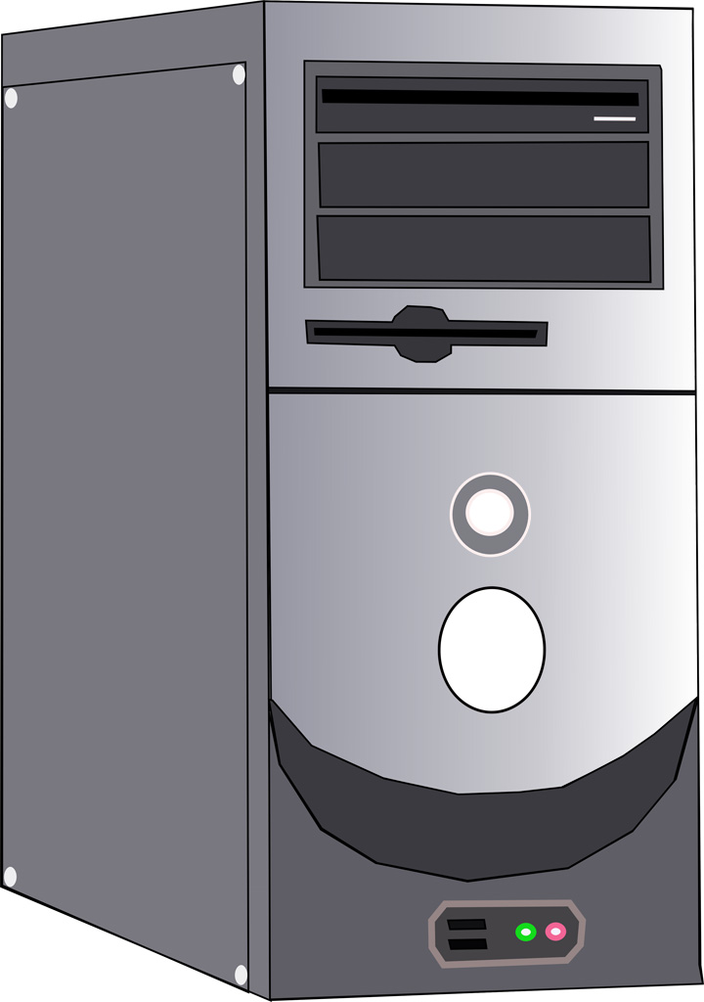
Overview of GRAPE9-MPX system
@www.altera.com
Use Altera ArriaV developing boards with PCIe
Use two PCIe extender boards (G9MG from KFCR co. ) enabling system with upto 16 FPGA boards
Develop compiler system (Goose compiler, LSUMP)
  Program written in C/C++ with pragma

Slide 37
Picture of GRAPE9-MPX

Slide 38
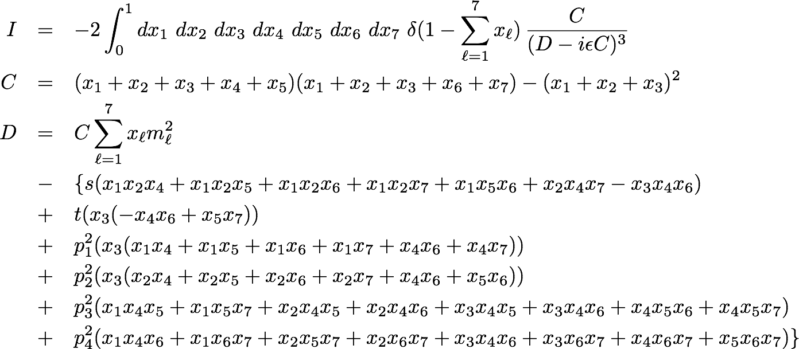

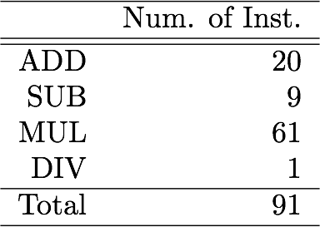
Feynman diagram used in measurement
Two loop crossed box diagram (Yuasa et al. 2012, Doncker et al. 2014)
result：-0.0853513981
Number of ops.: 128 (including load/store)
6-dimentional integral

Slide 39



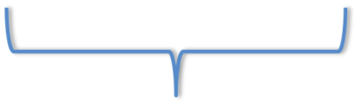
Method of the measurement
Replace 6 loops to 2 loops by loop fusion
Total number of points
To fit GRAPE9-MPX hardware
Measure execution time of overall calculation of loop integral with given (N_{i} , N_{j})
Fix N_{j} :
Vary N_{i} :
Maximum problem size :

Slide 40
Performance with 12 boards
26.5 Gflops
(quadruple)
Influence of
data transfer
13.6 Gflops
(hexuple)
6.36Gflops
(octuple)
About 36 % of the peak performance
small
Problem size
large

Slide 41
Performance model
Elapsed time required for the calculation per one i-data point
Time for execution of the kernel instruction on GRAPE9-MPX
Number of instructions
Operation clock[Hz]
Number of j-data
Time required for the communication between the host and GRAPE9-MPX
Number of PE per board
Number of FPGA boards
Time to process on the host

Slide 42
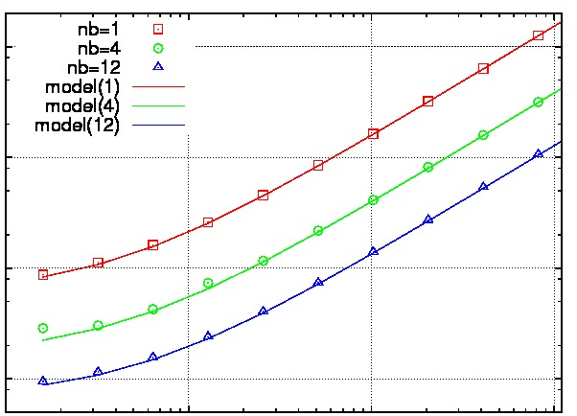
Comparison of the model and measurement
Case of octuple
Points: measurements
Lines: model
Good agreement!
Speed-up of 12 boards
11.6 times
faster
9.3 times
faster
Significantly improved from previous work (1.07 times for 4 boards)
small
Problem size
large

Slide 43
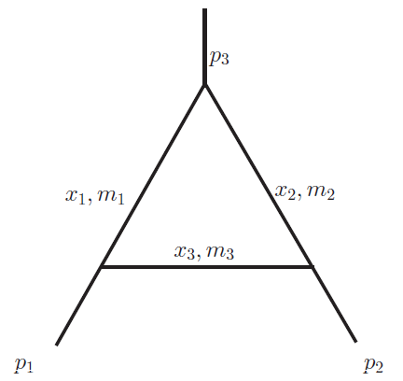
Example: 1-loop with 3 points
loop integral
analytical result
relative error of I from the analytical result

Slide 44
Example: 1-loop with 3 points(2)
Range for the case of double precision
(11-bit exponent)
Range for the case of quadruple precision (15-bit exponent)
error for
A single digit@double
(11-bit exponent)
20-digits@quadruple
(15-bit exponent)
Need precision with more than 10-digits -> need more than quadruple

Slide 45
Precise in DE
Integration
transformation
trapezoidal rule
parameters determining precision
  h (width of grids)
  Nh (cutoff distance in t-variable (t_{min} /t_{max}))
    control precision
      double : t_{min} = -6 (x_{min} = 10⁻³⁰⁸)
      quadruple : t_{min} = -9 (x_{min} = 10⁻⁴⁹³²)
Notes:
バックアップにまわす
DEはendpoints に あるsingularityが強いときに精度よく計算できる
のセリフを入れる
精度によって取れるtminがある, どこまで寄れるか？ how far can approach
端点特異性が強い場合は、doubleでは足りない可能性がある

Slide 46
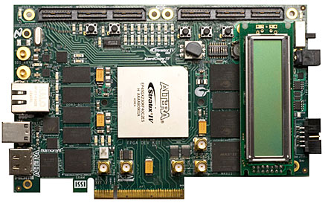
開発した多倍長精度専用ハードウェア
GRAPE-MP (daisaka et al. 2011)
  Structured ASIC (Nextreme NX2500 , 90nm)にPEを実装
  4倍精度(ただし指数部11bit) 6PE 100MHz動作
GRAPE-MPX (Nakasato et al. 2012)
  Altera StratixIVに4/6/8倍精度PEを実装
  PE数: 22 / 16 / 8, 123 / 95 / 74 MHz動作

Slide 47
GRAPE9-MPX
より規模の大きなシステムを構築し、ファインマン図形積分を計算
  G9MG(KFCR製PCIe extender)を用いてマルチボード化
  Altera ArriaVを使用
  PE数: 36/20/12, 92/81/70 MHz 動作
  IEEE754-2008: binary128 準拠(指数部15bit)
  ソフトウェア実装の100倍の性能
Notes:
ソフトウェアとの比較を書くこと
----- 会議メモ (2014/09/16 16:17) -----
繰り返しはなくす。

Slide 48
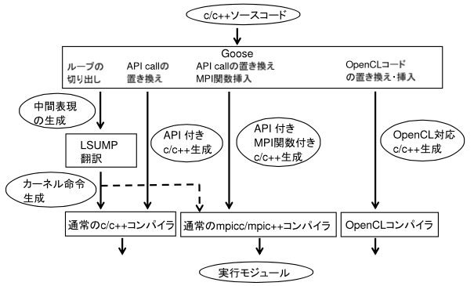
compilation process and functions
possible to generate a exe-file with MPI, GPU(by using OpenCL)
Notes:
英語化すること

