Slide 1

Machine Learning-based fast simulation in GeantV
Sofia Vallecorsa
for the GeantV project
ACAT 2017
21-25 August 2017
University of Washington, Seattle

Slide 2
Outline
Introduction
GEANTV framework for fast simulation
Machine learning approach
Generative Adversarial Networks for calorimeters
Summary and plans

Slide 3
Introduction
Detailed simulation has heavy computation requirements
  A large fraction of current computing resources are devoted to Monte Carlo production
Fast simulation is heavily used by experiments
  Mostly when accuracy requirements are more “relaxed” (searches, upgrade studies,…)
  A necessity in future HL-LHC runs
  Currently available solutions are detector dependent

Slide 4
GeantV fast simulation framework
Fast, modular and fully configurable
Introduce fastsim in GeantV framework
  Provide configurable interface (probably G4 userActions style)
  Composite solutions (mix/match fast and full simulation within the same event)
  A choice of basic tools: parametrization, libraries, machine learning tool

Slide 5
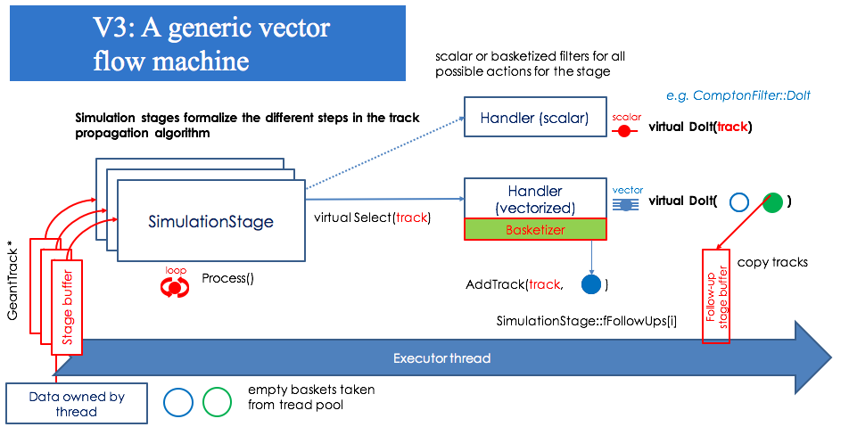
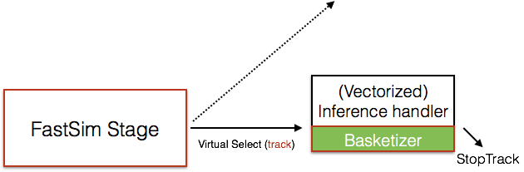
Integrating fast simulation in GeantV

Slide 6
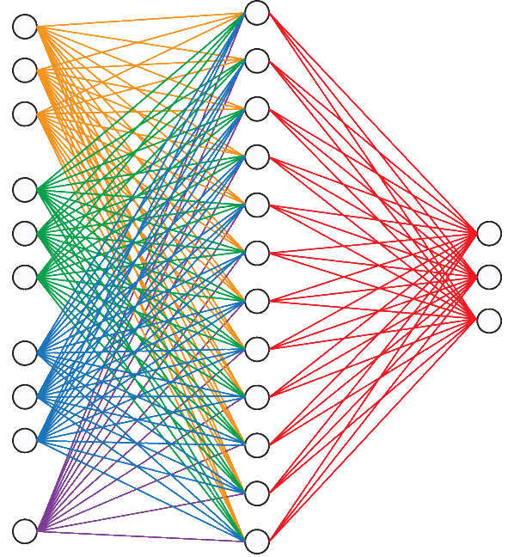
Machine Learning for fast sim

Slide 7
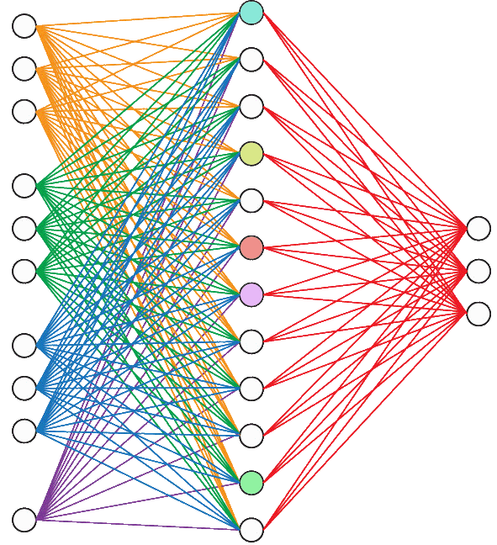
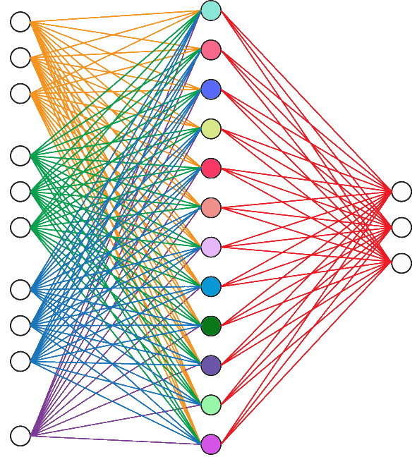
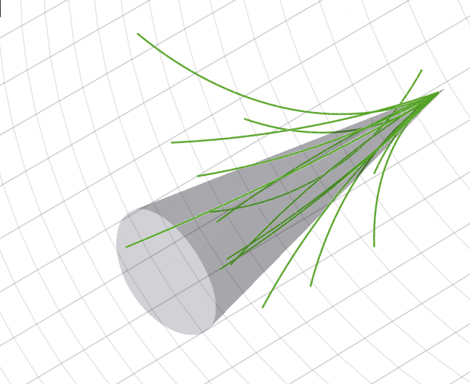
GeantV
Untrained Model
Training
Trained Model
Detector
http://www.physics.umd.edu/rgroups/hep/LegoCMS/
Physics (e⁺, e⁻,γ,π..)
Kinematics…
Convert saved NN for application in C++ environment through libraries as lwtnn

Slide 8
GeantV
Untrained Model
Training
Trained Model
Detector
http://www.physics.umd.edu/rgroups/hep/LegoCMS/
Physics (e⁺, e⁻,γ,π..)
Kinematics…
“Detector” info to drive the design/choice of model
A tool capable of optimizing the model configuration and train
Embed in GeantV

Slide 9
Design the ML model(s)
Initially focus on time consuming detectors
  Reproduce particle showers in electromagnetic and hadronic calorimeters
Train networks on full simulation
  Eventually test possibility of training on real data
Test different techniques
  Multi Objective regression, Feature extraction
Test different models
  Generative adversarial networks, Recurrent networks

Slide 10
Generative adversarial networks
arXiv:1406.2661v1
Simultaneously train two networks that compete and cooperate with each other:
Generator learns to generate data starting from random noise
Discriminator learns how to distinguish real data from generated data
The counterfeiter/police case
Counterfeiter shows police the fake money
Police says it is fake and gives feedback
Counterfeiter makes new money based on feedback
Iterate until police is fooled

Slide 11
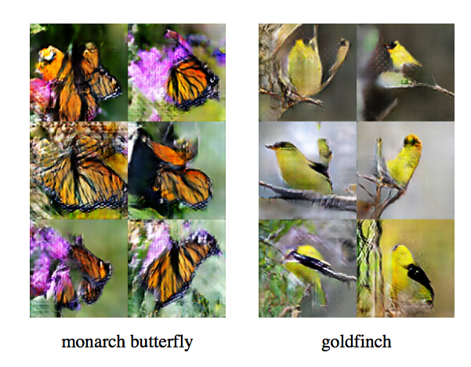
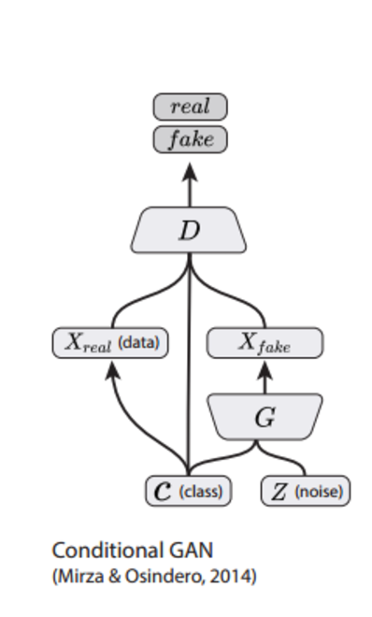
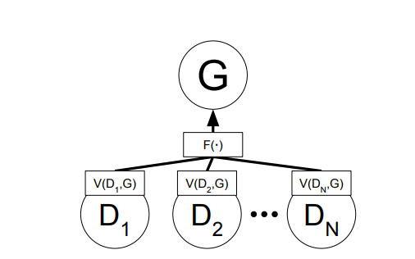
Many GAN flavors
Original GAN based on MLP in 2014
Deep Convolutional GAN in 2015
Conditional GAN
  Learn a parameterized generator p_{model}(x|θ);
  Useful to obtain a single generator object for all θ configurations
Auxiliary Classifer GAN
  D can assign a class to the image
Multi-adversarial
  G is trained on feedback aggregated by multiple D
Durugkar et al., ICLR 2017

Slide 12
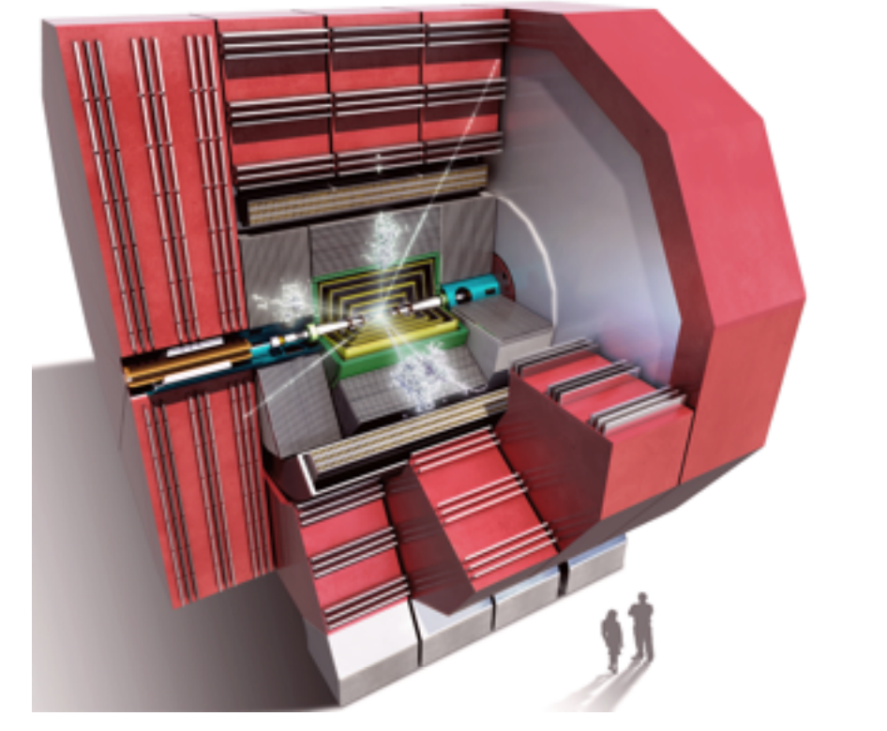
CLIC calorimeter
CLIC is a CERN project for a linear accelerator of electrons and positrons to TeV energies
Associated calorimeter detector design^{(*)}
An array of absorber material and silicon sensors
  ECAL (1.5 m inner radius, 5 mm×5 mm segmentation): 25 tungsten absorber layers + silicon sensors
  HCAL (3.0 cm×3.0 cm segmentation): 60 steel absorber layers + polystyrene scintillators
Data released within CERN OpenData initiative
^{(*)} http://cds.cern.ch/record/2254048#

Slide 13
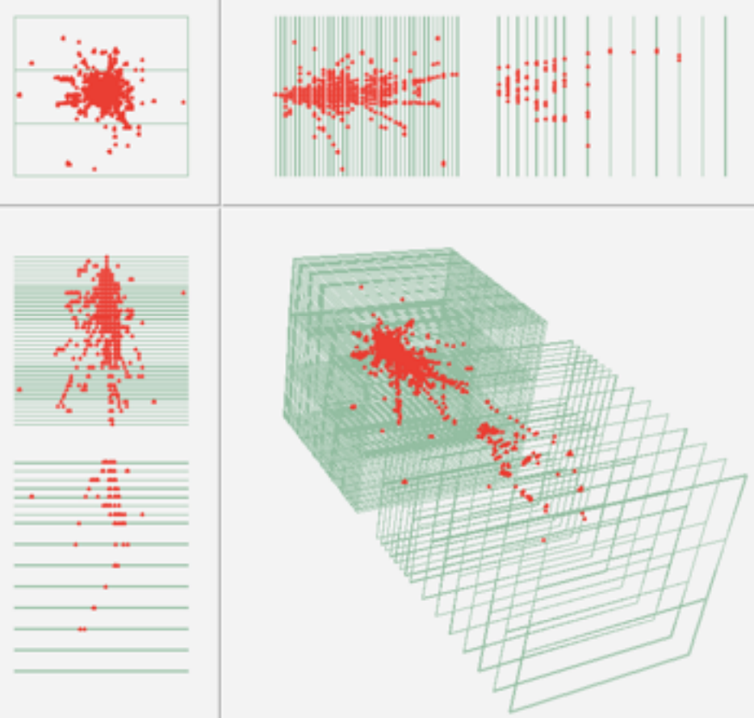
CLIC calorimeter data
Geant4 shower
Geant4 single-particle benchmark datasets (e⁺, e⁻, γ, π) (DD4hep/DDG4/ddsim)
Uniform energy distribution
Fixed energy points (10,50,100,200 GeV)
Simplified: no clustering/cluster id algorithms applied
Data is essentially a 3D image
primary
Ispy visualisation
25
25
25
Pierini, DS@HEP

Slide 14
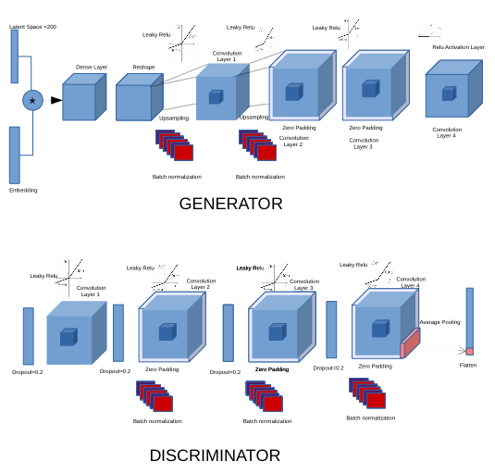
3d GAN for calorimeter images
Conditional GAN (particle type)
Based on convolution/deconvolutions
  3D (de)convolutions to describe full shower development
Implemented tips&tricks found in literature
  Some helpful (no batch normalisation in the last step, LeakyRelu, no hidden dense layers, no pooling layers)
  Some not (Adam optimiser)
Batch training
Loss is combined cross entropy
Y

Slide 15
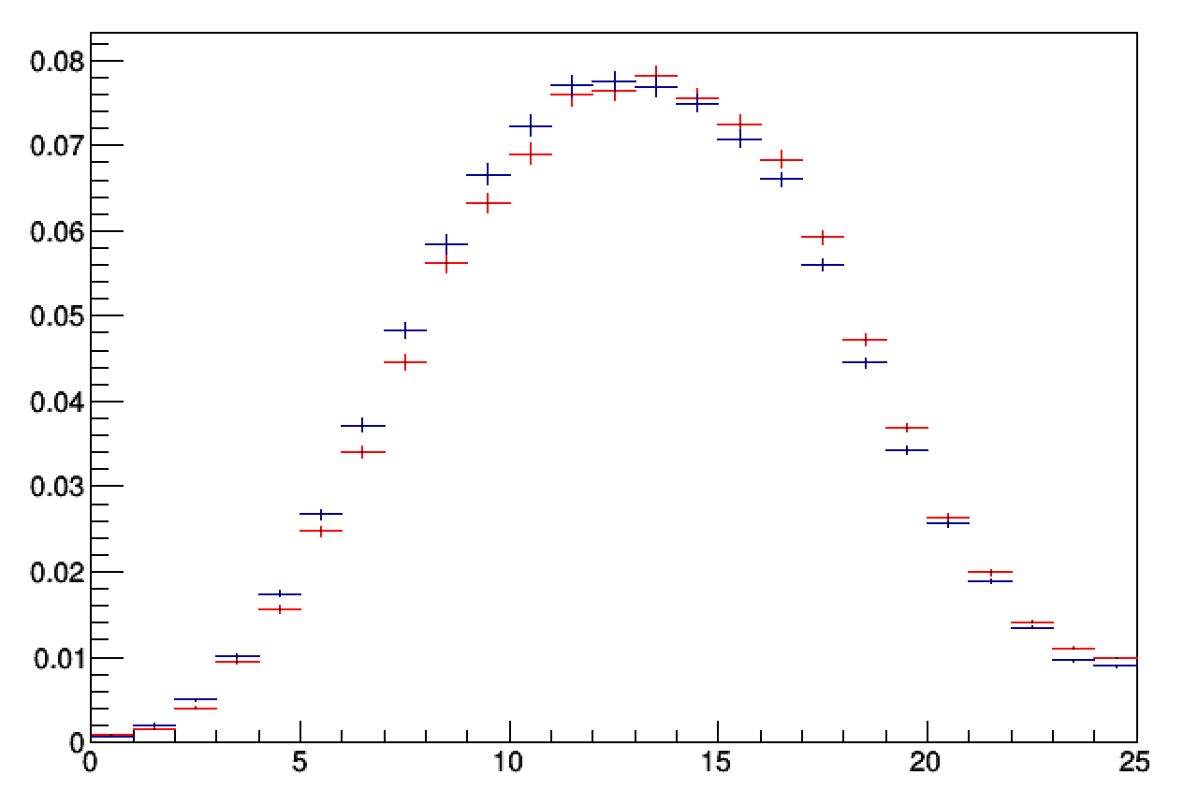
First 3d shower images
Train networks on 150k electrons/photons
Keep energy fixed at 100 GeV
Qualitative analysis show no collapse problem
Longitudinal shower shape slightly off
100 GeV electrons
Geant4
GAN generated
a.u.
Shower longitudinal section
Z

Slide 16
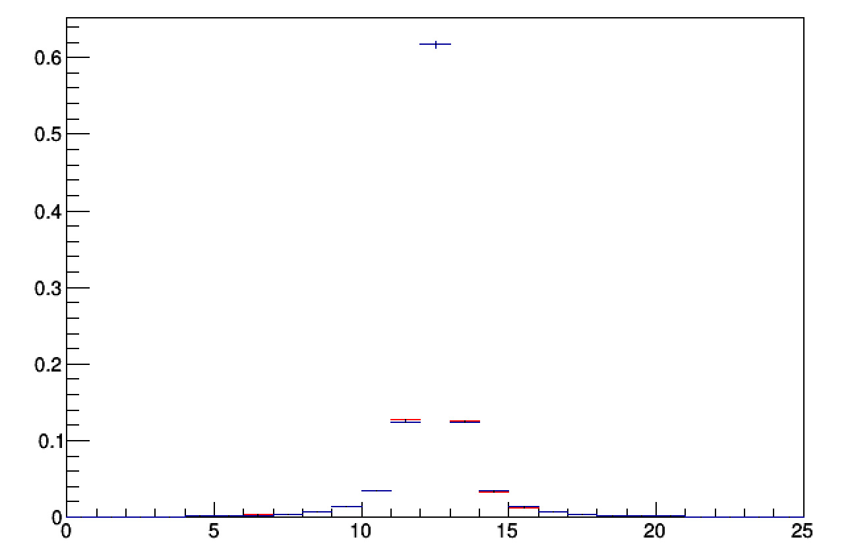
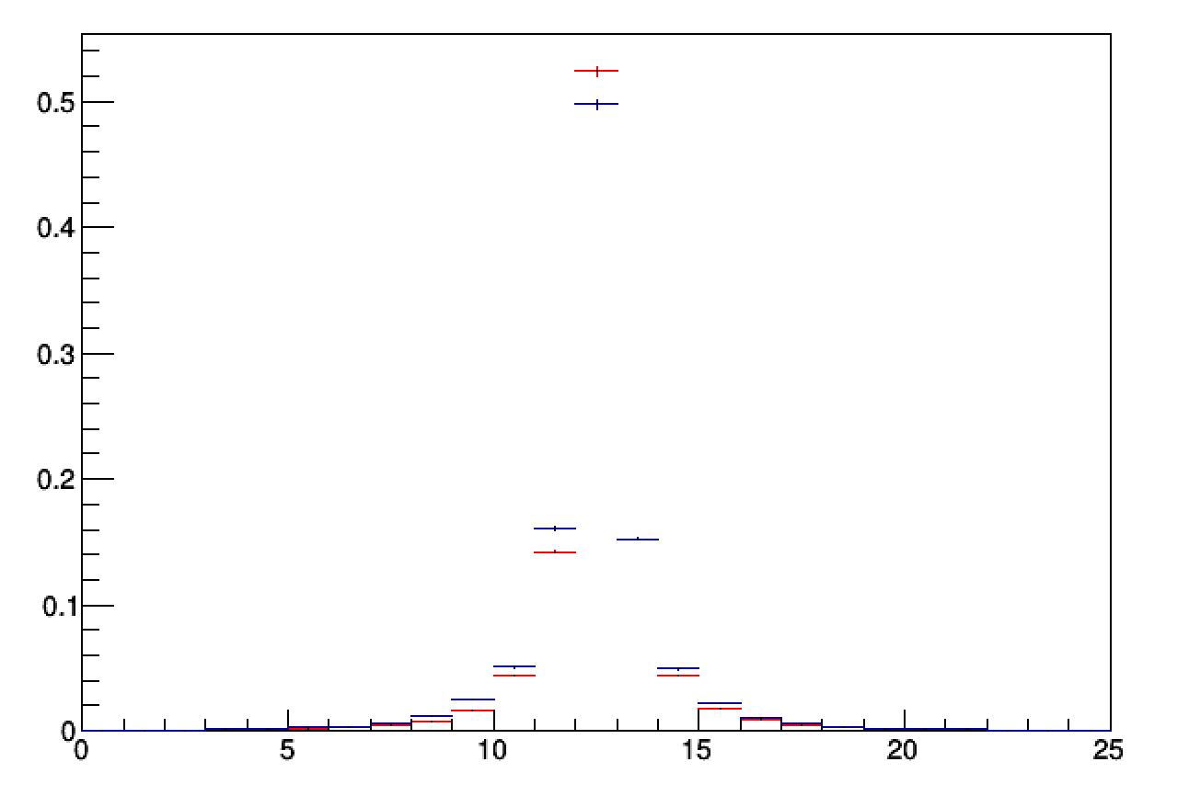
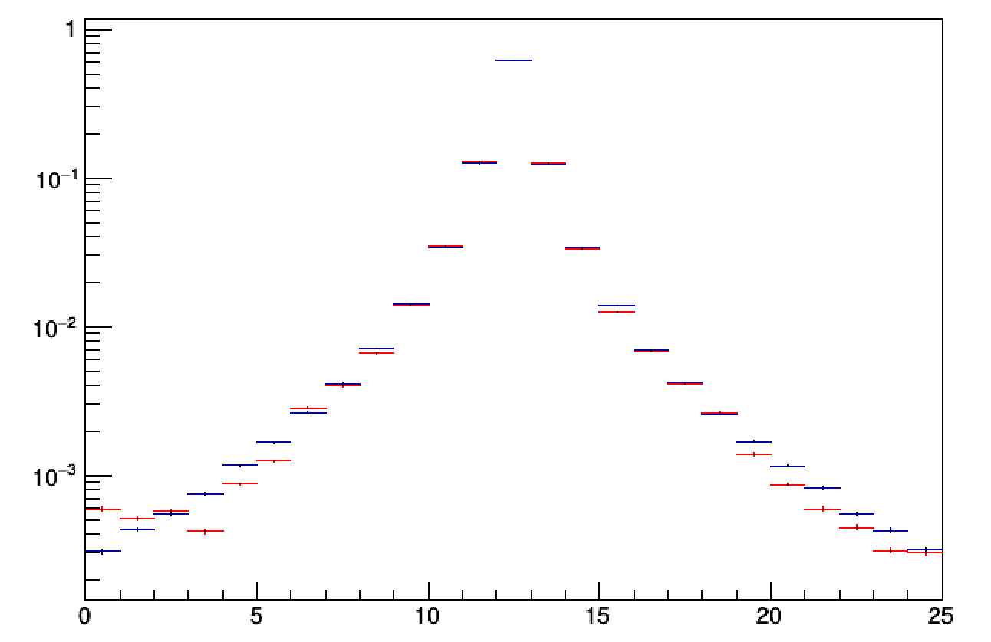
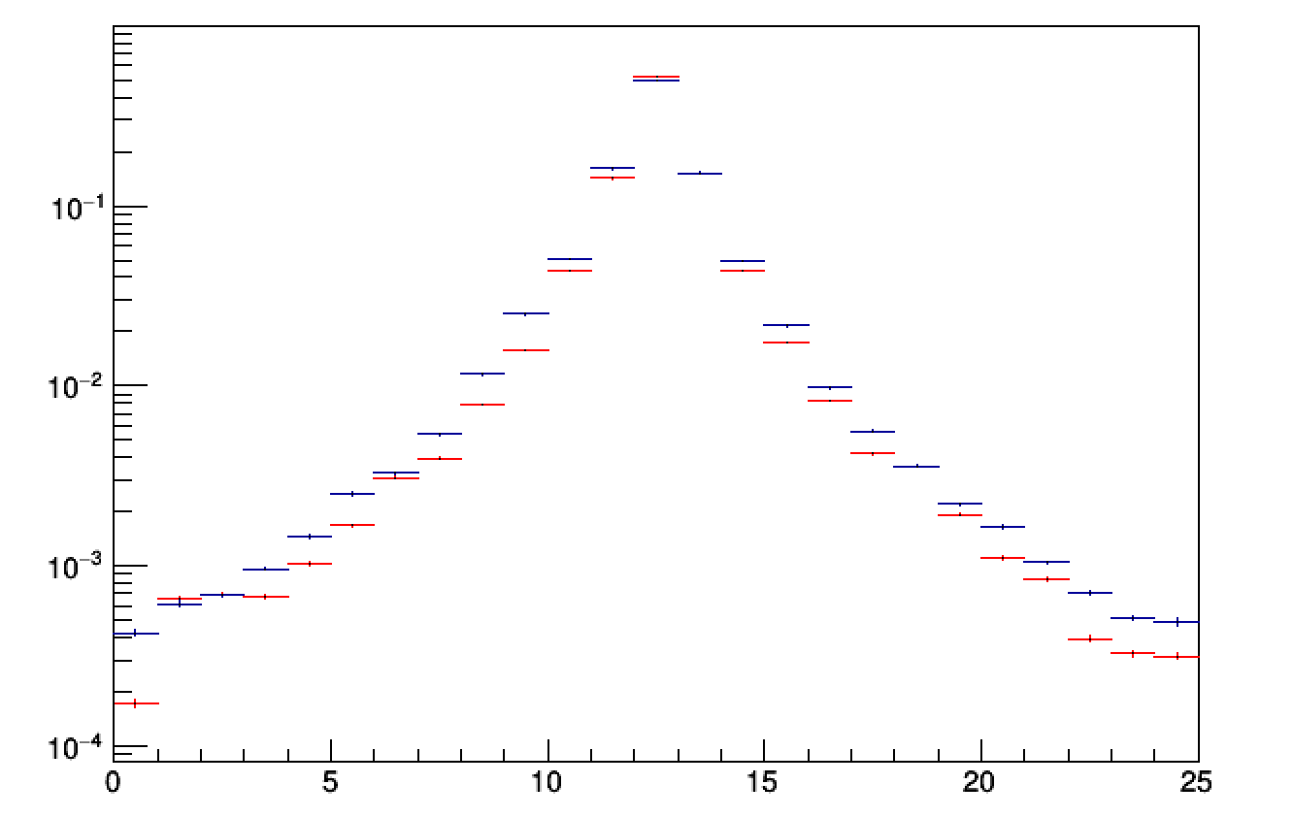
GAN generated showers
Shower transverse sections
a.u.
a.u.
Geant4
GAN generated
Y
X
100 GeV electrons
a.u.
a.u.
a.u.
Y
X

Slide 17
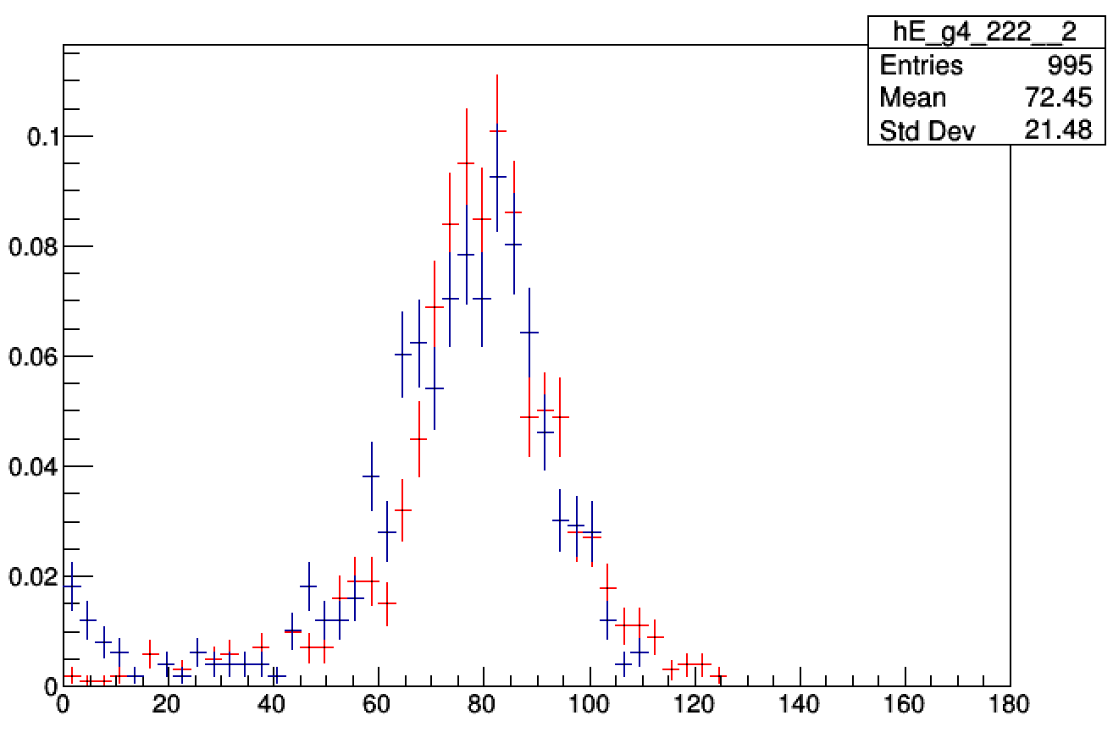
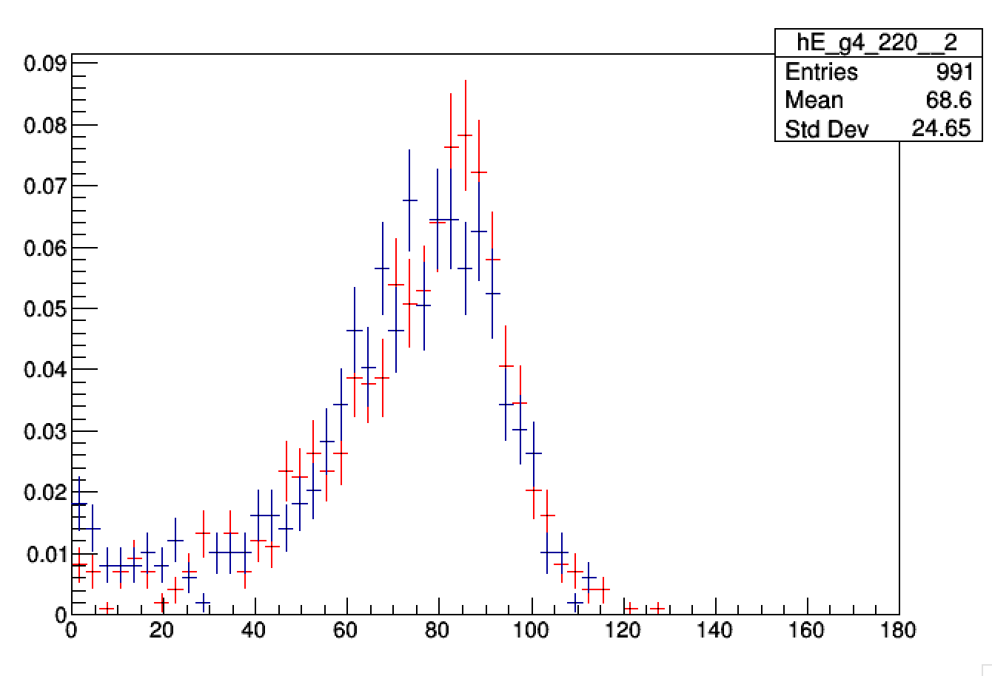
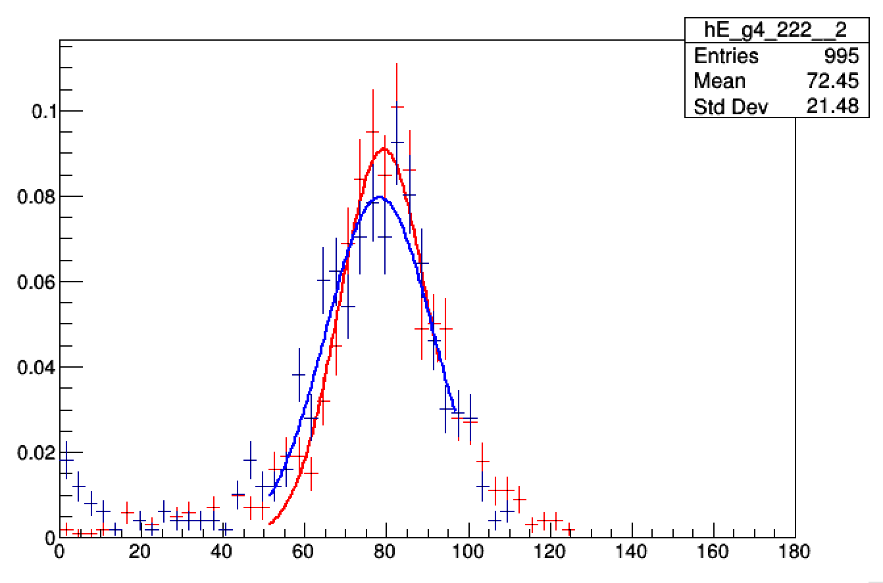
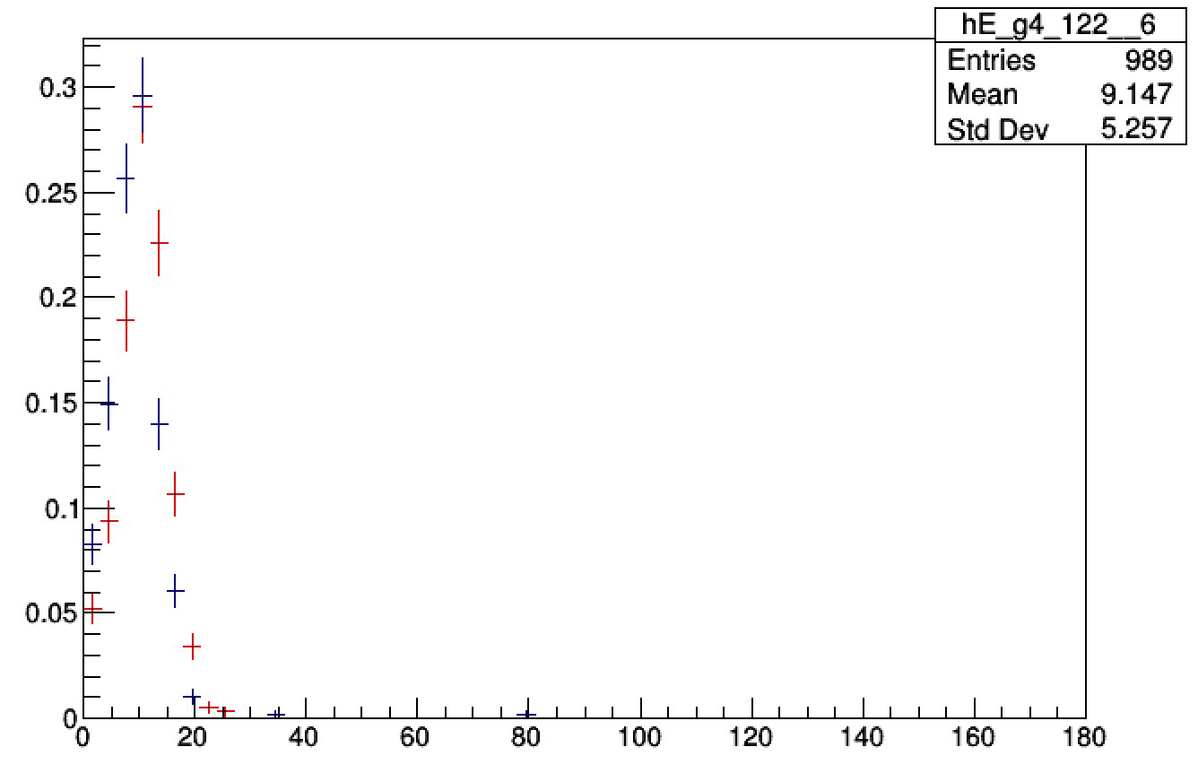
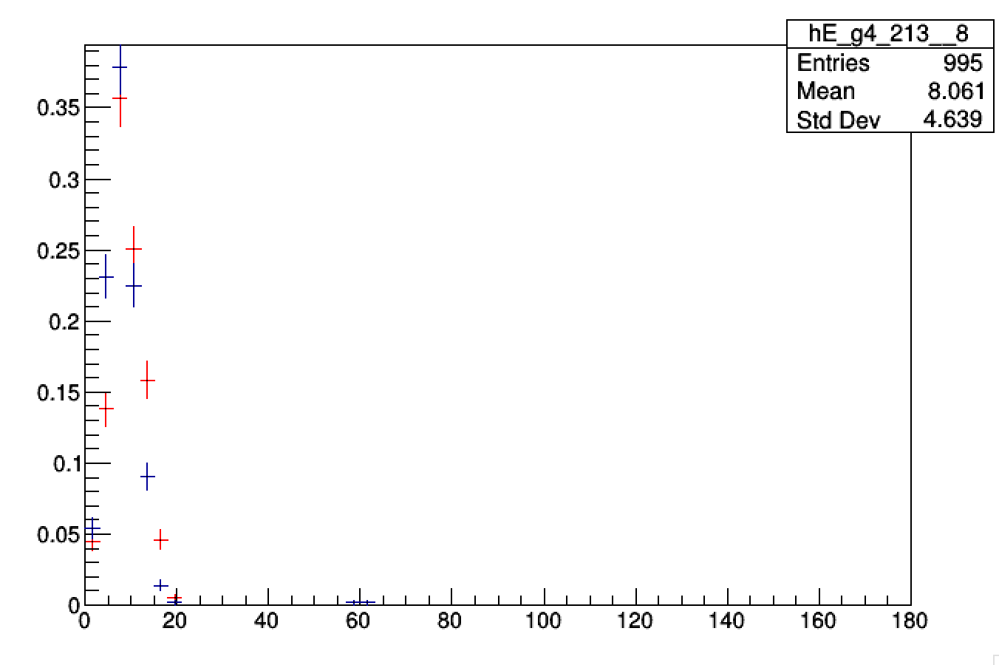
Single cell response
Preliminary
GAN/G4
Cell energy resolution
Y
Cell ID

Slide 18
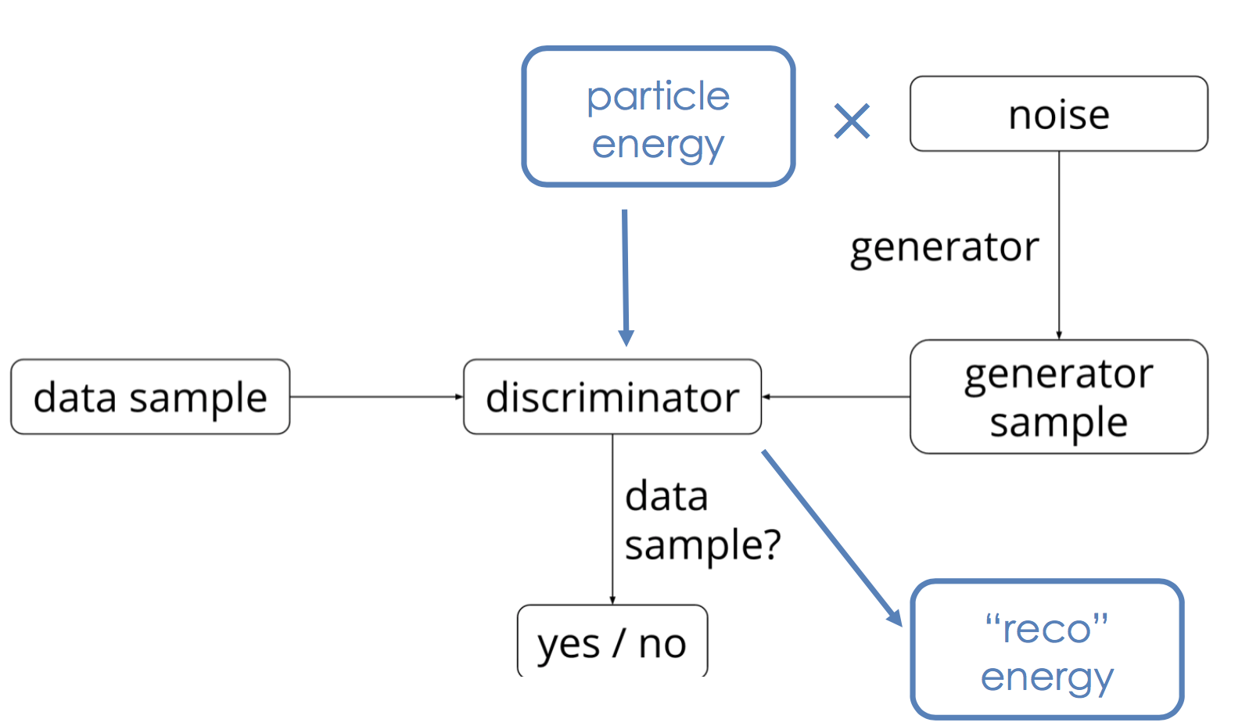
Energy as auxiliary classifier
Training the generator and the discriminator using primary particle energy
Add primary energy regression task to discriminator
Auxiliary loss weight is scaled down wrt shower’s
Train on large continuous spectrum: [0,500] GeV
Single particle type: electrons

Slide 19
Generated showers: longitudinal profile
a.u.
Geant4
GAN generated
a.u.
Z
Z
Shower longitudinal profile shifts towards G4
Agreement improves

Slide 20
Generated showers: transverse profile
a.u.
a.u.
a.u.
Geant4
GAN generated
X
X
a.u.
a.u.
a.u.
Geant4
GAN generated
a.u.
Y
Geant4
GAN generated
X
X
Y

Slide 21
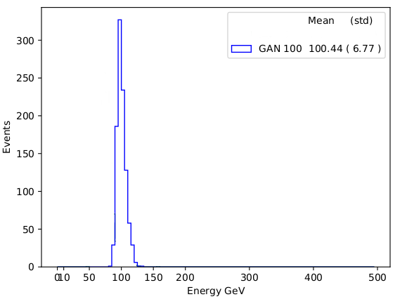
Energy regression
100 GeV
Consistency check
  Generate single energy samples
  Compare to discriminator reconstructed energy
Agreement is good.
  Performance degrades at the edges
150 GeV
200 GeV
300 GeV
50 GeV:
~20% off
500 GeV:
~12% off

Slide 22
Next steps
Have a first example ready by the end of the year
Ongoing optimization
  Test interpolation / extrapolation
  Effect of training sample statistics
Comparison to other fast simulation approaches
Generalize to multi-class approach (or multi-discriminator): primary particle entry point, angle, etc..
Start optimization via hyper-parameter scan

Slide 23
Timing
Keras + Tensorflow Implemetation | Time/Shower (msec)
My laptop (2.6 GHz Intel i7) | 66
NVIDIA GeForce GTX 1080 | 0.04
Generating a shower from trained model is extremely fast!
Training takes about 1 day on the GTX1080
  Training time cannot become a bottleneck
  Depending on the final use case retraining the networks might be necessary
  Embedded algorithms to perform hyper-parameters tuning and meta-optimization
  Scan large hyper-parameter space
Collaboration with Intel and CINECA (Italy) to test scaling on Marconi Intel Xeon Phi cluster

Slide 24
Summary
A configurable framework for fast simulation
  Easily embed user code
  A reasonable library of algorithms
A ML based tool
  Evaluation and optimization of several models
Integration in GEANTV: inference step first, then training tool
Prototype interface and ML proof of concept in GEANTV alpha
  Generalization and meta-optimization later on
  It could be back-ported to Geant4

Slide 25
Thank you

