Slide 1




Massive Parallel QCD Computing
on FPGA Accelerator
with Data-Flow Programming
Thomas Janson and Udo Kebschull
Infrastructure and Computer Systems in Data Processing (IRI)
Goethe University Frankfurt
Germany
ACAT 2017
University of Washington, Seattle

Slide 2
Introduction and Overview
Motivation: fully enabled parallelism and next neighbor search by using data-flow programming
Compute framework
Concept of data-flow programming
Wilson Dirac operator most intense algorithm
Algorithm and neighbor indexing
Dslash Operator as Dataflow Graph
Implementation
Results
Conclusion

Slide 3
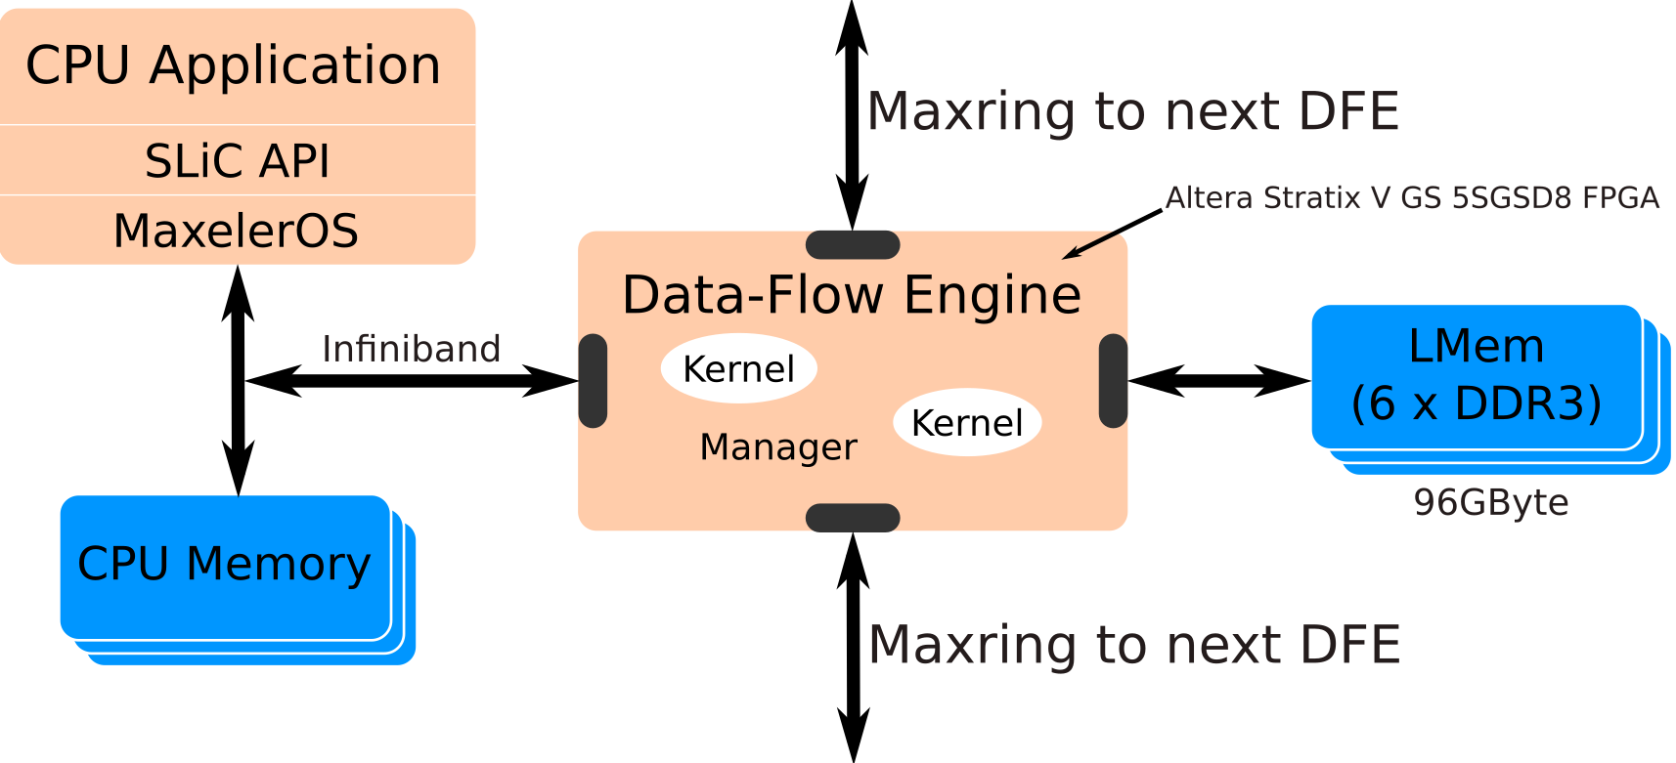
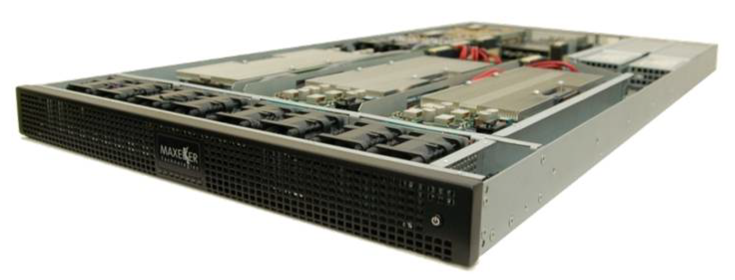
Framework – Maxeler System Architecture
Picture from: Maxeler Technologies, “Programming MPC Systems”, White Paper, June 2013

Slide 4
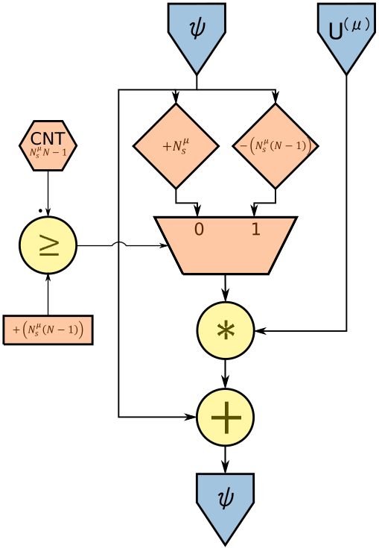
Concept of Data-Flow Programming
Algorithm as data-flow graph
Small set of node types
All nodes are fully pipelined
Arc can hold more than one data item
All arithmetic operations are spatially distributed
Control flow and data flow decoupled
Offset operator picks up data items within the data stream
Stream length known at compile time

Slide 5
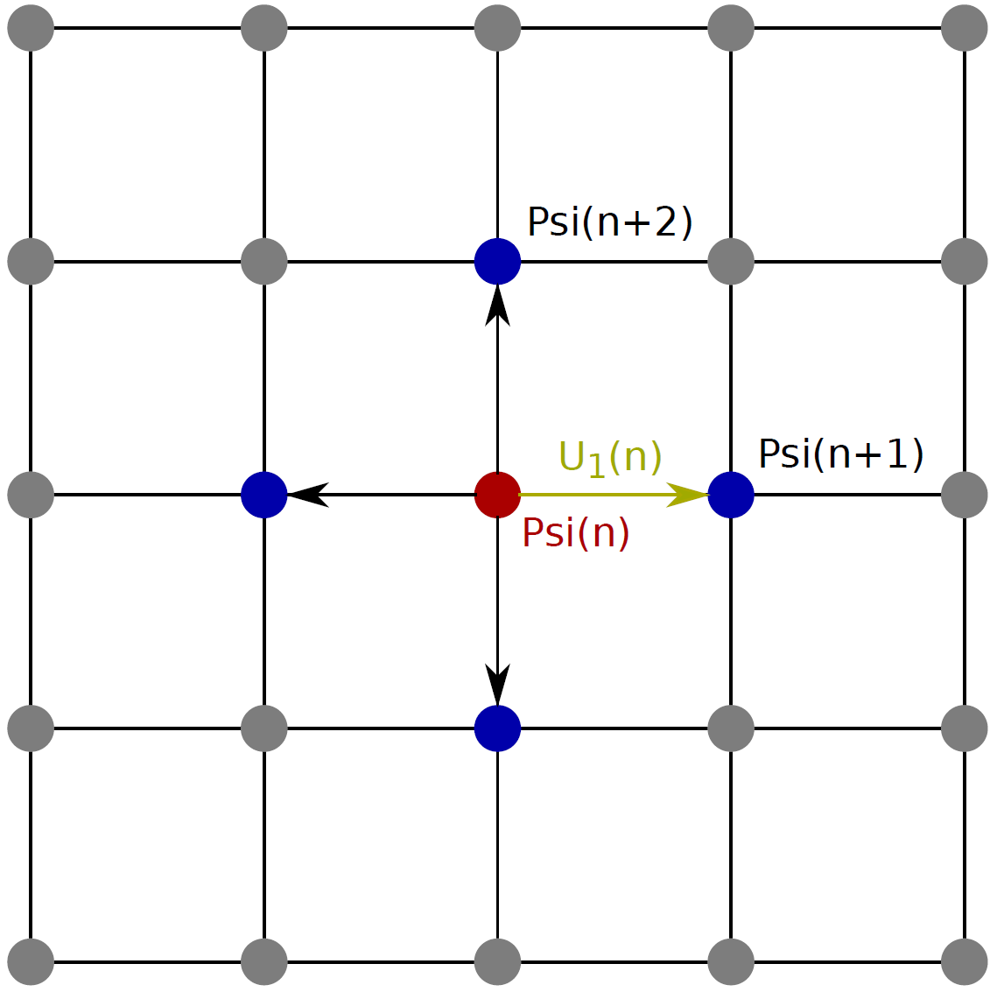
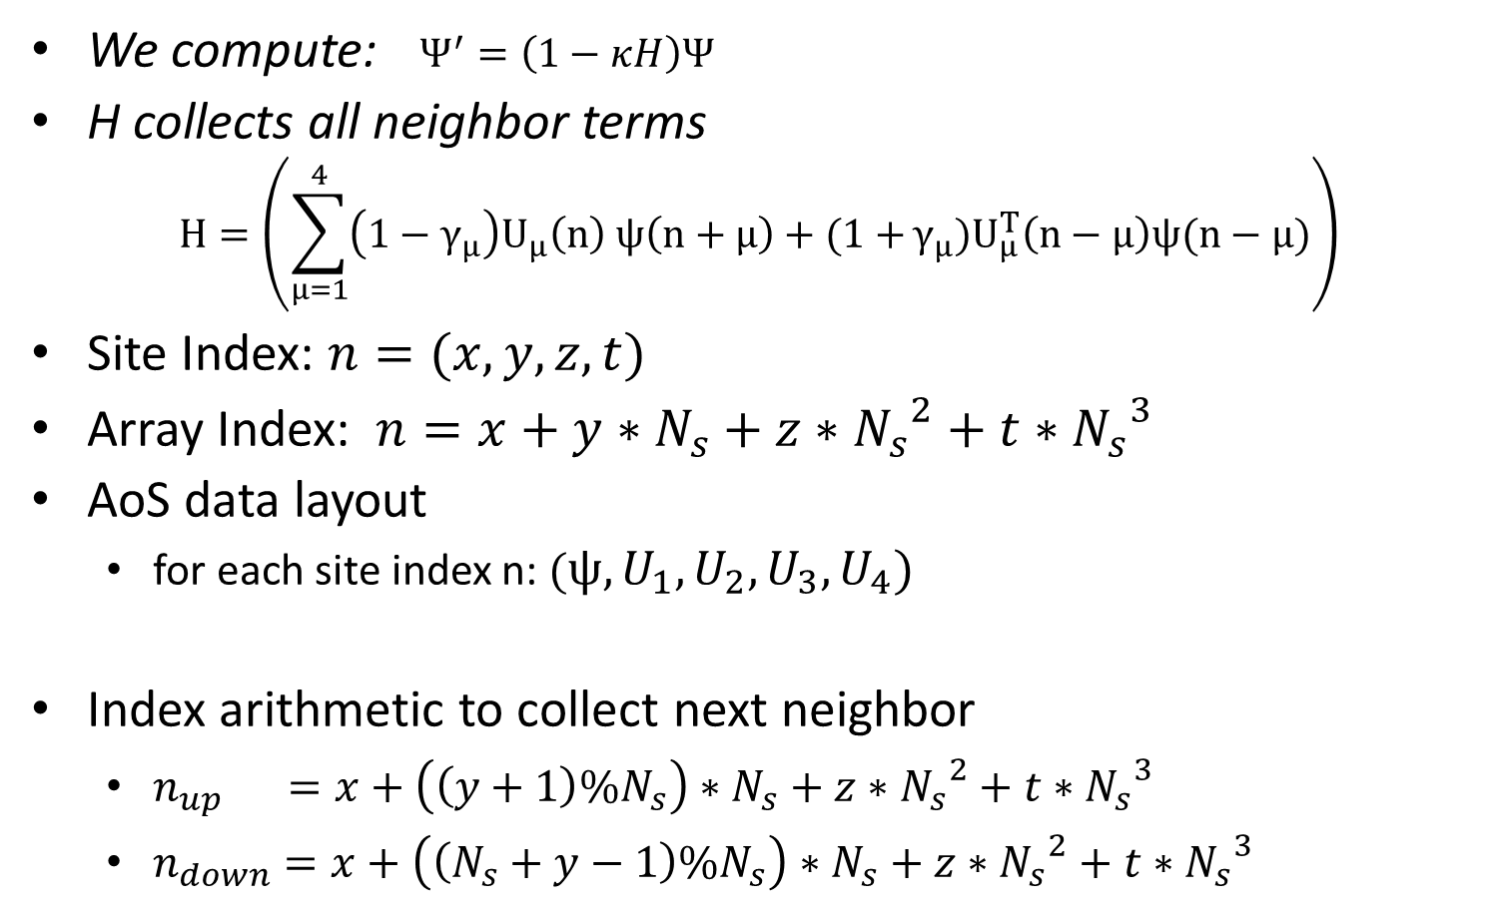
Wilson Dirac Operator
We compute: $Ψ^{′}=\left(1−κH\right)Ψ$
H collects all neighbor terms
$$H=\left(\sum_{μ=1}^{4}{\left(1−γ_{μ}\right)U_{μ}\left(n\right) ψ\left(n+μ\right)+(1+}γ_{μ})U_{μ}^{T}\left(n−μ\right)ψ(n−μ)\right)$$
Site Index: $n=(x,y,z,t)$
Array Index: $n=x+y∗N_{s}+z∗{N_{s}}^{2}+t∗{N_{s}}^{3}$
AoS data layout
  for each site index n: $(ψ,U_{1},U_{2},U_{3},U_{4})$
Index arithmetic to collect next neighbor
  $n_{up} =x+\left(\left(y+1\right)\%N_{s}\right)∗N_{s}+z∗{N_{s}}^{2}+t∗{N_{s}}^{3}$
  $n_{down}=x+\left(\left(N_{s}+y−1\right)\%N_{s}\right)∗N_{s}+z∗{N_{s}}^{2}+t∗{N_{s}}^{3}$

Slide 6
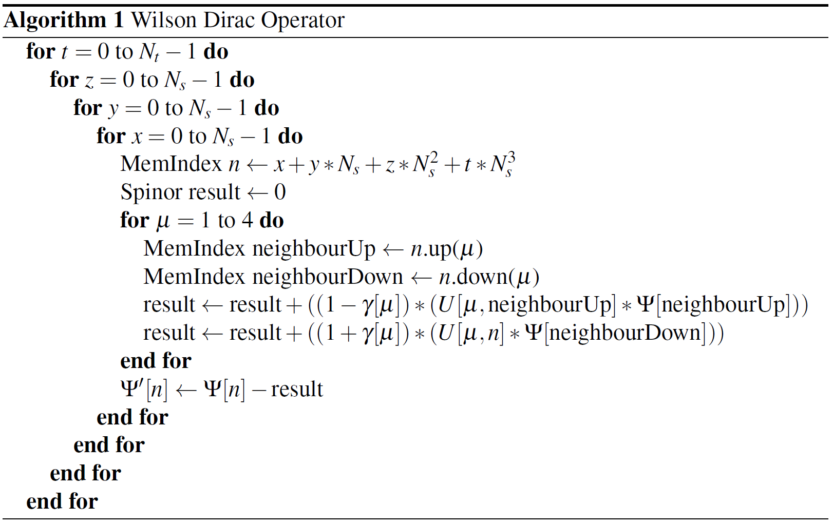
Algorithm

Slide 7
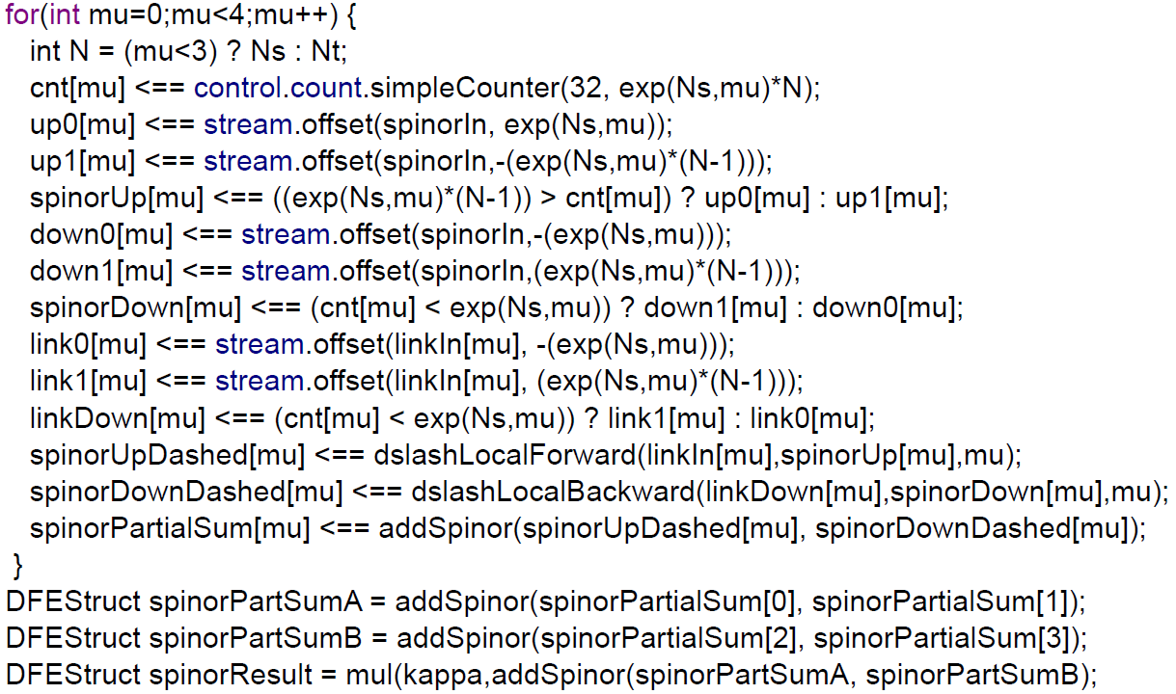
Data-Flow Graph in MaxJ
The outer for loops (x,y,z,t) are unrolled ( data stream )
The inner loop describes the four graphs for each direction

Slide 8
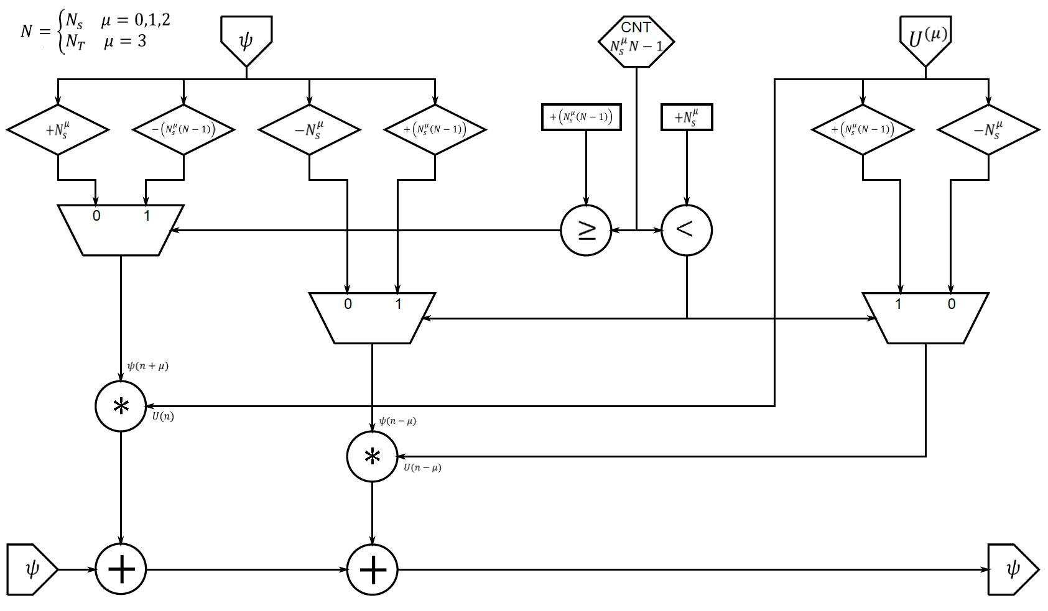
Dslash Operator as Data-Flow Graph
Loop transformation leads to:

Slide 9
Data Layout and Number Representation
We store the lattice in LMem
AoS ( array of structure ) data layout
We use 32 bit fixed-point number representation
  23 fractional bits, 7 bit mantissa ( signed integer )
  Advantage: much lower resource usage
  Entries for the link variable smaller than one
  ( unitary 3x3 matrices, determinant 1 )
  In case of spinor field, an estimation is done against a given data set ( shows relative error of 10^-4% against exact values computed with Mathematica )
  Same test against single precision floating point shows same relative error
  We use this design with the option to test against more data sets

Slide 10
Kernel Throughput
Kernel throughput depends on kernel clock rate
(133 MHz max)
We use 32 bit fixed-point number representation
Input stream with 47 GByte/s
Output stream with 12 GByte/s
Theoretical equivalent peak performance 176 GFLOP/s
  our kernel computes 1320 FLOPs each clock cycle

Slide 11
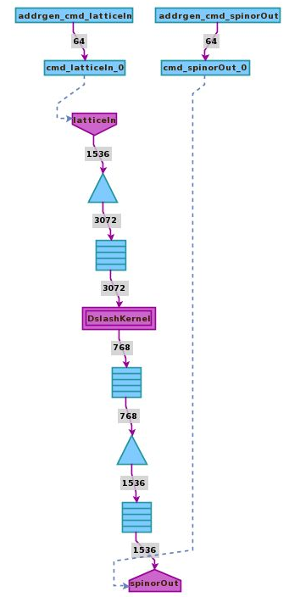
Memory Interface
We stream from LMem, and write the result back to LMem
6 x DDR3 memory , 384 bit interface
Burst rate 8 , 3072 bit intern
384 Byte in one kernel tick
Memory Interface 1066 Mbps
(hard to get timing closure)
Memory Interface configured with 800 Mbps and kernel with 100 MHz
The design is considered to be memory bound

Slide 12
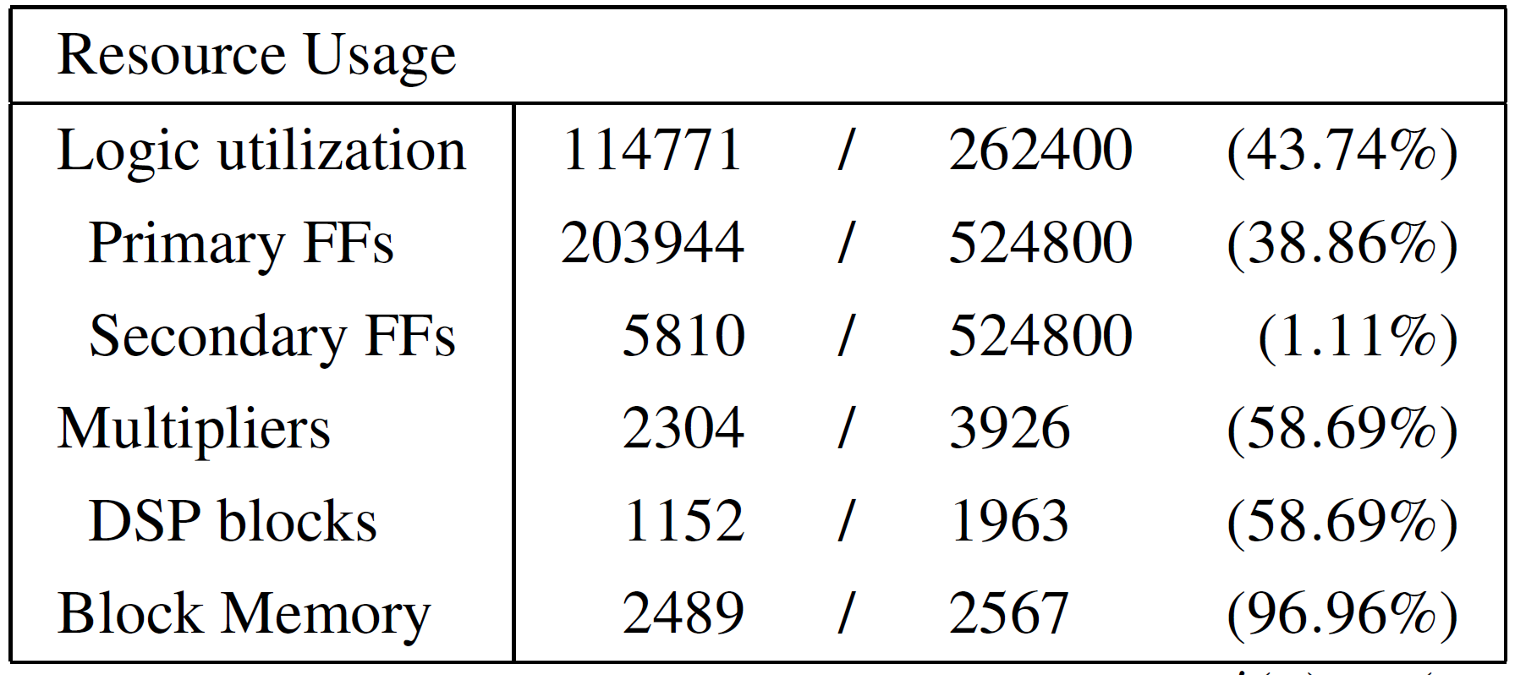
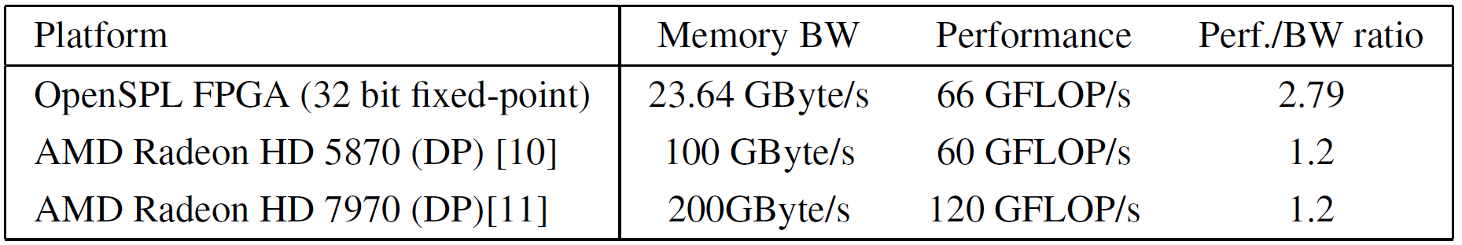
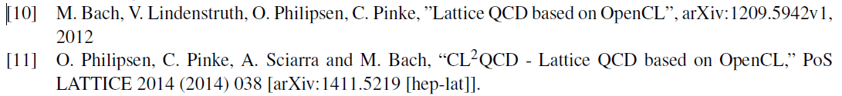
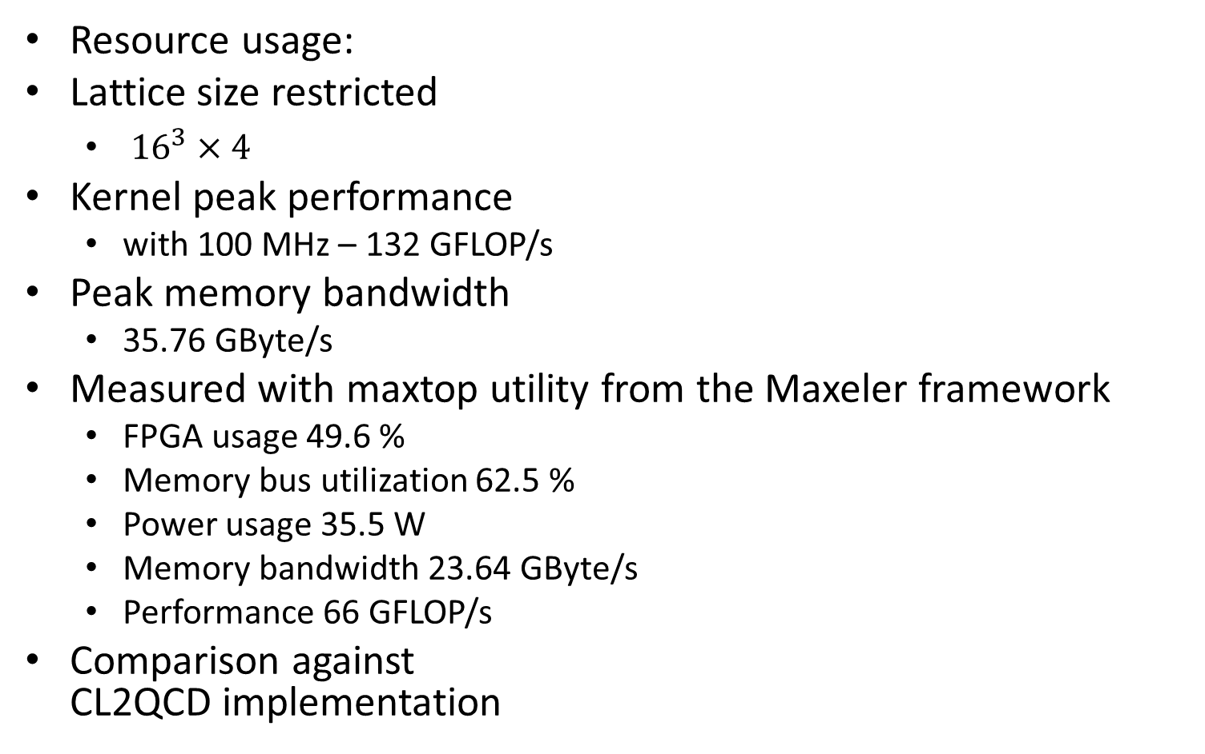
Implementation Results
Resource usage:
Lattice size restricted
  ${16}^{3}×4$
Kernel peak performance
  with 100 MHz – 132 GFLOP/s
Peak memory bandwidth
  35.76 GByte/s
Measured with maxtop utility from the Maxeler framework
  FPGA usage 49.6 %
  Memory bus utilization 62.5 %
  Power usage 35.5 W
  Memory bandwidth 23.64 GByte/s
  Performance 66 GFLOP/s
Comparison against
CL2QCD implementation

Slide 13
Conclusion
Dslash operator can be implemented in a highly parallel and efficient way on an FPGA using the data-flow approach
Processes all arithmetic operations in parallel with 1320 FLOPs per clock cycle
Measured memory bandwidth of 23.64 GByte/s
Measured performance 66 GFLOP/s
We reach a very good performance bandwidth ratio

