Slide 1
Meta: Toward generative C++
Goal: Making C++ more powerful, and simpler
Herb Sutter

Slide 2

Now Playing

Slide 3
Now Playing
Bja ne
r
and the
Unified
Universe

Slide 4
Now Playing
note: we’re already writing these, just
(a) by convention and
(b) described as English instead of as code
The C++ type system is unified!
property
flag
enum
traits
type
expr.
template
enum
class
CORBA
interface
iterator/
range
SI base
class
functor/
callable
dynamic
any
container
MI base
class
COM
class
value/
Regular
variant
“struct”
POD
value
…

Slide 5
Now Playing
note: we’re already writing these, just
(a) by convention and
(b) described as English instead of as code
The C++ type system is unified!
property
flag
enum
traits
type
expr.
template
enum
class
Metaclasses goal in a nutshell:
to name a subset of the universe of
classes having common characteristics,
express that subset using
compile-time code, and
make classes easier to write by letting class authors use the name as a generalized opt-in to get those characteristics.
CORBA
interface
iterator/
range
SI base
class
functor/
callable
dynamic
any
container
MI base
class
COM
class
value/
Regular
variant
“struct”
POD
value
…

Slide 6
The language at work
Source code
Compiler
Definition
class Point {
int x, y;
};
struct MyClass : Base {
void f() { /*...*/ }
// ...
};
for (m : members)
if (!v.has_access())
if(is_class())
v.make_private();
else // is_struct()
v.make_public();
for (f : functions) {
if (f.is_virtual_in_base_class()
&& !f.is_virtual())
f.make_virtual();
if (!f.is_virtual_in_base_class()
&& f.specified_override())
ERROR(“does not override”);
if (f.is_destructor())
if (members_dtors_noexcept())
f.make_noexcept();
}
class Point {
private:
int x, y;
public:
Point() =default;
~Point() noexcept =default;
Point(const Point&) =default;
Point& operator=(const Point&) =default;
Point(Point&&) =default;
Point& operator=(const Point&&) =default;
};
class MyClass : public Base {
public:
virtual void f() { /*...*/ }
// ...
};

Slide 7
The language at work
Source code
Compiler
Definition
class Point {
int x, y;
};
struct MyClass : Base {
void f() { /*...*/ }
// ...
};
class Point {
private:
int x, y;
public:
Point() =default;
~Point() noexcept =default;
Point(const Point&) =default;
Point& operator=(const Point&) =default;
Point(Point&&) =default;
Point& operator=(const Point&&) =default;
};
class MyClass : public Base {
public:
virtual void f() { /*...*/ }
// ...
};
Q: What if you could write your own code here, and give a name to a group of defaults & behaviors?
(treat it as ordinary code, share it as a library, etc.)

Slide 8
The language at work
nothing too crazy!
just participating in interpreting the meaning of definitions
Source code
Compiler
Definition
class Point {
int x, y;
};
struct MyClass : Base {
void f() { /*...*/ }
// ...
};
class Point {
private:
int x, y;
public:
Point() =default;
~Point() noexcept =default;
Point(const Point&) =default;
Point& operator=(const Point&) =default;
Point(Point&&) =default;
Point& operator=(const Point&&) =default;
};
class MyClass : public Base {
public:
virtual void f() { /*...*/ }
// ...
};
Q: What if you could write your own code here, and give a name to a group of defaults & behaviors?
(treat it as ordinary code, share it as a library, etc.)
not making the language grammar mutable
no grammar difference except allowing a metaclass name instead of general “class”
not making definitions mutable after the fact
no difference at all in classes,
no bifurcation of the type system

Slide 9
Metaclasses
$class denotes a metaclass.
Typical uses:
  Enforce rules (e.g., “all functions must be public and virtual”)
  Provide defaults (e.g., “functions are public and virtual by default”)
  Provide implicitly generated functions (e.g., “has virtual destructor by default,” “has full comparison operators and default memberwise implementations”)
namespace std::experimental { // for illustration
$class interface { /*...public pure virtual fns only + by default...*/ };
}
interface Shape { /*... public virtual enforced + default ...*/ };
more specific than “class”

Slide 10
interface (user code)
C++17
Proposed
class Shape {
public:
virtual int area() const =0;
virtual void scale_by(double factor) =0;
virtual ~Shape() noexcept { };
// careful not to write a nonpublic or
// nonvirtual function, or a copy/move
// operation, or a data member; no
// enforcement under maintenance
};
interface Shape {
int area() const;
void scale_by(double factor);
};
default + enforce: all public pure virtual functions
enforce: no data members, no copy/move

Slide 11
interface (implementation)
$class interface {
~interface() noexcept { }
constexpr {
compiler.require($interface.variables().empty(),
"interfaces may not contain data members");
for (auto f : $interface.functions()) {
compiler.require(!f.is_copy() && !f.is_move(),
"interfaces may not copy or move; consider a virtual clone()");
if (!f.has_access()) f.make_public();
compiler.require(f.is_public(), "interface functions must be public");
f.make_pure_virtual();
}
}
};

Slide 12
interface (implementation)
$class ⇒ metaclass
$class interface {
~interface() noexcept { }
constexpr {
compiler.require($interface.variables().empty(),
"interfaces may not contain data members");
for (auto f : $interface.functions()) {
compiler.require(!f.is_copy() && !f.is_move(),
"interfaces may not copy or move; consider a virtual clone()");
if (!f.has_access()) f.make_public();
compiler.require(f.is_public(), "interface functions must be public");
f.make_pure_virtual();
}
}
};
for each function in the instantiating class
enforce constraints, integrated with compiler messages
apply defaults where not specified by the user
define a type ⇒ metaprogram runs here
interface Shape {
int area() const;
void scale_by(double factor);
pair<int,int> get_extents() const;
};

Slide 13
interface (implementation)
$class interface {
~interface() noexcept { }
constexpr {
compiler.require($interface.variables().empty(),
"interfaces may not contain data members");
for (auto f : $interface.functions()) {
compiler.require(!f.is_copy() && !f.is_move(),
"interfaces may not copy or move; consider a virtual clone()");
if (!f.has_access()) f.make_public();
compiler.require(f.is_public(), "interface functions must be public");
f.make_pure_virtual();
}
}
};
+ no loss in usability, expressiveness, diagnostics, performance, …
even compared to other languages that added this as a built-in language feature
Look ma, no standardese!
Define language-like features using the language itself – can read the source code to “language features” like we can read the source code to STL and other libs
Bonus: Does my spec have a bug? Unit-test and debug it as usual… it’s just code
We do not have unit testing and debugging for “standardese”
interface Shape {
int area() const;
void scale_by(double factor);
pair<int,int> get_extents() const;
};

Slide 14
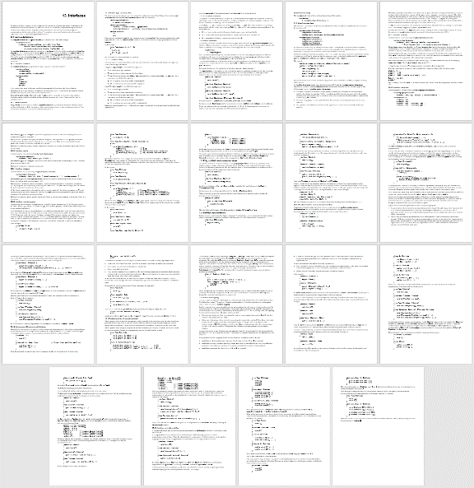
interface (implementation)
C# language: ~18pg, English
Proposed C++: ~10 lines, testable code
$class interface {
~interface() noexcept { }
constexpr {
compiler.require($interface.variables().empty(),
"interfaces may not contain data members");
for (auto f : $interface.functions()) {
compiler.require(!f.is_copy() && !f.is_move(),
"interfaces may not copy or move; "
"consider a virtual clone()");
if (!f.has_access()) f.make_public();
compiler.require(f.is_public(),
"interface functions must be public");
f.make_pure_virtual();
}
}
};

Slide 15
interface (user code)
C#, Java
Proposed C++
interface Shape {
int area();
void scale_by(double factor);
// ...
}
interface Shape {
int area() const;
void scale_by(double factor);
// ...
};

Slide 16
value (user code)
C++17
Proposed
class Point {
int x = 0, y = 0;
public:
Point(int, int);
// ... behavior functions ...
Point() = default;
friend bool operator==(const Point& a, const Point& b)
{ return a.x == b.x && a.y == b.y; }
friend bool operator!=(const Point& a, const Point& b)
{ return !(a == b); }
friend bool operator< (const Point& a, const Point& b)
{ return a.x < b.x || (a.x == b.x && a.y < b.y); }
friend bool operator> (const Point& a, const Point& b)
{ return b < a; }
friend bool operator>=(const Point& a, const Point& b)
{ return !(a < b); }
friend bool operator<=(const Point& a, const Point& b)
{ return !(b < a); }
};
value Point {
int x = 0, y = 0;
Point(int, int);
// ... behavior functions ...
};
default + enforce: copy/move, comparisons, default ctor
default (opt): private data, public functions
enforce: no virtual functions

Slide 17
value (implementation)
$class basic_value {
basic_value() = default;
basic_value(const basic_value& that) = default;
basic_value(basic_value&& that) = default;
basic_value& operator=(const basic_value& that) = default;
basic_value& operator=(basic_value&& that) = default;
constexpr {
for (auto f : $basic_value.variables())
if (!f.has_access()) f.make_private();
for (auto f : $basic_value.functions()) {
if (!f.has_access()) f.make_public();
compiler.require(!f.is_protected(), "a value type may not have a protected function");
compiler.require(!f.is_virtual(), "a value type may not have a virtual function");
compiler.require(!f.is_destructor() || f.is_public(), "a value destructor must be public");
}
}
};
$class value : basic_value, ordered { };

Slide 18
value (implementation)
value Point {
int x = 0, y = 0;
Point(int, int);
};
Point p(50, 100), p2; // ok, default constructible
p2 = get_some_point(); // ok, copyable
if (p == p2) { /*…*/ } // ok, == available
set<Point> s; // ok, < available
$class basic_value {
basic_value() = default;
basic_value(const basic_value& that) = default;
basic_value(basic_value&& that) = default;
basic_value& operator=(const basic_value& that) = default;
basic_value& operator=(basic_value&& that) = default;
constexpr {
for (auto f : $basic_value.variables())
if (!f.has_access()) f.make_private();
for (auto f : $basic_value.functions()) {
if (!f.has_access()) f.make_public();
compiler.require(!f.is_protected(), "a value type may not have a protected function");
compiler.require(!f.is_virtual(), "a value type may not have a virtual function");
compiler.require(!f.is_destructor() || f.is_public(), "a value destructor must be public");
}
}
};
$class value : basic_value, ordered { };
ordered provides <, >, <=, >=, ==, !=

Slide 19
When you can’t express it all in C++ code
Qt moc
Proposed
.h – with extensions
moc compiler
.h
generated
moc_*.cpp
.cpp
.cpp
C++ compiler
C++ compiler

Slide 20
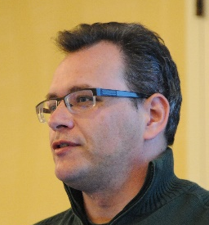

podio (particle physics data models, Benedikt Hegner)
Today (separate YAML script)
ExampleHit :
Description : "Example Hit"
Author : "B. Hegner"
Members:
- double x // x-coordinate
- double y // y-coordinate
- double z // z-coordinate
- double energy // measured
generate: 5 interrelated classes…
X, XCollection, XConst, XData, XObj
how: separate code generator

Slide 21
podio (particle physics data models, Benedikt Hegner)
Today (separate YAML script)
Proposed C++ (strawman)
ExampleHit :
Description : "Example Hit"
Author : "B. Hegner"
Members:
- double x // x-coordinate
- double y // y-coordinate
- double z // z-coordinate
- double energy // measured
podio::datatype ExampleHit {
string Description = "Example Hit";
string Author = "B. Hegner";
double x; // x-coordinate
double y; // y-coordinate
double z; // z-coordinate
double energy; // measured
};
generate: 5 interrelated classes…
X, XCollection, XConst, XData, XObj
how: separate code generator
default + enforce: constexpr static strings
generate: same 5 classes
how: during normal C++ compilation

Slide 22
Goals
Expand C++’s abstraction vocabulary beyond class/struct/union/enum
Enable writing compiler-enforced coding standards, hardware interface patterns, etc.
Enable writing “language extensions” as library code, with equal usability & efficiency
  Incl. valuable extensions we’d never standardize in the language because they’re too narrow (e.g., interface)
Eliminate the need for side languages & compilers (e.g., Qt moc, COM IDL/MIDL, C++/CX)
Benefits for users
Don’t have to wait for a new compiler
Can share “new language features” as libraries
Can even add productivity features themselves
Benefits for standardization
More features as libraries ⇒ easier evolution
Testable code ⇒ higher-quality proposals
Benefits for C++ implementations
< new language features ⇒ < compiler work
Can deprecate and remove classes of extensions

Slide 23
Meta: Toward generative C++
Goal: Making C++ more powerful, and simpler
Questions?

