Slide 1

Knowledge Preservation and Reproducibility in HEP (and beyond)
Re-use
Mike Hildreth
University of Notre Dame
+

Slide 2
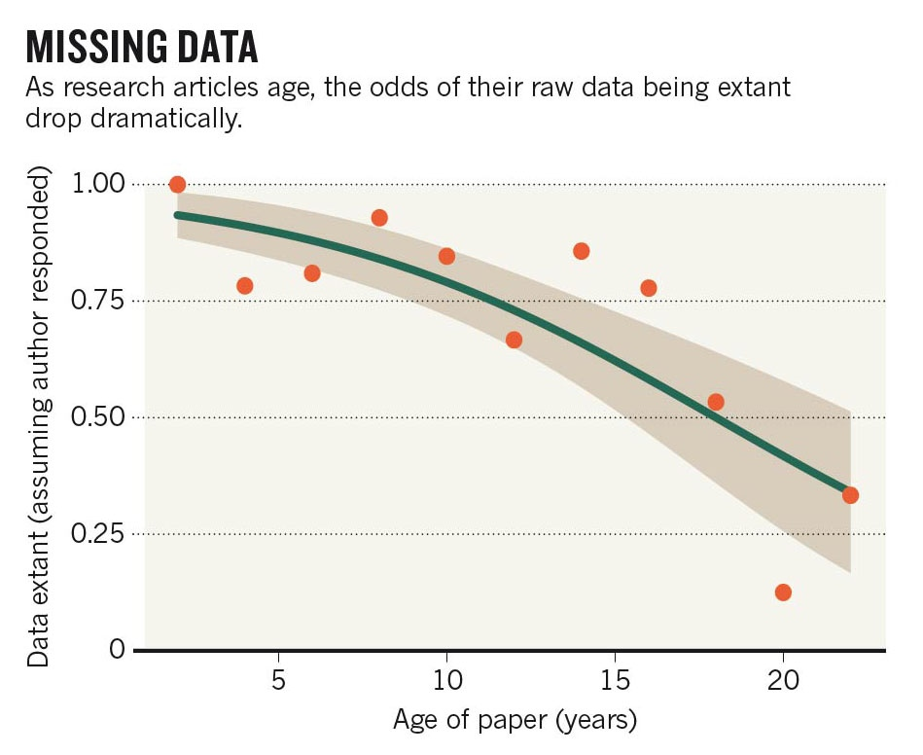
The Problem:
We lose data if we’re not careful!
Nature News, 19 December 2013

Slide 3

Preservation of Scientific Data
Huge investment in producing data for science is wasted if the data is lost or cannot be re-used
Crucial for the Reproducibility of scientific results
Reflected in new policies by many governments and funding agencies worldwide
TO KEEP YOUR DATA
…AND MAKE IT PUBLIC

Slide 4
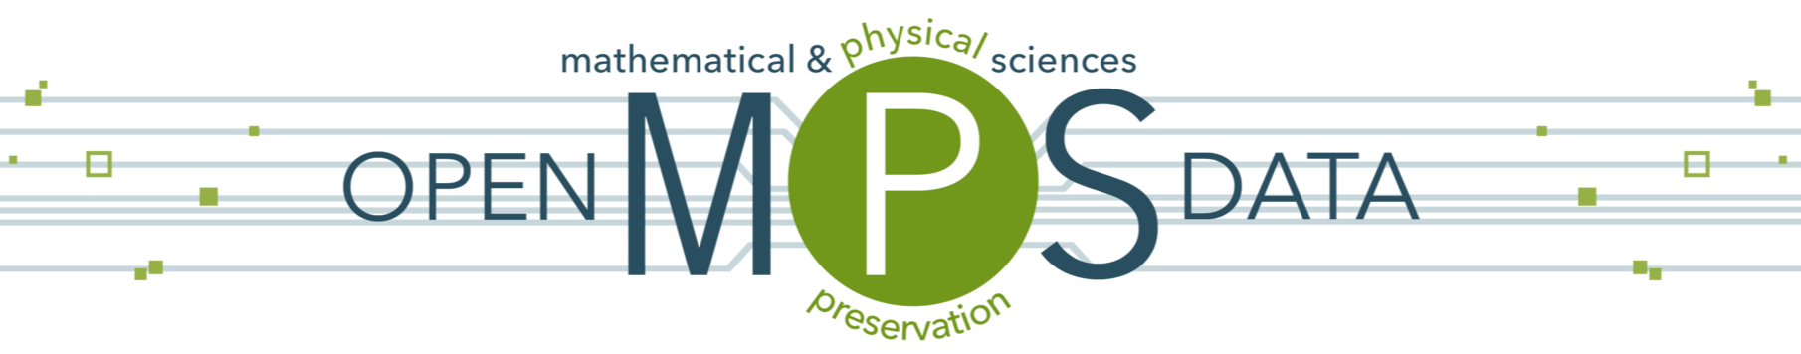
Policy Questions
What data should be saved?
What else should be saved besides the data to enable re-use?
Where should it be stored?
Who pays for the storage?
  Federal grants typically run 3 years
    after this the money is spent
Who pays to allow the public to access the data?
  network & storage infrastructure isn’t free
Funding agencies developing policies, need guidance
mpsopendata.crc.nd.edu

Slide 5
Policy Responses
Community exercise to provide feedback to NSF on knowledge preservation questions from Physical Sciences
Input from APS, ACS, surveys, workshops, etc.
Final Report just issued, some conclusions:
Data and other digital artifacts upon which publications are based should be made publicly available in a digital, machine-readable format, and persistently linked to those relevant publications.
Different disciplines have a wide variety of current practices and expectations for appropriate levels of the sharing of data and other scientific results. A discipline-specific policy discussion will be required to determine an appropriate level of preservation and re-use.
mpsopendata.crc.nd.edu

Slide 6
Policy Responses
Community exercise to provide feedback to NSF on knowledge preservation questions from Physical Sciences
Input from APS, ACS, surveys, workshops, etc.
Final Report just issued, some conclusions:
The provision of public access to data entails costs in infrastructure and human effort, and that some types of data may be impractical to archive, annotate, and share. Cost-benefit analyses should be conducted in order to set the level of expectations for the researcher, his or her institution, and the funding agency.
Creating incentives toward the sharing of data is the primary way to accomplish broad adoption of open access to data as the norm
mpsopendata.crc.nd.edu

Slide 7
Policy Responses
Beyond these (relatively obvious) conclusions, the report lays out a roadmap towards achieving a future where scientific data is re-useable.
What ingredients are necessary?
  The additional information that makes data re-useable:
    Application software, Workflows, Software environment, Simulation capabilities, Documentation, Data characterization, Measurement parameters/Metadata, etc.
  The cyberinfrastructure to capture, store, discover, and access all of this information
  Incentives (scientific, cultural, professional, economic) to drive the community in this direction
Rest of talk: explore work on various aspects of this problem
mpsopendata.crc.nd.edu

Slide 8
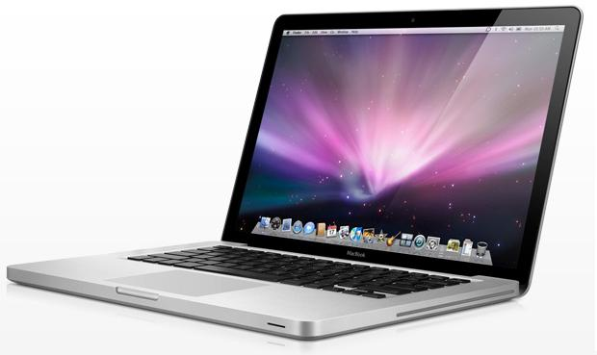
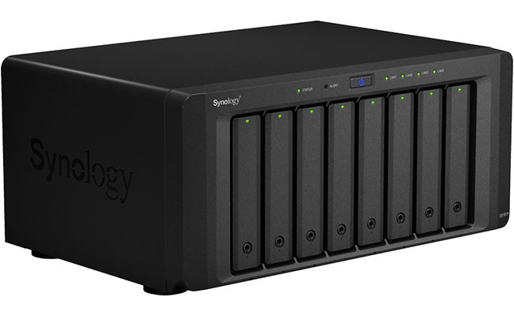
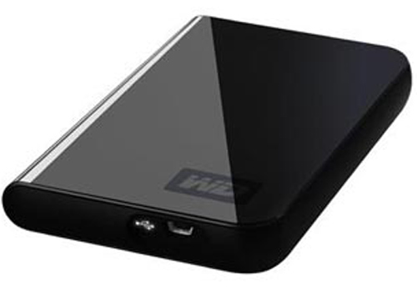
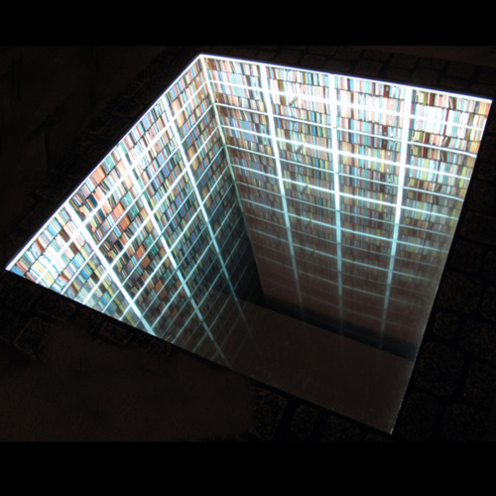
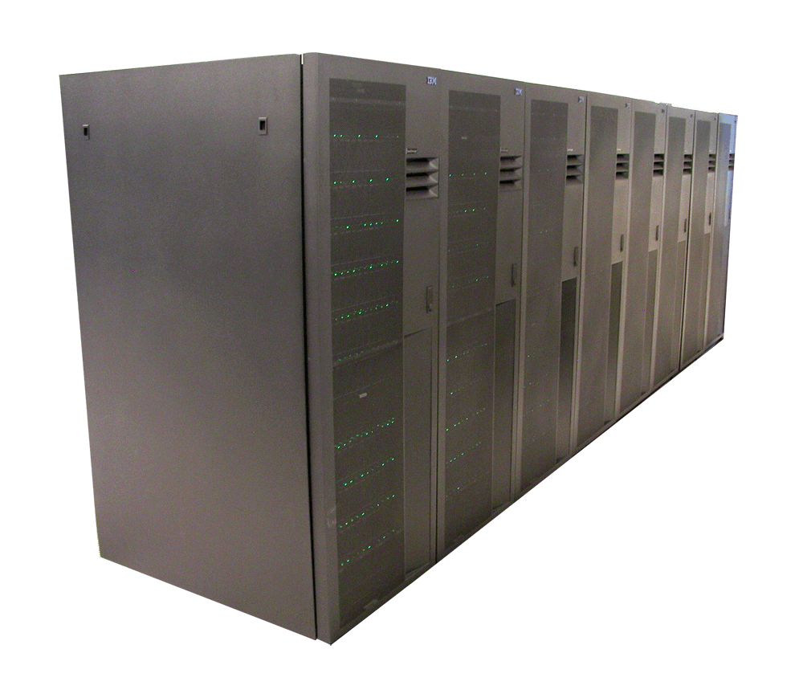
Keeping Science Results for Years
Data preservation: “backing up your hard drive”
  “easy”, needs to be automatic in terms of error checking, migration to new storage technologies

Slide 9
Keeping Science Results for Years
Data preservation: “backing up your hard drive”
  “easy”, needs to be automatic in terms of error checking, migration to new storage technologies
harder problem: software + “knowledge”
  Records/instructions of how data was processed
    lab notebooks, Web pages, napkin scribbles, etc.
  algorithms necessary to analyze the data, derive final results
  computer operating system and other software libraries necessary to run the software

Slide 10
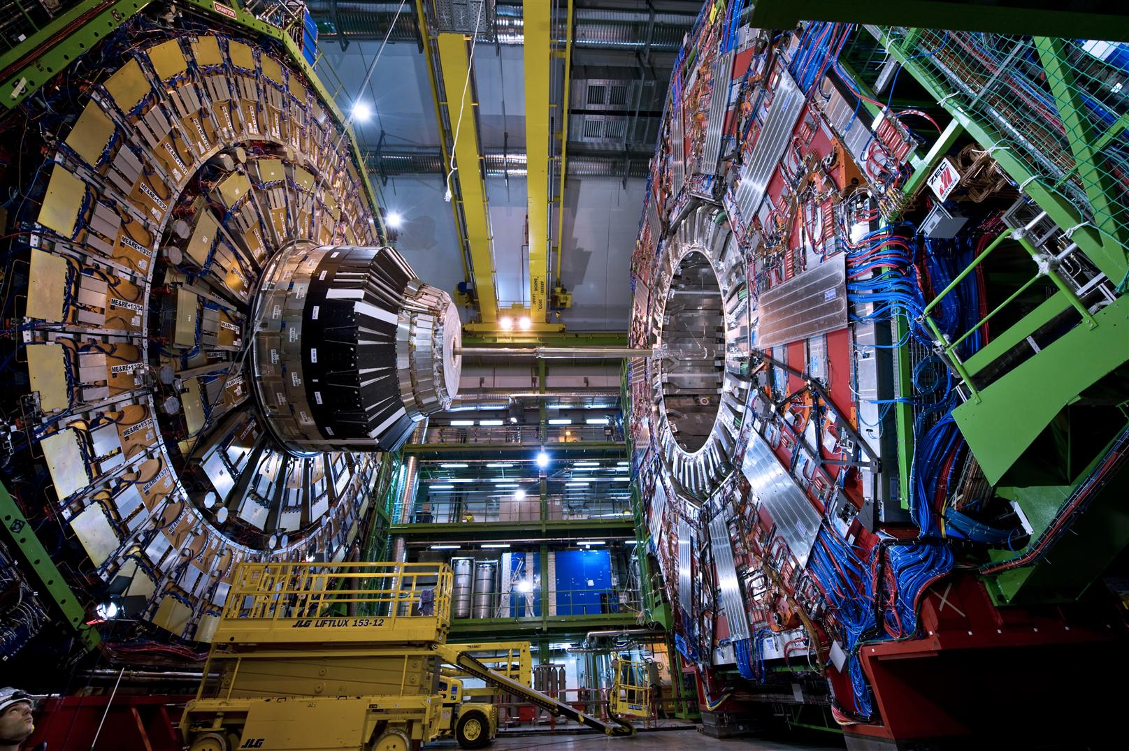
Knowledge Preservation at the LHC
Processed Data
Reduced Data
Twice-reduced Data
Selection/Analysis/Simplification
Selection/Simplification
From LHC
More Inputs
Twice-reduced Data
Higgs Discovery!
Must also be preserved
Further Analysis
Simulated Data

Slide 11
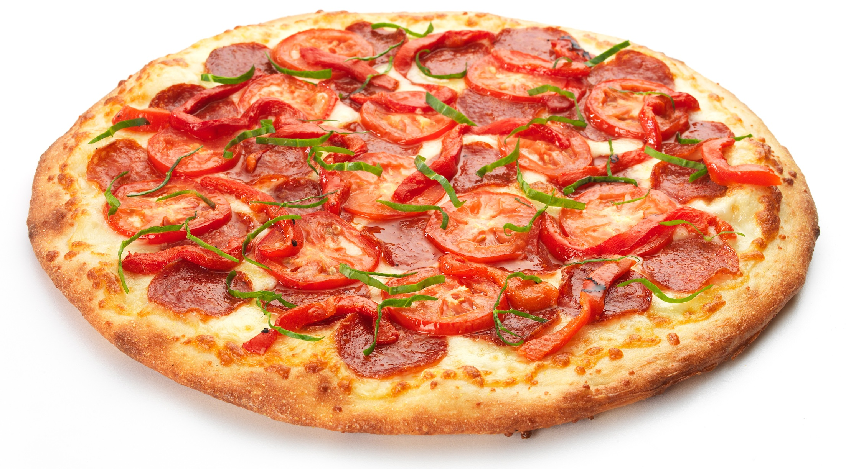
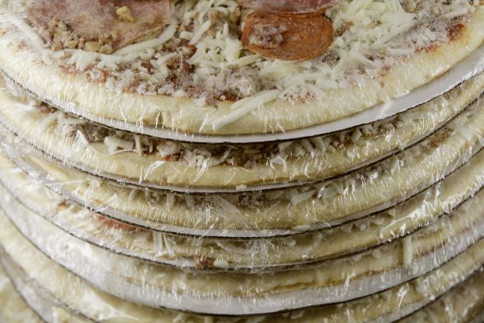
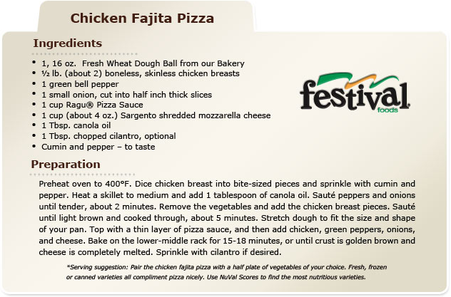
Pizza (=Knowledge) Preservation
Refrigeration
  preserve for a short time before it goes moldy
  hope that a short time is “long enough”
Frozen Pizza
  preserve until freezer burn takes over
  freeze code, operating system, data, so that it can be re-run later, assuming you still can
  Same procedures used for remote computing
Recipe
  make sure you can repeat, given the ingredients
“hope”
VM/Containers
github++

Slide 12






Data And Software Preservation for Open Science
  multi-disciplinary effort
    Notre Dame, Chicago, UIUC, Washington, Nebraska, NYU, (Fermilab, BNL)
  Links High Energy Physics effort to Biology, Astrophysics, Digital Curation, and other disciplines
  includes physicists, digital librarians, computer scientists
  aim to achieve some commonality across disciplines in
    meta-data descriptions of archived data
      What’s in the data, how can it be used?
    computational description (ontology/metadata development)
      how was the data processed?
      can computation replication be automated?
    impact of access policies on preservation infrastructure

Slide 13
DASPOS, in more detail
We are building a test technical infrastructure to implement a knowledge preservation system that can enable re-use
  “Scouting party” to figure out where the most pressing problems lie, and some solutions
    incorporate input from multi-disciplinary dialogue, use-case definitions, policy discussions
  Translate needs of analysts into a technical implementation of meta-data specification
  Develop means of specifying processing steps and the requirements of external infrastructure (databases, etc.)
  Implement “physics query” infrastructure across small-scale distributed network
  End result: “template architecture” for data/software/knowledge preservation systems

Slide 14
A Sample Computation
Config
v0.1
Databases
external
Input files
Output files
1
OS
1
my.exe
…
v4.6.31
…
v21.6A
N
M
libAA
v3.12.6
libBB
v6.1.3
libCC
v1.1.9
Many dependencies, many are versioned
Could have thousands of input/output files with same computation
Could have many computational steps in an analysis

Slide 15
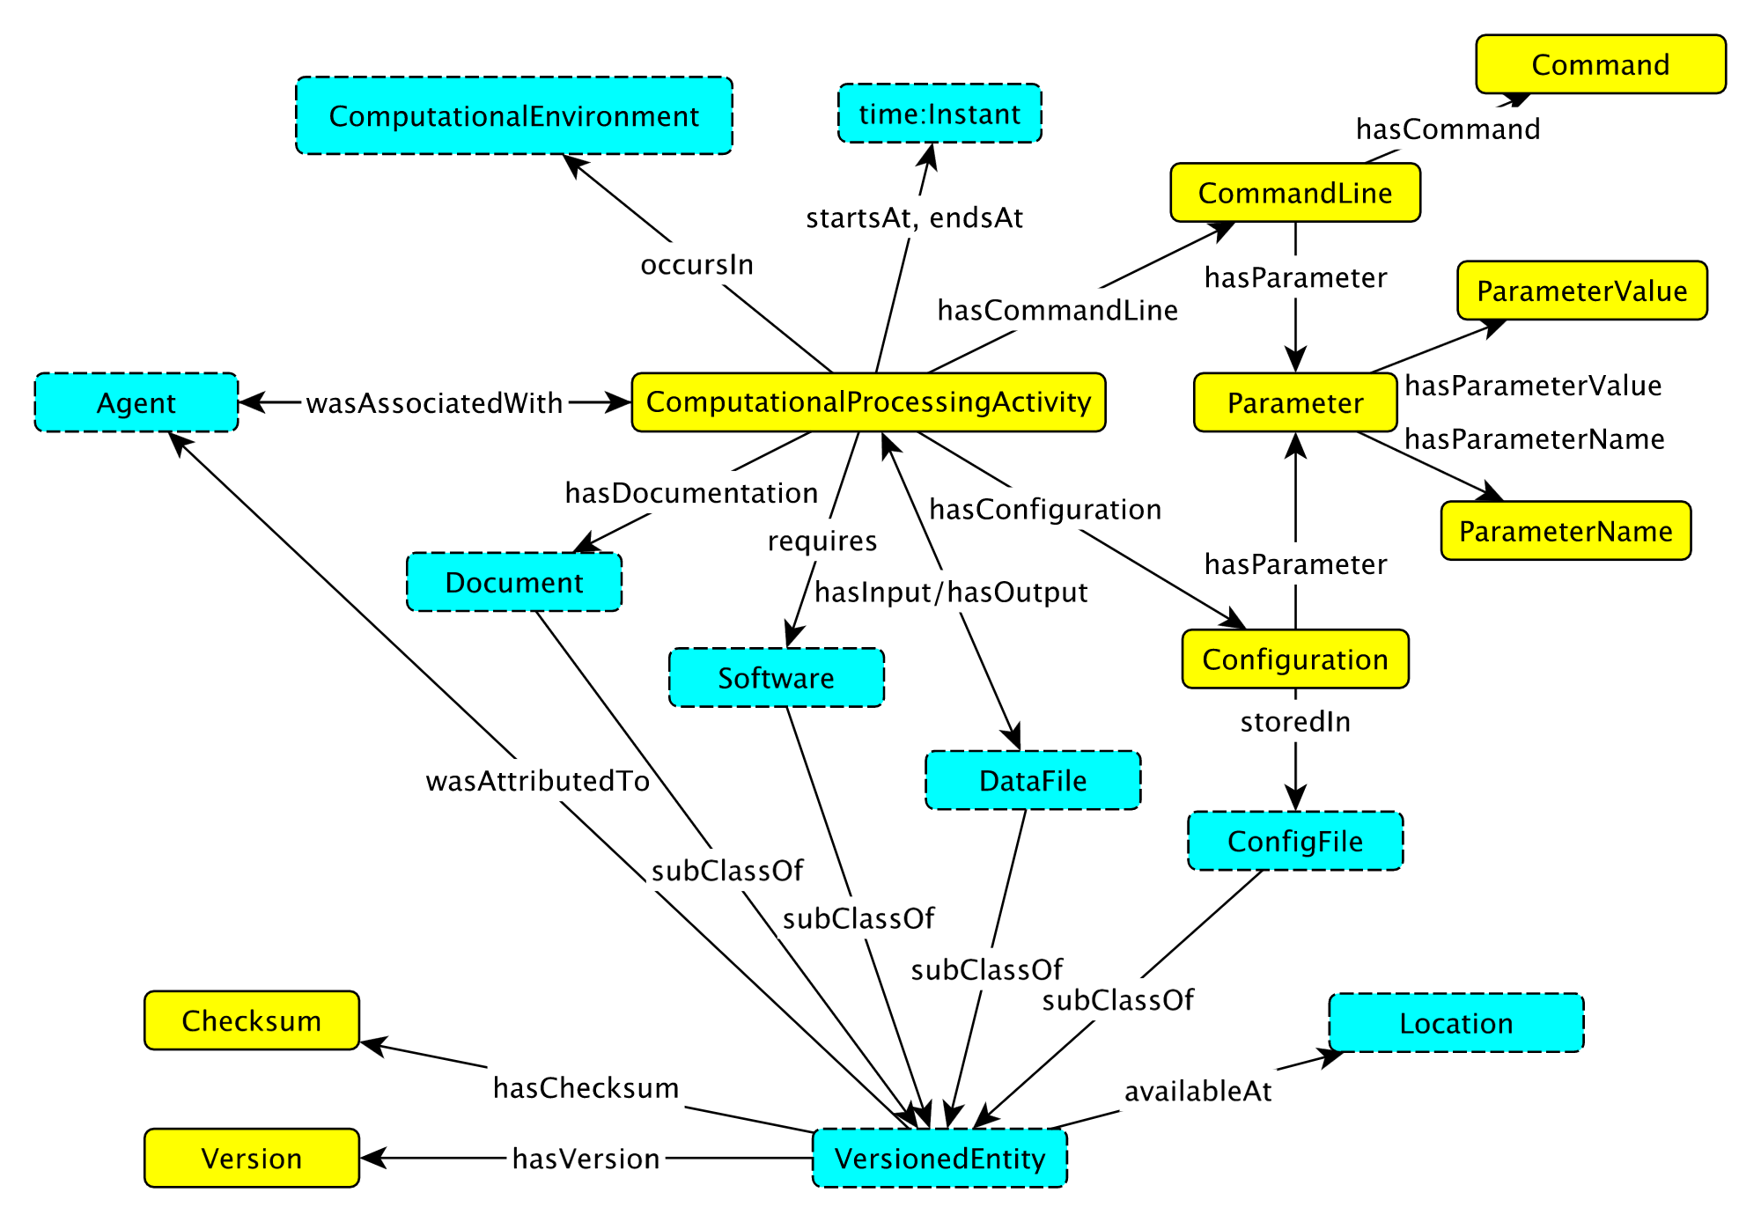
A Sample Computation
Metadata Pattern to describe Computation:
https://github.com/Vocamp/ComputationalActivity

Slide 16
Components in Development
Capture of a computation step
  Container technology
  “Smart Containers”
Capture of execution environment
  “Umbrella” software package*
Workflow capture and re-instantiation
  “PRUNE” tool*
  RECAST
  CERN Analysis Preservation Portal
Metadata to describe all of this
* http://ccl.cse.nd.edu/software/

Slide 17
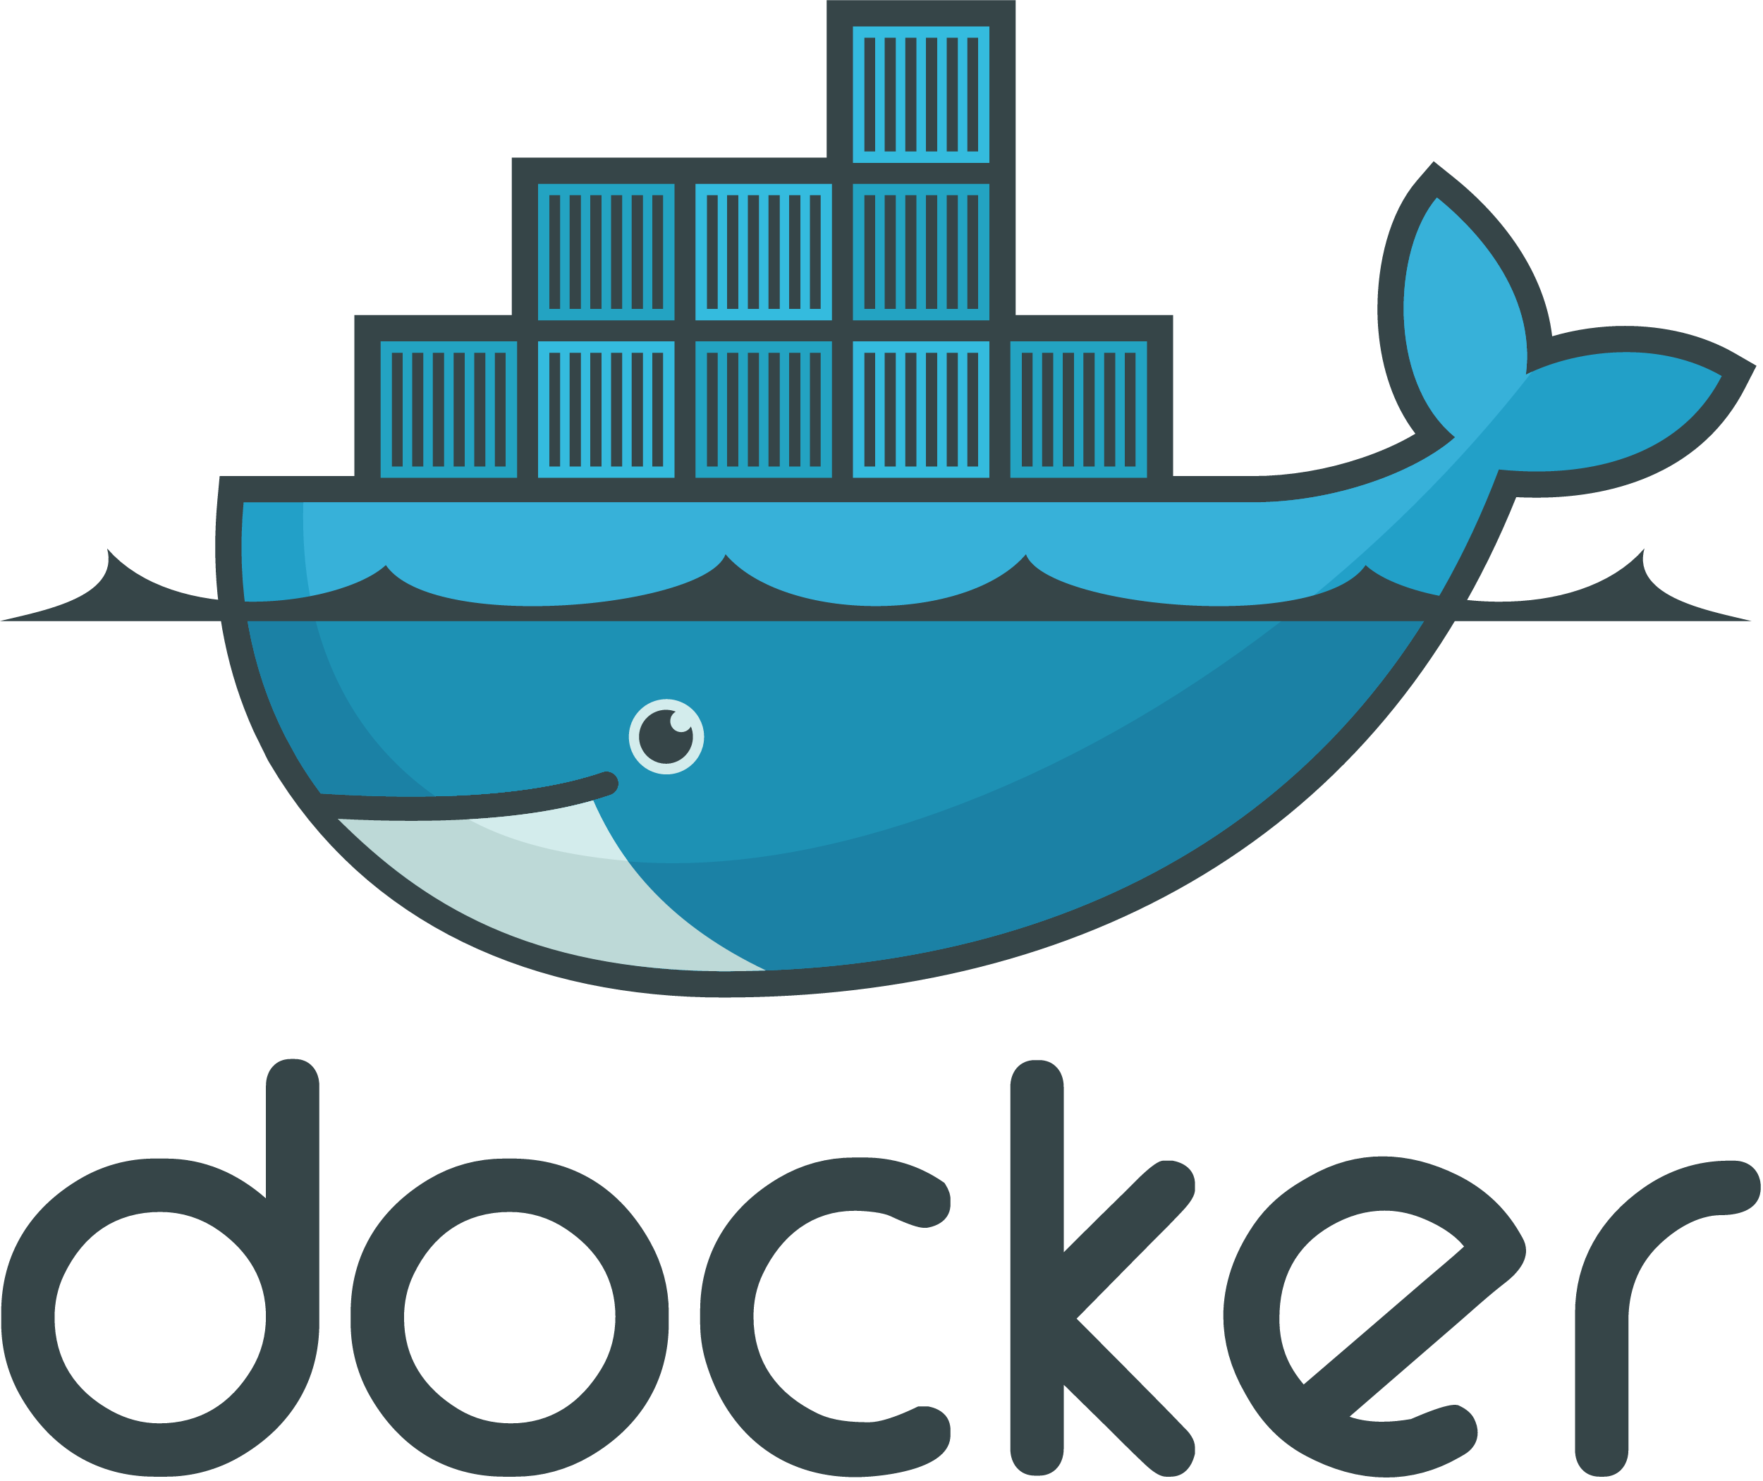
Containers
Tools like chroot and Docker sandbox the execution of an application
Offer the ability to convert application to a container/image: capture essentials of compute step
Virtualize only essential functions of the compute node environment, allow local system to provide the rest
much faster computation
becoming the preferred solution over Virtual Machines for many computing environments
  Requires container-ready infrastructure
App A
App B
Bin/Libs
Bin/Libs
Docker Engine
Portability = Preservation!
Host OS
Server
(See Deborah’s talk for more appropriate detail)

Slide 18
Containerization Tools
The average author/analyst is not sure what is required in order to capture her computation in a container structure
Some tools available associated with Docker
  also things like ReproZip, etc.
Many of these require expert-level understanding
  what is the best way to democratize?
Current state of tools not mature enough for general use

Slide 19




“Smart Containers”
5
Link things together into a knowledge graph
Search
API to write metadata
Metadata storage and standardization
Specification of data location
4
Add machine-readable labels

Slide 20
Workflow Preservation Tools
Vistrails https://www.vistrails.org/index.php/Main_Page
Kepler https://kepler-project.org/
Galaxy https://galaxyproject.org/
GenePattern http://software.broadinstitute.org/cancer/software/genepattern/
Pegasus https://pegasus.isi.edu/
Kurator http://www.sciencedirect.com/science/article/pii/S1877050912002980
CDE http://www.pgbovine.net/cde.html
Sumatra https://pythonhosted.org/Sumatra/
Jupyter https://jupyter.org/
Taverna http://www.taverna.org.uk/
torch.ch torch.ch
DataCenterHub https://datacenterhub.org/
RCloud http://stats.research.att.com/RCloud/
noWorkflow https://github.com/gems-uff/noworkflow
yesWorkflow https://github.com/yesworkflow-org/
prune ccl.cse.nd.edu/research/papers/prune-escience-2016.pdf
swift swift-lang.org
Hivebench (Elsevier)
HTCondor (sort of)
…
Many tools, many developed for specific applications, few if any have APIs to allow running in LHC/WLCG production environment

Slide 21
Workflow Preservation Tools
Vistrails https://www.vistrails.org/index.php/Main_Page
Kepler https://kepler-project.org/
Galaxy https://galaxyproject.org/
GenePattern http://software.broadinstitute.org/cancer/software/genepattern/
Pegasus https://pegasus.isi.edu/
Kurator http://www.sciencedirect.com/science/article/pii/S1877050912002980
CDE http://www.pgbovine.net/cde.html
Sumatra https://pythonhosted.org/Sumatra/
Jupyter https://jupyter.org/
Taverna http://www.taverna.org.uk/
torch.ch torch.ch
DataCenterHub https://datacenterhub.org/
RCloud http://stats.research.att.com/RCloud/
noWorkflow https://github.com/gems-uff/noworkflow
yesWorkflow https://github.com/yesworkflow-org/
prune ccl.cse.nd.edu/research/papers/prune-escience-2016.pdf
swift swift-lang.org
Hivebench (Elsevier)
HTCondor (sort of)
…
Many tools, many developed for specific applications, few if any have APIs to allow running in LHC/WLCG production environment
Wouldn’t it be nice if you had a tool that:
Automatically captured provenance and processing details for everything you did
could manage the bookkeeping for thousands of analysis jobs
provided a way of saving snapshots of work
could tell you “what did I do last week?”

Slide 22
RECAST
“Analysis”
Data Workflow
New Models
recast.perimeterinstitute.ca/
Preserved workflows can be re-used to compare new models with a published analysis
Reinterpretation possible with full detector simulation, analysis chain
“Folding” rather than “Unfolding”
Preferred ATLAS “Preservation Model”

Slide 23
CERN Open Data Portal
opendata.cern.ch
Outreach & Research: open to public
CMS has released AOD-level data, VMs for analysis code for 2010, 2011, and analysis examples *(2 external papers)*
All experiments have outreach data and examples
All LHC Experiments have approved data preservation/access policies; variety of approaches

Slide 24

CERN Analysis Preservation
Envisioned as a tool for the analysts to preserve, share and re-use analysis techniques, executables, and code

Slide 25
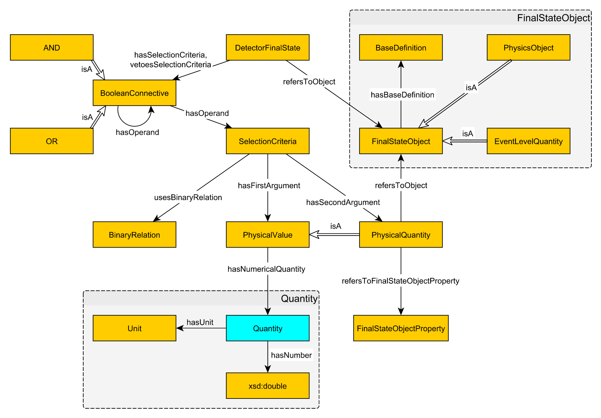
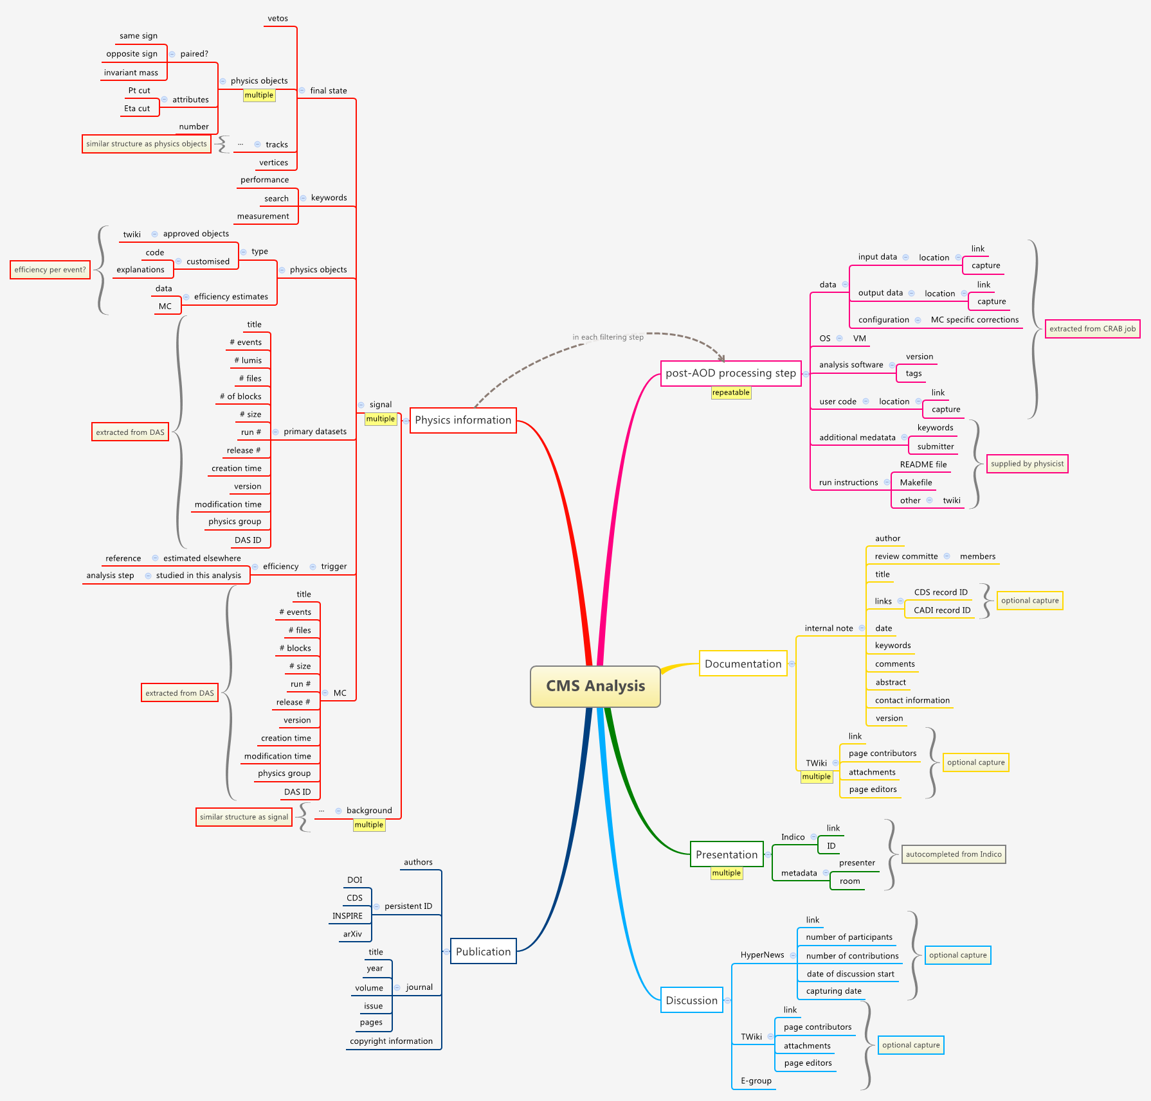
CERN Analysis Portal
Infrastructure to capture “description” of a physics analysis
“Knowledge Map”
Machinery developed to automatically ingest much of the needed information from experiment databases

Slide 26
CERN Analysis Preservation
blah
Many pieces, built from commodity units

Slide 27
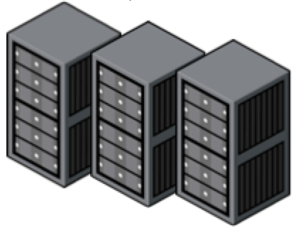
REANA: Analysis Backend
CERN Open Data
RECAST
…
data
software
environment
workflow
validate
ipynb
reinterpret
workflow
supporting multiple scenarios
  multiple computing clouds
    CERN OpenStack
  multiple running environments
    Docker with CVMFS, Umbrella
  multiple resource orchestration
    Kubernetes
  multiple workflow engines
    Yadage, DianaHep
  multiple shared storage systems
    Ceph, EOS
REANA
queue
workflow manager
job engine
Container registry
CERN OpenStack
HTCondor

Slide 28
Workflow & Environment Capture
JSON Specification of workflow:
Workflow Schematic:
Each computation executable preserved in a container ⇒ Reusable!
JSON specification chains steps into workflows, specifies input/output
Arbitrary composition of steps possible

Slide 29
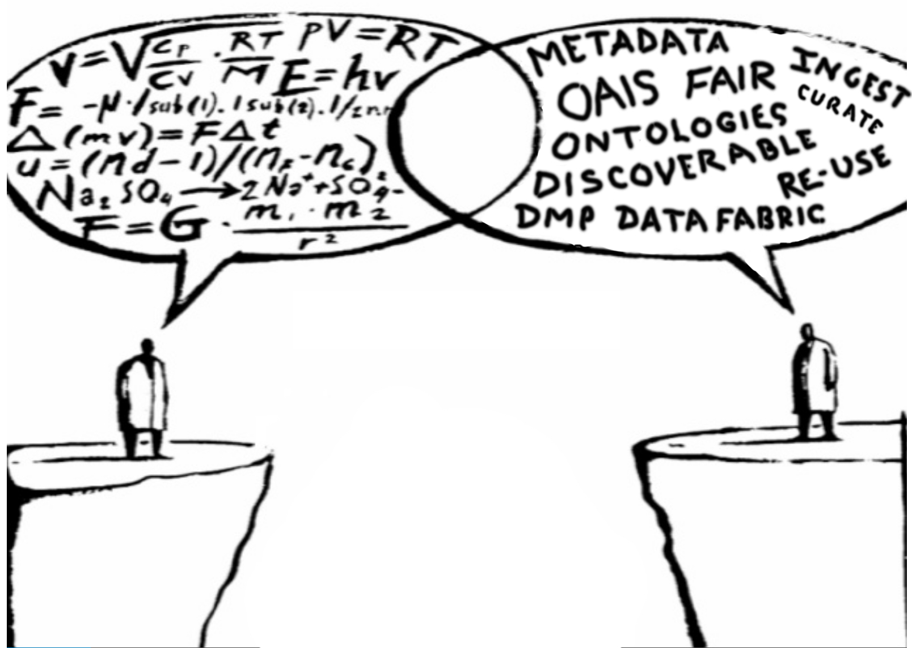
Next project?
Tools are key to further progress
Tools
Researcher/Data-Generator
Archivist/Data Scientist

Slide 30
Conclusions
Knowledge Preservation is complicated and difficult
  Technologically challenging to implement
  Many tools missing
But, progress is being made on many fronts
  CERN Analysis Portal represents a full demonstration of a “Knowledge Preservation” infrastructure
    Capture of all relevant information for a physics analysis
    Capability to re-instantiate computation, re-use modules
  Many tools common to computation, preservation
Still missing:
  Ease of use
  Discoverability
Emphasis on Re-use: underlines benefit to researchers, implies reproducibility

Slide 31
References
Douglas Thain, Peter Ivie, and Haiyan Meng,Techniques for Preserving Scientific Software Executions: Preserve the Mess or Encourage Cleanliness?,12th International Conference on Digital Preservation (iPres), November, 2015. DOI: 10.7274/R0CZ353M
Umbrella:
Haiyan Meng and Douglas Thain, Umbrella: A Portable Environment Creator for Reproducible Computing on Clusters, Clouds, and Grids, Workshop on Virtualization Technologies in Distributed Computing (VTDC) at HPDC, June, 2015. DOI: 10.1145/2755979.2755982
Haiyan Meng, Rupa Kommineni, Quan Pham, Robert Gardner, Tanu Malik and Douglas Thain (2015). An Invariant Framework for Conducting Reproducible Computational Science. Journal of Computational Science. April, DOI: 10.1016/j.jocs.2015.04.012
And the parrot packaging work as well:
Haiyan Meng, Matthias Wolf, Peter Ivie, Anna Woodard, Michael Hildreth, Douglas Thain, A Case Study in Preserving a High Energy Physics Application with Parrot, Journal of Physics: Conference Series (CHEP 2015), December, 2015.
RECAST demo:
https://recast-demo.cern.ch/
Metadata work:
K. Janowicz, P. Hitzler, B. Adams, D. Kolas, C. Vardeman II (2014). Five Stars of Linked Data Vocabulary Use. Semantic Web Journal. 5 (3), 17376
Charles Vardeman II, Adila Krisnadhi, Michelle Cheatham, Krzysztof Janowicz, Holly Ferguson, Pascal Hitzler, Aimee P. C. Buccellato (2015). An Ontology Design Pattern and Its Use Case for Modeling Material Transformation. Semantic Web Journal, to appear. http://www.semantic-web-journal.net/system/files/swj1303.pdf.

