Slide 1
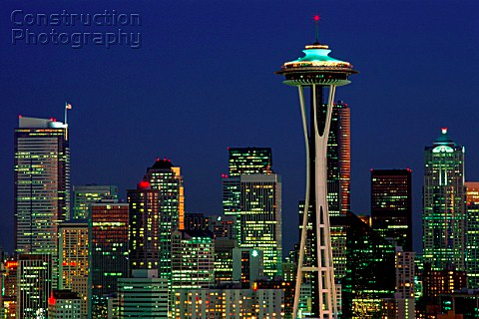

ACAT2017
Conference Summary
Pushpa Bhat
Fermilab
August 21-25, 2017
University of Washington, Seattle, USA

Slide 2
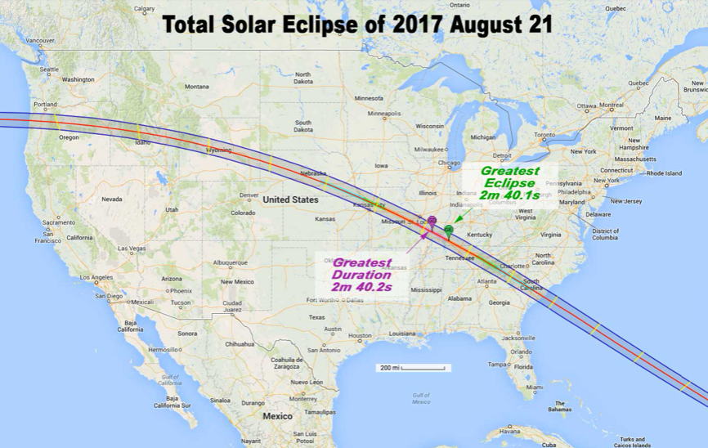
The Great American Eclipse!

Slide 3
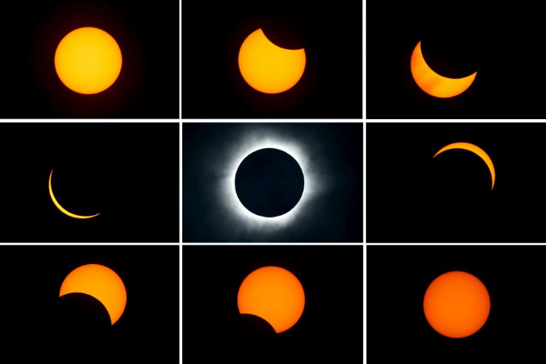

Slide 4
ACAT Workshop Series
Track 1: Computing Technology for Physics Research
  Languages, Software Quality, IDE, User interfaces
  Distributed and Parallel Computing
  Architecture
  Visualization
  Networking
  Online Computing
Track 2: Data Analysis – Algorithms and Tools
  Machine Learning
  Advanced Data Analysis environments
  Simulation, Reconstruction and Visualization Techniques
  Advanced Computing
Track 3: Computations in theoretical physics – Techniques and Methods
  Automatic Systems
  Higher Orders
  Computer Algebra Techniques and Applications
  Computational Physics, Theoretical and Simulation Aspects

Slide 5
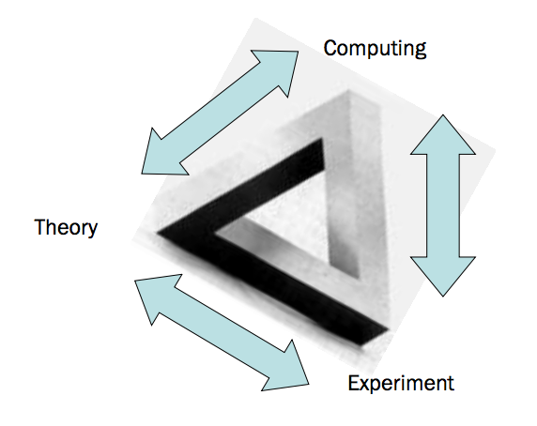
ACAT Workshop Series
Bridging
Disciplines
Raison d’être
Bridging
Communities
Denis Perret-Gallix

Slide 6

ACAT History
The Aztec
Feather Shield
Started in 1990 as AIHENP workshop
Artificial Intelligence in
High Energy and Nuclear Physics
1990 Lyon, France, March 19-24
1992 La Londe Les Maures, France, Jan. 13-18
1995 Pisa, Italy, April 3-8
1996 Lausanne, Sep. 2-6
1999 Heraklion, Crete, April 12-16

Slide 7
Some Early Pioneers of AIHENP
Close to the time of transition in 2000
Denis Perret-Gallix
Rene Brun
Bruce Denby (NN)
Slava Ilyin
Fred James
Andrei Kataev
Christian Kiesling (NN)
Leif Lonnblad (NN)
Carsten Petersen (NN)
Jos Vermaseren
Monique Werlen

Slide 8
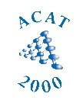
AIHENP becomes ACAT

Slide 9
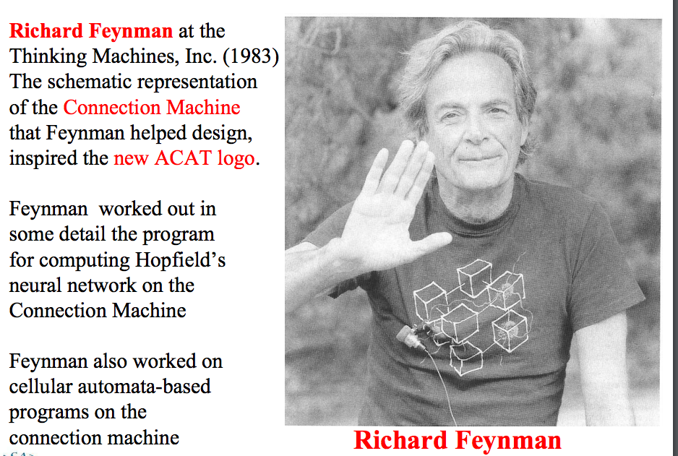
ACAT 2000 logo
Living Feynman’s dreams

Slide 10
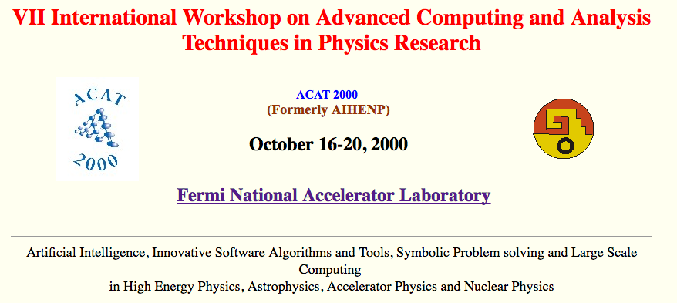
AIHENP → ACAT
http://conferences.fnal.gov/acat2000/
Checkout videos of plenary talks

Slide 11
ACAT2000 Heavy-Weights
Bjarne Stroustrup (C++)
  Initiation of HEP/Fermilab representation on International C++ Standards Committee
Ian Foster (Grid)
  Impetus for Grid Partnerships
Stephen Wolfram
John Moody (ML)
Alex Szalay
Robert Ryne
  Large scale simulations collaborations
Rene Brun
  Launches the effort for TMVA in ROOT

Slide 12
ACAT since 2000
2000 Fermilab, USA (Oct. 16 - 20)
2002 Moscow, Russia (June 24 – 28)
2003 KEK, Japan (Dec. 1 – 5)
2005 DESY, Germany (May 22 – 27)
2007 NIKEHF, The Netherlands (April 23 -27)
2008 Erice, Sicily (Nov. 3 -7)
2010 Jaipur, India (Feb. 22 -27)
2011 Uxbridge, UK (Sep. 5 – 9)
2013 IHEP, Beijing, China (May 16 -21)
2014 Prague, Czech Republic (Sep. 1 – 5)
2016 Valparaiso, Chile (Jan 18 – 22, 2016)

Slide 13
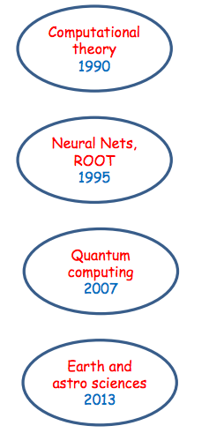
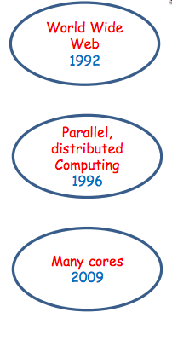
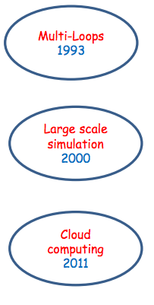
ACAT Highlights
Bridging
Disciplines
2014
2016

Slide 14

AI
Reloaded!
2017
18th edition of
AIHENP-ACAT Series

Slide 15
ACAT 2017
~200 participants
24 Plenary talks
4 round table discussions
86 parallel session talks
69 posters

Slide 16
Highlights of
ACAT 2017
Some Impressions

Slide 17
Track 1: Computing Technology for Physics Research
Heterogeneous Architectures
  Use of GPUs in CMS High level Trigger
  Use of GPUs in NA62
  Promising applications of FPGAs in lattice QCD computing
  Software development should adapt to exploit
Data Preservation Projects
  INFN CNAF
  Tevatron, LHC
Online systems and Triggers
Containers rising in importance
  for software deployment
  portability and scalability on super computers
Tools for software builds
Machine learning tools for fast simulations
Fast calorimeter Simulation in ATLAS
HEP visualization challenges in Reconstruction at the LHC/HL-LHC

Slide 18
Track 3:
Computations in Theoretical Physics
New Developments in methods for symbolic calculations, loop integrals
Loopedia: a new database for loop integrals
Higher order radiative corrections
Developments and optimizations of generators
Go-HEP: A new language for concurrent programming
Round table on Analytical vs Numerical methods for NNLO+ Computations for the LHC
ML in theoretical physics: PDFs to MC tools
Possible ML to accelerate Lattice QCD calculations

Slide 19
AI
Reloaded!
2017
18th edition of
AIHENP-ACAT Series

Slide 20
Track-2
Data Analysis: Algorithms and Tools
ML Algorithms
  NN, BDT, Many flavors of DNN
Applications
  Triggers, tracking, Objects, ID, Signal/background simulations, Physics
  Every aspects of data reconstruction
  End-to-end event reconstruction
Examples
  NN and BDTs in triggers in Belle II, LHC
  Pile-up mitigation at LHC
  Event reconstruction in neutrino experiments
  DNN for online, office tracking
  ML in theoretical physics: pdf to MC tools in lattice QCD
  Contributions even on Expert systems, cellular automata

Slide 21
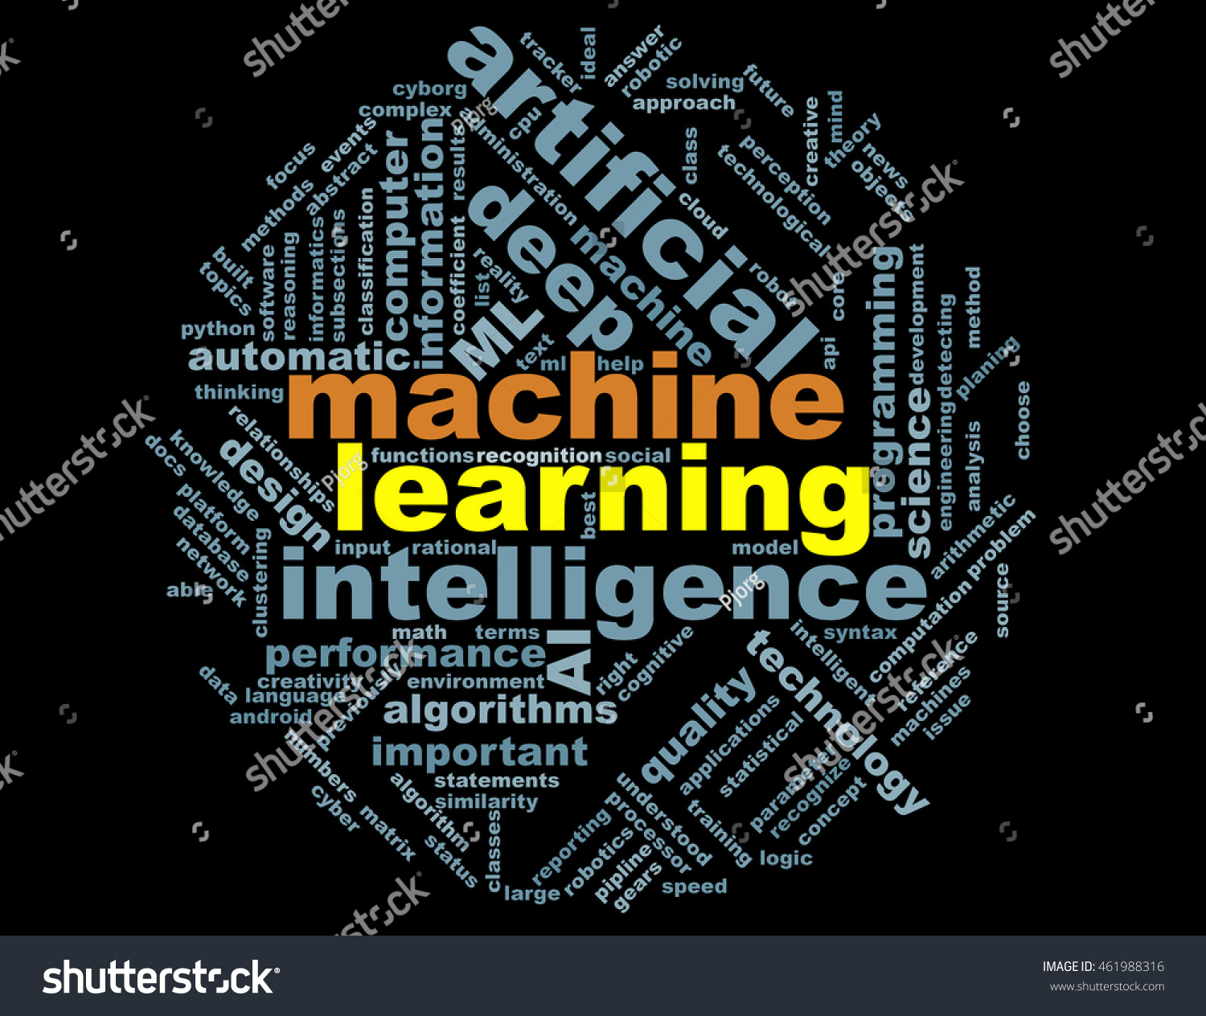

Slide 22
Machine Learning (1)
Paradigm for automated learning from data, using computer algorithms
Requiring little a priori information about the function to be learned
A method that can approximate a continuous non-linear function to arbitrary accuracy is called a universal approximator

Slide 23
Machine Learning (2)
Over the past ~three decades, Multivariate analysis (MVA) methods have gained gradual acceptance in HEP.
  They are now “state of the art”
Some of the most important physics results in HEP, in the past two decades, have come from the use MVA methods.
In 1990’s, I’d have on my title slide
“We are riding the wave of the future”
That future is here, and MVA/ML methods are only going to grow in importance!

Slide 24
Machine Learning (3)
Multivariate Analysis Methods (MVA)
  1990: Proponents and practitioners driven outside the mainstream
  1990-2000: Struggle for Acceptance by the HEP community
    JetNet, MLPFIT,...
    Applications at LEP, Tevatron, etc.
  2000: MVA/ML Getting more Accepted
  2010: MVA/ML becoming ubiquitous
  2017: Machine Learning on Steroids !? ☺

Slide 25
The Buzz about Deep Learning
Multi-scale Feature Learning with multiple hidden layers
  Each high-level layer learns increasingly higher-level features in the data
  Pre-train initial hidden layers with unsupervised learning
Use raw data inputs instead of derived “intelligent” variables (or use both)
  Pre-processing or feature extraction in the DNN
Final learning better than shallow networks, particularly when inputs are unprocessed raw variables!
However, need
  a lot of processing power (implement in GPUs)
  A lot of training data
    We have lots of data, lots of MC (but never enough), can also generate “limitless” data by small perturbations of generated data

Slide 26
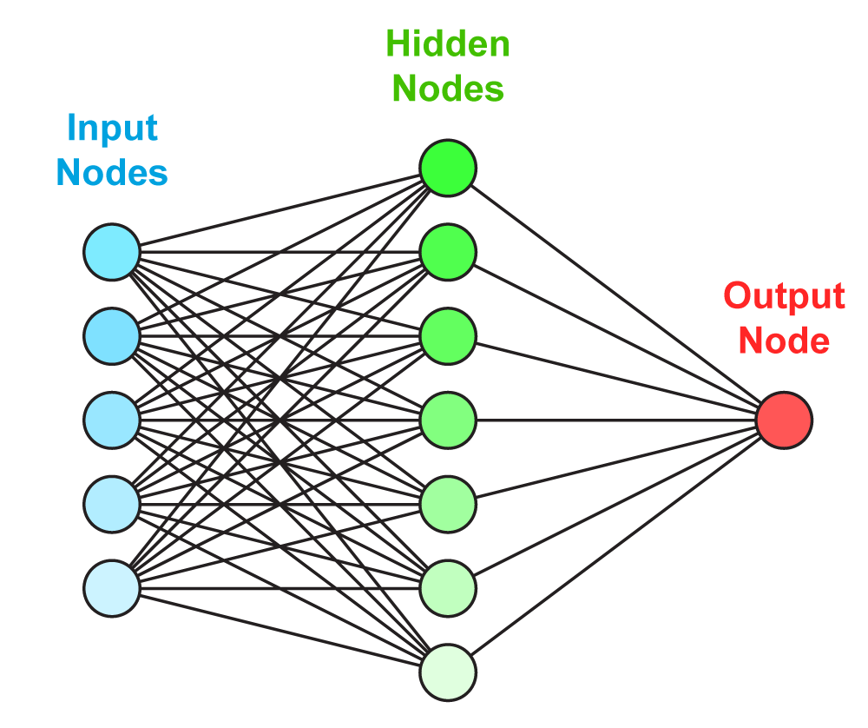
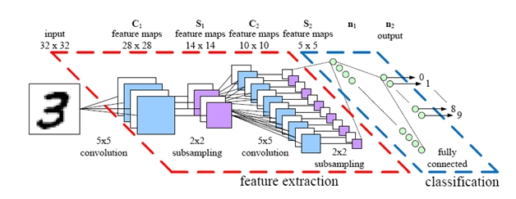
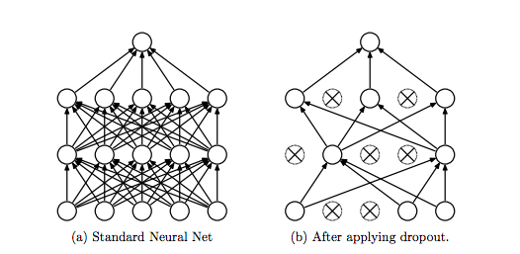
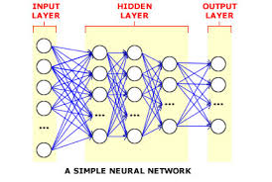
Deep Learning
Single hidden layer NN
“Dropout” algorithm
to avoid overfitting (pruning)
Multiple hidden layer NN

Slide 27
Deep Learning and all that Jazz
Many flavors of DNN
Deep FF FC neural networks
Convolutional
Recurrent
Adversarial
Many Applications:
Object ID
Signal/background discrimination
Regression
Fast simulation
End-to-end reconstruction
The resources required may not justify use in every case

Slide 28
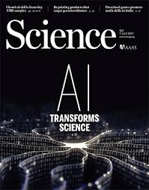
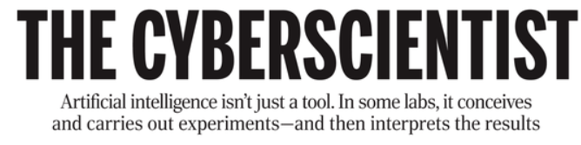
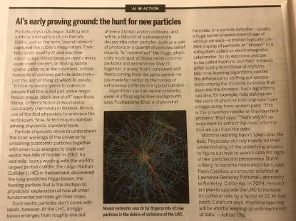

Slide 29
Prospects are great!
Stakes are high!
Until the Standard Model was incomplete, discoveries were (sort of) guaranteed.
Now there are no more such guarantees!
The stakes are very high as we try to discover new fundamental and profound principles of nature and, therefore, the bar for discoveries ought to be very high!
ML community has a serious responsibility!

Slide 30
Some Impressions
Amazing, diverse array of topics/applications
Excellent presentations and posters
13 collaborations represented
Great to see many new faces, and especially lots of passionate, talented young people!
ACAT 2017 provided a very friendly atmosphere for a productive meeting, lots of food, and food for thought, and inspiration for action!

Slide 31
Possible Special Tracks/Topics for Future ACATs
Accelerator Physics
  Simulations
  ML in accelerator controls
Astrophysics
  Already many ML applications
Statistics
Other Disciplines

Slide 32
Future Prospects
Lots of challenges
And
Exciting prospects for Awesome Discoveries
Develop the tools & skills to unravel the mysteries of the universe!

Slide 33
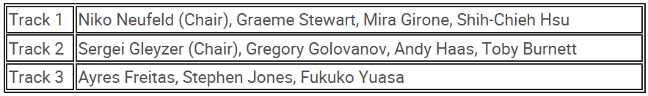
Big Thanks to
Scientific Program Committee
  Federico Carminati (Chair)
  and Track Coordinators (+ IAC)
Track Coordinators

Slide 34
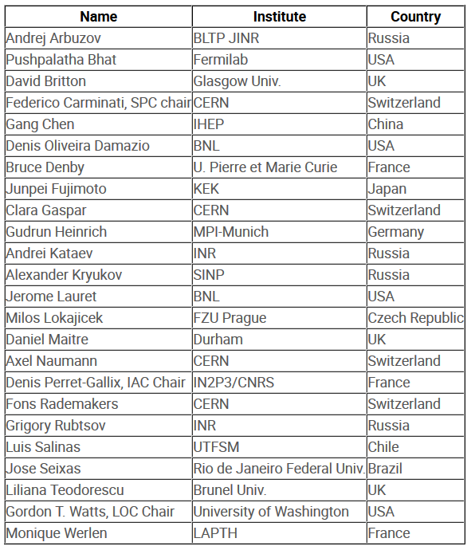
The International Advisory Committee

Slide 35
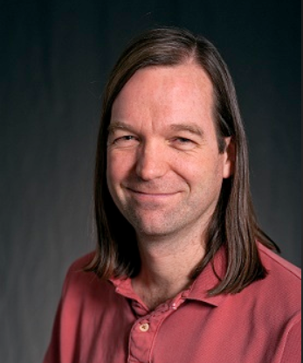
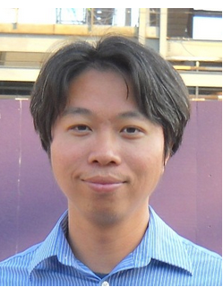
Huge Thanks to
Local Organizers
  Gordon Watts (Chair)
  Shih-Chieh Hsu (Co-chair)
  and team
for a great, fantastic conference!
All speakers and Participants

