Slide 1
Parallelized JUNO simulation software based on SNiPER
Tao Lin
Institute of High Energy Physics, CAS
ACAT 2017, Seattle

Slide 2
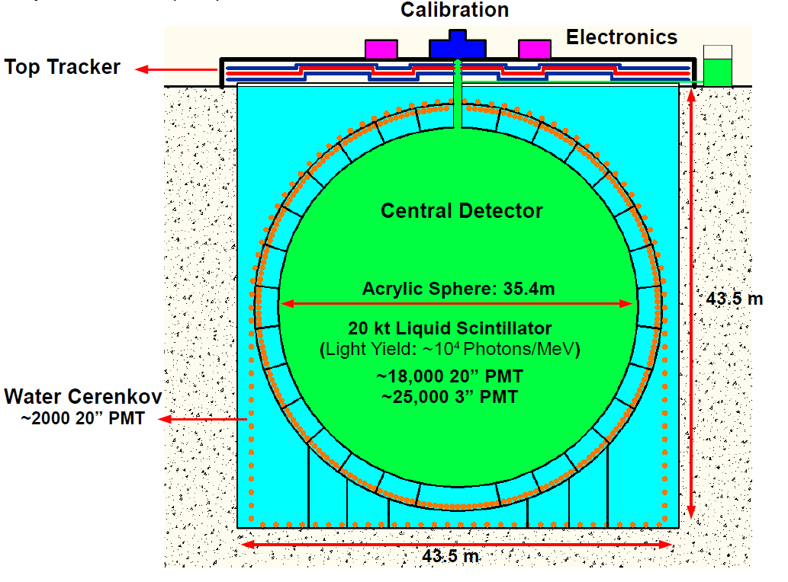
JUNO
(Jiangmen Underground Neutrino Observatory)
Physics goals: determine neutrino mass hierarchy and precisely measure oscillation parameters.
It’s located in southern China about 53 km away from Yangjiang and Taishan nuclear power plants.

Slide 3
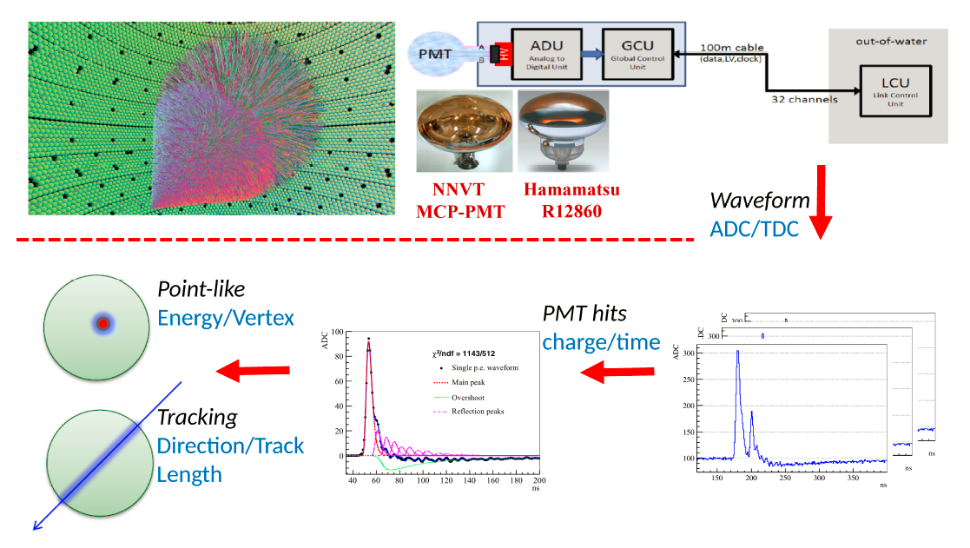
Offline Software
JUNO offline software is developed based on the SNiPER framework.

Slide 4
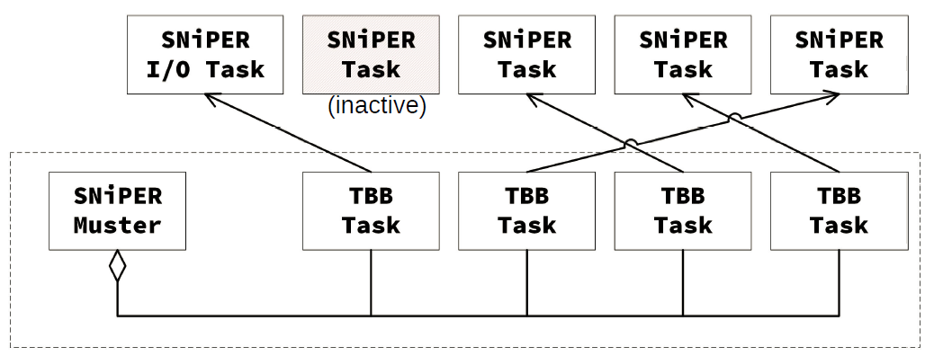
SNiPER Muster
(Talk is given by Jiaheng, Track 1 on Thursday)
SNiPER Muster (Multiple SNiPER Task Scheduler) is a task based scheduler.
  To process one event, a TBB task gets a SNiPER task first and runs SNiPER task once.
Events could be dispatched dynamically.
Notes:
TBB: Intel Threading Building Blocks.
SNiPER task is configured by user and could be run in sequential mode.
TBB Task is underlying worker.

Slide 5
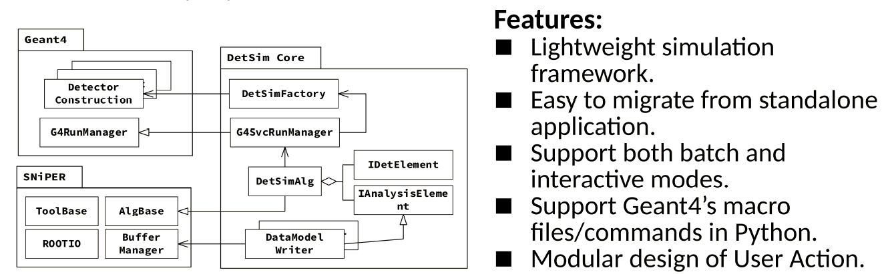
Detector Simulation Framework
Detector simulation framework is implemented to integrate SNiPER and Geant4.
Starting from Geant4 10.x, multi-threaded Geant4 applications enable event-level parallelism.
  With the evolution of Geant4, it makes possible to run simulation with Intel TBB, MPI and so on.
A. Dotti et al., arXiv:1605.01792

Slide 6
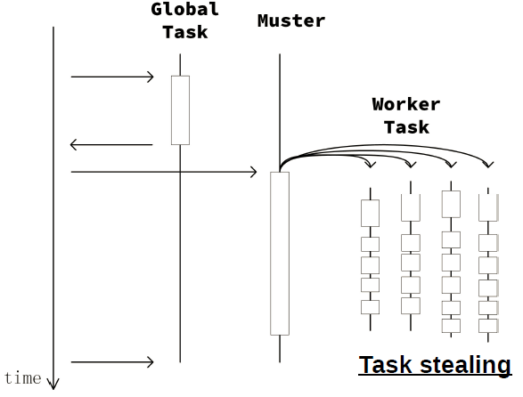
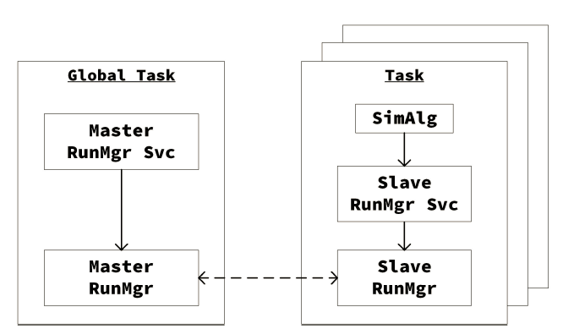
SNiPER Muster based Simulation Framework
Derived from Geant4’s run managers.
  Event loop is controlled by SNiPER Muster.
Global task initializes Master RunMgr before Slave RunMgrs start.

Slide 7
Performance optimization
Hotspot:
  Due to a lot of optical photons accessing refractive index, mutex used in Geant4’s material properties table became a hotspot.
CPU: Intel(R) Xeon(R) CPU E5-2680 v3 @ 2.50GHz (2 sockets, 12 cores per socket).
Memory: 64 GB
OS: Scientific Linux 6.5; GCC: 4.9.4
TBB: tbb2017_20160916oss
Geant4: 10.03.p01
  G4EmStandardPhysics + G4OpticalPhysics
Particle: 2.2 MeV gamma at center.
After optimization, we can get a better performance.

Slide 8
Summary and Plans
An event-level parallelism simulation framework is developed based on Geant4 10.x and SNiPER Muster.
  Benefit from the multi-threading support and thread safe of Geant4 10.x.
Plan: using MPI to speedup events such as cosmic ray muons.

Slide 9
Thank you!

