Slide 1
Towards the final TFC architecture
13 October 2016
F. Alessio, CERN

Slide 2
The new TFC system at a glance
S-ODIN responsible for controlling upgraded readout system
Distributing timing and synchronous commands
Manages the dispatching of events to the EFF
Rate regulates the system
STORAGE
SOL40 responsible for interfacing FE and TELL40
Fan-out TFC information to TELL40
Fan-in THROTTLE information from TELL40
Distribute TFC information to FE
+ clock and timing
Distribute ECS configuration data to FE
Receive ECS monitoring data from FE
DATA
2

Slide 3
The new TFC system at a glance
S-ODIN responsible for controlling upgraded readout system
Distributing timing and synchronous commands
Manages the dispatching of events to the EFF
Rate regulates the system
STORAGE
SOL40 responsible for interfacing FE and TELL40
Fan-out TFC information to TELL40
Fan-in THROTTLE information from TELL40
Distribute TFC information to FE
+ clock and timing
Distribute ECS configuration data to FE
Receive ECS monitoring data from FE
DATA
Does not need fixed and deterministic clock nor latency + readout control
Needs fixed an deterministic clock phase and fixed latency + configuration + monitoring + readout control
3

Slide 4
TFC on common hardware backbone
Specs:
Firepower of 48 bidir links
TFC interface on SFP+ (possibly two SFP+)
Deterministic on board external PLL for resynchronization
Same exact hardware (PCIe40), firmware defines the functionality: SODIN, SOL40, TELL40
The Host PC is the PC controlling the board (ex CCPCServer/SPECServer → GbtServer)
In principle ~100 Gbps of ECS access and data bandwidth
External connection to TFC/LHC peripheral boards via electrical connections
As usual, tight and proficuous collaboration with CPPM
4

Slide 5
Definition of partitions
Partitioning is considered essential in our architecture
commissioning, local tests, exclude/include
#TELL40s → VELO: 52, UT: 68, SCIFI: 144, RICH: 101, CALO: 42, MUON:28
→ total = 435
Partition:
«minimal» ensemble of detectors that can be run independently with TFC and ECS
VELO = 2 (A/C side)
UT = 2 (A/C)
SciFi = 4 (Q1/Q2/Q3/Q4)
RICH = 3 (1 for RICH1 and 2 for RICH2, A/C)
CALO = 1
MUON = 1
Total = 13
NB: partitioning has direct impact on the (cost of the) TFC architecture
5

Slide 6
TFC system in the upgrade (as of v1.5)
The TFC system has gone through an optimisation procedure and things have changed since ...
LHCb-PUB-2012-001 (v1.5)
6

Slide 7
TFC architecture – option 1a
In principle, dedicated SOL40 per partition to cover TELL40s, but...
7

Slide 8
Option 1a - considerations
# of SODINs = 1 → single Readout Supervisor
→ total available destinations = 48
Each SODIN should transmit data bank, so interface to DAQ + PC
Partitioning ensured by independent cores inside SODIN FPGA
Routing inside FPGA done accordingly
# of SOL40s dictated by sub-detectors needs for FEs + SOL40s needed to drive TELL40s
SOL40s for FE → VELO: 4, UT: 3, SCIFI: 12, RICH: 10, CALO: 2, MUON: 6 → total = 37
37+13 = 50 (> 48 available links) ...
TELL40s → VELO: 52, UT: 68, SCIFI: 144, RICH: 101, CALO: 42, MUON:28 → total = 435
Minimum # of SOL40s to cover sub-detectors: 435/48 = 10
→ Total number of SOL40s: 37 + 10 = 47 (!) + cannot run more than 10 partitions in parallel
All costs in kCHF | Number | # DAQ interface | # PC interface | # MPO splitter | # MiniPOD pairs not needed | Individual total costs | Unitary cost | Cost per type of card | Total cost | Total Online
SODIN | 1 | 1 | 1 |  |  | 16 | 16.0 | 16 | 592 | 148
SOL40 for TELL40 | 10 |  | 10 | 80 |  | 132 | 13.2 | 576
SOL40 for FE | 37 |  | 37 |  |  | 444 | 12.0
8

Slide 9
Option 1a - considerations
3. Very limited possibility to expand the system
Not enough output from SODIN
Only possibility would be to add additional SOL40 to cascade the system
Very costly (add 10 kCHF for each SOL40 added)
Complicated in terms of distributing TFC commands → double hop at SOL40 to FE not advisable!
Maintains bidirectionality with TELL40s
However, raised the question of opportunity, do we need it at all?
This was the main argument to drop the PON architecture (see next)
5. Fixed phase and deterministic latency is ensured by using 8b10b encoding & Altera GX transceivers
Additional hop
9

Slide 10
TFC in the PON architecture
10

Slide 11
TFC in the PON architecture
# of SODIN == # of PON trees + SuperMaster (13+1=14)
+ 14 TTC-PON 1:64 splitters – cover 435+37 destinations at min
+ 14 OLTs transmitters + 37 ONUs receivers
Each SODIN should transmit data bank, so interface to DAQ + PC
No need of MiniPODs in SODIN. Equip each of them with 1 pair just to talk to SuperMaster.
Partitioning is ensured by architecture.
SuperMaster only used during central data taking.
Resynchronization with LHC at partition level.
Dependent on future of PON → technology bound.
Online bearing entirely the additional costs of the architecture → to what gain?
All costs in kCHF | Number | # DAQ interface | # PC interface | # OLT transmitter | # ONU Receiver | # PON splitter | # MiniPOD pairs not needed | Individual total costs | Unitary cost | Cost per type of card | Total cost | Total Onl
SODIN | 14 | 14 | 14 | 14 |  | 14 | 42 | 207.2 | 14.8 | 207.2 | 746 (+154 kCHF) | 302 (+154 kCHF)
SOL40 for FE | 37 |  | 37 |  | 37 |  |  | 451.4 | 12.2 | 451.4
TELL40 overcost | 435 |  |  |  | 435 |  |  | 87 | 0.2 | 87
11

Slide 12
TFC on the new TTC-PON backbone
From S. Baron & E. Mendes,
https://indico.cern.ch/event/465344/
12

Slide 13
TFC on the new TTC-PON backbone
13

Slide 14
TFC on the new TTC-PON backbone
14

Slide 15
TFC on the new TTC-PON backbone
15

Slide 16
TFC on the new TTC-PON backbone
16

Slide 17
TFC on the new TTC-PON backbone
Enormous bandwidth downstream
17

Slide 18
TFC on the new TTC-PON backbone
18

Slide 19
TFC on the new TTC-PON backbone
Need a «training» or «re-calibration» every time a new ONU is added + monitoring
→ Added complexity
19

Slide 20
Do we actually need SODIN-TELL40 bidir?
Upstream communication seems the most complicated issue in the TTC-PON architecture and probably we don’t even need it
TELL40 will throttle locally
Roundtrip between SODIN-TELL40 for a specific BXID would be complicated and adds logic in the TELL40
Need to fix a maximum latency (SODIN-TELL40 for trigger)
Complicated in a fully asynchronous system...
Information on backpressure rather sent through network : will be investigated
→ SODIN could apply «gears» to its trigger rate by reducing the rate by the same proportion
20

Slide 21
TFC in the PON architecture
long story short: scrapped
21

Slide 22
Option 1b → 1a optimized
Some of the limitations from 1a can then be overcome if bidir is dropped
22

Slide 23
Option 1b - considerations
# of SODINs = 1 → single Readout Supervisor
→ total available destinations = 48
Each SODIN should transmit data bank, so interface to DAQ + PC
Partitioning ensured by independent cores inside SODIN FPGA
Routing inside FPGA done accordingly, very simple management
# of SOL40s dictated by sub-detectors needs for FEs solely + splitters
SOL40s for FE → VELO: 4, UT: 3, SCIFI: 12, RICH: 10, CALO: 2, MUON: 6 → total = 37
Total number of SOL40s: 37
1 additional PC per SOL40 w/o interface to DAQ (37)
Minimum # of splitters: 12 if 1x64 splitters (VELO can be 1 partition), 24 if 1x32 splitters
Heavily profiting from a second SFP+ on PCIe40 ...
 | Number | # DAQ interface | # PC interface | # PLC splitter | # MPO splitter | # MiniPOD pairs not needed | Individual total costs | Unitary cost | Cost per type of card | Total cost | Total Onl
SODIN | 1 | 1 | 1 |  |  |  | 16 | 16.0 | 16 | 466 (-126 kCHF)* | 22 (-126 kCHF)
SOL40 for TELL40 | 0 |  | 0 | 12 | 0 |  | 6 | 0.5 | 450
SOL40 for FE | 37 |  | 37 |  |  |  | 444 | 12.0
23
*A quarter of a 1 MCHF lower than with PON

Slide 24
Option 1b - considerations
3. Good flexibility to expand the system later on or to accommodate changes
More available output from SODIN → ~11
Maybe only splitter if TELL40s not enough
Can even include other partitions later on
No more bidirectionality with TELL40s
Possible that the backpressure information will be transmitted by network to SODIN for fast feedback
In any case, must be available to ECS for monitoring
Fixed phase and deterministic latency is ensured by using 8b10b encoding, Altera GX transceivers and monitoring in FPGA
This was already tested for previous versions of FPGAs
To be redone in the next months with testbench
24

Slide 25
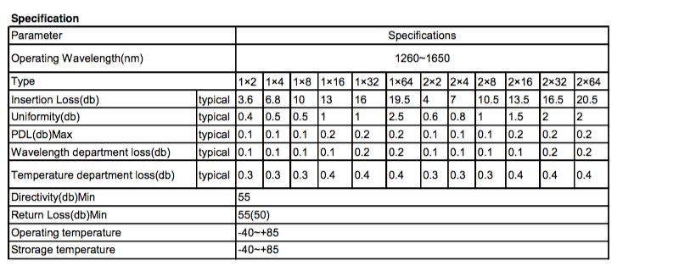
Considerations on optical splitters
In the next week a optical PLC splitter will be searched, found and qualified
Choose PLC over FBT cause not sensitive to wavelength (to be used at 1310nm) and higher degree of splitting (can go up to 1:64)
Better stability across all ratios
Level of power budget seems appropriate
NB: suggestions from experts welcome... ☺
25

Slide 26
TFC commands and data
TFC information will remain the same: 64 bits @ 40 MHz encoded in 8b10b
→ 2.56 Gbps user data, 3.2 Gbps with encoding (no extra logic needed)
MEP accept command when MEP ready:
Take MEP address and send all fragments to that address
Dynamic mechanisms based on well-oiled mechanism used today
Investigations ongoing to see if a different mechanism is more suited for upgraded system
This may possible be dropped at the TFC level
Trigger command to accept events for that BXID:
Trigger acting as a VETO to rate regulate the system
Not based on physics decision (NO LLT)
Unbiased (random) rate regulation of the system by reducing the rate at which trigger is set → based on «gears»
A subset of these commands is relayed to the FEs
26

Slide 27
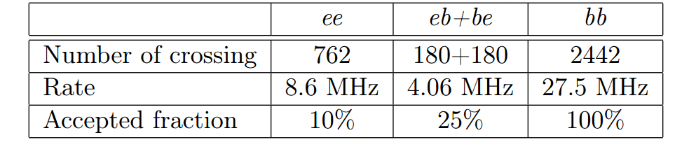

Rate regulation to reduce output bandwith
Rate regulation in SODIN is considered as the safest mechanism to reduce output bandwidth or relieve backpressure
Out of the full 40 MHz, only ~28 MHz contains beam-beam, ~4 MHz contains beam-empty/empty-beam, ~8 MHz contains emtpy-empty
SODIN can have a programmable mask that defines the rate of crossing types to be kept
100% for bb, 25% for eb/be and 10% for ee
Effectively the full input rate is 30 MHz.
→ This was described in EDMS 1606939 as Renaud mentioned a while ago.
27

Slide 28
TFC output bandwidth
SODIN will also transmit a data bank to the DAQ for each «accepted event»
Also defines the MEP size (can be dynamic and also very big)
Currently is 44 bytes @ 1 MHz → 352 Mbps / 44 bytes @ 40 MHz → ~14 Gbps
Can be expanded to include more informations as we have ~100 Gbps for central data taking
Can be reduced to allow max 10 partitions to run in parallel (~10 Gbps → 32 bytes/8 words)
Word | 31 | 30 | 29 | 28 | 27 | 26 | 25 | 24 | 23 | 22 | 21 | 20 | 19 | 18 | 17 | 16 | 15 | 14 | 13 | 12 | 11 | 10 | 9 | 8 | 7 | 6 | 5 | 4 | 3 | 2 | 1 | 0
#H0 | Size in bytes = 44 |  |  |  |  |  |  |  |  |  |  |  |  |  |  |  | Magic Patter = 0xCBCB
#H1 | Source ID = “ODIN S/N” |  |  |  |  |  |  |  |  |  |  |  |  |  |  |  | Version = 2 |  |  |  |  |  |  |  | Type = 0x10
#D0 | Run Number (31 .. 0)
#D1 | Event Type (31 .. 0)
#D2 | Orbit ID (31 .. 0)
#D3 | Event ID (63 .. 32)
#D4 | Event ID (31 .. 0)
#D5 | GPS Time (63 .. 32)
#D6 | GPS Time (31 .. 0)
#D7 | Error Flags |  |  |  |  |  |  |  | Detector Status (23 .. 0)
#D8 | LHC info |  |  |  |  |  |  |  | BX Type |  | R | R |  | Trigger Type |  |  | R | R | R | R | Bunch ID
28

Slide 29
Final TFC architecture
Numbers of TELL40s/SOL40s important in defining the architecture
29

Slide 30
Last topic: SOL40 firmware
Remember (again!): merging TFC and ECS on same link!
SOL40 firmware will take care of doing all the complicated bit manipulations needed to control GBTs, its SCAs and your FE chipsets
Single firmware for everybody with all necessary features and requirements
minimize unconformities, highly programmable and customizable
modular (can get a core and put it somewhere else in an eval board)
Centrally provided with ECS support
In addition it will distribute the TFC commands from SODIN to FE with fixed latency.
30

Slide 31
SOL40-SCA core
1 core per GBT, scalable support for SCAs, all SCA buses, vendor/FPGA independent, modular control, error detection capabilities
This is a CERN-wide development: i.e. the other experiments are going to use it.
31

Slide 32
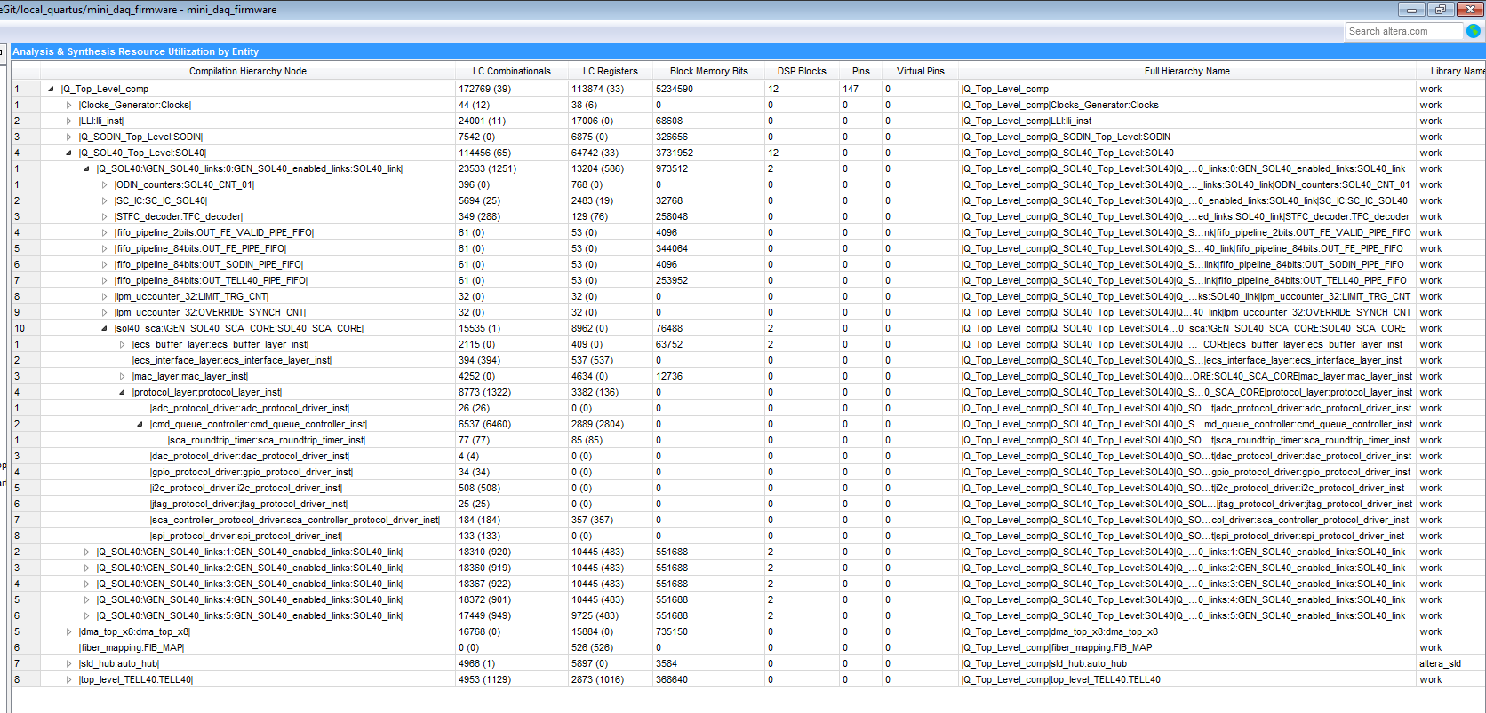
Current usage of SOL40 – Arria 10
32

Slide 33
Current usage of SOL40 – Arria 10
Compiled for 6 SOL40 links
7 SCAs per SOL40 link + 1 links for GBT
All SCA channels, protocols and decoder/encoders
SOL40 firmware takes 66% of used logical resources + 71% of used memory
This corresponds to 16.5% of entire FPGA ALMs and 6.5% of all memory bits
Projection: comfortably 24 links. Surely not 48 links as of today.
More work needed here ...
33

Slide 34
Current usage of SOL40 – Arria 10
One module is too heavy (25% of the whole SOL40_SCA core.
Work will go there to make it lightweigth
logic too complicated + fancy features we don’t need).
In addition, develop a SOL40_SCA for LHCb
stripped down things LHCb doesn’t use
34

Slide 35
Conclusion, what today?
Today we have a final version of the TFC architecture, with costs, estimates, modules and all that it is needed...
PON technology was abandoned as considered too costly and its benefits not usefule for us
SODIN-TELL40 bidirectionality abandoned as TELL40 throttles locally and throttle mechanism too complicated and heavy
Streamlined system to support partitioning in a simple and scalable way
Data bank definition and commands definition finalized
What do we need from sub-detectors now?
Precise estimate of number of TELL40s
Down to the # of links per TELL40s, partitioning and
Precise estimate of number of SOL40s
Work is needed to reduce the size of the SOL40-SCA core
Detailed input from you on
# of GBT links per SOL40
# of SCAs per GBT link
# of channels (and list of channels) per SCA
Detailed ommands mapping at SOL40 level
35

Slide 36
Backup
36

Slide 37
Costs per item
37

Slide 38
Option 2a
38

Slide 39
Option 2b
39

Slide 40
Option 2b
40

Slide 41
Option 3a
41

Slide 42
Option 3b
42

Slide 43
Option 3bopt, now option 1 ☺
43

Slide 44
Option | Cost | Pros | Cons
1a (fully PON) | 746 kCHF 392 kCHF just Onl | Easy partitioning, TTC-based, scalable but at high cost (~20k/partition) | Limitation from PON splitter, 100% dependent on PON technology
2a (hybrid, one SODIN) | 676 kCHF 232 kCHF just Onl | Single SODIN Master, can throw away PON if needed and replace with p-to-p (becomes 3a) | Not easily scalable if >64 SOL40s, need to add a layer of SOL40s just for partitioning (not needed in global)
2b (hybrid, many SODINs) | 589 kCHF 145 kCHF just Onl | Single SODIN Master, partitioning inside FPGA, can throw away PON if needed and replace with p-to-p (becomes 3b) | Not easily scalable if >64 SOL40s, need to add a layer (+link) of SOL40s just for partitioning (not needed in global)
3a (fully p-to-p, as many SODINs as partitions) | 668 kCHF 224 kCHF just Onl | Streamlined, independent from PON, easy partitioning inside FPGA, easy to scale within partition | Need of an additional SuperMaster just to monitor global the run
3b→1a (fully p-to-p, TELL40s served by dedicated SOL40s) | 592 kCHF 148 kCHF just Onl | Independent from PON, partitioning inside FPGA, single SODIN Master, expensive to scale up | At the limit of # of links for 1 SODIN – no margin. Solution would be to cascade SOL40 for TELL1s.
3bopt → 1b (fully p-to-p, TELL40s served by SOL40s to FEs) | 480 kCHF 36 kCHF just Onl | Independent from PON, partitioning inside FPGA, single SODIN Master, easy to scale up, many more links available in ODIN, cheap | Highly appreciated second SFP+ on PCIe40.
44

Slide 45
Total costs
 |  | Number | # DAQ interface | # PC interface | # OLT transmitter | # ONU Receiver | # PON splitter | # MPO splitter | # MiniPOD pairs not needed | Individual total costs | Unitary cost | Cost per type of card | Total cost | Total Onl
Architecture 1 | SODIN | 14 | 14 | 14 | 14 |  | 14 |  | 42 | 207.2 | 14.8 | 207.2 | 746 | 302
 | SOL40 for FE | 37 |  | 37 |  | 37 |  |  |  | 451.4 | 12.2 | 451.4
 | TELL40 overcost | 435 |  |  |  | 435 |  |  |  | 87 | 0.2 | 87
Architecture 2a | SODIN | 1 | 1 | 1 | 1 |  | 1 |  | 3 | 14.8 | 14.8 | 14.8 | 676 | 232
 | SOL40 for TELL40 | 13 | 13 | 13 |  | 13 |  | 26 | 5 | 210 | 16.2 | 661.4
 | SOL40 for FE | 37 |  | 37 |  | 37 |  |  |  | 451.4 | 12.2
Architecture 2b | SODIN | 1 | 1 | 1 | 1 |  | 1 |  | 3 | 14.8 | 14.8 | 137.8 | 589 | 145
 | SODIN for TELL40 | 10 |  | 10 |  |  |  | 20 |  | 123 | 12.3
 | SOL40 for FE | 37 |  | 37 |  | 37 |  |  |  | 451.4 | 12.2 | 451.4
Architecture 3a | SODIN | 14 | 14 | 14 |  |  |  | 28 | 5 | 223.7 | 16.0 | 223.7 | 668 | 224
 | SOL40 for FE | 37 |  | 37 |  |  |  |  |  | 444 | 12.0 | 444
Architecture 3b | SODIN | 1 | 1 | 1 |  |  |  |  |  | 16 | 16.0 | 16 | 592 | 148
 | SOL40 for TELL40 | 10 |  | 10 |  |  |  | 80 |  | 132 | 13.2 | 576
 | SOL40 for FE | 37 |  | 37 |  |  |  |  |  | 444 | 12.0
Architecture 3bopt | SODIN | 1 | 1 | 1 |  |  |  |  |  | 16 | 16.0 | 16 | 466 | 22
 | SOL40 for TELL40 | 0 |  | 0 |  |  | 12 | 0 |  | 6 | 0.5 | 450
 | SOL40 for FE | 37 |  | 37 |  |  |  |  |  | 444 | 12.0
45

Slide 46
Costs per item
Costs per item | kCHF
DAQ interface | 4
PC interface | 4
PCIe40 | 8
OLT transmitter | 1
ONU receiver | 0.2
PON splitter | 0.5
MPO splitter | 0.15
MiniPODs (pair of tx/rx) | 0.9
46

