Slide 1
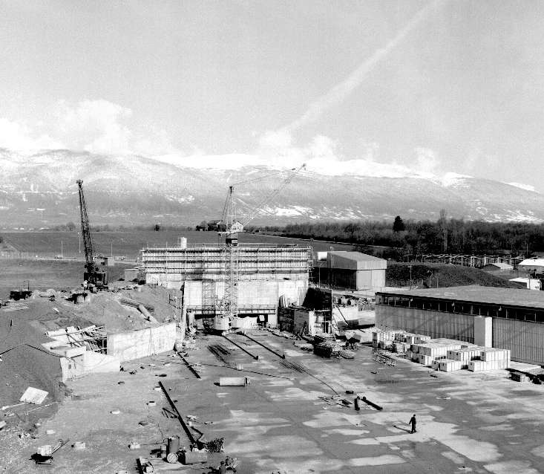
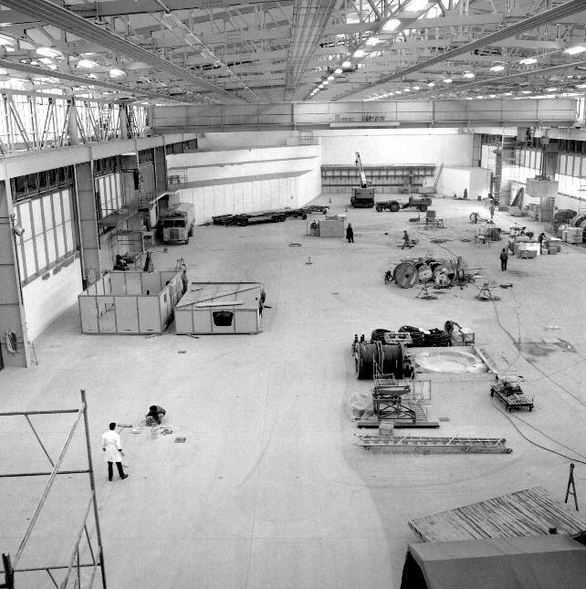
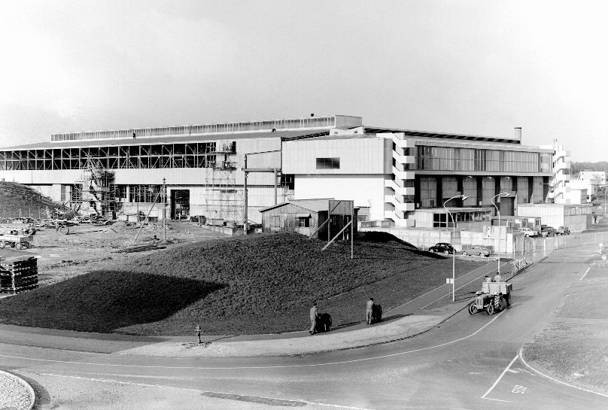

East Area Renovation Project
Team meeting # 2 – EDMS1721265
News
East Hall under construction - 1962
Sébastien Evrard / EN-EA, 23-09-2016

Slide 2
NEWS
Project management
Report to IEFC
Safety
Organizational tools
WP meetings overview

Slide 3
Project mandate
CLOUD, IRRAD & CHARM
Detailed
study
Priority for the Organization
Cost & Schedule review
Energy optimization & sustainability effort
https://edms.cern.ch/document/1715122/1

Slide 4
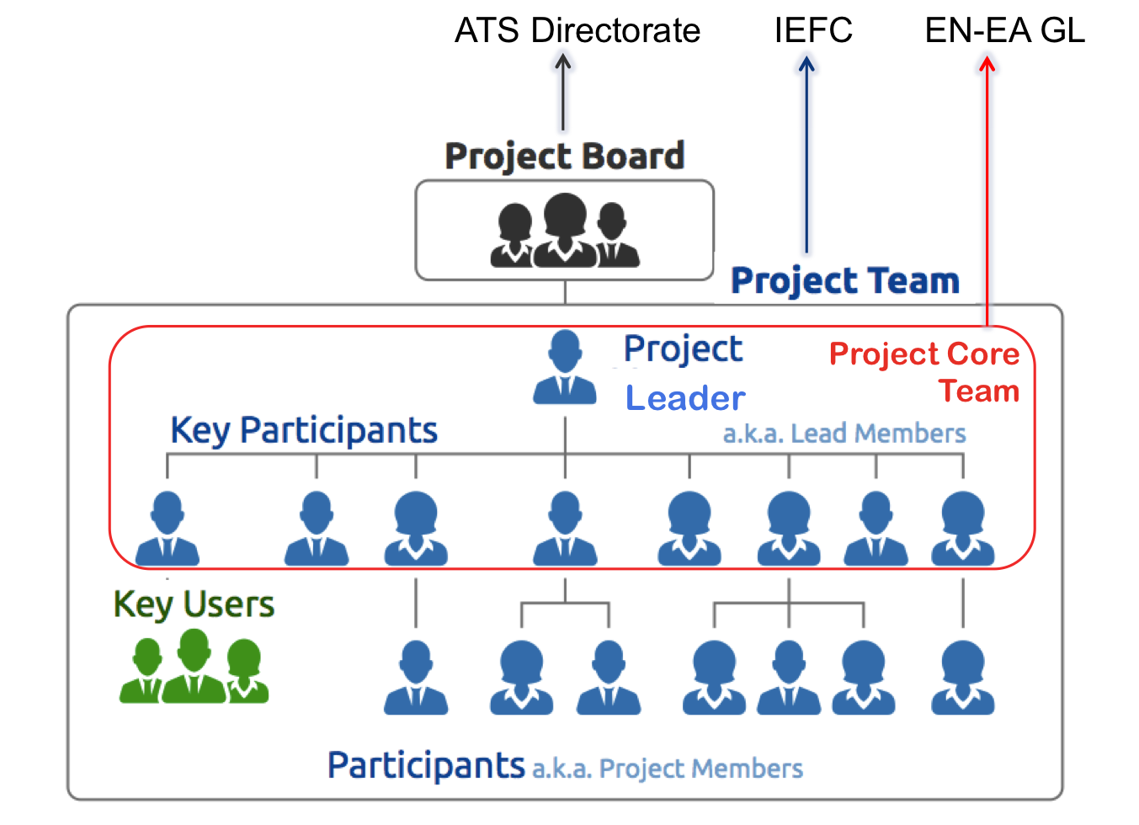
Project management
The East Area Renovation is a Cost to Completion (CtC) project fully driven by the EN-EA Group.
Project management plan (PMP) under approval EDMS 1716531
Proposed structure
Courtesy P. Bonnal / OpenSE

Slide 5
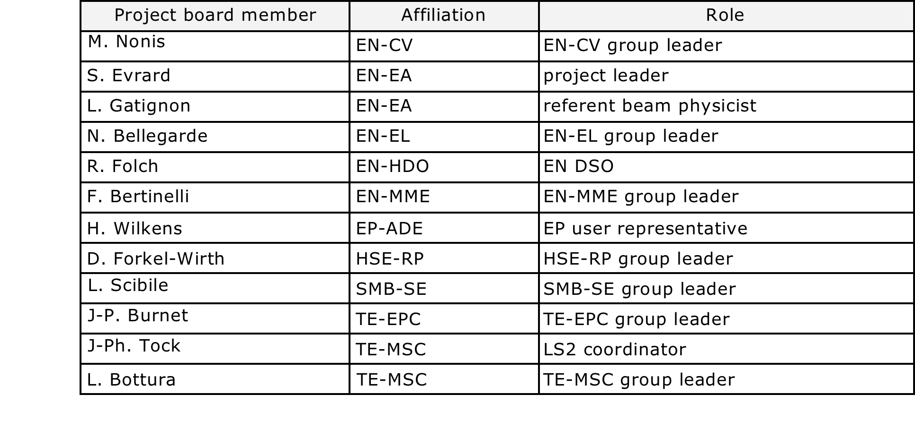
Project Board (proposed membership)

Slide 6
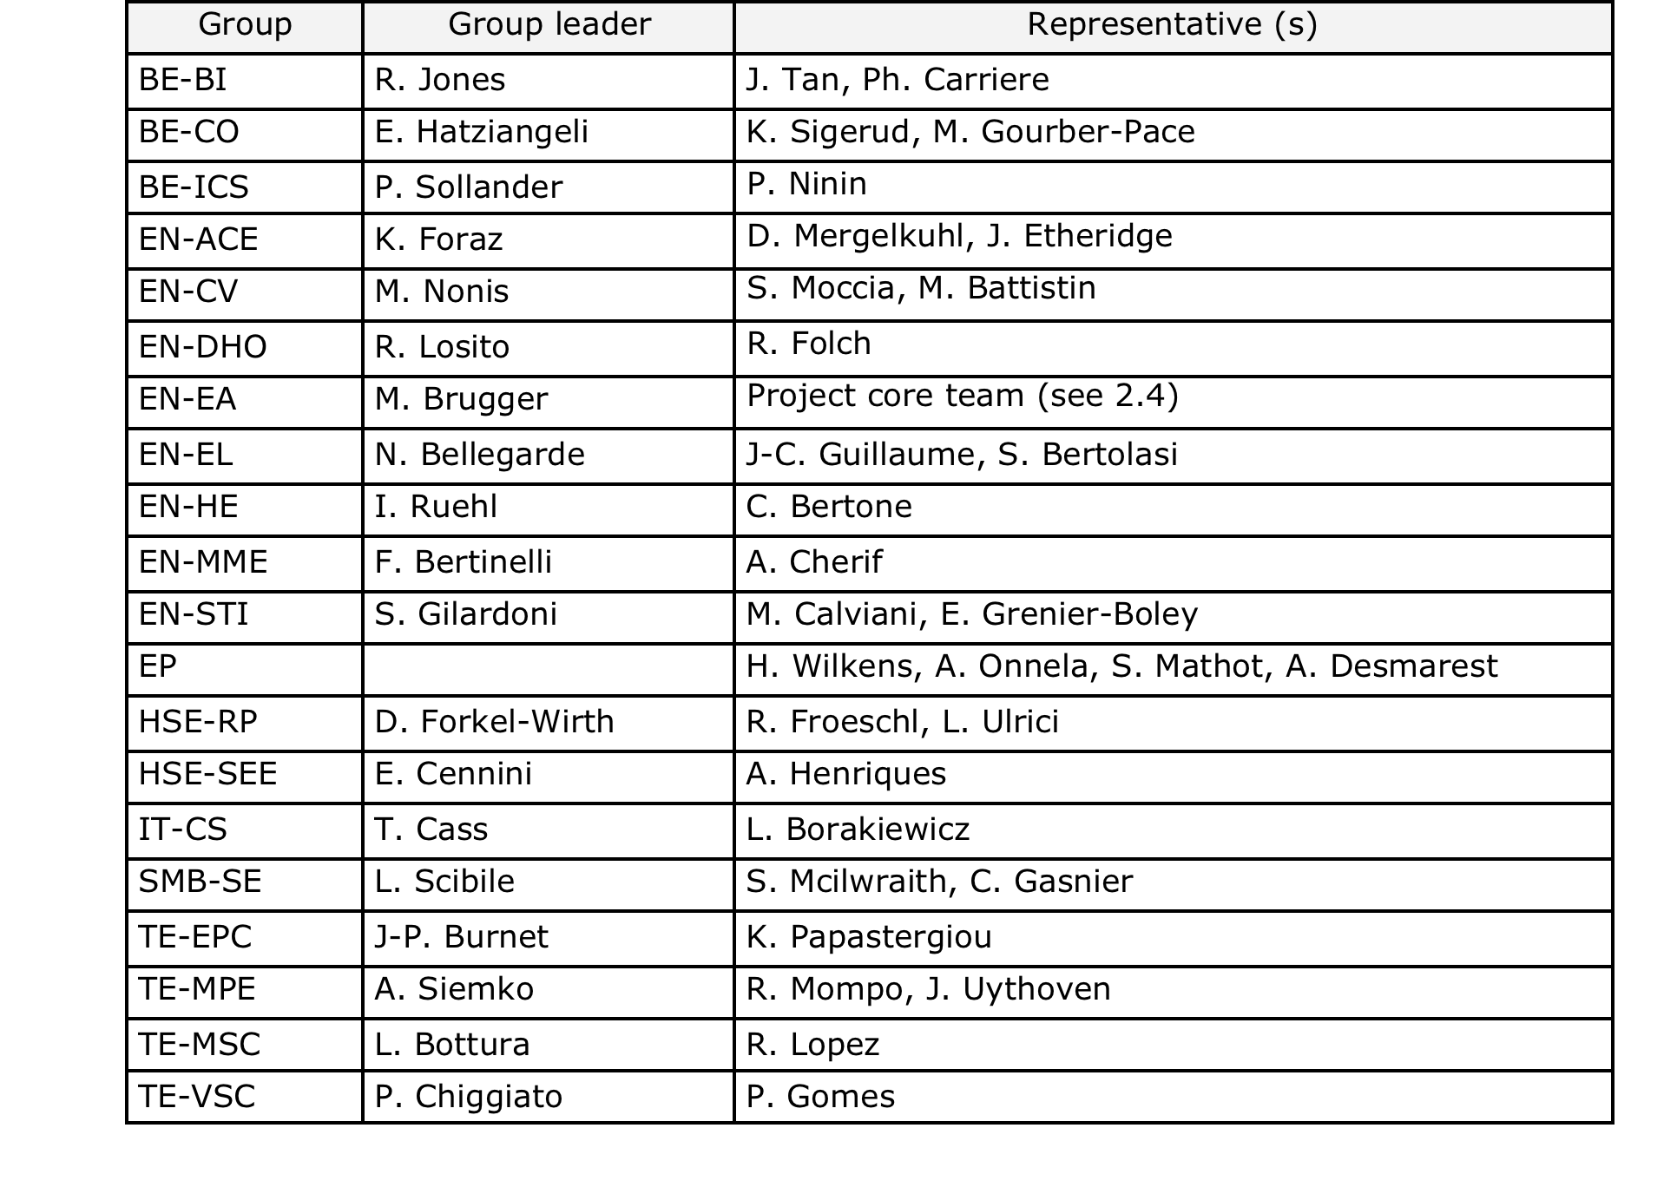
Project Team (proposed membership)

Slide 7
IEFC report on September 2nd
https://edms.cern.ch/document/1716532/1
Feedbacks:
  include EN-MME in project team (synergies with B.156)
  Include EN-HE and a representative from RP-waste in project team
  Update PLAN tool with new activity requests → action needed from each group !
  Improved accessibility to beam line equipment is required
  Offices for physicists in shift: B. 263 is an option (discussion with EP space manager)
  Energy savings → less cooling power required → some cooling power available for the South Hall (OpenMed)
  Schedule: distinguish Beam commissioning & Hardware commissioning: different responsibility and time slot.
  Survey team would like to implement a new reference network in B. 157.

Slide 8
Project Safety Officer (PSO)
The Project Safety Officer (PSO) oversees and coordinates safety aspects of the EA renovation project:
  verify that safety aspects have been correctly considered within the different work packages, that the proposed safety measures are consistent with the general Safety policy of the Project as well as with the CERN safety rules, and that they are effectively applied.
  Identify the safety issues arising at the interface between work packages and, whenever required, asking the relevant work packages to apply appropriate measures.
  Coordinate the editorial work for the safety documentation of the different facilities concerned by the project.
The PSO is Erwan Harrouch (EN-EA)

Slide 9
LSA (Launch safety Agreement)
This document provides an overview of the conventional (non-radiological) Safety requirements applicable to the project and its related Safety documentation. After the launch Safety discussion (held on 19/09/16), it is the 2nd Step of the editorial process in the Safety Documentation Management procedure (EDMS 1177755).
This document is an integral part of the Safety file for the project that the Project Leader shall:
  maintain and keep it updated during the life cycle of the project in order to demonstrate compliance with the Safety requirements stated in this document;
  make available to the HSE Unit upon request and before any periodic inspection.
Safety domains relevant to the project are identified jointly (HSE + Project)
General Safety requirements are defined accordingly by HSE
PL ensures that Project Engineers follow these safety requirements in their WP’s.
Domains covered: Products and material, Mechanical Safety, Structural Mechanics, Welding activities, Heating, Ventilation and Air Conditioning (HVAC) Systems, Electrical Safety, Non-ionizing radiation Safety (excluding sound and UV), Chemical Safety, Fire Safety, Noise, Workplace Safety, Protection of the environment, Worksite
Define need (or not) of formal «safety clearance» given by HSE Head prior to operation

Slide 10
Organizational tools
EDMS: https://edms.cern.ch/project/CERN-0000169544
Indico: https://indico.cern.ch/category/8407/
E-groups:
  East-area-renovation-project-team@cern.ch : members of the Project team.
  East-area-renovation-core-team-project@cern.ch: members of the Project core team.
SharePoint: https://espace.cern.ch/East-Area-Renovation-Project
dfs: https://dfsweb.web.cern.ch/dfsweb/Services/DFS/DFSBrowser.aspx/Workspaces/e/EastAreaRenovation/

Slide 11
WP meetings
Inputs for
    EQUIPMENT/SYSTEM CONCERNED: detailed list of items
    Schedule
    Cost/Budget
    Procurement
    Manufacturing
    Logistics
    Design/integration
    Interfaces: impact on other items (cabling, cooling, control,…), removal, waste.
    Resources (manpower & budget)
    Risk assessment
    Safety (hardware, operation, safety file)
    AOB
Thursday 18 August EN-EA
Thursday 25 August BE-BI
Thursday 01 September TE-MSC
Thursday 15 September TE-EPC
Thursday 22 September EN-STI
Thursday 29 September EN-CV
Thursday 29 September SMB-SE
Friday 30 September EN-EL
More to come in October

Slide 12
Next PT meetings
The next Project team meetings are going to take place on:
Friday 23 September, 15.00-16.30 in B.30/7-010
Friday 21 October, 15.00-16.30 in B.30/7-010
Friday 18 November, 15.00-16.30 in B.30/7-010
Friday 16 December, 15.00-16.30 in B.30/7-010

Slide 13
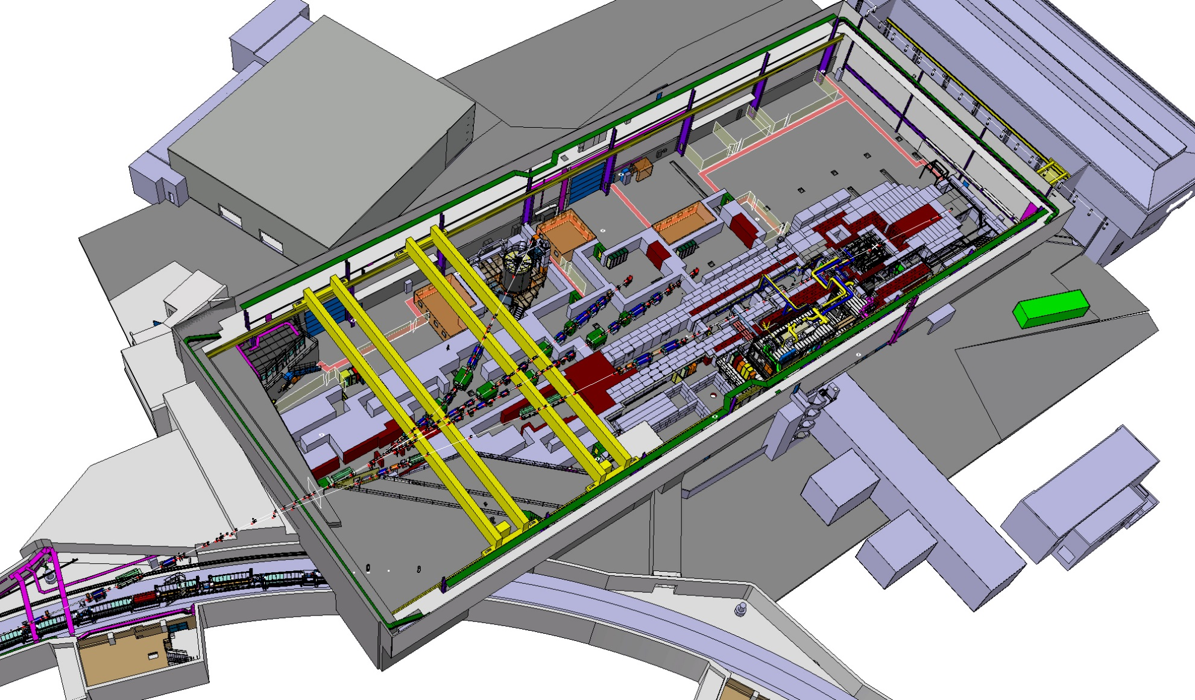
Thanks for your attention!

