Slide 1
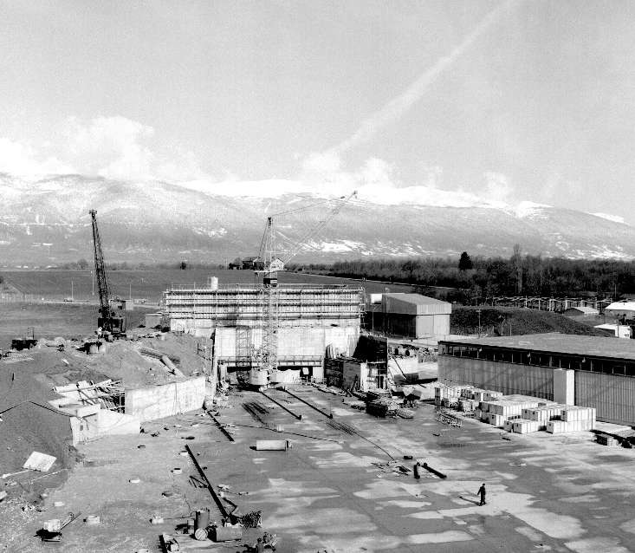
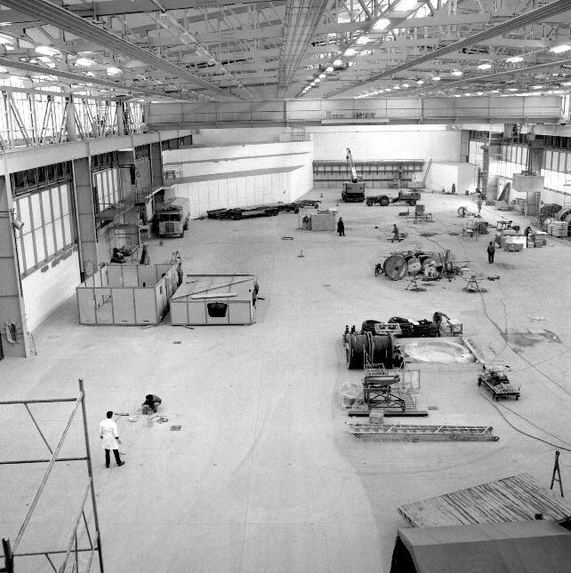
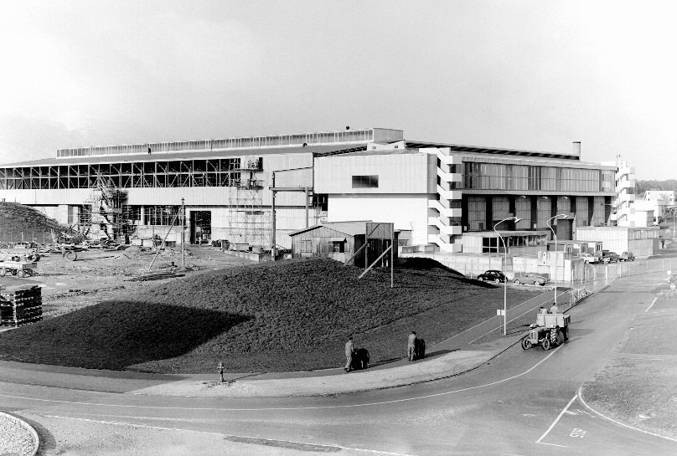

Naming convention and layout database for the East Area
East Hall under construction - 1962
Erwan Harrouch/ EN-EA, 23-09-2016

Slide 2
Presentation outline
Current situation in the East Area
Naming convention proposals
What’s next?

Slide 3
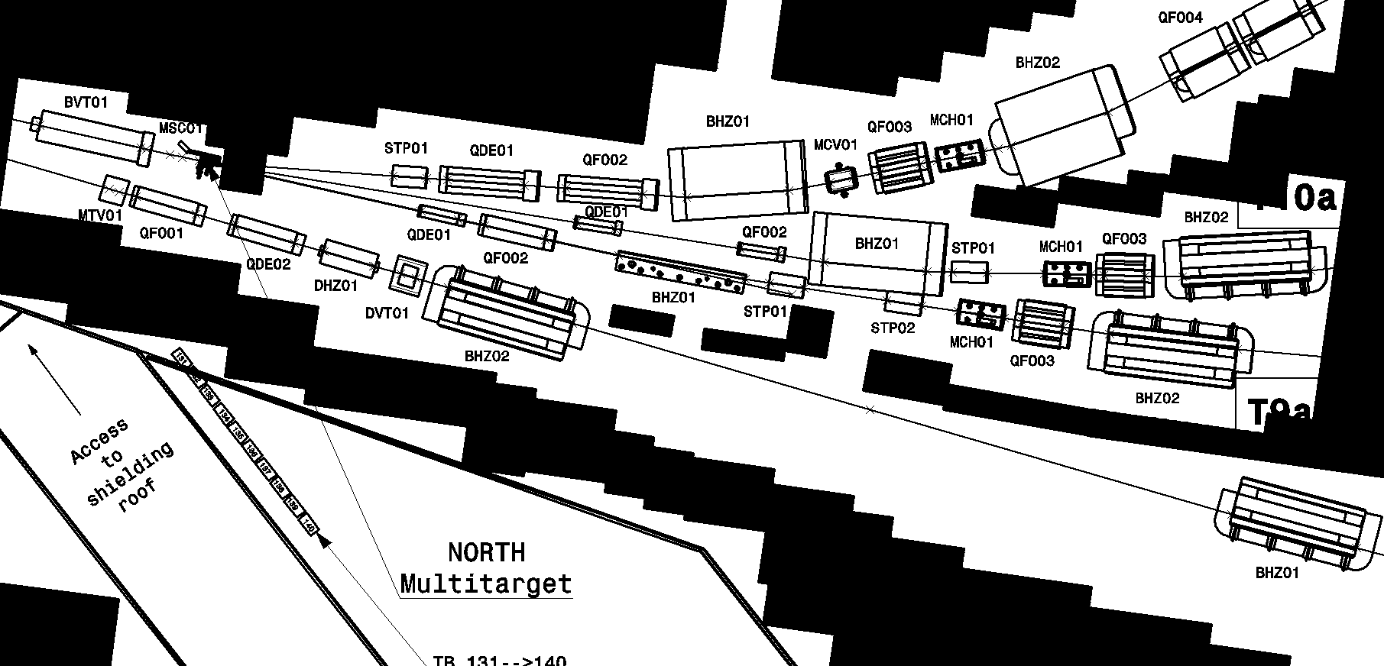
Current situation
Beamline components named after their role in the beam optics
Beamline components with identical names on several beamlines, different types of equipment with the same name…

Slide 4
Naming convention : Proposal 1
Proposal 1 : East area naming convention based on the model of the North area
X
C
S
V
.
6
4
0
1
0
0
Equipment code
Position code
Equipment code (Slide 6):
  S the first letter indicates the system to which the equipment belongs and must be chosen from to the list of systems.
  F the second letter defines the family of the equipment within a given system.
  TT the last two letters defines the type within a family, the model for a given type and lastly the variant.
Position code :
  The 3 first identify the beamline concerned (Slide 7).
  The 2 next digits give the position in meters from the first equipment of the section.
  The last digit is used to differentiate equipment when they are located in the same position.

Slide 5
Naming convention : Proposal 2
Proposal 2 : East area naming convention based on the model of the PS.
T
0
8
.
X
C
S
V
.
0
1
0
Beamline prefix
Equipment code
Position code
Beamline prefix :
  The beamline prefix indicate on which beamline the equipment is located (Slide 7).
Equipment code :
  S the first letter indicates the system to which the equipment belongs and must be chosen from to the list of systems given in (Slide 6).
  F the second letter defines the family of the equipment within a given system.
  TT the last two letters defines the type within a family, the model for a given type and lastly the variant.
Position code :
  The 2 first digits locate the equipment from the origin of the beam line in meters,
  the last digits is used in case two beamline components are located in the same position

Slide 6
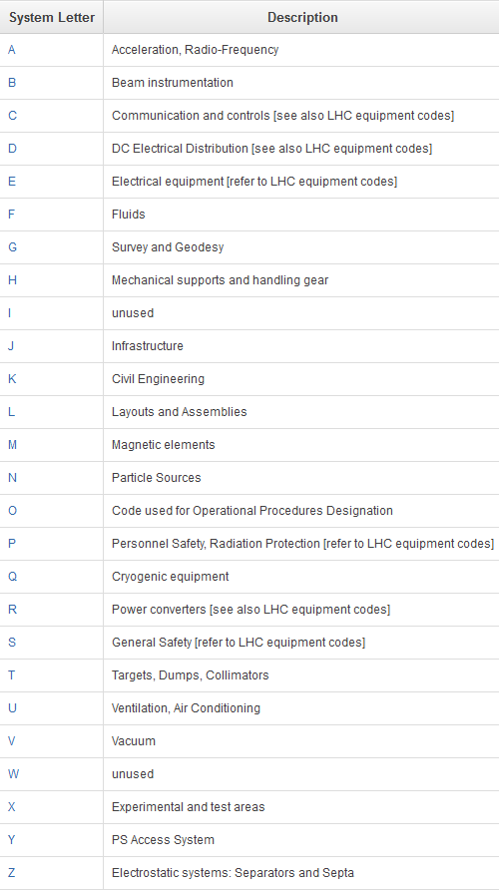
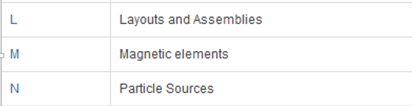
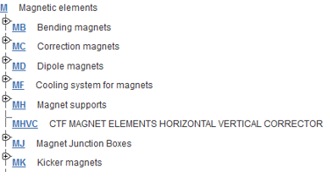
Equipment codes : Example
Available on the Naming portal

Slide 7
Naming convention : Positioning
Positioning of the equipment :
Targets
Ex:
XCSV.640010
T08.XCSV.100
BHZ
T11_{650…}
BHZ PS
BHZ
T10_{640…}
F61_{610…}
T08_{620…}
T09_{630…}
PS
Line | Proposal 1 Position code (3 first digits) | Proposal 2 Beamline prefix | Origin of the line
F61 | 610 | F61 | BHZ (PS)
T8 | 620 | T08 | BHZ
T9 | 630 | T09 | BHZ
T10 | 640 | T10 | Target T10 T11
T11 | 650 | T11 | Target T10 T11

Slide 8
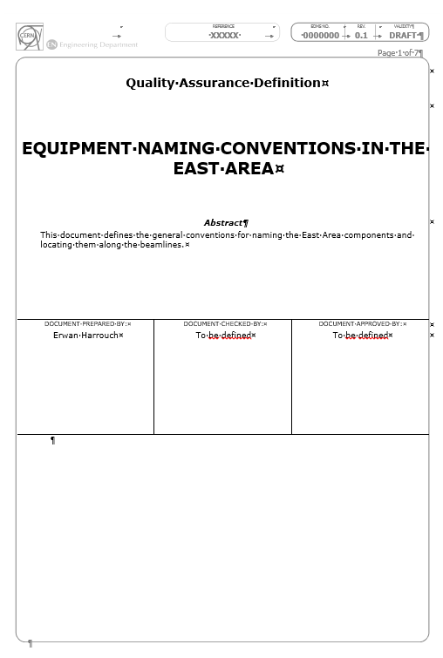
What is next?
The equipment code should be provided by its owner.
Please provide all your equipment code relevant to the new beamlines so they will be validated by the CERN naming service and the project coordination
The naming convention document will be sent for circulation in the coming weeks.
Once the naming convention, your equipment code and the beatch files will be approved the first version of the beamlines layout will be published.
All the beamline components will be stored in the CERN layout database to centralize all the information on the equipment.
  CERN Layout database

Slide 9
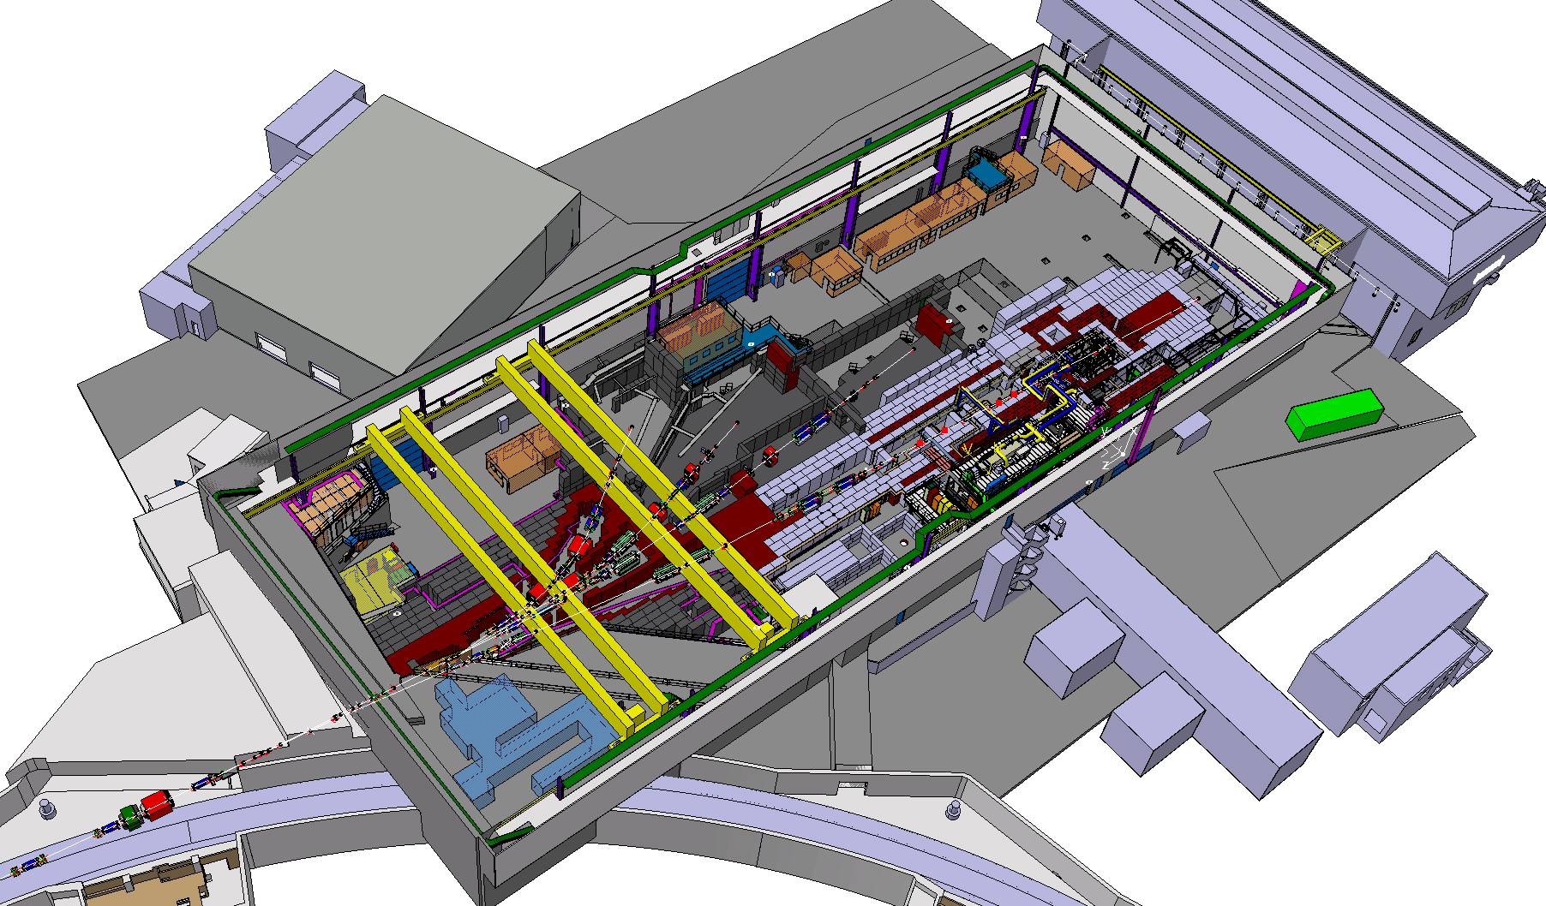

THANKS FOR YOUR ATTENTION ! QUESTIONS ?

