Slide 1
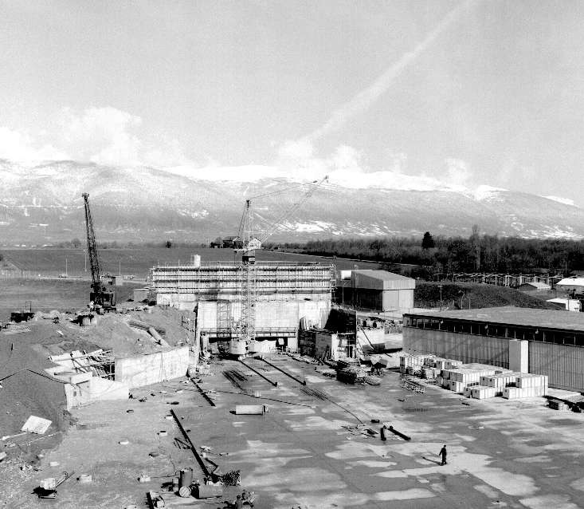
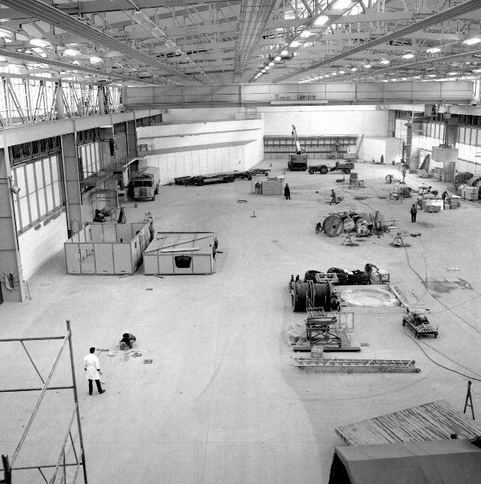
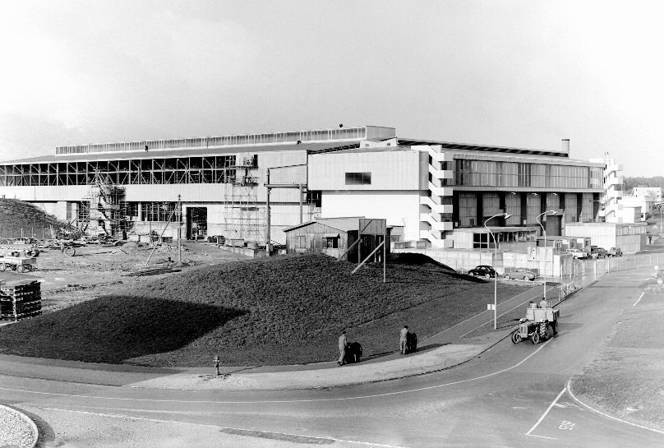

East Area Renovation Project
Planning activities
East Hall under construction - 1962
Quentin Bouirek / EN-EA, 23-09-2016

Slide 2
Master schedule
SHUTDOWN/TS | PROTON PHYSICS |  | 2 | 0 | 1 | 6 |  |  |  |  |  | 2 | 0 | 1 | 7 |  |  |  |  |  |  |  |  | 2 | 0 | 1 | 8 |  |  |  |  |  |  |  |  | 2 | 0 | 1 | 9 |  |  |  |  |  |  |  |  | 2 | 0 | 2 | 0 |  |  |  |  |  |  |  |  | 2 | 0 | 2 | 1
COMMISSIONING | IONS | J | A | S | O | N | D | J | F | M | A | M | J | J | A | S | O | N | D | J | F | M | A | M | J | J | A | S | O | N | D | J | F | M | A | M | J | J | A | S | O | N | D | J | F | M | A | M | J | J | A | S | O | N | D | J | F | M | A | M | J | J | A | S | O | N | D
Group | Activity
TE-EPC | Procure Power Converter
TE-MSC | Prepare new yokes
TE-MSC | Remove magnets
TE-MSC | Modify magnets
TE-MSC | Re-install magnets
EN-EL | Renovate AC&DC distribution
EN-CV | Renovate cooling systems
SMB-SE | Building
TE-EPC | Install new power converters
EN-EA | Change beam line layout + vacuum beam pipe
EN-ACE | Survey
All | Commission new facility
Commissioning after injectors &LHC, driven by Power Converters
SMB-CE intervention during operation under investigation

Slide 3
Project management schedule
Global vision on the project
Completed after each WP meetings

Slide 4
Synthetic linear schedule
Easy overview of the ongoing activities
Highlighting the coactivity
Evolving areas and timescale, depending the currents activities

Slide 5
EA Renovation linear schedule

Slide 6
Gantt project
Online Gantt
Possibility to display Safety information, File numbers, IMPACT numbers
Online Project Accelerator Complex Schedule

Slide 7

Summary
  Waiting for your inputs, constraints and waiting period.
  quentin.bouirek@cern.ch
  63705
  Thanks for you attention !

