Slide 1
Observations and measurements on the impact of earthquakes and cultural noise on the LHC operation and their extrapolation to HL-LHC parameters.
B. Di Girolamo, M. Guinchard, M. Schaumann, J. Wenninger
Acknowledgments:
N. Azaryan, J. Budagov, R. Corsini, P. Fessia, M. Fitterer, D. Gamba, A. Gorzawski,
M. Lyablin, M. Poehler, R. Steinhagen
Review of the needs for a hollow e-lens for the HL-LHC
6th October 2016

Slide 2
Outline
  Summary of civil engineering studies for HL-LHC
  Ground motion and measurements at CERN
  Study of long-distance earthquakes
    Correlation of ground motion with LHC data
    Simulation of ring orbit responds
    Simulations using HL-LHC optics
  Simulation of local small seismic activity (Geothermie2020)
  Other observations of beam oscillations

Slide 3
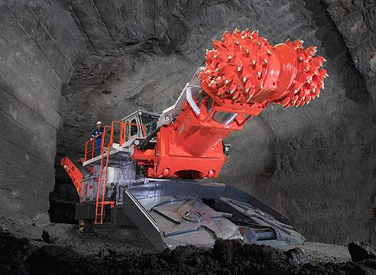
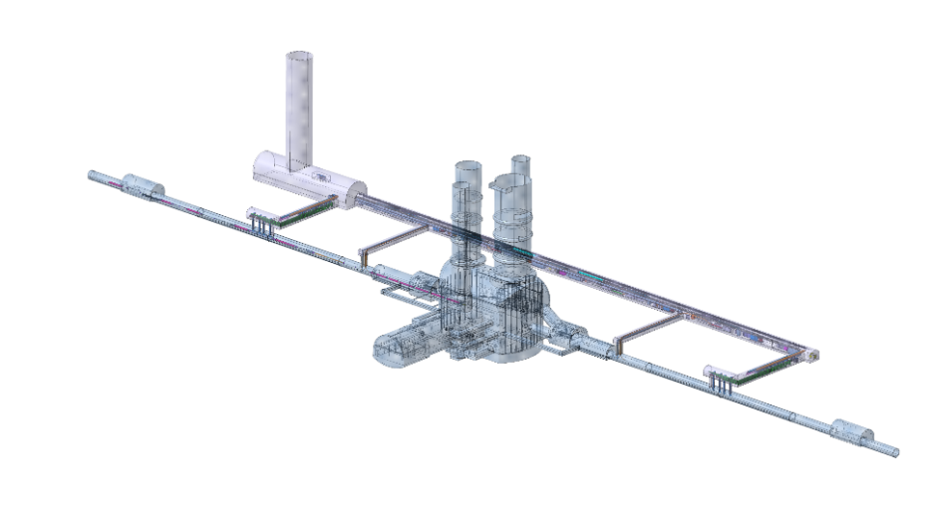
HL-LHC civil engineering
The HL-LHC civil engineering work implies the construction of new access shafts, underground galleries and caverns in points 1 and 5.
  The distance between the new underground structures and the LHC tunnel is approximately 40 m.
Most of the work must be completed before LS3 for installation of HL-LHC equipment.
  Some work overlaps with LHC operation, which could lead to performance degradation of the LHC due to beam offsets at IP, emittance growth from noise etc.
M. Guinchard & J. Wenninger

Slide 4
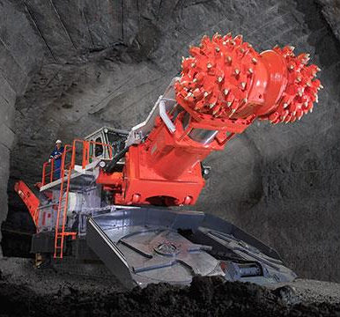
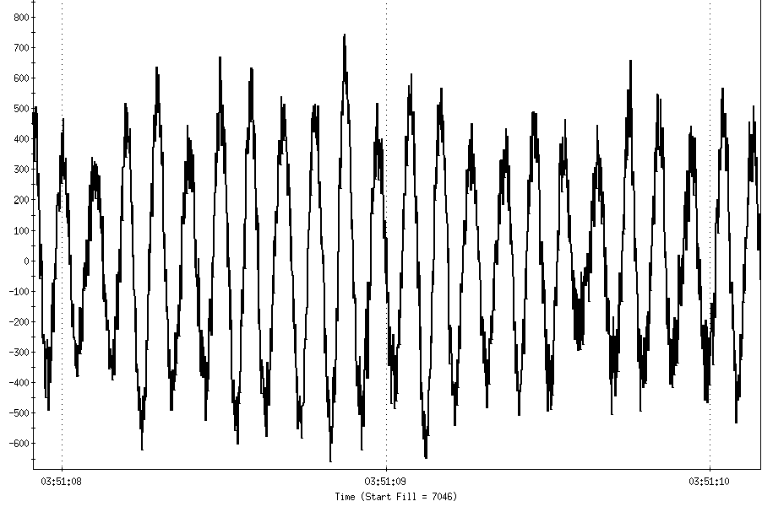
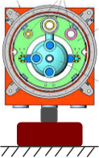
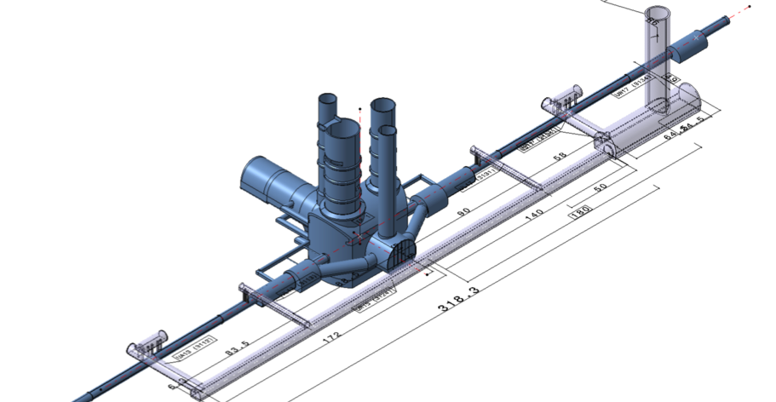
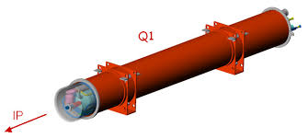
From noise to the beam
To evaluate the impact of CE, the transfer functions of the ground (vertical H2, horizontal H1) and of the triplet support (ground to CM H0) have been determined in a number of test setups.
Parasitic beam observations were made whenever this was possible.
H2 (ω)
H1 (ω)
H0 (ω)
In (ω)
Out (ω)
H2 (ω)
Beam stability
H0 (ω)
H1 (ω)
M. Guinchard & J. Wenninger

Slide 5
Summary of Civil Engineering Studies
  Vibration tests reveal strong mechanical resonances of the triplet [8 - 20 Hz].
      The resonances can boost ground vibrations to amplitudes that can be problematic for the beams.
      A feasibility study of a fast beam orbit feedback system could be considered.
  The excavation of caverns and underground structures should be made during LS2.
  The convolution of measured transfer functions seems to indicate that the construction of the HL-LHC CE vertical shafts should be compatible with beam operation (2018).

Slide 6
Outline
  Summary of civil engineering studies for HL-LHC
  Ground motion and measurements at CERN
  Study of long-distance earthquakes
    Correlation of ground motion with LHC data
    Simulation of ring orbit responds
    Simulations using HL-LHC optics
  Simulation of local small seismic activity (Geothermie2020)
  Other observations of beam oscillations

Slide 7
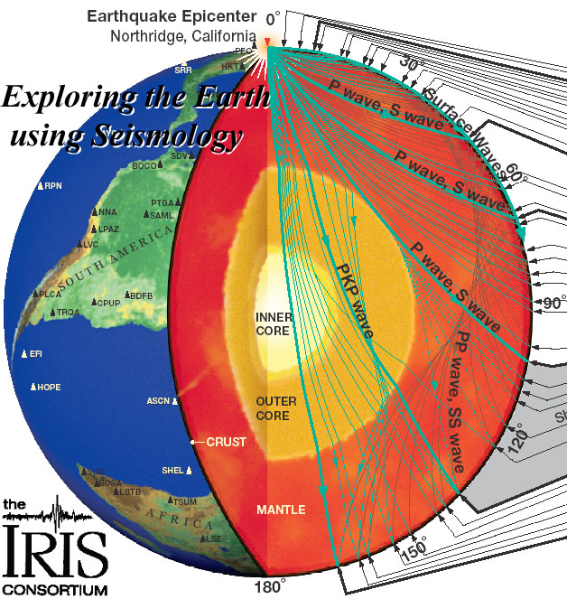
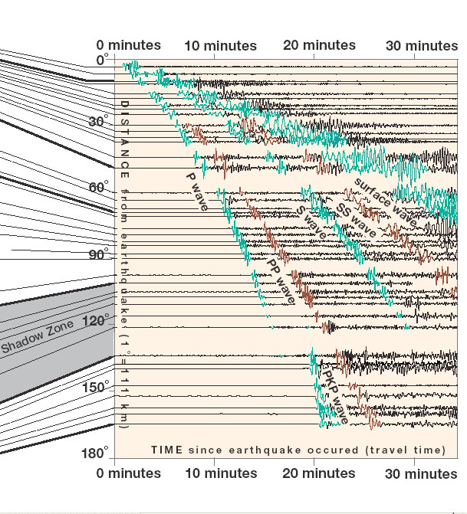
Waves from Earthquakes
The different types of body (Pressure, Shear) and surface (Rayleigh, Love) waves, the multiple paths and reflections of the wave produce a complex signature of earthquakes at seismic measurement stations – and also at the LHC.
Although the seismic activity in the Geneva area is very low, waves from far away earthquakes can affect the LHC.
L. Braille (Purdue U.) / The IRIS (Incorporated Research Institutions for Seismology) consortium
Slide from J. Wenninger

Slide 8
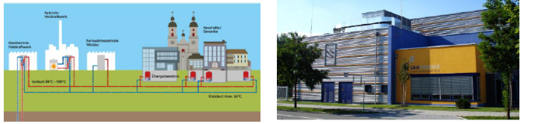
Geothermie 2020
Geothermie 2020 is a renewable energy production project
by the Canton of Geneva to exploit geothermal energy
for electricity production and heat generation.
Principle of energy exploitation: water is pumped into a bore hole under high pressure to stimulate a geothermal reservoir.
This may induce seismic activity and earthquakes of magnitude ~2 have to be expected.
  Duration: ~1 second, rate: 1/week – 1/month?
  Amplitude ~1 μm (factor 10 uncertainty).

Slide 9
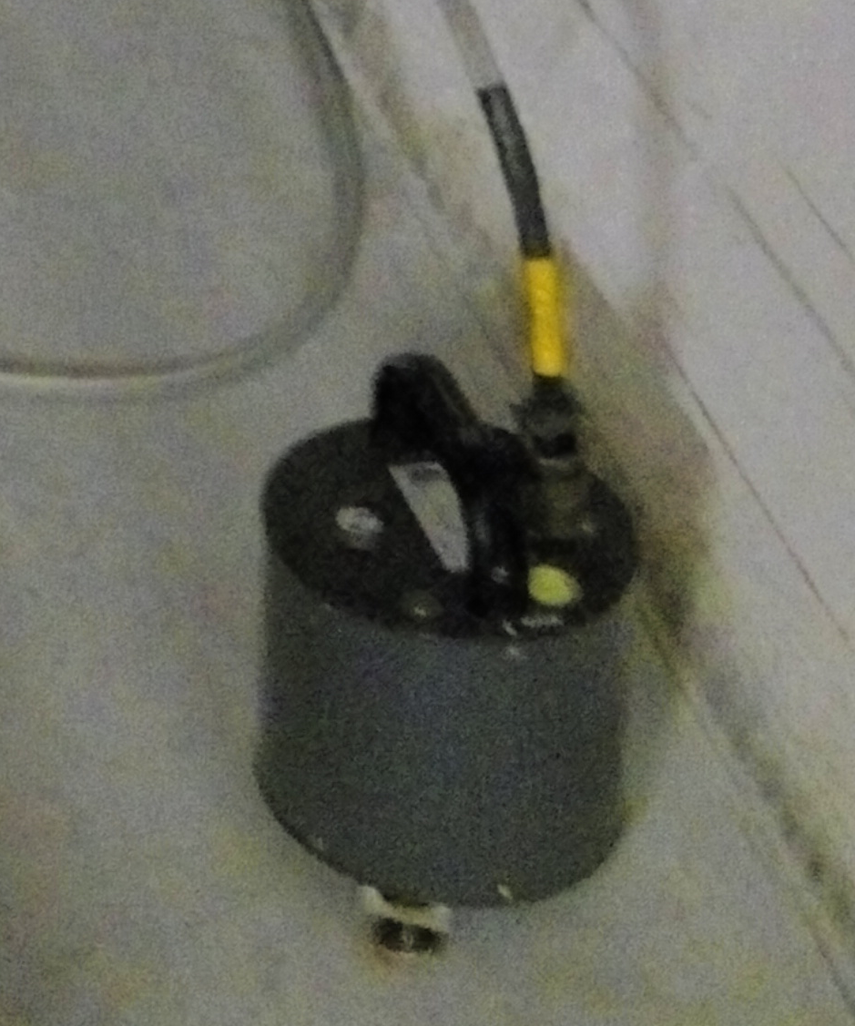
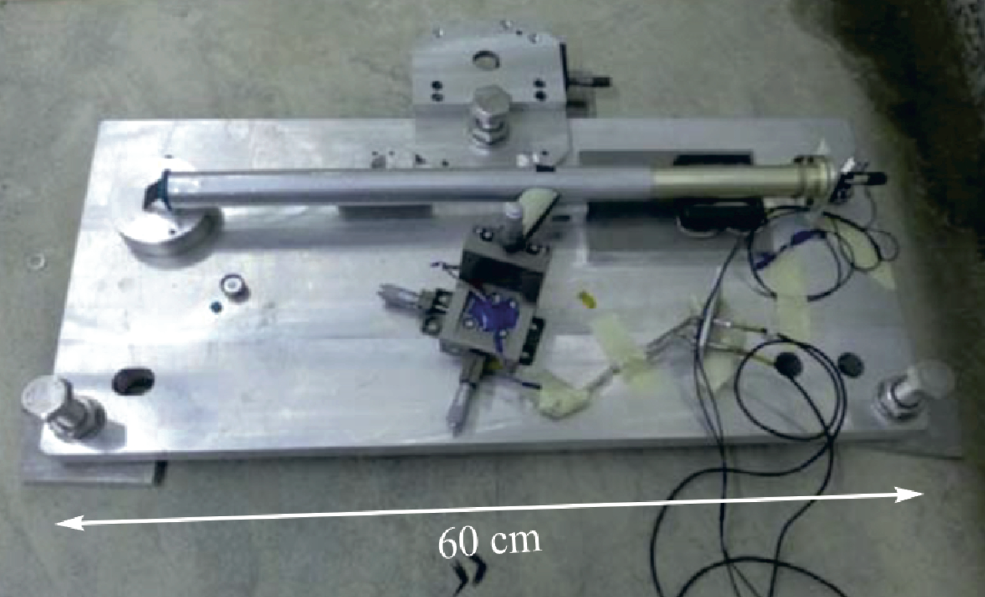
Earthquake Monitoring around CERN
Monitoring of the regional seismic activity is poor (from the Swiss side).
In the context of the Geothermie 2020 project (see below) a network is been build to monitor the natural seismic activity down to magnitude ~1.5 (Geneva Univ.).
Ground motion measurements at CERN:
  Network of geophones (EN-MME) will be installed in the
  LHC service areas of Point 1 and 5
    Installation foreseen during EYETS 2016/2017.
    Currently a prototype is installed in TT1, operating since Apr. 2016.
  Precision Laser Inclinometers (PLI, collaboration between CERN, ATLAS, Dubna Institute)
    Long term plan is to install devices in ATLAS cavern.
        Currently a prototype is installed in TT1, operating since Mar. 2015.
Notes:
Observation with LHC beam instrumentation: DOROS, Orbit BPMs, ADT ObsBox, BLMs, BBQ, WPS/HLS (position sensors on triplets), Luminosity, Beam intensity…

Slide 10
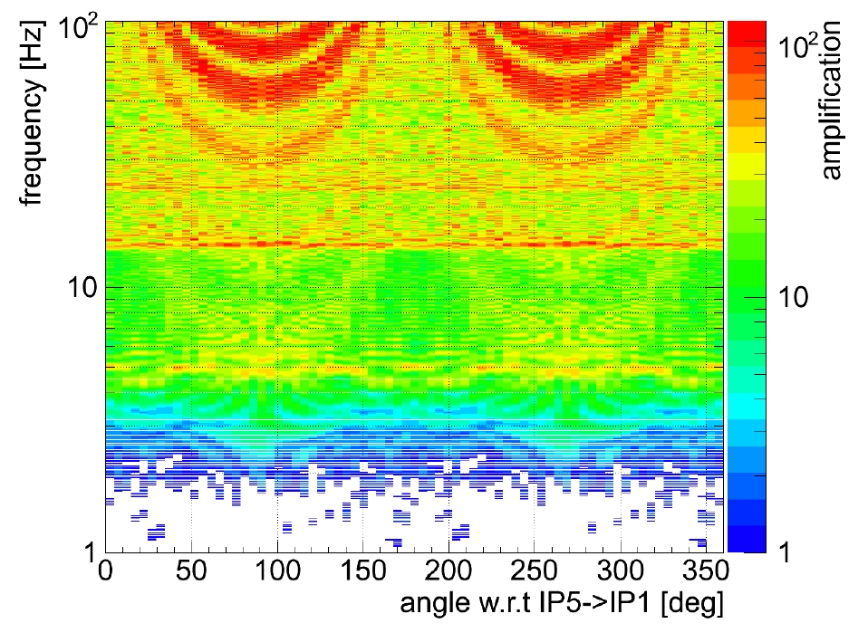
LHC Ring Response
Simulations of the amplification of the wave effect on orbit displacement due to the LHC lattice were carried out during the design of the orbit feedback (by R. Steinhagen).
The response of the LHC to ground motion waves depends on wavelength and direction, the amplification can reach a factor ~100 for waves travelling along the LSS in IR1 and IR5 (direction NW →SE).
Large amplifications are associated to resonant response of (parts of) the LHC.
Transverse wave (S), vertical plane, v = 2000 m/s
λ = 200 m
Currently this study is been extended in order to obtain the response under HL-LHC conditions.
R. Steinhagen, CERN Thesis 2007-058
Slide from J. Wenninger

Slide 11
Simulation of Ring Response
Simulation tool under development
Input
Measured ground motion (in mm)
Travel direction of the wave w.r.t LHC
  “snapshots” of the wave’s passage
  quadrupole offsets
  closed orbit change due to offsets
Output
  Time evolution of the ring response in terms of RMS and mean orbit.

Slide 12
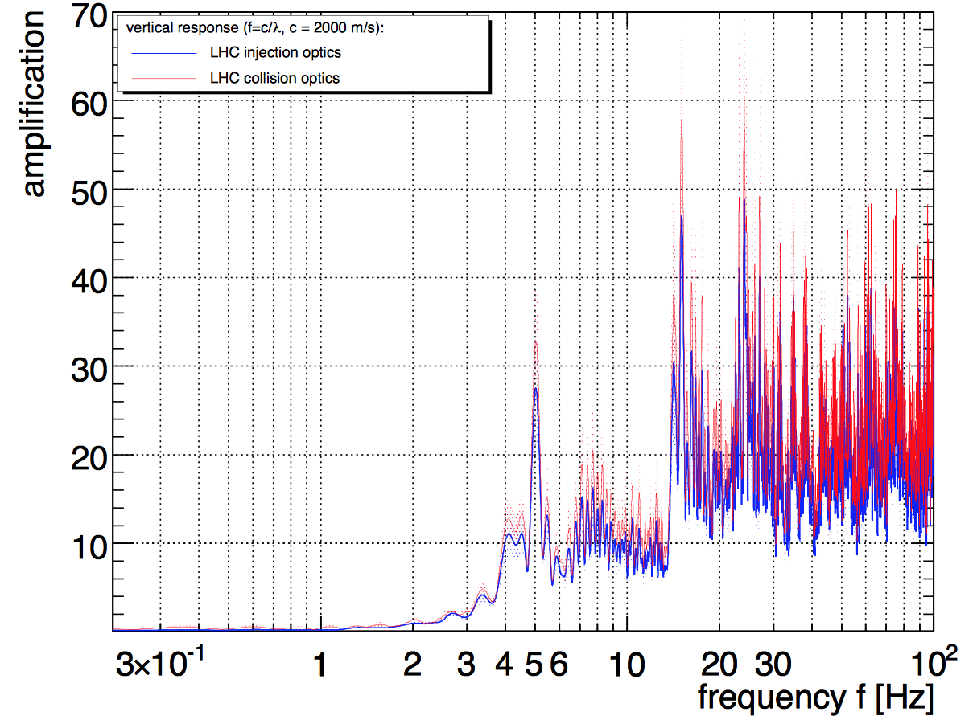
Benchmarking Simulations
Vertical plane response to transverse wave excitation, v = 2000 m/s
V6.503 injection optics,
injection tunes,
V6.5.seq
R. Steinhagen
new simulation
R. Steinhagen, CERN Thesis 2007-058
Results for vertical responds from new simulation tool are in good agreement with the old study.
  All important resonances appear at the same frequencies and with approximately the same ratios to each other.
  In the horizontal plane larger discrepancies are observed.
  The simulation code is still under development and being reviewed.

Slide 13
Outline
  Summary of civil engineering studies for HL-LHC
  Ground motion and measurements at CERN
  Study of long-distance earthquakes
    Correlation of ground motion with LHC data
    Simulation of ring orbit responds
    Simulations using HL-LHC optics
  Simulation of local small seismic activity (Geothermie2020)
  Other observations of beam oscillations

Slide 14
Observed Earthquakes at the LHC
Location | Date | Mag | LHC | DR (mm) | Int (10¹³ p/beam)
Italy | 20-05-12 | 6 | 4 TeV collisions | ±60 | 14
Costa-Rica | 05-09-12 | 7.6 | 4 TeV collisions | ±80 | 19
Chile | 16-09-15 | 8.3 | Injection | ±200 | 5
Chile | 17-09-15 | 6.5 | 6.5 TeV collisions | ±15 | 10
Italy | 24-08-16 | 6.2 | Injection (MD) | ±60 | 0.3
Ascension Islands | 29-08-16 | 7.1 | 6.5 TeV collisions | ±20 | 20
Presented at Charmonix 2016
New events with available ground motion measurements in TT1.
Qualitative estimate of RMS orbit distortion impact (LHC):
If beams would be dumped for a certain orbit movement, strongly depends on tail population, wave properties …
Scaling the loss pattern at TCP,
the first Italy event could have dumped under
HL-LHC conditions.
50μm (≈0.25σ@TCP) beam dumps unlikely
>~100μm (≈0.5σ@TCP) beam dumps probable
>~200μm (≈1σ@TCP) beam dumps definitive

Slide 15


Italy Earthquake, 24th Aug. 2016
Magnitude 6.2 in ITALY
Wednesday, August 24, 2016 at 01:36:33 UTC
The prototype ground motion devices in TT1 recorded the event.
LHC
~2min
epicenter
Main frequencies: 0.1-0.3 Hz (8-3s)
Geophone measurement TT1
Inclinometer data TT1
10min
Amatrice after the earthquake

Slide 16
Italy Earthquake: LHC Observations
The LHC was performing MDs and only Beam 1 was present at the time of the earthquake.
Inclinometer signal
±10mrad
Timing and overall shape of ground motion measurement and orbit signal fit.
Meas. mean orbit
±60μm
Losses increase with increased mean orbit
Meas. RMS orbit
no signal visible
TCP BLMs in IR7
nicely correlate with orbit
Noise floor of this BLM

Slide 17
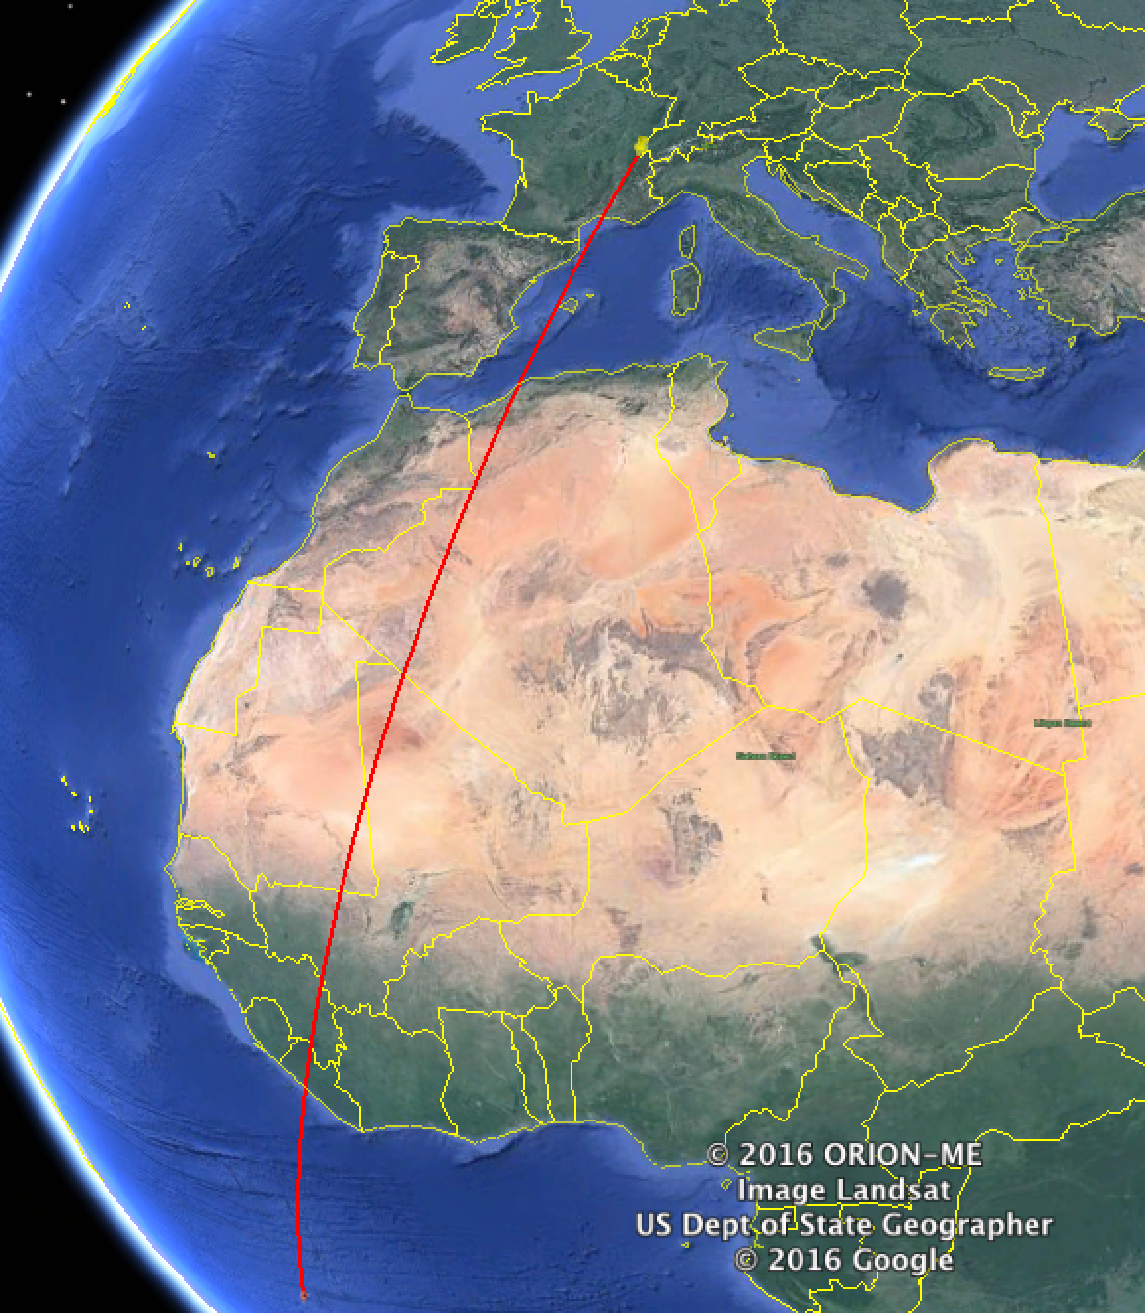
Ascension Islands Earthquake, 29th Aug. 2016
Magnitude 7.1 in Ascension Islands
Monday, August 29, 2016 at 04:29:57 UTC
LHC
LHC was in stable collisions
1h
Epicenter
Main frequencies: 0.05-0.1 Hz (10-20s)

Slide 18
Observations on the LHC Beam
Clear correlations between ground motion in TT1, orbit and losses in IP7.
Hor. Mean Orbit
BLM TPC CL7

Slide 19
Correlations of Ground Motion with Luminosity
Luminosity shows good correlation with ground motion in TT1.
ALICE/LHCb oscillate in phase with the ground motion.
ATLAS/CMS oscillate with π/2 phase difference.

Slide 20
Simulation of Orbit Responds
Simulation with Inclinometer data
No proper calibration to units of meter (as required for the simulation).
→ Amplitude of simulated RMS orbit distortion not reliable.
Assumed same signal for longitudinal and vertical offsets.
→ Some frequencies and amplitudes may not be covered in simulation.
→ Where orbit and inclinometer show equivalent peaks the simulation follows.
Inclinometer signal
measured radial orbit
measured RMS orbit
Simulated vertical RMS orbit

Slide 21
Simulations with HL-LHC Optics
Compared to the 2016 LHC optics the sim. RMS orbit response increases by a factor
~2 for round HL-LHC optics
~3 for flat HL-LHC optics

Slide 22
Outline
  Summary of civil engineering studies for HL-LHC
  Ground motion and measurements at CERN
  Study of long-distance earthquakes
    Correlation of ground motion with LHC data
    Simulation of ring orbit responds
    Simulations using HL-LHC optics
  Simulation of local small seismic activity (Geothermie2020)
  Other observations of beam oscillations

Slide 23
Seismic activity from Geothermie 2020
Seismic signal (magnitude ~1.8)
measured during a test injection of high pressure water
Amplitude ~4-6μm
Duration <10s
Report of RESONANCE Ingenieurs-Conseils SA, RT-424.02-1/MK/CB/ST/CL, data provided by Martin Koller, data set used SMZW_093

Slide 24
Simulation Results for 2016 Conditions
2016 Optics
For the simulation it was assumed that plane wave fronts travel parallel to the LHC plane.
Propagation direction: IP1->IP5
Propagation direction: IP3->IP7
RMS quad. displacement up to ~2μm
Peak ~40μm
Peak ~120μm
IP5
IP5
RMS orbit strongly dependent on direction of the wave → factor 3
Earthquake wave
IP3
IP7
IP3
IP7
IP1
Earthquake wave
IP1

Slide 25
HL-LHC Optics Cases
Vertical Response
Propagation Direction: IP1-> IP5
Propagation Direction: IP4-> IP8
Peak ~250μm for flat optics
Peak ~100μm
IP5
RMS orbit increases by a factor 2-3 for HL-LHC optics, with resonant spikes up to a factor 5 for flat optics.
IP5
Earthquake wave
IP3
IP7
IP3
IP7
IP1
Earthquake wave
IP1

Slide 26
Outline
  Summary of civil engineering studies for HL-LHC
  Ground motion and measurements at CERN
  Study of long-distance earthquakes
    Correlation of ground motion with LHC data
    Simulation of ring orbit responds
    Simulations using HL-LHC optics
  Simulation of local small seismic activity (Geothermie2020)
  Other observations of beam oscillations

Slide 27
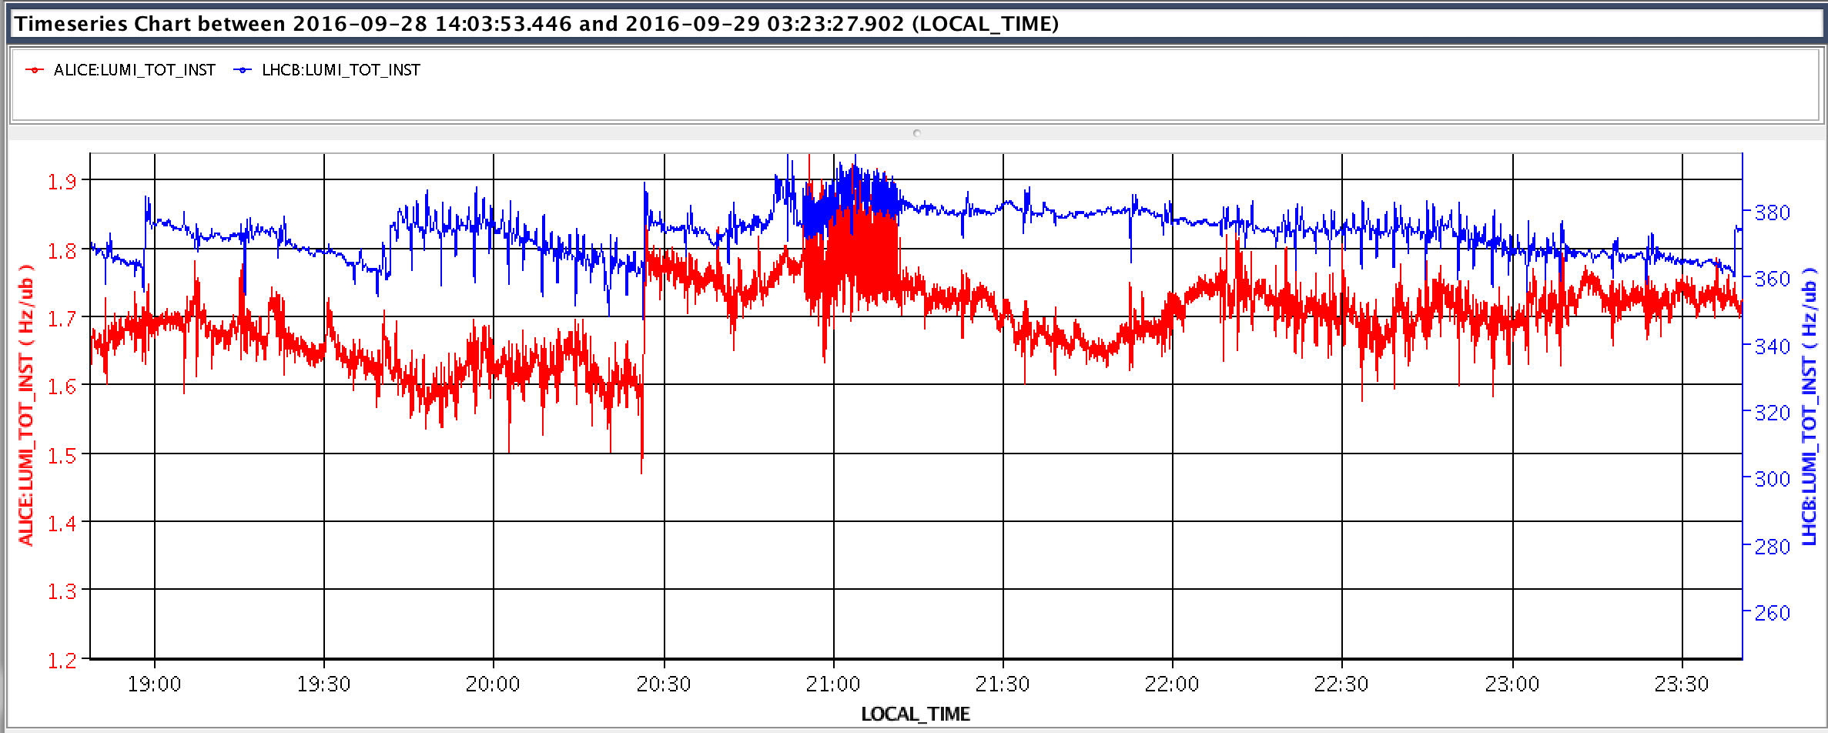
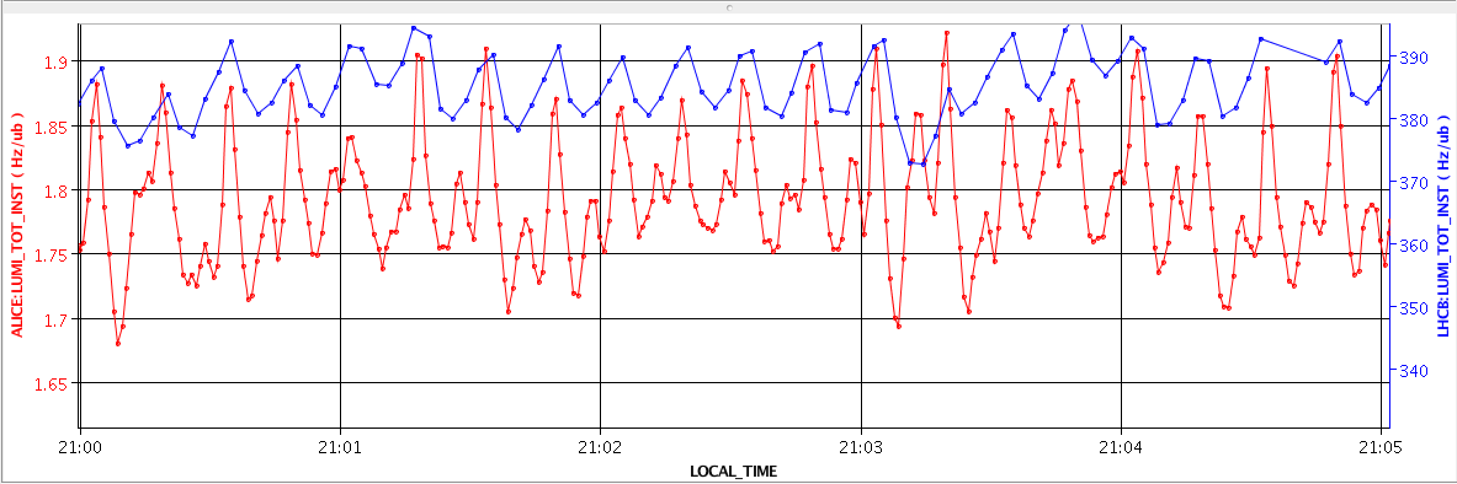
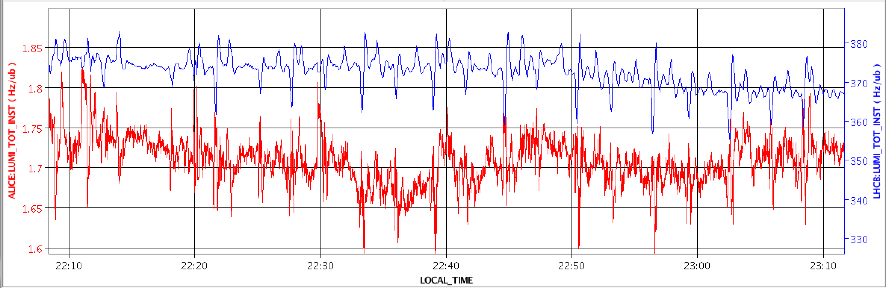
Luminosity Oscillations of Levelled Experiments
Luminosity oscillations of levelled experiments are frequently observed.
  Period ~15 seconds
  Period ~2.5 minutes
Example
Fill 5345

Slide 28
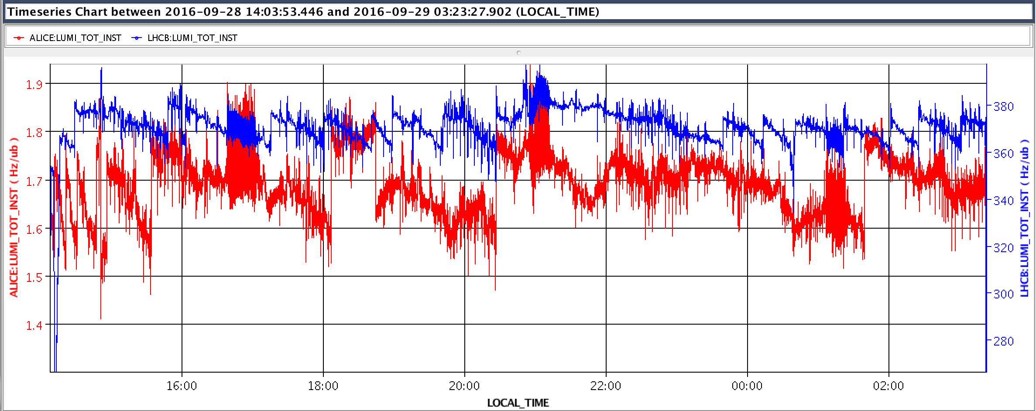
Luminosity Oscillations: Fill 5345
Effects have often a similar duration (~minutes) and re-appearing intervals (~hours).
→ Seems to be caused by a technological source.
ALICE
LHCb
~4h
~4h
~30min
~15min
~15min
~50min
~1 - 2h
~15min
~4h
both effects overlap

Slide 29
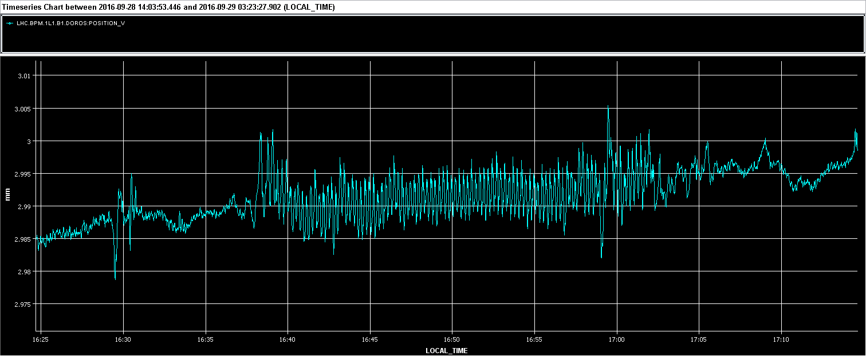
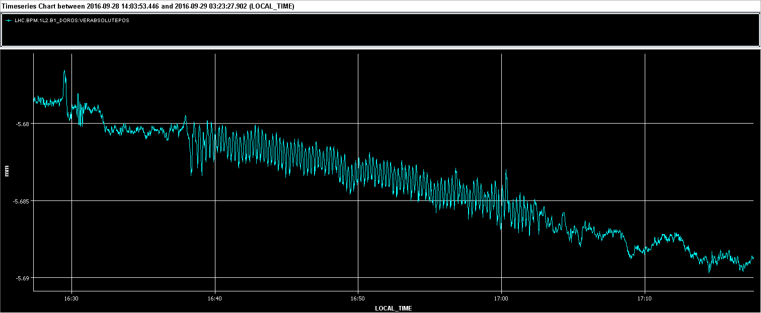
Effect with ~15s Period
Oscillation of amplitude ~±4 μm in vertical at Q1 BPM in IR1 (β = 1200 m)
  amplitude in arcs is ~ 2 μm
Oscillation of amplitude ~±1 μm in vertical at Q1 BPM in IR2 (β = 60 m)
  amplitude in arcs is a little larger
→ The oscillations of the orbit may be a bit too small to explain the luminosity fluctuations unless the source is a quadrupole.
  The orbit oscillations are due to the beam offset w.r.t. quadrupole axis,
  The luminosity fluctuation due to the β-function modulation. The levelled experiments are much more sensitive !
DOROS BPM B1 – IR1
10 μm
5 μm
B2 shows similar amplitude in both cases
DOROS BPM B1 – IR2

Slide 30
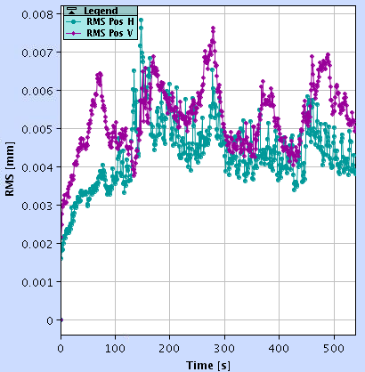
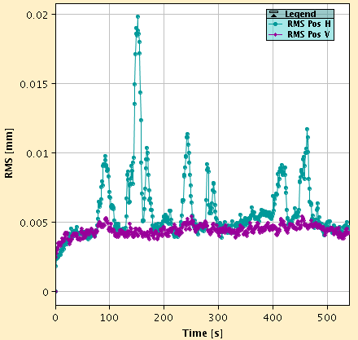
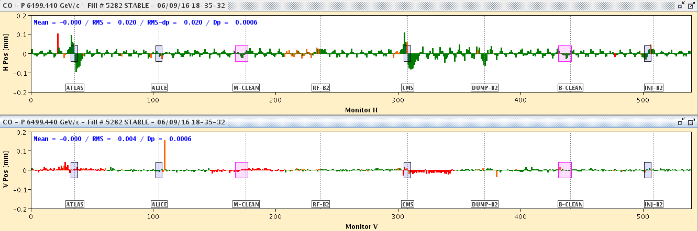
Effect with ~2.5min Period
A second effect with a different frequency causes:
Orbit oscillations mostly observed in B2-Hor with amplitudes of ~20 μm.
Periodic ‘spikes’ are observed in the RMS orbit of B2.
Example Fill 5282
RMS Orbit B2
RMS Orbit B1

Slide 31
Conclusions
Civil engineering:
  Strong mechanical resonances of the triplet at [8, 20 Hz].
  Excavation of HL-LHC vertical shafts should be compatible with 2018 LHC operation.
Large earthquakes (M>6) have a clear impact on the LHC.
  So far NO event cased a beam dump.
  (Prototype) ground motion measurements at CERN are under commissioning.
    IP1 and 5 are planned to be equipped with geophones in the EYETS 2016.
Simulations to predict the ring orbit response are being renewed and extended to as well make estimates for HL-LHC.
  Simulations are still in the development phase.

Slide 32
Backup

Slide 33
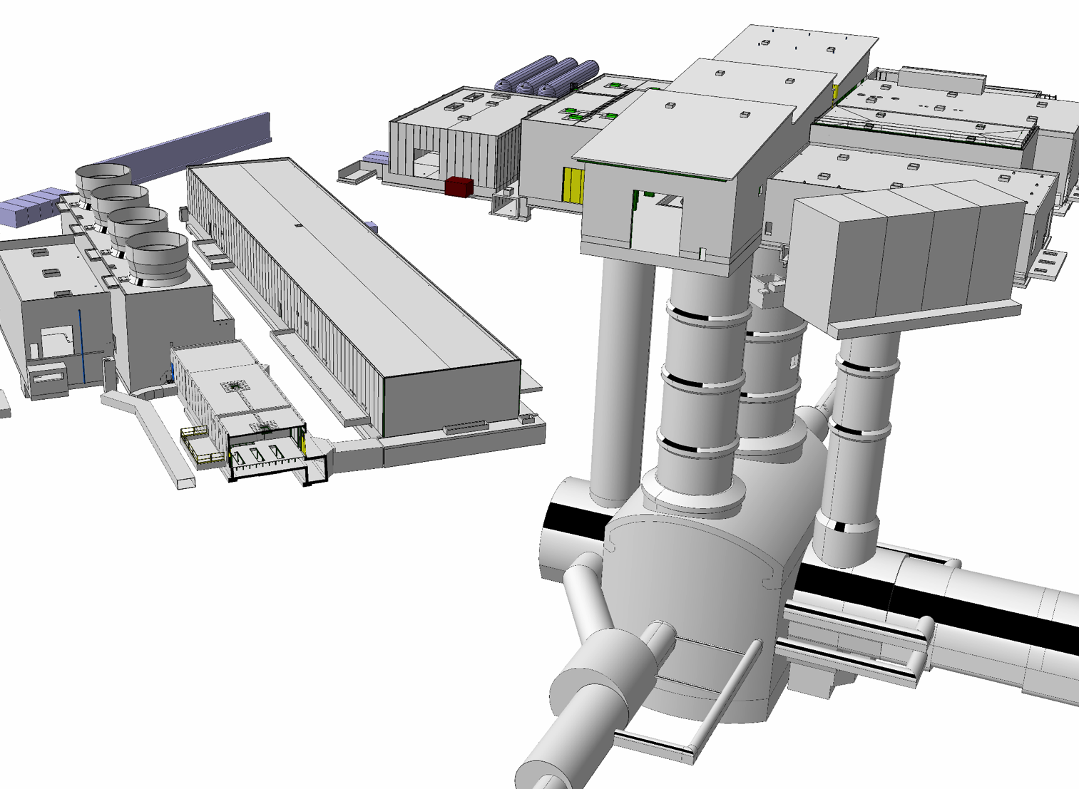
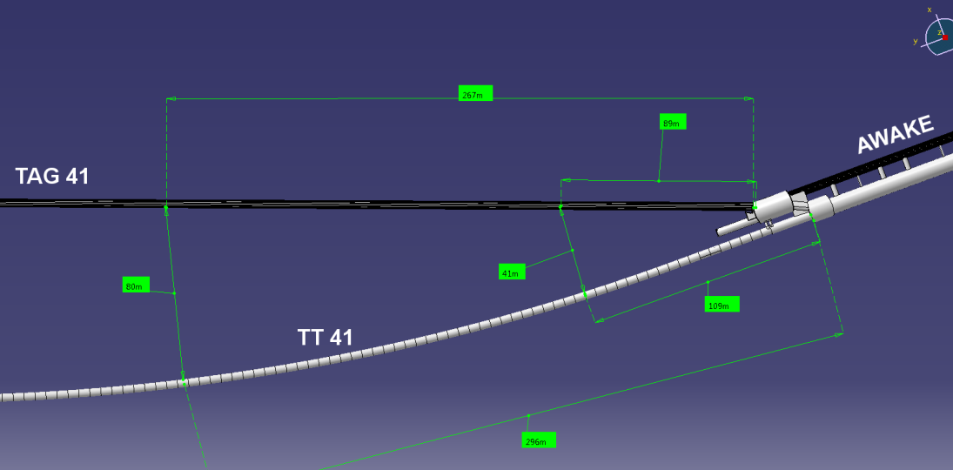
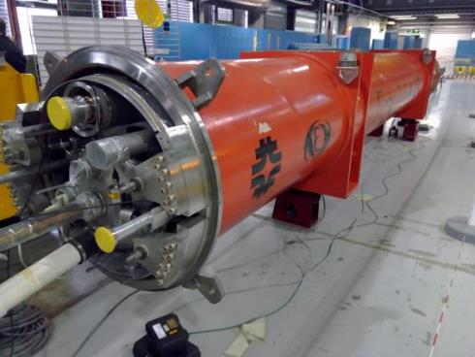
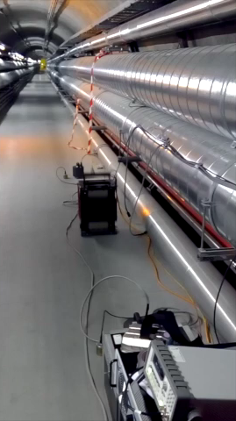
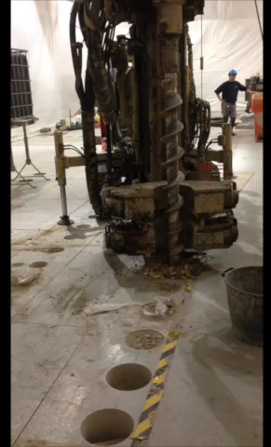

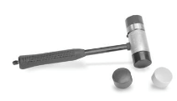
Transfer Function Measurements
H2 (ω)
H1 (ω)
H0 (ω)
In (ω)
Out (ω)
Measurements in ATLAS area (UL16/SR1)
with a vibration truck
Measurements in AWAKE area (TAG41/TT41)
with a shaker
Measurements at SM18
with Q1 triplet spare
40 m
M. Guinchard & J. Wenninger

Slide 34
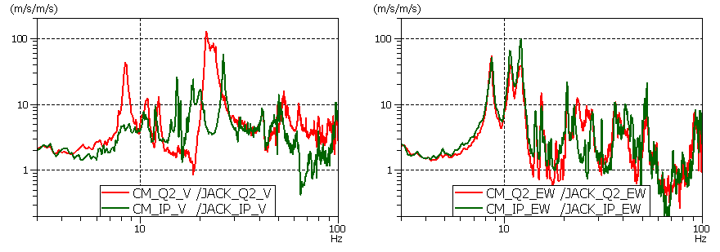
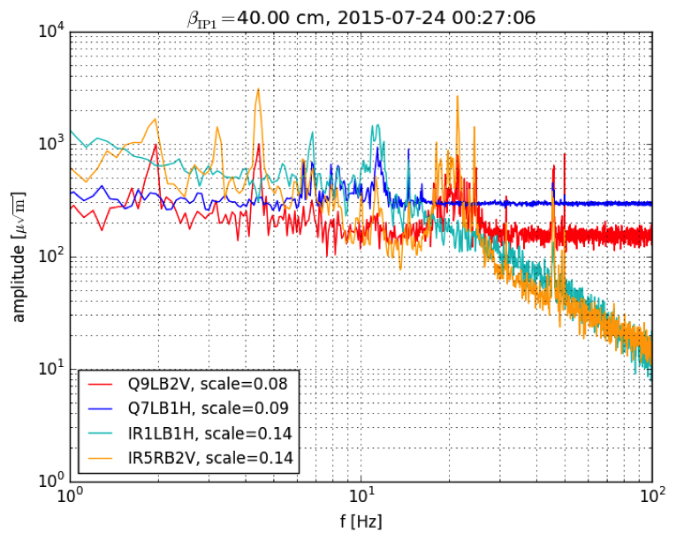
Transfer Function Results for H0(ω)
Measurement of Q1 transfer function H0 shows strong modes at 21.5 Hz, 8.4 Hz and 12 Hz.
Vertical
Lateral
8.4 Hz
8.4 Hz
21.5 Hz
12 Hz
M. Guinchard
Measurements performed using the ADT and the DOROS BPMs at the Q1’s and the 100Hz BLM data confirm the presence of activity in the frequency range of the triplet resonances.
FFT of a sample of the BLM 100Hz data
2015 ADT and DOROS BPM data
4.5Hz
21.4Hz
Normalized by √β
8.4Hz
22.9Hz
12Hz
2x22.9Hz
DOROS
12 Hz
20 Hz
M. Fitterer

Slide 35
Transfer Function Results for H1(ω) and H2(ω)
      TT41 (H1(ω)) measurement dominated by shear waves, SR1 (H2(ω)) measurement by pressure waves – confirmed by wave propagation speed.
      Gain for vertical measurement is possibly biased by surface waves.
      The source distance is together with planning decoupling the main ally that we have to minimize / avoid impact on beams.
H2(ω)
H1(ω)
Horizontal -40m
Horizontal -80m
M. Guinchard & J. Wenninger

Slide 36
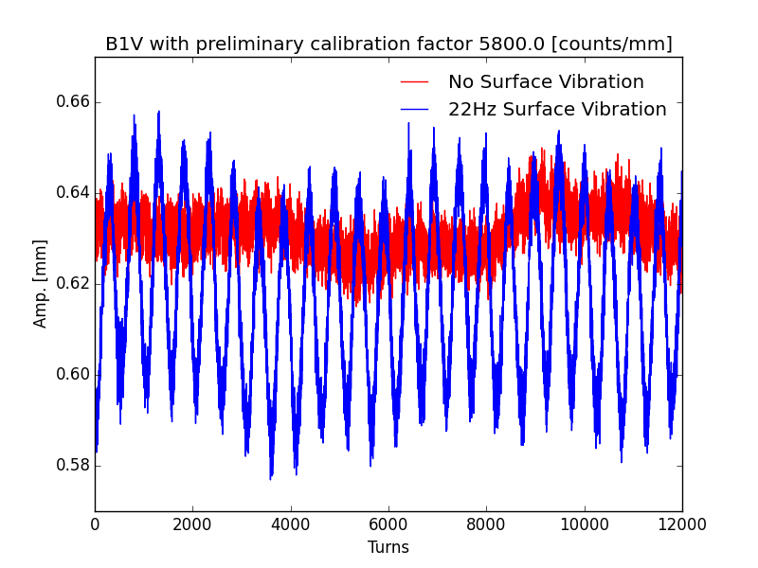
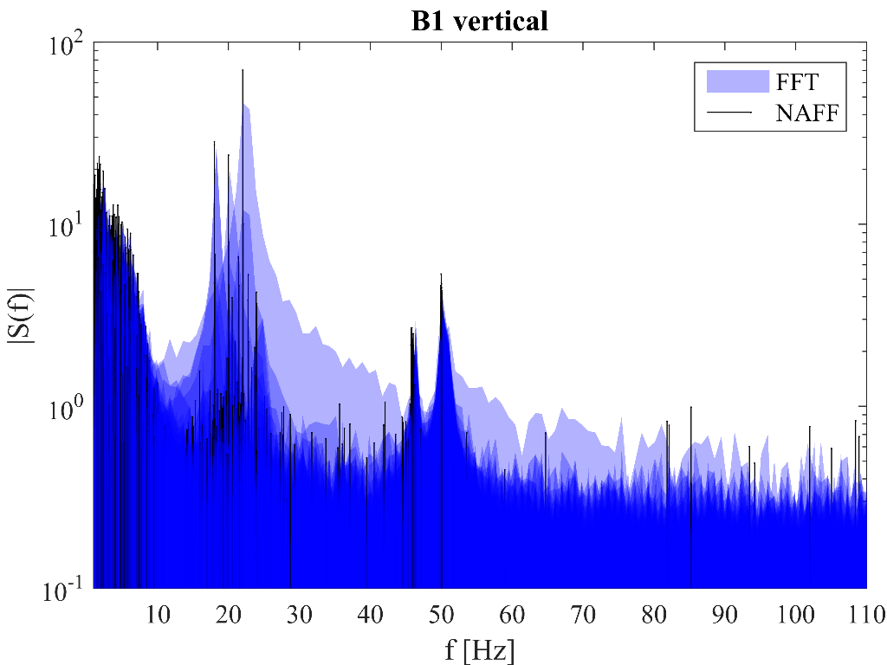
Vibrating truck impact on LHC beam
Beam measurements with the vibrating truck were performed for the squeezed optics (80 cm) at 6.5 TeV and at injection.
  Multi-turn data (all BPMs) & ADT data.
Measurements results:
  Beam oscillations were only observed in the vertical plane ⇔ truck location.
  Beam oscillations were only observed for vibration frequencies of 18-22 Hz – consistent with the triplet resonances.
  Observed B1/B2 amplitude ratio of ~2.5 implies that the different triplet quads oscillated with different amplitudes.
  The oscillation amplitudes of the triplet CMs were in the few μm range for a ground motion amplitudes of ~50 nm in the tunnel.
Dark blue = no truck
The observations are consistent with the triplet resonances that enhance the vibrations by a factor >> 10
M. Guinchard & J. Wenninger

Slide 37
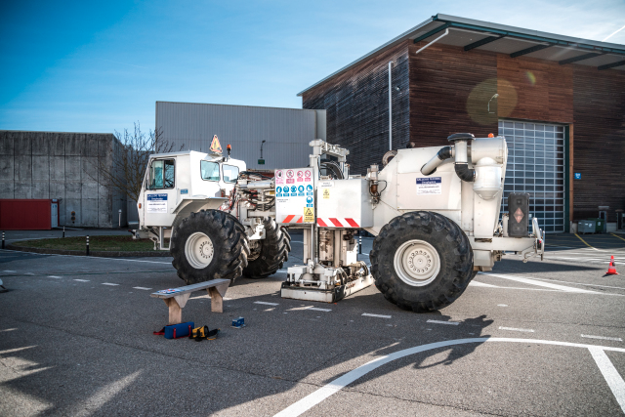

Truck → triplet predictions
      Expected motion of the triplet magnetic center during truck tests.
2-3 µm @ 22 Hz (average of both sides) – consistent with beam observations !
beam
M. Guinchard & J. Wenninger

Slide 38
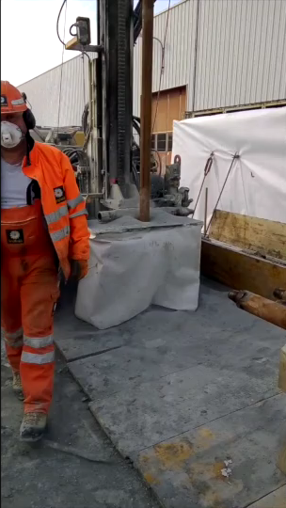
Core drilling → triplet predictions
      The expected motion of the triplet magnetic center vs depth remains at level of ≈ 0.1-0.2 μm – acceptable.
M. Guinchard & J. Wenninger
38

Slide 39
Frequencies of Earthquakes
Frequency spectrum of waves induced by earthquakes ranges from ~ mHz (earth oscillations and surface waves) to ~100 Hz for local seismic events.
The signatures of large and distant earthquakes (teleseismic) are dominated by low frequencies < 1 Hz.
Ground motion from local earthquakes (Geothermie 2020) extends to higher frequencies.
Slide from J. Wenninger

Slide 40
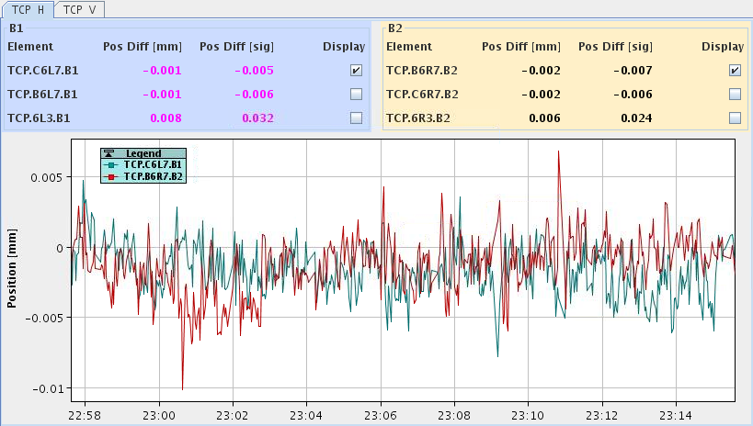
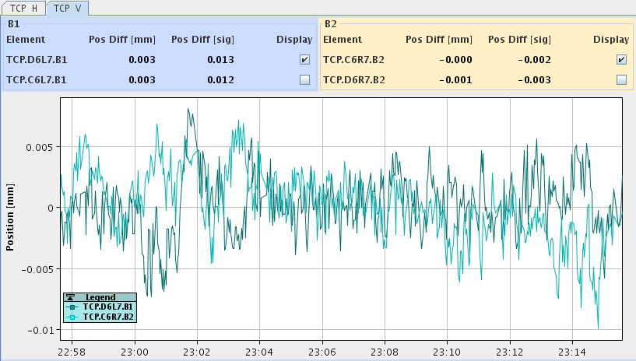
Orbit Stability at TCP
The orbit at the TCP during stable collisions is controlled to
±5μm.
±5μm
±5μm
J. Wenninger

Slide 41
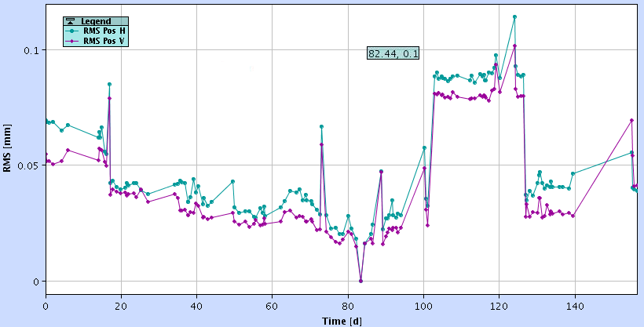
RMS Orbit over the year
single bunch fills
RMS orbit stable <50μm
wrong calibration of some BPM crates
reference mid July
J. Wenninger

Slide 42
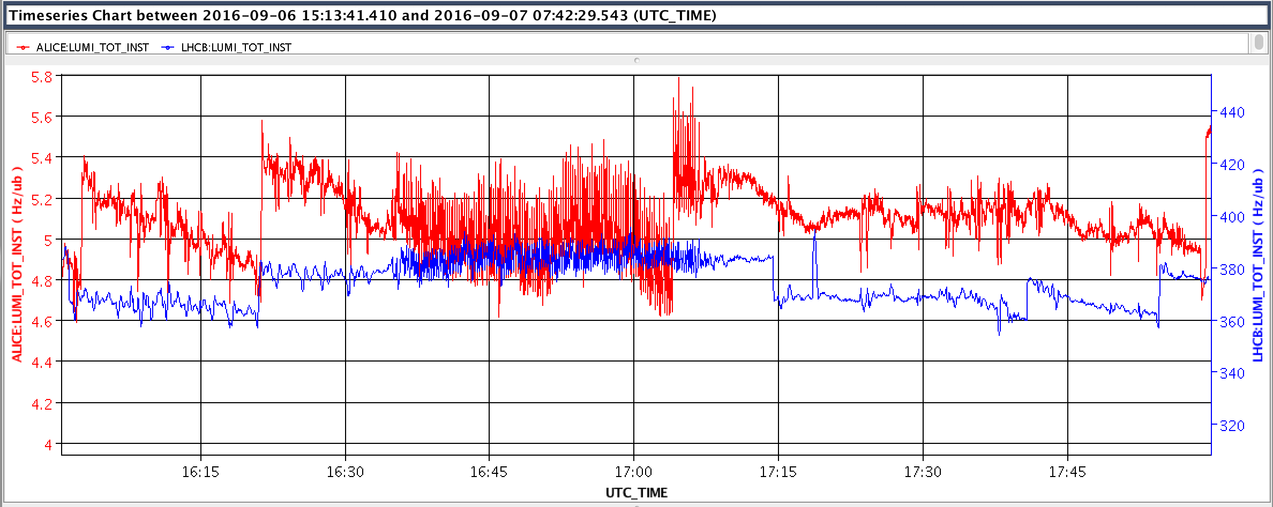
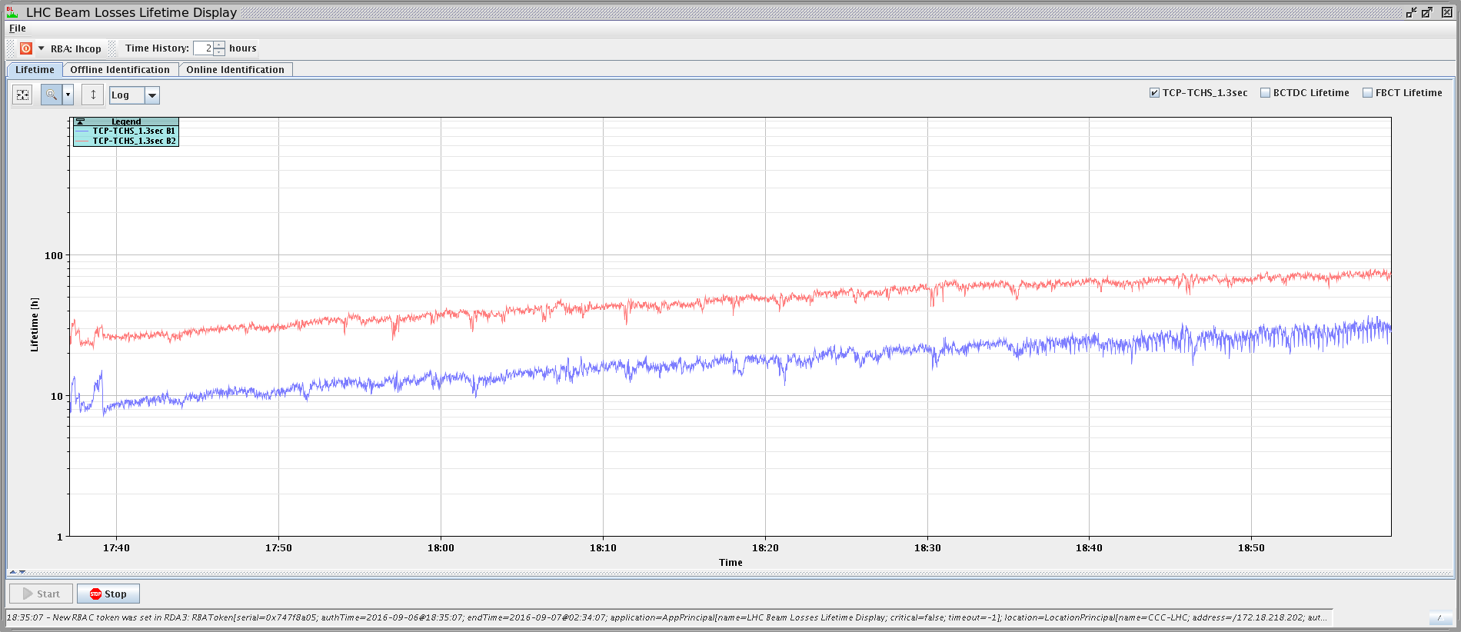
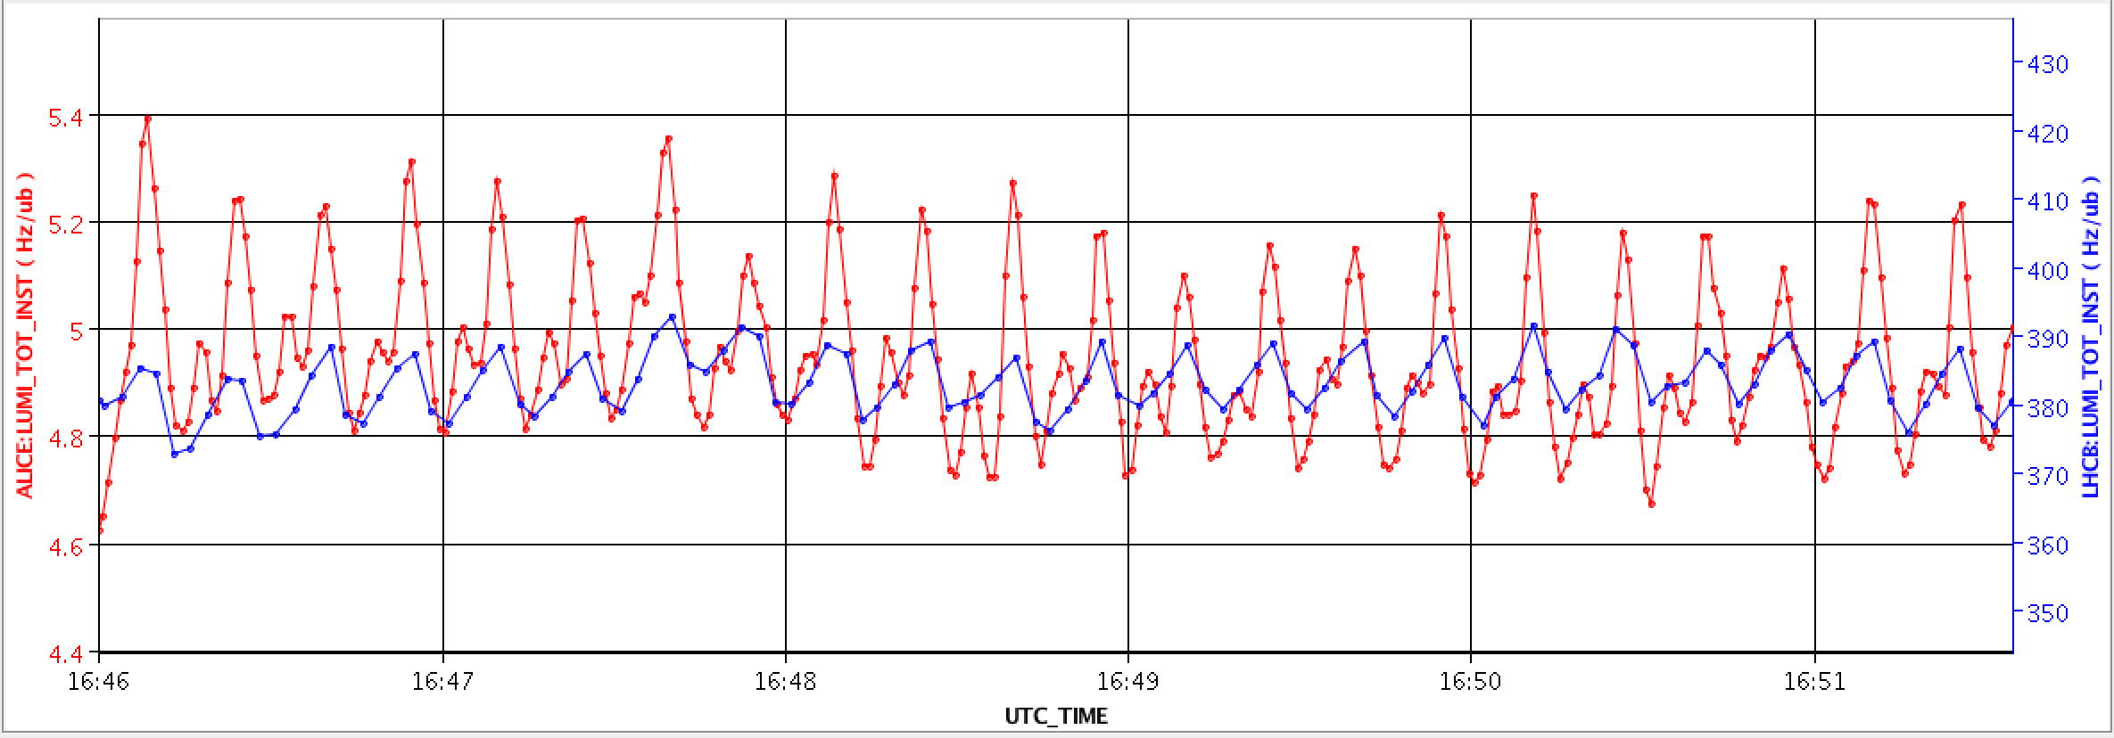
Luminosity Oscillations of Levelled Experiments
Luminosity oscillations of levelled experiments are frequently observed.
These oscillations correspond to ~2-4 μm of vertical beam separation at the IPs (@ β*= 3 and 10m).
Period ~15 seconds
Example
Fill 5282
  Effect also visible on B1 lifetime (→ losses at TCP).

Slide 43
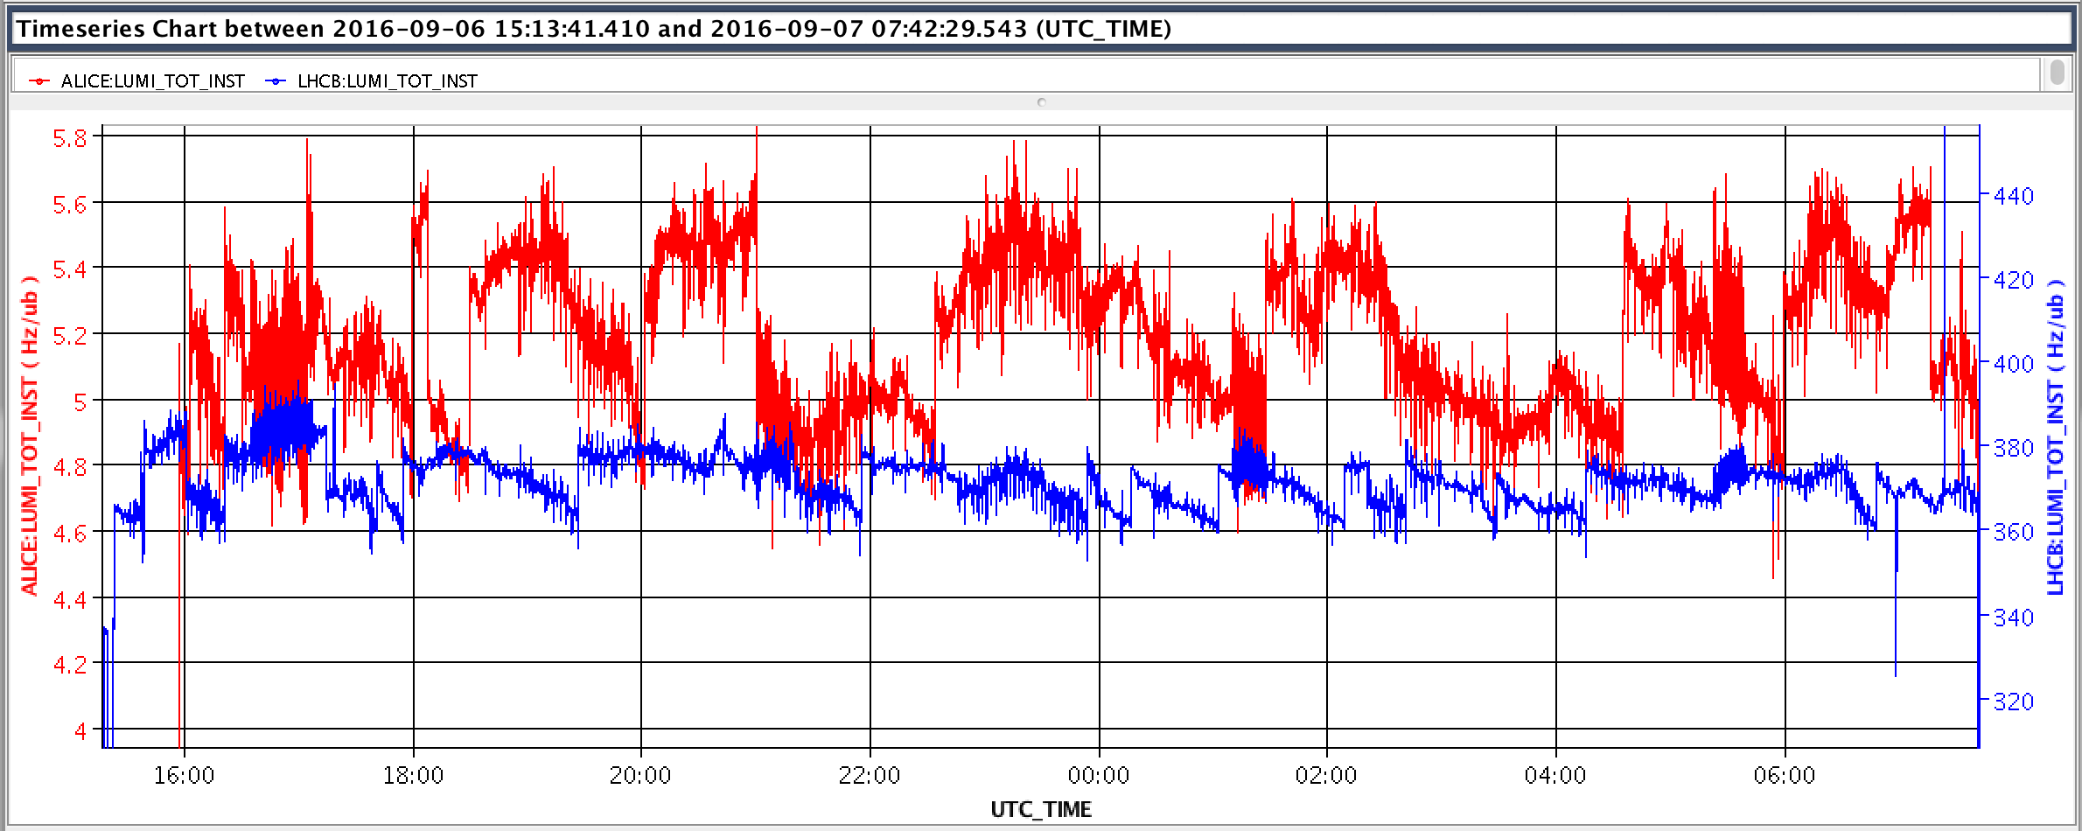
Luminosity Oscillations: Fill 5282
Effect has often a similar duration and re-appearing intervals.
→ Seems to be caused by a technological source, which is so far unknown.
ALICE
LHCb
~4h
~4h
~4h
~31min
~16min
~17min
~17min

Slide 44
Luminosity change due to beta-beat
Luminosity change due to beta-beating with offset levelling:

Slide 45
Summary of Ground Motion Studies (1)
Large earthquakes (M>6) have a clear impact on the LHC, even if originating at long distance.
  So far NO event cased a beam dump.
  Potentially only one event would have dumped under HL-LHC conditions.
  Nearby small earthquakes have not been observed.
Prototypes of geophones and high precision laser inclinometers are under commissioning and recording ground motions in TT1.
  Since the ground motion backgrounds in TT1 and the LHC tunnel are quite different, any correlation to LHC beam data can only be meaningful for long-distance earthquakes.
  For systematic correlation studies of the effect of ground motion on LHC operation, ground motion measurement devices are required in the LHC tunnel.
    → Geophones will be installed in Point 1 and 5 in the EYETS and the data will be logged to the database from next year on.

Slide 46
Summary of Ground Motion Studies (2)
Simulations to predict the ring orbit response are being renewed and extended.
  The simulation code is still under development and all new simulation results presented here are very preliminary.
  Long-distance strong earthquakes:
    Clearly observed on orbit, BLM and luminosity.
    Simulation show already a qualitative reasonable agreement.
    Simulation indicate that for HL-LHC optics orbit oscillations are increased by a factor 2-3 w.r.t. the current LHC.
  Potential seismic activity from Geothermie 2020 project:
    No comparison with beam data possible.
    Simulations with current LHC collision optics show rms orbit distortions > 120μm, which could probably be survived.
    For HL-LHC optics the simulation suggests (depending on the direction of the wave) an enhancement of a factor ~2-3,
      → which would most probably cause beam dumps.

