Slide 1
Operational experience from Tevatron and relevance for HL-LHC
Alexander Valishev
CERN, Review of Hollow E-Lens Needs for HL-LHC
October 6th, 2016

Slide 2
Acknowledgments
The entire Tevatron Team!
Dean Still, Vladimir Shiltsev, Giulio Stancari, Miriam Fitterer.

Slide 3
Questions
What did we learn about losses and halo removal from the Tevatron experience that can be relevant for HL-LHC?
General description of machine and operations. Lost stores and losses vs. machine cycle. Major causes of losses. Collimation system performance.
E-lens uses, reliability, and compatibility with collider operations.
What performance can we expect in HL-LHC? Tracking simulations on expected halo survival vs. amplitude, removal rates, and effects on the core – talk by M.Fitterer.
Measured effects of depleted halo population with hollow e-lens and relevance for HL-LHC – talk by G.Stancari.

Slide 4
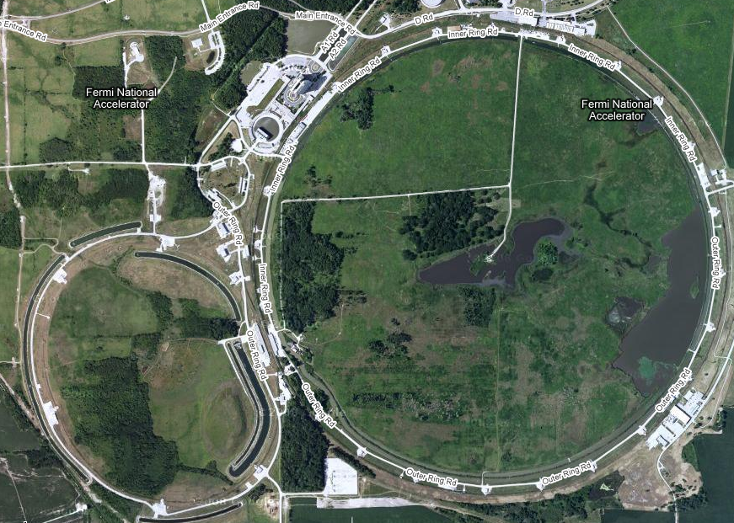
Aerial View of Tevatron
Linac
protons
CDF
Booster
antiprotons
Debuncher/Accumulator
Main Injector/Recycler
D0

Slide 5
Tevatron Parameters
Beam energy | 0.98 TeV
N bunches – 2 beams in one vacuum pipe! | 36 (3×12)
Beam stored energy | 2 MJ
Protons per bunch | 2.9×10¹¹
Antiproton per bunch | 0.9×10¹¹
Initial proton emittance (95% norm) | 18 μm
Initial antiproton emittance (95% norm) | 8 μm
Initial proton bunch length | 0.55 m
Initial antiproton bunch length | 0.45 m
Initial momentum spread | 0.0012
β-function at IP | 0.28 m
Betatron tunes (Q_{x},Q_{y}) | 20.583, 20.585
Record initial luminosity | 4.3×10³² cm⁻²s⁻¹
Initial luminosity lifetime | 5 h

Slide 6
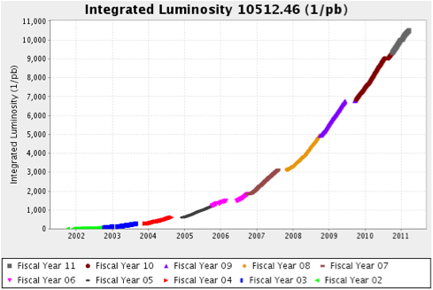
Tevatron Run II Integrated Luminosity
best week: 73 pb⁻¹, Apr 2009
2011: 1.2 fb⁻¹
best month: 273 pb⁻¹, Mar 2010
2010: 2.47 fb⁻¹
2009: 1.9 fb⁻¹
2008: 1.8 fb⁻¹
2007: 1.3 fb⁻¹

Slide 7
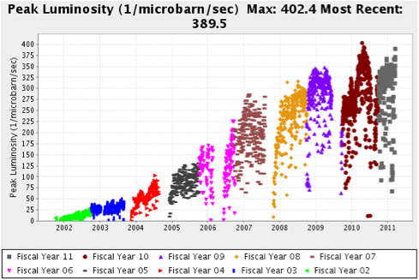
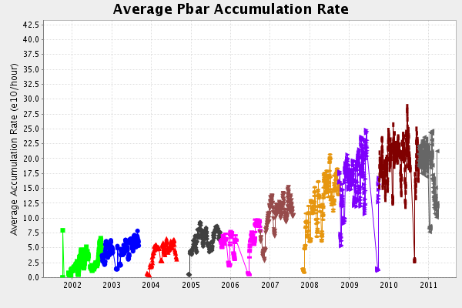

Initial luminosity and $\overline{p}$ Accumulation Rate

Slide 8
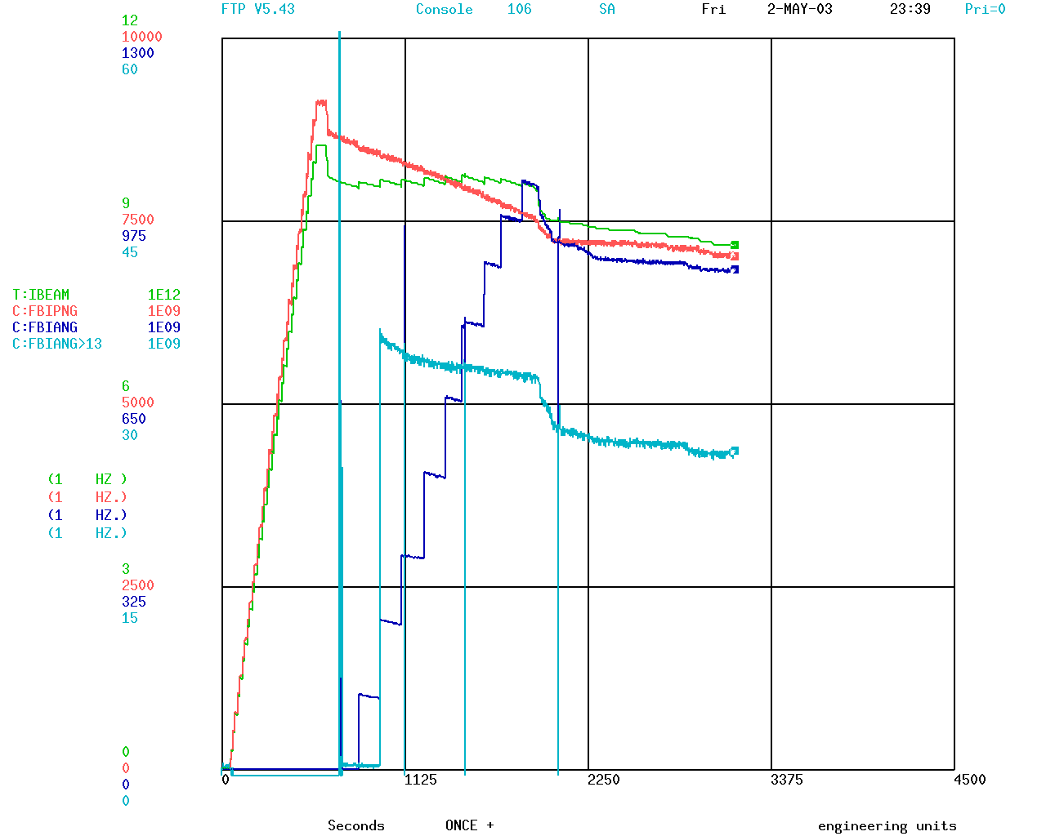
Collider Fill Cycle for Store 2511 in 2003
pbar injection
Total intensity
Proton intensity
Pbar intensity
Pbar bunch no.13
`
acceleration
collisions
squeeze
Store 2511 L₀=0.4x10³²

Slide 9
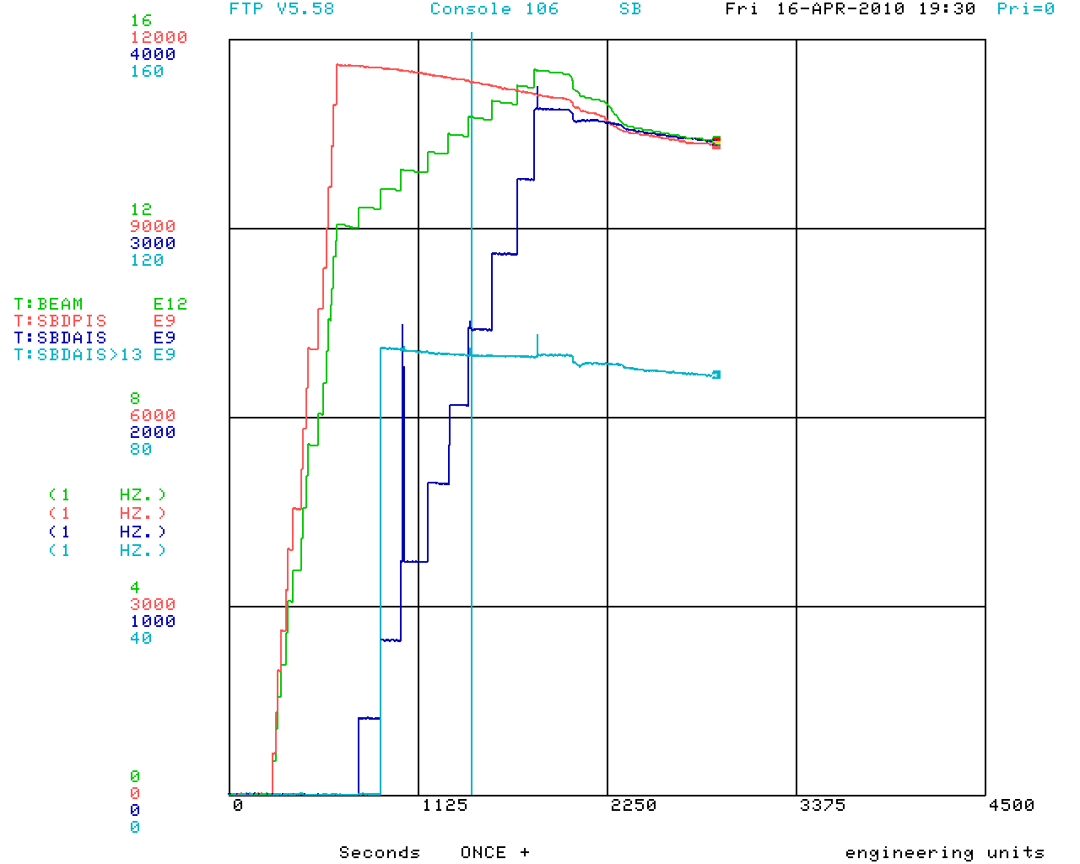
Collider Fill Cycle for the Record Store
Total intensity
Proton intensity
Pbar intensity
Pbar bunch no.13
Record Store 7747 L₀=4x10³²

Slide 10
Contributions to Luminosity Loss and (Some) Fixes
Beam lifetime at 150GeV: Ultimately were losing 5% protons and 1% antiprotons | Optimization of sextupoles
 | Machine impedance (Lambertsons)
 | Improved injection helical orbits
Beam losses on ramp: ultimately ~2% | Better helical orbits (beam-beam separation)
 | Improved coupling (repaired all 800 dipoles)
 | Improved instrumentation (machine reproducibility)
Beam losses in squeeze: 2% protons and <1% pbars | Better helical orbits
 | Collimation (2010)
 | Improved aperture
β* and beam separation | Better lattice control
Luminosity lifetime: dominated by luminous losses, IBS. Beam-beam ~5% | Better helix
 | New proton working point
 | Second order chromaticity
Reliability: in FY2010 averaged 120 store hours/week (71%) | cryo, controls, TEL, orbit stabilization, collimation

Slide 11
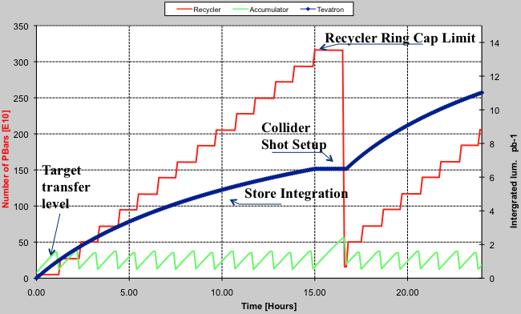
Operations Strategy
Model of collider operation
  Antiproton transmission efficiencies
  Stacking rate in Accumulator as function of stack size
  Pbar lifetime in Recycler
  Tevatron initial
    Luminosity
    Luminosity decay
  Shot setup time
The model was used to determine
the optimal operating parameters to
maximize luminosity integral

Slide 12
Tevatron Collimation System
Two-Stage Halo Removal System
  4 primary W targets
  8 secondary L-shaped collimators
Collimator
Scattered
trajectories
Target 5mm W
@ ~5 σ
Proton Set 1
D49 Tar, E03 & F172 2nd
Proton Set 2
D171Tar, D173 & A0
Pbar Set 1
F49 Tar, F48 & D172
Pbar Set 2
F173 Tar, F171 & E02
Collimator 1.5m
@~6 σ

Slide 13
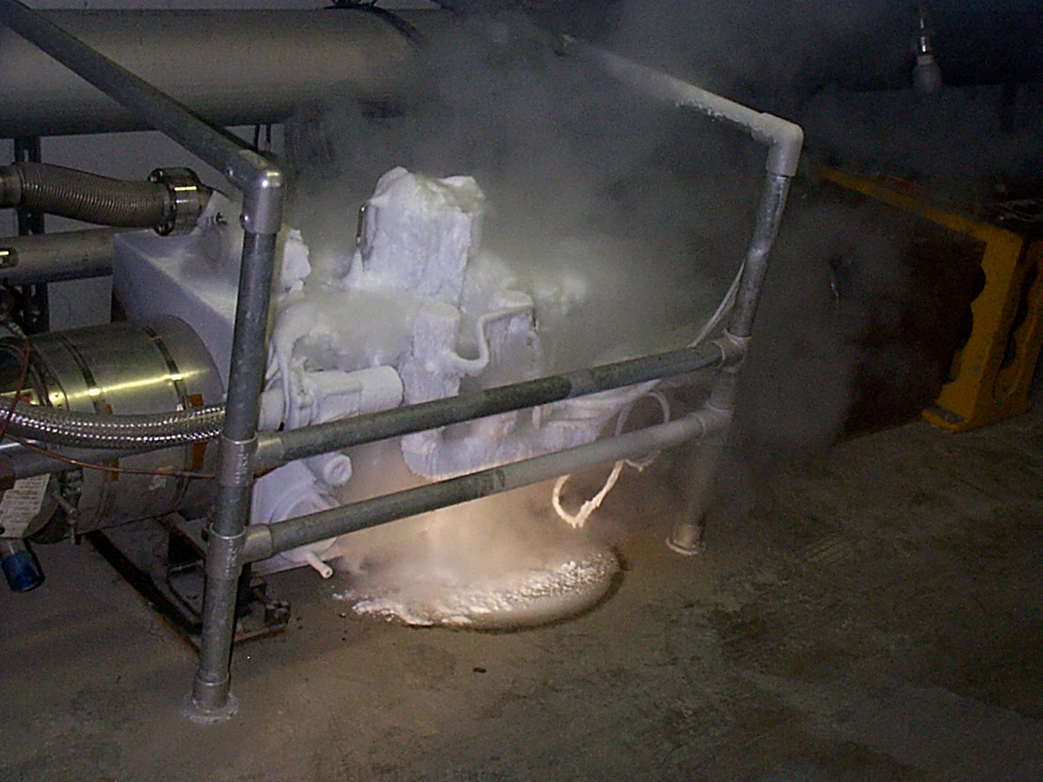
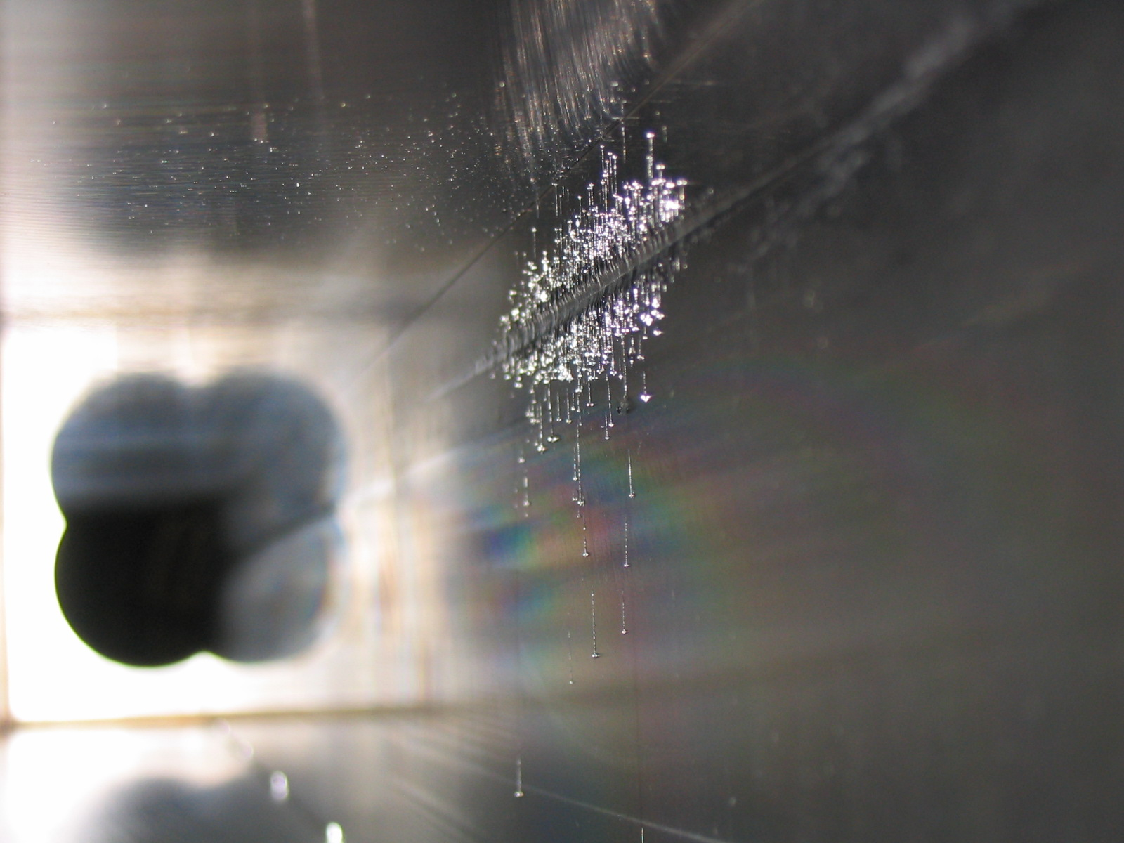
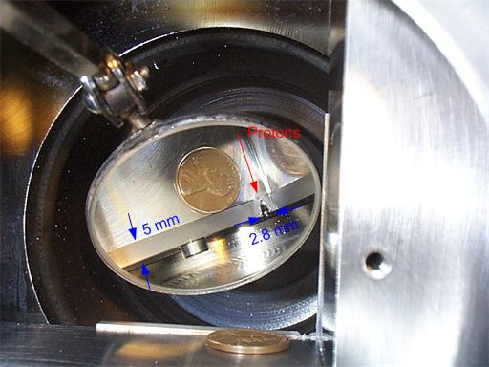
Protection Against Catastrophic Failures
December 5, 2003
  First learned of a new category of quench called a “Fast Quench”
  A Roman Pot moved into beam due to a controls error causing beam loss damaging 2 collimators and 2 spool pieces (3 correction elements)
C18 spool
E03 1.5m collimator
D49 target

Slide 14
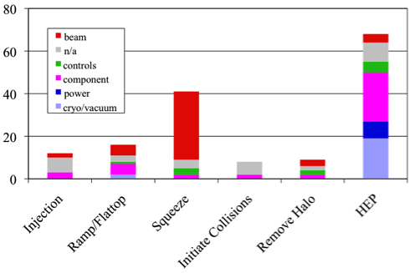
Quench Statistics
Total quenches in HEP mode Oct.2007-Mar.2011: 154
Percentage
  Ramp: 16
  Squeeze: 41
  Collisions: 68
32 quenches in squeeze
were caused by beam
dynamics related losses
Total number of stores 1200 – one in 40 lost in squeeze, between Apr. 09-Mar.11 14 of 372 lost in squeeze – one in 30
A quench during squeeze accounts for ~8pb⁻¹ – lost ~3% integral
  Integrated dose leads to equipment failures in detectors

Slide 15
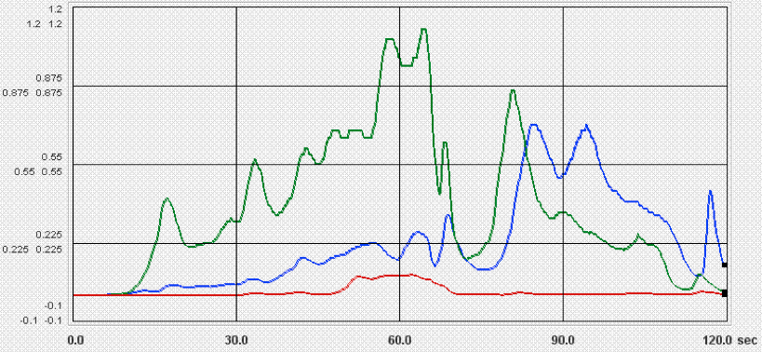
Collimating Losses in Squeeze
- Store in Dec. 2010
- Store in Jun 2010
- Store after scraping
0.55
C:D0BLUB (Rad/s)
-0.1
A single proton collimator + orbit control reduced losses.
Since implementation in Dec. 2010 114 stores – no quenches in squeeze
Halo was generated through fast (seconds) beam-beam mechanism
Cleaning with collimators was sustainable at Tevatron intensity/energy

Slide 16
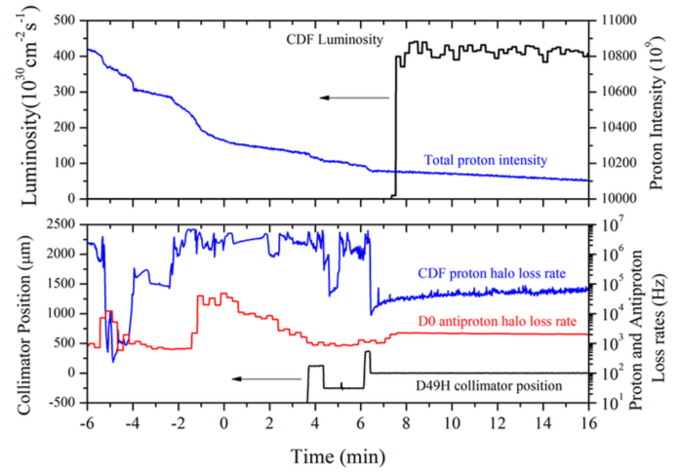
Losses in HEP
Often detectors “blinded” by losses (not by pile-up) in the first minutes of a store – soft collimator would be beneficial, and would result in integrated luminosity improvement.

Slide 17
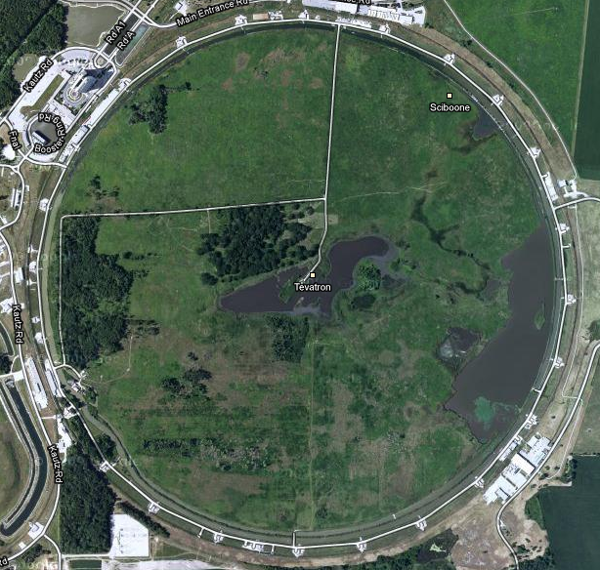
Tevatron Electron Lenses
e- beam energy | < 10 kV
Peak e- current | < 3 A
Solenoid B-field | 3 T
Gun B-field | 0.3 T
e- beam radius (SEFT) | 2.3 mm
Interaction length | 2 m
TEL-1 βx/βy | 95/32 m
TEL-2 βx/βy | 66/160 m
CDF
TEL-2
TEL-1
antiprotons
protons
D0
V.Shiltsev, Electron Lenses for Super-Colliders, Springer 2015
V. Shiltsev et al., Phys. Rev. ST AB 11 (2008) 103501
V.Shiltsev et al., NJP 10 (2008) 043042
G. Stancari et al., Phys. Rev. Lett. 107 (2011) 084802

Slide 18
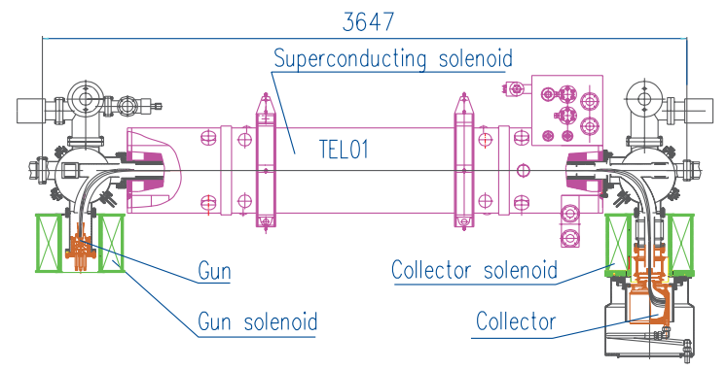
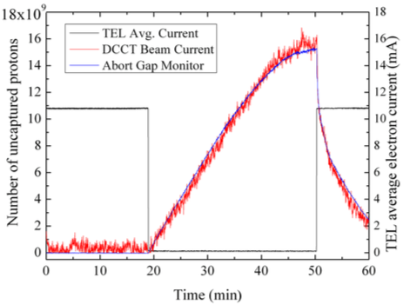
TEL-1
In continuous operation 24/7 2001-2011
  Excellent reliability record
    5 failures (2 of them in-tunnel electronics)
    1 trip resulted in store abort
  Lessons: beam stability, noise, shape, control, etc.
Mostly used for smooth abort gap cleaning
  Also a versatile tool for beam removal – once scraped all beam after abort kickers failure
Long-range beam-beam compensation demonstration

Slide 19
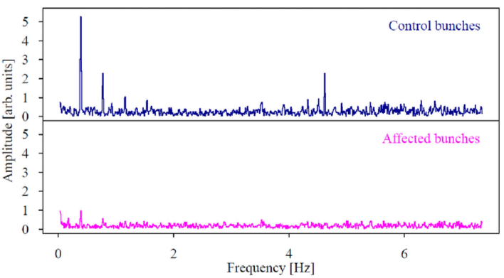
TEL-2
Commissioned in 2006-2007
Nonlinear transverse beam profile, head-on beam-beam compensation studies
Studies of coherent stability of e-p system
Hollow-beam collimation studies – talk by G.Stancari

Slide 20
Conclusion
Beam loss, especially uncontrolled, was a major factor in Tevatron Run II collider operations
The two-stage collimation system was mostly adequate in stable beam operation and protected against catastrophic failures
Transition modes (ramp, squeeze) posed the biggest threats owing to complex long-range beam-beam configuration
Tevatron Electron Lenses demonstrated remarkable reliability and versatility in collider operations
  Uncaptured beam removal
  Beam-beam compensation
  Collimation
Much experience gained in modeling/simulations

Slide 21
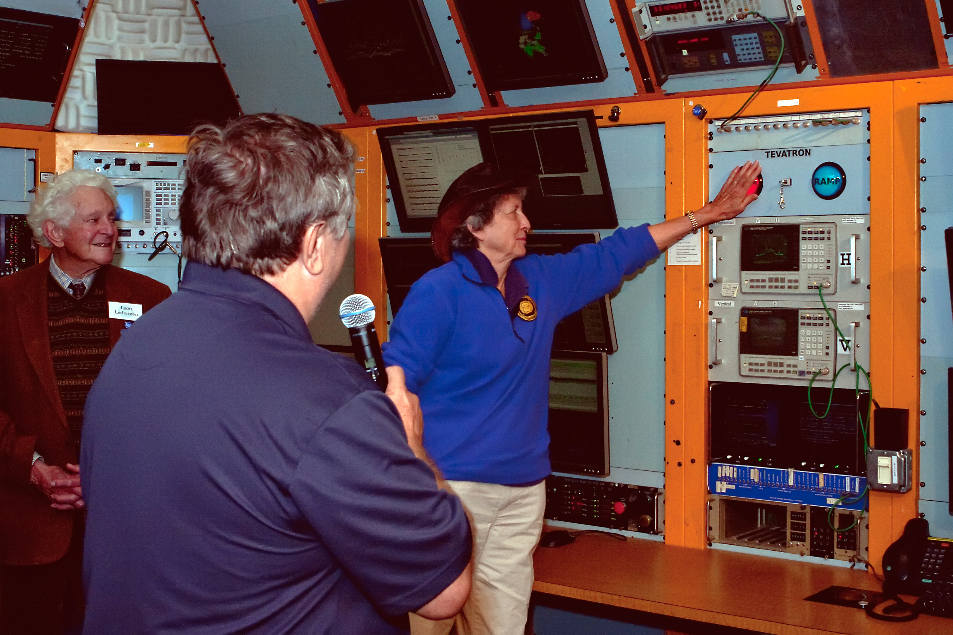
2011 - 2016
Fermilab's second director and 1988 Nobel Prize Laureate Leon Lederman (left) and Bob Mau watch as Dr. Helen Edwards terminates the final beam
in the Tevatron collider in the Fermilab Main Control Room on September 30, 2011

