Slide 1
What can be gained with a HEL in terms of increased diffusion for HL-LHC
Miriam Fitterer, G. Stancari, A. Valishev, Fermilab
R. Bruce, D. Perini, S. Redaelli, A. Rossi, J. Wagner, CERN
CERN, Review of Hollow E-Lens Needs for HL-LHC
October 6th, 2016

Slide 2
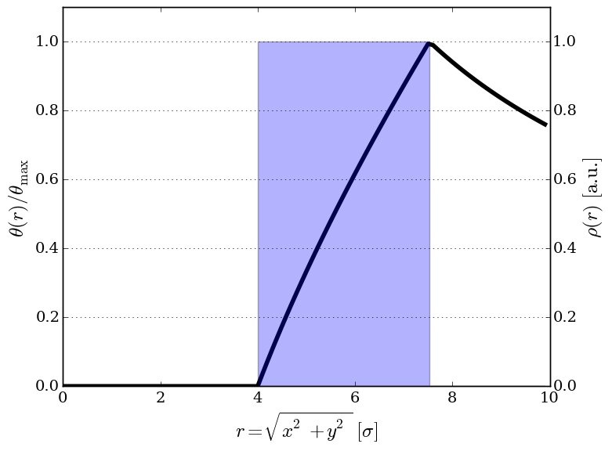
Literature HEL simulations
simulations for LHC:
  V. Previtali, G. Stancari, A. Valishev , S. Redaelli, FERMILAB-TM-2560-APC
  A. Valishev, FERMILAB-TM-2584-APC
HL-LHC simulations and experimental results (first drafts published):
  HL-LHC: M. Fitterer, G. Stancari, A. Valishev, S. Redaelli: FERMILAB-TM-2636-AD
  LHC experiment: M. Fitterer, G. Stancari, A. Valishev FERMILAB-TM-2635-AD
modeling of e-lens:
  kick from ideal uniform profile:
  e-lens bends:
  G. Stancari, FERMILAB-FN-0972-APC
  multipole expansion to model realistic
  profiles: I. Morzov, G. Stancari, A. Valishev,
  D. Shatilov, FERMILAB-CONF-12-126-APC

Slide 3
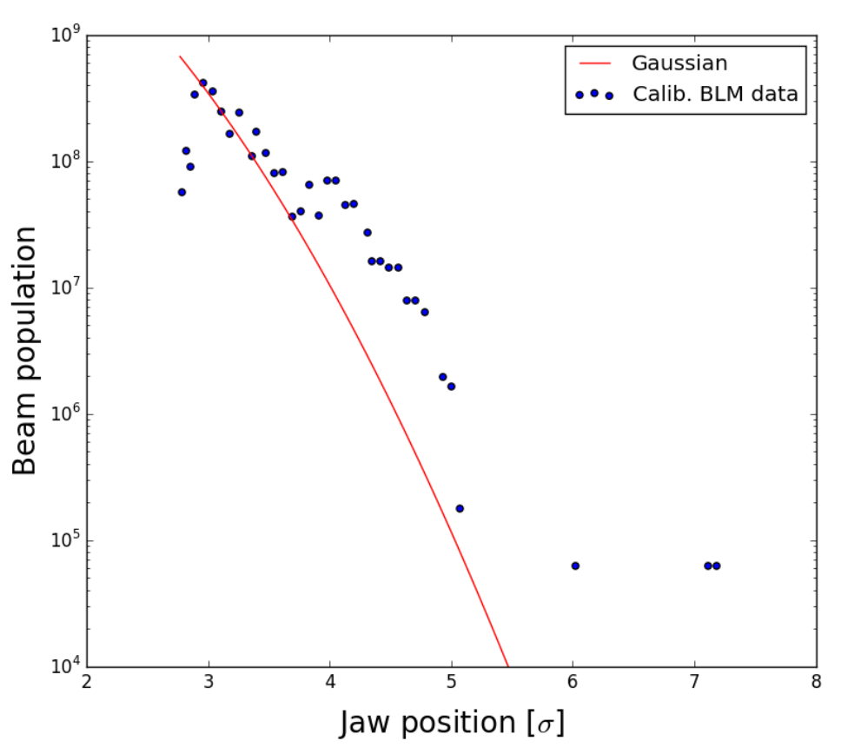
Simulations
available codes: SixTrack, LifeTrac and Merlin
main objectives:
effect of HEL on:
  halo -> compare halo removal rates := 𝛥I_{halo}/𝛥t
    halo removal rates for different scenarios with and without HEL
    obtain halo removal rates vs amplitude
    study effect of influence of longitudinal plane
  beam core -> emittance + losses
6.5 TeV
strong dependence on beam distribution model:
beam core: 6D Gaussian distribution cut at 6 σ
halo:
  to predict the true losses a good knowledge of halo population and diffusion is needed (see Gianluca’s, Yanni’s and Fanouria’s talks) -> in general very difficult task!
  instead use uniform transverse distribution between 4 and 6 σ and with δp=0 and Gaussian in (z-δp/p) cut at 6σ
G. Valentino

Slide 4
LHC HEL simulations
  simulation parameters:
nominal LHC V6.503 collision optics (β*_{IP1/5}=55 cm)
beam parameters: N_{p}=1.15x10¹¹, ε_{N}=3.75 µm, σ_{E}=1.1x10⁻⁴, σ_{z}=7.5 cm
HEL in IR4 with β_{x}= β_{y}
σ_{δ}=
main results for halo:
no HEL: minimal losses with beam-beam (0.002%/s = 0.12%/min = 8%/h)
with HEL, DC mode, I_{HEL} = 3.6 A:
  halo removal rates much smaller without beam-beam than with beam-beam
  strong dependence on momentum
random mode (current modulation): HEL becomes dominant loss mechanism
A. Valishev
HEL mode | beam-beam | long. distr. | halo removal rate
 |  |  | %/s | %/h
DC, 3.6 A | no | Gaussian | 0.01 | 40
 | yes |  | 0.07 | 250
random 3.6 A | no | Gaussian | 0.33 | 1180
 | yes |  | 0.35 | 1267
  for details: V. Previtali, G. Stancari, A. Valishev , S. Redaelli, FERMILAB-TM-2560-APC, FERMILAB-TM-2584-APC

Slide 5
LHC HEL simulations
main results for core:
HEL bends: in DC mode no effect
random mode (current modulation): HEL bends induce emittance growth for U-shape, not for S-shape due to uncompensated kicks for U-shape (without beam-beam + 10% modulation: S-shape - 0 %/h, U-shape - 38 %/h)

Slide 6
HL-LHC simulations + experiments
Simulation studies and experiments:
  beam core (for details see FERMILAB-TM-2635-AD):
    in DC mode no emittance growth is expected from the HEL
    in pulsed mode the HEL can induce noise on the beam core -> emittance growth
    experiment this September at the LHC at injection + simulations in order to estimate tolerance on noise (in progress), see LSWG meeting.
  halo (for details see FERMILAB-TM-2636-AD):
  comparison of halo removal rates without and with HEL for different key scenarios in order to evaluate of HEL performance at top energy
  impact of a pulsed operation. Option for pulsing/modulating are currently:
    random: random modulation of the e-lens current (white noise)
    resonant: switching the e-lens on/off every nth turn (drives nth order resonances)

Slide 7
HL-LHC HEL halo simulations
  HL-LHC scenarios:
  beta* leveling:

Slide 8
HL-LHC HEL halo simulations
  simulation parameters:
  code: LifeTrac
  HL-LHC layout V1.0
  HEL in IR4 with β_{x}= β_{y,} inner radius 4 σ (=beam sigma with 2.5 µm emittance)
  HEL current of 3.6 A (CDR value), 5.0 A (maximum of current gun)
  halo distribution: uniform transverse distribution between 4 and 6 σ with δp/p=0 or Gaussian in (z-δp/p) cut at 6 σ (σ = beam sigma)
  main observations (details see next slides):
  halo removal rates depend on:
    δp/p, smallest rates for δp/p=0 (strong dependence, up to x100 or more)
    -> in the following only removal rates for Gaussian in (z,δp/p)
    non-linearities: the “stronger” the non-linearity the higher the halo removal rate
  non linearities considered:
    chromaticity and Landau damping octupoles needed for beam stability in particular for separated beams (flat top)
    beam-beam (full crabbing + long-range)
    magnetic errors (”standard” errors from latest error tables as used for dynamic aperture simulations)
  pulsing considerably increases the halo removal rates. Random pulsing is most efficient.

Slide 9
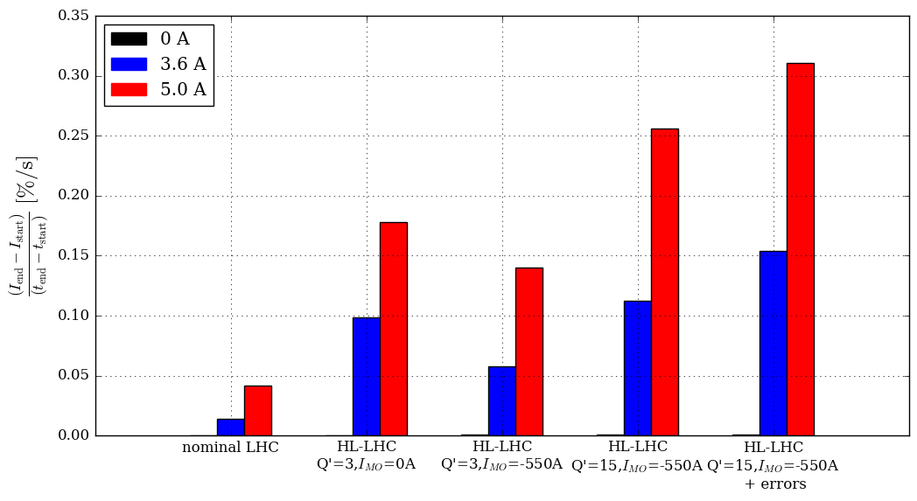
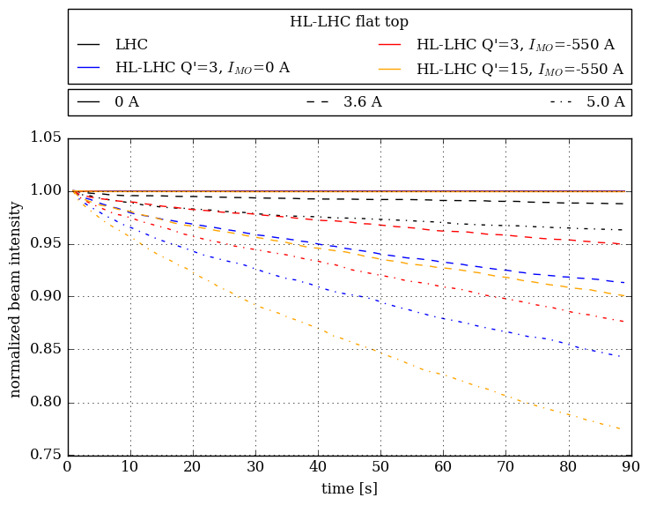
HL-LHC HEL halo simulations
Flat top – dependency on chromaticy and octupole current:
  halo removal rates for Q’=3, I_{MO}=0 could be very dependent on working point due to small tune spread
  highest halo removal rate for high chroma + octupoles + further increase with errors
  halo removal rates for 3.6 A between 0.06 %s (= 3.45 %/min = 207 %/h) and 0.15 %/s (= 9.25 %/min = 555 %/h)

Slide 10
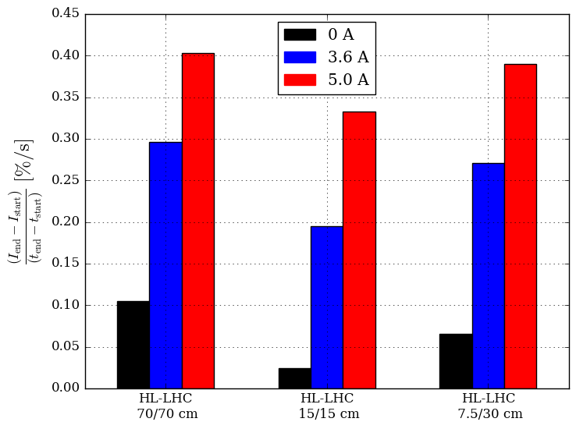
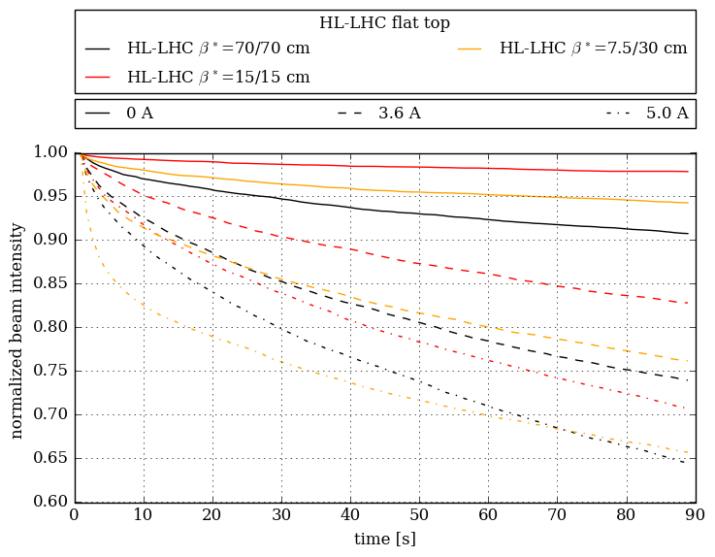
HL-LHC HEL halo simulations
Leveling – dependency on β* and beam intensity (see leveling scenario):
  already losses without HEL (small DA)
  highest halo removal rate for β*=70 cm (smallest DA)
  halo removal rates for 3.6 A around x2 higher than at flat top, explicitly between 0.20 %s (= 11.70 %/min = 702 %/h) and 0.30 %/s (= 17.76 %/min = 1060 %/h)

Slide 11
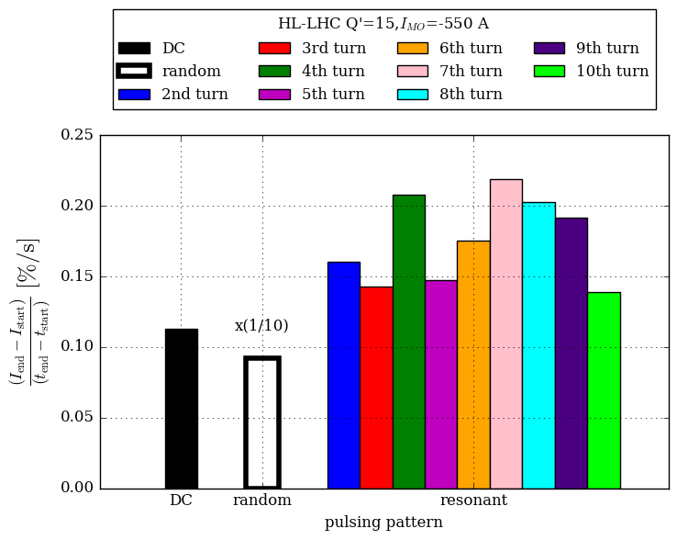
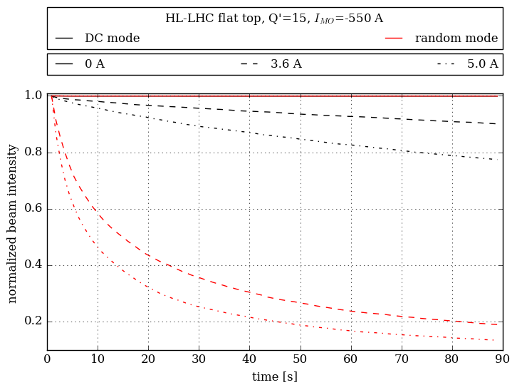
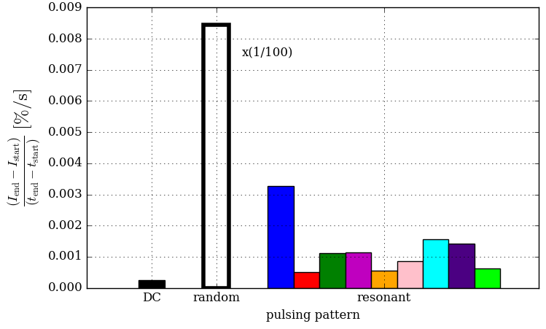
HL-LHC HEL halo simulations
flat-top with pulsing:
  random mode: pulsing becomes dominant loss mechanism for (for random even the same for δp/p =0 and (z,δp/p))
  random mode much more effective than resonant mode, in particular for δp/p =0
  random, 3.6 A: around 0.92 %/s (= 55.26 %/min = 3320 %/h)
  resonant, 3.6 A: 0.14 %s (= 8.58 %/min = 514 %/h) to 0.22 %/s (= 13.14 %/min = 789 %/h)

Slide 12
Conclusion and Outlook
  Halo:
  HEL increases the halo removal rates in all cases considerably
  stronger non-linearities imply in general higher halo removal rates
  pulsing considerably increases the diffusion, random mode much more efficient than resonant mode
  small removal rates for separated beams compared to colliding beams
    ➡ do we need to pulse at flat top in order to clean the halo within minutes?
  for colliding beams 11.70 %/min - 17.76 %/min are reached, sufficient for continuous halo depletion ➡ no pulsing
  losses can differ by a order of magnitude for on and off-momentum particles
    ➡ more studies needed: changes with real IR3/IR7 betatron and momentum cleaning, dependence on dispersion@HEL, …

Slide 13
Conclusion and Outlook
  Core:
  in DC mode configuration no effect in terms of increased losses or emittance growth on the beam core is expected (even with U-shape)
  pulsed e-lens operation:
    random mode much more efficient than resonant mode
    with the resonant mode one could find an excitation pattern which doesn’t affect the core, but depletes the halo (remember: only certain resonances are driven)
    in case of profile imperfections in the e-beam, pulsing induces noise on the p-beam
      ➡ solid definition of tolerances on profile imperfections needed

Slide 14
Backup Slides

Slide 15
DA for beta*-leveling HL-LHC
minimum DA caluclated with LifeTrac
no errors, octupole current of -550 A (MOF)
spectrometer configuration in IR2/8 yielding smallest DA
half crossing angle IR1/5: 295 urad
beam-beam: full crabbing + long range

Slide 16
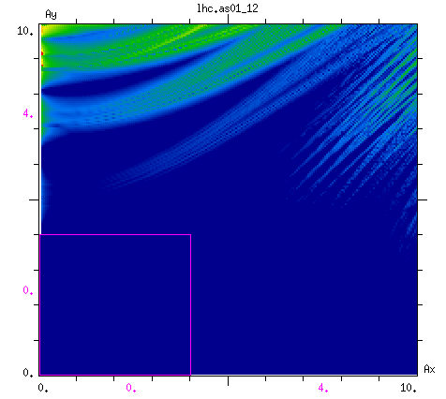
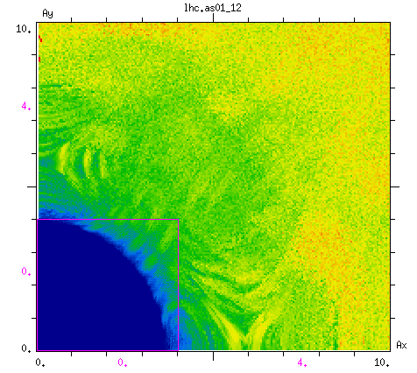
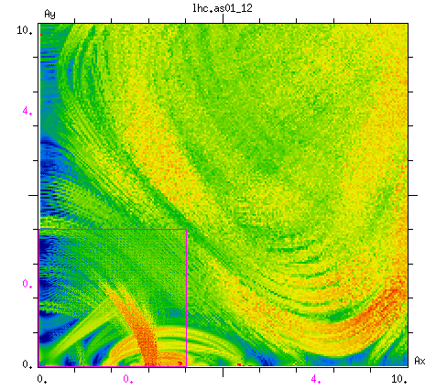
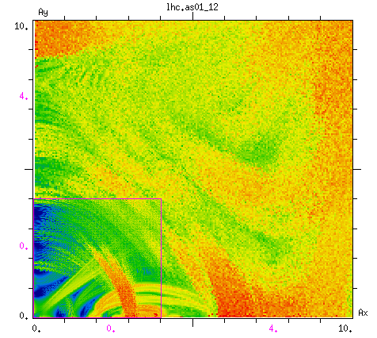
FMA analysis
flat top, Q’=15, IMO=-550 A
small non-linearities
"uniform” enhancement of diffusion
no HEL
3.6 A
15 cm β*, Q’=3, IMO=-550 A
strong non-linearities
HEL enhances resonances

Slide 17
Simulation Parameters LHC
  for details: V. Previtali, G. Stancari, A. Valishev , S. Redaelli, FERMILAB-TM-2560-APC, FERMILAB-TM-2584-APC
uniform transverse distribution between 4 and 6 σ, Gaussian in (z,δp/p) or δp/p=0
nominal LHC V6.503 collision optics (β*_{IP1/5}=50 cm), no errors, no octupoles, Q’=2
single collimator (black absorber) @ 6 σ
equal β_{x}= β_{y} =180 m @ e-lens, installed in IR4 @ -40 m from IP
beam parameters: N_{p}=1.15x10¹¹, ε_{N}=3.75 µm, σ_{E}=1.1x10⁻⁴, σ_{z}=7.5 cm
10⁴ particles, 5x10⁶ turns = 450 s real machine time
with and without beam-beam
in case of beam-beam: collisions in IP1/5/8, 94 long-range interactions, 25 ns bunch spacing

Slide 18
Simulation Parameters HL-LHC
  for details: M. Fitterer, G. Stancari, A. Valishev, S. Redaelli: FERMILAB-TM-2636-AD
    uniform transverse distribution between 4 and 6 σ, Gaussian in (z,δp/p)
HL-LHC V1.0 layout
single collimator (black absorber) @ 6 σ
equal β_{x}= β_{y} @ e-lens, installed in IR4 @ -40 m from IP, inner radius adjusted to 4 beam sigma (ε_{N}=2.5 µm)
beam parameters flat top: N_{p}=2.2x10¹¹, ε_{N}=2.5 µm, σ_{E}=1.1x10⁻⁴, σ_{z}=7.5 cm
beam parameters leveling: N_{p}=1.1-2.2x10¹¹, ε_{N}=2.5 µm, σ_{E}=1.1x10⁻⁴, σ_{z}=7.5 cm
10⁴ particles, 10⁶ turns = 90 s real machine time
with and without beam-beam
in case of beam-beam: collisions in IP1/2/5/8, 25 ns bunch spacing, full crabbing + long range beam-beam, spectrometer configuration in IP2/8 featuring smallest DA
latest error tables
coupling: fine coupling correction stopped at closest1 (matching step omitted)

Slide 19
Halo removal rates HL-LHC at flat top
    uniform transverse distribution between 4 and 6 σ, Gaussian in (z,δp/p)
HL-LHC V1.0 layout
single collimator (black absorber) @ 6 σ
HEL current [A] | β*(IP1/2/5/8) [cm] | Q’ | oct. current [A] | errors | halo removal rate
 |  |  |  |  | %/s | %/h
no HEL | 6/10/6/3 | 3 | 0 | no | 0.000 | 0.9
 |  | 3 | -550 |  | 0.001 | 2.9
 |  | 15 | -550 |  | 0.001 | 3.2
 |  | 15 | -550 | yes | 0.001 | 2.2
3.6 |  | 3 | 0 | no | 0.099 | 355.0
 |  | 3 | -550 |  | 0.058 | 207.0
 |  | 15 | -550 |  | 0.113 | 406.0
 |  | 15 | -550 | yes | 0.154 | 555.0
5.0 |  | 3 | 0 | no | 0.178 | 642.0
 |  | 3 | -550 |  | 0.140 | 505.0
 |  | 15 | -550 |  | 0.256 | 923.0
 |  | 15 | -550 | yes | 0.311 | 1120.0
Notes:
Reliability for FY2010 includes the 4-week shutdown. If one counts only the scheduled operation time, the uptime figure is 48/(48-4)*71%=77%

Slide 20
Halo removal rates HL-LHC during β* leveling
    uniform transverse distribution between 4 and 6 σ, Gaussian in (z,δp/p)
HL-LHC V1.0 layout
single collimator (black absorber) @ 6 σ
HEL current [A] | β*(IP1/5) [cm] | bunch intensity [10¹¹] | Q’ | oct. current [A] | halo removal rate
 |  |  |  |  | %/s | %/h
no HEL | 7.5/30 | 2.2 | 3 | -550 | 0.065 | 234.0
 | 15/15 | 1.1 |  |  | 0.024 | 87.7
 | 70/70 | 1.1 |  |  | 0.105 | 378.0
3.6 | 7.5/30 | 2.2 | 3 | -550 | 0.271 | 974.0
 | 15/15 | 1.1 |  |  | 0.195 | 702.0
 | 70/70 | 1.1 |  |  | 0.296 | 1060.0
5.0 | 7.5/30 | 2.2 | 3 | -550 | 0.389 | 1400.0
 | 15/15 | 1.1 |  |  | 0.332 | 1200.0
 | 70/70 | 1.1 |  |  | 0.403 | 1450.0
Notes:
Reliability for FY2010 includes the 4-week shutdown. If one counts only the scheduled operation time, the uptime figure is 48/(48-4)*71%=77%

Slide 21
Halo removal rates HL-LHC at flat top + pulsing
    uniform transverse distribution between 4 and 6 σ, Gaussian in (z,δp/p)
HL-LHC V1.0 layout
single collimator (black absorber) @ 6 σ
HEL current [A] | β*(IP1/2/5/8) [cm] | pulsing pattern | Q’ | oct. current [A] | halo removal rate
 |  |  |  |  | %/s | %/h
3.6 | 6/10/6/3 | none (DC) | 15 | -550 | 0.113 | 406.0
 |  | random |  |  | 0.921 | 3320.0
 |  | 2nd |  |  | 0.161 | 578.0
 |  | 3rd |  |  | 0.143 | 514.0
 |  | 4th |  |  | 0.208 | 749.0
 |  | 5th |  |  | 0.147 | 530.0
 |  | 6th |  |  | 0.176 | 632.0
 |  | 7th |  |  | 0.219 | 789.0
 |  | 8th |  |  | 0.203 | 730.0
 |  | 9th |  |  | 0.192 | 691.0
 |  | 10th |  |  | 0.139 | 501.0
Notes:
Reliability for FY2010 includes the 4-week shutdown. If one counts only the scheduled operation time, the uptime figure is 48/(48-4)*71%=77%

Slide 22
Halo removal rates HL-LHC at flat top + pulsing
    uniform transverse distribution between 4 and 6 σ, δp/p =0
HL-LHC V1.0 layout
single collimator (black absorber) @ 6 σ
HEL current [A] | β*(IP1/2/5/8) [cm] | pulsing pattern | Q’ | oct. current [A] | halo removal rate
 |  |  |  |  | %/s | %/h
3.6 | 6/10/6/3 | none (DC) | 15 | -550 | 0.000 | 0.9
 |  | random |  |  | 0.846 | 3050.0
 |  | 2nd |  |  | 0.001 | 2.2
 |  | 3rd |  |  | 0.003 | 11.8
 |  | 4th |  |  | 0.001 | 1.8
 |  | 5th |  |  | 0.001 | 4.0
 |  | 6th |  |  | 0.001 | 4.1
 |  | 7th |  |  | 0.001 | 2.0
 |  | 8th |  |  | 0.001 | 3.1
 |  | 9th |  |  | 0.002 | 5.6
 |  | 10th |  |  | 0.001 | 5.1
Notes:
Reliability for FY2010 includes the 4-week shutdown. If one counts only the scheduled operation time, the uptime figure is 48/(48-4)*71%=77%

