Slide 1

Alternative methods for halo depletion
R. Bruce
Material from many colleagues: P. Baudrenghien, O. Bruning, X. Buffat, M. Buzio, R. Chritin, M. Fitterer, H. Garcia, W. Hofle, T. Mastoridis, S. Papadopoulou, T. Pieloni, Y. Papaphilippou, S. Redaelli, H. Thiesen, D. Valuch, J. Wagner, J. Wenninger
2016.10.07

Slide 2
Introduction
If we need to deplete the halo, are there any alternatives to the hollow electron lens?
Several options to be studied
  Tune ripple
  ADT resonant excitation
  Crab cavity resonant excitation
  Long-range beam-beam
  Orbit feedback
Aim of presentation
  Summarize previous studies and show status of studies for each option
  Advantages and disadvantages (personal view - open for discussion!)

Slide 3
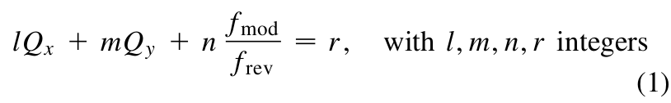
Tune ripple
Idea: By modulating tunes at a fixed frequency, resonance sidebands are introduced around the existing resonance lines (Bruning, Willeke PRL 76:3719)
Use detuning with amplitude of the beam
Could put resonance line on halo while leaving core unaffected
  Choose frequency (tune position) and amplitude (strength) of modulation
Some uncertainties on how to use present LHC hardware

Slide 4
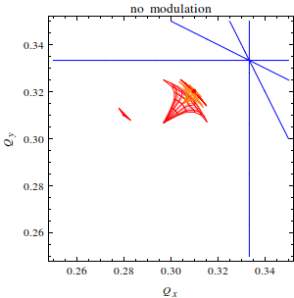
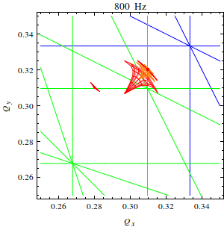
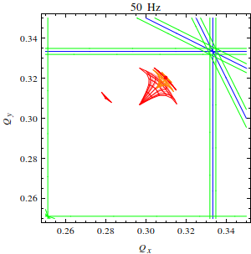
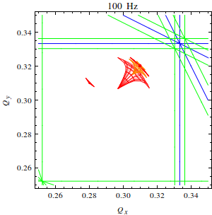
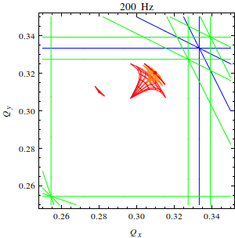
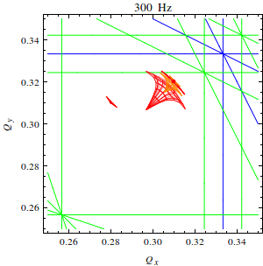
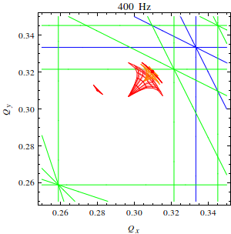
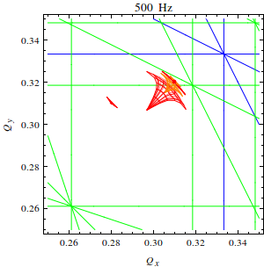
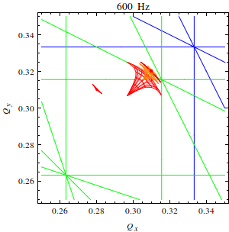
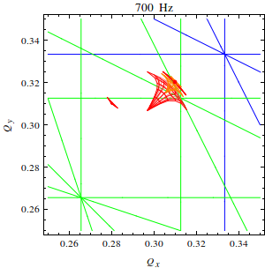
Examples of tune footprints, 5th order
Simplified picture of tune footprints and resonance lines
Careful: while hitting tail on some bunches, don’t hit core of some bunches

Slide 5
Needed frequency for LHC
Using simplified picture: Depending on tune, which tune footprint we want to hit, and which resonance we want to use: big spread of possible frequencies... 50-800Hz
  different bunches have different footprints depending on where they collide. Need to be careful... when hitting the halo in some bunches, we risk to hit the core in others!

Slide 6
Elements to use
Cold magnets: risk for problems with quench protection system
  Not a fundamental showstopper – SC magnets modulated at HERA - but needs very careful checks and preparation
Easiest magnets to use in the LHC: warm trim quadrupoles MQWB in IR3/7
  8 units installed
Measurements carried out to verify power converter capabilities
  Applying modulation to 4 magnets in IR7 in parallel

Slide 7
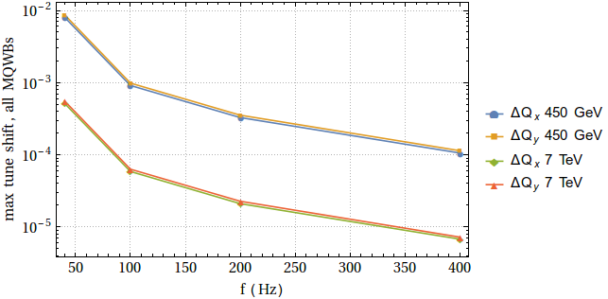
Max achievable tune shift
Folding in measurements of attenuation in vacuum chamber (M. Buzio, R. Chritin et al.)

Slide 8
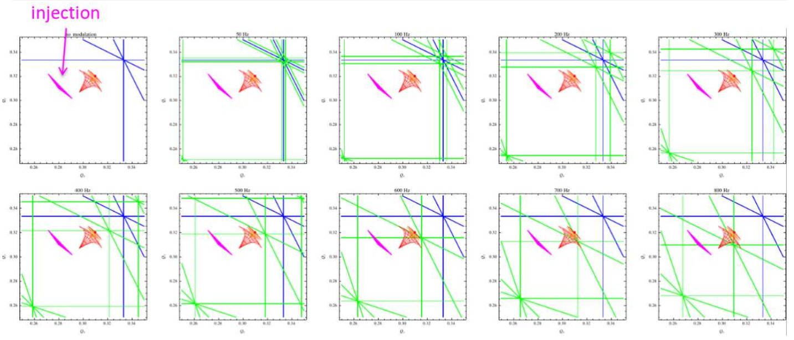
LHC MDs
First MD was carried out in August 2016 at injection (MD 1691)
Tune spread from octupoles at 10 A

Slide 9
MD procedure
Inject 2 nominal bunches; blow up one with ADT to create tails
Measure emittance with wire scanners
Start modulation and observe losses
Stop; measure emittance with wire scanners
Scrape down with TCP for accurate profile measurement

Slide 10
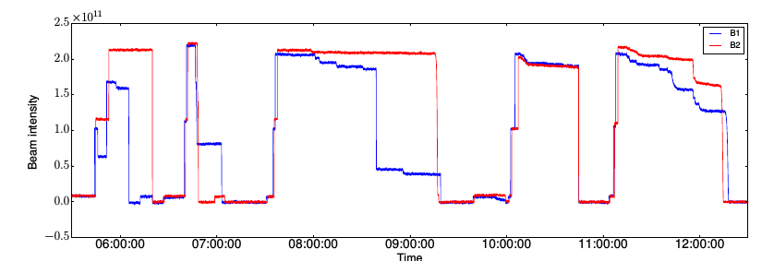
Beam intensity in MD

Slide 11
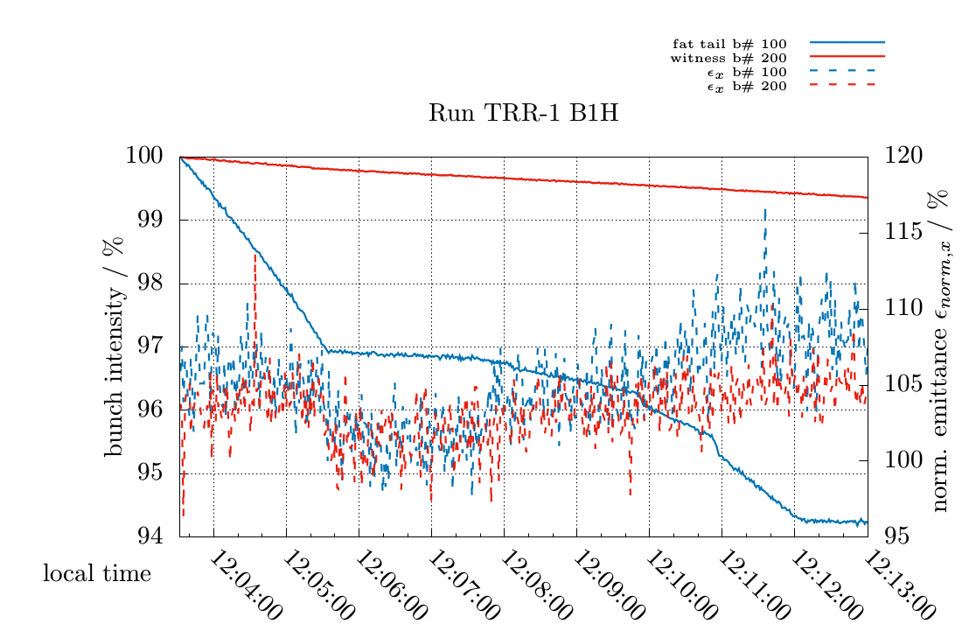
MD results (1)
Ripple applied on warm magnets in IR7 (RQT4.L7)
Max. frequency achieved = 333 Hz
More losses on blown-up bunch
J. Wagner

Slide 12
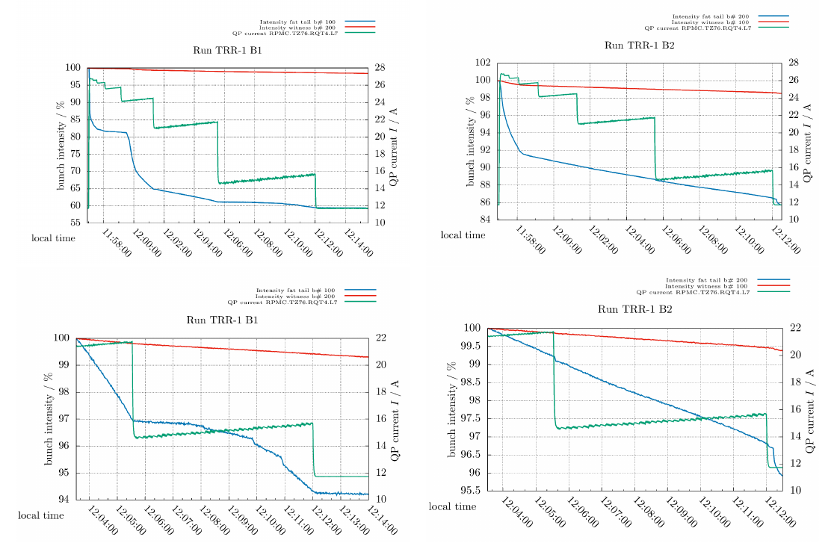
MD results (2)
When applying the ripple, jumps observed in the quadrupole current
  Not understood
  Expected some
  jumps from tune
  correction, but
  these were
  uncorrelated
J. Wagner

Slide 13
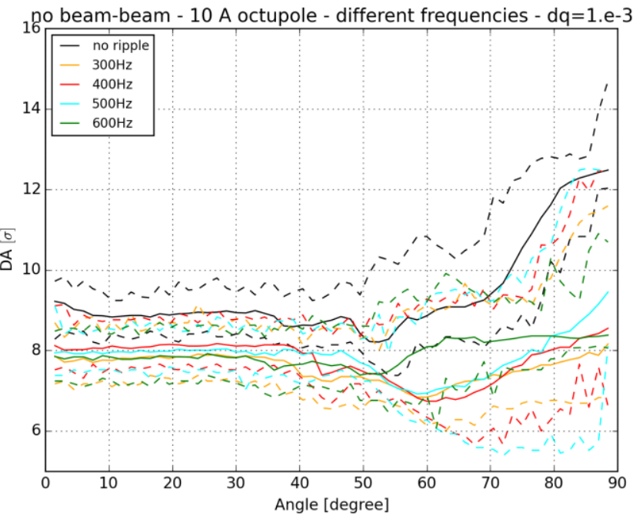
Status of simulations
Some dynamic aperture studies started for MDs
  Simulations still at an early
  stage
See some reduction of DA
with ripple
M. Fitterer

Slide 14
Advantages and disadvantages: tune ripple
Advantages
  Uses existing hardware
Disadvantages
  Relies on detuning with amplitude
    Can we find a resonance line that cleans all halo without touching core of any bunches with different tunr footprints? How well is the tune known in squeeze / adjust? Smearing in tune from chromaticity etc.?
  Not straight-forward to choose frequency and amplitude – which resonance line do we use, what order of excitation?
  Hardware limits frequencies and amplitude of excitation
    limited number of warm quadrupoles, not straight-forward to use superconducting magnets
  Magnets act in parallel on both beams – cannot tune B1 and B2 separately
  Cannot leave some “witness trains” unaffected

Slide 15
Outline
If we need to deplete the halo, are there any alternatives to the hollow electron lens?
Several options to be studied
  Tune ripple
  ADT resonant excitation
  Crab cavity resonant excitation
  Long-range beam-beam
  Orbit feedback
Comparison to hollow e-lens and summary

Slide 16
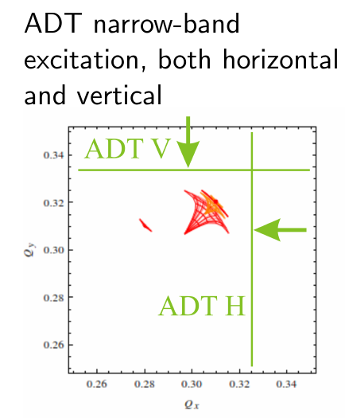
Transverse damper (ADT) narrow-band excitation
Instead of modulating the tune with a quadrupole, we could use the transverse damper (electric field kicker) to make a narrow-band excitation
Rely on detuning with amplitude.
Simplest approach: Knowing the fractional tune of the halo Q_{h} apply kick in resonance at frequency

Slide 17
MDs on ADT excitation
3 MDs carried out in the LHC (Aug 2015, Nov 2015, July 2016)
Procedure: prepare 3 bunches
  1 witness outside excitation window
  1 witness in excitation window
  1 with blown-up tails in excitation window
ADT narrow-band excitation
  Fixed frequency
  Frequency scans
  Hope that we clean the tails of the “fat” bunch and not touch core of excited witness bunch
collimator scans to measure bunch population
measurement of detuning with amplitude with AC dipole (with OMC team)
empirical exploration based on tune footprint

Slide 18
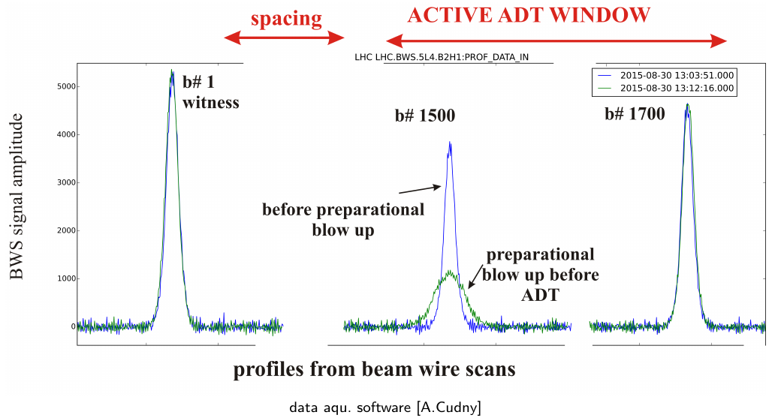
Bunch scheme in ADT MDs

Slide 19
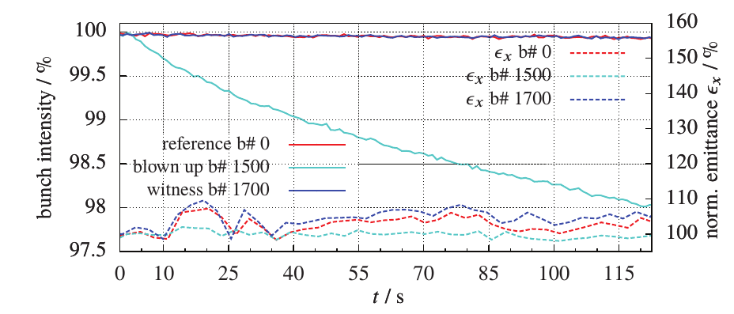
Results: 1st ADT MD
August 2015: several scans where core was affected, but one promising result
J. Wagner
WEPMW028 IPAC2016, CERN-ACC-NOTE-2016-0009

Slide 20
Results: 2nd ADT MD
Novemver 2015 – goal: repeat promising case
Carried out parasitically during crystal MD, so very limited time
Some problems: ADT window was reset by injections, so fat-tail bunch not excited =>
inconclusive

Slide 21
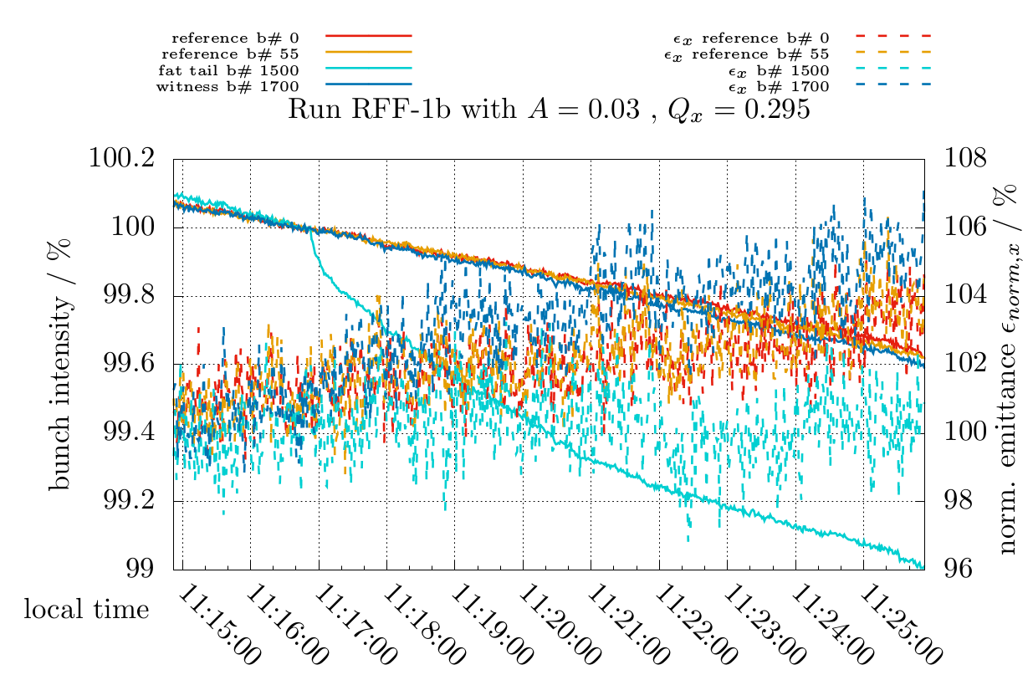
Results: 3rd ADT MD
July 2016 – same goal: repeat promising case and do frequency sweeps
Again, carried out parasitically during crystal MD, so very limited time
Worse beam conditions – “natural” losses and emittance blowup
See again much larger loss on fat-tail bunch, but possibly some effect on excited witness bunch
Ongoing: analysis of scraping for profile measurements
J. Wagner

Slide 22
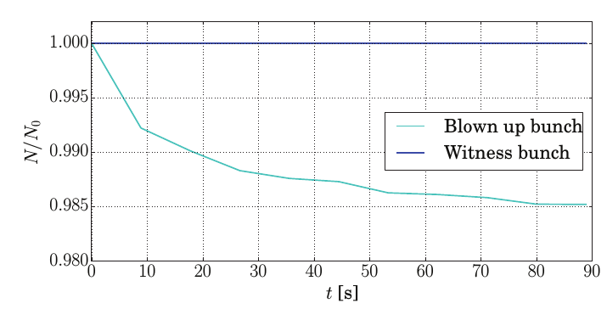
Status of simulations
Simulations started using simplified model based on 1-turn map
  Including ADT, octupole and collimator cut
Can qualitatively reproduce observations
  Do we really deplete the halo?
More detailed simulations using e.g. SixTrack to come
H. Garcia
WEPMW028 IPAC2016

Slide 23
Advantages and disadvantages:
ADT narrow-band excitation
Advantages
  Uses existing hardware
  No hardware limits within studied frequency and amplitude range
  Flexible setup: acts on individual trains and on B1 and B2 separately
Disadvantages
  Relies on detuning with amplitude =>
    Can we find a resonance line that cleans all halo without touching core of any bunches with different tunr footprints? How well is the tune known in squeeze / adjust? Smearing in tune from chromaticity etc.?

Slide 24
Outline
If we need to deplete the halo, are there any alternatives to the hollow electron lens?
Several options to be studied
  Tune ripple
  ADT resonant excitation
  Crab cavity resonant excitation
  Long-range beam-beam
  Orbit feedback
Comparison to hollow e-lens and summary

Slide 25
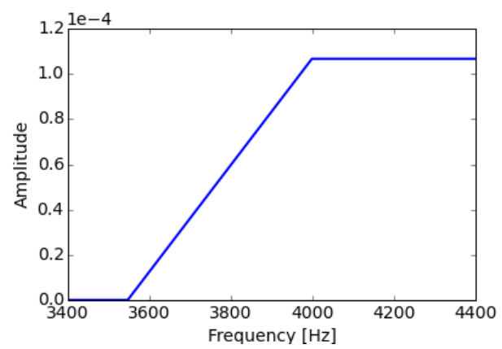
Crab cavity noise
Idea: inject noise on crab cavities, resulting in transverse kicks
  Narrow-band noise: as for ADT, kick in resonance with the tune of the halo
  Shaped noise: Increase efficiency of halo cleaning by adapting the noise spectrum to the tune distribution
T. Mastoridis

Slide 26
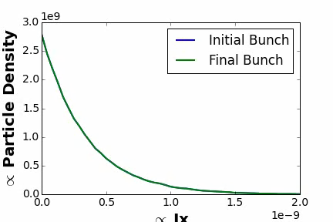
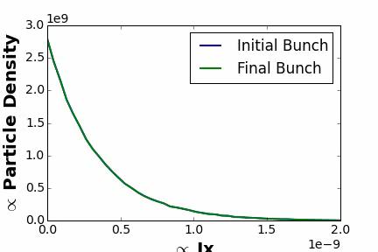
Simulations
Using PyHeadTail (1-turn map + kicks)
Comparing sweep of single frequency with shaped noise
Frequency sweep
Shaped noise
T. Mastoridis

Slide 27
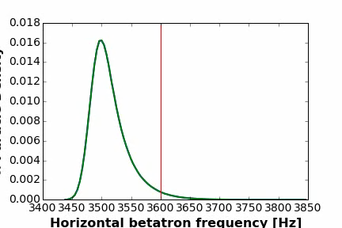
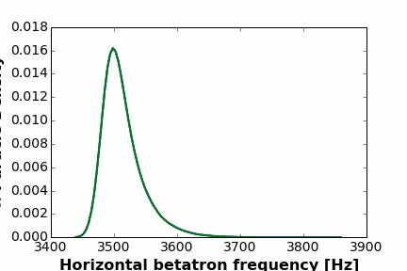
Simulations (2)
Frequency sweep
Shaped noise
T. Mastoridis

Slide 28
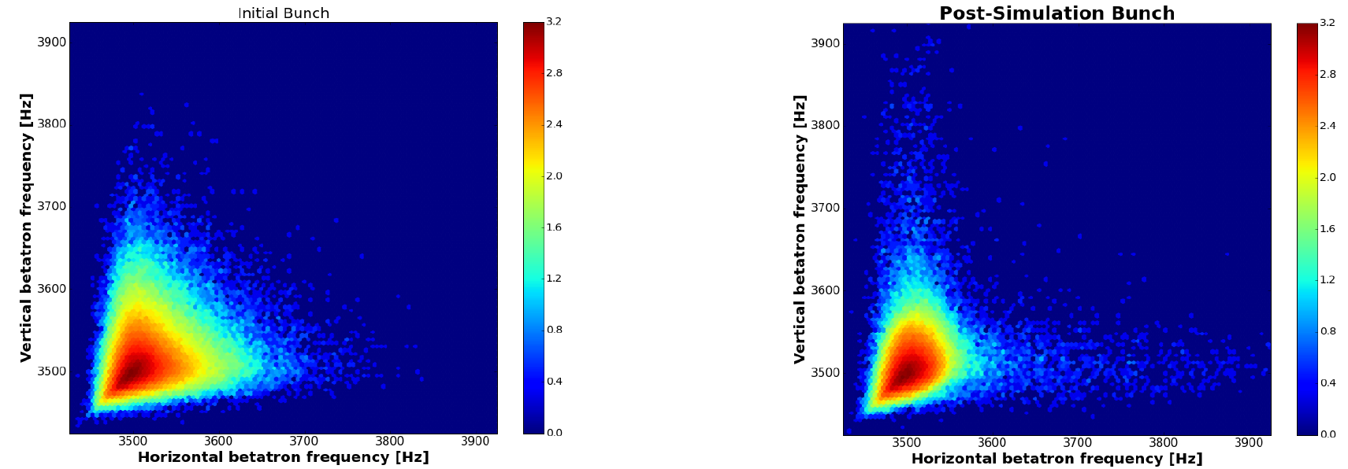
Simulation results
2D-cleaning
T. Mastoridis

Slide 29
Advantages and disadvantages: crab cavity noise
Advantages
  Shaped noise seems more efficient than “single tones” and sweeps used with ADT
  Might be able to clean “radially” with shaped noise
  Has more power than ADT. Needed?
Disadvantages
  Relies on detuning with amplitude =>
    Can we find a resonance line that cleans all halo without touching core of any bunches with different tune footprints? How well is the tune known in squeeze / adjust? Smearing in tune from chromaticity etc.?
  Cannot switch on/off between trains to leave a witness train
  Relies on future hardware – beam tests not possible in LHC. Can be tested in SPS?
Why not use shaped noise with ADT?
  Combining shaped noise with existing hardware => we can do tests in the LHC
  Ongoing discussions with collimation team, RF team and ADT team about future MDs

Slide 30
Outline
If we need to deplete the halo, are there any alternatives to the hollow electron lens?
Several options to be studied
  Tune ripple
  ADT resonant excitation
  Crab cavity resonant excitation
  Long-range beam-beam
  Orbit feedback
Comparison to hollow e-lens and summary

Slide 31
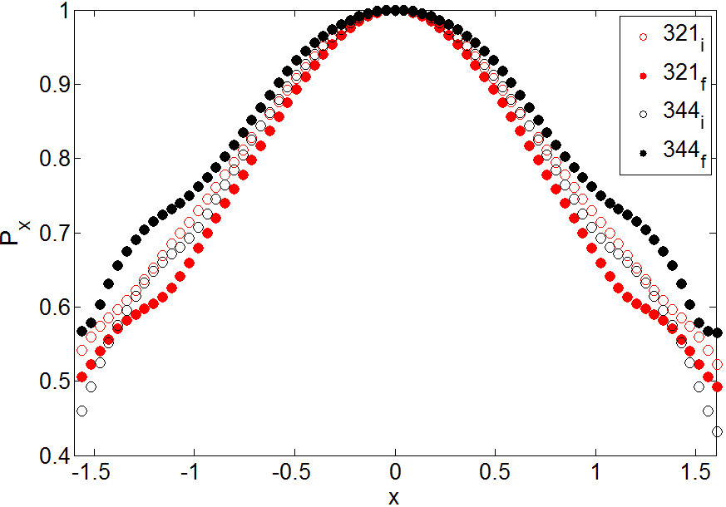
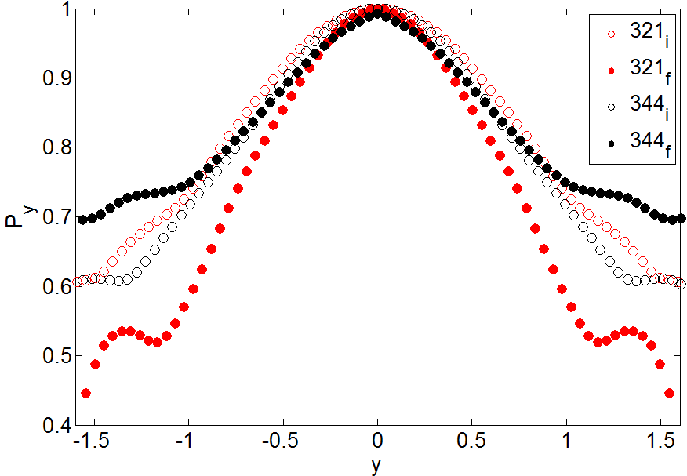
Long-range beam-beam
Idea: operate with a crossing angle such that we are at the limit of the dynamic aperture
Many beam-beam studies in the past, but not dedicated to halo cleaning – unknown territory
Very recent preliminary studies on profiles in 2016 long-range MD: long-range BB seems to rather populate the tails (ongoing studies)
  Not evident how to use for halo cleaning. Bunch with less long-range has tails cleaned better (radiation damping)
2.5h
2.5h
First bunch
Middle of train
  S. Papadopoulou

Slide 32
Advantages and disadvantages – long-range beam-beam
Advantages
  It’s automatically there
Disadvantages
  Not evident to get it to work
  Different action on different bunches, e.g. colliding, non-colliding, packman etc. Can we really clean all halo?
  Crossing angle not a parameter we can easily tune
  Hard to control depletion rate and range. How much can halo be depleted?
  How would one use it in the squeeze and adjust?
Could one use wires to get a similar effect with more flexibility?

Slide 33
Outline
If we need to deplete the halo, are there any alternatives to the hollow electron lens?
Several options to be studied
  Tune ripple
  ADT resonant excitation
  Crab cavity resonant excitation
  Long-range beam-beam
  Orbit feedback
Comparison to hollow e-lens and summary

Slide 34
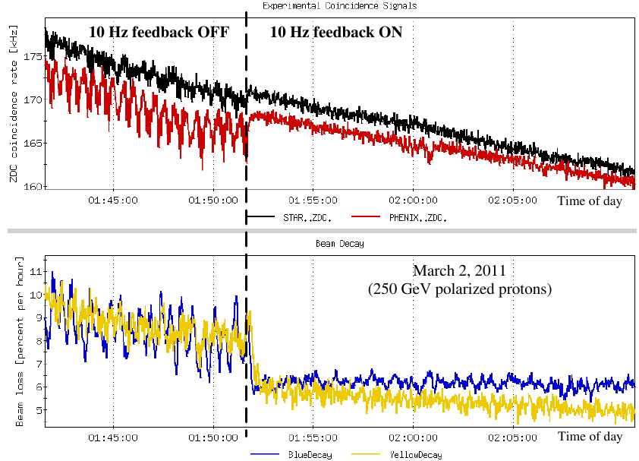
Fast orbit feedback
If loss spikes are caused by fast orbit movements, a fast feedback could be an alternative mitigation
  Can never compensate crab cavity failures though
Some experience at RHIC:
  faster orbit feedback now counter-acting 10 Hz oscillation frequencies on the beam (was 1 Hz)
  See improvement in luminosity and beam losses
  R. Michnoff et al., MOP268, PAC2011

Slide 35
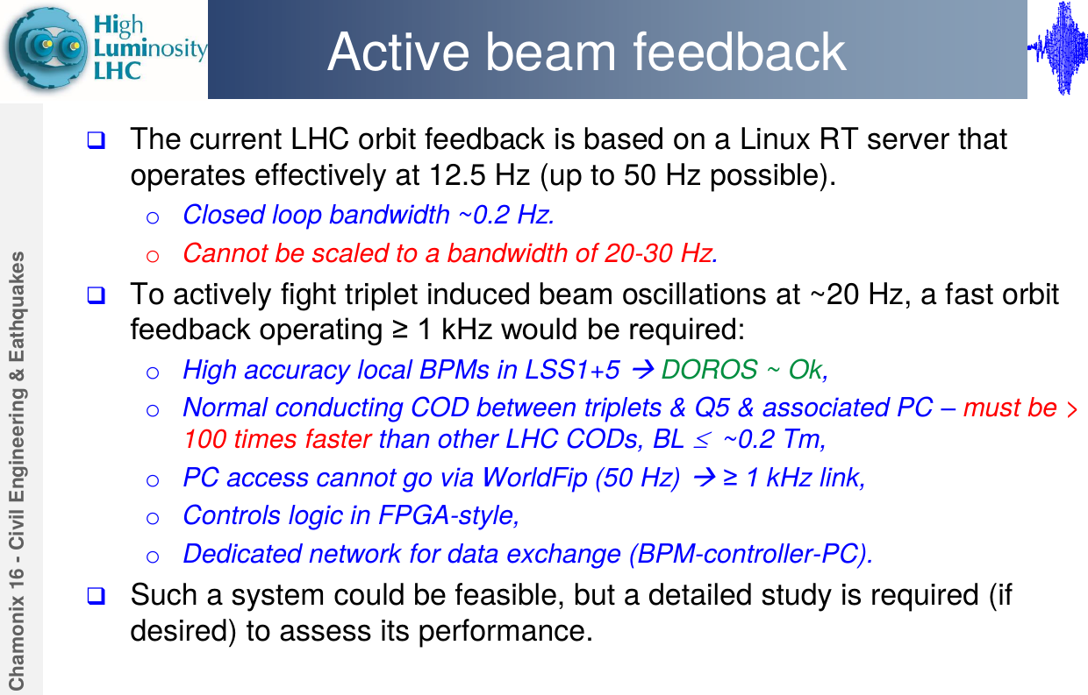
J. Wenninger

Slide 36
Outline
If we need to deplete the halo, are there any alternatives to the hollow electron lens?
Several options to be studied
  Tune ripple
  ADT resonant excitation
  Crab cavity resonant excitation
  Long-range beam-beam
  Orbit feedback
Comparison to hollow e-lens and summary

Slide 37
Comparison to hollow e-lens and summary
(personal reflections for discussion)
The alternative methods rely on amplitude detuning. Open questions:
  Can we find a resonance or excitation mode that cleans all halo without touching the core of any bunches with different tune footprints (non-colliding, packman etc)?
  How well is the tune known in squeeze / adjust?
  Smearing in tune from chromaticity etc.?
Hollow electron lens acts in amplitude space and not in tune space
At present, hollow electron lens is the well-proven concept (beam studies + simulations)
Among the alternative methods, ADT (possibly with shaped noise) seems promising
  Existing hardware, very flexible, can leave a witness train
Fast orbit feedback could possibly be implemented (large project) to cure loss spikes from orbit movements but does not help against crab cavity failures

Slide 38
Thanks for the attention!

Slide 39
Backup

Slide 40
Comparison of methods – for discussion
Method | Amplitude or tune action | Train-by-train action | Beam tests possible? | Existing or new hardware | Flexibility
Hollow E-lens | Amplitude | Yes | Yes (Tevatron) | New | High
Tune ripple | Tune | No | Yes | Existing | Low
ADT | Tune | Yes | Yes | Existing | High
Crab cavities | Tune | No | SPS in 2018? | New
Long-range BB | Tune | No | Yes | Existing | Low

Slide 41
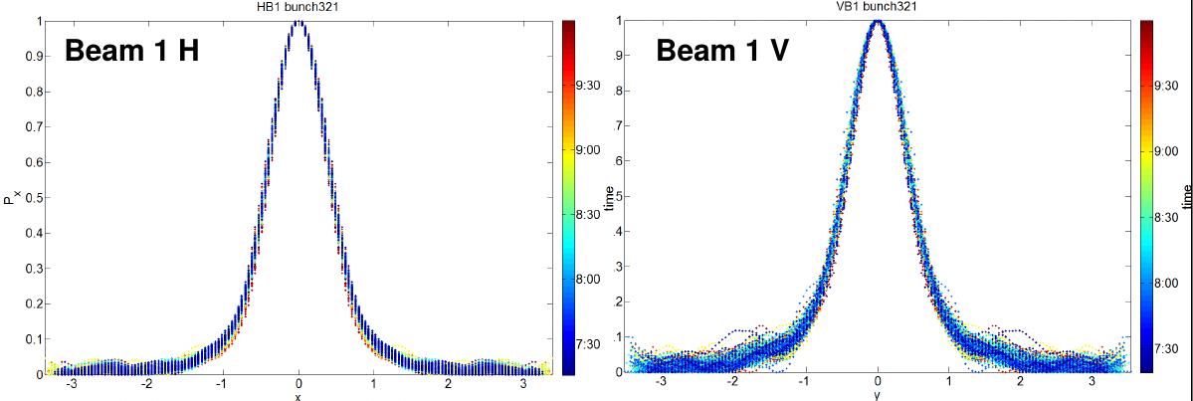

Slide 42
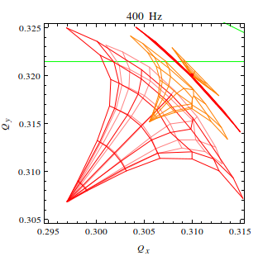
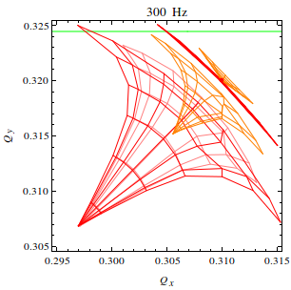
Zoomed tune footprints
Zoom on collision tunes – separated and colliding beams, 6.5 TeV, b*=55cm
No HO
HO IP1/5/8
HO IP8
HO IP1/5/8
LR IP1/5 one side only

Slide 43
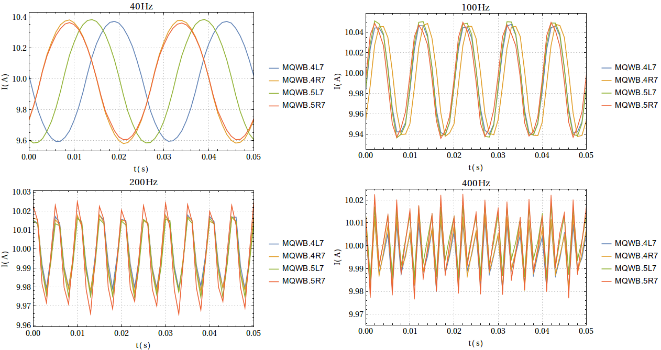
Power converter measurements
Measurement data at max amplitude magnets could also be synchronized

Slide 44
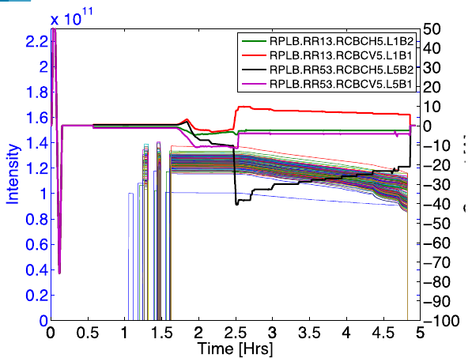
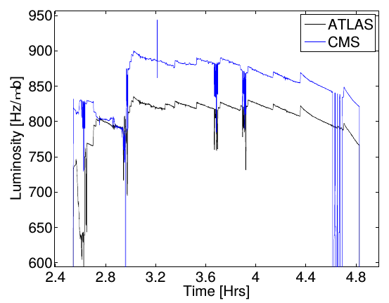
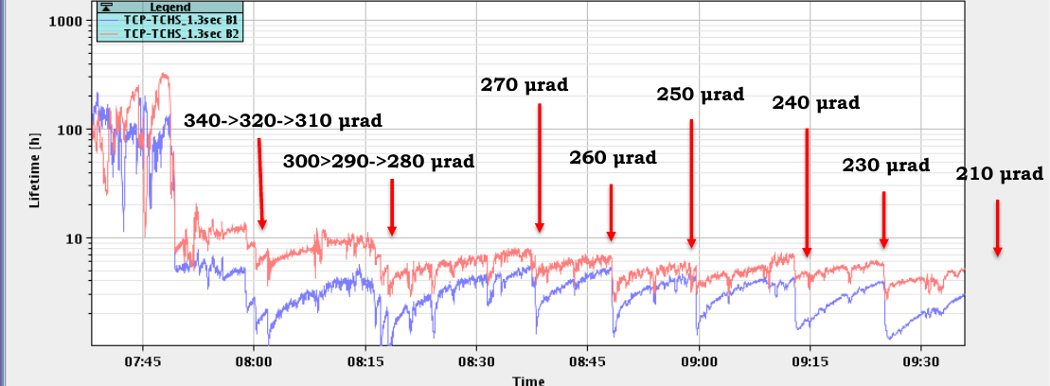

Slide 45
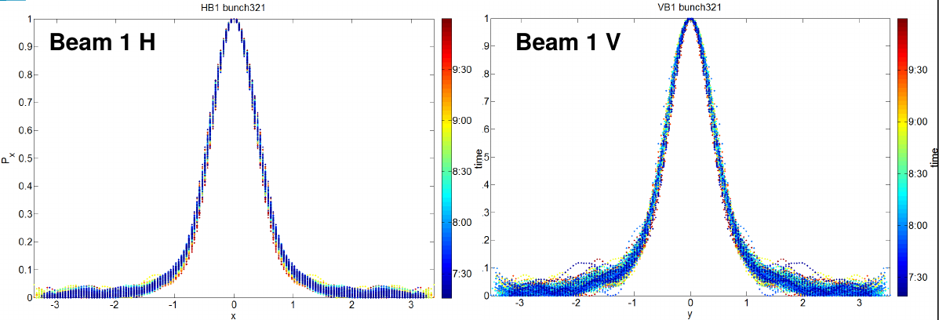
Observations on luminosity lifetime
Profiles during beam-beam MD
Unclear if tails are reduced due to beam-beam or radiation damping
S. Papadopoulou

